Slide 1
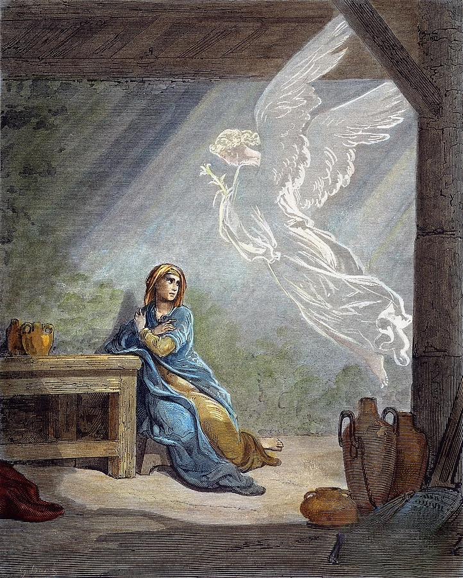
December 22, 2024
WELCOME!
Trinity Lutheran Church
Fourth Sunday of Advent
Notes:
Image: Five Loaves by Caroline Coolidge Brown. Copyright © Caroline Coolidge Brown. All rights reserved. Used by permission of the artist.

Slide 2
= Please stand if able
= Please be seated
Prelude - By Pam Sherman
Office of the Acolyte
Ringing of the Bell
Welcome

Slide 3
Lighting The Advent Wreath
R: O Come, O Come Emmanuel.
C: We light the 1st candle in the hope of your coming. (Light 1st Candle)
C: We light the 2nd candle in love for you and our neighbors. (Light 2nd Candle)
C: We light the 3rd candle with joy in the promise. (Light 3rd Candle)
Notes:
Image: Preparing yeast dough. Copyright © tomasworks/iStock/Thinkstock. Used by permission.

Slide 4
Lighting The Advent Wreath
R: With Mary we hope for the peace the promised messiah will bring to all creation.
C: We light the 4th candle for peace on earth. (Light 4th Candle)
Notes:
Image: Preparing yeast dough. Copyright © tomasworks/iStock/Thinkstock. Used by permission.

Slide 5
THANKSGIVING FOR BAPTISM
All may make the sign of the cross, the sign marked at baptism, as the presiding minister begins.
P: Blessed be the holy Trinity, ☩ one God, the fountain of living water, the rock who gave us birth, our light and our salvation.
C: Amen.
Notes:
Image: Preparing yeast dough. Copyright © tomasworks/iStock/Thinkstock. Used by permission.

Slide 6
P: Joined to Christ in the waters of baptism, we are clothed with God's mercy and forgiveness. Let us give thanks for the gift of baptism.
Water may be poured into the font as the presiding minister gives thanks.
THANKSGIVING FOR BAPTISM
Notes:
Image: Preparing yeast dough. Copyright © tomasworks/iStock/Thinkstock. Used by permission.

Slide 7
P: We give you thanks, O God, for in the beginning your Spirit moved over the waters and by your Word you created the world, calling forth life in which you took delight. Through the waters of the flood you delivered Noah and his family. Through the sea you led your people Israel from slavery into freedom.
THANKSGIVING FOR BAPTISM
Notes:
Image: Preparing yeast dough. Copyright © tomasworks/iStock/Thinkstock. Used by permission.

Slide 8
P: At the river your Son was baptized by John and anointed with the Holy Spirit. By water and your Word you claim us as daughters and sons, making us heirs of your promise and servants of all. We praise you for the gift of water that sustains life, and above all we praise you for the gift of new life in Jesus Christ.
THANKSGIVING FOR BAPTISM
Notes:
Image: Preparing yeast dough. Copyright © tomasworks/iStock/Thinkstock. Used by permission.

Slide 9
P: Shower us with your Spirit, and renew our lives with your forgiveness, grace, and love. To you be given honor and praise through Jesus Christ our Lord in the unity of the Holy Spirit, now and forever.
THANKSGIVING FOR BAPTISM
C: Amen.
Notes:
Image: Preparing yeast dough. Copyright © tomasworks/iStock/Thinkstock. Used by permission.

Slide 10
CONFESSION AND FORGIVENESS
All may make the sign of the cross, the sign marked at baptism…
L: We confess our sins before God and one another.
Pause for silence and reflection.
L: Gracious God,
Notes:
Image: Five Loaves by Caroline Coolidge Brown. Copyright © Caroline Coolidge Brown. All rights reserved. Used by permission of the artist.

Slide 11
CONFESSION AND FORGIVENESS
C: We confess to you and to our siblings in Christ that we have made decisions which have caused harm to you and our neighbors. We have put our selfish desires ahead of the needs of others. We have sought comfort in worldly things and forgotten you.
Notes:
Image: Five Loaves by Caroline Coolidge Brown. Copyright © Caroline Coolidge Brown. All rights reserved. Used by permission of the artist.

Slide 12
CONFESSION AND FORGIVENESS
C: For these and for all the ways in which we have fallen short, forgive us. Lead us back into a right relationship with you, our neighbors, and all of creation.
Notes:
Image: Five Loaves by Caroline Coolidge Brown. Copyright © Caroline Coolidge Brown. All rights reserved. Used by permission of the artist.

Slide 13
CONFESSION AND FORGIVENESS
P: Beloved of God, I bring you good news of great joy for all people, for in Jesus Christ, all things are made new. For his sake, God forgives us all our sin and calls us into abundant life. Receive this gift with joy, in Jesus name.
C: Amen
Notes:
Image: Five Loaves by Caroline Coolidge Brown. Copyright © Caroline Coolidge Brown. All rights reserved. Used by permission of the artist.

Slide 14
Gathering Song
“Oh, Come, Oh, Come, Emmanuel”
LBW 34

Slide 15
“Oh, Come, Oh, Come, Emmanuel” LBW 34
1 Oh, come, oh, come, Emmanuel,
and ransom captive Israel,
that mourns in lonely exile here
until the Son of God appear.
Refrain
Rejoice! Rejoice! Emmanuel
shall come to you, O Israel.
Notes:
Image: Five Loaves by Caroline Coolidge Brown. Copyright © Caroline Coolidge Brown. All rights reserved. Used by permission of the artist.

Slide 16
“Oh, Come, Oh, Come, Emmanuel” LBW 34
2 Oh, come, oh, come, great Lord of might,
who to your tribes on Sinai’s height
in ancient times once gave the law
in cloud, and majesty, and awe.
Refrain
Rejoice! Rejoice! Emmanuel
shall come to you, O Israel.
Notes:
Image: Five Loaves by Caroline Coolidge Brown. Copyright © Caroline Coolidge Brown. All rights reserved. Used by permission of the artist.

Slide 17
“Oh, Come, Oh, Come, Emmanuel” LBW 34
3 Oh, come, strong Branch of Jesse, free
your own from Satan’s tyranny;
from depths of hell your people save
and give them vict’ry o’er the grave.
  Refrain
  Rejoice! Rejoice! Emmanuel
  shall come to you, O Israel.
Notes:
Image: Five Loaves by Caroline Coolidge Brown. Copyright © Caroline Coolidge Brown. All rights reserved. Used by permission of the artist.

Slide 18
“Oh, Come, Oh, Come, Emmanuel” LBW 34
4 Oh, come, blest Dayspring, come and cheer
our spirits by your advent here;
disperse the gloomy clouds of night,
and death’s dark shadows put to flight.
  Refrain
  Rejoice! Rejoice! Emmanuel
  shall come to you, O Israel
Notes:
Image: Five Loaves by Caroline Coolidge Brown. Copyright © Caroline Coolidge Brown. All rights reserved. Used by permission of the artist.

Slide 19
“Oh, Come, Oh, Come, Emmanuel” LBW 34
5 Oh, come, O Key of David, come,
and open wide our heav’nly home;
make safe the way that leads on high,
and close the path to misery.
  Refrain
  Rejoice! Rejoice! Emmanuel
  shall come to you, O Israel
Notes:
Image: Five Loaves by Caroline Coolidge Brown. Copyright © Caroline Coolidge Brown. All rights reserved. Used by permission of the artist.

Slide 20
APOSTOLIC GREETING
P: The grace of our Lord Jesus Christ, the love of God, and the communion of the Holy Spirit be with you all.
C: And also with you.
Notes:
Image: Five Loaves by Caroline Coolidge Brown. Copyright © Caroline Coolidge Brown. All rights reserved. Used by permission of the artist.

Slide 21
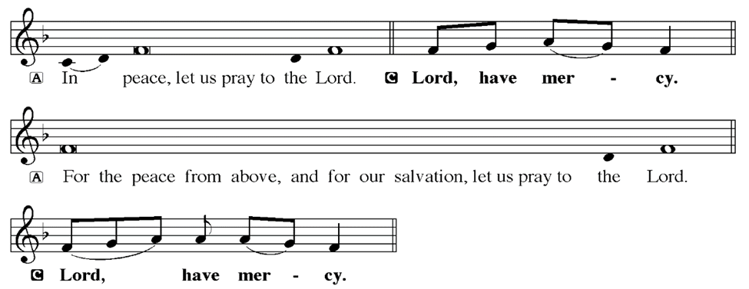
KYRIE
Notes:
Image: Five Loaves by Caroline Coolidge Brown. Copyright © Caroline Coolidge Brown. All rights reserved. Used by permission of the artist.

Slide 22
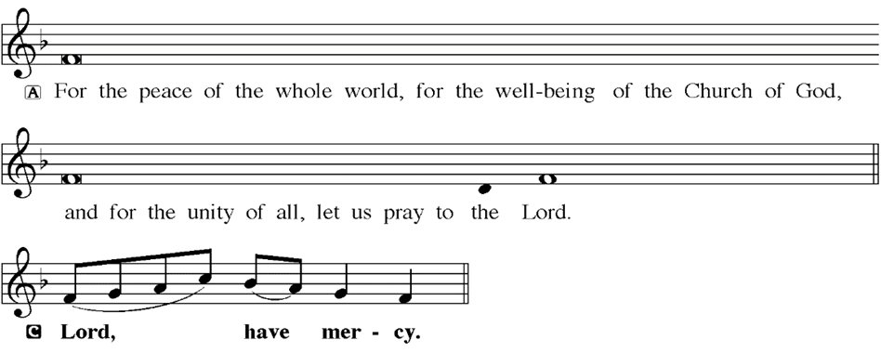
KYRIE
Notes:
Image: Five Loaves by Caroline Coolidge Brown. Copyright © Caroline Coolidge Brown. All rights reserved. Used by permission of the artist.

Slide 23
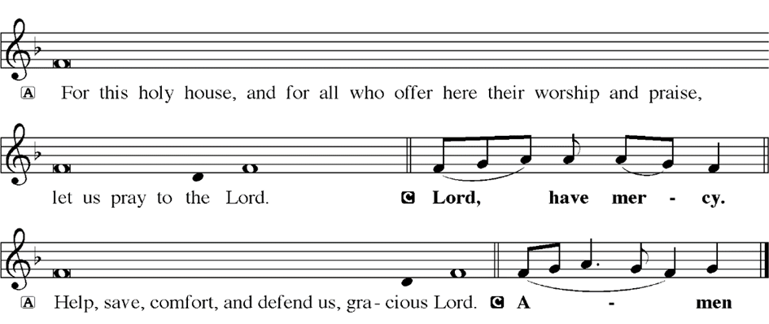
KYRIE
Notes:
Image: Five Loaves by Caroline Coolidge Brown. Copyright © Caroline Coolidge Brown. All rights reserved. Used by permission of the artist.

Slide 24
HYMN OF PRAISE
Glory be to God in heaven;
peace, goodwill to all the earth.
Mighty God of all creation,
Father of surpassing worth:
we exalt you, we adore you,
we lift high our thanks and praise.
Saints and angels bow before you; here on earth our songs we raise.
Notes:
Image: Five Loaves by Caroline Coolidge Brown. Copyright © Caroline Coolidge Brown. All rights reserved. Used by permission of the artist.

Slide 25
HYMN OF PRAISE
Glory be to Christ forever,
Lamb of God and Lord of love.
Son of God and gracious Savior, you have come from heav’n above;
on the cross you died to save us; now you reign at God’s right hand.
Hear our prayer; restore, forgive us; in your promise firm we stand.
Notes:
Image: Five Loaves by Caroline Coolidge Brown. Copyright © Caroline Coolidge Brown. All rights reserved. Used by permission of the artist.

Slide 26
HYMN OF PRAISE
Holy One we now acclaim you;
Lord alone, to you we call;
Holy One in faith we name you,
God most high, yet near to all:
Jesus Christ, with God the Spirit,
in the Father’s splendor bright.
For the peace that we inherit,
glory be to God on high!
Notes:
Image: Five Loaves by Caroline Coolidge Brown. Copyright © Caroline Coolidge Brown. All rights reserved. Used by permission of the artist.

Slide 27
PRAYER OF THE DAY
P: Let us pray… Almighty God, like Mary, help us embrace humility and readiness as we navigate the unexpected. May we respond to your call with a willing heart, trusting in your guidance and love. In Jesus name we pray.
C: Amen
Notes:
Image: Five Loaves by Caroline Coolidge Brown. Copyright © Caroline Coolidge Brown. All rights reserved. Used by permission of the artist.

Slide 28

Notes:
Image: Five Loaves by Caroline Coolidge Brown. Copyright © Caroline Coolidge Brown. All rights reserved. Used by permission of the artist.

Slide 29
Luke 1:26-56
L: The Holy Gospel according to Luke, the first chapter.
C: Glory to you O’ Lord!
Notes:
Image: Five Loaves by Caroline Coolidge Brown. Copyright © Caroline Coolidge Brown. All rights reserved. Used by permission of the artist.

Slide 30
Luke 1:26-56
²⁶In the sixth month the angel Gabriel was sent by God to a town in Galilee called Nazareth, ²⁷to a virgin engaged to a man whose name was Joseph, of the house of David. The virgin’s name was Mary. ²⁸And he came to her and said, “Greetings, favored one! The Lord is with you.” ²⁹But she was much perplexed by his words and pondered what sort of greeting this might be.
Notes:
Image: Five Loaves by Caroline Coolidge Brown. Copyright © Caroline Coolidge Brown. All rights reserved. Used by permission of the artist.

Slide 31
Luke 1:26-56
³⁰The angel said to her, “Do not be afraid, Mary, for you have found favor with God. ³¹And now, you will conceive in your womb and bear a son, and you will name him Jesus. ³²He will be great, and will be called the Son of the Most High, and the Lord God will give to him the throne of his ancestor David. ³³He will reign over the house of Jacob forever, and of his kingdom there will
Notes:
Image: Five Loaves by Caroline Coolidge Brown. Copyright © Caroline Coolidge Brown. All rights reserved. Used by permission of the artist.

Slide 32
Luke 1:26-56
be no end.” ³⁴Mary said to the angel, “How can this be, since I am a virgin?” ³⁵The angel said to her, “The Holy Spirit will come upon you, and the power of the Most High will overshadow you; therefore the child to be born will be holy; he will be called Son of God. ³⁶And now, your relative Elizabeth in her old age has also conceived a son; and this is the sixth month for her who
Notes:
Image: Five Loaves by Caroline Coolidge Brown. Copyright © Caroline Coolidge Brown. All rights reserved. Used by permission of the artist.

Slide 33
Luke 1:26-56
was said to be barren. ³⁷For nothing will be impossible with God.” ³⁸Then Mary said, “Here am I, the servant of the Lord; let it be with me according to your word.” Then the angel departed from her.
³⁹In those days Mary set out and went with haste to a Judean town in the hill country, ⁴⁰where she entered the house of Zechariah and greeted
Notes:
Image: Five Loaves by Caroline Coolidge Brown. Copyright © Caroline Coolidge Brown. All rights reserved. Used by permission of the artist.

Slide 34
Luke 1:26-56
Elizabeth. ⁴¹When Elizabeth heard Mary’s greeting, the child leaped in her womb. And Elizabeth was filled with the Holy Spirit ⁴²and exclaimed with a loud cry, “Blessed are you among women, and blessed is the fruit of your womb. ⁴³And why has this happened to me, that the mother of my Lord comes to me? ⁴⁴For as soon as I heard the sound of your greeting, the child in my
Notes:
Image: Five Loaves by Caroline Coolidge Brown. Copyright © Caroline Coolidge Brown. All rights reserved. Used by permission of the artist.

Slide 35
Luke 1:26-56
womb leaped for joy. ⁴⁵And blessed is she who believed that there would be a fulfillment of what was spoken to her by the Lord.”
⁴⁶And Mary said, “My soul magnifies the Lord, ⁴⁷and my spirit rejoices in God my Savior, ⁴⁸for he has looked with favor on the lowliness of his servant. Surely, from now on all generations will call me blessed; ⁴⁹for the Mighty One
Notes:
Image: Five Loaves by Caroline Coolidge Brown. Copyright © Caroline Coolidge Brown. All rights reserved. Used by permission of the artist.

Slide 36
Luke 1:26-56
has done great things for me, and holy is his name. ⁵⁰His mercy is for those who fear him from generation to generation. ⁵¹He has shown strength with his arm; he has scattered the proud in the thoughts of their hearts. ⁵²He has brought down the powerful from their thrones, and lifted up the lowly; ⁵³he has filled the hungry with good things, and sent the rich
Notes:
Image: Five Loaves by Caroline Coolidge Brown. Copyright © Caroline Coolidge Brown. All rights reserved. Used by permission of the artist.

Slide 37
Luke 1:26-56
away empty. ⁵⁴He has helped his servant Israel, in remembrance of his mercy, ⁵⁵according to the promise he made to our ancestors, to Abraham and to his descendants forever.” ⁵⁶And Mary remained with her about three months and then returned to her home.
Notes:
Image: Five Loaves by Caroline Coolidge Brown. Copyright © Caroline Coolidge Brown. All rights reserved. Used by permission of the artist.

Slide 38
Luke 1:26-56
R: This is the Word of the Lord.
C: Praise to You, O Christ
Notes:
Image: Five Loaves by Caroline Coolidge Brown. Copyright © Caroline Coolidge Brown. All rights reserved. Used by permission of the artist.

Slide 39
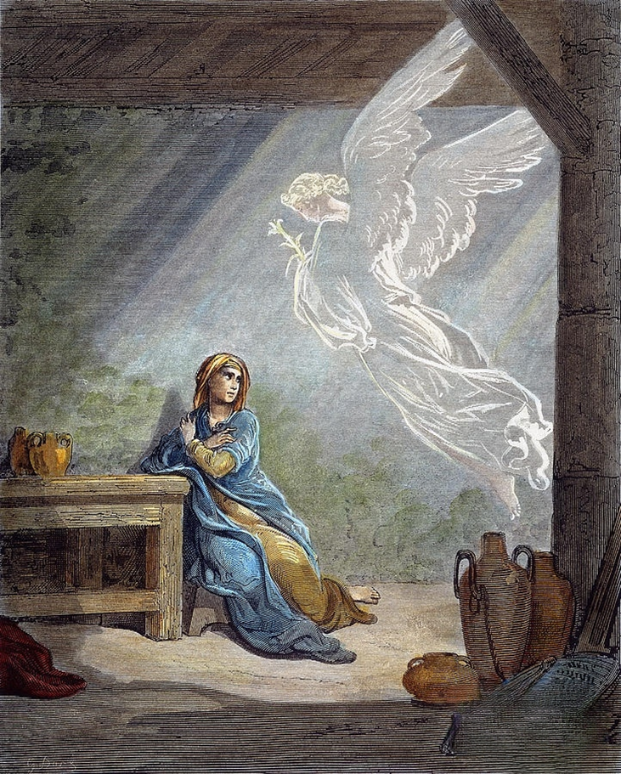
Sermon

Slide 40
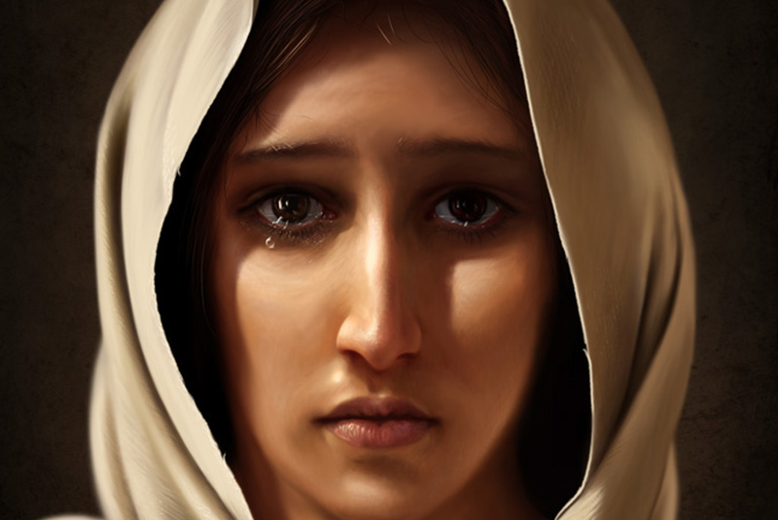
Sermon

Slide 41
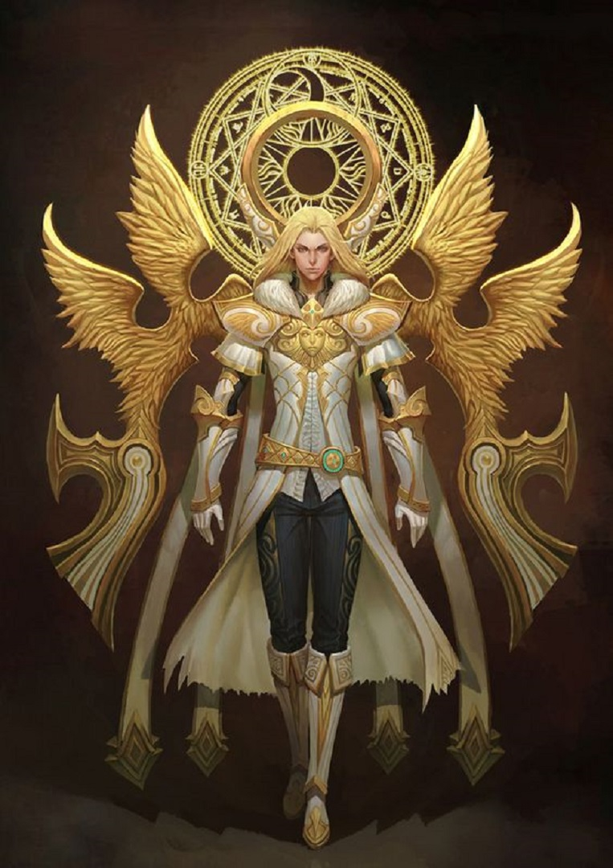
Sermon

Slide 42
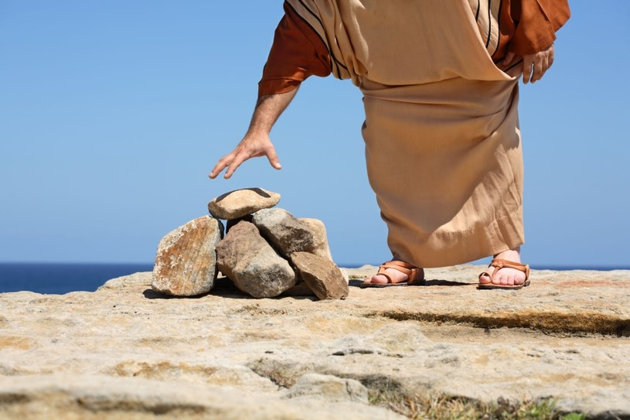
Sermon

Slide 43
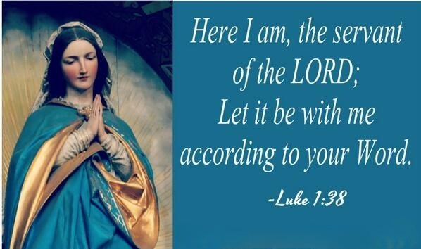
Sermon

Slide 44
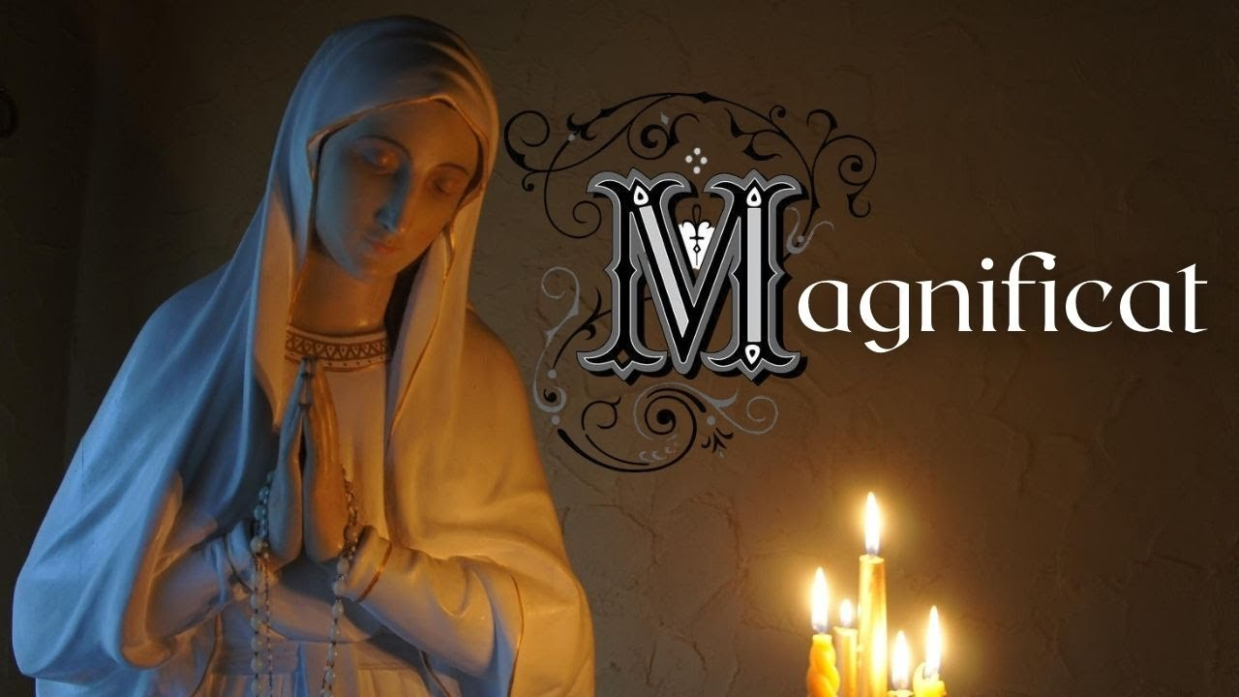
Sermon

Slide 45
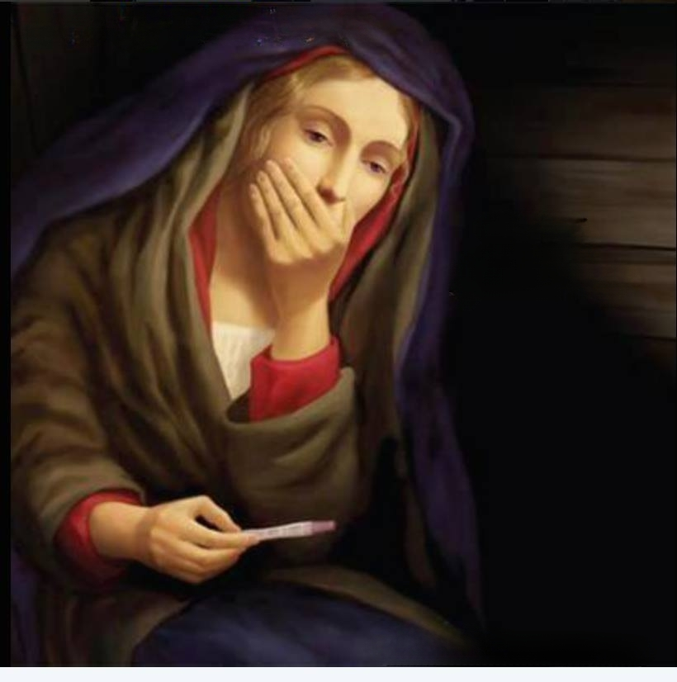
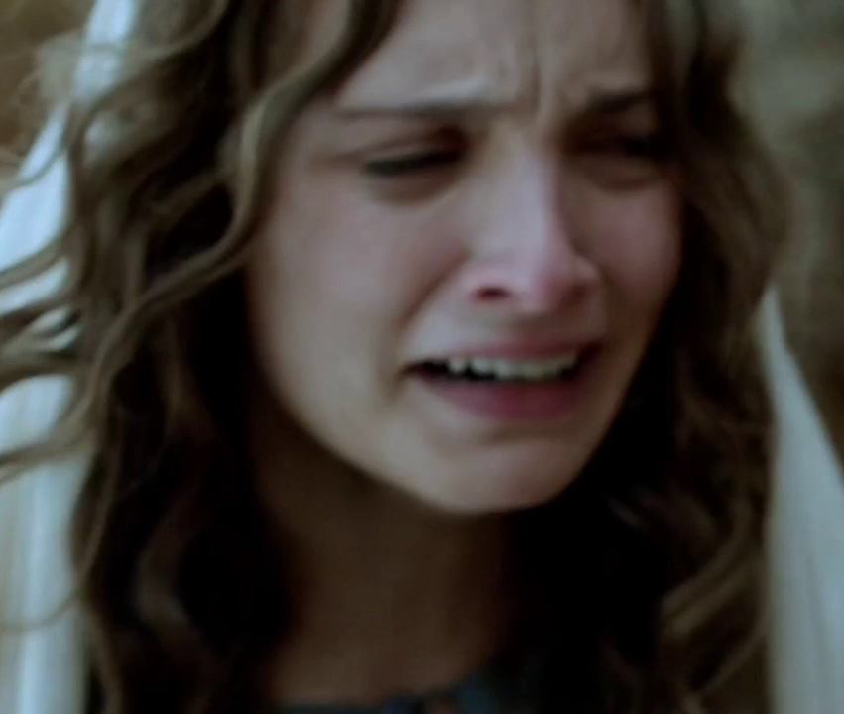
Sermon
Perplexed
Or
Terrified
Probably both!

Slide 46
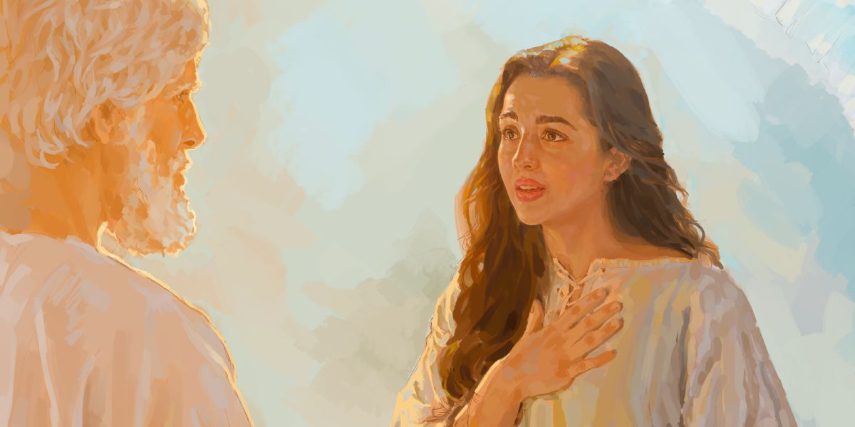
Sermon

Slide 47
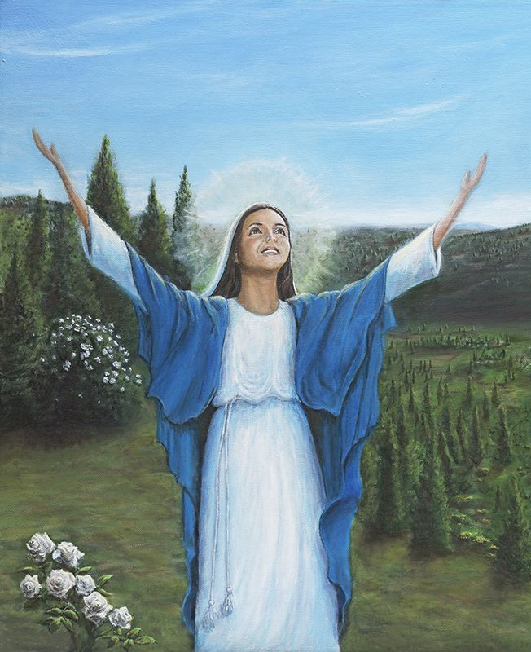
Sermon

Slide 48
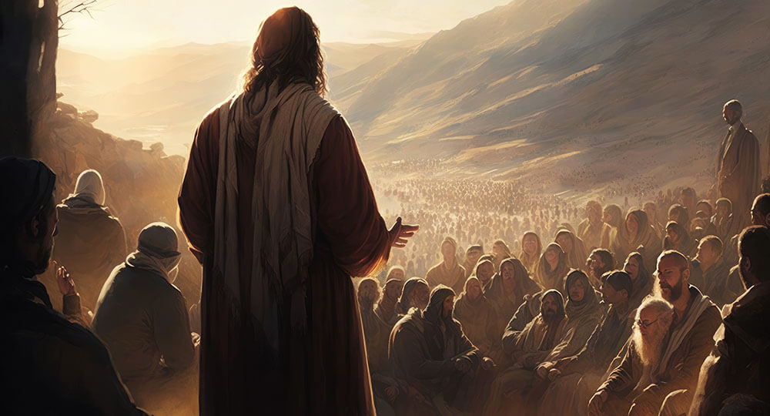
Sermon

Slide 49
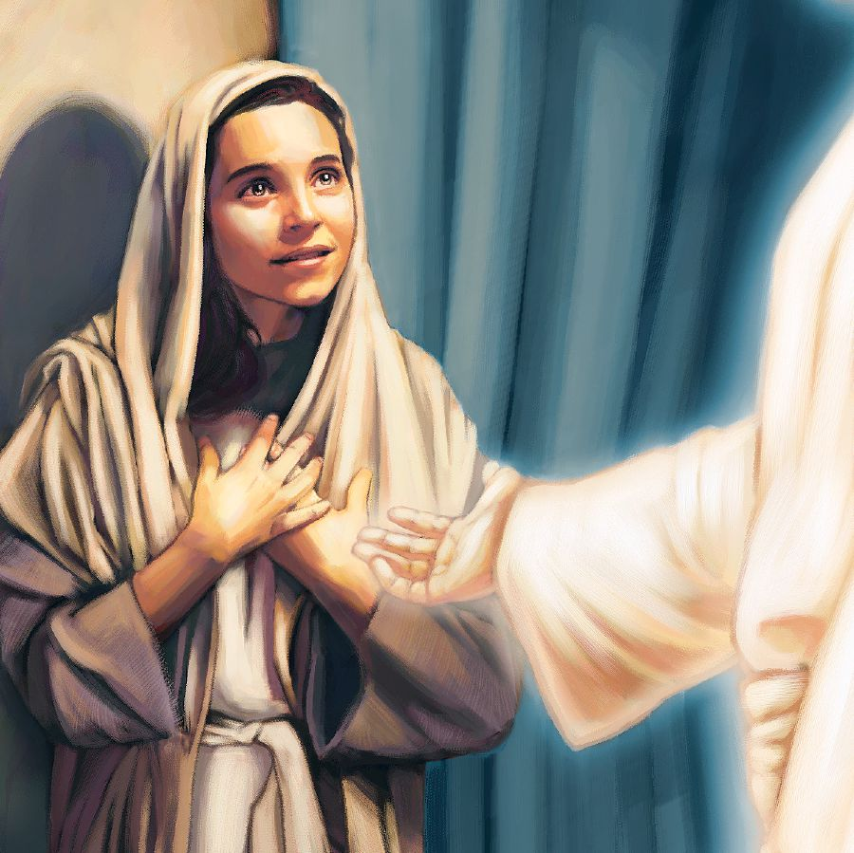
Sermon

Slide 50
Special Music
The Annunciation and The Magnificat
Pastor Mel
&
Lexie Angles

Slide 51
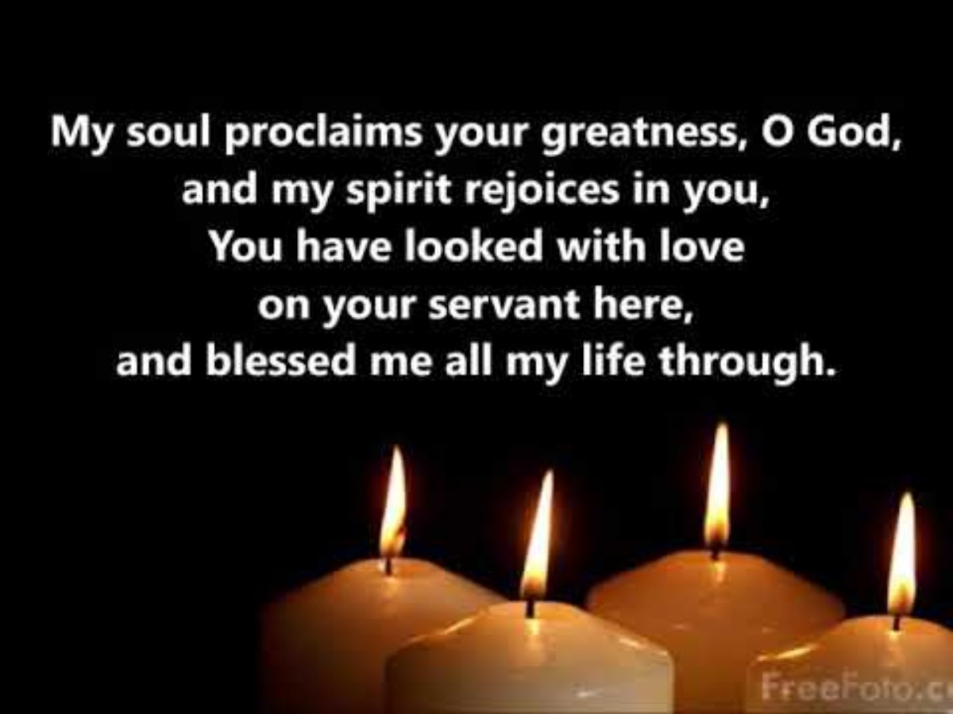

Slide 52
NICENE CREED
C: We believe in one God, the Father, the Almighty, maker of heaven and earth, of all that is, seen and unseen.

Slide 53
NICENE CREED
C: We believe in one Lord, Jesus Christ, the only Son of God, eternally begotten of the Father, God from God, Light from Light, true God from true God, begotten, not made, of one Being with the Father.

Slide 54
NICENE CREED
C: Through him all things were made. For us and for our salvation he came down from heaven; by the power of the Holy Spirit he became incarnate from the virgin Mary, and was made man. For our sake he was crucified under Pontius Pilate;

Slide 55
NICENE CREED
C: he suffered death and was buried. On the third day he rose again in accordance with the Scriptures; he ascended into heaven and is seated at the right hand of the Father. He will come again in glory to judge the living and the dead, and his kingdom will have no end.

Slide 56
NICENE CREED
C: We believe in the Holy Spirit, the Lord, the giver of life, who proceeds from the Father and the Son. With the Father and the Son he is worshiped and glorified. He has spoken through the prophets. We believe in one holy catholic and apostolic Church.

Slide 57
NICENE CREED
C: We acknowledge one Baptism for the forgiveness of sins. We look for the resurrection of the dead, and the life of the world to come. Amen.

Slide 58
PRAYERS
Each petition will end with the words,
A: God, in your mercy,
C: Hear our prayer.

Slide 59
PRAYERS OF INTERCESSION
The prayer concludes…
P: We lift up all our prayers, spoken and unspoken to you. In Jesus’ name we pray.
C: Amen.

Slide 60
OFFERING
Notes:
Image: Five Loaves by Caroline Coolidge Brown. Copyright © Caroline Coolidge Brown. All rights reserved. Used by permission of the artist.

Slide 61
OFFERING PRAYER
Notes:
Image: Five Loaves by Caroline Coolidge Brown. Copyright © Caroline Coolidge Brown. All rights reserved. Used by permission of the artist.

Slide 62
THE GREAT THANKSGIVING
All the Baptized are welcome to celebrate this Holy Meal.

Slide 63
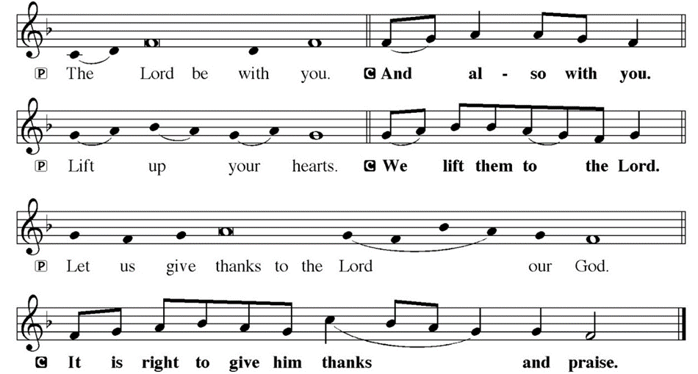
DIALOGUE

Slide 64
THE PREFACE
P: It is indeed right and salutary…
… we praise your name and join their unending hymn.

Slide 65
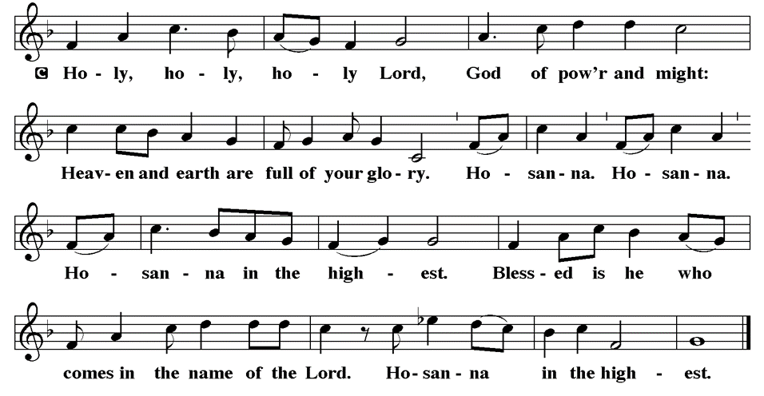
THE SANCTUS

Slide 66
EUCHARISTIC PRAYER
P: Holy God, the Beginning and the End…
…both now and forever.
C: Amen.

Slide 67
THE LORD’S PRAYER
C: Our Father, who art in heaven, hallowed be thy name, thy kingdom come, thy will be done, on earth as it is in heaven. Give us this day our daily bread; and forgive us our trespasses, as we forgive those who trespass against us; and lead us not into temptation, but deliver us from evil.

Slide 68
THE LORD’S PRAYER
C: For thine is the kingdom, and the power, and the glory, forever and ever. Amen.

Slide 69
INVITATION TO COMMUNION
P: Jesus, who came to fulfill Isaiah’s prophecy, now invites you to the feast of freedom in his name. He meets us now in the bread and wine and proclaims to us good news for all creation. This good news is for you!

Slide 70
COMMUNION DISTRIBUTION
All will commune “By Station”.
The bread may be broken for distribution. As the ministers give the bread and wine, they say these words :
The body of Christ, given for you.
The blood of Christ, shed for you.
The communicant may say: Amen.

Slide 71
POST COMMUNION BLESSING
The blessing is said to all after the distribution by station. It is said after each table is fed at the railing.
P: May this body and blood of our Lord and Savior, Jesus Christ, strengthen, keep and unite us, now and forever, amen.

Slide 72
POST COMMUNION CANTACLE

Slide 73
POST COMMUNION CANTACLE

Slide 74
POST COMMUNION PRAYER
P: Let us pray… Generous God, we thank you for the gift of life, for the bread of salvation. We thank you for coming among us, for leading us into peace. We thank you for showering us with mercy, for sending us into the world. Come, Lord Jesus, and go with us as we feed the hungry in your name.
C: Amen.

Slide 75

ANNOUNCEMENTS
Notes:
Image: Five Loaves by Caroline Coolidge Brown. Copyright © Caroline Coolidge Brown. All rights reserved. Used by permission of the artist.

Slide 76
SENDING BLESSING
P: God of endings and beginnings, God in the darkness and the light, God, our hope for the journey, bless and keep you ☩ now and forever.
C: Amen.

Slide 77
Sending Song
“Prepare the Royal Highway”
LBW 26
Notes:
Image: Five Loaves by Caroline Coolidge Brown. Copyright © Caroline Coolidge Brown. All rights reserved. Used by permission of the artist.

Slide 78
“Prepare the Royal Highway” LBW 26
1 Prepare the royal highway;
the King of kings is near!
Let ev'ry hill and valley
a level road appear!
Then greet the King of glory,
foretold in sacred story:
Refrain
Hosanna to the Lord,
for he fulfills God's word!
Notes:
Image: Preparing yeast dough. Copyright © tomasworks/iStock/Thinkstock. Used by permission.

Slide 79
“Prepare the Royal Highway” LBW 26
2 God's people, see him coming:
your own eternal king!
Palm branches strew before him!
Spread garments! Shout and sing!
God's promise will not fail you!
No more shall doubt assail you!
  Refrain
  Hosanna to the Lord,
  for he fulfills God's word!
Notes:
Image: Preparing yeast dough. Copyright © tomasworks/iStock/Thinkstock. Used by permission.

Slide 80
“Prepare the Royal Highway” LBW 26
3 Then fling the gates wide open
to greet your promised king!
Your king, yet ev'ry nation
its tribute too may bring.
All lands will bow before him;
their voices join your singing:
  Refrain
  Hosanna to the Lord,
  for he fulfills God's word!
Notes:
Image: Preparing yeast dough. Copyright © tomasworks/iStock/Thinkstock. Used by permission.

Slide 81
“Prepare the Royal Highway” LBW 26
4 His is no earthly kingdom;
it comes from heav'n above.
His rule is peace and freedom
and justice, truth, and love.
So let your praise be sounding
for kindness so abounding:
  Refrain
  Hosanna to the Lord,
  for he fulfills God's word!
Notes:
Image: Preparing yeast dough. Copyright © tomasworks/iStock/Thinkstock. Used by permission.

Slide 82
DISMISSAL
P: … Depart in Christ’s Love.
C: Seeking, welcoming, and serving all. Amen!
POSTLUDE
By
Pam Sherman
From sundaysandseasons.com. Copyright © 2024 Augsburg Fortress. All rights reserved. Reprinted by permission under Augsburg Fortress Liturgies Annual License #SAS023830. New Revised Standard Version Bible, Copyright © 1989, Division of Christian Education of the National Council of the Churches of Christ in the United States of America. Used by permission. All rights reserved. Revised Common Lectionary, Copyright © 1992 Consultation on Common Texts, admin Augsburg Fortress. Used by permission.

