Slide 1
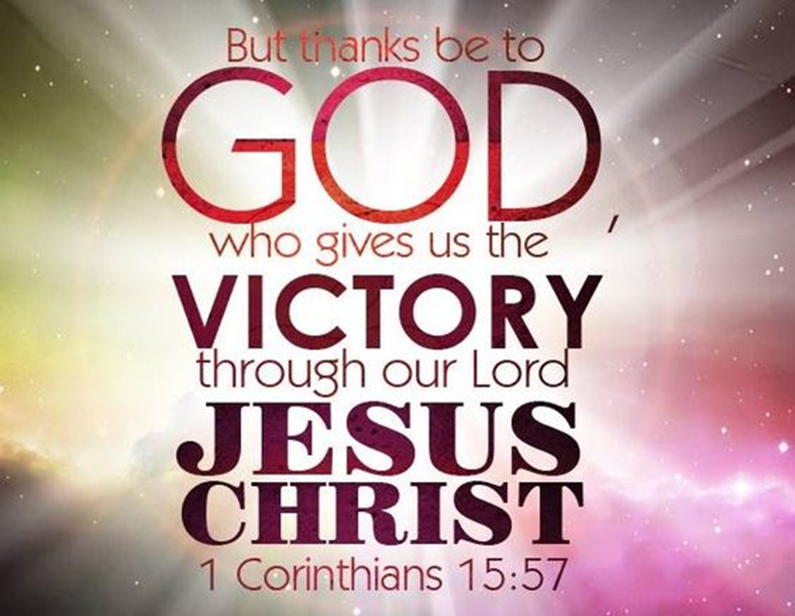
Trinity Evangelical Lutheran Church
May 12, 2024
WELCOME!
Notes:
Image: Five Loaves by Caroline Coolidge Brown. Copyright © Caroline Coolidge Brown. All rights reserved. Used by permission of the artist.

Slide 2
Prelude By Roxanne Groff
= Please stand if able
= Please be seated
Office of the Acolyte and Ringing of the Bell
Welcome
Notes:
Image: Five Loaves by Caroline Coolidge Brown. Copyright © Caroline Coolidge Brown. All rights reserved. Used by permission of the artist.

Slide 3
CONFESSION AND FORGIVENESS
All may make the sign of the cross, the sign marked at baptism…
L: We confess our sins before God and one another.
Pause for silence and reflection.
L: Risen God,
Notes:
Image: Five Loaves by Caroline Coolidge Brown. Copyright © Caroline Coolidge Brown. All rights reserved. Used by permission of the artist.

Slide 4
CONFESSION AND FORGIVENESS
C: We confess to you, to ourselves, and to one another that we have caused harm by the things we have said and done, and by the things we have not said and not done.
Notes:
Image: Five Loaves by Caroline Coolidge Brown. Copyright © Caroline Coolidge Brown. All rights reserved. Used by permission of the artist.

Slide 5
CONFESSION AND FORGIVENESS
C: Take away our sins that we might fully embody your commandment to love you with all our hearts, souls, minds, and strength, and to love our neighbors as ourselves.
Notes:
Image: Five Loaves by Caroline Coolidge Brown. Copyright © Caroline Coolidge Brown. All rights reserved. Used by permission of the artist.

Slide 6
CONFESSION AND FORGIVENESS
L: In grace and mercy, God forgives all our sins, and with joy and expectation calls us into new life for the sake of the world, ☩ through Jesus Christ our savior.
C: Amen.
Notes:
Image: Five Loaves by Caroline Coolidge Brown. Copyright © Caroline Coolidge Brown. All rights reserved. Used by permission of the artist.

Slide 7
Gathering Song
“My Lord, What A Morning”
ELW 438
Notes:
Image: Five Loaves by Caroline Coolidge Brown. Copyright © Caroline Coolidge Brown. All rights reserved. Used by permission of the artist.

Slide 8
“My Lord, What A Morning” LBW 272
Refrain
My Lord, what a morning;
my Lord, what a morning;
oh, my Lord, what a morning,
when the stars begin to fall.
1 You will hear the trumpet sound,
to wake the nations underground,
looking to my God's right hand,
when the stars begin to fall.
Notes:
Image: Five Loaves by Caroline Coolidge Brown. Copyright © Caroline Coolidge Brown. All rights reserved. Used by permission of the artist.

Slide 9
“My Lord, What A Morning” LBW 272
Refrain
My Lord, what a morning;
my Lord, what a morning;
oh, my Lord, what a morning,
when the stars begin to fall.
2 You will hear the sinner cry,
to wake the nations underground,
looking to my God's right hand,
when the stars begin to fall
Notes:
Image: Five Loaves by Caroline Coolidge Brown. Copyright © Caroline Coolidge Brown. All rights reserved. Used by permission of the artist.

Slide 10
“My Lord, What A Morning” LBW 272
Refrain
My Lord, what a morning;
my Lord, what a morning;
oh, my Lord, what a morning,
when the stars begin to fall.
3 You will hear the Christian shout,
to wake the nations underground,
looking to my God's right hand,
when the stars begin to fall.
Notes:
Image: Five Loaves by Caroline Coolidge Brown. Copyright © Caroline Coolidge Brown. All rights reserved. Used by permission of the artist.

Slide 11
“My Lord, What A Morning” LBW 272
Refrain
My Lord, what a morning;
my Lord, what a morning;
oh, my Lord, what a morning,
when the stars begin to fall.
Notes:
Image: Five Loaves by Caroline Coolidge Brown. Copyright © Caroline Coolidge Brown. All rights reserved. Used by permission of the artist.

Slide 12
APOSTOLIC GREETING
P: The grace of our Lord Jesus Christ, the love of God, and the communion of the Holy Spirit be with you all.
C: And also with you.
Notes:
Image: Five Loaves by Caroline Coolidge Brown. Copyright © Caroline Coolidge Brown. All rights reserved. Used by permission of the artist.

Slide 13
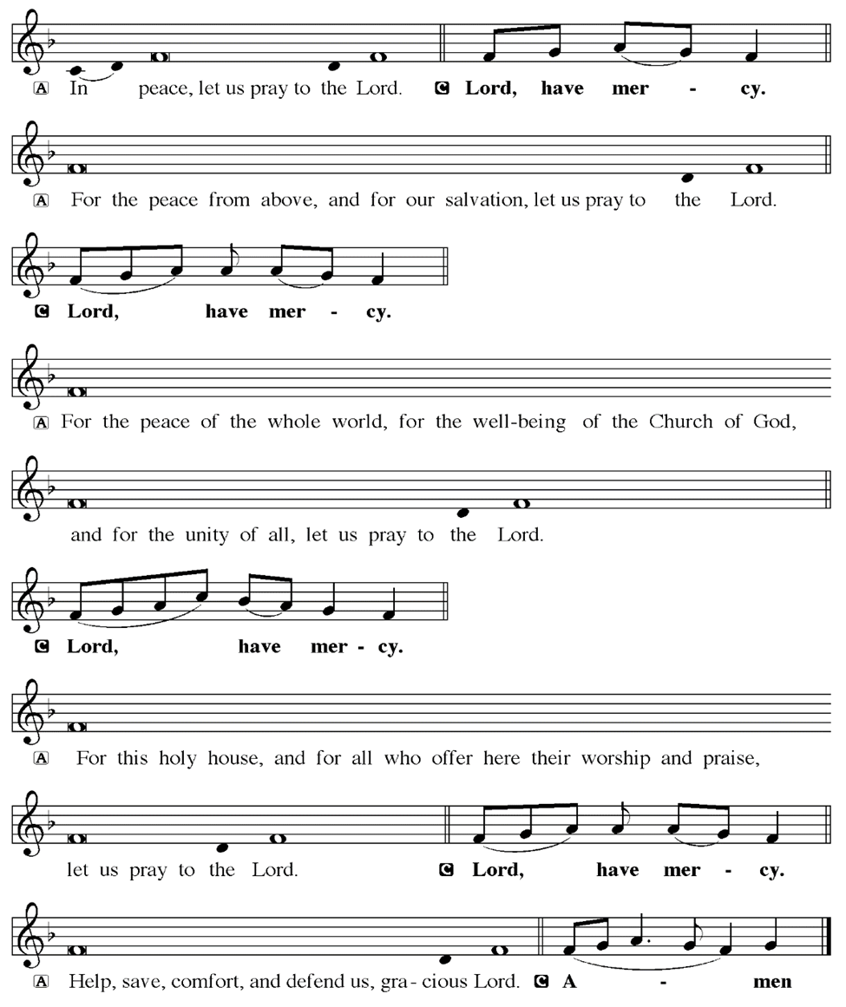
KYRIE
Notes:
Image: Five Loaves by Caroline Coolidge Brown. Copyright © Caroline Coolidge Brown. All rights reserved. Used by permission of the artist.

Slide 14
KYRIE
Notes:
Image: Five Loaves by Caroline Coolidge Brown. Copyright © Caroline Coolidge Brown. All rights reserved. Used by permission of the artist.

Slide 15
KYRIE
Notes:
Image: Five Loaves by Caroline Coolidge Brown. Copyright © Caroline Coolidge Brown. All rights reserved. Used by permission of the artist.

Slide 16
HYMN OF PRAISE
Glory be to God in heaven;
peace, goodwill to all the earth.
Mighty God of all creation,
Father of surpassing worth:
we exalt you, we adore you,
we lift high our thanks and praise.
Saints and angels bow before you; here on earth our songs we raise.
Notes:
Image: Five Loaves by Caroline Coolidge Brown. Copyright © Caroline Coolidge Brown. All rights reserved. Used by permission of the artist.

Slide 17
HYMN OF PRAISE
Glory be to Christ forever,
Lamb of God and Lord of love.
Son of God and gracious Savior, you have come from heav’n above;
on the cross you died to save us; now you reign at God’s right hand.
Hear our prayer; restore, forgive us; in your promise firm we stand.
Notes:
Image: Five Loaves by Caroline Coolidge Brown. Copyright © Caroline Coolidge Brown. All rights reserved. Used by permission of the artist.

Slide 18
HYMN OF PRAISE
Holy One we now acclaim you;
Lord alone, to you we call;
Holy One in faith we name you,
God most high, yet near to all:
Jesus Christ, with God the Spirit,
in the Father’s splendor bright.
For the peace that we inherit,
glory be to God on high!
Notes:
Image: Five Loaves by Caroline Coolidge Brown. Copyright © Caroline Coolidge Brown. All rights reserved. Used by permission of the artist.

Slide 19
PRAYER OF THE DAY
P: Let us pray… God of resurrection, yours is the promise of eternal life in Jesus Christ, yet we are so often surrounded by pain, illness, and death. Stir up in us the hope of salvation, and the strong conviction that we will overcome the trials of this life and live in your tender, loving presence forevermore. In Jesus’ name we pray.
C: Amen
Notes:
Image: Five Loaves by Caroline Coolidge Brown. Copyright © Caroline Coolidge Brown. All rights reserved. Used by permission of the artist.

Slide 20

Notes:
Image: Preparing yeast dough. Copyright © tomasworks/iStock/Thinkstock. Used by permission.

Slide 21
Scripture Reading
R: Our scripture reading is from the Book of 1st Corinthians, Chapter 15.
C: Glory to you O’ Lord! (Spoken)
Notes:
Image: Five Loaves by Caroline Coolidge Brown. Copyright © Caroline Coolidge Brown. All rights reserved. Used by permission of the artist.

Slide 22
1 Corinthians 15:1-26, 51-57
Now I would remind you, brothers and sisters, of the good news that I proclaimed to you, which you in turn received, in which also you stand, ²through which also you are being saved, if you hold firmly to the message that I proclaimed to you—unless you have come to believe in vain.
Notes:
Image: Five Loaves by Caroline Coolidge Brown. Copyright © Caroline Coolidge Brown. All rights reserved. Used by permission of the artist.

Slide 23
1 Corinthians 15:1-26, 51-57
³ For I handed on to you as of first importance what I in turn had received: that Christ died for our sins in accordance with the scriptures, ⁴ and that he was buried, and that he was raised on the third day in accordance with the scriptures, ⁵ and that he appeared to Cephas, then to the twelve. ⁶ Then he appeared to more than five hundred brothers and sisters
Notes:
Image: Five Loaves by Caroline Coolidge Brown. Copyright © Caroline Coolidge Brown. All rights reserved. Used by permission of the artist.

Slide 24
1 Corinthians 15:1-26, 51-57
at one time, most of whom are still alive, though some have died. ⁷ Then he appeared to James, then to all the apostles. ⁸ Last of all, as to one untimely born, he appeared also to me. ⁹ For I am the least of the apostles, unfit to be called an apostle, because I persecuted the church of God. ¹⁰ But by the grace of God I am what I am, and his grace toward me has not been
Notes:
Image: Five Loaves by Caroline Coolidge Brown. Copyright © Caroline Coolidge Brown. All rights reserved. Used by permission of the artist.

Slide 25
1 Corinthians 15:1-26, 51-57
in vain. On the contrary, I worked harder than any of them—though it was not I, but the grace of God that is with me. ¹¹ Whether then it was I or they, so we proclaim and so you have come to believe.
¹² Now if Christ is proclaimed as raised from the dead, how can some of you say there is no resurrection of the dead? ¹³ If there is no resurrection of
Notes:
Image: Five Loaves by Caroline Coolidge Brown. Copyright © Caroline Coolidge Brown. All rights reserved. Used by permission of the artist.

Slide 26
1 Corinthians 15:1-26, 51-57
the dead, then Christ has not been raised; ¹⁴ and if Christ has not been raised, then our proclamation has been in vain and your faith has been in vain. ¹⁵ We are even found to be misrepresenting God, because we testified of God that he raised Christ—whom he did not raise if it is true that the dead are not raised. ¹⁶ For if the dead are not raised, then Christ has
Notes:
Image: Five Loaves by Caroline Coolidge Brown. Copyright © Caroline Coolidge Brown. All rights reserved. Used by permission of the artist.

Slide 27
1 Corinthians 15:1-26, 51-57
not been raised. ¹⁷ If Christ has not been raised, your faith is futile and you are still in your sins. ¹⁸ Then those also who have died in Christ have perished. ¹⁹ If for this life only we have hoped in Christ, we are of all people most to be pitied.
²⁰ But in fact Christ has been raised from the dead, the first fruits of those who have died. ²¹ For since death came
Notes:
Image: Five Loaves by Caroline Coolidge Brown. Copyright © Caroline Coolidge Brown. All rights reserved. Used by permission of the artist.

Slide 28
1 Corinthians 15:1-26, 51-57
through a human being, the resurrection of the dead has also come through a human being; ²² for as all die in Adam, so all will be made alive in Christ. ²³But each in his own order: Christ the first fruits, then at his coming those who belong to Christ. ²⁴Then comes the end, when he hands over the kingdom to God the Father,
Notes:
Image: Five Loaves by Caroline Coolidge Brown. Copyright © Caroline Coolidge Brown. All rights reserved. Used by permission of the artist.

Slide 29
1 Corinthians 15:1-26, 51-57
after he has destroyed every ruler and every authority and power. ²⁵ For he must reign until he has put all his enemies under his feet. ²⁶ The last enemy to be destroyed is death.
⁵¹ Listen, I will tell you a mystery! We will not all die, but we will all be changed, ⁵² in a moment, in the twinkling of an eye, at the last trumpet.
Notes:
Image: Five Loaves by Caroline Coolidge Brown. Copyright © Caroline Coolidge Brown. All rights reserved. Used by permission of the artist.

Slide 30
1 Corinthians 15:1-26, 51-57
For the trumpet will sound, and the dead will be raised imperishable, and we will be changed. ⁵³ For this perishable body must put on imperishability, and this mortal body must put on immortality. ⁵⁴ When this perishable body puts on imperishability, and this mortal body puts on immortality, then the saying
Notes:
Image: Five Loaves by Caroline Coolidge Brown. Copyright © Caroline Coolidge Brown. All rights reserved. Used by permission of the artist.

Slide 31
1 Corinthians 15:1-26, 51-57
that is written will be fulfilled:
“Death has been swallowed up in victory.” ⁵⁵ “Where, O death, is your victory? Where, O death, is your sting?” ⁵⁶ The sting of death is sin, and the power of sin is the law. ⁵⁷ But thanks be to God, who gives us the victory through our Lord Jesus Christ.
Notes:
Image: Five Loaves by Caroline Coolidge Brown. Copyright © Caroline Coolidge Brown. All rights reserved. Used by permission of the artist.

Slide 32
1 Corinthians 15:1-26, 51-57
R: This is the Word of the Lord.
C: Praise to You, O Christ (Spoken)
Notes:
Image: Five Loaves by Caroline Coolidge Brown. Copyright © Caroline Coolidge Brown. All rights reserved. Used by permission of the artist.

Slide 33
Sermon
Notes:
Image: Five Loaves by Caroline Coolidge Brown. Copyright © Caroline Coolidge Brown. All rights reserved. Used by permission of the artist.

Slide 34
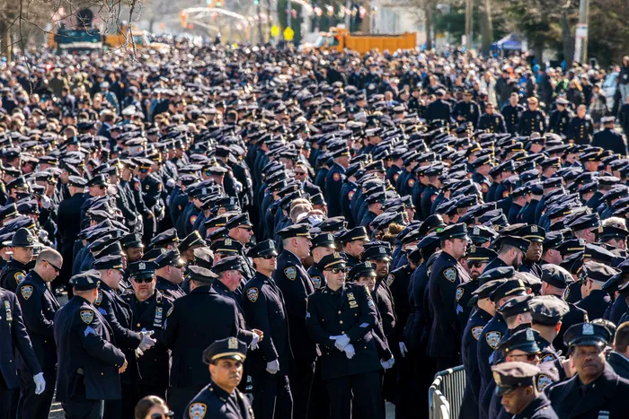
Sermon
Notes:
Image: Five Loaves by Caroline Coolidge Brown. Copyright © Caroline Coolidge Brown. All rights reserved. Used by permission of the artist.

Slide 35

Sermon
Notes:
Image: Five Loaves by Caroline Coolidge Brown. Copyright © Caroline Coolidge Brown. All rights reserved. Used by permission of the artist.

Slide 36

Sermon
Notes:
Image: Five Loaves by Caroline Coolidge Brown. Copyright © Caroline Coolidge Brown. All rights reserved. Used by permission of the artist.

Slide 37
Sermon
Good | Bad
?
?
Death
Notes:
Image: Five Loaves by Caroline Coolidge Brown. Copyright © Caroline Coolidge Brown. All rights reserved. Used by permission of the artist.

Slide 38

Sermon
Notes:
Image: Five Loaves by Caroline Coolidge Brown. Copyright © Caroline Coolidge Brown. All rights reserved. Used by permission of the artist.

Slide 39
Sermon
Good | Bad
?
?
Death
Notes:
Image: Five Loaves by Caroline Coolidge Brown. Copyright © Caroline Coolidge Brown. All rights reserved. Used by permission of the artist.

Slide 40
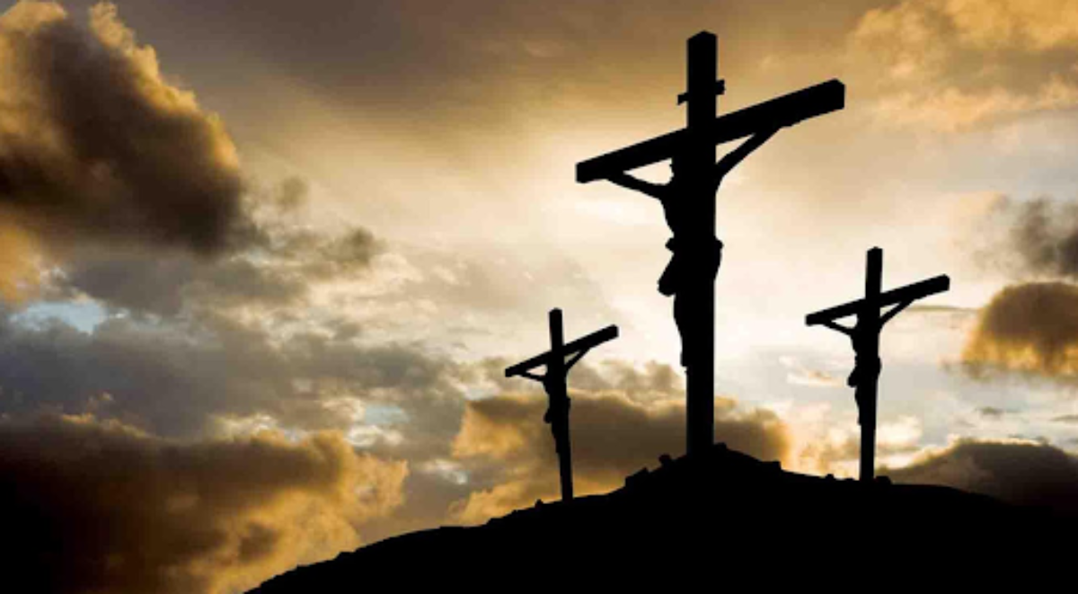
Sermon
Notes:
Image: Five Loaves by Caroline Coolidge Brown. Copyright © Caroline Coolidge Brown. All rights reserved. Used by permission of the artist.

Slide 41
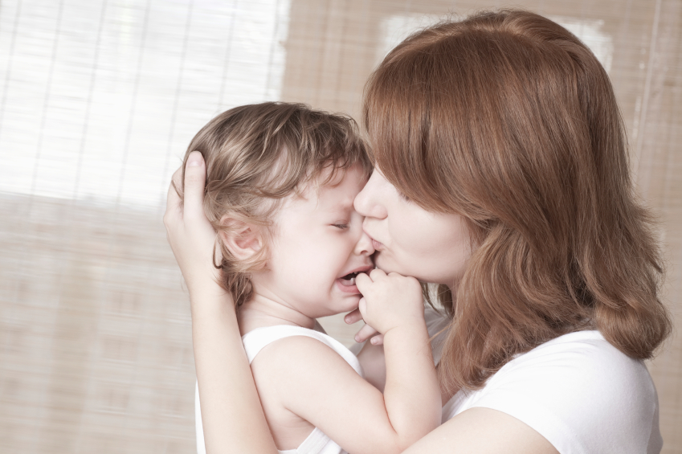
Sermon
Notes:
Image: Five Loaves by Caroline Coolidge Brown. Copyright © Caroline Coolidge Brown. All rights reserved. Used by permission of the artist.

Slide 42

Sermon
Notes:
Image: Five Loaves by Caroline Coolidge Brown. Copyright © Caroline Coolidge Brown. All rights reserved. Used by permission of the artist.

Slide 43
NICENE CREED
C: We believe in one God, the Father, the Almighty, maker of heaven and earth, of all that is, seen and unseen.

Slide 44
NICENE CREED
C: We believe in one Lord, Jesus Christ, the only Son of God, eternally begotten of the Father, God from God, Light from Light, true God from true God, begotten, not made, of one Being with the Father.

Slide 45
NICENE CREED
C: Through him all things were made. For us and for our salvation he came down from heaven; by the power of the Holy Spirit he became incarnate from the virgin Mary, and was made man. For our sake he was crucified under Pontius Pilate;

Slide 46
NICENE CREED
C: he suffered death and was buried. On the third day he rose again in accordance with the Scriptures; he ascended into heaven and is seated at the right hand of the Father. He will come again in glory to judge the living and the dead, and his kingdom will have no end.

Slide 47
NICENE CREED
C: We believe in the Holy Spirit, the Lord, the giver of life, who proceeds from the Father and the Son. With the Father and the Son he is worshiped and glorified. He has spoken through the prophets. We believe in one holy catholic and apostolic Church.

Slide 48
NICENE CREED
C: We acknowledge one Baptism for the forgiveness of sins. We look for the resurrection of the dead, and the life of the world to come. Amen.

Slide 49
PRAYERS OF INTERCESSION
Each petition will end with the words,
A: God of new life,
The congregation will respond with:
C: In mercy, hear our prayer.

Slide 50
PRAYERS OF INTERCESSION
The prayer concludes…
P: We place in your arms all for whom we pray, out loud or in our hearts, confident in your mercy and grace, through Jesus Christ, our savior.
C: Amen.

Slide 51
OFFERING
Notes:
Image: Five Loaves by Caroline Coolidge Brown. Copyright © Caroline Coolidge Brown. All rights reserved. Used by permission of the artist.

Slide 52
OFFERING PRAYER
Notes:
Image: Five Loaves by Caroline Coolidge Brown. Copyright © Caroline Coolidge Brown. All rights reserved. Used by permission of the artist.

Slide 53
THE GREAT THANKSGIVING
All the Baptized are welcome to celebrate this Holy Meal.

Slide 54
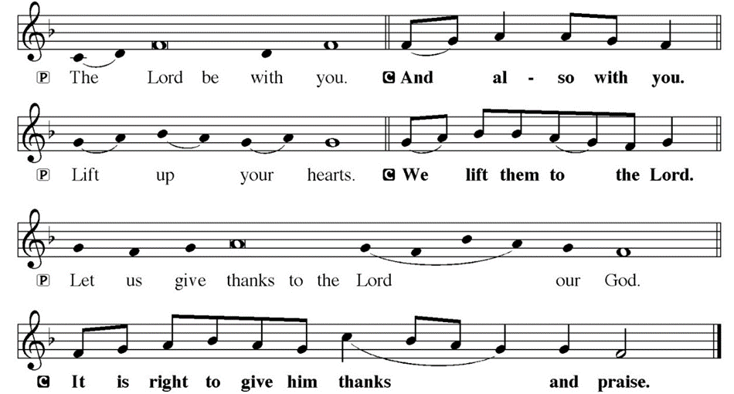
DIALOGUE

Slide 55
THE PREFACE
P: It is indeed right and salutary…
… we praise your name and join their unending hymn.

Slide 56
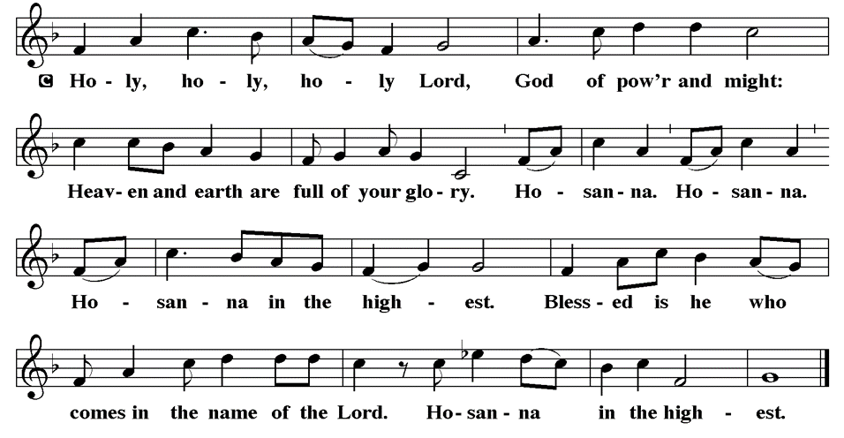
THE SANCTUS

Slide 57
EUCHARISTIC PRAYER
P: Holy, living, and loving God…
…both now and forever.
C: Amen.

Slide 58
THE LORD’S PRAYER
C: Our Father, who art in heaven, hallowed be thy name, thy kingdom come, thy will be done, on earth as it is in heaven. Give us this day our daily bread; and forgive us our trespasses, as we forgive those who trespass against us; and lead us not into temptation, but deliver us from evil.

Slide 59
THE LORD’S PRAYER
C: For thine is the kingdom, and the power, and the glory, forever and ever. Amen.

Slide 60
INVITATION TO COMMUNION
P: Jesus who is patient and kind invites you to the feast of love in his name. Come and feast in the presence of our savior.

Slide 61
COMMUNION DISTRIBUTION
All will commune “At the Rail”.
The bread may be broken for distribution. As the ministers give the bread and wine, they say these words :
The body of Christ, given for you.
The blood of Christ, shed for you.
The communicant may say: Amen.

Slide 62
POST COMMUNION BLESSING
P: May this body and blood of our Lord and Savior, Jesus Christ, strengthen, keep and unite us, ☩ now and forever, amen.
C: Amen.

Slide 63
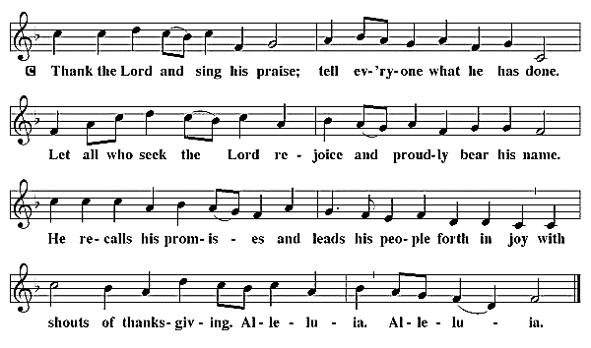
POST COMMUNION CANTACLE

Slide 64
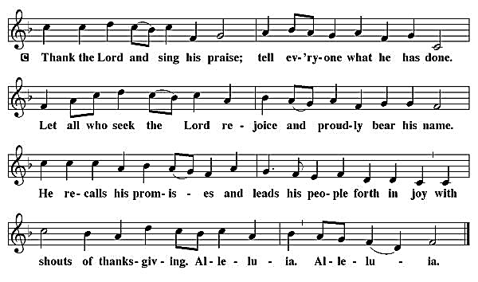
POST COMMUNION CANTACLE

Slide 65
POST COMMUNION PRAYER
P: Let us pray… Shepherding God, you have prepared a table before us and nourished us with your love. Send us forth from this banquet to proclaim your goodness and share the abundant mercy of Jesus, our redeemer and friend.
C: Amen

Slide 66

ANNOUNCEMENTS
Notes:
Image: Five Loaves by Caroline Coolidge Brown. Copyright © Caroline Coolidge Brown. All rights reserved. Used by permission of the artist.

Slide 67
SENDING BLESSING
P: Alleluia! Christ is risen!
C: Christ is risen indeed! Alleluia!
P: The God of resurrection power, the Christ of unending joy, and the Spirit of Easter hope ☩ bless you now and always.
C: Amen.

Slide 68
Sending Song
“Amazing Grace, How Sweet the Sound”
LBW 448
Notes:
Image: Five Loaves by Caroline Coolidge Brown. Copyright © Caroline Coolidge Brown. All rights reserved. Used by permission of the artist.

Slide 69
“Amazing Grace, How Sweet the Sound”
LBW 448
1 Amazing grace, how sweet the sound,
that saved a wretch like me!
I once was lost, but now am found;
was blind, but now I see.
Notes:
Image: Preparing yeast dough. Copyright © tomasworks/iStock/Thinkstock. Used by permission.

Slide 70
“Amazing Grace, How Sweet the Sound”
LBW 448
2 ’Twas grace that taught my heart to fear,
and grace my fears relieved;
how precious did that grace appear
the hour I first believed!
Notes:
Image: Preparing yeast dough. Copyright © tomasworks/iStock/Thinkstock. Used by permission.

Slide 71
“Amazing Grace, How Sweet the Sound”
LBW 448
3 Through many dangers, toils, and snares
I have already come;
’tis grace has brought me safe thus far,
and grace will lead me home.
Notes:
Image: Preparing yeast dough. Copyright © tomasworks/iStock/Thinkstock. Used by permission.

Slide 72
“Amazing Grace, How Sweet the Sound”
LBW 448
4 The Lord has promised good to me;
his word my hope secures;
he will my shield and portion be
as long as life endures.
Notes:
Image: Preparing yeast dough. Copyright © tomasworks/iStock/Thinkstock. Used by permission.

Slide 73
DISMISSAL
P: … Depart in Christ’s Love.
C: Seeking, welcoming, and serving all. Amen!
POSTLUDE
By Roxanne Groff
From sundaysandseasons.com. Copyright © 2024 Augsburg Fortress. All rights reserved. Reprinted by permission under Augsburg Fortress Liturgies Annual License #SAS023830. New Revised Standard Version Bible, Copyright © 1989, Division of Christian Education of the National Council of the Churches of Christ in the United States of America. Used by permission. All rights reserved. Revised Common Lectionary, Copyright © 1992 Consultation on Common Texts, admin Augsburg Fortress. Used by permission.

