Slide 1

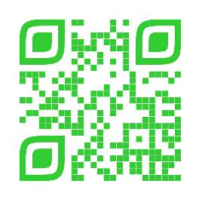
Announcements
Trinity
Lutheran Church
December 1, 2024
Scan Me!

Slide 2

Welcome
Bishop Dillahunt

Slide 3

Body, Mind, Spirit
Body: Avoid frying foods. Bake, broil, steam or microwave when possible.
Mind: Remember little kindnesses and forget small faults.
Spirit: Be hopeful.

Slide 4


Our Office Secretary Is Sharon Fourman
Church Office Schedule
Tues-Thurs, 8:00 am – 11:30 am
Office Phone: (937) 692-5670
Email: secretary@pitsburgtlc.org

Slide 5

The Trinity Trumpet
A Monthly Newsletter
Published by Trinity Lutheran Church,
Pitsburg, OH
We’re looking for stories and pictures of Trinity people in action!
Submit to Secretary, Sharon Fourman at secretary@pitsburgtlc.org
Articles and Info due on or about the 15th of each month

Slide 6

Trinity Trumpet
    Your Trinity Trumpet Newsletter for December is available!
    Please take your copy before you leave today!

Slide 7
Trinity Trumpet
    Newsletter Deadline is Tuesday, December 17, 2024
    Please turn in all your newsworthy items to Sharon Fourman at:
    secretary@pitsburgtlc.org

Slide 8

We’re Online!
www.pitsburgtlc.org
Sermons and announcements are posted weekly
Trinity Trumpet is Posted here too!
The ‘Official’ Trinity Calendar is available for you to see!
Pictures, Videos and more!
Also, like us on FaceBook at
facebook.com/pitsburgtrinitylutheran.church

Slide 9
We’re Online!
www.pitsburgtlc.org
We now have our own QR Code!
Scan this code with your Smartphone and you will connect to all our Online media (Facebook, YouTube, and our own Church Website)

Slide 10

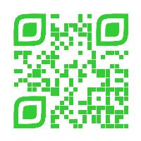
Online Giving
www.pitsburgtlc.org
Click the “Give to Trinity” Button
Stay current in your giving even when you can’t make it to Worship!
Separate Giving Categories for:
    General Treasury
    Benevolence/Mission Support
    Building Fund
    Annual Christmas Auction
    Memorial Funds
    Thrive Capital Campaign

Slide 11


Church
Council
Trinity Church Council
Next Regular Meeting
January 15, 2025
@ 7:00 pm

Slide 12


Trinity’s Team Meetings
Next Meeting
TBD
@ 6:00 pm
On the Agenda – Preparing the proposed 2023 budget

Slide 13
Please Pass the Pew Pads
(We now track Communion on the Pads)

Slide 14

Worship Team
Next Meeting:
  TBD

Slide 15

Mutual Ministry Team
  Julie Kossler
  VACANT
  Peggy Didier
  Please see one of them with your comments and suggestions
  Next Meeting - TBD

Slide 16


Choice FISH Pantry
Please join us every Friday @ 3:30 pm
400 Markwith Dr, Greenville OH
Most Needed Items
Kidney Beans
Canned Peas
Hamburger Helper
Pork & Beans
Canned Mixed Veggies
Large Cans of Soups
Applesauce
Boxed Meals
(i.e. Rice a Roni)

Slide 17
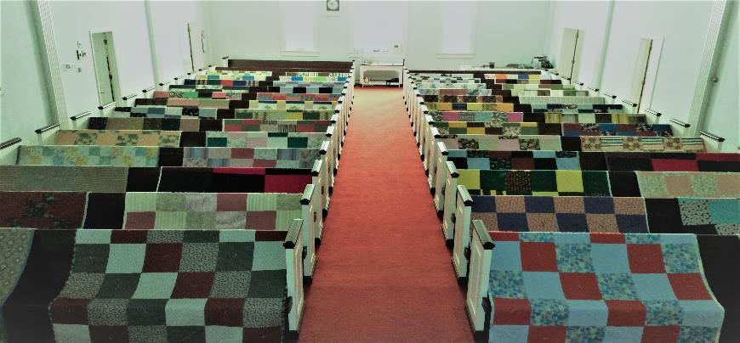
Prayers and Squares
Quilting Ministry
Thursday, December 12 @ 10:30 am
Tuesday, December 31 @ 10:00 am

Slide 18


Next Meeting:
December 4, 2024
@ 11:30 am
Christmas Party!!!
Notes:
This Photo by Unknown Author is licensed under CC BY-NC

Slide 19

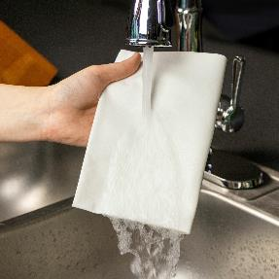
ULTIMATE CLEANING CLOTH SALE
1 for $7.00
2 for $10.00
5 for $20.00
See
  Portia Boord or Diane Warner

Slide 20


Ladies and Gents Luncheon
Date: January 16, 2025
Where: Montage, 527 South Broadway Greenville
For Reservations/Questions:
        See Linda Baker or call her @ 937 545-8410

Slide 21
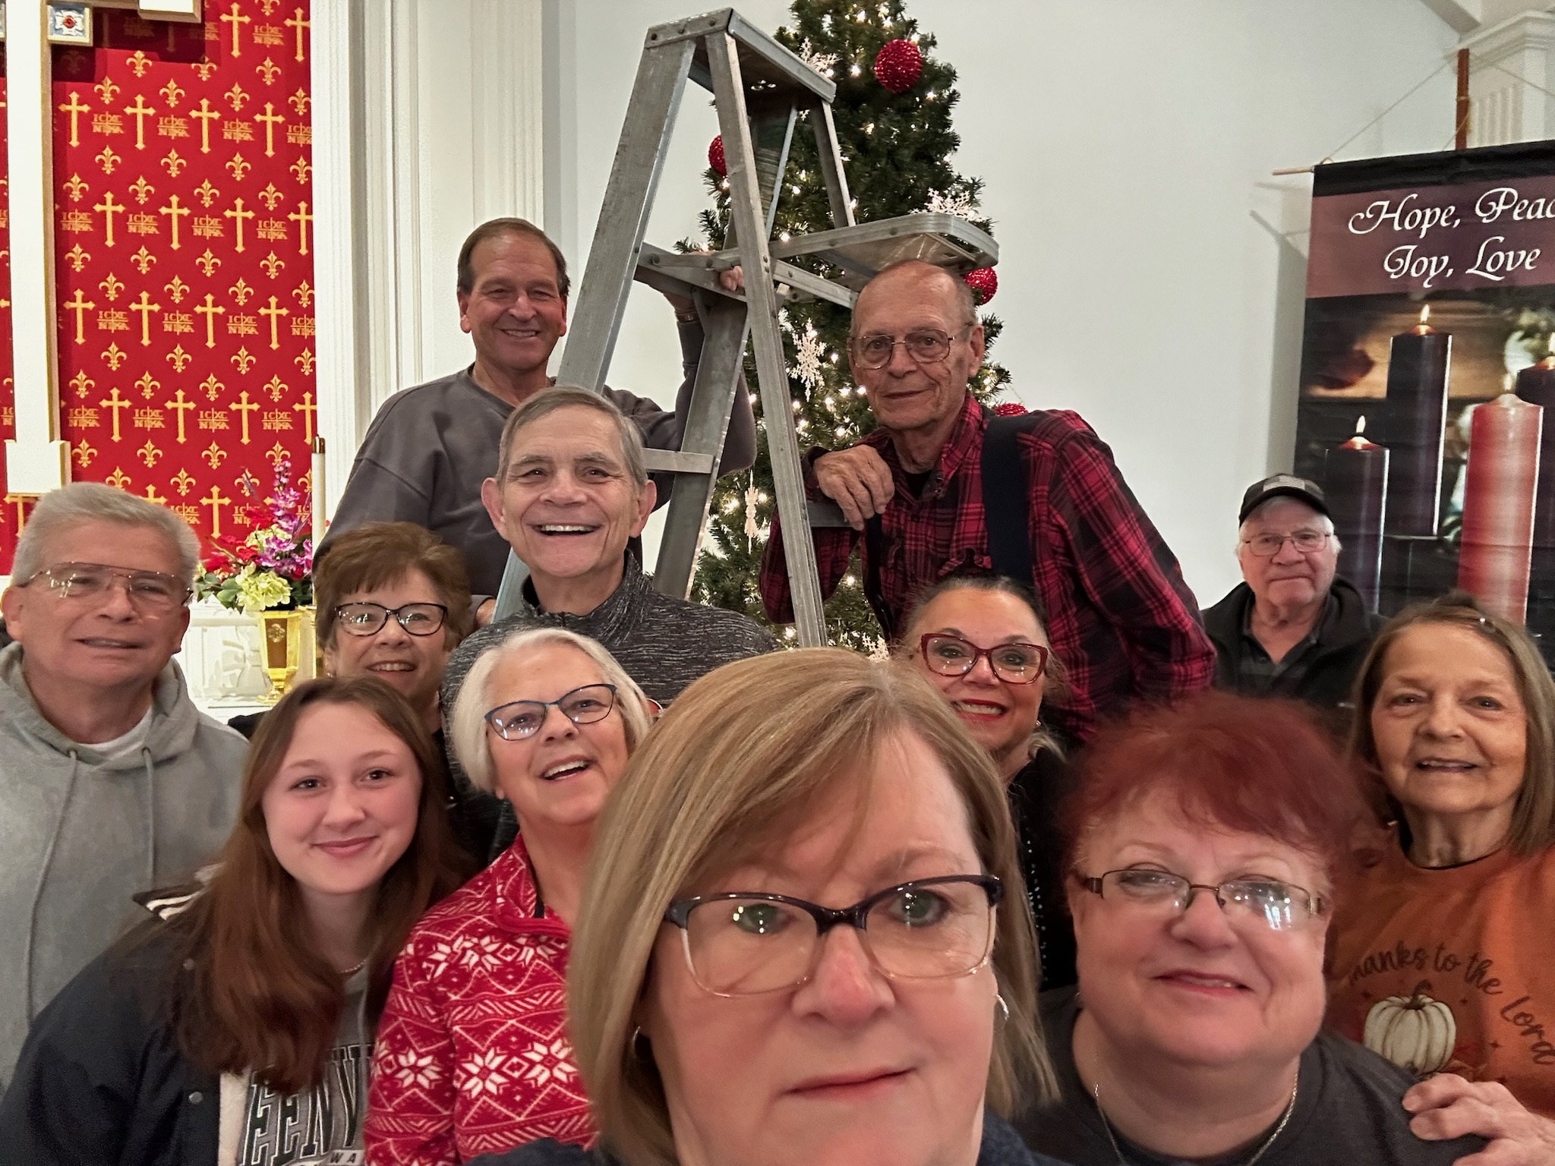
BIG THANK YOU!!!
To all who helped decorate the Church and Sanctuary!

Slide 22

Confirmation Program
    Sunday Mornings @ 9:00 am
    Weekly Worship attendance is required (In person or via FaceBook)
    Worship Notes may be emailed to pastor@pitsburgtlc.org or placed in Pr Mel’s mailbox outside the Church Office
    Confirmands are HIGHLY encouraged to take turns as Acolyte

Slide 23

    Who can be an Acolyte? YOU CAN!!!
    Ask Pr Mel about training opportunities
    Please sign up for Acolyte Duty on the chart by the Church Office!
    Confirmation Students are Highly Encouraged to perform Acolyte duty…
    Please sign up today!

Slide 24
New Member Class
We are forming a “New Member” Class for anyone who wants to learn more about Being Lutheran and what Being a member of Trinity entails
    Classes will begin January 8th
    Classes start at 12:00 Noon or as soon after Worship as possible
    Please see Pastor Mel if Interested in attending

Slide 25

    If you would like to sponsor the Altar Flowers, see PJ to Sign Up!

Slide 26

Next Meeting
December 5, 2024 @ 10:00 am
Purpose – Plan Christmas Program, Youth Quake, and Other Events!
Please come if you can!

Slide 27

Blood Pressure Screening
BP Screening
By Appointment
In The Nursery
Notes:
Cover: Sermon on the Mount by Laura James. Copyright © Laura James. All rights reserved. Used by permission of the artist.

Slide 28

Calling all Adults!
Join Us For “Christian Conversations”
Not Your Ordinary Adult Sunday School
Sharing – Discussion - Prayer
Every Sunday @
9:30 am
Notes:
Cover: Sermon on the Mount by Laura James. Copyright © Laura James. All rights reserved. Used by permission of the artist.

Slide 29
Kick off the Advent/Christmas Season
Help decorate your Church Sanctuary
When? This Saturday!!! November 30th @ 10 am
Donuts and juice/coffee will be served!
Notes:
Cover: Sermon on the Mount by Laura James. Copyright © Laura James. All rights reserved. Used by permission of the artist.

Slide 30

The Chosen
On Hiatus Until January 2025
Notes:
Cover: Sermon on the Mount by Laura James. Copyright © Laura James. All rights reserved. Used by permission of the artist.

Slide 31

Trinity Troops
Date: TODAY!!! -- After Worship
Where: Trinity Fellowship Hall
Who: Youth 4th – 6th Grades
What: Fun and Snacks! Making felt Blankets!!!
Trinity Troops!

Slide 32

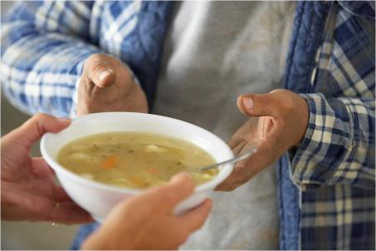
Grace Resurrection Community Center
Soup Kitchen Meal
When: Wednesday, December 18th
10:00 am to 1:00 pm.
Where: 433 Water Street in Greenville

Slide 33
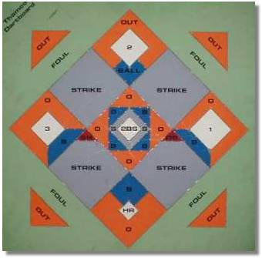


Monday December 2, 2024
7:30 pm
@ Beech grove Church of the Brethren
3420 Harrison Rd, Hollansburg OH

Slide 34
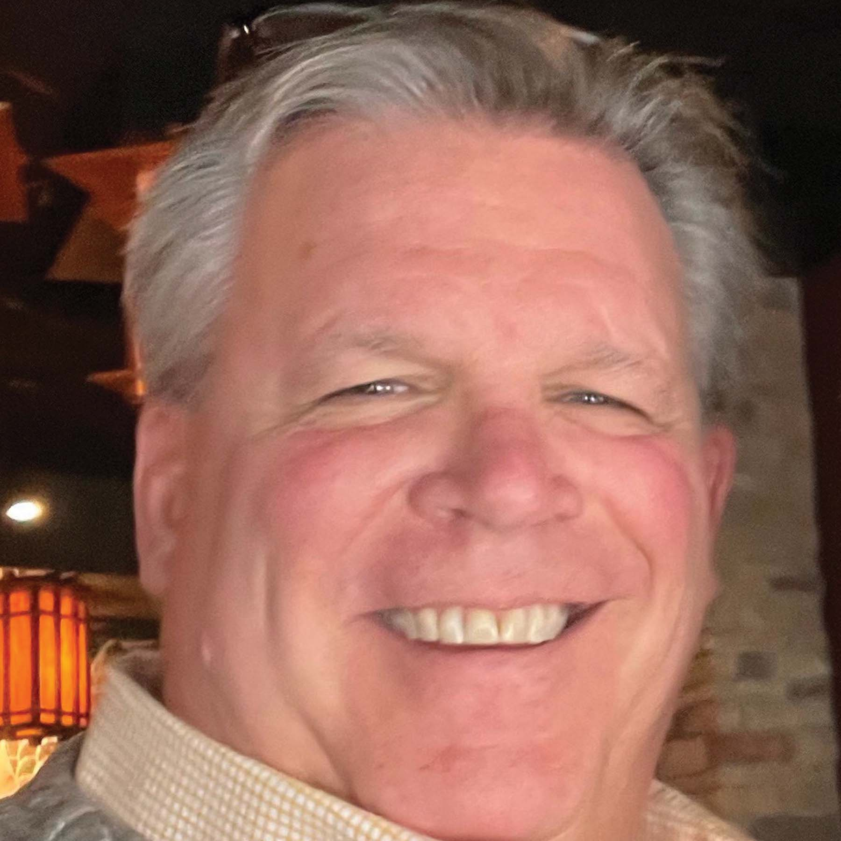
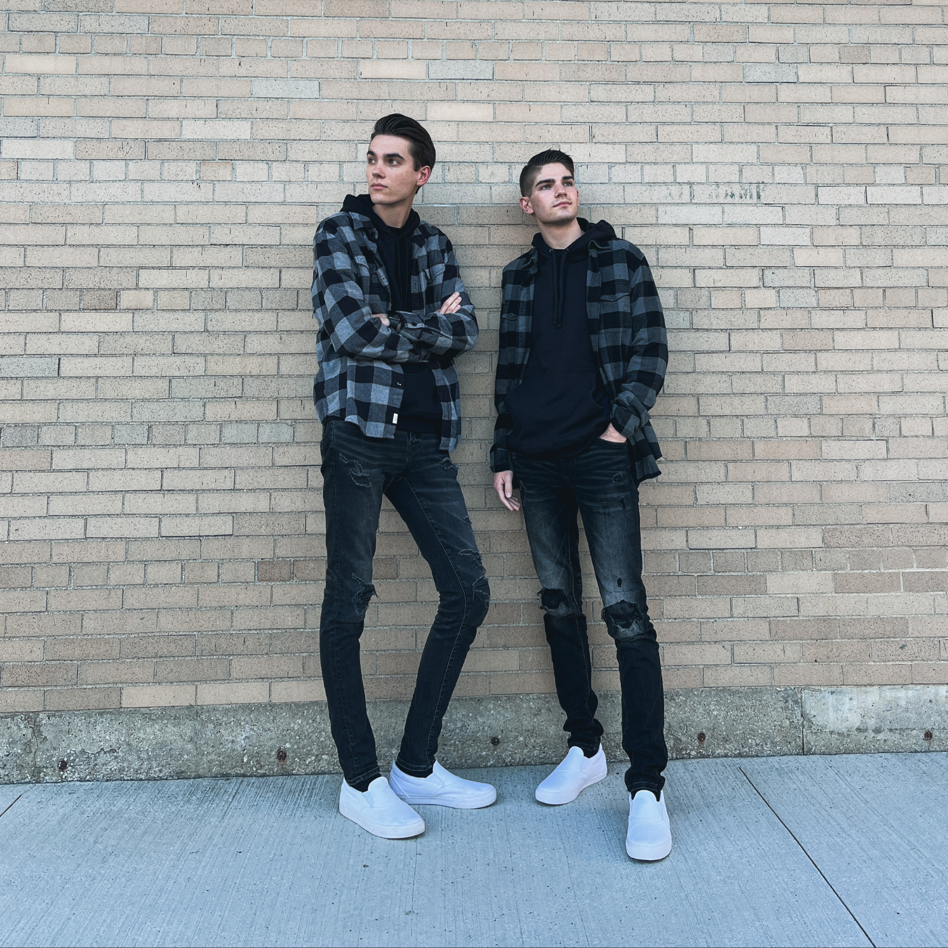
Trinity Youth (7th – 12th Grades)
  Key Speaker
  Pr Bill Yonker
  Where: Holiday Inn Cincinnati Eastgate
  Cost: $129 + Room + Food
  Info: Pr Mel or PJ
  Ages: 7th – 12th Grades
  Price increase after Dec 5th
  Music By
  The Scally Brothers

Slide 35
Special Guest-THIS Sunday!
We will welcome Bishop Suzanne Dillahunt this Sunday, Dec 1st!!
She will attend Adult Sunday School and speak about what is happening around the Synod
Please see PJ or Linda Baker if you can assist with breakfast
We plan to serve breakfast at 9:15 am
Notes:
Cover: Sermon on the Mount by Laura James. Copyright © Laura James. All rights reserved. Used by permission of the artist.

Slide 36

Community Blood Drive | November 19 @ 2:30 pm
Ladies & Gents Luncheon @ Tolly’s | November 21 @ 11:30 am
Thanksgiving Eve Service | November 27 @ 7:00 pm
Advent Soup Supper & Video Discussion | December 4, 11, & 18 @ 6:30 pm
Children’s Christmas Program Practice | December 7 @ 10:00 am
Children’s Christmas Program | December 8 @ 10:30 am
Darke County Christmas Fund Drive | December 13 & 14 @ 10 am-8 pm
GRCC Soup Kitchen | December 18 @ 9:30 am
Christmas Eve Worship Services | December 24 @ 4 $ 10 pm
Ugly Christmas Sweater Sunday | December 29 @ 10:30 am
Notes:
Cover: Sermon on the Mount by Laura James. Copyright © Laura James. All rights reserved. Used by permission of the artist.

Slide 37
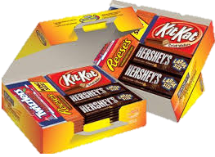
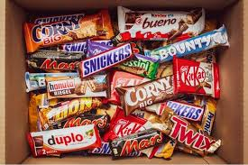
Trinity Youth
Fun (d) Raiser!
Candy Bar Sales!
Large Selection
$2 Each
Supports Youth Quake 2025
Notes:
Cover: Sermon on the Mount by Laura James. Copyright © Laura James. All rights reserved. Used by permission of the artist.

