Slide 1

October 8, 2023
WELCOME!
Trinity Lutheran Church
Notes:
Image: Five Loaves by Caroline Coolidge Brown. Copyright © Caroline Coolidge Brown. All rights reserved. Used by permission of the artist.

Slide 2
= Please stand if able
= Please be seated
Prelude - By Roxanne Groff
Office of the Acolyte
Ringing of the Bell
Welcome

Slide 3
THANKSGIVING FOR BAPTISM
All may make the sign of the cross, the sign marked at baptism, as the presiding minister begins.
P: Blessed be the holy Trinity, ☩ one God, the fountain of living water, the rock who gave us birth, our light and our salvation.
C: Amen.
Notes:
Image: Preparing yeast dough. Copyright © tomasworks/iStock/Thinkstock. Used by permission.

Slide 4
P: Joined to Christ in the waters of baptism, we are clothed with God's mercy and forgiveness. Let us give thanks for the gift of baptism.
Water may be poured into the font as the presiding minister gives thanks.
THANKSGIVING FOR BAPTISM
Notes:
Image: Preparing yeast dough. Copyright © tomasworks/iStock/Thinkstock. Used by permission.

Slide 5
P: We give you thanks, O God, for in the beginning your Spirit moved over the waters and by your Word you created the world, calling forth life in which you took delight. Through the waters of the flood you delivered Noah and his family. Through the sea you led your people Israel from slavery into freedom.
THANKSGIVING FOR BAPTISM
Notes:
Image: Preparing yeast dough. Copyright © tomasworks/iStock/Thinkstock. Used by permission.

Slide 6
P: At the river your Son was baptized by John and anointed with the Holy Spirit. By water and your Word you claim us as daughters and sons, making us heirs of your promise and servants of all. We praise you for the gift of water that sustains life, and above all we praise you for the gift of new life in Jesus Christ.
THANKSGIVING FOR BAPTISM
Notes:
Image: Preparing yeast dough. Copyright © tomasworks/iStock/Thinkstock. Used by permission.

Slide 7
P: Shower us with your Spirit, and renew our lives with your forgiveness, grace, and love. To you be given honor and praise through Jesus Christ our Lord in the unity of the Holy Spirit, now and forever.
THANKSGIVING FOR BAPTISM
C: Amen.
Notes:
Image: Preparing yeast dough. Copyright © tomasworks/iStock/Thinkstock. Used by permission.

Slide 8
CONFESSION AND FORGIVENESS
All may make the sign of the cross, the sign marked at baptism…
L: We confess our sins before God and one another.
Pause for silence and reflection.
L: God of all that is,
Notes:
Image: Five Loaves by Caroline Coolidge Brown. Copyright © Caroline Coolidge Brown. All rights reserved. Used by permission of the artist.

Slide 9
CONFESSION AND FORGIVENESS
C: We have failed to trust you to care for us. We have tried to be our own god in our lives and the lives of others. We have not listened to your call, nor lived in faithfulness to you. We have caused harm directly and indirectly to ourselves, our neighbors, and your creation.
Notes:
Image: Five Loaves by Caroline Coolidge Brown. Copyright © Caroline Coolidge Brown. All rights reserved. Used by permission of the artist.

Slide 10
CONFESSION AND FORGIVENESS
C: In your infinite grace and mercy, forgive and restore us, so that with your help, we might become the people you created us to be.
Notes:
Image: Five Loaves by Caroline Coolidge Brown. Copyright © Caroline Coolidge Brown. All rights reserved. Used by permission of the artist.

Slide 11
CONFESSION AND FORGIVENESS
L: Hear the good news: By the power of the Holy Spirit we are made new creations in Christ Jesus, and through his selfless sacrifice, God forgives us all our sin. Walk with God in this newness of life.
C: Amen.
Notes:
Image: Five Loaves by Caroline Coolidge Brown. Copyright © Caroline Coolidge Brown. All rights reserved. Used by permission of the artist.

Slide 12
Gathering Song/Hymn of Praise
“Spirit of God, Descend Upon My Heart”
LBW 486

Slide 13
Spirit of God, Descend Upon My Heart LBW 486
1 Spirit of God, descend upon my heart;
wean it from earth, through all its pulses move;
stoop to my weakness, strength to me impart,
and make me love you as I ought to love.
Notes:
Image: Five Loaves by Caroline Coolidge Brown. Copyright © Caroline Coolidge Brown. All rights reserved. Used by permission of the artist.

Slide 14
Spirit of God, Descend Upon My Heart LBW 486
2 I ask no dream, no prophet ecstasies,
no sudden rending of the veil of clay,
no angel visitant, no op'ning skies;
but take the dimness of my soul away.
Notes:
Image: Five Loaves by Caroline Coolidge Brown. Copyright © Caroline Coolidge Brown. All rights reserved. Used by permission of the artist.

Slide 15
Spirit of God, Descend Upon My Heart LBW 486
3 Have you not bid me love you, God and King;
all, all your own, soul, heart, and strength, and mind?
I see your cross; there teach my heart to cling.
Oh, let me seek you and, oh, let me find!
Notes:
Image: Five Loaves by Caroline Coolidge Brown. Copyright © Caroline Coolidge Brown. All rights reserved. Used by permission of the artist.

Slide 16
Spirit of God, Descend Upon My Heart LBW 486
4 Teach me to love you as your angels love,
one holy passion filling all my frame:
the baptism of the heav'n-descended dove,
my heart an altar, and your love the flame.
Notes:
Image: Five Loaves by Caroline Coolidge Brown. Copyright © Caroline Coolidge Brown. All rights reserved. Used by permission of the artist.

Slide 17
APOSTOLIC GREETING
P: The grace of our Lord Jesus Christ, the love of God, and the communion of the Holy Spirit be with you all.
C: And also with you.
Notes:
Image: Five Loaves by Caroline Coolidge Brown. Copyright © Caroline Coolidge Brown. All rights reserved. Used by permission of the artist.

Slide 18
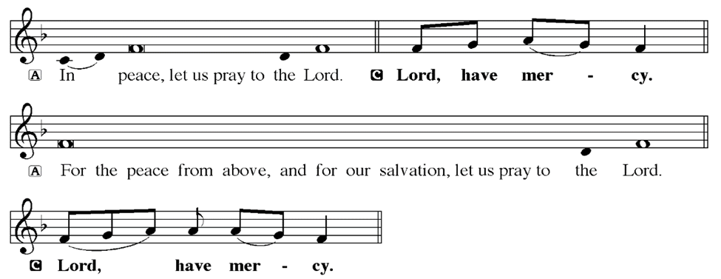
KYRIE
Notes:
Image: Five Loaves by Caroline Coolidge Brown. Copyright © Caroline Coolidge Brown. All rights reserved. Used by permission of the artist.

Slide 19
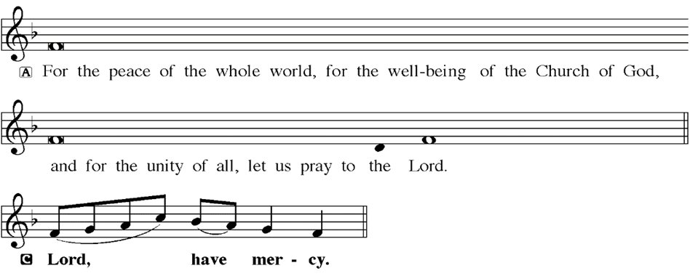
KYRIE
Notes:
Image: Five Loaves by Caroline Coolidge Brown. Copyright © Caroline Coolidge Brown. All rights reserved. Used by permission of the artist.

Slide 20
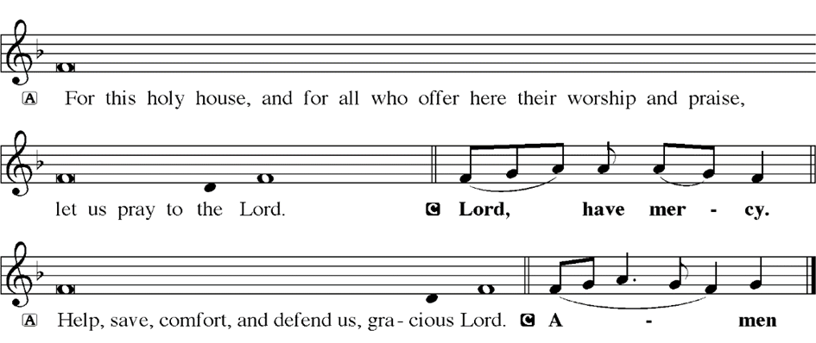
KYRIE
Notes:
Image: Five Loaves by Caroline Coolidge Brown. Copyright © Caroline Coolidge Brown. All rights reserved. Used by permission of the artist.

Slide 21
HYMN OF PRAISE
Glory be to God in heaven;
peace, goodwill to all the earth.
Mighty God of all creation,
Father of surpassing worth:
we exalt you, we adore you,
we lift high our thanks and praise.
Saints and angels bow before you; here on earth our songs we raise.
Notes:
Image: Five Loaves by Caroline Coolidge Brown. Copyright © Caroline Coolidge Brown. All rights reserved. Used by permission of the artist.

Slide 22
HYMN OF PRAISE
Glory be to Christ forever,
Lamb of God and Lord of love.
Son of God and gracious Savior, you have come from heav’n above;
on the cross you died to save us; now you reign at God’s right hand.
Hear our prayer; restore, forgive us; in your promise firm we stand.
Notes:
Image: Five Loaves by Caroline Coolidge Brown. Copyright © Caroline Coolidge Brown. All rights reserved. Used by permission of the artist.

Slide 23
HYMN OF PRAISE
Holy One we now acclaim you;
Lord alone, to you we call;
Holy One in faith we name you,
God most high, yet near to all:
Jesus Christ, with God the Spirit,
in the Father’s splendor bright.
For the peace that we inherit,
glory be to God on high!
Notes:
Image: Five Loaves by Caroline Coolidge Brown. Copyright © Caroline Coolidge Brown. All rights reserved. Used by permission of the artist.

Slide 24
PRAYER OF THE DAY
P: Let us pray… Guiding God, you have gifted us with your commandments to help us love you with all we are, and to love our neighbors as ourselves. Help us to keep them that all might live together in peace.
C: Amen
Notes:
Image: Five Loaves by Caroline Coolidge Brown. Copyright © Caroline Coolidge Brown. All rights reserved. Used by permission of the artist.

Slide 25

Notes:
Image: Five Loaves by Caroline Coolidge Brown. Copyright © Caroline Coolidge Brown. All rights reserved. Used by permission of the artist.

Slide 26
Scripture Reading
L: Our scripture reading for this day is from Deuteronomy chapters 5 and 6.
C: Glory to you O’ Lord! (Spoken)
Notes:
Image: Five Loaves by Caroline Coolidge Brown. Copyright © Caroline Coolidge Brown. All rights reserved. Used by permission of the artist.

Slide 27
Deuteronomy 5:1-21; 6:4-9
Chapter 5
Moses convened all Israel, and said to them: Hear, O Israel, the statutes and ordinances that I am addressing to you today; you shall learn them and observe them diligently. ² The Lord our God made a covenant with us at Horeb. ³ Not with our ancestors did the Lord make this covenant, but with us, who are all of us here alive today. ⁴ The Lord
Notes:
Image: Five Loaves by Caroline Coolidge Brown. Copyright © Caroline Coolidge Brown. All rights reserved. Used by permission of the artist.

Slide 28
Deuteronomy 5:1-21; 6:4-9
spoke with you face to face at the mountain, out of the fire. ⁵ (At that time I was standing between the Lord and you to declare to you the words of the Lord; for you were afraid because of the fire and did not go up the mountain.) And he said:
⁶ I am the Lord your God, who brought you out of the land of Egypt, out of the house of slavery; ⁷ you shall have no
Notes:
Image: Five Loaves by Caroline Coolidge Brown. Copyright © Caroline Coolidge Brown. All rights reserved. Used by permission of the artist.

Slide 29
Deuteronomy 5:1-21; 6:4-9
other gods before me.
⁸ You shall not make for yourself an idol, whether in the form of anything that is in heaven above, or that is on the earth beneath, or that is in the water under the earth. ⁹ You shall not bow down to them or worship them; for I the Lord your God am a jealous God, punishing children for the iniquity of parents, to the third and fourth
Notes:
Image: Five Loaves by Caroline Coolidge Brown. Copyright © Caroline Coolidge Brown. All rights reserved. Used by permission of the artist.

Slide 30
Deuteronomy 5:1-21; 6:4-9
generation of those who reject me, ¹⁰but showing steadfast love to the thousandth generation of those who love me and keep my commandments.
¹¹ You shall not make wrongful use of the name of the Lord your God, for the Lord will not acquit anyone who misuses his name.
¹² Observe the sabbath day and keep it holy, as the Lord your God commanded
Notes:
Image: Five Loaves by Caroline Coolidge Brown. Copyright © Caroline Coolidge Brown. All rights reserved. Used by permission of the artist.

Slide 31
Deuteronomy 5:1-21; 6:4-9
you. ¹³ Six days you shall labor and do all your work. ¹⁴ But the seventh day is a sabbath to the Lord your God; you shall not do any work—you, or your son or your daughter, or your male or female slave, or your ox or your donkey, or any of your livestock, or the resident alien in your towns, so that your male and female slave may rest as well as you. ¹⁵ Remember that you were a slave
Notes:
Image: Five Loaves by Caroline Coolidge Brown. Copyright © Caroline Coolidge Brown. All rights reserved. Used by permission of the artist.

Slide 32
Deuteronomy 5:1-21; 6:4-9
in the land of Egypt, and the Lord your God brought you out from there with a mighty hand and an outstretched arm; therefore the Lord your God commanded you to keep the sabbath day.
¹⁶ Honor your father and your mother, as the Lord your God commanded you, so that your days may be long and that it may go well with you in the land that the Lord your God is giving you.
Notes:
Image: Five Loaves by Caroline Coolidge Brown. Copyright © Caroline Coolidge Brown. All rights reserved. Used by permission of the artist.

Slide 33
Deuteronomy 5:1-21; 6:4-9
¹⁷ You shall not murder.
¹⁸ Neither shall you commit adultery.
¹⁹ Neither shall you steal.
²⁰ Neither shall you bear false witness against your neighbor.
²¹ Neither shall you covet your neighbor’s wife. Neither shall you desire your neighbor’s house, or field, or male or female slave, or ox, or donkey, or anything that belongs to your neighbor.
Notes:
Image: Five Loaves by Caroline Coolidge Brown. Copyright © Caroline Coolidge Brown. All rights reserved. Used by permission of the artist.

Slide 34
Deuteronomy 5:1-21; 6:4-9
Chapter 6
⁴ Hear, O Israel: The Lord is our God, the Lord alone. ⁵ You shall love the Lord your God with all your heart, and with all your soul, and with all your might. ⁶ Keep these words that I am commanding you today in your heart. ⁷ Recite them to your children and talk about them when you are at home and when you are away, when you lie down and when you rise.
Notes:
Image: Five Loaves by Caroline Coolidge Brown. Copyright © Caroline Coolidge Brown. All rights reserved. Used by permission of the artist.

Slide 35
Deuteronomy 5:1-21; 6:4-9
⁸ Bind them as a sign on your hand, fix them as an emblem on your forehead, ⁹ and write them on the doorposts of your house and on your gates.
Notes:
Image: Five Loaves by Caroline Coolidge Brown. Copyright © Caroline Coolidge Brown. All rights reserved. Used by permission of the artist.

Slide 36
Deuteronomy 5:1-21; 6:4-9
R: This is the Word of the Lord.
C: Praise to You, O Christ (Spoken)
Notes:
Image: Five Loaves by Caroline Coolidge Brown. Copyright © Caroline Coolidge Brown. All rights reserved. Used by permission of the artist.

Slide 37
Sermon

Slide 38
Hymn of the Day
“Lord, Keep Up Steadfast in Your Word”
LBW 230

Slide 39
“Lord, Keep Up Steadfast in Your Word” LBW 230
1 Lord, keep us steadfast in your word;
curb those who by deceit or sword
would wrest the kingdom from your Son
and bring to naught all he has done.

Slide 40
“Lord, Keep Up Steadfast in Your Word” LBW 230
2 Lord Jesus Christ, your pow'r make known,
for you are Lord of lords alone;
defend your holy church, that we
may sing your praise eternally.

Slide 41
“Lord, Keep Up Steadfast in Your Word” LBW 230
3 O Comforter of priceless worth,
send peace and unity on earth;
support us in our final strife
and lead us out of death to life.

Slide 42
APOSTLE’S CREED
C: I believe in God, the Father almighty, creator of heaven and earth.

Slide 43
APOSTLE’S CREED
C: I believe in Jesus Christ, his only Son, our Lord. He was conceived by the power of the Holy Spirit and born of the virgin Mary. He suffered under Pontius Pilate, was crucified, died, and was buried.

Slide 44
APOSTLE’S CREED
C: He descended into hell. On the third day he rose again. He ascended into heaven, and is seated at the right hand of the Father. He will come again to judge the living and the dead.

Slide 45
APOSTLE’S CREED
C: I believe in the Holy Spirit, the holy catholic Church, the communion of saints, the forgiveness of sins, the resurrection of the body, and the life everlasting. Amen.

Slide 46
NICENE CREED
C: We believe in one God, the Father, the Almighty, maker of heaven and earth, of all that is, seen and unseen.

Slide 47
NICENE CREED
C: We believe in one Lord, Jesus Christ, the only Son of God, eternally begotten of the Father, God from God, Light from Light, true God from true God, begotten, not made, of one Being with the Father.

Slide 48
NICENE CREED
C: Through him all things were made. For us and for our salvation he came down from heaven; by the power of the Holy Spirit he became incarnate from the virgin Mary, and was made man. For our sake he was crucified under Pontius Pilate;

Slide 49
NICENE CREED
C: he suffered death and was buried. On the third day he rose again in accordance with the Scriptures; he ascended into heaven and is seated at the right hand of the Father. He will come again in glory to judge the living and the dead, and his kingdom will have no end.

Slide 50
NICENE CREED
C: We believe in the Holy Spirit, the Lord, the giver of life, who proceeds from the Father and the Son. With the Father and the Son he is worshiped and glorified. He has spoken through the prophets. We believe in one holy catholic and apostolic Church.

Slide 51
NICENE CREED
C: We acknowledge one Baptism for the forgiveness of sins. We look for the resurrection of the dead, and the life of the world to come. Amen.

Slide 52
QUILT TYING AND PRESENTATION
This Quilt was lovingly crafted for recovery and healing especially for XXX.
Let us pray…

Slide 53
PRAYERS OF INTERCESSION
Each petition will end with the words,
A: Eternal God,
The congregation will respond with:
C: In mercy, hear our prayer.

Slide 54
PRAYERS OF INTERCESSION
The prayer concludes…
P: We place in your loving arms these, our prayers, spoken and unspoken, trusting in your boundless mercy, though Jesus Christ our Savior.
C: Amen.

Slide 55
SHARING OF THE Peace
The Sharing of the Peace that began when the congregation arrived is now shared with the Pastor at this time...
P: The peace of the Lord be with you always.
C: And also with you.

Slide 56
OFFERING
Notes:
Image: Five Loaves by Caroline Coolidge Brown. Copyright © Caroline Coolidge Brown. All rights reserved. Used by permission of the artist.

Slide 57
OFFERING PRAYER
Notes:
Image: Five Loaves by Caroline Coolidge Brown. Copyright © Caroline Coolidge Brown. All rights reserved. Used by permission of the artist.

Slide 58
THE GREAT THANKSGIVING
All the Baptized are welcome to celebrate this Holy Meal.

Slide 59
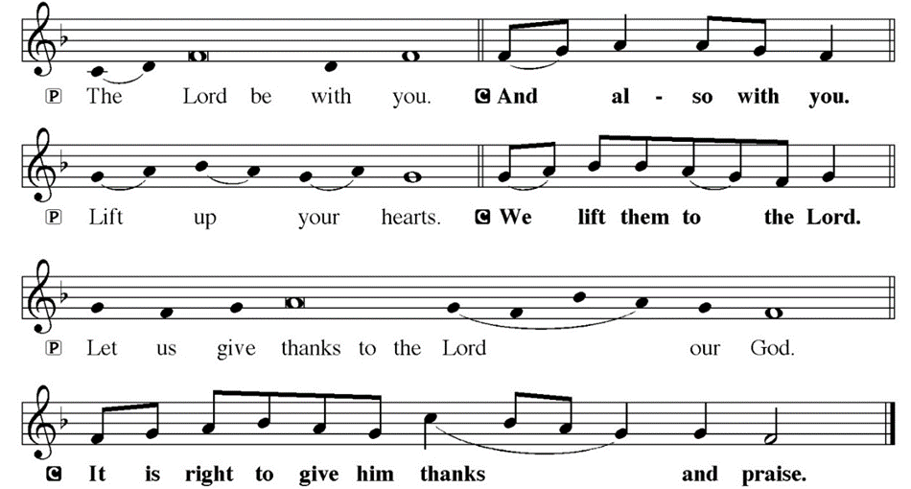
DIALOGUE

Slide 60
THE PREFACE
P: It is indeed right and salutary…
… we praise your name and join their unending hymn.

Slide 61
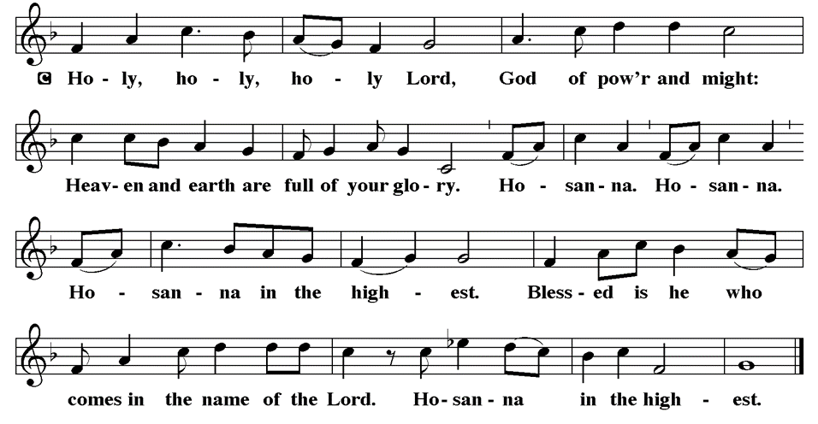
THE SANCTUS

Slide 62
EUCHARISTIC PRAYER
P: Holy God…
…both now and forever.
C: Amen.

Slide 63
THE LORD’S PRAYER
C: Our Father, who art in heaven, hallowed be thy name, thy kingdom come, thy will be done, on earth as it is in heaven. Give us this day our daily bread; and forgive us our trespasses, as we forgive those who trespass against us; and lead us not into temptation, but deliver us from evil.

Slide 64
THE LORD’S PRAYER
C: For thine is the kingdom, and the power, and the glory, forever and ever. Amen.

Slide 65
INVITATION TO COMMUNION
P: God who liberated God’s people from Egypt, also liberated all creation through the death and resurrection of Jesus Christ. Come share now in this holy feast, in remembrance of Jesus’ saving grace. All is prepared.

Slide 66
COMMUNION DISTRIBUTION
All will commune “At the Rail”.
The bread may be broken for distribution. As the ministers give the bread and wine, they say these words :
The body of Christ, given for you.
The blood of Christ, shed for you.
The communicant may say: Amen.

Slide 67
POST COMMUNION CANTACLE

Slide 68
POST COMMUNION CANTACLE

Slide 69
POST COMMUNION PRAYER
P: Let us pray… Blessed be your name, O God, for we have feasted on your Word, Christ Jesus, the joy and delight of our hearts. Strengthened by this food, send us to gather the world to your banquet, where none are left out and all are satisfied. In Jesus’ name we pray.
C: Amen

Slide 70
ANNOUNCEMENTS
Notes:
Image: Five Loaves by Caroline Coolidge Brown. Copyright © Caroline Coolidge Brown. All rights reserved. Used by permission of the artist.

Slide 71
SENDING BLESSING
P: The God of glory, Jesus Christ, name above all names, and the Spirit who lives in you, bless you † now and forever.
C: Amen.

Slide 72
Sending Song
“Awesome God”
W & P 13
Notes:
Image: Five Loaves by Caroline Coolidge Brown. Copyright © Caroline Coolidge Brown. All rights reserved. Used by permission of the artist.

Slide 73
“Awesome God” W & P 13
Our God, is an Awesome God
He reigns, from Heaven above
With wisdom, power, and love
Our God is an Awesome God!
Repeat 3X
Notes:
Image: Preparing yeast dough. Copyright © tomasworks/iStock/Thinkstock. Used by permission.

Slide 74
DISMISSAL
P: … Depart in Christ’s Love.
C: Seeking, welcoming, and serving all. Amen!
POSTLUDE
By
Roxanne Groff
From sundaysandseasons.com. Copyright © 2023 Augsburg Fortress. All rights reserved. Reprinted by permission under Augsburg Fortress Liturgies Annual License #SAS023830. New Revised Standard Version Bible, Copyright © 1989, Division of Christian Education of the National Council of the Churches of Christ in the United States of America. Used by permission. All rights reserved. Revised Common Lectionary, Copyright © 1992 Consultation on Common Texts, admin Augsburg Fortress. Used by permission.

