Slide 1
March 17, 2024
WELCOME!
Trinity Lutheran Church
Notes:
Image: Five Loaves by Caroline Coolidge Brown. Copyright © Caroline Coolidge Brown. All rights reserved. Used by permission of the artist.

Slide 2
= Please stand if able
= Please be seated
Prelude - By Pan Sherman
Office of the Acolyte
Ringing of the Bell
Welcome

Slide 3
THANKSGIVING FOR BAPTISM
All may make the sign of the cross, the sign marked at baptism, as the presiding minister begins.
P: Blessed be the holy Trinity, ☩ one God, the fountain of living water, the rock who gave us birth, our light and our salvation.
C: Amen.
Notes:
Image: Preparing yeast dough. Copyright © tomasworks/iStock/Thinkstock. Used by permission.

Slide 4
P: Joined to Christ in the waters of baptism, we are clothed with God's mercy and forgiveness. Let us give thanks for the gift of baptism. Water may be poured into the font as the presiding minister gives thanks.
THANKSGIVING FOR BAPTISM
Notes:
Image: Preparing yeast dough. Copyright © tomasworks/iStock/Thinkstock. Used by permission.

Slide 5
P: We give you thanks, O God, for in the beginning your Spirit moved over the waters and by your Word you created the world, calling forth life in which you took delight. Through the waters of the flood you delivered Noah and his family. Through the sea you led your people Israel from slavery into freedom.
THANKSGIVING FOR BAPTISM
Notes:
Image: Preparing yeast dough. Copyright © tomasworks/iStock/Thinkstock. Used by permission.

Slide 6
P: At the river your Son was baptized by John and anointed with the Holy Spirit. By water and your Word you claim us as daughters and sons, making us heirs of your promise and servants of all. We praise you for the gift of water that sustains life, and above all we praise you for the gift of new life in Jesus Christ.
THANKSGIVING FOR BAPTISM
Notes:
Image: Preparing yeast dough. Copyright © tomasworks/iStock/Thinkstock. Used by permission.

Slide 7
P: Shower us with your Spirit, and renew our lives with your forgiveness, grace, and love. To you be given honor and praise through Jesus Christ our Lord in the unity of the Holy Spirit, now and forever.
THANKSGIVING FOR BAPTISM
C: Amen.
Notes:
Image: Preparing yeast dough. Copyright © tomasworks/iStock/Thinkstock. Used by permission.

Slide 8
CONFESSION AND FORGIVENESS
All may make the sign of the cross, the sign marked at baptism…
L: We confess our sins before God and one another.
Pause for silence and reflection.
L: God of love,
Notes:
Image: Five Loaves by Caroline Coolidge Brown. Copyright © Caroline Coolidge Brown. All rights reserved. Used by permission of the artist.

Slide 9
CONFESSION AND FORGIVENESS
C: When we look inward and are honest with ourselves, we see where we have lived as though you are not our God. We have sought after our own gain rather than the good of all. We have not loved you or our neighbors as ourselves. We have betrayed and denied you in what we have done and not done.
Notes:
Image: Five Loaves by Caroline Coolidge Brown. Copyright © Caroline Coolidge Brown. All rights reserved. Used by permission of the artist.

Slide 10
CONFESSION AND FORGIVENESS
C: Create in us clean hearts, O God, that we might become what you have called us to be.
Notes:
Image: Five Loaves by Caroline Coolidge Brown. Copyright © Caroline Coolidge Brown. All rights reserved. Used by permission of the artist.

Slide 11
CONFESSION AND FORGIVENESS
L: God whose unfathomable love went to the cross for our sake now forgives us all our sins and welcomes us all over again into the promise of eternal life in ☩ Christ’s name.
C: Amen.
Notes:
Image: Five Loaves by Caroline Coolidge Brown. Copyright © Caroline Coolidge Brown. All rights reserved. Used by permission of the artist.

Slide 12
GATHERING SONG
“My Lord, What A Morning”
ELW 438
Notes:
Image: Five Loaves by Caroline Coolidge Brown. Copyright © Caroline Coolidge Brown. All rights reserved. Used by permission of the artist.

Slide 13
“My Lord, What A Morning” ELW 438
Refrain
My Lord, what a morning;
my Lord, what a morning;
oh, my Lord, what a morning,
when the stars begin to fall.
Notes:
Image: Five Loaves by Caroline Coolidge Brown. Copyright © Caroline Coolidge Brown. All rights reserved. Used by permission of the artist.

Slide 14
“My Lord, What A Morning” ELW 438
1 You will hear the trumpet sound,
to wake the nations underground,
looking to my God's right hand,
when the stars begin to fall.
Notes:
Image: Five Loaves by Caroline Coolidge Brown. Copyright © Caroline Coolidge Brown. All rights reserved. Used by permission of the artist.

Slide 15
“My Lord, What A Morning” ELW 438
2 You will hear the sinner cry,
to wake the nations underground,
looking to my God's right hand,
when the stars begin to fall.
Notes:
Image: Five Loaves by Caroline Coolidge Brown. Copyright © Caroline Coolidge Brown. All rights reserved. Used by permission of the artist.

Slide 16
“My Lord, What A Morning” ELW 438
3 You will hear the Christian shout,
to wake the nations underground,
looking to my God's right hand,
when the stars begin to fall.
Notes:
Image: Five Loaves by Caroline Coolidge Brown. Copyright © Caroline Coolidge Brown. All rights reserved. Used by permission of the artist.

Slide 17
APOSTOLIC GREETING
P: The grace of our Lord Jesus Christ, the love of God, and the communion of the Holy Spirit be with you all.
C: And also with you.
Notes:
Image: Five Loaves by Caroline Coolidge Brown. Copyright © Caroline Coolidge Brown. All rights reserved. Used by permission of the artist.

Slide 18
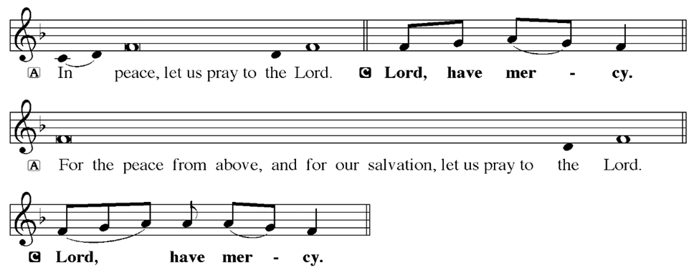
KYRIE
Notes:
Image: Five Loaves by Caroline Coolidge Brown. Copyright © Caroline Coolidge Brown. All rights reserved. Used by permission of the artist.

Slide 19
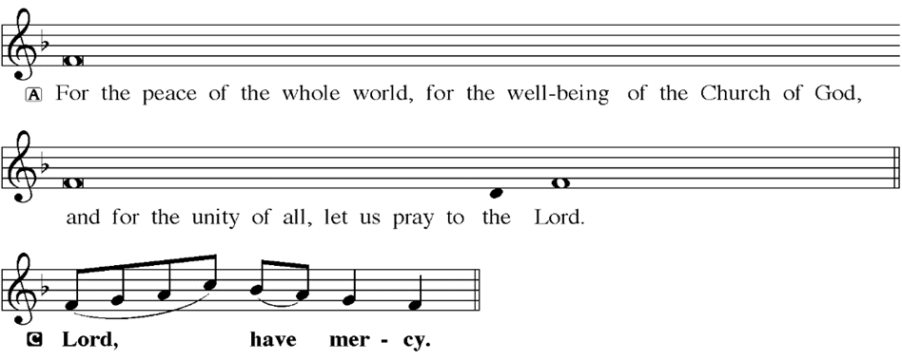
KYRIE
Notes:
Image: Five Loaves by Caroline Coolidge Brown. Copyright © Caroline Coolidge Brown. All rights reserved. Used by permission of the artist.

Slide 20
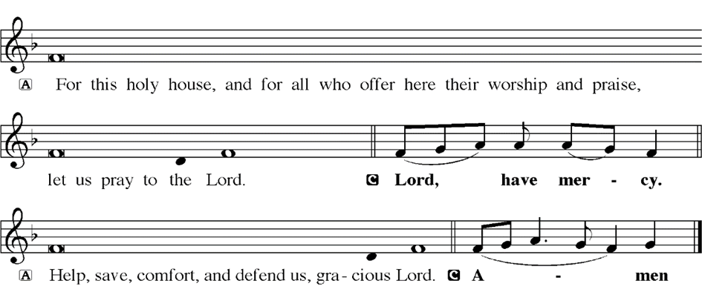
KYRIE
Notes:
Image: Five Loaves by Caroline Coolidge Brown. Copyright © Caroline Coolidge Brown. All rights reserved. Used by permission of the artist.

Slide 21
HYMN OF PRAISE
Glory be to God in heaven;
peace, goodwill to all the earth.
Mighty God of all creation,
Father of surpassing worth:
we exalt you, we adore you,
we lift high our thanks and praise.
Saints and angels bow before you; here on earth our songs we raise.
Notes:
Image: Five Loaves by Caroline Coolidge Brown. Copyright © Caroline Coolidge Brown. All rights reserved. Used by permission of the artist.

Slide 22
HYMN OF PRAISE
Glory be to Christ forever,
Lamb of God and Lord of love.
Son of God and gracious Savior, you have come from heav’n above;
on the cross you died to save us; now you reign at God’s right hand.
Hear our prayer; restore, forgive us; in your promise firm we stand.
Notes:
Image: Five Loaves by Caroline Coolidge Brown. Copyright © Caroline Coolidge Brown. All rights reserved. Used by permission of the artist.

Slide 23
HYMN OF PRAISE
Holy One we now acclaim you;
Lord alone, to you we call;
Holy One in faith we name you,
God most high, yet near to all:
Jesus Christ, with God the Spirit,
in the Father’s splendor bright.
For the peace that we inherit,
glory be to God on high!
Notes:
Image: Five Loaves by Caroline Coolidge Brown. Copyright © Caroline Coolidge Brown. All rights reserved. Used by permission of the artist.

Slide 24
PRAYER OF THE DAY
P: Let us pray… God of the beginning and of the end, you ask us to put our trust not in worldly things, but in heavenly things. As we navigate the challenges of daily life and the much larger challenges faced by our communities and all creation, give us confidence in your power and grace, that we might live into our faith each day. In Jesus’ name we pray.
C: Amen
Notes:
Image: Five Loaves by Caroline Coolidge Brown. Copyright © Caroline Coolidge Brown. All rights reserved. Used by permission of the artist.

Slide 25
Notes:
Image: Five Loaves by Caroline Coolidge Brown. Copyright © Caroline Coolidge Brown. All rights reserved. Used by permission of the artist.

Slide 26
Scripture Reading
L: Our scripture reading for this day is from the Gospel of Mark, the 13th Chapter.
C: Glory to you O’ Lord!
Notes:
Image: Five Loaves by Caroline Coolidge Brown. Copyright © Caroline Coolidge Brown. All rights reserved. Used by permission of the artist.

Slide 27
Mark 13:1-8, 24-37
As he came out of the temple, one of his disciples said to him, “Look, Teacher, what large stones and what large buildings!” ² Then Jesus asked him, “Do you see these great buildings? Not one stone will be left here upon another; all will be thrown down.”
³ When he was sitting on the Mount of Olives opposite the temple, Peter, James, John, and Andrew asked him
Notes:
Image: Five Loaves by Caroline Coolidge Brown. Copyright © Caroline Coolidge Brown. All rights reserved. Used by permission of the artist.

Slide 28
Mark 13:1-8, 24-37
privately, ⁴ “Tell us, when will this be, and what will be the sign that all these things are about to be accomplished?” ⁵ Then Jesus began to say to them, “Beware that no one leads you astray. ⁶ Many will come in my name and say, ‘I am he!’ and they will lead many astray. ⁷ When you hear of wars and rumors of wars, do not be alarmed; this must take place, but the end is still to come. ⁸ For
Notes:
Image: Five Loaves by Caroline Coolidge Brown. Copyright © Caroline Coolidge Brown. All rights reserved. Used by permission of the artist.

Slide 29
Mark 13:1-8, 24-37
nation will rise against nation, and kingdom against kingdom; there will be earthquakes in various places; there will be famines. This is but the beginning of the birth pangs.
²⁴ “But in those days, after that suffering, the sun will be darkened, and the moon will not give its light, ²⁵ and the stars will be falling from heaven, and the powers in the heavens will be shaken.
Notes:
Image: Five Loaves by Caroline Coolidge Brown. Copyright © Caroline Coolidge Brown. All rights reserved. Used by permission of the artist.

Slide 30
Mark 13:1-8, 24-37
²⁶ Then they will see ‘the Son of Man coming in clouds’ with great power and glory. ²⁷ Then he will send out the angels, and gather his elect from the four winds, from the ends of the earth to the ends of heaven.
²⁸ “From the fig tree learn its lesson: as soon as its branch becomes tender and puts forth its leaves, you know that summer is near. ²⁹ So also, when you
Notes:
Image: Five Loaves by Caroline Coolidge Brown. Copyright © Caroline Coolidge Brown. All rights reserved. Used by permission of the artist.

Slide 31
Mark 13:1-8, 24-37
see these things taking place, you know that he is near, at the very gates. ³⁰ Truly I tell you, this generation will not pass away until all these things have taken place. ³¹Heaven and earth will pass away, but my words will not pass away.
³² “But about that day or hour no one knows, neither the angels in heaven, nor the Son, but only the Father.
Notes:
Image: Five Loaves by Caroline Coolidge Brown. Copyright © Caroline Coolidge Brown. All rights reserved. Used by permission of the artist.

Slide 32
Mark 13:1-8, 24-37
³³ Beware, keep alert; for you do not know when the time will come. ³⁴ It is like a man going on a journey, when he leaves home and puts his slaves in charge, each with his work, and commands the doorkeeper to be on the watch.
Notes:
Image: Five Loaves by Caroline Coolidge Brown. Copyright © Caroline Coolidge Brown. All rights reserved. Used by permission of the artist.

Slide 33
Mark 13:1-8, 24-37
³⁵ Therefore, keep awake—for you do not know when the master of the house will come, in the evening, or at midnight, or at cockcrow, or at dawn, ³⁶ or else he may find you asleep when he comes suddenly. ³⁷ And what I say to you I say to all: Keep awake.”
Notes:
Image: Five Loaves by Caroline Coolidge Brown. Copyright © Caroline Coolidge Brown. All rights reserved. Used by permission of the artist.

Slide 34
Mark 13:1-8, 24-37
R: This is the Word of the Lord.
C: Praise to You, O Christ
Notes:
Image: Five Loaves by Caroline Coolidge Brown. Copyright © Caroline Coolidge Brown. All rights reserved. Used by permission of the artist.

Slide 35
Sermon

Slide 36
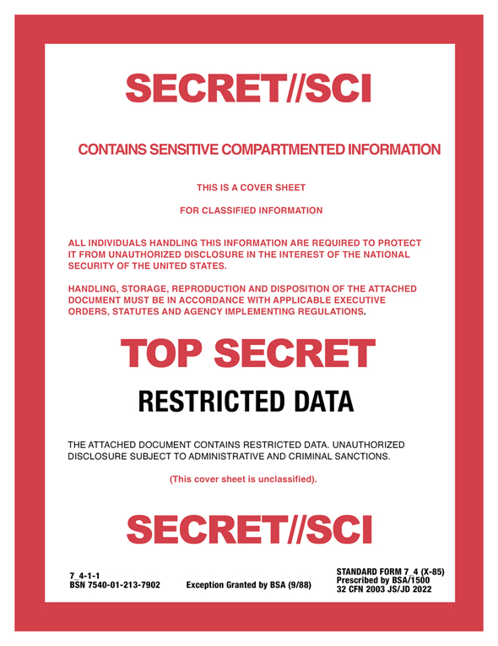
Sermon

Slide 37
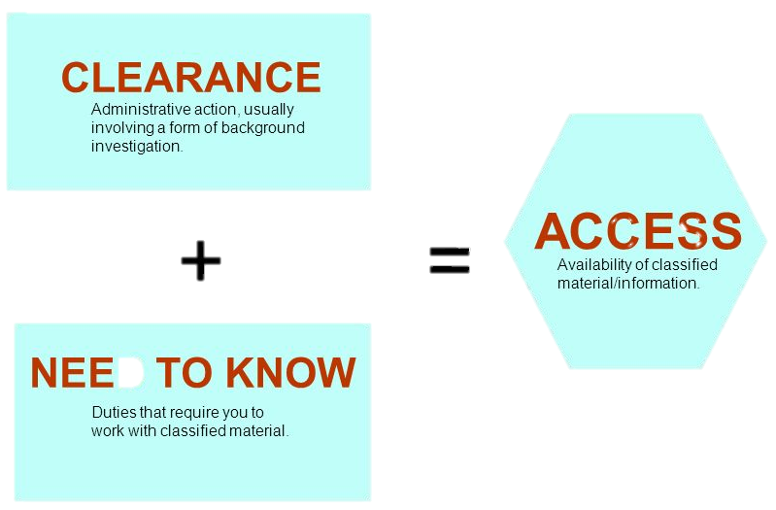
Sermon

Slide 38
Sermon
Data Storage | Units
Byte | 8 Bits
KiloByte | 1000 Bytes
Megabyte | 1000 Kilobytes
Gigabyte | 1000 Megabytes
Terabyte | 1,000 Gigabytes
Petabyte | 1,000 Terabytes
Exabyte | 1,000 Petabytes
Zettabyte | 1,000 Exabytes
1 ZB = 1,000,000,000,000,000,000,000 Bits

Slide 39
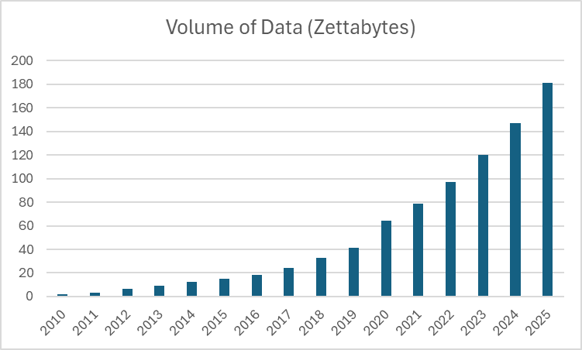
Sermon

Slide 40
Sermon

Slide 41
Sermon

Slide 42
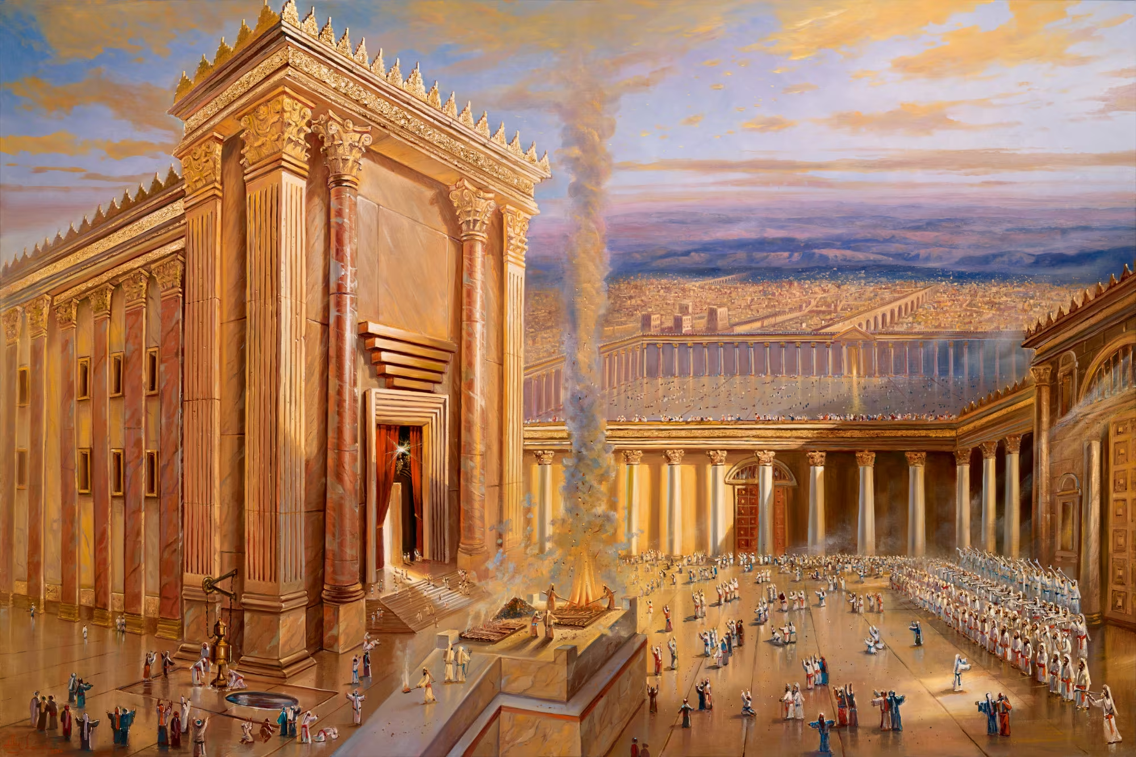
Sermon

Slide 43
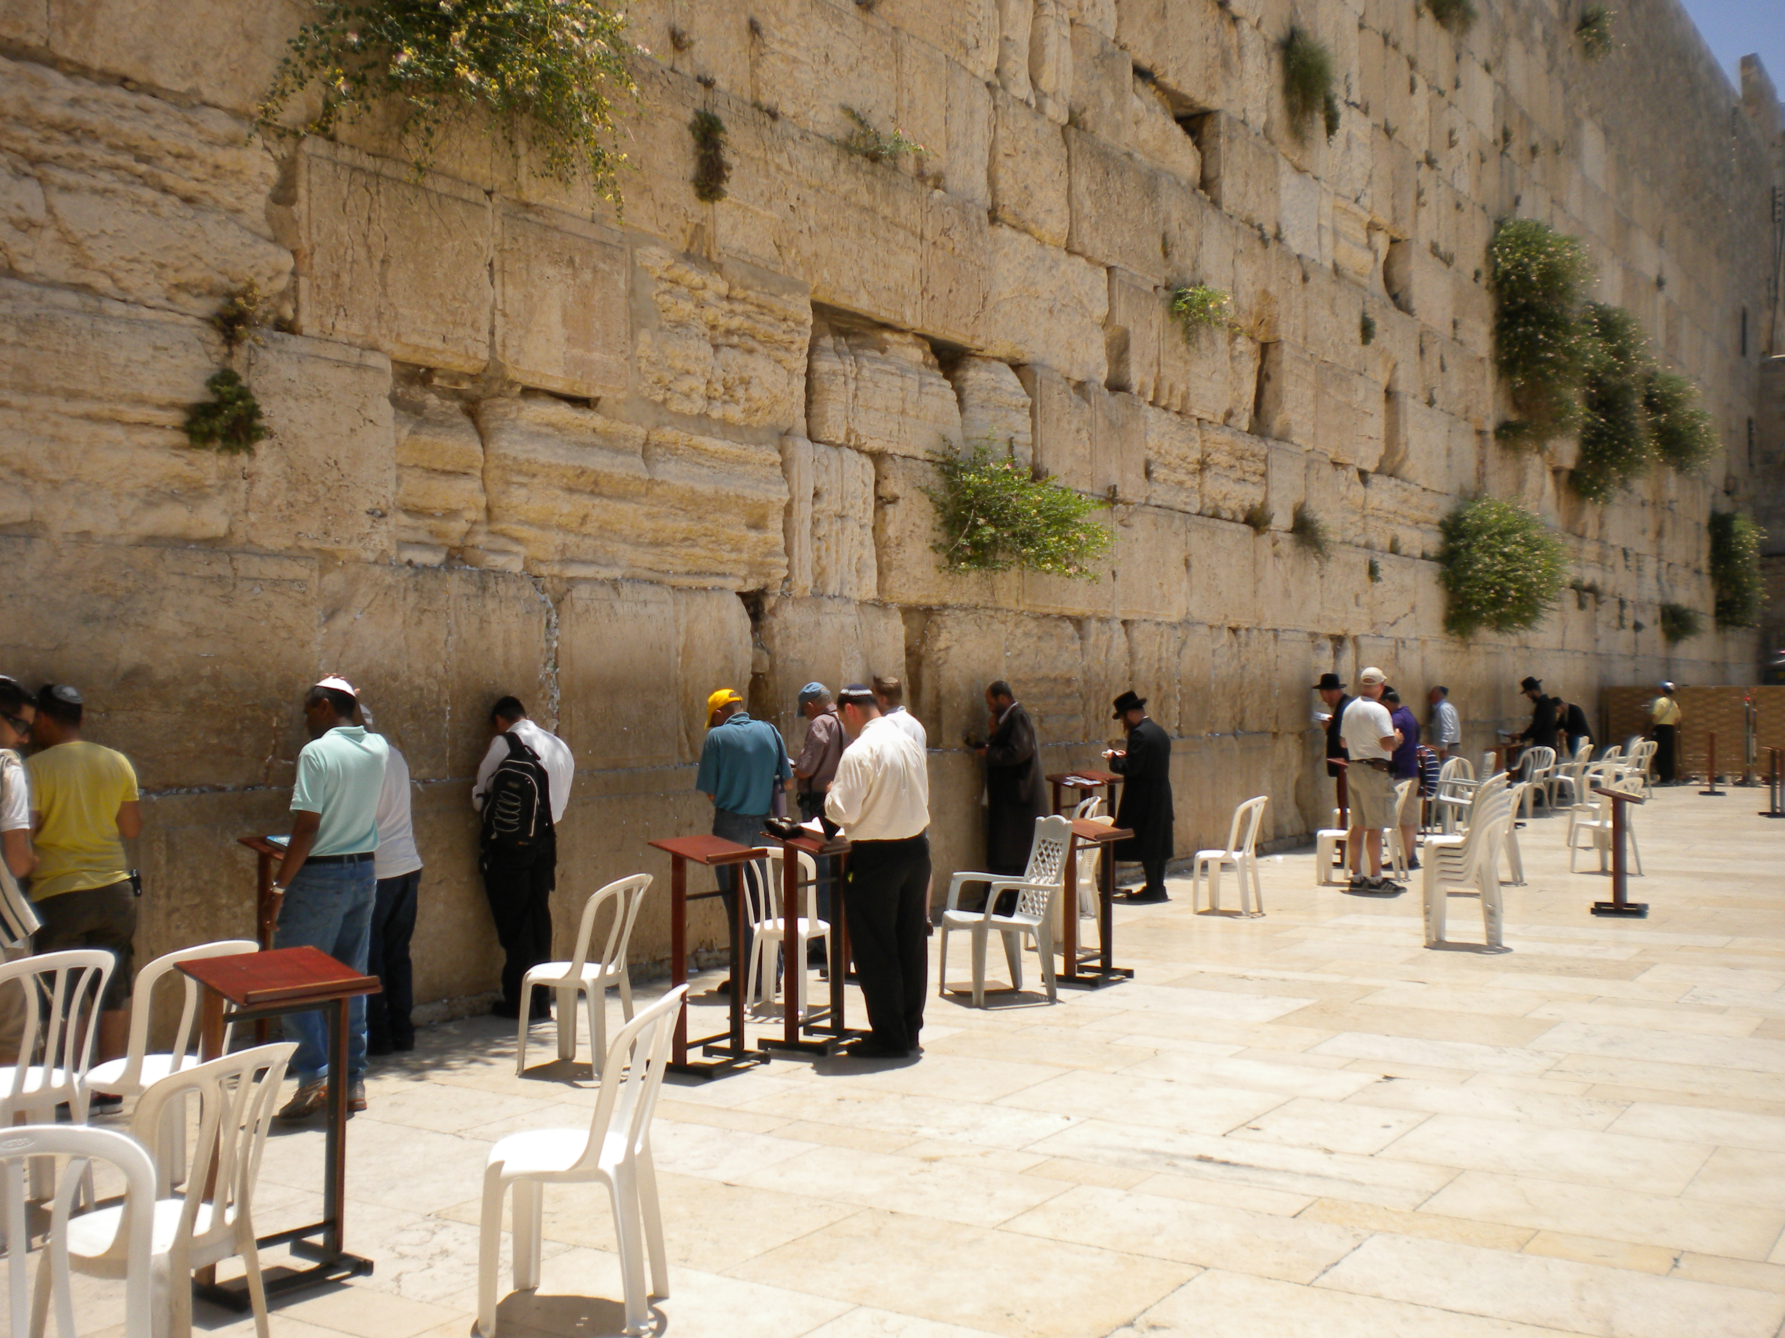
Sermon

Slide 44
Sermon

Slide 45
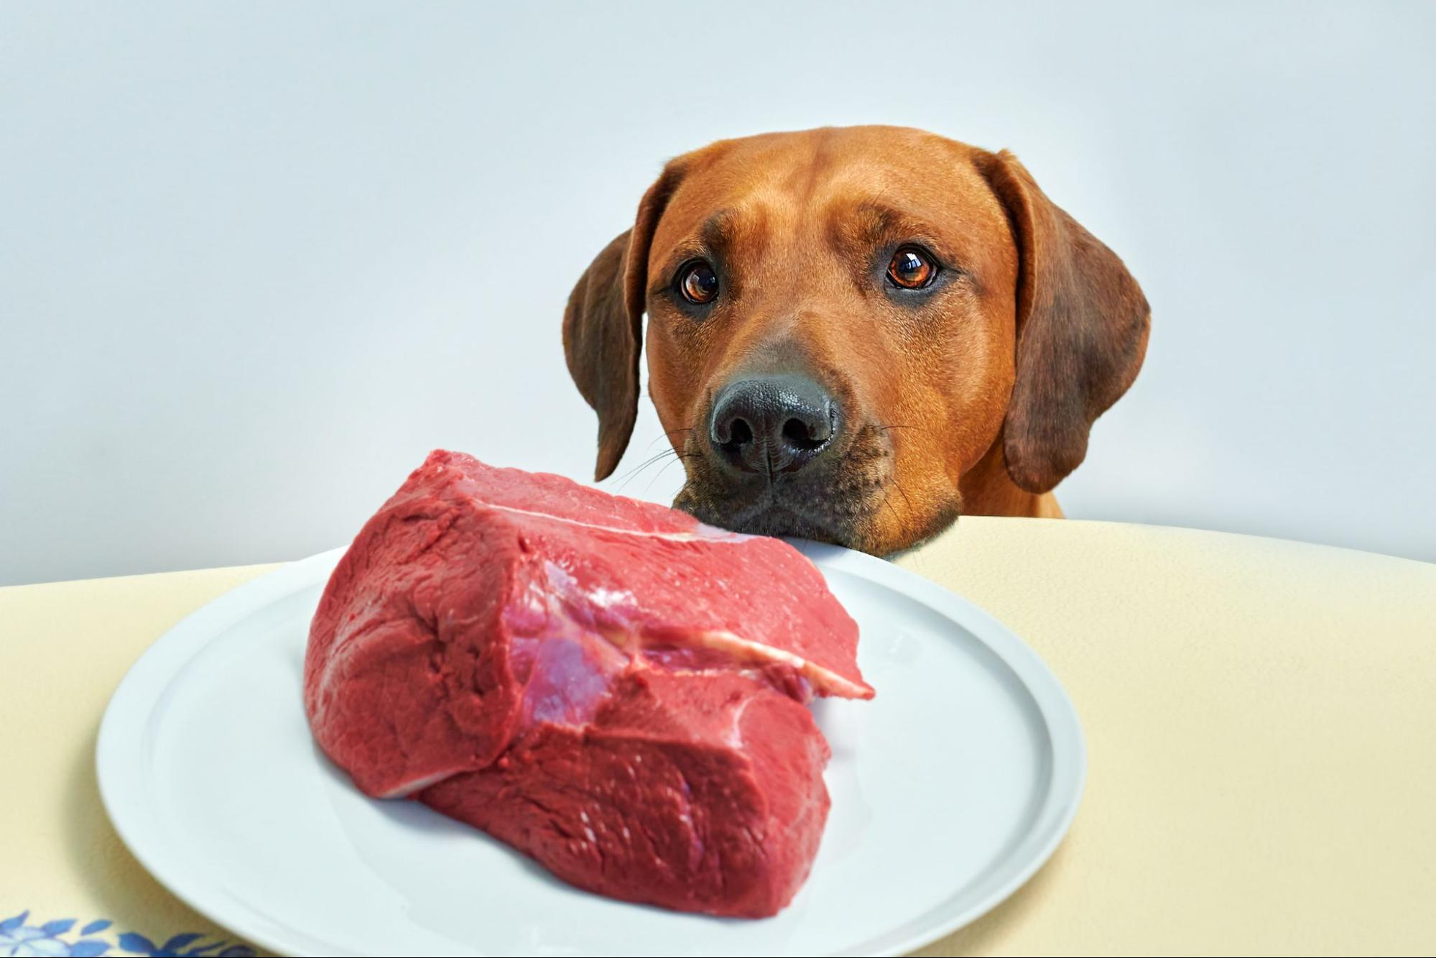
Sermon
Stay
Calm
Stay
Alert
Stay

Slide 46
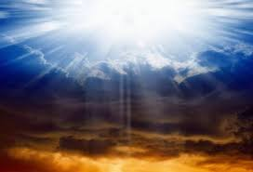

Slide 47
HYMN OF THE DAY
XXX

Slide 48
XXX

Slide 49
APOSTLE’S CREED
C: I believe in God, the Father almighty, creator of heaven and earth.

Slide 50
APOSTLE’S CREED
C: I believe in Jesus Christ, his only Son, our Lord. He was conceived by the power of the Holy Spirit and born of the virgin Mary. He suffered under Pontius Pilate, was crucified, died, and was buried.

Slide 51
APOSTLE’S CREED
C: He descended into hell. On the third day he rose again. He ascended into heaven, and is seated at the right hand of the Father. He will come again to judge the living and the dead.

Slide 52
APOSTLE’S CREED
C: I believe in the Holy Spirit, the holy catholic Church, the communion of saints, the forgiveness of sins, the resurrection of the body, and the life everlasting. Amen.

Slide 53
NICENE CREED
C: We believe in one God, the Father, the Almighty, maker of heaven and earth, of all that is, seen and unseen.

Slide 54
NICENE CREED
C: We believe in one Lord, Jesus Christ, the only Son of God, eternally begotten of the Father, God from God, Light from Light, true God from true God, begotten, not made, of one Being with the Father.

Slide 55
NICENE CREED
C: Through him all things were made. For us and for our salvation he came down from heaven; by the power of the Holy Spirit he became incarnate from the virgin Mary, and was made man. For our sake he was crucified under Pontius Pilate;

Slide 56
NICENE CREED
C: he suffered death and was buried. On the third day he rose again in accordance with the Scriptures; he ascended into heaven and is seated at the right hand of the Father. He will come again in glory to judge the living and the dead, and his kingdom will have no end.

Slide 57
NICENE CREED
C: We believe in the Holy Spirit, the Lord, the giver of life, who proceeds from the Father and the Son. With the Father and the Son he is worshiped and glorified. He has spoken through the prophets. We believe in one holy catholic and apostolic Church.

Slide 58
NICENE CREED
C: We acknowledge one Baptism for the forgiveness of sins. We look for the resurrection of the dead, and the life of the world to come. Amen.

Slide 59
QUILT TYING AND PRESENTATION
This Quilt was lovingly crafted for recovery and healing especially the Trinity Prayers and Squares Quilting Ministry…
Let us pray…

Slide 60
PRAYERS OF INTERCESSION
Each petition will end with the words,
A: God of the journey,
The congregation will respond with:
C: In mercy, hear our prayer.

Slide 61
PRAYERS OF INTERCESSION
The prayer concludes…
P: Confident that you walk alongside us in our need, we lift to you all our prayers, spoken and unspoken, through Jesus Christ our savior.
C: Amen.

Slide 62
OFFERING
Notes:
Image: Five Loaves by Caroline Coolidge Brown. Copyright © Caroline Coolidge Brown. All rights reserved. Used by permission of the artist.

Slide 63
OFFERING PRAYER
Notes:
Image: Five Loaves by Caroline Coolidge Brown. Copyright © Caroline Coolidge Brown. All rights reserved. Used by permission of the artist.

Slide 64
THE GREAT THANKSGIVING
All the Baptized are welcome to celebrate this Holy Meal.

Slide 65
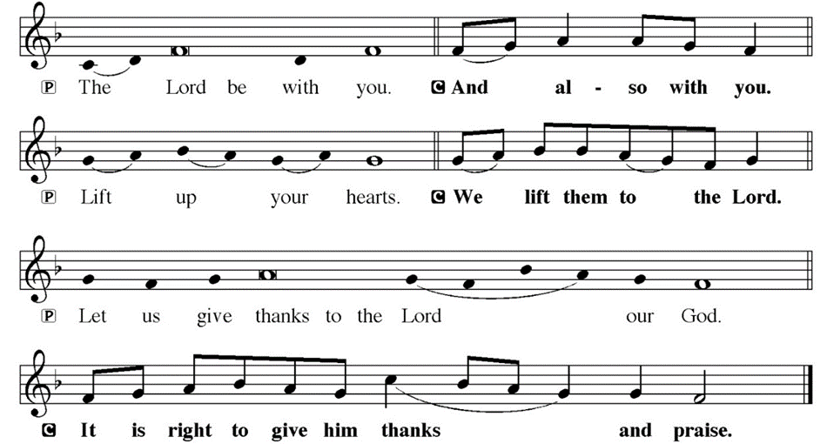
DIALOGUE

Slide 66
THE PREFACE
P: It is indeed right and salutary…
… we praise your name and join their unending hymn.

Slide 67
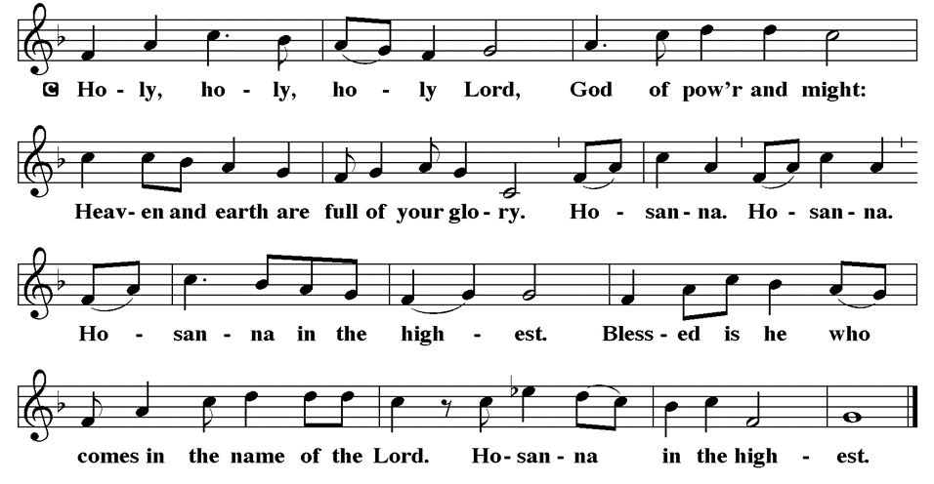
THE SANCTUS

Slide 68
EUCHARISTIC PRAYER
P: Holy God, our living Water…
…both now and forever.
C: Amen.

Slide 69
THE LORD’S PRAYER
C: Our Father, who art in heaven, hallowed be thy name, thy kingdom come, thy will be done, on earth as it is in heaven. Give us this day our daily bread; and forgive us our trespasses, as we forgive those who trespass against us; and lead us not into temptation, but deliver us from evil.

Slide 70
THE LORD’S PRAYER
C: For thine is the kingdom, and the power, and the glory, forever and ever. Amen.

Slide 71
INVITATION TO COMMUNION
P: You are invited now to the feast in which Jesus meets us and strengthens us for the work of the gospel. Come and be fed, for all is prepared.

Slide 72
COMMUNION DISTRIBUTION
All will commune “By Station”.
The bread may be broken for distribution. As the ministers give the bread and wine, they say these words :
The body of Christ, given for you.
The blood of Christ, shed for you.
The communicant may say: Amen.

Slide 73
POST COMMUNION BLESSING
P: May this body and blood of our Lord and Savior, Jesus Christ, strengthen, keep, and unity us, ☩ now and forever,
C: Amen.

Slide 74
POST COMMUNION CANTACLE

Slide 75
POST COMMUNION CANTACLE

Slide 76
POST COMMUNION PRAYER
P: Let us pray… Giver of every gift, Christ’s body is our food, and we are Christ’s body. Raise us to life by your power for the benefit of all and to your glory, now and forever.
C: Amen

Slide 77
ANNOUNCEMENTS
Notes:
Image: Five Loaves by Caroline Coolidge Brown. Copyright © Caroline Coolidge Brown. All rights reserved. Used by permission of the artist.

Slide 78
SENDING BLESSING
P: Jesus who was there at the beginning and will be there at the end, reminds us that he is here in this place with us right now, and invites you to this holy table to share in his presence through bread and wine. Come and be fed.
C: Amen.

Slide 79
Sending Song
“Here I Am, Lord”
ELW 574
Notes:
Image: Five Loaves by Caroline Coolidge Brown. Copyright © Caroline Coolidge Brown. All rights reserved. Used by permission of the artist.

Slide 80
“Here I Am, Lord” ELW 574
1 "I, the Lord of sea and sky,
I have heard my people cry.
All who dwell in dark and sin
my hand will save.
I, who made the stars of night,
I will make their darkness bright.
Who will bear my light to them?
Whom shall I send?"
Notes:
Image: Preparing yeast dough. Copyright © tomasworks/iStock/Thinkstock. Used by permission.

Slide 81
“Here I Am, Lord” ELW 574
Refrain
Here I am, Lord. Is it I, Lord?
I have heard you calling in the night.
I will go, Lord, if you lead me.
I will hold your people in my heart.
Notes:
Image: Preparing yeast dough. Copyright © tomasworks/iStock/Thinkstock. Used by permission.

Slide 82
“Here I Am, Lord” ELW 574
2 "I, the Lord of snow and rain,
I have borne my people's pain.
I have wept for love of them.
They turn away.
I will break their hearts of stone,
give them hearts for love alone.
I will speak my word to them.
Whom shall I send?"
Notes:
Image: Preparing yeast dough. Copyright © tomasworks/iStock/Thinkstock. Used by permission.

Slide 83
“Here I Am, Lord” ELW 574
Refrain
Here I am, Lord. Is it I, Lord?
I have heard you calling in the night.
I will go, Lord, if you lead me.
I will hold your people in my heart.
Notes:
Image: Preparing yeast dough. Copyright © tomasworks/iStock/Thinkstock. Used by permission.

Slide 84
“Here I Am, Lord” ELW 574
3 "I, the Lord of wind and flame,
I will tend the poor and lame.
I will set a feast for them.
My hand will save.
Finest bread I will provide
till their hearts be satisfied.
I will give my life to them.
Whom shall I send?"
Notes:
Image: Preparing yeast dough. Copyright © tomasworks/iStock/Thinkstock. Used by permission.

Slide 85
“Here I Am, Lord” ELW 574
Refrain
Here I am, Lord. Is it I, Lord?
I have heard you calling in the night.
I will go, Lord, if you lead me.
I will hold your people in my heart.
Notes:
Image: Preparing yeast dough. Copyright © tomasworks/iStock/Thinkstock. Used by permission.

Slide 86
DISMISSAL
P: … Depart in Christ’s Love.
C: Seeking, welcoming, and serving all. Amen!
POSTLUDE
By
Pam Sherman
From sundaysandseasons.com. Copyright © 2024 Augsburg Fortress. All rights reserved. Reprinted by permission under Augsburg Fortress Liturgies Annual License #SAS023830. New Revised Standard Version Bible, Copyright © 1989, Division of Christian Education of the National Council of the Churches of Christ in the United States of America. Used by permission. All rights reserved. Revised Common Lectionary, Copyright © 1992 Consultation on Common Texts, admin Augsburg Fortress. Used by permission.

