Slide 1

WELCOME!
Trinity Lutheran Church
November 9, 2025
Notes:
Image: Preparing yeast dough. Copyright © tomasworks/iStock/Thinkstock. Used by permission.

Slide 2
= Please stand if able
= Please be seated
Prelude - By Roxanne Groff
Office of the Acolyte
Ringing of the Bell
Welcome – PJ Musser
Notes:
Image: Five Loaves by Caroline Coolidge Brown. Copyright © Caroline Coolidge Brown. All rights reserved. Used by permission of the artist.

Slide 3
THANKSGIVING FOR BAPTISM
All may make the sign of the cross, the sign marked at baptism, as the presiding minister begins.
L: We gather in the name of our creator, redeemer ☩, and sustainer.
C: Amen.
Notes:
Image: Preparing yeast dough. Copyright © tomasworks/iStock/Thinkstock. Used by permission.

Slide 4
L: Joined to Christ and named as God’s beloved…
… lead us by your divine spark to lives of compassion and mercy.
Water may be poured into the font as the presiding minister gives thanks.
THANKSGIVING FOR BAPTISM
Notes:
Image: Preparing yeast dough. Copyright © tomasworks/iStock/Thinkstock. Used by permission.

Slide 5
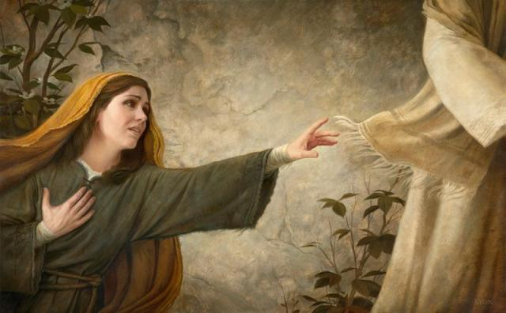
Hymn of Praise
“O God, Our Help in Ages Past ”
LBW 320
Notes:
Image: Five Loaves by Caroline Coolidge Brown. Copyright © Caroline Coolidge Brown. All rights reserved. Used by permission of the artist.

Slide 6
“O God, Our Help in Ages Past ”
LBW 320
1 O God, our help in ages past,
our hope for years to come,
our shelter from the stormy blast,
and our eternal home:
2 Under the shadow of your throne
your saints have dwelt secure;
sufficient is your arm alone,
and our defense is sure.
Notes:
Image: Five Loaves by Caroline Coolidge Brown. Copyright © Caroline Coolidge Brown. All rights reserved. Used by permission of the artist.

Slide 7
“O God, Our Help in Ages Past ” LBW 320
3 Before the hills in order stood
or earth received its frame,
from everlasting you are God,
to endless years the same.
4 A thousand ages in your sight
are like an evening gone,
short as the watch that ends the night
before the rising sun.
Notes:
Image: Five Loaves by Caroline Coolidge Brown. Copyright © Caroline Coolidge Brown. All rights reserved. Used by permission of the artist.

Slide 8
“O God, Our Help in Ages Past ”
LBW 320
5 Time, like an ever-rolling stream,
soon bears us all away;
we fly forgotten, as a dream
dies at the op’ning day.
6 O God, our help in ages past,
our hope for years to come,
still be our guard while troubles last
and our eternal home!
Notes:
Image: Five Loaves by Caroline Coolidge Brown. Copyright © Caroline Coolidge Brown. All rights reserved. Used by permission of the artist.

Slide 9
APOSTOLIC GREETING
P: May the amazing grace of Jesus, the extravagant love of God, and the communion of the Holy Spirit be with you all.
C: And also with you.
Notes:
Image: Five Loaves by Caroline Coolidge Brown. Copyright © Caroline Coolidge Brown. All rights reserved. Used by permission of the artist.

Slide 10
PRAYER OF THE DAY
L: God of Glory, we are gathered today in your presence to celebrate and give thanks for all of the gifts and talents given to women. While we recognize the abundance we have, we also recognize the struggles of women in our own country and around the world.
Notes:
Image: Five Loaves by Caroline Coolidge Brown. Copyright © Caroline Coolidge Brown. All rights reserved. Used by permission of the artist.

Slide 11
PRAYER OF THE DAY
L: Sometimes these struggles are voiced or are internal conflicts that only You know about. Lord, bring peace and joy to our hearts today. Allow us to fully absorb the presence of you and of the community of strong women surrounding us.
C: Amen
Notes:
Image: Five Loaves by Caroline Coolidge Brown. Copyright © Caroline Coolidge Brown. All rights reserved. Used by permission of the artist.

Slide 12

Notes:
Image: Preparing yeast dough. Copyright © tomasworks/iStock/Thinkstock. Used by permission.

Slide 13
First Reading-Naomi and Ruth-(Ruth 1:7-16)
⁷ So Naomi set out from the place where she had been living, she and her two daughters-in- law, and they went on their way to go back to the land of Judah. ⁸ But Naomi said to her two daughters-in-law, “Go back each of you to your mother’s house. May the LORD deal kindly with you, as you have dealt with the dead and with me.
Notes:
Image: Five Loaves by Caroline Coolidge Brown. Copyright © Caroline Coolidge Brown. All rights reserved. Used by permission of the artist.

Slide 14
First Reading-Naomi and Ruth-(Ruth 1:7-16)
⁹ The LORD grant that you may find security, each of you in the house of your husband.” Then she kissed them, and they wept aloud. ¹⁰ They said to her, “No, we will return with you to your people.” ¹¹ But Naomi said, ‘Turn back, my daughters, why will you go with me?...No, my daughters, it has been far more bitter for me than for you, because
Notes:
Image: Five Loaves by Caroline Coolidge Brown. Copyright © Caroline Coolidge Brown. All rights reserved. Used by permission of the artist.

Slide 15
First Reading-Naomi and Ruth-(Ruth 1:7-16)
the hand of the LORD has turned against me.” ¹⁴ Then they wept aloud again. Orpah kissed her mother-in-law, but Ruth clung to her.¹⁵ So Naomi said, “See, your sister-in-law has gone back to her people and to her gods; return after your sister-in-law.”
Notes:
Image: Five Loaves by Caroline Coolidge Brown. Copyright © Caroline Coolidge Brown. All rights reserved. Used by permission of the artist.

Slide 16
First Reading-Naomi and Ruth-(Ruth 1:7-16)
¹⁶ But Ruth said, “Do not press me to leave you or to turn back from following you!
Where you go, I will go.
where you lodge, I will lodge,
Your people shall be my people,
and your God my God.”
Notes:
Image: Five Loaves by Caroline Coolidge Brown. Copyright © Caroline Coolidge Brown. All rights reserved. Used by permission of the artist.

Slide 17
Ruth and Naomi
R: Holy Wisdom, Living Word.
C: Thanks be to God.
Notes:
Image: Five Loaves by Caroline Coolidge Brown. Copyright © Caroline Coolidge Brown. All rights reserved. Used by permission of the artist.

Slide 18
Psalm 139:1-14
¹ O Lord, you have searched me and known me.
² You know when I sit down and when I rise up; you discern my thoughts from far away.
³ You search out my path and my lying down and are acquainted with all my ways.
⁴ Even before a word is on my tongue, O Lord, you know it completely.
⁵ You hem me in, behind and before, and lay your hand upon me.
Notes:
Image: Five Loaves by Caroline Coolidge Brown. Copyright © Caroline Coolidge Brown. All rights reserved. Used by permission of the artist.

Slide 19
Psalm 139:1-14
⁶ Such knowledge is too wonderful for me; it is so high that I cannot attain it.
⁷ Where can I go from your spirit? Or where can I flee from your presence?
⁸ If I ascend to heaven, you are there; if I make my bed in Sheol, you are there.
⁹ If I take the wings of the morning and settle at the farthest limits of the sea,
¹⁰ even there your hand shall lead me, and your right hand shall hold me fast.
Notes:
Image: Five Loaves by Caroline Coolidge Brown. Copyright © Caroline Coolidge Brown. All rights reserved. Used by permission of the artist.

Slide 20
Psalm 139:1-14
¹¹ If I say, “Surely the darkness shall cover me, and night wraps itself around me,”
¹² even the darkness is not dark to you; the night is as bright as the day, for darkness is as light to you.
¹³ For it was you who formed my inward parts; you knit me together in my mother’s womb.
¹⁴ I praise you, for I am fearfully and wonderfully made. Wonderful are your works; that I know very well.
Notes:
Image: Five Loaves by Caroline Coolidge Brown. Copyright © Caroline Coolidge Brown. All rights reserved. Used by permission of the artist.

Slide 21
GOSPEL: Matthew 9:18-25
L: The Holy Gospel according to Matthew, the ninth chapter.
C: Glory to you, O Lord.
Notes:
Image: Five Loaves by Caroline Coolidge Brown. Copyright © Caroline Coolidge Brown. All rights reserved. Used by permission of the artist.

Slide 22
GOSPEL READING - Matthew 9:18-25
¹⁸ While [Jesus] was saying these things to them, suddenly a leader came in and knelt before him, saying, “My daughter has just died, but come and lay your hand on her, and she will live.”¹⁹ And Jesus got up and followed him, with his disciples. ²⁰ Then suddenly a woman who had been suffering
Notes:
Image: Five Loaves by Caroline Coolidge Brown. Copyright © Caroline Coolidge Brown. All rights reserved. Used by permission of the artist.

Slide 23
GOSPEL READING - Matthew 9:18-25
from a flow of blood for twelve years came up behind him and touched the fringe of his cloak, ²¹ for she was saying to herself, “If I only touch his cloak, I will be made well.” ²² Jesus turned, and seeing her he said, “Take heart, daughter; your faith has made you well.” And the woman was made well from that moment.
Notes:
Image: Five Loaves by Caroline Coolidge Brown. Copyright © Caroline Coolidge Brown. All rights reserved. Used by permission of the artist.

Slide 24
GOSPEL READING - Matthew 9:18-25
²³ When Jesus came to the leader’s house and saw the flute players and the crowd making a commotion, ²⁴ he said, “Go away, for the girl is not dead but sleeping.” And they laughed at him. ²⁵ But when the crowd had been put outside, he went in and took her by the hand, and the girl got up.
Notes:
Image: Five Loaves by Caroline Coolidge Brown. Copyright © Caroline Coolidge Brown. All rights reserved. Used by permission of the artist.

Slide 25
Conclusion of Readings
L: The Gospel, the Good News made real for you.
C: Praise to you, O Christ!
L: Holy Wisdom, Holy Word
C: Thanks be to God
Notes:
Image: Five Loaves by Caroline Coolidge Brown. Copyright © Caroline Coolidge Brown. All rights reserved. Used by permission of the artist.

Slide 26

SERMON
Kathy Kathman
Notes:
Image: Five Loaves by Caroline Coolidge Brown. Copyright © Caroline Coolidge Brown. All rights reserved. Used by permission of the artist.

Slide 27
Hymn of the Day
“Blest Be the Tie That Binds”
LBW 370
Notes:
Image: Five Loaves by Caroline Coolidge Brown. Copyright © Caroline Coolidge Brown. All rights reserved. Used by permission of the artist.

Slide 28
“Blest Be the Tie That Binds” LBW 370
1 Blest be the tie that binds
our hearts in Christian love;
the unity of heart and mind
is like to that above.
2 Before our Father’s throne
we pour our ardent prayers;
our fears, our hopes, our aims are one,
our comforts and our cares.

Slide 29
“Blest Be the Tie That Binds” LBW 370
3 We share our mutual woes,
our mutual burdens bear,
and often for each other flows
the sympathizing tear.
4 From sorrow, toil, and pain,
and sin we shall be free;
and perfect love and friendship reign
through all eternity.

Slide 30
APOSTLE’S CREED
C: I believe in God, the Father almighty, creator of heaven and earth.

Slide 31
APOSTLE’S CREED
C: I believe in Jesus Christ, his only Son, our Lord. He was conceived by the power of the Holy Spirit and born of the virgin Mary. He suffered under Pontius Pilate, was crucified, died, and was buried.

Slide 32
APOSTLE’S CREED
C: He descended into hell. On the third day he rose again. He ascended into heaven, and is seated at the right hand of the Father. He will come again to judge the living and the dead.

Slide 33
APOSTLE’S CREED
C: I believe in the Holy Spirit, the holy catholic Church, the communion of saints, the forgiveness of sins, the resurrection of the body, and the life everlasting. Amen.

Slide 34
PRAYERS OF INTERCESSION
L: In solidarity with your people from every nation and knit together with all of creation, we boldly pray for the church, our world, and all those in need. Inspire your church, like Ruth and Naomi, to extend arms of compassion and empathy in times of challenge.

Slide 35
PRAYERS OF INTERCESSION
L: Equip communities to be welcoming, to show mercy, and to lean into relationships so that all people may know your care. God our soul,
C: Hear our prayer.

Slide 36
PRAYERS OF INTERCESSION
L: Guide leaders to reflect the spark of your divine wisdom. Open eyes to see the goodness of your created world and encourage the tender care of those cast aside. Reveal yourself in unexpected places and in the leadership of those called to help. God our Spark,
C: Hear our prayer.

Slide 37
PRAYERS OF INTERCESSION
L: Bring healing, like the woman who bled for twelve years, to all who are suffering. Give strength to the weary, uplift the lowly, and amplify the voices of those quieted. Breathe new life into forgotten places, end wars, rejuvenate lands, and uplift spirits. We offer prayers of strength and healing for ………..God our Strength,
C: Hear our prayer.

Slide 38
PRAYERS OF INTERCESSION
L: Trusting in your love for us, we offer these prayers and whatever else weighs heavy upon us to you, in the name of Jesus.
C: Amen.

Slide 39
SHARING OF THE PEACE
(The Sharing of the Peace that began when the congregation arrived is now shared with the Worship Leader at this time...)
L: The peace of the Lord be with you always.
C: And also with you.

Slide 40
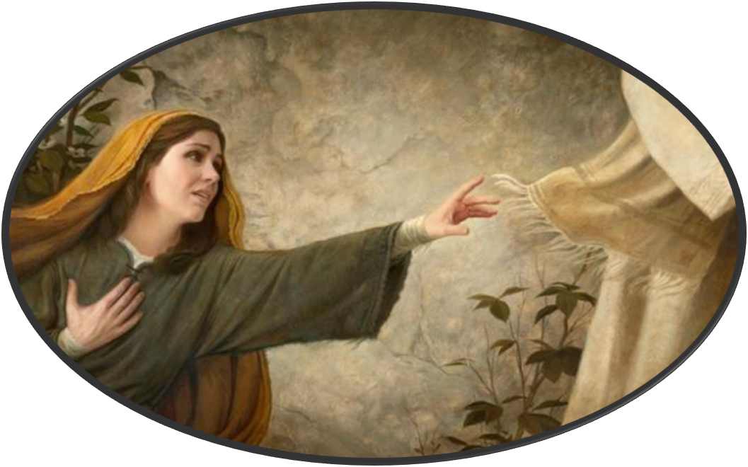
OFFERING
Notes:
Image: Five Loaves by Caroline Coolidge Brown. Copyright © Caroline Coolidge Brown. All rights reserved. Used by permission of the artist.

Slide 41
OFFERING PRAYER
L: So, let’s pray for the offerings we receive this day… God of Abundance,
C: You create goodness in everything we offer. Use these gifts to bless the world. Strengthen ministries, empower leaders, and inspire generosity so that all may know your love.
Notes:
Image: Five Loaves by Caroline Coolidge Brown. Copyright © Caroline Coolidge Brown. All rights reserved. Used by permission of the artist.

Slide 42
OFFERING PRAYER
C: Reveal this love to us once again as we gather at your table that we might embody your compassionate care in all we do.
C: Amen.
Notes:
Image: Five Loaves by Caroline Coolidge Brown. Copyright © Caroline Coolidge Brown. All rights reserved. Used by permission of the artist.

Slide 43
THE LORD’S PRAYER
C: Our Father, who art in heaven, hallowed be thy name, thy kingdom come, thy will be done, on earth as it is in heaven. Give us this day our daily bread; and forgive us our trespasses, as we forgive those who trespass against us; and lead us not into temptation, but deliver us from evil.

Slide 44
THE LORD’S PRAYER
C: For thine is the kingdom, and the power, and the glory, forever and ever. Amen.

Slide 45

ANNOUNCEMENTS
Notes:
Image: Five Loaves by Caroline Coolidge Brown. Copyright © Caroline Coolidge Brown. All rights reserved. Used by permission of the artist.

Slide 46
SENDING BLESSING
L: Receive the blessing of God who breathes creativity into every soul and lights up every vision with purpose. Bless the women of the world with the strength that they need, with empathy that brings us together, and with gratitude that moves us all forward. ☩ May your love be our guide, and your justice our song that we sing and live out each day.
C: Amen

Slide 47
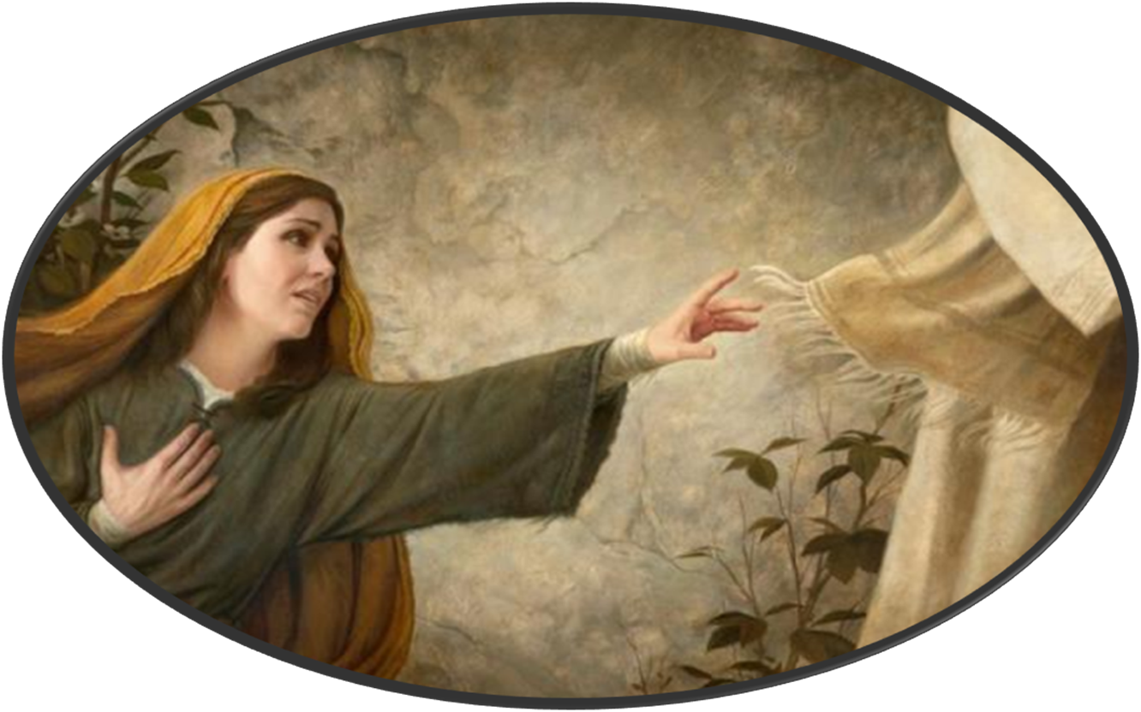
Sending Song
“Praise and Thanksgiving”
LBW 409
Notes:
Image: Five Loaves by Caroline Coolidge Brown. Copyright © Caroline Coolidge Brown. All rights reserved. Used by permission of the artist.

Slide 48
“Praise And Thanksgiving” ELW 689
1 Praise and thanksgiving, God, we would offer
for all things living, you have made good:
harvest of sown fields, fruits of the orchard,
hay from the mown fields, blossom and wood.
Notes:
Image: Five Loaves by Caroline Coolidge Brown. Copyright © Caroline Coolidge Brown. All rights reserved. Used by permission of the artist.

Slide 49
“Praise And Thanksgiving” ELW 689
2 God, bless the labor we bring to serve you,
that with our neighbor we may be fed.
Sowing or tilling, we would work with you,
harvesting, milling for daily bread.
Notes:
Image: Five Loaves by Caroline Coolidge Brown. Copyright © Caroline Coolidge Brown. All rights reserved. Used by permission of the artist.

Slide 50
“Praise And Thanksgiving” ELW 689
3 Father, providing food for your children,
by Wisdom's guiding teach us to share
one with another, so that, rejoicing
with us, all others may know your care.
Notes:
Image: Five Loaves by Caroline Coolidge Brown. Copyright © Caroline Coolidge Brown. All rights reserved. Used by permission of the artist.

Slide 51
“Praise And Thanksgiving” ELW 689
4 Then will your blessing reach ev'ry people,
freely confessing your gracious hand.
Where you are reigning, no one will hunger;
your love sustaining showers the land.
Notes:
Image: Five Loaves by Caroline Coolidge Brown. Copyright © Caroline Coolidge Brown. All rights reserved. Used by permission of the artist.

Slide 52
DISMISSAL
P: … Depart in Christ’s Love.
C: Seeking, welcoming, and serving all. Amen!
POSTLUDE
By Roxanne Groff
From sundaysandseasons.com. Copyright © 2025 Augsburg Fortress. All rights reserved. Reprinted by permission under Augsburg Fortress Liturgies Annual License #SAS023830. New Revised Standard Version Bible, Copyright © 1989, Division of Christian Education of the National Council of the Churches of Christ in the United States of America. Used by permission. All rights reserved. Revised Common Lectionary, Copyright © 1992 Consultation on Common Texts, admin Augsburg Fortress. Used by permission.

