Slide 1
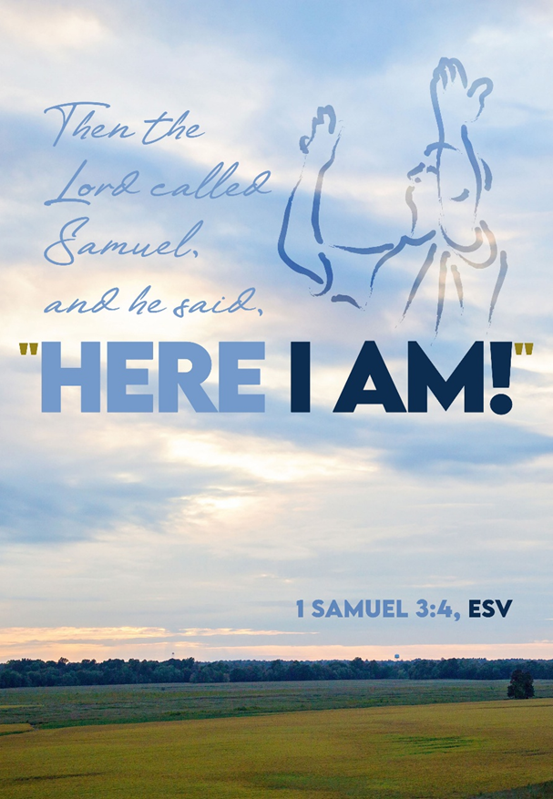
October 12, 2025
WELCOME!
Trinity Lutheran Church
Notes:
Image: Five Loaves by Caroline Coolidge Brown. Copyright © Caroline Coolidge Brown. All rights reserved. Used by permission of the artist.

Slide 2
= Please stand if able
= Please be seated
Prelude - By Roxanne Groff
Office of the Acolyte
Ringing of the Bell
Welcome
Notes:
Image: Five Loaves by Caroline Coolidge Brown. Copyright © Caroline Coolidge Brown. All rights reserved. Used by permission of the artist.

Slide 3
THANKSGIVING FOR BAPTISM
All may make the sign of the cross, the sign marked at baptism, as the presiding minister begins.
P: Blessed be the holy Trinity, ☩ one God, the fountain of living water, the rock who gave us birth, our light and our salvation.
C: Amen.
Notes:
Image: Preparing yeast dough. Copyright © tomasworks/iStock/Thinkstock. Used by permission.

Slide 4
P: Joined to Christ in the waters of baptism, we are clothed with God's mercy and forgiveness. Let us give thanks for the gift of baptism.
Water may be poured into the font as the presiding minister gives thanks.
THANKSGIVING FOR BAPTISM
Notes:
Image: Preparing yeast dough. Copyright © tomasworks/iStock/Thinkstock. Used by permission.

Slide 5
P: We give you thanks, O God, for in the beginning your Spirit moved over the waters and by your Word you created the world, calling forth life in which you took delight. Through the waters of the flood you delivered Noah and his family. Through the sea you led your people Israel from slavery into freedom.
THANKSGIVING FOR BAPTISM
Notes:
Image: Preparing yeast dough. Copyright © tomasworks/iStock/Thinkstock. Used by permission.

Slide 6
P: At the river your Son was baptized by John and anointed with the Holy Spirit. By water and your Word you claim us as daughters and sons, making us heirs of your promise and servants of all. We praise you for the gift of water that sustains life, and above all we praise you for the gift of new life in Jesus Christ.
THANKSGIVING FOR BAPTISM
Notes:
Image: Preparing yeast dough. Copyright © tomasworks/iStock/Thinkstock. Used by permission.

Slide 7
P: Shower us with your Spirit, and renew our lives with your forgiveness, grace, and love. To you be given honor and praise through Jesus Christ our Lord in the unity of the Holy Spirit, now and forever.
THANKSGIVING FOR BAPTISM
C: Amen.
Notes:
Image: Preparing yeast dough. Copyright © tomasworks/iStock/Thinkstock. Used by permission.

Slide 8
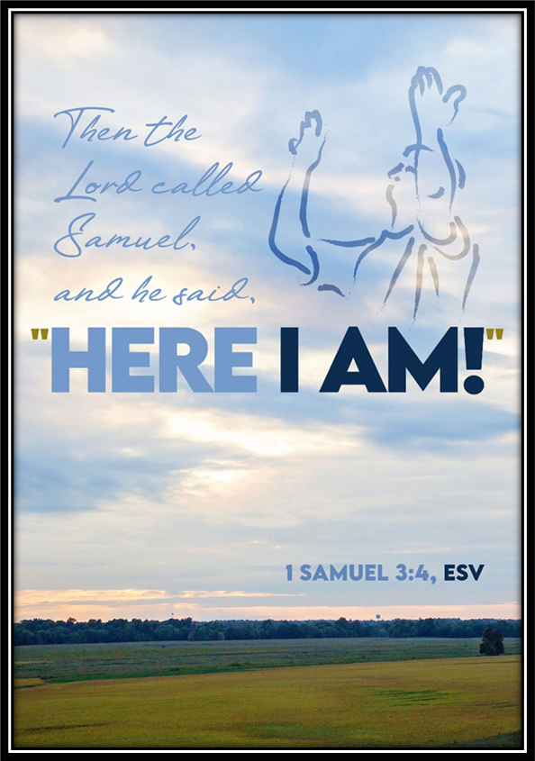
Gathering Song
“Be Thou My Vision”
ELW 793

Slide 9
“Be Thou My Vision” ELW 793
1 Be thou my vision, O Lord of my heart;
naught be all else to me, save that thou art:
thou my best thought both by day and by night,
waking or sleeping, thy presence my light.

Slide 10
“Be Thou My Vision” ELW 793
2 Be thou my wisdom, and thou my true word;
I ever with thee and thou with me, Lord.
Thou my soul's shelter, and thou my high tow'r,
raise thou me heav'nward, O Pow'r of my pow'r.

Slide 11
“Be Thou My Vision” ELW 793
3 Riches I heed not, nor vain, empty praise,
thou mine inheritance, now and always:
thou and thou only, the first in my heart,
great God of heaven, my treasure thou art.

Slide 12
“Be Thou My Vision” ELW 793
4 Light of my soul, after victory won,
may I reach heaven's joys, O heaven's Sun!
Heart of my own heart, whatever befall,
still be my vision, O Ruler of all.

Slide 13
APOSTOLIC GREETING
P: The grace of our Lord Jesus Christ, the love of God, and the communion of the Holy Spirit be with you all.
C: And also with you.
Notes:
Image: Five Loaves by Caroline Coolidge Brown. Copyright © Caroline Coolidge Brown. All rights reserved. Used by permission of the artist.

Slide 14
PRAYER OF THE DAY
P: God who calls, open our ears to listen for your voice amid the clamor of our daily lives. Help us to discern your call from among the many distractions that confront us each day, that we might live each day according to your will. In Jesus’ name we pray.
C: Amen.
Notes:
Image: Five Loaves by Caroline Coolidge Brown. Copyright © Caroline Coolidge Brown. All rights reserved. Used by permission of the artist.

Slide 15

Notes:
Image: Five Loaves by Caroline Coolidge Brown. Copyright © Caroline Coolidge Brown. All rights reserved. Used by permission of the artist.

Slide 16
Scripture Reading
L: Our scripture reading is from 1st Samuel, Chapter 3.
C: Glory to you O’ Lord!
Notes:
Image: Five Loaves by Caroline Coolidge Brown. Copyright © Caroline Coolidge Brown. All rights reserved. Used by permission of the artist.

Slide 17
1 Samuel 3:1-21
Now the boy Samuel was ministering to the Lord under Eli. The word of the Lord was rare in those days; visions were not widespread. ²At that time Eli, whose eyesight had begun to grow dim so that he could not see, was lying down in his room; ³the lamp of God had not yet gone out, and Samuel was lying down in the temple of the Lord, where the ark of God
Notes:
Image: Five Loaves by Caroline Coolidge Brown. Copyright © Caroline Coolidge Brown. All rights reserved. Used by permission of the artist.

Slide 18
1 Samuel 3:1-21
was. ⁴Then the Lord called, “Samuel! Samuel!” and he said, “Here I am!” ⁵and ran to Eli, and said, “Here I am, for you called me.” But he said, “I did not call; lie down again.” So he went and lay down. ⁶The Lord called again, “Samuel!” Samuel got up and went to Eli, and said, “Here I am, for you called me.” But he said, “I did not call, my son; lie down again.” ⁷Now Samuel
Notes:
Image: Five Loaves by Caroline Coolidge Brown. Copyright © Caroline Coolidge Brown. All rights reserved. Used by permission of the artist.

Slide 19
1 Samuel 3:1-21
did not yet know the Lord, and the word of the Lord had not yet been revealed to him. ⁸The Lord called Samuel again, a third time. And he got up and went to Eli, and said, “Here I am, for you called me.” Then Eli perceived that the Lord was calling the boy. ⁹Therefore Eli said to Samuel, “Go, lie down; and if he calls you, you shall say, ‘Speak, Lord, for your
Notes:
Image: Five Loaves by Caroline Coolidge Brown. Copyright © Caroline Coolidge Brown. All rights reserved. Used by permission of the artist.

Slide 20
1 Samuel 3:1-21
servant is listening.’” So Samuel went and lay down in his place. ¹⁰Now the Lord came and stood there, calling as before, “Samuel! Samuel!” And Samuel said, “Speak, for your servant is listening.”
¹¹Then the Lord said to Samuel, “See, I am about to do something in Israel that will make both ears of anyone who hears of it tingle. ¹²On that day I
Notes:
Image: Five Loaves by Caroline Coolidge Brown. Copyright © Caroline Coolidge Brown. All rights reserved. Used by permission of the artist.

Slide 21
1 Samuel 3:1-21
will fulfill against Eli all that I have spoken concerning his house, from beginning to end. ¹³For I have told him that I am about to punish his house forever, for the iniquity that he knew, because his sons were blaspheming God, and he did not restrain them. ¹⁴Therefore I swear to the house of Eli that the iniquity of Eli’s house shall not be expiated by sacrifice or
Notes:
Image: Five Loaves by Caroline Coolidge Brown. Copyright © Caroline Coolidge Brown. All rights reserved. Used by permission of the artist.

Slide 22
1 Samuel 3:1-21
offering forever.” ¹⁵Samuel lay there until morning; then he opened the doors of the house of the Lord. Samuel was afraid to tell the vision to Eli. ¹⁶But Eli called Samuel and said, “Samuel, my son.” He said, “Here I am.” ¹⁷Eli said, “What was it that he told you? Do not hide it from me. May God do so to you and more also, if you hide anything from me of all that
Notes:
Image: Five Loaves by Caroline Coolidge Brown. Copyright © Caroline Coolidge Brown. All rights reserved. Used by permission of the artist.

Slide 23
1 Samuel 3:1-21
he told you.” ¹⁸So Samuel told him everything and hid nothing from him. Then he said, “It is the Lord; let him do what seems good to him.”
¹⁹As Samuel grew up, the Lord was with him and let none of his words fall to the ground.
Notes:
Image: Five Loaves by Caroline Coolidge Brown. Copyright © Caroline Coolidge Brown. All rights reserved. Used by permission of the artist.

Slide 24
1 Samuel 3:1-21
²⁰And all Israel from Dan to Beer-sheba knew that Samuel was a trustworthy prophet of the Lord. ²¹The Lord continued to appear at Shiloh, for the Lord revealed himself to Samuel at Shiloh by the word of the Lord.
Notes:
Image: Five Loaves by Caroline Coolidge Brown. Copyright © Caroline Coolidge Brown. All rights reserved. Used by permission of the artist.

Slide 25
1 Samuel 3:1-21
R: This is the Word of the Lord!
C: Praise to You, O Christ
Notes:
Image: Five Loaves by Caroline Coolidge Brown. Copyright © Caroline Coolidge Brown. All rights reserved. Used by permission of the artist.

Slide 26
Sermon

Slide 27
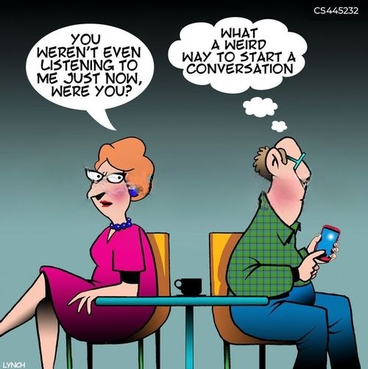
Sermon

Slide 28
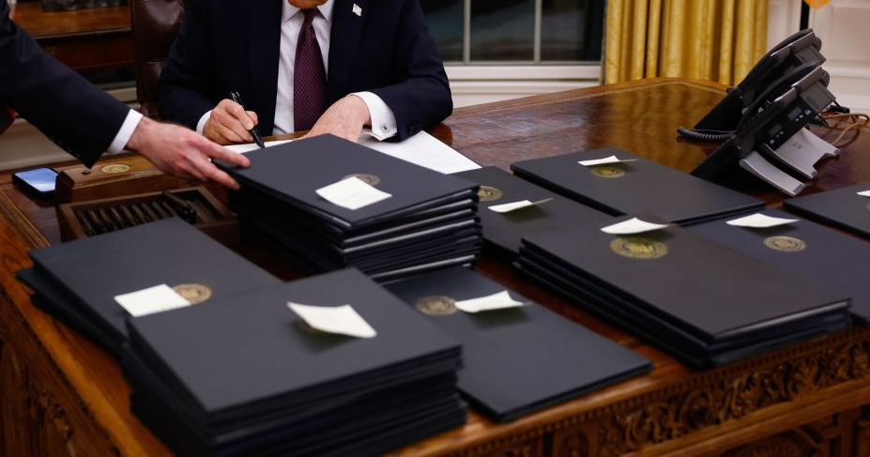
Sermon

Slide 29
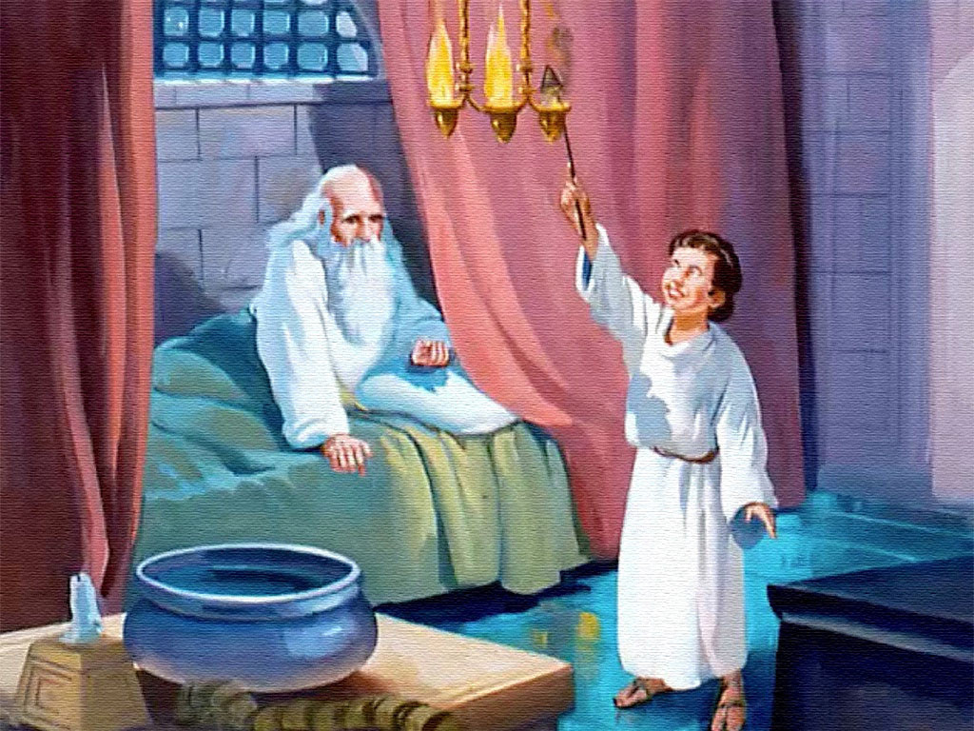
Sermon

Slide 30
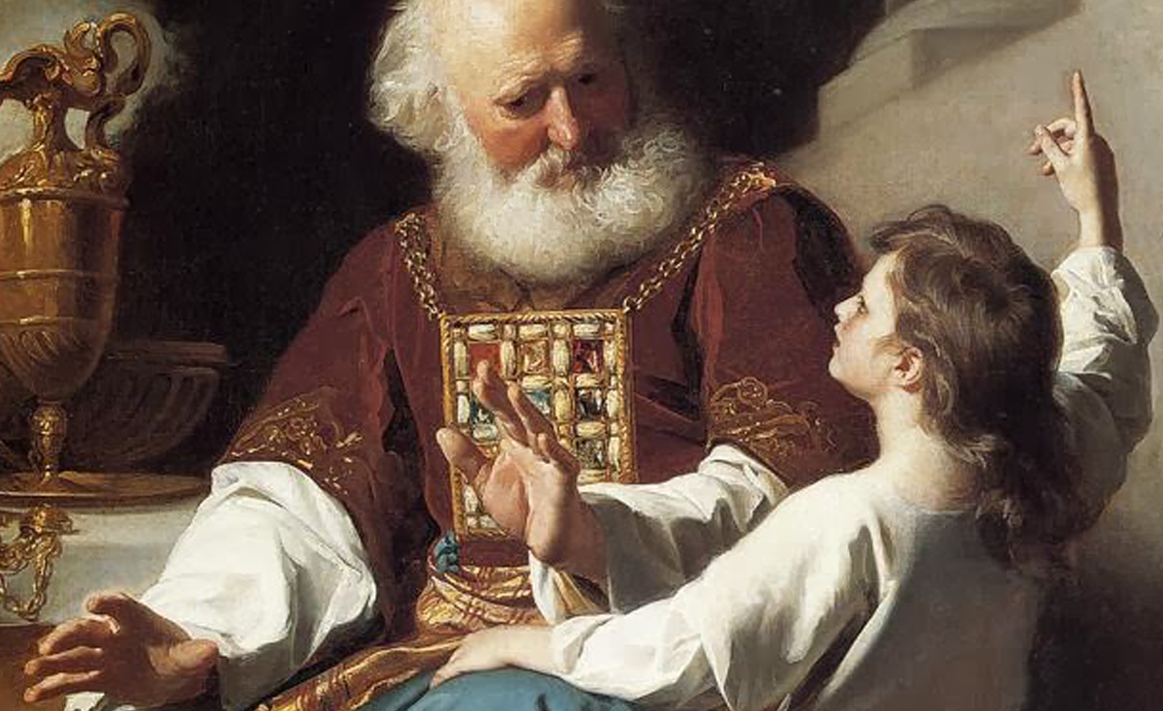
Sermon

Slide 31

Sermon

Slide 32

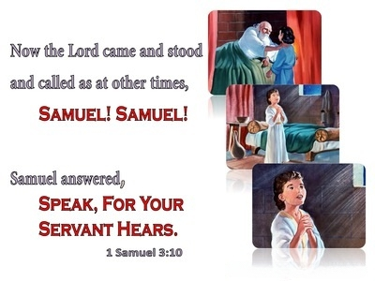
Sermon

Slide 33
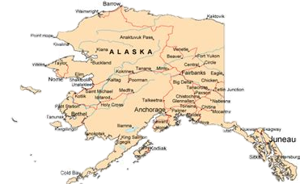

Sermon

Slide 34

Sermon

Slide 35

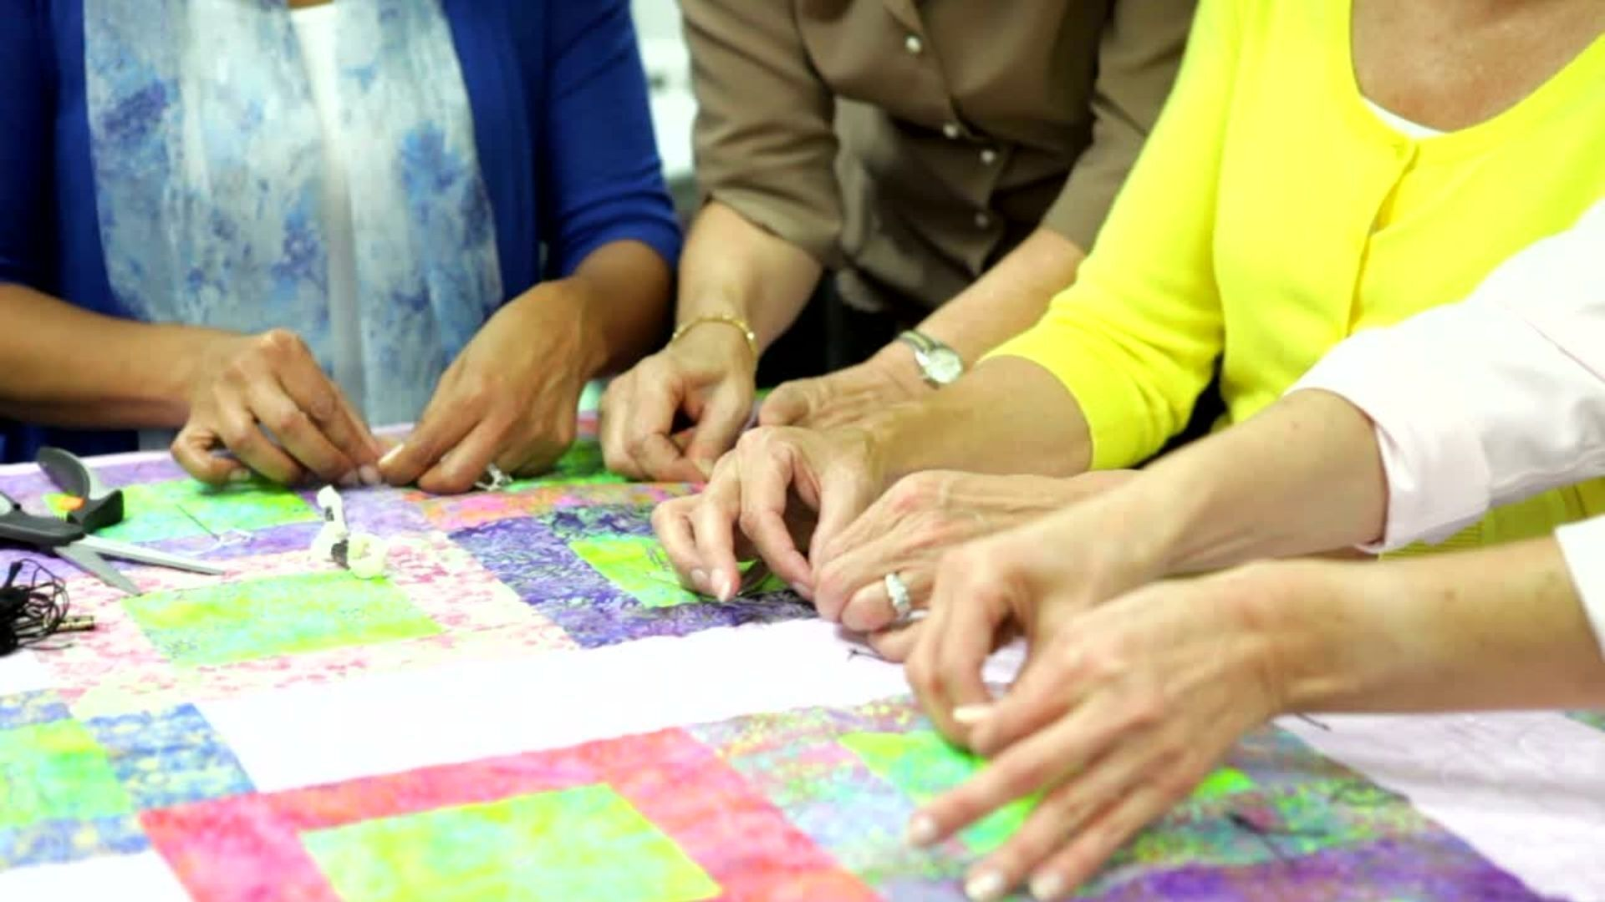
Sermon
Listening for God to Speak
God’s Call
Doing God’s Mission

Slide 36
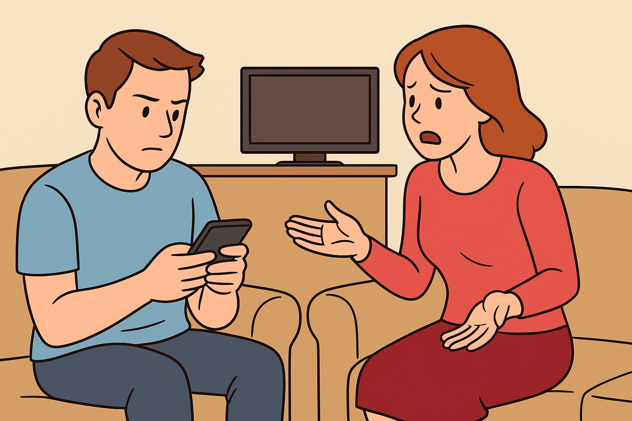

Sermon

Slide 37

Sermon

Slide 38
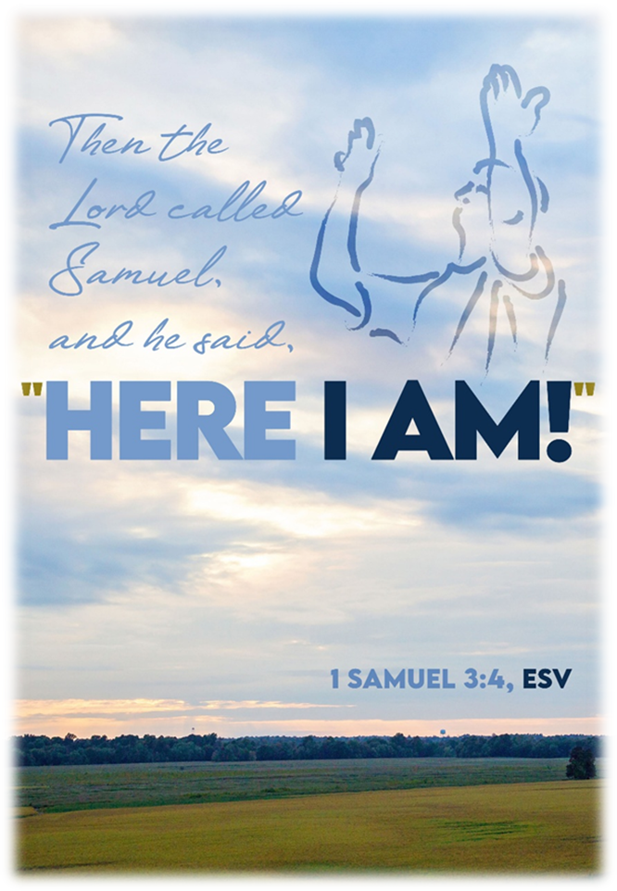
Hymn of the Day
“Softly and Tenderly Jesus Is Calling”
ELW 608

Slide 39
“Softly and Tenderly Jesus Is Calling”
ELW 608
1 Softly and tenderly Jesus is calling,
calling for you and for me.
See, on the portals he's waiting and watching,
watching for you and for me.

Slide 40
“Softly and Tenderly Jesus Is Calling”
ELW 608
Refrain
"Come home, (Come home,)
come home! (come home!)
You who are weary, come home."
Earnestly, tenderly, Jesus is calling,
calling, "O sinner, come home!"

Slide 41
“Softly and Tenderly Jesus Is Calling”
ELW 608
2 Why should we tarry when Jesus is pleading,
pleading for you and for me?
Why should we linger and heed not his mercies,
mercies for you and for me?

Slide 42
“Softly and Tenderly Jesus Is Calling”
ELW 608
Refrain
"Come home, (Come home,)
come home! (come home!)
You who are weary, come home."
Earnestly, tenderly, Jesus is calling,
calling, "O sinner, come home!"

Slide 43
“Softly and Tenderly Jesus Is Calling”
ELW 608
3 Oh, for the wonderful love he has promised,
promised for you and for me!
Though we have sinned, he has mercy and pardon,
pardon for you and for me.

Slide 44
“Softly and Tenderly Jesus Is Calling”
ELW 608
Refrain
"Come home, (Come home,)
come home! (come home!)
You who are weary, come home."
Earnestly, tenderly, Jesus is calling,
calling, "O sinner, come home!"

Slide 45
APOSTLE’S CREED
C: I believe in God, the Father almighty, creator of heaven and earth.

Slide 46
APOSTLE’S CREED
C: I believe in Jesus Christ, his only Son, our Lord. He was conceived by the power of the Holy Spirit and born of the virgin Mary. He suffered under Pontius Pilate, was crucified, died, and was buried.

Slide 47
APOSTLE’S CREED
C: He descended into hell. On the third day he rose again. He ascended into heaven, and is seated at the right hand of the Father. He will come again to judge the living and the dead.

Slide 48
APOSTLE’S CREED
C: I believe in the Holy Spirit, the holy catholic Church, the communion of saints, the forgiveness of sins, the resurrection of the body, and the life everlasting. Amen.

Slide 49
PRAYERS OF INTERCESSION
Each petition will end with the words,
A: God of promise,
The congregation will respond with:
C: Hear our prayer.

Slide 50
PRAYERS OF INTERCESSION
The prayer concludes…
P: We lift all these prayers, and those of our hearts, to your loving care, O God. Receive them and restore our hope in your promises. In Jesus’ name.
C: Amen.

Slide 51
OFFERING/OFFERING PRAYER
Notes:
Image: Five Loaves by Caroline Coolidge Brown. Copyright © Caroline Coolidge Brown. All rights reserved. Used by permission of the artist.

Slide 52
THE LORD’S PRAYER
C: Our Father, who art in heaven, hallowed be thy name, thy kingdom come, thy will be done, on earth as it is in heaven. Give us this day our daily bread; and forgive us our trespasses, as we forgive those who trespass against us; and lead us not into temptation, but deliver us from evil.

Slide 53
THE LORD’S PRAYER
C: For thine is the kingdom, and the power, and the glory, forever and ever. Amen.

Slide 54

ANNOUNCEMENTS
Notes:
Image: Five Loaves by Caroline Coolidge Brown. Copyright © Caroline Coolidge Brown. All rights reserved. Used by permission of the artist.

Slide 55
SENDING BLESSING
P: The God of righteousness, who gives justice to the oppressed, who gives food to the hungry, who sets the prisoners free, ☩ bless you now and forever.
C: Amen.

Slide 56
SENDING HYMN
“Here I Am, Lord”
ELW 574

Slide 57
“Here I Am, Lord” ELW 574
1 "I, the Lord of sea and sky,
I have heard my people cry.
All who dwell in dark and sin
my hand will save.
I, who made the stars of night,
I will make their darkness bright.
Who will bear my light to them?
Whom shall I send?"

Slide 58
“Here I Am, Lord” ELW 574
Refrain
Here I am, Lord. Is it I, Lord?
I have heard you calling in the night.
I will go, Lord, if you lead me.
I will hold your people in my heart.

Slide 59
“Here I Am, Lord” ELW 574
2 "I, the Lord of snow and rain,
I have borne my people's pain.
I have wept for love of them.
They turn away.
I will break their hearts of stone,
give them hearts for love alone.
I will speak my word to them.
Whom shall I send?"

Slide 60
“Here I Am, Lord” ELW 574
Refrain
Here I am, Lord. Is it I, Lord?
I have heard you calling in the night.
I will go, Lord, if you lead me.
I will hold your people in my heart.

Slide 61
“Here I Am, Lord” ELW 574
3 "I, the Lord of wind and flame,
I will tend the poor and lame.
I will set a feast for them.
My hand will save.
Finest bread I will provide
till their hearts be satisfied.
I will give my life to them.
Whom shall I send?"

Slide 62
“Here I Am, Lord” ELW 574
Refrain
Here I am, Lord. Is it I, Lord?
I have heard you calling in the night.
I will go, Lord, if you lead me.
I will hold your people in my heart.

Slide 63
DISMISSAL
P: … Depart in Christ’s Love.
C: Seeking, welcoming, and serving all. Amen!
POSTLUDE
By
Roxanne Groff
From sundaysandseasons.com. Copyright © 2025 Augsburg Fortress. All rights reserved. Reprinted by permission under Augsburg Fortress Liturgies Annual License #SAS023830. New Revised Standard Version Bible, Copyright © 1989, Division of Christian Education of the National Council of the Churches of Christ in the United States of America. Used by permission. All rights reserved. Revised Common Lectionary, Copyright © 1992 Consultation on Common Texts, admin Augsburg Fortress. Used by permission.

