Slide 1
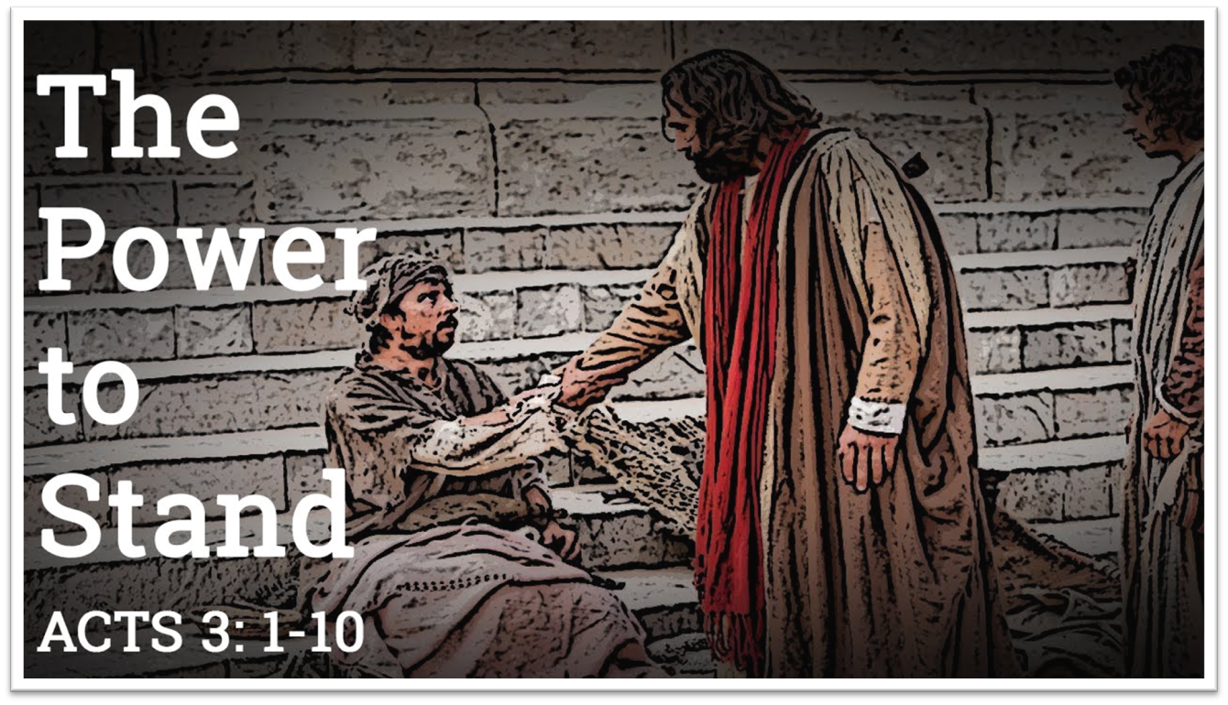

Announcements
Trinity Evangelical Lutheran Church
April 14, 2024
Scan Me!

Slide 2

Body, Mind, Spirit
MIND: Write a poem.
BODY: Try a new hair style.
SPIRIT: Learn the story behind your favorite hymn.

Slide 3


Our Office Secretary Is Sharon Fourman
Church Office Schedule
Tues, Wed, & Thurs
  8:00 am – 12:00 noon
Church Office: 937 692-5670
Email: secretary@pitsburgtlc.org

Slide 4


The Trinity Trumpet
A Monthly Newsletter
Published by Trinity Lutheran Church,
Pitsburg, OH
We’re looking for stories and pictures of Trinity people in action!
Submit to Secretary, Sharon Fourman at secretary@pitsburgtlc.org
Articles and Info due on or about the 15th of each month

Slide 5

Trinity Trumpet
    Your Trinity Trumpet Newsletter for April is available!
    Please take your copy before you leave today!

Slide 6
Trinity Trumpet
    Newsletter Deadline is Tuesday, April 16, 2024
    Please turn in all your newsworthy items to Sharon Fourman at:
    secretary@pitsburgtlc.org

Slide 7

We’re Online!
www.pitsburgtlc.org
Sermons and announcements are posted weekly
Trinity Trumpet is Posted here too!
The ‘Official’ Trinity Calendar is available for you to see!
Pictures, Videos and more!
Also, like us on FaceBook at
facebook.com/pitsburgtrinitylutheran.church

Slide 8
We’re Online!
www.pitsburgtlc.org
We now have our own QR Code!
Scan this code with your Smartphone and you will connect to all our Online media (Facebook, YouTube, and our own Church Website)

Slide 9
Online Giving
www.pitsburgtlc.org
Click the “Give to Trinity” Button
Stay current in your giving even when you can’t make it to Worship!
Separate Giving Categories for:
    General Treasury
    Benevolence/Mission Support
    Building Fund
    Annual Christmas Auction
    Memorial Funds
    Thrive Capital Campaign

Slide 10


Church
Council
Trinity Church Council
No Meeting in April!
Next Regular Meeting
May 15, 2024
@ 7:00 pm

Slide 11


Trinity’s Team Meetings
Next Meeting
TBD
@ 6:00 pm
On the Agenda – Preparing the proposed 2023 budget

Slide 12
Please Pass the Pew Pads
(We now track Communion on the Pads)

Slide 13

Worship Team
Next Meeting:
  TBD

Slide 14

Mutual Ministry Team
  Julie Kossler
  VACANT
  Peggy Didier
  Please see one of them with your comments and suggestions
  Next Meeting - TBD

Slide 15


Choice FISH Pantry
Please join us every Friday @ 3:30 pm
400 Markwith Dr, Greenville OH
Most Needed Items
Kidney Beans
Canned Peas
Hamburger Helper
Pork & Beans
Canned Mixed Veggies
Large Cans of Soups
Applesauce
Boxed Meals
(i.e. Rice a Roni)

Slide 16
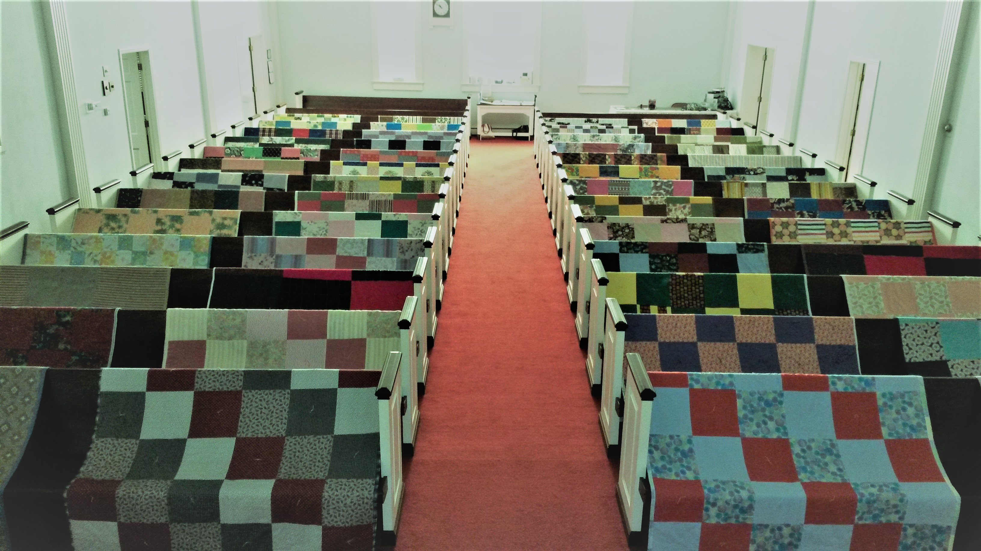
Prayers and Squares
Quilting Ministry
Tuesday, April 30 @ 10:00 am
Thursday, May 9 @ 10:00 am

Slide 17

Next Meeting:
May 1, 2024
@ 11:30 am
Please note the Date & Time!!!

Slide 18


Ladies and Gents Luncheon
Date: April 18th ^{t} @ 11:30 am
Where: Huey Magoo’s, 9196 N Main St, Englewood, OH 45415-1123
For Reservations/Questions:
        See Linda Baker or call her @ 937 545-0975

Slide 19

Confirmation Program
    Next Class – April 10 @ 6:30 pm – 8:30 pm
    Weekly Worship attendance is required (In person or via FaceBook)
    Worship Notes may be emailed to pastor@pitsburgtlc.org or placed in Pr Mel’s mailbox outside the Church Office
    Confirmands are HIGHLY encouraged to take turns as Acolyte

Slide 20

    Who can be an Acolyte? YOU CAN!!!
    Ask Pr Mel about training opportunities
    Please sign up for Acolyte Duty on the chart by the Church Office!
    Confirmation Students are Highly Encouraged to perform Acolyte duty…
    Please sign up today!

Slide 21
New Member Class
We are forming a “New Member” Class for anyone who wants to learn more about Being Lutheran and what Being a member of Trinity entails
    Classes will begin January 8th
    Classes start at 12:00 Noon or as soon after Worship as possible
    Please see Pastor Mel if Interested in attending

Slide 22

    Commemorate special days like Anniversaries, Birthdays, Baptisms and more…
    See PJ to Sign Up!

Slide 23

Next Meeting
May 2, 2024 @ 10:00 am
Purpose -- plan for Arc Encounter Trip
Please come if you can!

Slide 24

Blood Pressure Screening
BP Screening
By Appointment
In The Nursery
Notes:
Cover: Sermon on the Mount by Laura James. Copyright © Laura James. All rights reserved. Used by permission of the artist.

Slide 25


Holy Communion – Today!
Communion Today
Safe for all humans (Especially sinners)
Holy Communion Schedule
    First and Third Sundays each month
    All White and Red Sundays of the Church Year

Slide 26

Calling all Adults!
Join Us For “Christian Conversations”
Not Your Ordinary Adult Sunday School
Sharing – Discussion - Prayer
Free Donuts, Juice, and Coffee
Every Sunday @
9:30 am
Notes:
Cover: Sermon on the Mount by Laura James. Copyright © Laura James. All rights reserved. Used by permission of the artist.

Slide 27

Trinity Troops
Date: TODAY!!! -- After Worship
Where: Trinity Fellowship Hall
Who: Youth 5th – 6th Grades
What: Fun and Food! (Ham & Scalloped Potatoes – Yummy!!!)
Trinity Troops!

Slide 28

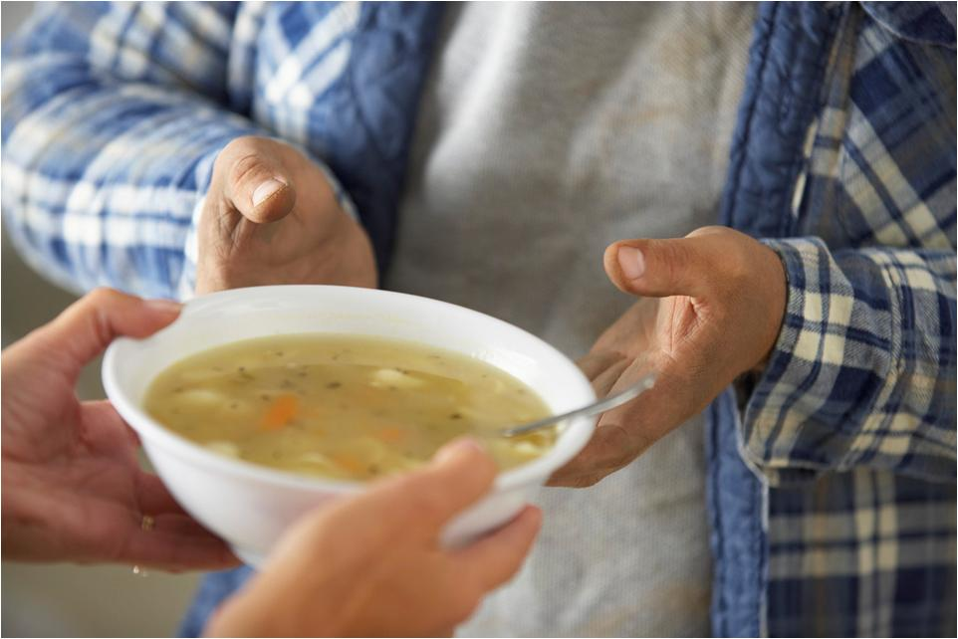
Grace Resurrection Community Center
Soup Kitchen Meal
When: Wednesday, March 20th
10:00 am to 1:00 pm.
Where: 433 Water Street in Greenville

Slide 29

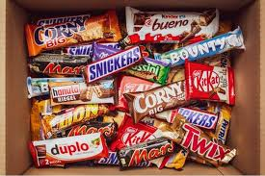
Trinity Youth
Fun (d) Raiser!
Candy Bar Sales!
Large Selection
$2 Each
Supports our youth
Notes:
Cover: Sermon on the Mount by Laura James. Copyright © Laura James. All rights reserved. Used by permission of the artist.

Slide 30

Trinity Youth Sunday!
April 28, 2024
Trinity youth will be leading Worship!
Notes:
Cover: Sermon on the Mount by Laura James. Copyright © Laura James. All rights reserved. Used by permission of the artist.

Slide 31


Trinity Trip To The Ark!
When: May 18
Who: Trinity Family and Friends!
Interested? See PJ Musser
Adult (ages 18–59) - $59.99
Senior (ages 60+) - $49.99
Youth (ages 11–17) - $31.99
Children (10 and under) FREE
pricing before tax | parking not included
Notes:
Cover: Sermon on the Mount by Laura James. Copyright © Laura James. All rights reserved. Used by permission of the artist.

