Slide 1

February 23, 2025
WELCOME!
Trinity Lutheran Church
Notes:
Image: Five Loaves by Caroline Coolidge Brown. Copyright © Caroline Coolidge Brown. All rights reserved. Used by permission of the artist.

Slide 2
= Please stand if able
= Please be seated
Prelude - By Pam Sherman
Office of the Acolyte
Ringing of the Bell
Welcome

Slide 3
THANKSGIVING FOR BAPTISM
All may make the sign of the cross, the sign marked at baptism, as the presiding minister begins.
P: Blessed be the holy Trinity, ☩ one God, the fountain of living water, the rock who gave us birth, our light and our salvation.
C: Amen.
Notes:
Image: Preparing yeast dough. Copyright © tomasworks/iStock/Thinkstock. Used by permission.

Slide 4
P: Joined to Christ in the waters of baptism, we are clothed with God's mercy and forgiveness. Let us give thanks for the gift of baptism.
Water may be poured into the font as the presiding minister gives thanks.
THANKSGIVING FOR BAPTISM
Notes:
Image: Preparing yeast dough. Copyright © tomasworks/iStock/Thinkstock. Used by permission.

Slide 5
P: We give you thanks, O God, for in the beginning your Spirit moved over the waters and by your Word you created the world, calling forth life in which you took delight. Through the waters of the flood you delivered Noah and his family. Through the sea you led your people Israel from slavery into freedom.
THANKSGIVING FOR BAPTISM
Notes:
Image: Preparing yeast dough. Copyright © tomasworks/iStock/Thinkstock. Used by permission.

Slide 6
P: At the river your Son was baptized by John and anointed with the Holy Spirit. By water and your Word you claim us as daughters and sons, making us heirs of your promise and servants of all. We praise you for the gift of water that sustains life, and above all we praise you for the gift of new life in Jesus Christ.
THANKSGIVING FOR BAPTISM
Notes:
Image: Preparing yeast dough. Copyright © tomasworks/iStock/Thinkstock. Used by permission.

Slide 7
P: Shower us with your Spirit, and renew our lives with your forgiveness, grace, and love. To you be given honor and praise through Jesus Christ our Lord in the unity of the Holy Spirit, now and forever.
THANKSGIVING FOR BAPTISM
C: Amen.
Notes:
Image: Preparing yeast dough. Copyright © tomasworks/iStock/Thinkstock. Used by permission.

Slide 8
Gathering Song
“Oh, For A Thousand Tongues to Sing”
LBW 559

Slide 9
“Oh, For A Thousand Tongues to Sing”
LBW 559
1 Oh, for a thousand tongues to sing
my great Redeemer’s praise,
the glories of my God and King,
the triumphs of his grace!
Notes:
Image: Five Loaves by Caroline Coolidge Brown. Copyright © Caroline Coolidge Brown. All rights reserved. Used by permission of the artist.

Slide 10
“Oh, For A Thousand Tongues to Sing”
LBW 559
2 My gracious Master and my God,
assist me to proclaim,
to spread through all the earth abroad
the honors of your name.
Notes:
Image: Five Loaves by Caroline Coolidge Brown. Copyright © Caroline Coolidge Brown. All rights reserved. Used by permission of the artist.

Slide 11
“Oh, For A Thousand Tongues to Sing”
LBW 559
3 The name of Jesus charms our fears
and bids our sorrows cease,
sings music in the sinner’s ears,
brings life and health and peace.
Notes:
Image: Five Loaves by Caroline Coolidge Brown. Copyright © Caroline Coolidge Brown. All rights reserved. Used by permission of the artist.

Slide 12
“Oh, For A Thousand Tongues to Sing”
LBW 559
4 He breaks the pow’r of canceled sin;
he sets the pris’ner free.
His blood can make the foulest clean;
his blood avails for me.
Notes:
Image: Five Loaves by Caroline Coolidge Brown. Copyright © Caroline Coolidge Brown. All rights reserved. Used by permission of the artist.

Slide 13
“Oh, For A Thousand Tongues to Sing”
LBW 559
5 To God all glory, praise, and love
be now and ever giv’n
by saints below and saints above,
the church in earth and heav’n.
Notes:
Image: Five Loaves by Caroline Coolidge Brown. Copyright © Caroline Coolidge Brown. All rights reserved. Used by permission of the artist.

Slide 14
APOSTOLIC GREETING
P: The grace of our Lord Jesus Christ, the love of God, and the communion of the Holy Spirit be with you all.
C: And also with you.
Notes:
Image: Five Loaves by Caroline Coolidge Brown. Copyright © Caroline Coolidge Brown. All rights reserved. Used by permission of the artist.

Slide 15
PRAYER OF THE DAY
P: Let us pray… Gracious God, help us embrace and extend the forgiveness and compassion we witness in Jesus’ actions. May we live in grateful and faithful response to your immeasurable love. In Jesus’ name we pray.
C: Amen
Notes:
Image: Five Loaves by Caroline Coolidge Brown. Copyright © Caroline Coolidge Brown. All rights reserved. Used by permission of the artist.

Slide 16

Notes:
Image: Five Loaves by Caroline Coolidge Brown. Copyright © Caroline Coolidge Brown. All rights reserved. Used by permission of the artist.

Slide 17
Luke 7:1-17
L: Our scripture reading is from Luke, Chapter 7.
C: Glory to you O’ Lord!
Notes:
Image: Five Loaves by Caroline Coolidge Brown. Copyright © Caroline Coolidge Brown. All rights reserved. Used by permission of the artist.

Slide 18
Luke 7:36-50
³⁶One of the Pharisees asked Jesus to eat with him, and he went into the Pharisee’s house and took his place at the table. ³⁷And a woman in the city, who was a sinner, having learned that he was eating in the Pharisee’s house, brought an alabaster jar of ointment. ³⁸She stood behind him at his feet, weeping, and began to bathe his feet with her tears and to dry them
Notes:
Image: Five Loaves by Caroline Coolidge Brown. Copyright © Caroline Coolidge Brown. All rights reserved. Used by permission of the artist.

Slide 19
Luke 7:36-50
with her hair. Then she continued kissing his feet and anointing them with the ointment. ³⁹Now when the Pharisee who had invited him saw it, he said to himself, “If this man were a prophet, he would have known who and what kind of woman this is who is touching him – that she is a sinner.” ⁴⁰Jesus spoke up and said to him,
Notes:
Image: Five Loaves by Caroline Coolidge Brown. Copyright © Caroline Coolidge Brown. All rights reserved. Used by permission of the artist.

Slide 20
Luke 7:36-50
“Simon, I have something to say to you.” “Teacher,” he replied, “Speak.” ⁴¹“A certain creditor had two debtors; one owed five hundred denarii, and the other fifty. ⁴²When they could not pay, he canceled the debts for both of them. Now which of them will love him more?” ⁴³Simon answered, “I suppose the one for whom he
Notes:
Image: Five Loaves by Caroline Coolidge Brown. Copyright © Caroline Coolidge Brown. All rights reserved. Used by permission of the artist.

Slide 21
Luke 7:36-50
canceled the greater debt.” And Jesus said to him, “You have judged rightly.” ⁴⁴Then turning toward the woman, he said to Simon, “Do you see this woman? I entered your house; you gave me no water for my feet, but she has bathed my feet with her tears and dried them with her hair. ⁴⁵You gave me no kiss, but from
Notes:
Image: Five Loaves by Caroline Coolidge Brown. Copyright © Caroline Coolidge Brown. All rights reserved. Used by permission of the artist.

Slide 22
Luke 7:36-50
the time I came in she has not stopped kissing my feet. ⁴⁶You did not anoint my head with oil, but she has anointed my feet with ointment. ⁴⁷Therefore, I tell you, her sins, which were many, have been forgiven; hence she has shown great love. But the one to whom little is forgiven, loves little.”
Notes:
Image: Five Loaves by Caroline Coolidge Brown. Copyright © Caroline Coolidge Brown. All rights reserved. Used by permission of the artist.

Slide 23
Luke 7:36-50
⁴⁸Then he said to her, “Your sins are forgiven.” ⁴⁹But those who were at the table with him began to say among themselves, “Who is this who even forgives sins?” ⁵⁰And he said to the woman, “Your faith has saved you; go in peace.”
Notes:
Image: Five Loaves by Caroline Coolidge Brown. Copyright © Caroline Coolidge Brown. All rights reserved. Used by permission of the artist.

Slide 24
Luke 7:36-50
R: This is the Word of the Lord.
C: Praise to You, O Christ
Notes:
Image: Five Loaves by Caroline Coolidge Brown. Copyright © Caroline Coolidge Brown. All rights reserved. Used by permission of the artist.

Slide 25

Sermon

Slide 26

Sermon

Slide 27
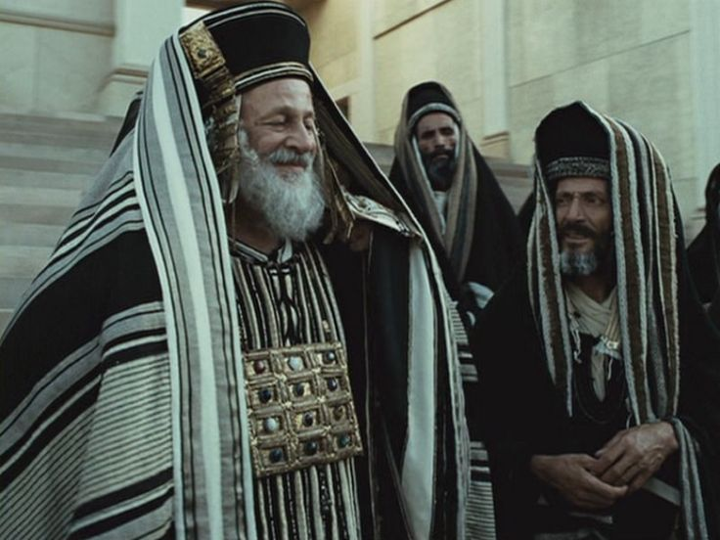
Sermon

Slide 28

Sermon

Slide 29
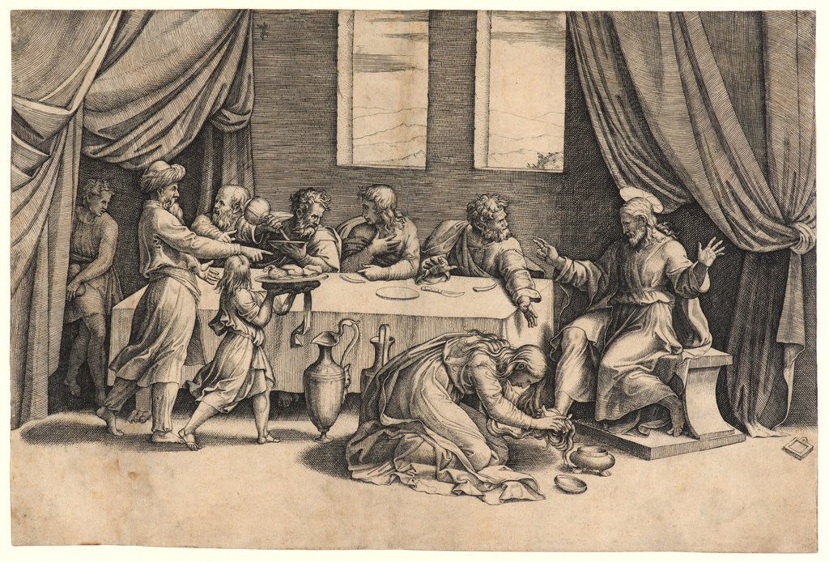
Sermon

Slide 30
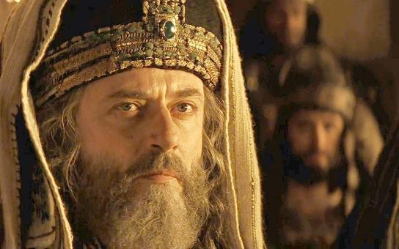
Sermon

Slide 31
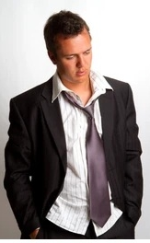
Sermon

Slide 32
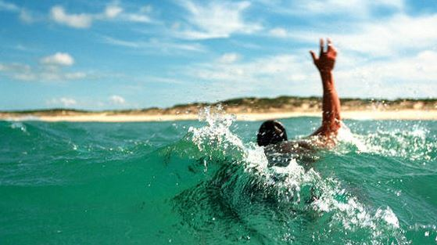
Sermon

Slide 33

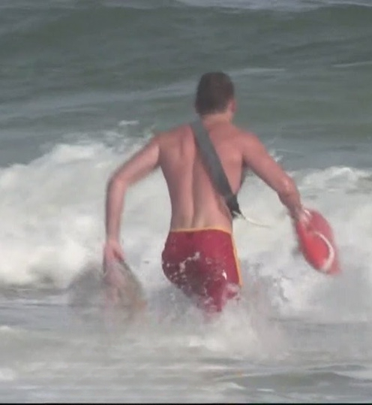
Sermon

Slide 34
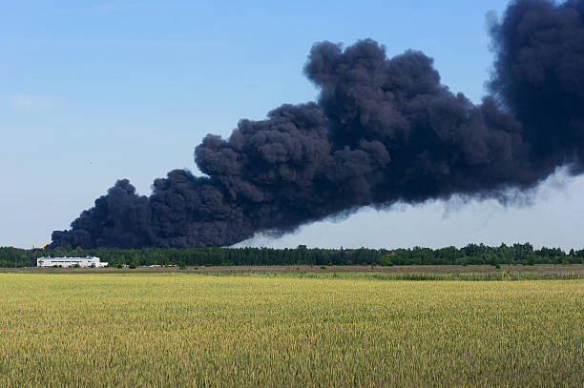
Sermon

Slide 35

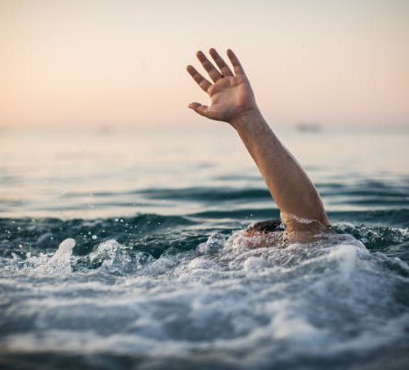
Sermon

Slide 36

Sermon

Slide 37
HYMN OF THE DAY
“There’s A Wideness in God’s Mercy”
LBW 290

Slide 38
There’s A Wideness in God’s Mercy--LBW 290
1 There’s a wideness in God’s mercy,
like the wideness of the sea;
there’s a kindness in his justice
which is more than liberty.
There is no place where earth’s sorrows
are more felt than up in heav’n.
There is no place where earth’s failings
have such kindly judgment giv’n.

Slide 39
“There’s A Wideness in God’s Mercy”
LBW 290
2 There is welcome for the sinner,
and a promised grace made good;
there is mercy with the Savior;
there is healing in his blood.
There is grace enough for thousands
of new worlds as great as this;
there is room for fresh creations
in that upper home of bliss.

Slide 40
“There’s A Wideness in God’s Mercy”
LBW 290
3 For the love of God is broader
than the measures of our mind;
and the heart of the eternal
is most wonderfully kind.
There is plentiful redemption
in the blood that has been shed;
there is joy for all the members
in the sorrows of the head.

Slide 41
“There’s A Wideness in God’s Mercy”
LBW 290
4 ’Tis not all we owe to Jesus;
it is something more than all:
greater good because of evil,
larger mercy through the fall.
If our love were but more simple,
we should take him at his word;
and our lives would be all sunshine
in the sweetness of our Lord.

Slide 42
APOSTLE’S CREED
C: I believe in God, the Father almighty, creator of heaven and earth.

Slide 43
APOSTLE’S CREED
C: I believe in Jesus Christ, his only Son, our Lord. He was conceived by the power of the Holy Spirit and born of the virgin Mary. He suffered under Pontius Pilate, was crucified, died, and was buried.

Slide 44
APOSTLE’S CREED
C: He descended into hell. On the third day he rose again. He ascended into heaven, and is seated at the right hand of the Father. He will come again to judge the living and the dead.

Slide 45
APOSTLE’S CREED
C: I believe in the Holy Spirit, the holy catholic Church, the communion of saints, the forgiveness of sins, the resurrection of the body, and the life everlasting. Amen.

Slide 46
PRAYERS
Each petition will end with the words,
  A: God, draw near,
  C: Hear our prayer.

Slide 47
PRAYERS OF INTERCESSION
The prayer concludes…
P: Trusting in your mercy and grace, we lift up all of our prayers to you.
C: Amen.

Slide 48

OFFERING
Notes:
Image: Five Loaves by Caroline Coolidge Brown. Copyright © Caroline Coolidge Brown. All rights reserved. Used by permission of the artist.

Slide 49
OFFERING PRAYER
Notes:
Image: Five Loaves by Caroline Coolidge Brown. Copyright © Caroline Coolidge Brown. All rights reserved. Used by permission of the artist.

Slide 50
THE LORD’S PRAYER
C: Our Father, who art in heaven, hallowed be thy name, thy kingdom come, thy will be done, on earth as it is in heaven. Give us this day our daily bread; and forgive us our trespasses, as we forgive those who trespass against us; and lead us not into temptation, but deliver us from evil.

Slide 51
THE LORD’S PRAYER
C: For thine is the kingdom, and the power, and the glory, forever and ever. Amen.

Slide 52

ANNOUNCEMENTS
Notes:
Image: Five Loaves by Caroline Coolidge Brown. Copyright © Caroline Coolidge Brown. All rights reserved. Used by permission of the artist.

Slide 53
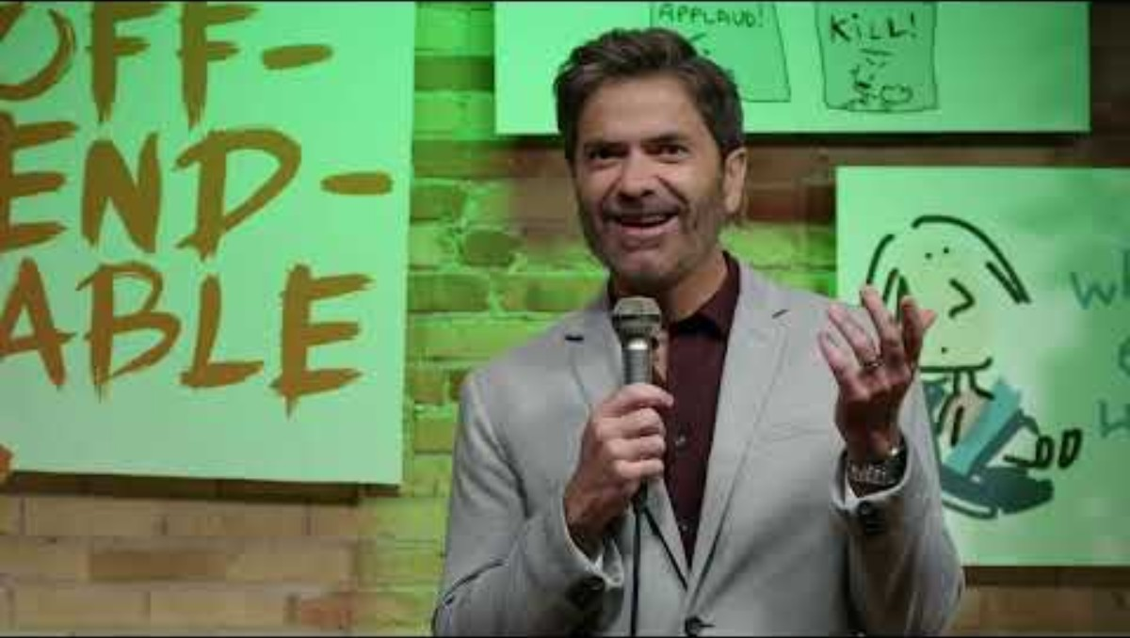
Lenten Video Study/Discussion
Notes:
Image: Five Loaves by Caroline Coolidge Brown. Copyright © Caroline Coolidge Brown. All rights reserved. Used by permission of the artist.

Slide 54
SENDING BLESSING
P: The Spirit of the triune God bless you with joy, anoint you with compassion, ☩ and send you in love.
C: Amen.

Slide 55
Sending Song
“Great Is Thy Faithfulness”
ELW 733
Notes:
Image: Five Loaves by Caroline Coolidge Brown. Copyright © Caroline Coolidge Brown. All rights reserved. Used by permission of the artist.

Slide 56
“Great Is Thy Faithfulness” ELW 733
1 Great is thy faithfulness, O God my Father;
there is no shadow of turning with thee;
thou changest not, thy compassions they fail not;
as thou hast been, thou forever wilt be.
Notes:
Image: Preparing yeast dough. Copyright © tomasworks/iStock/Thinkstock. Used by permission.

Slide 57
“Great Is Thy Faithfulness” ELW 733
Refrain
Great is thy faithfulness! Great is thy faithfulness!
Morning by morning new mercies I see;
all I have needed thy hand hath provided;
great is thy faithfulness, Lord, unto me!
Notes:
Image: Preparing yeast dough. Copyright © tomasworks/iStock/Thinkstock. Used by permission.

Slide 58
“Great Is Thy Faithfulness” ELW 733
2 Summer and winter and springtime and harvest,
sun, moon, and stars in their courses above
join with all nature in manifold witness
to thy great faithfulness, mercy, and love.
Notes:
Image: Preparing yeast dough. Copyright © tomasworks/iStock/Thinkstock. Used by permission.

Slide 59
“Great Is Thy Faithfulness” ELW 733
Refrain
Great is thy faithfulness! Great is thy faithfulness!
Morning by morning new mercies I see;
all I have needed thy hand hath provided;
great is thy faithfulness, Lord, unto me!
Notes:
Image: Preparing yeast dough. Copyright © tomasworks/iStock/Thinkstock. Used by permission.

Slide 60
“Great Is Thy Faithfulness” ELW 733
3 Pardon for sin and a peace that endureth,
thine own dear presence to cheer and to guide;
strength for today and bright hope for tomorrow,
blessings all mine, with ten thousand beside!
Notes:
Image: Preparing yeast dough. Copyright © tomasworks/iStock/Thinkstock. Used by permission.

Slide 61
“Great Is Thy Faithfulness” ELW 733
Refrain
Great is thy faithfulness! Great is thy faithfulness!
Morning by morning new mercies I see;
all I have needed thy hand hath provided;
great is thy faithfulness, Lord, unto me!
Notes:
Image: Preparing yeast dough. Copyright © tomasworks/iStock/Thinkstock. Used by permission.

Slide 62
DISMISSAL
P: … Depart in Christ’s Love.
C: Seeking, welcoming, and serving all. Amen!
From sundaysandseasons.com. Copyright © 2025 Augsburg Fortress. All rights reserved. Reprinted by permission under Augsburg Fortress Liturgies Annual License #SAS023830. New Revised Standard Version Bible, Copyright © 1989, Division of Christian Education of the National Council of the Churches of Christ in the United States of America. Used by permission. All rights reserved. Revised Common Lectionary, Copyright © 1992 Consultation on Common Texts, admin Augsburg Fortress. Used by permission.

Slide 63
DISMISSAL
POSTLUDE
By
Pam Sherman
From sundaysandseasons.com. Copyright © 2025 Augsburg Fortress. All rights reserved. Reprinted by permission under Augsburg Fortress Liturgies Annual License #SAS023830. New Revised Standard Version Bible, Copyright © 1989, Division of Christian Education of the National Council of the Churches of Christ in the United States of America. Used by permission. All rights reserved. Revised Common Lectionary, Copyright © 1992 Consultation on Common Texts, admin Augsburg Fortress. Used by permission.

