Slide 1

October 19, 2025
WELCOME!
Trinity Lutheran Church
Notes:
Image: Five Loaves by Caroline Coolidge Brown. Copyright © Caroline Coolidge Brown. All rights reserved. Used by permission of the artist.

Slide 2
= Please stand if able
= Please be seated
Prelude - By Roxanne Groff
Office of the Acolyte
Ringing of the Bell
Welcome

Slide 3
CONFESSION AND FORGIVENESS
All may make the sign of the cross, the sign marked at baptism…
P: We confess our sins before God and one another.
Pause for silence and reflection.
P: Holy God,
Notes:
Image: Five Loaves by Caroline Coolidge Brown. Copyright © Caroline Coolidge Brown. All rights reserved. Used by permission of the artist.

Slide 4
CONFESSION AND FORGIVENESS
C: You have created us in your image, protected and nourished us, and called us into your work of justice. Yet while we profess these truths, we forget who we are and whose we are. We put our trust in ourselves, in material goods, and in worldly powers instead of trusting you. We prioritize our comfort over our neighbor’s needs.
Notes:
Image: Five Loaves by Caroline Coolidge Brown. Copyright © Caroline Coolidge Brown. All rights reserved. Used by permission of the artist.

Slide 5
CONFESSION AND FORGIVENESS
C: Call us back to you, God. Forgive us our failings, and direct us back onto the path you would have us tread.
Notes:
Image: Five Loaves by Caroline Coolidge Brown. Copyright © Caroline Coolidge Brown. All rights reserved. Used by permission of the artist.

Slide 6
CONFESSION AND FORGIVENESS
P: Hear the good news, siblings in Christ. You have been created in wholeness, claimed in love, and forgiven according to God’s boundless grace. Nothing—even the worst we do or fail to do—can separate us from the love of our God. Receive this forgiveness with joy, in the name of Jesus, our savior and friend.
C: Amen.
Notes:
Image: Five Loaves by Caroline Coolidge Brown. Copyright © Caroline Coolidge Brown. All rights reserved. Used by permission of the artist.

Slide 7
Gathering Song
“Just As I Am”
LBW 296

Slide 8
“Just As I Am” LBW 296
1 Just as I am, without one plea,
but that thy blood was shed for me,
and that thou bidd’st me come to thee,
O Lamb of God, I come, I come.
Notes:
Image: Five Loaves by Caroline Coolidge Brown. Copyright © Caroline Coolidge Brown. All rights reserved. Used by permission of the artist.

Slide 9
“Just As I Am” LBW 296
2 Just as I am, and waiting not
to rid my soul of one dark blot,
to thee, whose blood can cleanse each spot,
O Lamb of God, I come, I come.
Notes:
Image: Five Loaves by Caroline Coolidge Brown. Copyright © Caroline Coolidge Brown. All rights reserved. Used by permission of the artist.

Slide 10
“Just As I Am” LBW 296
3 Just as I am, though tossed about
with many a conflict, many a doubt,
fightings and fears within, without,
O Lamb of God, I come, I come.
4 Just as I am, poor, wretched, blind;
sight, riches, healing of the mind,
yea, all I need in thee to find,
O Lamb of God, I come, I come.
Notes:
Image: Five Loaves by Caroline Coolidge Brown. Copyright © Caroline Coolidge Brown. All rights reserved. Used by permission of the artist.

Slide 11
“Just As I Am” LBW 296
5 Just as I am, thou wilt receive,
wilt welcome, pardon, cleanse, relieve;
because thy promise I believe,
O Lamb of God, I come, I come,
6 Just as I am; thy love unknown
has broken ev’ry barrier down;
now to be thine, yea, thine alone,
O Lamb of God, I come, I come.
Notes:
Image: Five Loaves by Caroline Coolidge Brown. Copyright © Caroline Coolidge Brown. All rights reserved. Used by permission of the artist.

Slide 12
APOSTOLIC GREETING
P: The grace of our Lord Jesus Christ, the love of God, and the communion of the Holy Spirit be with you all.
C: And also with you.
Notes:
Image: Five Loaves by Caroline Coolidge Brown. Copyright © Caroline Coolidge Brown. All rights reserved. Used by permission of the artist.

Slide 13
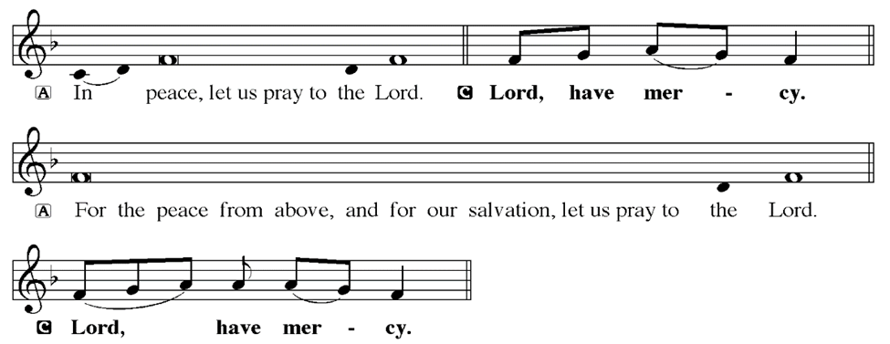
KYRIE
Notes:
Image: Five Loaves by Caroline Coolidge Brown. Copyright © Caroline Coolidge Brown. All rights reserved. Used by permission of the artist.

Slide 14
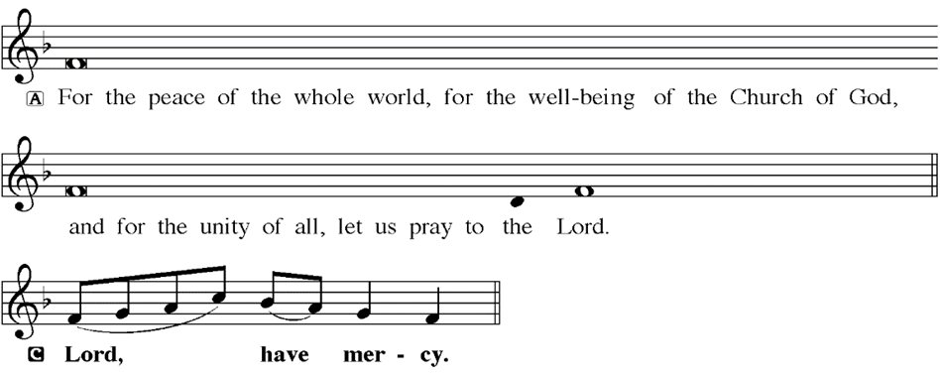
KYRIE
Notes:
Image: Five Loaves by Caroline Coolidge Brown. Copyright © Caroline Coolidge Brown. All rights reserved. Used by permission of the artist.

Slide 15
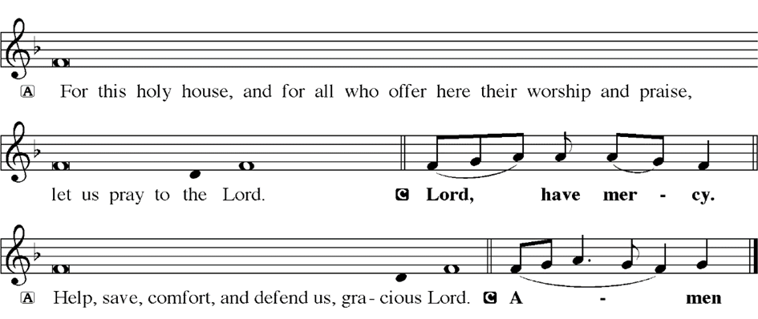
KYRIE
Notes:
Image: Five Loaves by Caroline Coolidge Brown. Copyright © Caroline Coolidge Brown. All rights reserved. Used by permission of the artist.

Slide 16
HYMN OF PRAISE
Glory be to God in heaven;
peace, goodwill to all the earth.
Mighty God of all creation,
Father of surpassing worth:
we exalt you, we adore you,
we lift high our thanks and praise.
Saints and angels bow before you; here on earth our songs we raise.
Notes:
Image: Five Loaves by Caroline Coolidge Brown. Copyright © Caroline Coolidge Brown. All rights reserved. Used by permission of the artist.

Slide 17
HYMN OF PRAISE
Glory be to Christ forever,
Lamb of God and Lord of love.
Son of God and gracious Savior, you have come from heav’n above;
on the cross you died to save us; now you reign at God’s right hand.
Hear our prayer; restore, forgive us; in your promise firm we stand.
Notes:
Image: Five Loaves by Caroline Coolidge Brown. Copyright © Caroline Coolidge Brown. All rights reserved. Used by permission of the artist.

Slide 18
HYMN OF PRAISE
Holy One we now acclaim you;
Lord alone, to you we call;
Holy One in faith we name you,
God most high, yet near to all:
Jesus Christ, with God the Spirit,
in the Father’s splendor bright.
For the peace that we inherit,
glory be to God on high!
Notes:
Image: Five Loaves by Caroline Coolidge Brown. Copyright © Caroline Coolidge Brown. All rights reserved. Used by permission of the artist.

Slide 19
PRAYER OF THE DAY
P: Let us pray… Loving God, you do not see as we see, but look on our hearts and know us deeply. Help us to see others as you do—with love, compassion, and boundless grace, that we might live in harmony with our siblings here and throughout creation. In Jesus’ name we pray.
C: Amen
Notes:
Image: Five Loaves by Caroline Coolidge Brown. Copyright © Caroline Coolidge Brown. All rights reserved. Used by permission of the artist.

Slide 20

Notes:
Image: Five Loaves by Caroline Coolidge Brown. Copyright © Caroline Coolidge Brown. All rights reserved. Used by permission of the artist.

Slide 21
Scripture Reading
L: Our scripture reading is from 1 Samuel, Chapter 16 and Psalm, Chapter 51.
C: Glory to you O’ Lord!
Notes:
Image: Five Loaves by Caroline Coolidge Brown. Copyright © Caroline Coolidge Brown. All rights reserved. Used by permission of the artist.

Slide 22
1 Samuel 16:1-13; Psalm 51:10-14
1 Samuel 16
¹The Lord said to Samuel, “How long will you grieve over Saul? I have rejected him from being king over Israel. Fill your horn with oil and set out; I will send you to Jesse the Bethlehemite, for I have provided for myself a king among his sons.” ²Samuel said, “How can
Notes:
Image: Five Loaves by Caroline Coolidge Brown. Copyright © Caroline Coolidge Brown. All rights reserved. Used by permission of the artist.

Slide 23
1 Samuel 16:1-13; Psalm 51:10-14
1 Samuel 16
I go? If Saul hears of it, he will kill me.” And the Lord said, “Take a heifer with you, and say, ‘I have come to sacrifice to the Lord.’ ³Invite Jesse to the sacrifice, and I will show you what you shall do; and you shall anoint for me the one whom I name to you.” ⁴Samuel did what the Lord commanded,
Notes:
Image: Five Loaves by Caroline Coolidge Brown. Copyright © Caroline Coolidge Brown. All rights reserved. Used by permission of the artist.

Slide 24
1 Samuel 16:1-13; Psalm 51:10-14
1 Samuel 16
and came to Bethlehem. The elders of the city came to meet him trembling, and said, “Do you come peaceably?” ⁵He said, “Peaceably; I have come to sacrifice to the Lord; sanctify yourselves and come with me to the sacrifice.” And he sanctified Jesse and his sons and invited
Notes:
Image: Five Loaves by Caroline Coolidge Brown. Copyright © Caroline Coolidge Brown. All rights reserved. Used by permission of the artist.

Slide 25
1 Samuel 16:1-13; Psalm 51:10-14
1 Samuel 16
them to the sacrifice.
⁶When they came, he looked on Eliab and thought, “Surely the Lord’s anointed is now before the Lord.” ⁷But the Lord said to Samuel, “Do not look on his appearance or on the height of his stature, because I have rejected him; for the Lord does not see as
Notes:
Image: Five Loaves by Caroline Coolidge Brown. Copyright © Caroline Coolidge Brown. All rights reserved. Used by permission of the artist.

Slide 26
1 Samuel 16:1-13; Psalm 51:10-14
1 Samuel 16
mortals see; they look on the outward appearance, but the Lord looks on the heart.” ⁸Then Jesse called Abinadab, and made him pass before Samuel. He said, “Neither has the Lord chosen this one.” ⁹Then Jesse made Shammah pass by. And he said, “Neither has the Lord chosen this one.” ¹⁰Jesse
Notes:
Image: Five Loaves by Caroline Coolidge Brown. Copyright © Caroline Coolidge Brown. All rights reserved. Used by permission of the artist.

Slide 27
1 Samuel 16:1-13; Psalm 51:10-14
1 Samuel 16
made seven of his sons pass before Samuel, and Samuel said to Jesse, “The Lord has not chosen any of these.” ¹¹Samuel said to Jesse, “Are all your sons here?” And he said, “There remains yet the youngest, but he is keeping the sheep.” And Samuel said to Jesse, “Send and bring him; for we will
Notes:
Image: Five Loaves by Caroline Coolidge Brown. Copyright © Caroline Coolidge Brown. All rights reserved. Used by permission of the artist.

Slide 28
1 Samuel 16:1-13; Psalm 51:10-14
1 Samuel 16
not sit down until he comes here.” ¹²He sent and brought him in. Now he was ruddy, and had beautiful eyes, and was handsome. The Lord said, “Rise and anoint him; for this is the one.” ¹³Then Samuel took the horn of oil, and anointed him in the presence of his brothers; and the spirit of the Lord
Notes:
Image: Five Loaves by Caroline Coolidge Brown. Copyright © Caroline Coolidge Brown. All rights reserved. Used by permission of the artist.

Slide 29
1 Samuel 16:1-13; Psalm 51:10-14
1 Samuel 16
came mightily upon David from that day forward. Samuel then set out and went to Ramah.
Psalm 51
¹⁰Create in me a clean heart, O God, and put a new and right spirit within me. ¹¹Do not cast me away
Notes:
Image: Five Loaves by Caroline Coolidge Brown. Copyright © Caroline Coolidge Brown. All rights reserved. Used by permission of the artist.

Slide 30
1 Samuel 16:1-13; Psalm 51:10-14
Psalm 51
from your presence, and do not take your holy spirit from me. ¹²Restore to me the joy of your salvation, and sustain in me a willing spirit. ¹³Then I will teach transgressors your ways, and sinners will return to you.
Notes:
Image: Five Loaves by Caroline Coolidge Brown. Copyright © Caroline Coolidge Brown. All rights reserved. Used by permission of the artist.

Slide 31
1 Samuel 16:1-13; Psalm 51:10-14
Psalm 51
¹⁴Deliver me from bloodshed, O God, O God of my salvation, and my tongue will sing aloud of your deliverance.
Notes:
Image: Five Loaves by Caroline Coolidge Brown. Copyright © Caroline Coolidge Brown. All rights reserved. Used by permission of the artist.

Slide 32
1 Samuel 16:1-13; Psalm 51:10-14
R: This is the Word of the Lord.
C: Praise to You, O Christ
Notes:
Image: Five Loaves by Caroline Coolidge Brown. Copyright © Caroline Coolidge Brown. All rights reserved. Used by permission of the artist.

Slide 33

Sermon

Slide 34
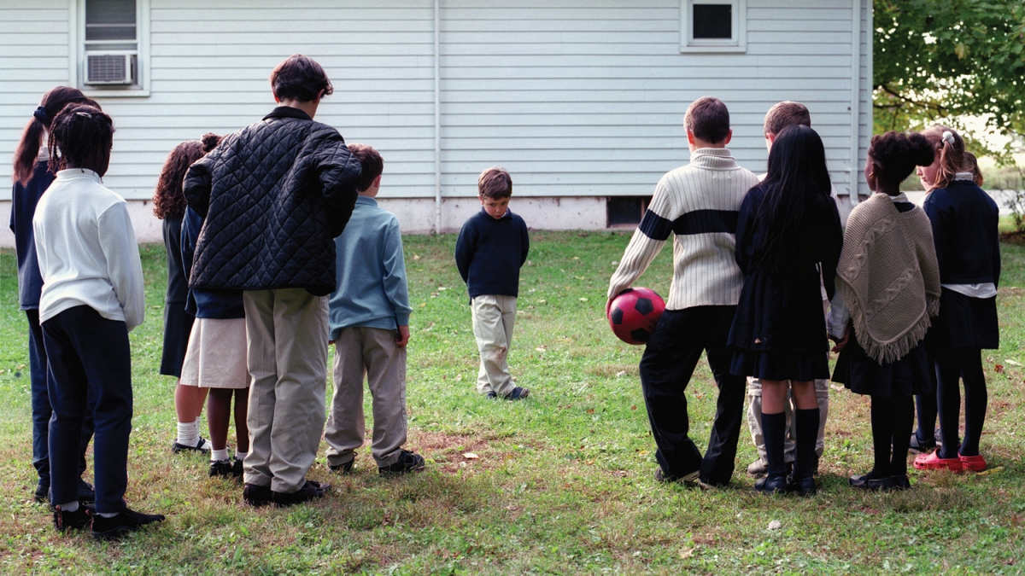

Sermon

Slide 35
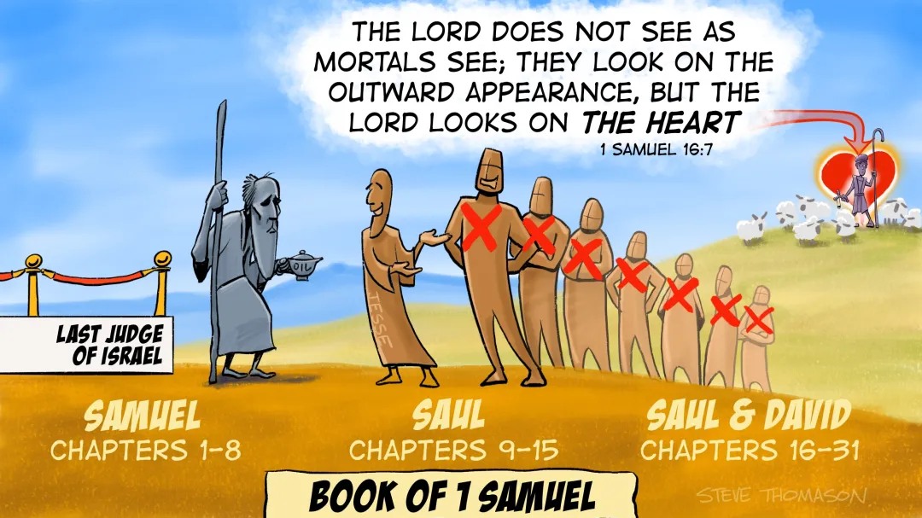
Sermon

Slide 36
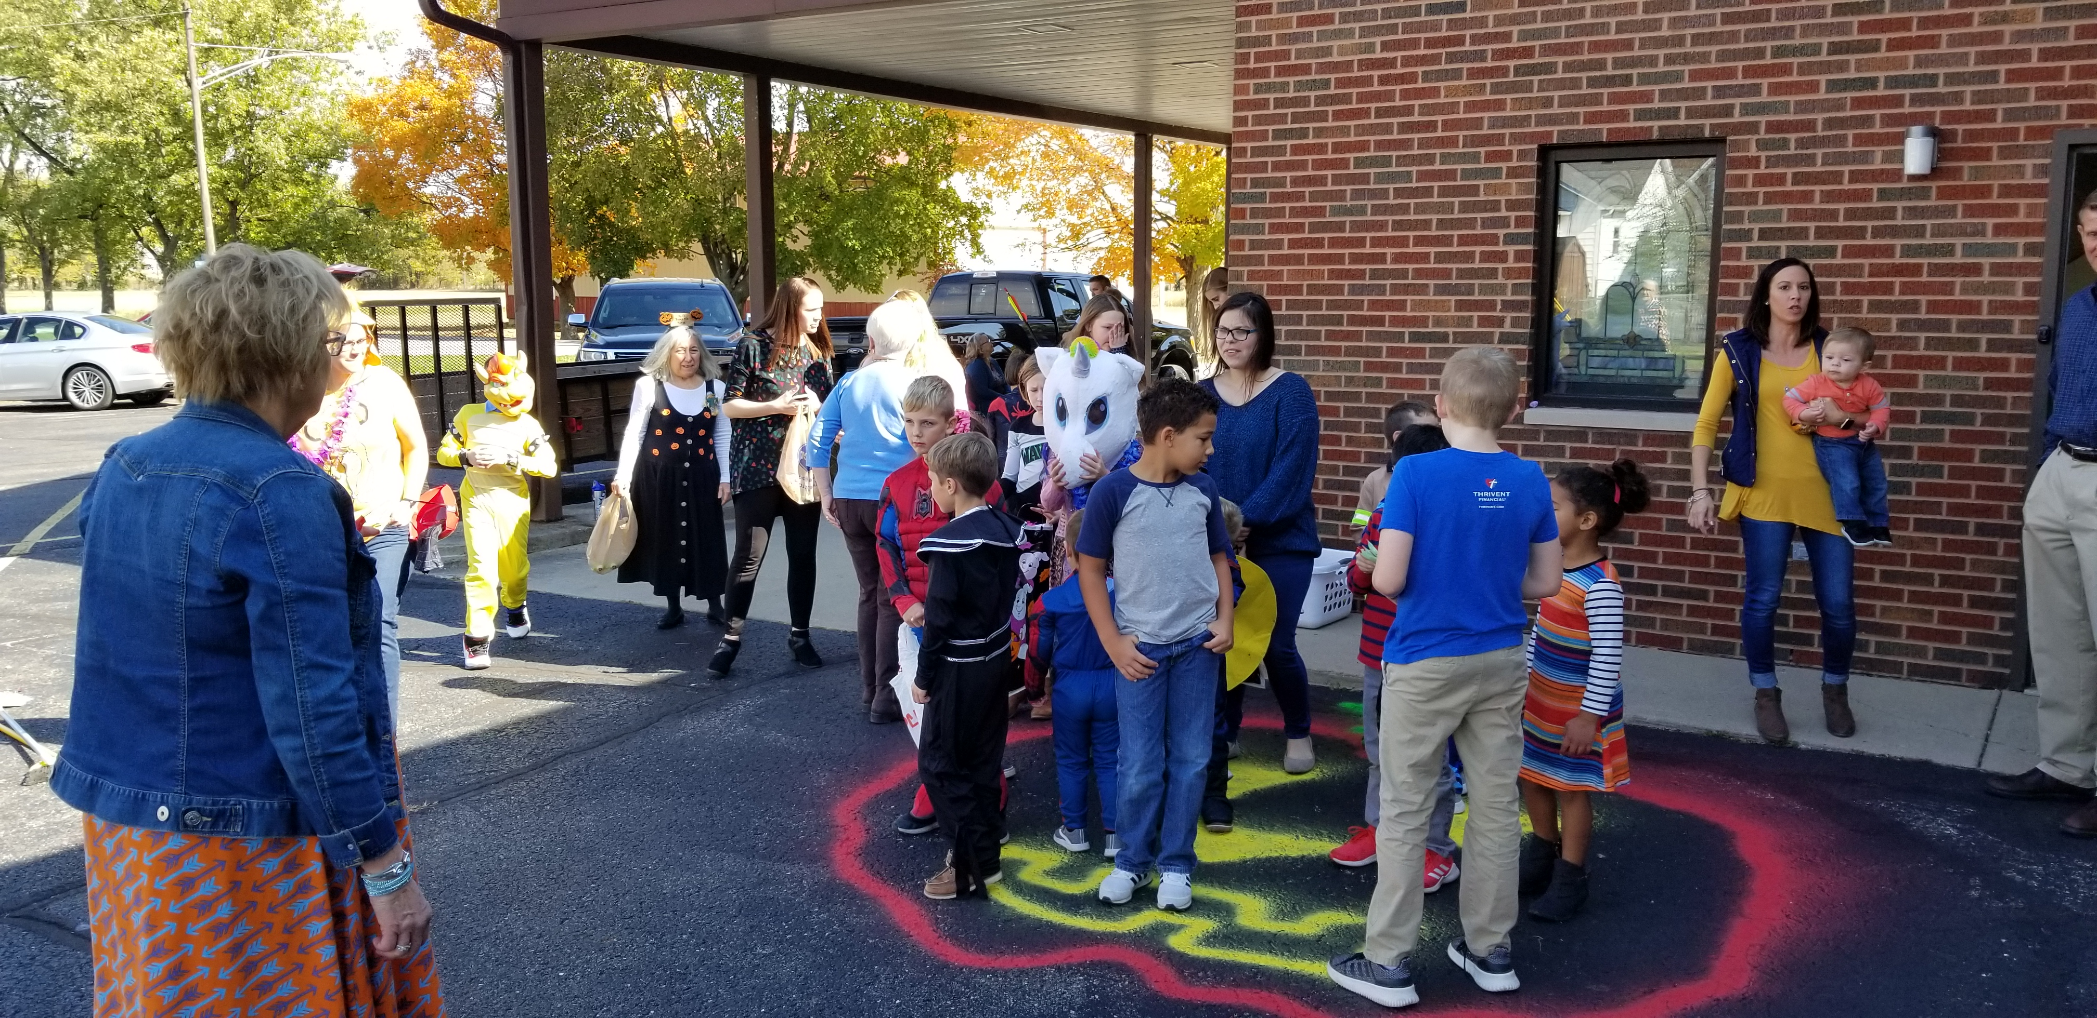
Sermon

Slide 37

Sermon

Slide 38
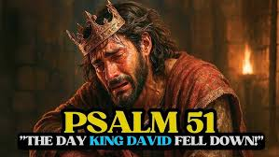
Sermon

Slide 39
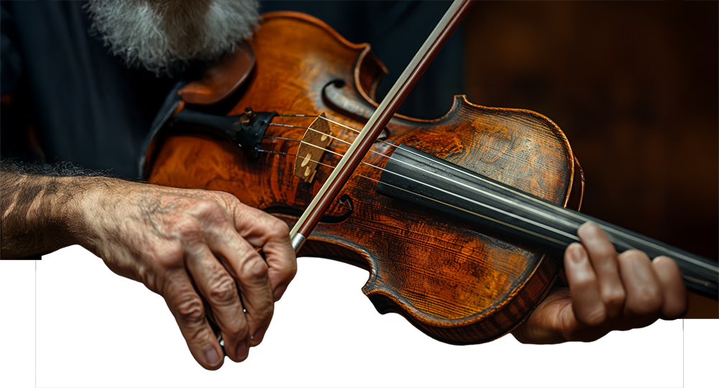
Sermon

Slide 40
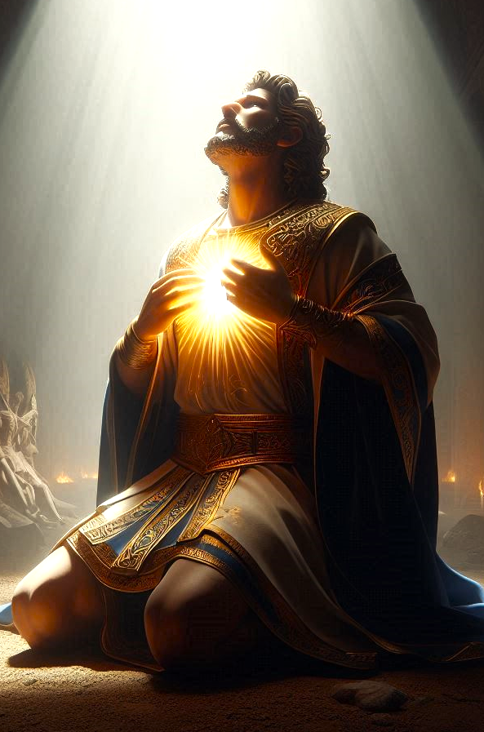
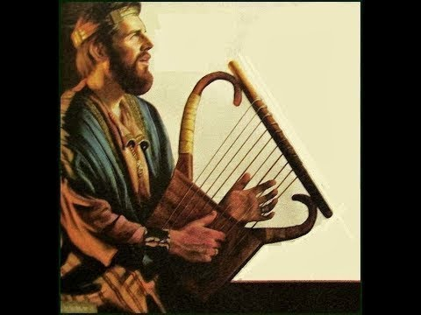
Sermon

Slide 41

Sermon

Slide 42
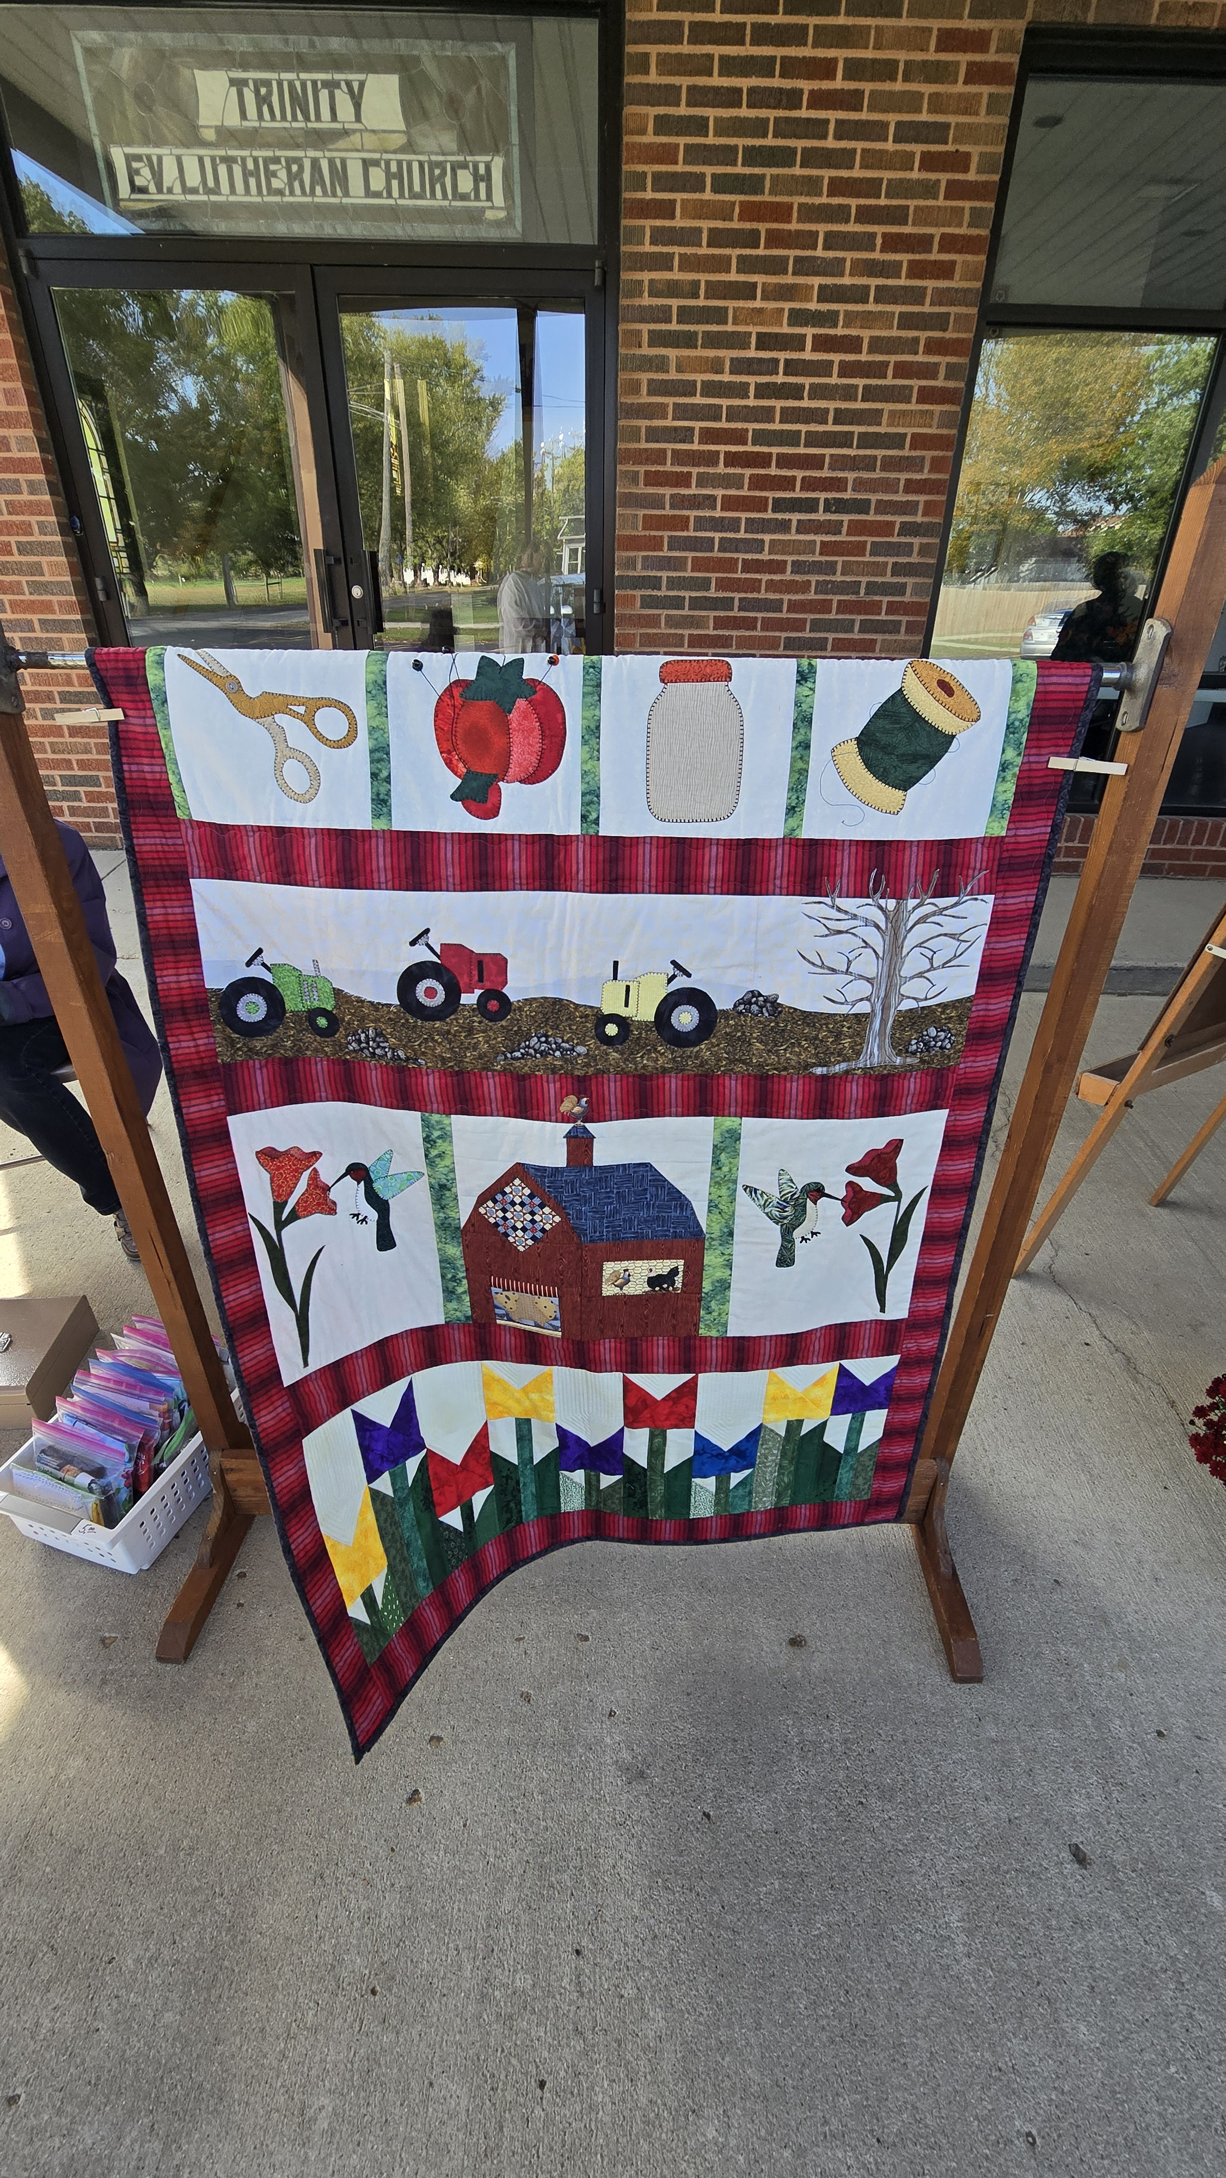
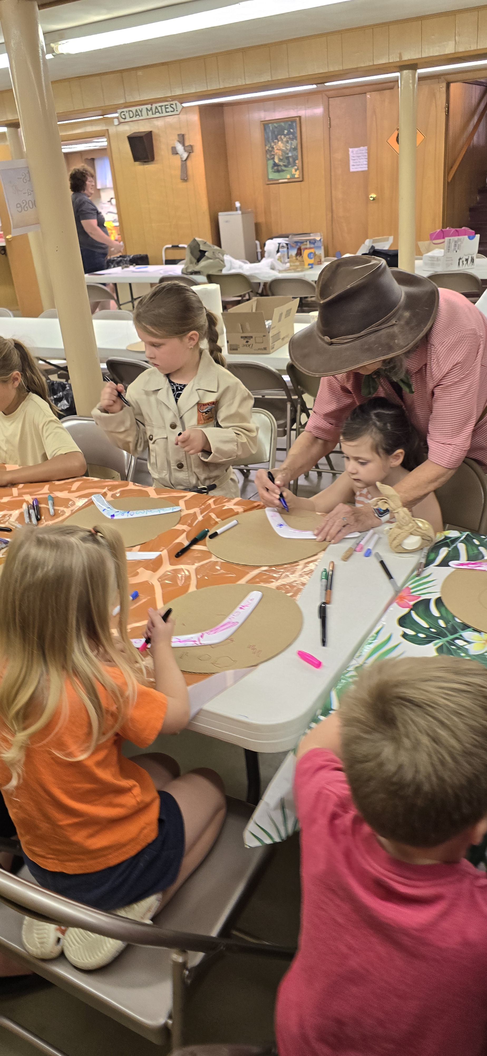
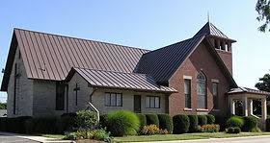
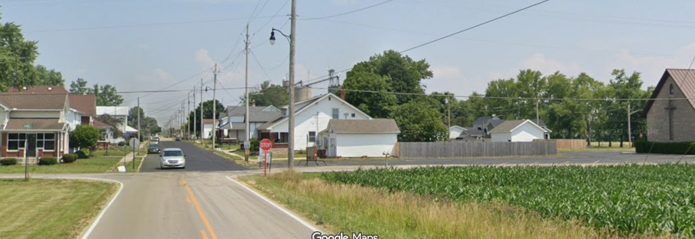
Sermon

Slide 43

Sermon

Slide 44
APOSTLE’S CREED
C: I believe in God, the Father almighty, creator of heaven and earth.

Slide 45
APOSTLE’S CREED
C: I believe in Jesus Christ, his only Son, our Lord. He was conceived by the power of the Holy Spirit and born of the virgin Mary. He suffered under Pontius Pilate, was crucified, died, and was buried.

Slide 46
APOSTLE’S CREED
C: He descended into hell. On the third day he rose again. He ascended into heaven, and is seated at the right hand of the Father. He will come again to judge the living and the dead.

Slide 47
APOSTLE’S CREED
C: I believe in the Holy Spirit, the holy catholic Church, the communion of saints, the forgiveness of sins, the resurrection of the body, and the life everlasting. Amen.

Slide 48
PRAYERS
Each petition will end with the words,
A: God of promise,
C: Hear our prayer.

Slide 49
PRAYERS OF INTERCESSION
The prayer concludes…
P: We lift all these prayers, and those of our hearts, to your loving care, O God. Receive them and restore our hope in your promises. In Jesus’ name.
C: Amen.

Slide 50

OFFERING/PRAYER
Notes:
Image: Five Loaves by Caroline Coolidge Brown. Copyright © Caroline Coolidge Brown. All rights reserved. Used by permission of the artist.

Slide 51
THE GREAT THANKSGIVING
All the Baptized are welcome to celebrate this Holy Meal.

Slide 52
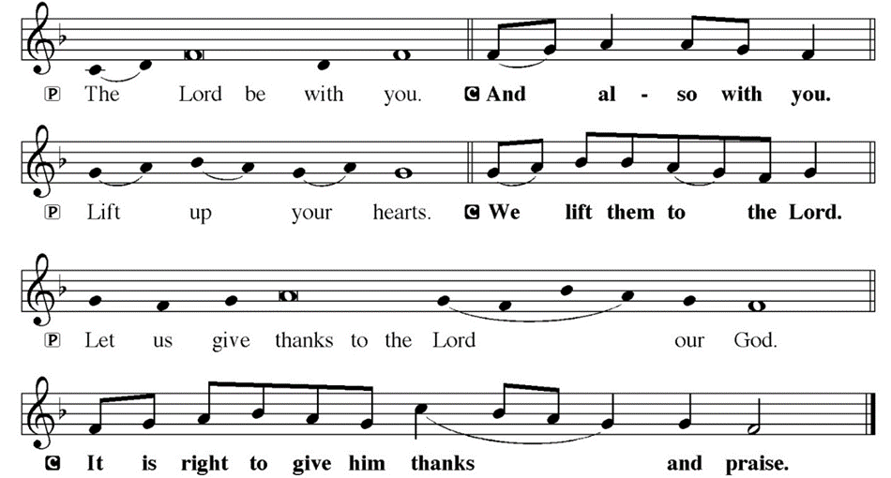
DIALOGUE

Slide 53
THE PREFACE
P: It is indeed right and salutary…
… we praise your name and join their unending hymn.

Slide 54
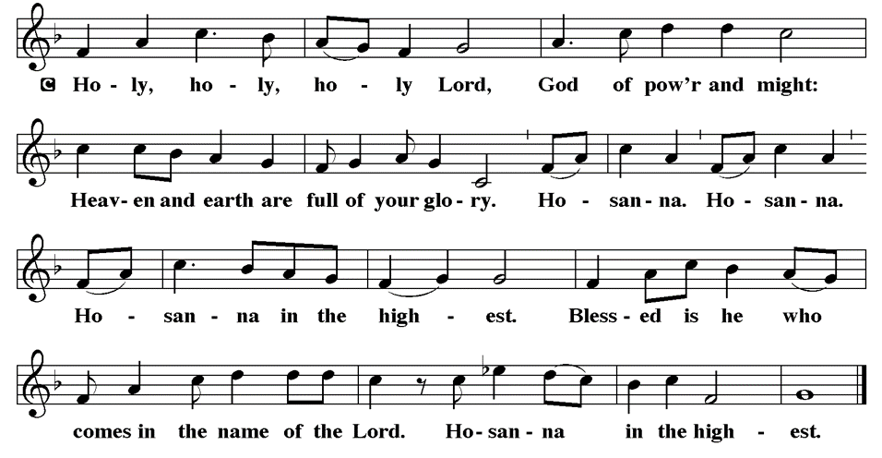
THE SANCTUS

Slide 55
EUCHARISTIC PRAYER
P: Holy God, our maker, redeemer, and healer…
…both now and forever.
C: Amen.

Slide 56
THE LORD’S PRAYER
C: Our Father, who art in heaven, hallowed be thy name, thy kingdom come, thy will be done, on earth as it is in heaven. Give us this day our daily bread; and forgive us our trespasses, as we forgive those who trespass against us; and lead us not into temptation, but deliver us from evil.

Slide 57
THE LORD’S PRAYER
C: For thine is the kingdom, and the power, and the glory, forever and ever. Amen.

Slide 58
INVITATION TO COMMUNION
P: Jesus, our one true king, invites you now to this royal banquet, to be nourished on his very presence in these elements of bread and wine. Come with your siblings in Christ, and feast with our savior and friend.

Slide 59
COMMUNION DISTRIBUTION
All will commune “By Station”.
The bread may be broken for distribution. As the ministers give the bread and wine, they say these words :
The body of Christ, given for you.
The blood of Christ, shed for you.
The communicant may say: Amen.

Slide 60
POST COMMUNION BLESSING
P: May this Body and Blood of our Savior Jesus Christ strengthen, keep, and unite us, now and forever, amen.

Slide 61
POST COMMUNION CANTACLE

Slide 62
POST COMMUNION CANTACLE

Slide 63
POST COMMUNION PRAYER
P: O God, through this meal you have strengthened us and appointed us to be your servants. Send us to do good and to share our possessions with all in need. We ask this in Jesus’ name.
C: Amen.

Slide 64

ANNOUNCEMENTS
Notes:
Image: Five Loaves by Caroline Coolidge Brown. Copyright © Caroline Coolidge Brown. All rights reserved. Used by permission of the artist.

Slide 65
SENDING BLESSING
P: The God of righteousness, who gives justice to the oppressed, ho gives food to the hungry, who sets the prisoners free, ☩ bless you now and forever.
C: Amen.

Slide 66
Sending Song
“Love Divine, All Loves Excelling”
LBW 315
Notes:
Image: Five Loaves by Caroline Coolidge Brown. Copyright © Caroline Coolidge Brown. All rights reserved. Used by permission of the artist.

Slide 67
“Love Divine, All Loves Excelling” -- LBW 315
1 Love divine, all loves excelling,
Joy of heav’n, to earth come down!
Fix in us thy humble dwelling,
all thy faithful mercies crown.
Jesus, thou art all compassion,
pure, unbounded love thou art;
visit us with thy salvation,
enter ev’ry trembling heart.
Notes:
Image: Preparing yeast dough. Copyright © tomasworks/iStock/Thinkstock. Used by permission.

Slide 68
“Love Divine, All Loves Excelling” -- LBW 315
2 Breathe, oh, breathe thy loving Spirit
into ev’ry troubled breast;
let us all in thee inherit;
let us find thy promised rest.
Take away the love of sinning;
Alpha and Omega be;
end of faith, as its beginning,
set our hearts at liberty.
Notes:
Image: Preparing yeast dough. Copyright © tomasworks/iStock/Thinkstock. Used by permission.

Slide 69
“Love Divine, All Loves Excelling” -- LBW 315
3 Come, Almighty, to deliver;
let us all thy life receive;
suddenly return, and never,
nevermore thy temples leave.
Thee we would be always blessing,
serve thee as thy hosts above,
pray, and praise thee without ceasing,
glory in thy perfect love.
Notes:
Image: Preparing yeast dough. Copyright © tomasworks/iStock/Thinkstock. Used by permission.

Slide 70
“Love Divine, All Loves Excelling” -- LBW 315
4 Finish then thy new creation,
pure and spotless let us be;
let us see thy great salvation
perfectly restored in thee!
Changed from glory into glory,
till in heav’n we take our place,
till we cast our crowns before thee,
lost in wonder, love, and praise!
Notes:
Image: Preparing yeast dough. Copyright © tomasworks/iStock/Thinkstock. Used by permission.

Slide 71
DISMISSAL
P: … Depart in Christ’s Love.
C: Seeking, welcoming, and serving all. Amen!
POSTLUDE
By
Roxanne Groff
From sundaysandseasons.com. Copyright © 2025 Augsburg Fortress. All rights reserved. Reprinted by permission under Augsburg Fortress Liturgies Annual License #SAS023830. New Revised Standard Version Bible, Copyright © 1989, Division of Christian Education of the National Council of the Churches of Christ in the United States of America. Used by permission. All rights reserved. Revised Common Lectionary, Copyright © 1992 Consultation on Common Texts, admin Augsburg Fortress. Used by permission.

