Slide 1
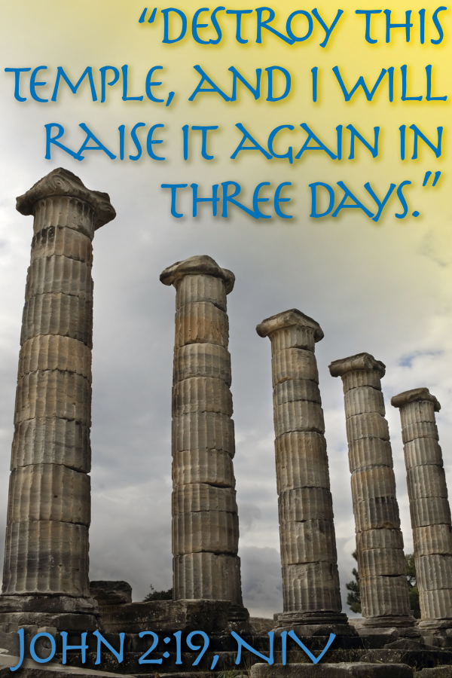
January 18, 2026
WELCOME!
Trinity Lutheran Church
Notes:
Image: Five Loaves by Caroline Coolidge Brown. Copyright © Caroline Coolidge Brown. All rights reserved. Used by permission of the artist.

Slide 2
= Please stand if able
= Please be seated
Prelude - By Roxanne Groff
Office of the Acolyte
Ringing of the Bell
Welcome

Slide 3
CONFESSION AND FORGIVENESS
All may make the sign of the cross, the sign marked at baptism…
L: We confess our sins before God and one another.
Pause for silence and reflection.
L: God of grace and mercy,
Notes:
Image: Five Loaves by Caroline Coolidge Brown. Copyright © Caroline Coolidge Brown. All rights reserved. Used by permission of the artist.

Slide 4
CONFESSION AND FORGIVENESS
C: We who have seen the signs of Jesus’ presence in the world still fall into doubt and despair. We put our trust in ourselves and in the powers of the world, in material goods and in finite and fallible people. In our fear we act out against our neighbors, and hurt those most in need of our help.
Notes:
Image: Five Loaves by Caroline Coolidge Brown. Copyright © Caroline Coolidge Brown. All rights reserved. Used by permission of the artist.

Slide 5
CONFESSION AND FORGIVENESS
C: Restore our faith, O God. Forgive us for our failings and make us one with our beloved siblings throughout creation.
Notes:
Image: Five Loaves by Caroline Coolidge Brown. Copyright © Caroline Coolidge Brown. All rights reserved. Used by permission of the artist.

Slide 6
CONFESSION AND FORGIVENESS
P: Our God hears and answers us, His beloved children. With love and tenderness God washes away all our sins. Know that you are always whole, always loved, and always held, even in your doubts and failings. ☩ Go forth with joy in this good news.
C: Amen.
Notes:
Image: Five Loaves by Caroline Coolidge Brown. Copyright © Caroline Coolidge Brown. All rights reserved. Used by permission of the artist.

Slide 7
Gathering Song/Hymn of Praise
“All Hail the Power of Jesus’ Name”
LBW 328
(Verses 1, 3, 6, & 7 only)

Slide 8
“All Hail the Power of Jesus’ Name” LBW 328
(Verses 1, 3, 6, & 7 only)
1 All hail the pow’r of Jesus’ name!
Let angels prostrate fall;
bring forth the royal diadem
and crown him Lord of all.
Bring forth the royal diadem
and crown him Lord of all.
Notes:
Image: Five Loaves by Caroline Coolidge Brown. Copyright © Caroline Coolidge Brown. All rights reserved. Used by permission of the artist.

Slide 9
“All Hail the Power of Jesus’ Name” LBW 328
(Verses 1, 3, 6, & 7 only)
3 O seed of Israel’s chosen race
now ransomed from the fall,
hail him who saves you by his grace
and crown him Lord of all.
Hail him who saves you by his grace
and crown him Lord of all.
Notes:
Image: Five Loaves by Caroline Coolidge Brown. Copyright © Caroline Coolidge Brown. All rights reserved. Used by permission of the artist.

Slide 10
“All Hail the Power of Jesus’ Name” LBW 328
(Verses 1, 3, 6, & 7 only)
6 Let ev’ry kindred, ev’ry tribe
on this terrestrial ball
to him all majesty ascribe
and crown him Lord of all.
To him all majesty ascribe
and crown him Lord of all.
Notes:
Image: Five Loaves by Caroline Coolidge Brown. Copyright © Caroline Coolidge Brown. All rights reserved. Used by permission of the artist.

Slide 11
“All Hail the Power of Jesus’ Name” LBW 328
(Verses 1, 3, 6, & 7 only)
7 Oh, that with yonder sacred throng
we at his feet may fall!
We’ll join the everlasting song
and crown him Lord of all.
We’ll join the everlasting song
and crown him Lord of all.
Notes:
Image: Five Loaves by Caroline Coolidge Brown. Copyright © Caroline Coolidge Brown. All rights reserved. Used by permission of the artist.

Slide 12
APOSTOLIC GREETING
P: The grace of our Lord Jesus Christ, the love of God, and the communion of the Holy Spirit be with you all.
C: And also with you.
Notes:
Image: Five Loaves by Caroline Coolidge Brown. Copyright © Caroline Coolidge Brown. All rights reserved. Used by permission of the artist.

Slide 13
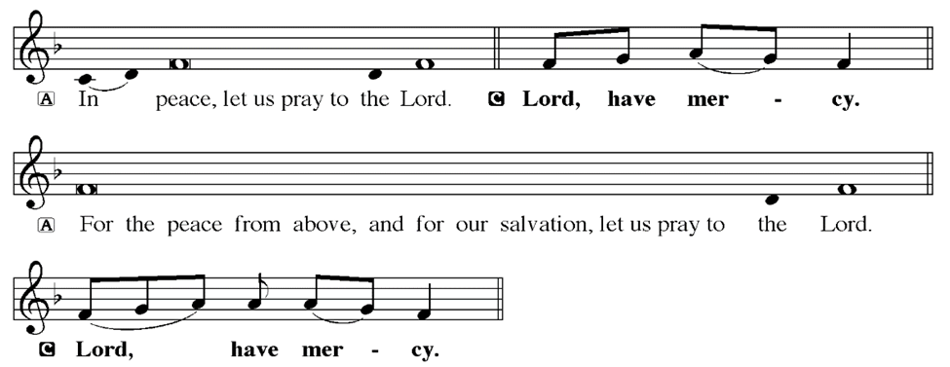
KYRIE
Notes:
Image: Five Loaves by Caroline Coolidge Brown. Copyright © Caroline Coolidge Brown. All rights reserved. Used by permission of the artist.

Slide 14
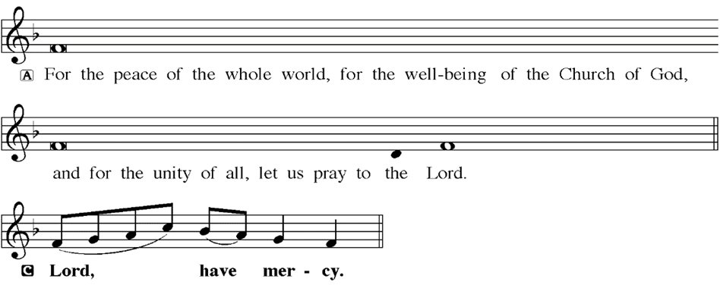
KYRIE
Notes:
Image: Five Loaves by Caroline Coolidge Brown. Copyright © Caroline Coolidge Brown. All rights reserved. Used by permission of the artist.

Slide 15
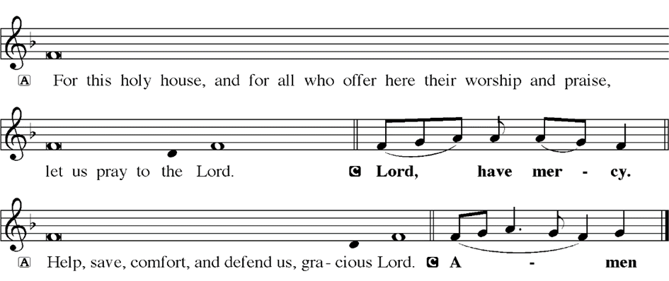
KYRIE
Notes:
Image: Five Loaves by Caroline Coolidge Brown. Copyright © Caroline Coolidge Brown. All rights reserved. Used by permission of the artist.

Slide 16
HYMN OF PRAISE
Glory be to God in heaven;
peace, goodwill to all the earth.
Mighty God of all creation,
Father of surpassing worth:
we exalt you, we adore you,
we lift high our thanks and praise.
Saints and angels bow before you; here on earth our songs we raise.
Notes:
Image: Five Loaves by Caroline Coolidge Brown. Copyright © Caroline Coolidge Brown. All rights reserved. Used by permission of the artist.

Slide 17
HYMN OF PRAISE
Glory be to Christ forever,
Lamb of God and Lord of love.
Son of God and gracious Savior, you have come from heav’n above;
on the cross you died to save us; now you reign at God’s right hand.
Hear our prayer; restore, forgive us; in your promise firm we stand.
Notes:
Image: Five Loaves by Caroline Coolidge Brown. Copyright © Caroline Coolidge Brown. All rights reserved. Used by permission of the artist.

Slide 18
HYMN OF PRAISE
Holy One we now acclaim you;
Lord alone, to you we call;
Holy One in faith we name you,
God most high, yet near to all:
Jesus Christ, with God the Spirit,
in the Father’s splendor bright.
For the peace that we inherit,
glory be to God on high!
Notes:
Image: Five Loaves by Caroline Coolidge Brown. Copyright © Caroline Coolidge Brown. All rights reserved. Used by permission of the artist.

Slide 19
PRAYER OF THE DAY
P: Let us pray… Almighty God, even Jesus became angry at the sight of injustice being done in your name. Rouse us from our complacency and spur us to action on behalf of the poor, the marginalized, and the disabled, for the sake of Jesus Christ, who calls us to follow him. In his name we pray.
C: Amen
Notes:
Image: Five Loaves by Caroline Coolidge Brown. Copyright © Caroline Coolidge Brown. All rights reserved. Used by permission of the artist.

Slide 20

Notes:
Image: Five Loaves by Caroline Coolidge Brown. Copyright © Caroline Coolidge Brown. All rights reserved. Used by permission of the artist.

Slide 21
Scripture Reading
L: Our scripture reading is from the Gospel of John, Chapter 2.
C: Glory to you O’ Lord!
Notes:
Image: Five Loaves by Caroline Coolidge Brown. Copyright © Caroline Coolidge Brown. All rights reserved. Used by permission of the artist.

Slide 22
John 2:13-25
¹³The Passover of the Jews was near, and Jesus went up to Jerusalem. ¹⁴In the temple he found people selling cattle, sheep, and doves, and the money changers seated at their tables. ¹⁵Making a whip of cords, he drove all of them out of the temple, both the sheep and the cattle. He also poured out the coins of the money changers and overturned
Notes:
Image: Five Loaves by Caroline Coolidge Brown. Copyright © Caroline Coolidge Brown. All rights reserved. Used by permission of the artist.

Slide 23
John 2:13-25
their tables. ¹⁶He told those who were selling the doves, “Take these things out of here! Stop making my Father’s house a marketplace!” ¹⁷His disciples remembered that it was written, “Zeal for your house will consume me.” ¹⁸The Jews then said to him, “What sign can you show us for doing this?” ¹⁹Jesus answered them, “Destroy this temple, and in three
Notes:
Image: Five Loaves by Caroline Coolidge Brown. Copyright © Caroline Coolidge Brown. All rights reserved. Used by permission of the artist.

Slide 24
John 2:13-25
days I will raise it up.” ²⁰The Jews then said, “This temple has been under construction for forty-six years, and will you raise it up in three days?” ²¹But he was speaking of the temple of his body. ²²After he was raised from the dead, his disciples remembered that he had said this; and they believed the scripture and the word that Jesus had spoken.
Notes:
Image: Five Loaves by Caroline Coolidge Brown. Copyright © Caroline Coolidge Brown. All rights reserved. Used by permission of the artist.

Slide 25
John 2:13-25
²³When he was in Jerusalem during the Passover festival, many believed in his name because they saw the signs that he was doing. ²⁴But Jesus on his part would not entrust himself to them, because he knew all people ²⁵and needed no one to testify about anyone; for he himself knew what was in everyone.
Notes:
Image: Five Loaves by Caroline Coolidge Brown. Copyright © Caroline Coolidge Brown. All rights reserved. Used by permission of the artist.

Slide 26
John 2:13-25
R: This is the Word of the Lord.
C: Praise to You, O Christ
Notes:
Image: Five Loaves by Caroline Coolidge Brown. Copyright © Caroline Coolidge Brown. All rights reserved. Used by permission of the artist.

Slide 27
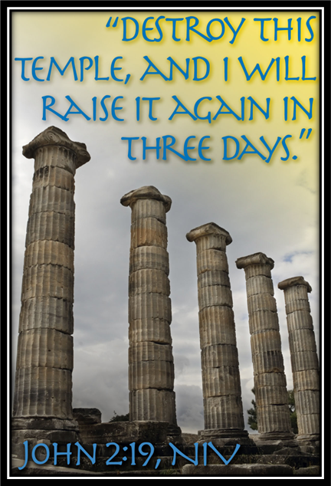
Sermon

Slide 28
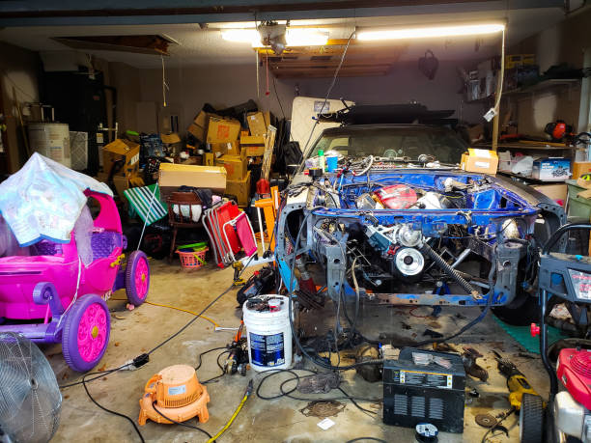
Sermon
Not my garage…
But it could be…

Slide 29
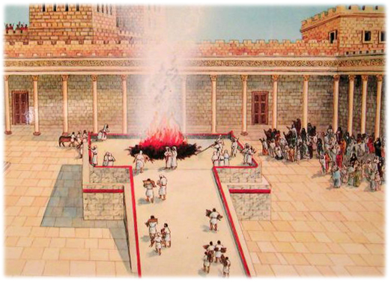
Sermon

Slide 30
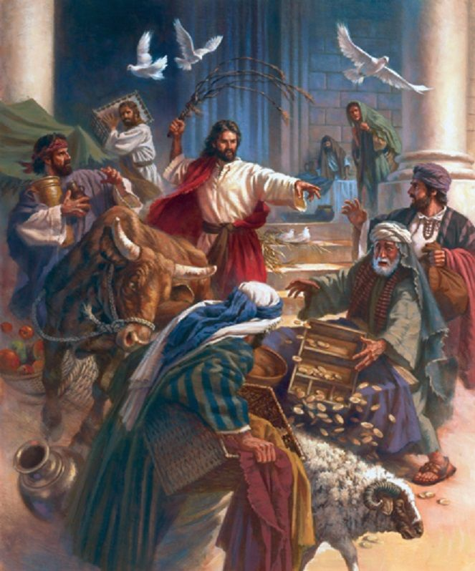
Sermon

Slide 31
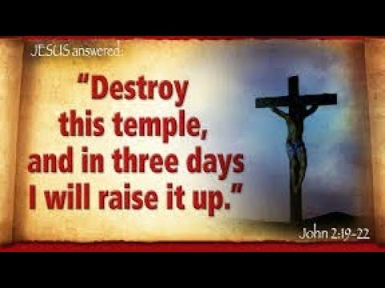
Sermon

Slide 32
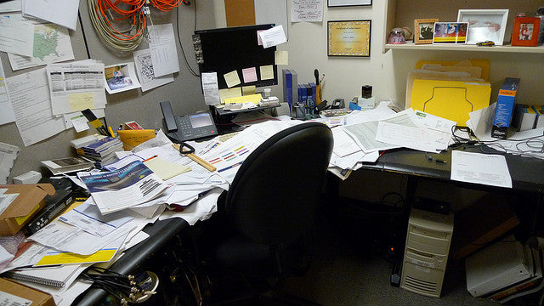
Sermon
Not my office…
But it could be…

Slide 33
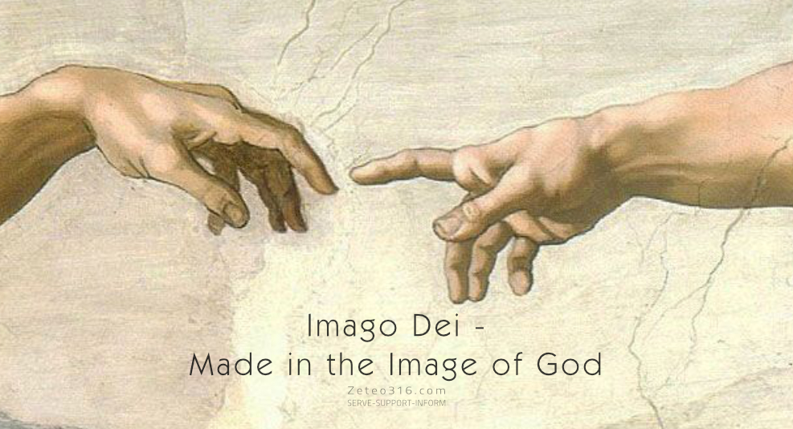
Sermon

Slide 34
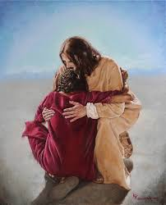
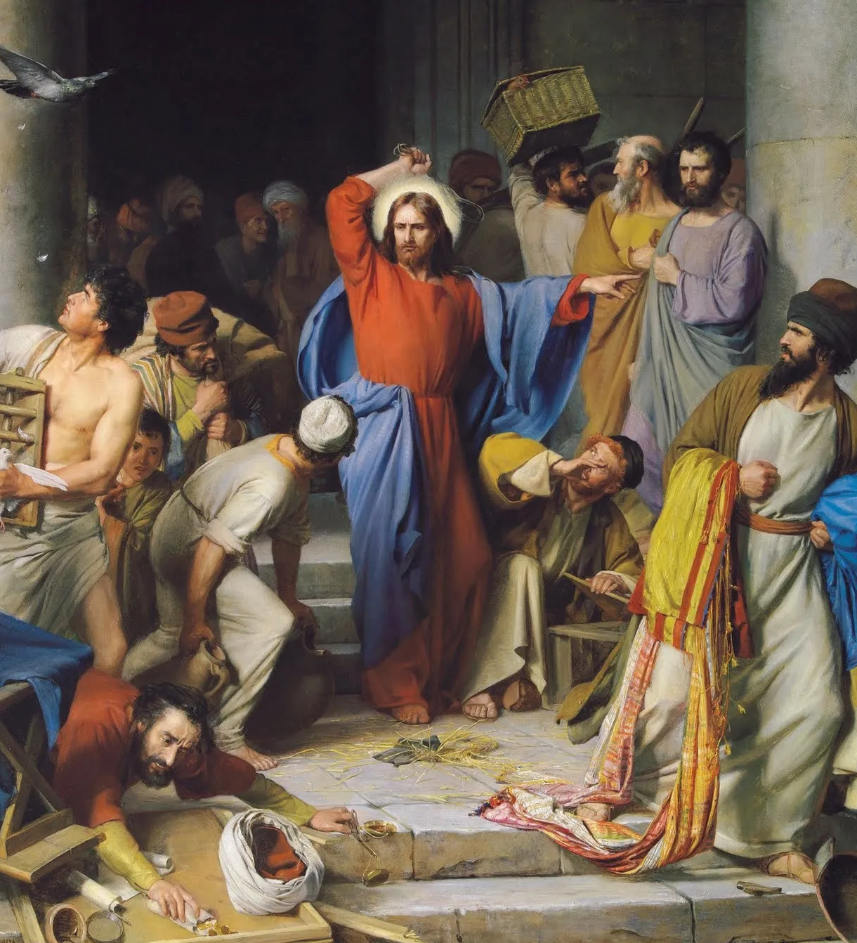
Sermon

Slide 35
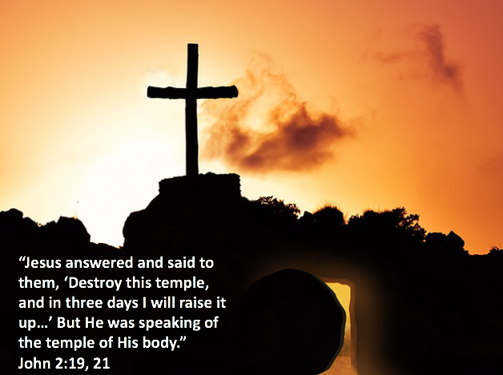
Sermon

Slide 36
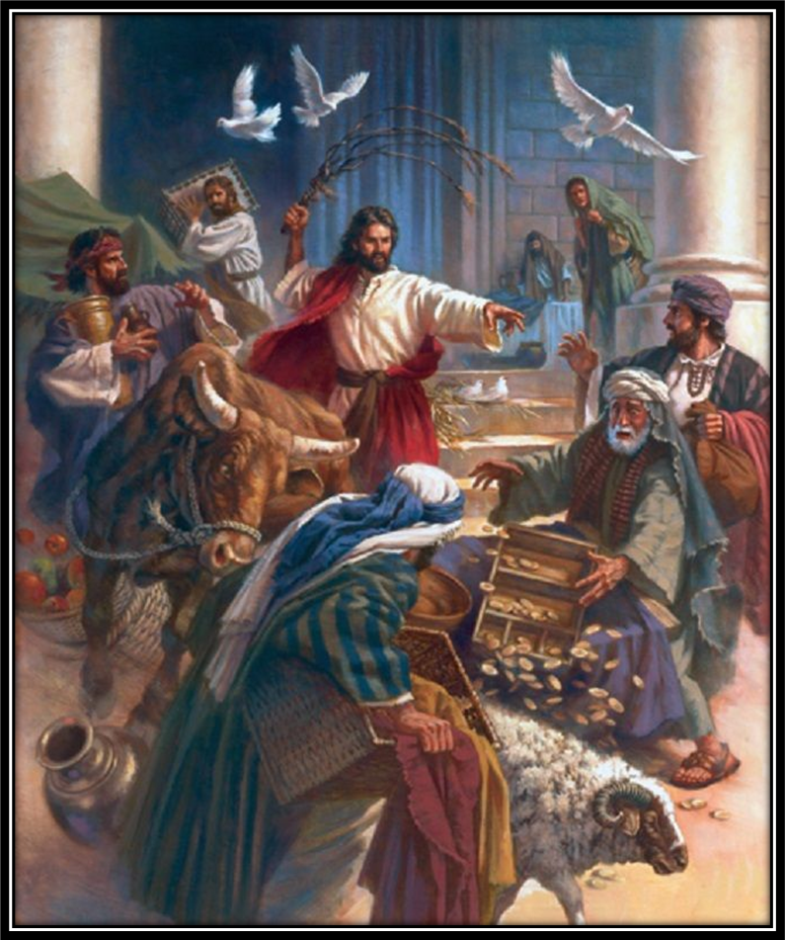
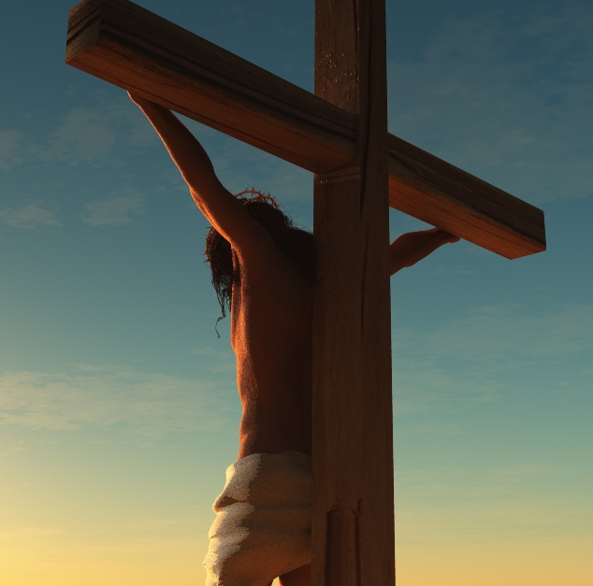
Sermon

Slide 37
Sermon
GOD
Grace
LOVE
Mercy
Humans

Slide 38
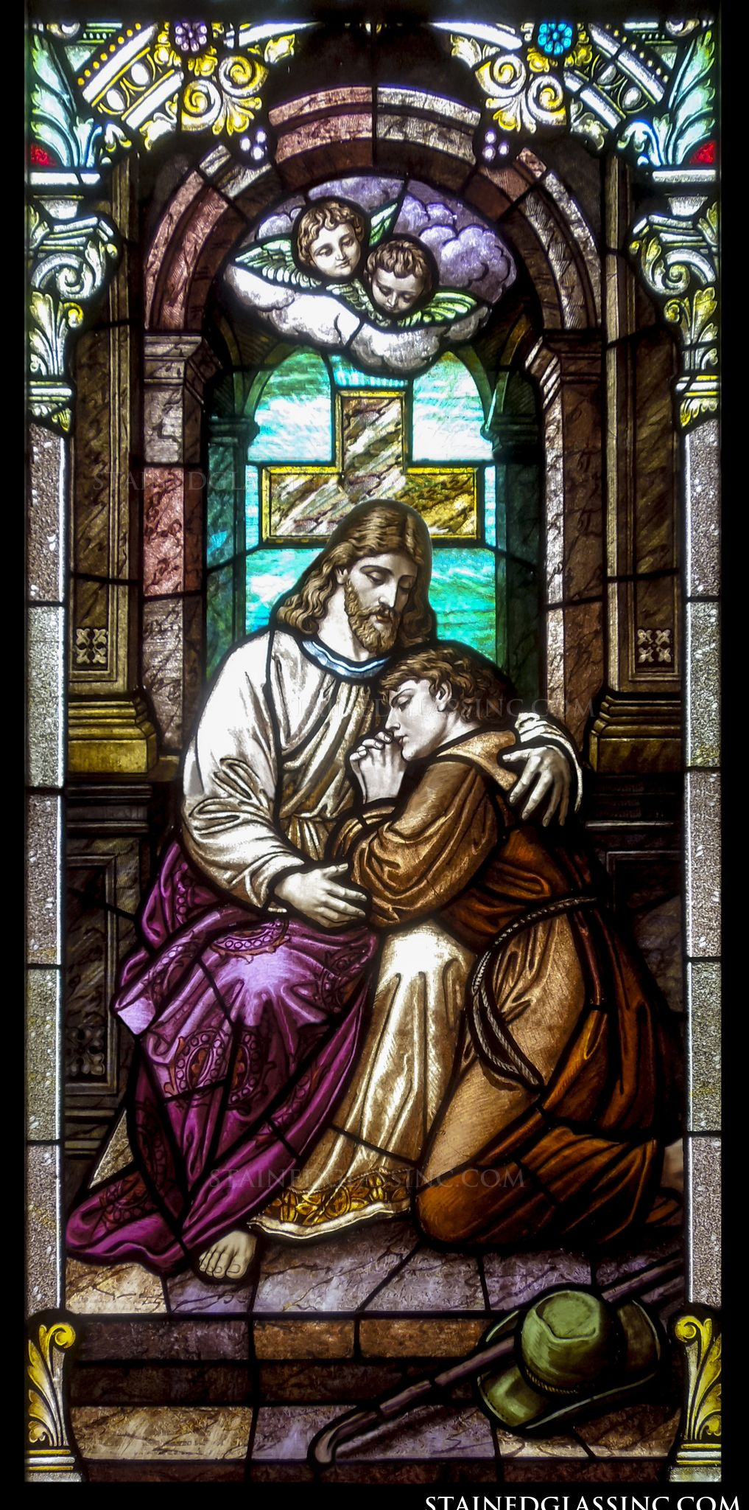
Sermon

Slide 39
APOSTLE’S CREED
C: I believe in God, the Father almighty, creator of heaven and earth.

Slide 40
APOSTLE’S CREED
C: I believe in Jesus Christ, his only Son, our Lord. He was conceived by the power of the Holy Spirit and born of the virgin Mary. He suffered under Pontius Pilate, was crucified, died, and was buried.

Slide 41
APOSTLE’S CREED
C: He descended into hell. On the third day he rose again. He ascended into heaven, and is seated at the right hand of the Father. He will come again to judge the living and the dead.

Slide 42
APOSTLE’S CREED
C: I believe in the Holy Spirit, the holy catholic Church, the communion of saints, the forgiveness of sins, the resurrection of the body, and the life everlasting. Amen.

Slide 43
NICENE CREED
C: We believe in one God, the Father, the Almighty, maker of heaven and earth, of all that is, seen and unseen.

Slide 44
NICENE CREED
C: We believe in one Lord, Jesus Christ, the only Son of God, eternally begotten of the Father, God from God, Light from Light, true God from true God, begotten, not made, of one Being with the Father.

Slide 45
NICENE CREED
C: Through him all things were made. For us and for our salvation he came down from heaven; by the power of the Holy Spirit he became incarnate from the virgin Mary, and was made man. For our sake he was crucified under Pontius Pilate;

Slide 46
NICENE CREED
C: he suffered death and was buried. On the third day he rose again in accordance with the Scriptures; he ascended into heaven and is seated at the right hand of the Father. He will come again in glory to judge the living and the dead, and his kingdom will have no end.

Slide 47
NICENE CREED
C: We believe in the Holy Spirit, the Lord, the giver of life, who proceeds from the Father and the Son. With the Father and the Son he is worshiped and glorified. He has spoken through the prophets. We believe in one holy catholic and apostolic Church.

Slide 48
NICENE CREED
C: We acknowledge one Baptism for the forgiveness of sins. We look for the resurrection of the dead, and the life of the world to come. Amen.

Slide 49
PRAYERS
Each petition will end with the words,
A: God of light,
C: Hear our prayers.

Slide 50
PRAYERS OF INTERCESSION
The prayer concludes…
P: We lift these prayers and those of our hearts into your care, through Jesus Christ our light and our life.
C: Amen.

Slide 51
OFFERING - OFFERING PRAYER
Notes:
Image: Five Loaves by Caroline Coolidge Brown. Copyright © Caroline Coolidge Brown. All rights reserved. Used by permission of the artist.

Slide 52
THE GREAT THANKSGIVING
All the Baptized are welcome to celebrate this Holy Meal.

Slide 53
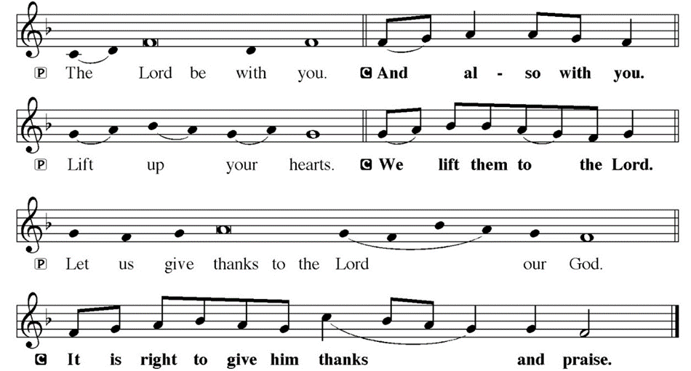
DIALOGUE

Slide 54
THE PREFACE
P: It is indeed right and salutary…
… we praise your name and join their unending hymn.

Slide 55
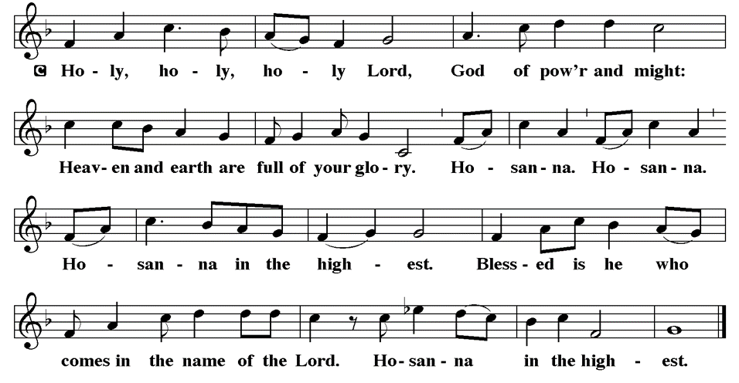
THE SANCTUS

Slide 56
EUCHARISTIC PRAYER
P: Blessed are you, O holy God…
…both now and forever.
C: Amen.

Slide 57
THE LORD’S PRAYER
C: Our Father, who art in heaven, hallowed be thy name, thy kingdom come, thy will be done, on earth as it is in heaven. Give us this day our daily bread; and forgive us our trespasses, as we forgive those who trespass against us; and lead us not into temptation, but deliver us from evil.

Slide 58
THE LORD’S PRAYER
C: For thine is the kingdom, and the power, and the glory, forever and ever. Amen.

Slide 59
INVITATION TO COMMUNION
P: The one who makes God’s house a place of worship makes this table a place of mercy and grace. Come into Jesus’ presence and be nourished, forgiven, and strengthened for all that is to come.

Slide 60
COMMUNION DISTRIBUTION
All may commune “By Station”.
The bread may be broken for distribution. As the ministers give the bread and wine, they say these words :
The body of Christ, given for you.
The blood of Christ, shed for you.
The communicant may say: Amen.

Slide 61
POST COMMUNION BLESSING
P: May this body and blood of our Lord and Savior, Jesus Christ, strengthen, keep and unite us, ☩ now and forever, amen.

Slide 62
POST COMMUNION CANTACLE

Slide 63
POST COMMUNION CANTACLE

Slide 64
POST COMMUNION PRAYER
P: Let us pray… Radiant God, we have seen your glory in the face of Jesus Christ. In the sacrament of his body and blood you have drawn us to your heart. Send us from this table with delight. May our lives reflect the beauty of your love, and bear witness to all we have seen and heard, through Jesus Christ, our Lord.
C: Amen.

Slide 65
SENDING OF HOMEBOUND COMMUNION
P: Gracious God, whose mercy endures from generation to generation: bless those who go forth to share your word and sacrament with our sisters and brothers who are sick or homebound.

Slide 66
SENDING OF HOMEBOUND COMMUNION
P: In your love and care, nourish and strengthen those to whom we bring this communion, that through the body and blood of your Son we may all know the hope of your promised coming in Jesus Christ our Lord.
C: Amen.

Slide 67
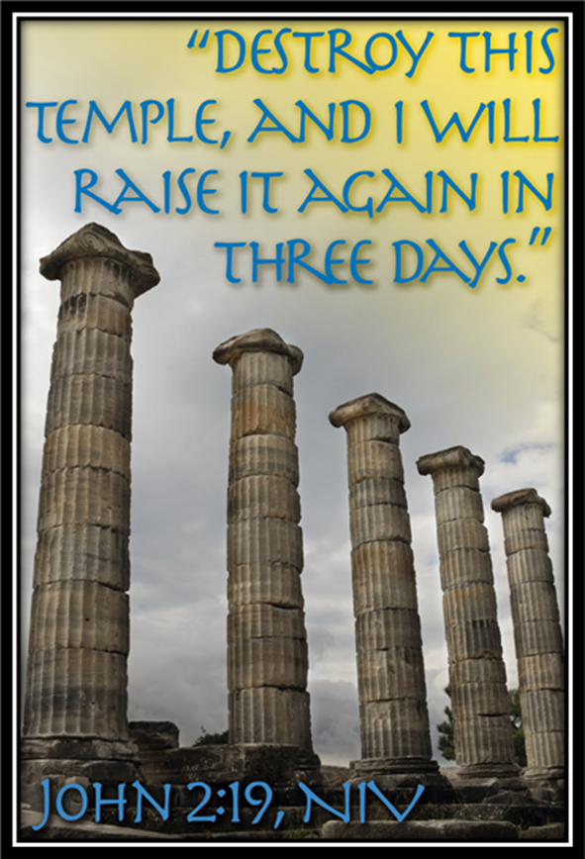
ANNOUNCEMENTS
Notes:
Image: Five Loaves by Caroline Coolidge Brown. Copyright © Caroline Coolidge Brown. All rights reserved. Used by permission of the artist.

Slide 68
SENDING BLESSING
P: May the triune God, who has put a new song in your mouth and tuned your heart for praise ☩ bless you now and forever.
C: Amen.

Slide 69
Sending Song
“Stand Up, Stand Up for Jesus”
LBW 389
Notes:
Image: Five Loaves by Caroline Coolidge Brown. Copyright © Caroline Coolidge Brown. All rights reserved. Used by permission of the artist.

Slide 70
“Stand Up, Stand Up for Jesus” LBW 389
1 Stand up, stand up for Jesus,
as soldiers of the cross,
lift high his royal banner;
it must not suffer loss.
From vict’ry unto vict’ry
his army he shall lead,
till ev’ry foe is vanquished
and Christ is Lord indeed.
Notes:
Image: Preparing yeast dough. Copyright © tomasworks/iStock/Thinkstock. Used by permission.

Slide 71
“Stand Up, Stand Up for Jesus” LBW 389
2 Stand up, stand up for Jesus;
the trumpet call obey;
stand forth in mighty conflict
in this his glorious day.
Let all his faithful serve him
against unnumbered foes;
let courage rise with danger,
and strength to strength oppose.
Notes:
Image: Preparing yeast dough. Copyright © tomasworks/iStock/Thinkstock. Used by permission.

Slide 72
“Stand Up, Stand Up for Jesus” LBW 389
3 Stand up, stand up for Jesus,
stand in his strength alone;
the arm of flesh will fail you,
you dare not trust your own.
Put on the gospel armor;
each piece put on with prayer.
Where duty calls or danger,
be never wanting there.
Notes:
Image: Preparing yeast dough. Copyright © tomasworks/iStock/Thinkstock. Used by permission.

Slide 73
“Stand Up, Stand Up for Jesus” LBW 389
4 Stand up, stand up for Jesus,
the strife will not be long;
this day the din of battle,
the next the victor’s song.
The soldiers, overcoming,
their crown of life shall see,
and with the King of glory
shall reign eternally.
Notes:
Image: Preparing yeast dough. Copyright © tomasworks/iStock/Thinkstock. Used by permission.

Slide 74
DISMISSAL
P: … Depart in Christ’s Love.
C: Seeking, welcoming, and serving all. Amen!
POSTLUDE
By
Roxanne Groff
From sundaysandseasons.com. Copyright © 2026 Augsburg Fortress. All rights reserved. Reprinted by permission under Augsburg Fortress Liturgies Annual License #SAS023830. New Revised Standard Version Bible, Copyright © 1989, Division of Christian Education of the National Council of the Churches of Christ in the United States of America. Used by permission. All rights reserved. Revised Common Lectionary, Copyright © 1992 Consultation on Common Texts, admin Augsburg Fortress. Used by permission.

