Slide 1
First Sunday of Advent December 3, 2023
WELCOME!
Trinity Lutheran Church
Notes:
Image: Five Loaves by Caroline Coolidge Brown. Copyright © Caroline Coolidge Brown. All rights reserved. Used by permission of the artist.

Slide 2
= Please stand if able
= Please be seated
Prelude - By Roxanne Groff
Office of the Acolyte
Ringing of the Bell
Welcome

Slide 3
Lighting of the Advent Wreath
R: Jeremiah proclaims the promise:
C: The days are surely coming, says the Lord.
R: I will appoint a righteous ruler and my people will be saved.
(light candle 1)
C: This is the candle of hope, and it illuminates God’s promise
Notes:
Image: Preparing yeast dough. Copyright © tomasworks/iStock/Thinkstock. Used by permission.

Slide 4
THANKSGIVING FOR BAPTISM
All may make the sign of the cross, the sign marked at baptism, as the presiding minister begins.
P: Blessed be the holy Trinity, ☩ one God, the fountain of living water, the rock who gave us birth, our light and our salvation.
C: Amen.
Notes:
Image: Preparing yeast dough. Copyright © tomasworks/iStock/Thinkstock. Used by permission.

Slide 5
P: Joined to Christ in the waters of baptism, we are clothed with God's mercy and forgiveness. Let us give thanks for the gift of baptism. Water may be poured into the font as the presiding minister gives thanks.
THANKSGIVING FOR BAPTISM
Notes:
Image: Preparing yeast dough. Copyright © tomasworks/iStock/Thinkstock. Used by permission.

Slide 6
P: We give you thanks, O God, for in the beginning your Spirit moved over the waters and by your Word you created the world, calling forth life in which you took delight. Through the waters of the flood you delivered Noah and his family. Through the sea you led your people Israel from slavery into freedom.
THANKSGIVING FOR BAPTISM
Notes:
Image: Preparing yeast dough. Copyright © tomasworks/iStock/Thinkstock. Used by permission.

Slide 7
P: At the river your Son was baptized by John and anointed with the Holy Spirit. By water and your Word you claim us as daughters and sons, making us heirs of your promise and servants of all. We praise you for the gift of water that sustains life, and above all we praise you for the gift of new life in Jesus Christ.
THANKSGIVING FOR BAPTISM
Notes:
Image: Preparing yeast dough. Copyright © tomasworks/iStock/Thinkstock. Used by permission.

Slide 8
P: Shower us with your Spirit, and renew our lives with your forgiveness, grace, and love. To you be given honor and praise through Jesus Christ our Lord in the unity of the Holy Spirit, now and forever.
THANKSGIVING FOR BAPTISM
C: Amen.
Notes:
Image: Preparing yeast dough. Copyright © tomasworks/iStock/Thinkstock. Used by permission.

Slide 9
CONFESSION AND FORGIVENESS
All may make the sign of the cross, the sign marked at baptism…
P: We confess our sins before God and one another.
Pause for silence and reflection.
P: Ever-present God,
Notes:
Image: Five Loaves by Caroline Coolidge Brown. Copyright © Caroline Coolidge Brown. All rights reserved. Used by permission of the artist.

Slide 10
CONFESSION AND FORGIVENESS
C: We come before you in need of grace. Too often our thoughts are judgmental and condemning of others. Too often our words are sarcastic or harsh, as harmful as weapons. Too often our actions are motivated by selfishness and we do not recognize the hurt or need in others.
Notes:
Image: Five Loaves by Caroline Coolidge Brown. Copyright © Caroline Coolidge Brown. All rights reserved. Used by permission of the artist.

Slide 11
CONFESSION AND FORGIVENESS
C: Forgive us, O God, and draw us back into right relationship with you, our neighbors, and your creation.
Notes:
Image: Five Loaves by Caroline Coolidge Brown. Copyright © Caroline Coolidge Brown. All rights reserved. Used by permission of the artist.

Slide 12
CONFESSION AND FORGIVENESS
P: The promise is sure: Christ’s advent is near, and in Christ we are forgiven all our sin. Know that you are a beloved child of God, and be strengthened in all goodness.
C: Amen.
Notes:
Image: Five Loaves by Caroline Coolidge Brown. Copyright © Caroline Coolidge Brown. All rights reserved. Used by permission of the artist.

Slide 13
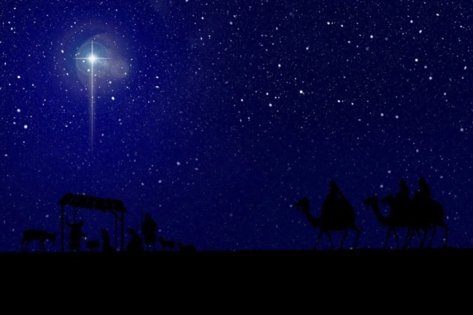
Gathering Song/Hymn of Praise
“Oh, Come, Oh, Come, Emmanuel”
LBW 34

Slide 14
“Oh, Come, Oh, Come, Emmanuel” LBW 34
1 Oh, come, oh, come, Emmanuel,
and ransom captive Israel,
that mourns in lonely exile here
until the Son of God appear.
Refrain
Rejoice! Rejoice! Emmanuel
shall come to you, O Israel.

Slide 15
“Oh, Come, Oh, Come, Emmanuel” LBW 34
2 Oh, come, oh, come, great Lord of might,
who to your tribes on Sinai’s height
in ancient times once gave the law
in cloud, and majesty, and awe.
Refrain
Rejoice! Rejoice! Emmanuel
shall come to you, O Israel.

Slide 16
“Oh, Come, Oh, Come, Emmanuel” LBW 34
3 Oh, come, strong Branch of Jesse, free
your own from Satan’s tyranny;
from depths of hell your people save
and give them vict’ry o’er the grave.
Refrain
Rejoice! Rejoice! Emmanuel
shall come to you, O Israel.

Slide 17
“Oh, Come, Oh, Come, Emmanuel” LBW 34
4 Oh, come, blest Dayspring, come and cheer
our spirits by your advent here;
disperse the gloomy clouds of night,
and death’s dark shadows put to flight.
Refrain
Rejoice! Rejoice! Emmanuel
shall come to you, O Israel.

Slide 18
“Oh, Come, Oh, Come, Emmanuel” LBW 34
5 Oh, come, O Key of David, come,
and open wide our heav’nly home;
make safe the way that leads on high,
and close the path to misery.
Refrain
Rejoice! Rejoice! Emmanuel
shall come to you, O Israel.

Slide 19
APOSTOLIC GREETING
P: The grace of our Lord Jesus Christ, the love of God, and the communion of the Holy Spirit be with you all.
C: And also with you.
Notes:
Image: Five Loaves by Caroline Coolidge Brown. Copyright © Caroline Coolidge Brown. All rights reserved. Used by permission of the artist.

Slide 20
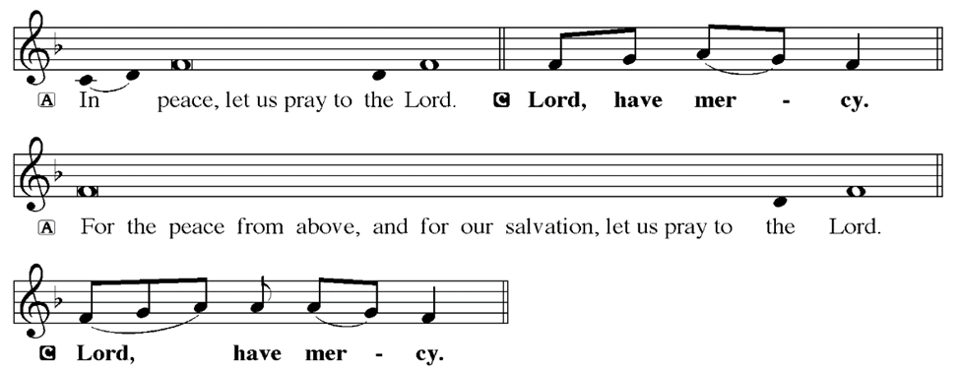
KYRIE
Notes:
Image: Five Loaves by Caroline Coolidge Brown. Copyright © Caroline Coolidge Brown. All rights reserved. Used by permission of the artist.

Slide 21
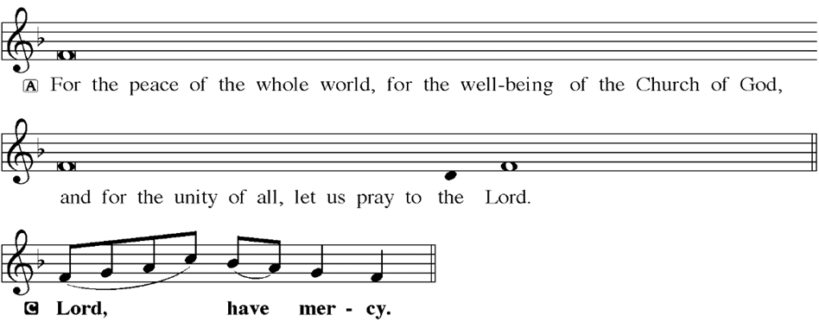
KYRIE
Notes:
Image: Five Loaves by Caroline Coolidge Brown. Copyright © Caroline Coolidge Brown. All rights reserved. Used by permission of the artist.

Slide 22
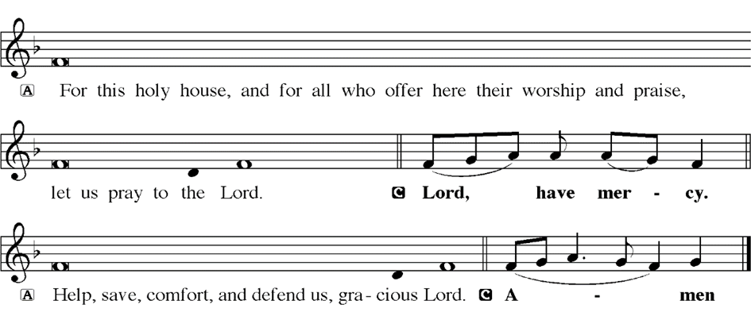
KYRIE
Notes:
Image: Five Loaves by Caroline Coolidge Brown. Copyright © Caroline Coolidge Brown. All rights reserved. Used by permission of the artist.

Slide 23
HYMN OF PRAISE
Glory be to God in heaven;
peace, goodwill to all the earth.
Mighty God of all creation,
Father of surpassing worth:
we exalt you, we adore you,
we lift high our thanks and praise.
Saints and angels bow before you; here on earth our songs we raise.
Notes:
Image: Five Loaves by Caroline Coolidge Brown. Copyright © Caroline Coolidge Brown. All rights reserved. Used by permission of the artist.

Slide 24
HYMN OF PRAISE
Glory be to Christ forever,
Lamb of God and Lord of love.
Son of God and gracious Savior, you have come from heav’n above;
on the cross you died to save us; now you reign at God’s right hand.
Hear our prayer; restore, forgive us; in your promise firm we stand.
Notes:
Image: Five Loaves by Caroline Coolidge Brown. Copyright © Caroline Coolidge Brown. All rights reserved. Used by permission of the artist.

Slide 25
HYMN OF PRAISE
Holy One we now acclaim you;
Lord alone, to you we call;
Holy One in faith we name you,
God most high, yet near to all:
Jesus Christ, with God the Spirit,
in the Father’s splendor bright.
For the peace that we inherit,
glory be to God on high!
Notes:
Image: Five Loaves by Caroline Coolidge Brown. Copyright © Caroline Coolidge Brown. All rights reserved. Used by permission of the artist.

Slide 26
PRAYER OF THE DAY
P: Let us pray… God of promise, stir up in us the anticipation of this holy season of waiting. Fill our hearts with hope for the messiah’s coming, and give us patience, for your time is not our time, and we do not know the day or the hour.
C: Amen
Notes:
Image: Five Loaves by Caroline Coolidge Brown. Copyright © Caroline Coolidge Brown. All rights reserved. Used by permission of the artist.

Slide 27
Notes:
Image: Five Loaves by Caroline Coolidge Brown. Copyright © Caroline Coolidge Brown. All rights reserved. Used by permission of the artist.

Slide 28
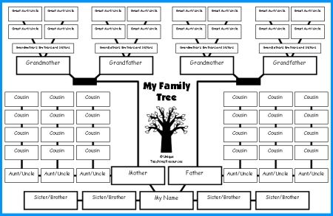
Notes:
Image: Five Loaves by Caroline Coolidge Brown. Copyright © Caroline Coolidge Brown. All rights reserved. Used by permission of the artist.

Slide 29
Scripture Reading
L: Our scripture reading is from the prophet Jeremiah, the 33rd chapter.
C: Glory to you O’ Lord! (Spoken)
Notes:
Image: Five Loaves by Caroline Coolidge Brown. Copyright © Caroline Coolidge Brown. All rights reserved. Used by permission of the artist.

Slide 30
Jeremiah 33:14-18
¹⁴ The days are surely coming, says the Lord, when I will fulfill the promise I made to the house of Israel and the house of Judah. ¹⁵ In those days and at that time I will cause a righteous Branch to spring up for David; and he shall execute justice and righteousness in the land. ¹⁶ In those days Judah will be saved and Jerusalem will live in safety. And this
Notes:
Image: Five Loaves by Caroline Coolidge Brown. Copyright © Caroline Coolidge Brown. All rights reserved. Used by permission of the artist.

Slide 31
Jeremiah 33:14-18
is the name by which it will be called: “The Lord is our righteousness.”
¹⁷ For thus says the Lord: David shall never lack a man to sit on the throne of the house of Israel, ¹⁸ and the Levitical priests shall never lack a man in my presence to offer burnt offerings, to make grain offerings, and to make sacrifices for all time.
Notes:
Image: Five Loaves by Caroline Coolidge Brown. Copyright © Caroline Coolidge Brown. All rights reserved. Used by permission of the artist.

Slide 32
Jeremiah 33:14-18
R: This is the Word of the Lord.
C: Praise to You, O Christ (Spoken)
Notes:
Image: Five Loaves by Caroline Coolidge Brown. Copyright © Caroline Coolidge Brown. All rights reserved. Used by permission of the artist.

Slide 33
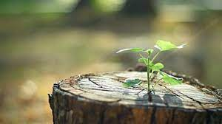
Sermon

Slide 34
Sermon
2014
2017
2023

Slide 35
Sermon

Slide 36
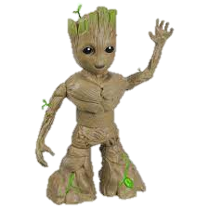
Sermon
I am Groot!

Slide 37
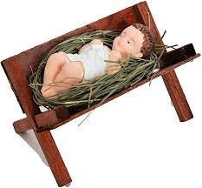
Sermon

Slide 38
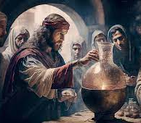
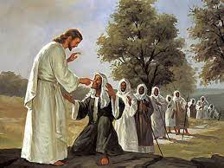
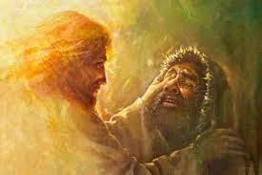
Sermon

Slide 39
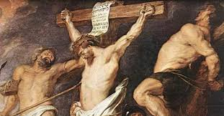
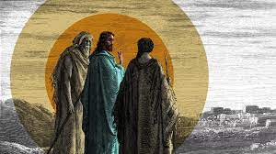
Sermon

Slide 40
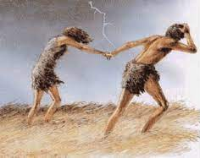
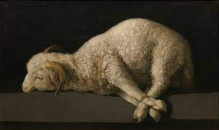
Sermon

Slide 41
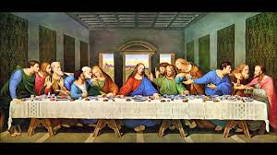
Sermon

Slide 42
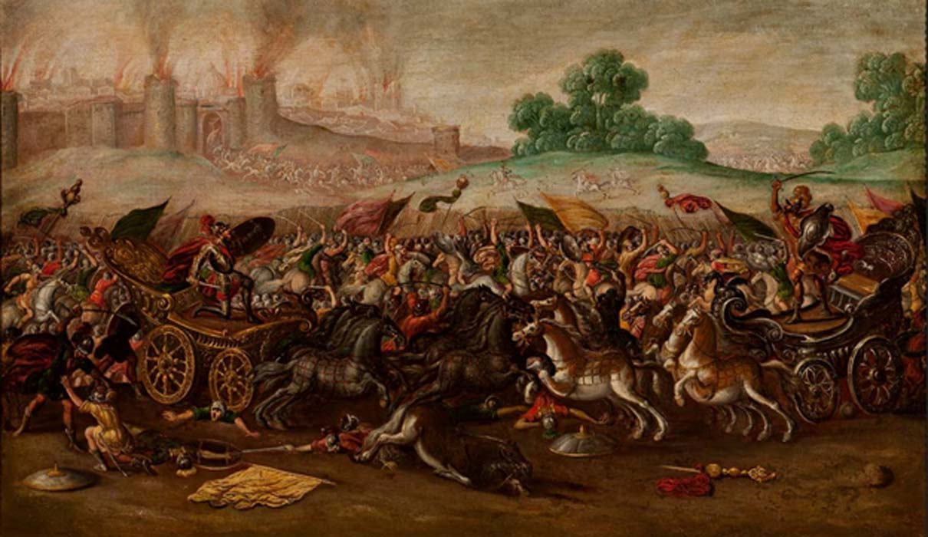
Sermon

Slide 43
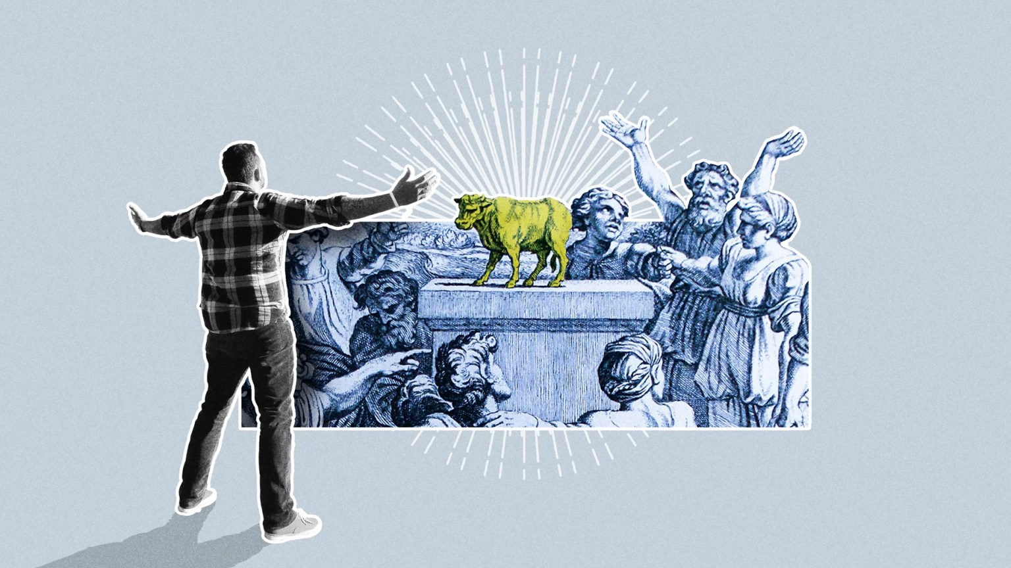
Sermon

Slide 44
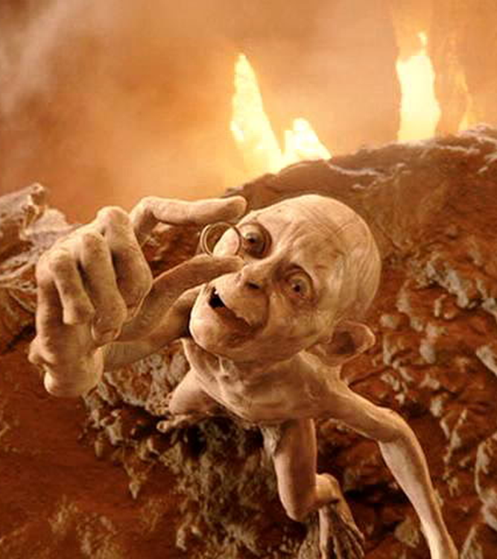
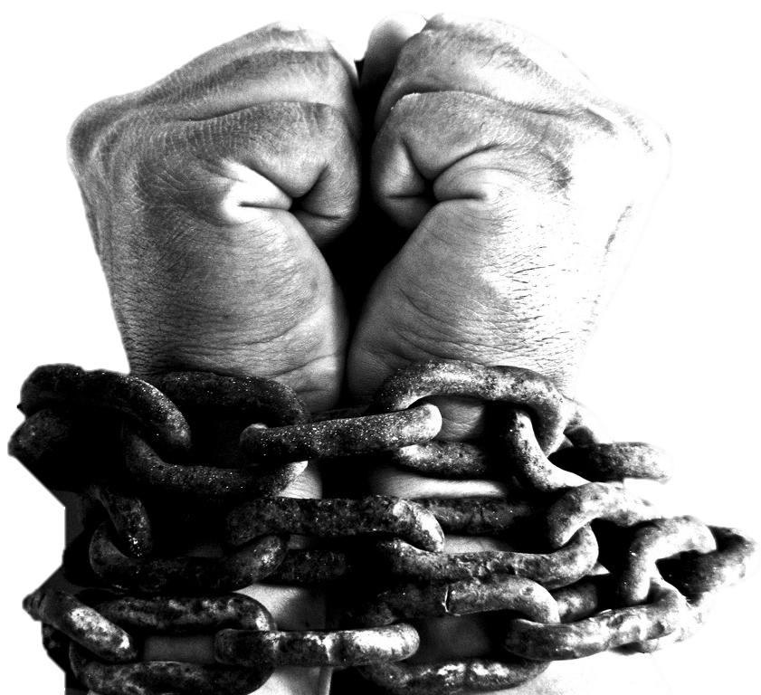
Sermon
We’re bound to our sin, to death, and to the devil…

Slide 45
Sermon

Slide 46
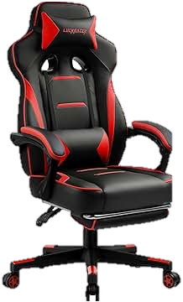
Sermon
His & Hers

Slide 47
Sermon

Slide 48
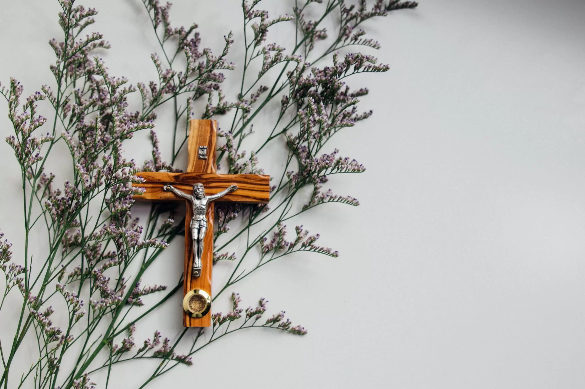
Sermon

Slide 49
Hymn of the Day
XXX

Slide 50
XXX
XXX

Slide 51
APOSTLE’S CREED
C: I believe in God, the Father almighty, creator of heaven and earth.

Slide 52
APOSTLE’S CREED
C: I believe in Jesus Christ, his only Son, our Lord. He was conceived by the power of the Holy Spirit and born of the virgin Mary. He suffered under Pontius Pilate, was crucified, died, and was buried.

Slide 53
APOSTLE’S CREED
C: He descended into hell. On the third day he rose again. He ascended into heaven, and is seated at the right hand of the Father. He will come again to judge the living and the dead.

Slide 54
APOSTLE’S CREED
C: I believe in the Holy Spirit, the holy catholic Church, the communion of saints, the forgiveness of sins, the resurrection of the body, and the life everlasting. Amen.

Slide 55
NICENE CREED
C: We believe in one God, the Father, the Almighty, maker of heaven and earth, of all that is, seen and unseen.

Slide 56
NICENE CREED
C: We believe in one Lord, Jesus Christ, the only Son of God, eternally begotten of the Father, God from God, Light from Light, true God from true God, begotten, not made, of one Being with the Father.

Slide 57
NICENE CREED
C: Through him all things were made. For us and for our salvation he came down from heaven; by the power of the Holy Spirit he became incarnate from the virgin Mary, and was made man. For our sake he was crucified under Pontius Pilate;

Slide 58
NICENE CREED
C: he suffered death and was buried. On the third day he rose again in accordance with the Scriptures; he ascended into heaven and is seated at the right hand of the Father. He will come again in glory to judge the living and the dead, and his kingdom will have no end.

Slide 59
NICENE CREED
C: We believe in the Holy Spirit, the Lord, the giver of life, who proceeds from the Father and the Son. With the Father and the Son he is worshiped and glorified. He has spoken through the prophets. We believe in one holy catholic and apostolic Church.

Slide 60
NICENE CREED
C: We acknowledge one Baptism for the forgiveness of sins. We look for the resurrection of the dead, and the life of the world to come. Amen.

Slide 61
QUILT TYING AND PRESENTATION
This Quilt was lovingly crafted for recovery and healing especially for XXX.
Let us pray…

Slide 62
PRAYERS OF INTERCESSION
Each petition will end with the words,
A: God of Justice,
The congregation will respond with:
C: In mercy, hear our prayer.

Slide 63
PRAYERS OF INTERCESSION
The prayer concludes…
P: We lift all our prayers, spoken and unspoken, into your loving arms, trusting in your love and mercy, through Jesus Christ, our Savior.
C: Amen.

Slide 64
SHARING OF THE Peace
The Sharing of the Peace that began when the congregation arrived is now shared with the Pastor at this time...
P: The peace of the Lord be with you always.
C: And also with you.

Slide 65
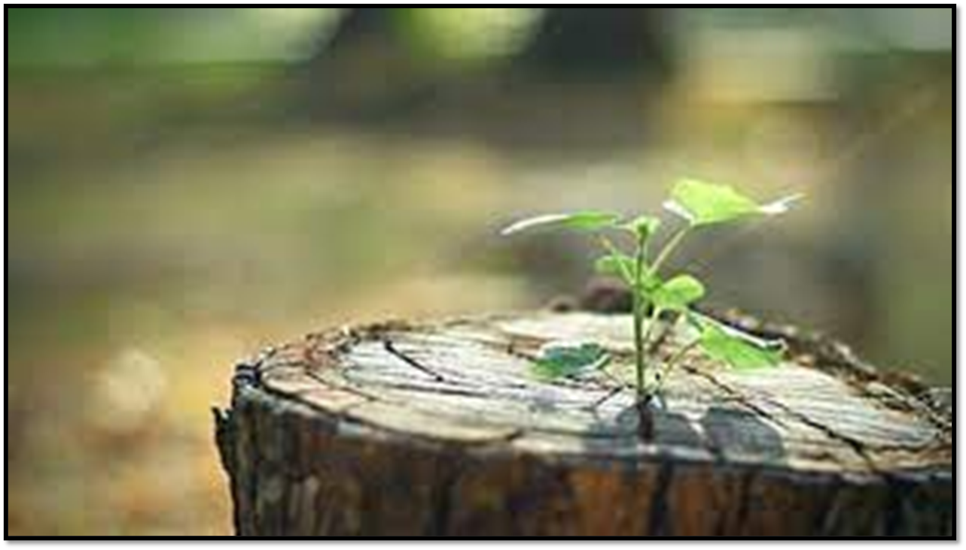
OFFERING
Notes:
Image: Five Loaves by Caroline Coolidge Brown. Copyright © Caroline Coolidge Brown. All rights reserved. Used by permission of the artist.

Slide 66
OFFERING PRAYER
Notes:
Image: Five Loaves by Caroline Coolidge Brown. Copyright © Caroline Coolidge Brown. All rights reserved. Used by permission of the artist.

Slide 67
THE GREAT THANKSGIVING
All the Baptized are welcome to celebrate this Holy Meal.

Slide 68
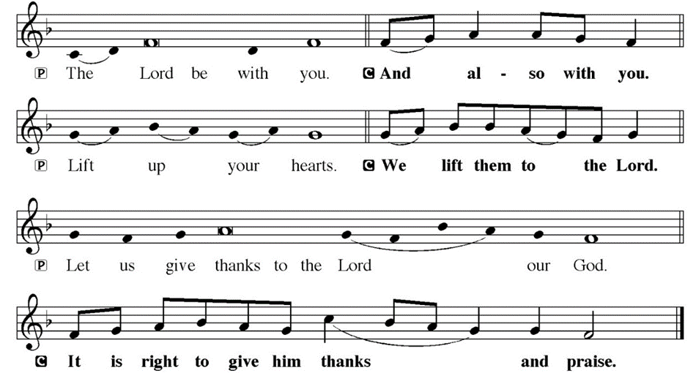
DIALOGUE

Slide 69
THE PREFACE
P: It is indeed right and salutary…
… we praise your name and join their unending hymn.

Slide 70
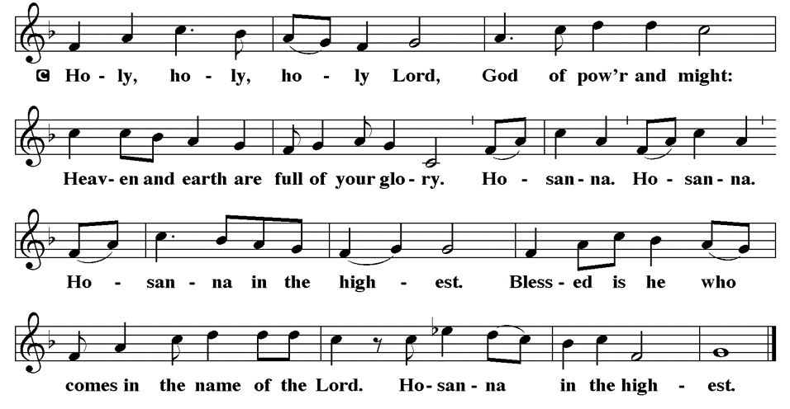
THE SANCTUS

Slide 71
EUCHARISTIC PRAYER
P: Holy God, the beginning and the end…
…both now and forever,
C: Amen.

Slide 72
THE LORD’S PRAYER
C: Our Father, who art in heaven, hallowed be thy name, thy kingdom come, thy will be done, on earth as it is in heaven. Give us this day our daily bread; and forgive us our trespasses, as we forgive those who trespass against us; and lead us not into temptation, but deliver us from evil.

Slide 73
THE LORD’S PRAYER
C: For thine is the kingdom, and the power, and the glory, forever and ever. Amen.

Slide 74
INVITATION TO COMMUNION
P: Christ Jesus, who is the fulfillment of Jeremiah’s prophecy, invites you to feast in his just and holy reign. Come share in the bread and wine that is Christ’s body and blood, and be strengthened for this time of waiting.

Slide 75
COMMUNION DISTRIBUTION
All will commune “At the Rail”.
The bread may be broken for distribution. As the ministers give the bread and wine, they say these words :
The body of Christ, given for you.
The blood of Christ, shed for you.
The communicant may say: Amen.

Slide 76
POST COMMUNION BLESSING
P: May this body and blood of our Lord and Savior, Jesus Christ, strengthen, keep, and unity us, ☩ now and forever,
C: Amen.

Slide 77
POST COMMUNION CANTACLE

Slide 78
POST COMMUNION CANTACLE

Slide 79
POST COMMUNION PRAYER
P: Let us pray… Generous God, in bread and cup you have revealed your glory for all people to see together. Nourished by this meal, send us out to proclaim your good news of liberation and release, brought to birth in Jesus Christ our Savior.
C: Amen.

Slide 80
ANNOUNCEMENTS
Notes:
Image: Five Loaves by Caroline Coolidge Brown. Copyright © Caroline Coolidge Brown. All rights reserved. Used by permission of the artist.

Slide 81
SENDING BLESSING
P: The God of peace bless you, the love of Christ sustain you in hope, and the anointing of the Spirit ☩ remain upon you now and forever.
C: Amen.

Slide 82
Sending Song
“Amazing Grace”
LBW 448
Notes:
Image: Five Loaves by Caroline Coolidge Brown. Copyright © Caroline Coolidge Brown. All rights reserved. Used by permission of the artist.

Slide 83
“Amazing Grace” LBW 448
1 Amazing grace, how sweet the sound,
that saved a wretch like me!
I once was lost, but now am found;
was blind, but now I see.
Notes:
Image: Preparing yeast dough. Copyright © tomasworks/iStock/Thinkstock. Used by permission.

Slide 84
“Amazing Grace” LBW 448
2 ’Twas grace that taught my heart to fear,
and grace my fears relieved;
how precious did that grace appear
the hour I first believed!
Notes:
Image: Preparing yeast dough. Copyright © tomasworks/iStock/Thinkstock. Used by permission.

Slide 85
“Amazing Grace” LBW 448
3 Through many dangers, toils, and snares
I have already come;
’tis grace has brought me safe thus far,
and grace will lead me home.
Notes:
Image: Preparing yeast dough. Copyright © tomasworks/iStock/Thinkstock. Used by permission.

Slide 86
“Amazing Grace” LBW 448
4 The Lord has promised good to me;
his word my hope secures;
he will my shield and portion be
as long as life endures.
Notes:
Image: Preparing yeast dough. Copyright © tomasworks/iStock/Thinkstock. Used by permission.

Slide 87
DISMISSAL
P: … Depart in Christ’s Love.
C: Seeking, welcoming, and serving all. Amen!
POSTLUDE
By
Roxanne Groff
From sundaysandseasons.com. Copyright © 2023 Augsburg Fortress. All rights reserved. Reprinted by permission under Augsburg Fortress Liturgies Annual License #SAS023830. New Revised Standard Version Bible, Copyright © 1989, Division of Christian Education of the National Council of the Churches of Christ in the United States of America. Used by permission. All rights reserved. Revised Common Lectionary, Copyright © 1992 Consultation on Common Texts, admin Augsburg Fortress. Used by permission.

