Slide 1

WELCOME
Trinity Evangelical Lutheran Church
July 21, 2024
Notes:
Image: Five Loaves by Caroline Coolidge Brown. Copyright © Caroline Coolidge Brown. All rights reserved. Used by permission of the artist.

Slide 2
Prelude By Roxanne Groff
= Please stand if able
= Please be seated
Office of the Acolyte and Ringing of the Bell
Welcome
Notes:
Image: Five Loaves by Caroline Coolidge Brown. Copyright © Caroline Coolidge Brown. All rights reserved. Used by permission of the artist.

Slide 3
CONFESSION AND FORGIVENESS
All may make the sign of the cross, the sign marked at baptism…
L: We confess our sins before God and one another.
Pause for silence and reflection.
L: Merciful God,
Notes:
Image: Five Loaves by Caroline Coolidge Brown. Copyright © Caroline Coolidge Brown. All rights reserved. Used by permission of the artist.

Slide 4
CONFESSION AND FORGIVENESS
C: As we stand before you in the all-revealing light of your eternal love, we cannot help but see all the ways we have sinned and fallen short. We have done and said things that have caused harm to others. We have failed to do and say things for the sake of peace and justice. We have continuously sought after our own comfort, rather than your world-transforming love.
Notes:
Image: Five Loaves by Caroline Coolidge Brown. Copyright © Caroline Coolidge Brown. All rights reserved. Used by permission of the artist.

Slide 5
CONFESSION AND FORGIVENESS
C: Forgive us for our selfishness and shortsightedness, and bring us into the way of active love of you and neighbor each new day.
Notes:
Image: Five Loaves by Caroline Coolidge Brown. Copyright © Caroline Coolidge Brown. All rights reserved. Used by permission of the artist.

Slide 6
CONFESSION AND FORGIVENESS
L: The good news is that Jesus died to cleanse us from sin, and because of this, our joy can be complete. Receive the forgiveness of all your sins, ☩ for the sake of Jesus Christ.
C: Amen.
Notes:
Image: Five Loaves by Caroline Coolidge Brown. Copyright © Caroline Coolidge Brown. All rights reserved. Used by permission of the artist.

Slide 7

Gathering Song
Oh, That the Lord Would Guide My Ways
LBW 480
Notes:
Image: Five Loaves by Caroline Coolidge Brown. Copyright © Caroline Coolidge Brown. All rights reserved. Used by permission of the artist.

Slide 8
Oh, That the Lord Would Guide My Ways LBW 480
1 Oh, that the Lord would guide my ways
to keep his statutes still!
Oh, that my God would grant me grace
to know and do his will!
Notes:
Image: Five Loaves by Caroline Coolidge Brown. Copyright © Caroline Coolidge Brown. All rights reserved. Used by permission of the artist.

Slide 9
Oh, That the Lord Would Guide My Ways LBW 480
2 Order my footsteps by your word
and make my heart sincere;
let sin have no dominion, Lord,
but keep my conscience clear.
3 Assist my soul, too apt to stray,
a stricter watch to keep;
and should I e'er forget your way,
restore your wand'ring sheep.
Notes:
Image: Five Loaves by Caroline Coolidge Brown. Copyright © Caroline Coolidge Brown. All rights reserved. Used by permission of the artist.

Slide 10
Oh, That the Lord Would Guide My Ways LBW 480
4 Make me to walk in your commands,
'tis a delightful road;
nor let my head or heart or hands
offend against my God.
Notes:
Image: Five Loaves by Caroline Coolidge Brown. Copyright © Caroline Coolidge Brown. All rights reserved. Used by permission of the artist.

Slide 11
APOSTOLIC GREETING
P: The grace of our Lord Jesus Christ, the love of God, and the communion of the Holy Spirit be with you all.
C: And also with you.
Notes:
Image: Five Loaves by Caroline Coolidge Brown. Copyright © Caroline Coolidge Brown. All rights reserved. Used by permission of the artist.

Slide 12
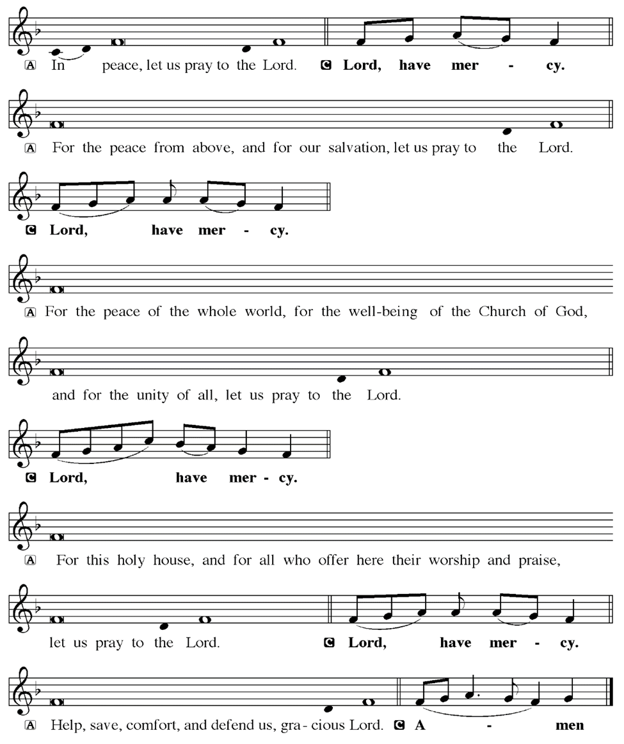
KYRIE
Notes:
Image: Five Loaves by Caroline Coolidge Brown. Copyright © Caroline Coolidge Brown. All rights reserved. Used by permission of the artist.

Slide 13
KYRIE
Notes:
Image: Five Loaves by Caroline Coolidge Brown. Copyright © Caroline Coolidge Brown. All rights reserved. Used by permission of the artist.

Slide 14
KYRIE
Notes:
Image: Five Loaves by Caroline Coolidge Brown. Copyright © Caroline Coolidge Brown. All rights reserved. Used by permission of the artist.

Slide 15
HYMN OF PRAISE
Glory be to God in heaven;
peace, goodwill to all the earth.
Mighty God of all creation,
Father of surpassing worth:
we exalt you, we adore you,
we lift high our thanks and praise.
Saints and angels bow before you; here on earth our songs we raise.
Notes:
Image: Five Loaves by Caroline Coolidge Brown. Copyright © Caroline Coolidge Brown. All rights reserved. Used by permission of the artist.

Slide 16
HYMN OF PRAISE
Glory be to Christ forever,
Lamb of God and Lord of love.
Son of God and gracious Savior, you have come from heav’n above;
on the cross you died to save us; now you reign at God’s right hand.
Hear our prayer; restore, forgive us; in your promise firm we stand.
Notes:
Image: Five Loaves by Caroline Coolidge Brown. Copyright © Caroline Coolidge Brown. All rights reserved. Used by permission of the artist.

Slide 17
HYMN OF PRAISE
Holy One we now acclaim you;
Lord alone, to you we call;
Holy One in faith we name you,
God most high, yet near to all:
Jesus Christ, with God the Spirit,
in the Father’s splendor bright.
For the peace that we inherit,
glory be to God on high!
Notes:
Image: Five Loaves by Caroline Coolidge Brown. Copyright © Caroline Coolidge Brown. All rights reserved. Used by permission of the artist.

Slide 18
PRAYER OF THE DAY
P: Let us pray… God our father, because we love you, we also love Jesus, your beloved son and our sibling. By the power of your Holy Spirit, give us the immovable faith that spurs us to action in love on behalf of all that you have created. Make us living channels for your mercy and healing, that we might bring joy and wholeness to all those we encounter today and every day.
C: Amen
Notes:
Image: Five Loaves by Caroline Coolidge Brown. Copyright © Caroline Coolidge Brown. All rights reserved. Used by permission of the artist.

Slide 19

Notes:
Image: Preparing yeast dough. Copyright © tomasworks/iStock/Thinkstock. Used by permission.

Slide 20
Scripture Reading
R: Our scripture reading for today is from First John, Chapter 5.
C: Glory to you O’ Lord! (Spoken)
Notes:
Image: Five Loaves by Caroline Coolidge Brown. Copyright © Caroline Coolidge Brown. All rights reserved. Used by permission of the artist.

Slide 21
1 John 5:1-6
Everyone who believes that Jesus is the Christ has been born of God, and everyone who loves the parent loves the child. ²By this we know that we love the children of God, when we love God and obey his commandments. ³For the love of God is this, that we obey his commandments. And his commandments are not burdensome, ⁴for whatever is born of God conquers
Notes:
Image: Five Loaves by Caroline Coolidge Brown. Copyright © Caroline Coolidge Brown. All rights reserved. Used by permission of the artist.

Slide 22
1 John 5:1-6
the world. And this is the victory that conquers the world, our faith. ⁵Who is it that conquers the world but the one who believes that Jesus is the Son of God?
⁶This is the one who came by water and blood, Jesus Christ, not with the water only but with the water and the blood. And the Spirit is the one that testifies, for the Spirit is the truth.
Notes:
Image: Five Loaves by Caroline Coolidge Brown. Copyright © Caroline Coolidge Brown. All rights reserved. Used by permission of the artist.

Slide 23
1 John 5:1-6
R: This is the Word of the Lord.
C: Praise to You, O Christ (Spoken)
Notes:
Image: Five Loaves by Caroline Coolidge Brown. Copyright © Caroline Coolidge Brown. All rights reserved. Used by permission of the artist.

Slide 24

SERMON
Notes:
Image: Five Loaves by Caroline Coolidge Brown. Copyright © Caroline Coolidge Brown. All rights reserved. Used by permission of the artist.

Slide 25
• OESTERLEN PRESENTATION Mrs. Julie Barhorst
Notes:
Image: Five Loaves by Caroline Coolidge Brown. Copyright © Caroline Coolidge Brown. All rights reserved. Used by permission of the artist.

Slide 26
APOSTLE’S CREED
C: I believe in God, the Father almighty, creator of heaven and earth.

Slide 27
APOSTLE’S CREED
C: I believe in Jesus Christ, his only Son, our Lord. He was conceived by the power of the Holy Spirit and born of the virgin Mary. He suffered under Pontius Pilate, was crucified, died, and was buried.

Slide 28
APOSTLE’S CREED
C: He descended into hell. On the third day he rose again. He ascended into heaven, and is seated at the right hand of the Father. He will come again to judge the living and the dead.

Slide 29
APOSTLE’S CREED
C: I believe in the Holy Spirit, the holy catholic Church, the communion of saints, the forgiveness of sins, the resurrection of the body, and the life everlasting. Amen.

Slide 30
NICENE CREED
C: We believe in one God, the Father, the Almighty, maker of heaven and earth, of all that is, seen and unseen.

Slide 31
NICENE CREED
C: We believe in one Lord, Jesus Christ, the only Son of God, eternally begotten of the Father, God from God, Light from Light, true God from true God, begotten, not made, of one Being with the Father.

Slide 32
NICENE CREED
C: Through him all things were made. For us and for our salvation he came down from heaven; by the power of the Holy Spirit he became incarnate from the virgin Mary, and was made man. For our sake he was crucified under Pontius Pilate;

Slide 33
NICENE CREED
C: he suffered death and was buried. On the third day he rose again in accordance with the Scriptures; he ascended into heaven and is seated at the right hand of the Father. He will come again in glory to judge the living and the dead, and his kingdom will have no end.

Slide 34
NICENE CREED
C: We believe in the Holy Spirit, the Lord, the giver of life, who proceeds from the Father and the Son. With the Father and the Son he is worshiped and glorified. He has spoken through the prophets. We believe in one holy catholic and apostolic Church.

Slide 35
NICENE CREED
C: We acknowledge one Baptism for the forgiveness of sins. We look for the resurrection of the dead, and the life of the world to come. Amen.

Slide 36
PRAYERS OF INTERCESSION
Each petition will end with the words,
A: God of love,
The congregation will respond with:
C: We lift our prayers to you.

Slide 37
PRAYERS OF INTERCESSION
The prayer concludes…
P: With all our siblings in Christ here and around the world, we lift all our prayers to you, through Jesus Christ our savior and friend.
C: Amen.

Slide 38

OFFERING
Notes:
Image: Five Loaves by Caroline Coolidge Brown. Copyright © Caroline Coolidge Brown. All rights reserved. Used by permission of the artist.

Slide 39
OFFERING PRAYER
Notes:
Image: Five Loaves by Caroline Coolidge Brown. Copyright © Caroline Coolidge Brown. All rights reserved. Used by permission of the artist.

Slide 40
THE GREAT THANKSGIVING
All the Baptized are welcome to celebrate this Holy Meal.

Slide 41
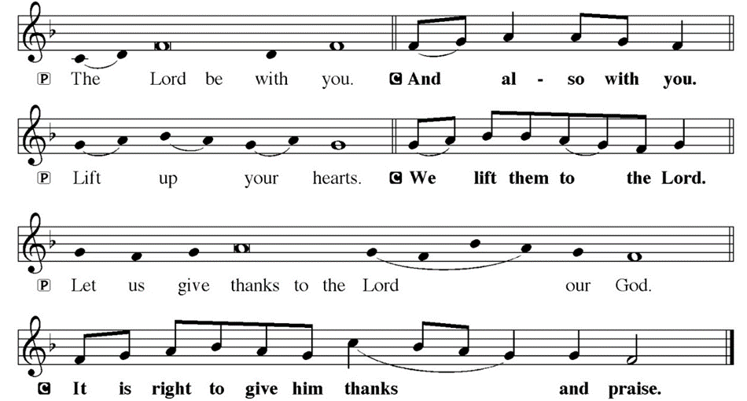
DIALOGUE

Slide 42
THE PREFACE
P: It is indeed right and salutary…
… we praise your name and join their unending hymn.

Slide 43
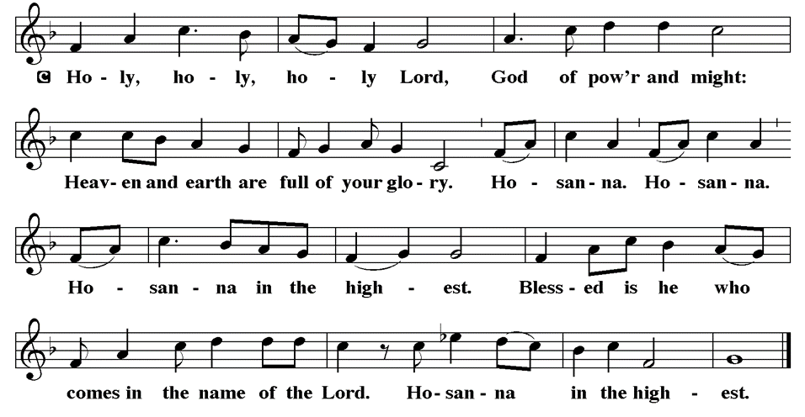
THE SANCTUS

Slide 44
EUCHARISTIC PRAYER
P: Holy God, our maker and redeemer…
…both now and forever.
C: Amen.

Slide 45
THE LORD’S PRAYER
C: Our Father, who art in heaven, hallowed be thy name, thy kingdom come, thy will be done, on earth as it is in heaven. Give us this day our daily bread; and forgive us our trespasses, as we forgive those who trespass against us; and lead us not into temptation, but deliver us from evil.

Slide 46
THE LORD’S PRAYER
C: For thine is the kingdom, and the power, and the glory, forever and ever. Amen.

Slide 47
INVITATION TO COMMUNION
P: Jesus, who is to be found fully present in this bread and wine, now invites you to be nourished on it at this table. Come and be joined with your siblings in Christ throughout time and space in this holy meal.

Slide 48
COMMUNION DISTRIBUTION
All will commune “by Station”.
The bread may be broken for distribution. As the ministers give the bread and wine, they say these words :
The body of Christ, given for you.
The blood of Christ, shed for you.
The communicant may say: Amen.

Slide 49
POST COMMUNION BLESSING
P: May this body and blood of our Lord and Savior, Jesus Christ, strengthen, keep and unite us, ☩ now and forever, amen.
C: Amen.

Slide 50
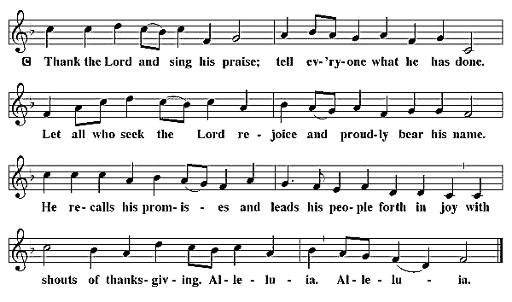
POST COMMUNION CANTACLE

Slide 51
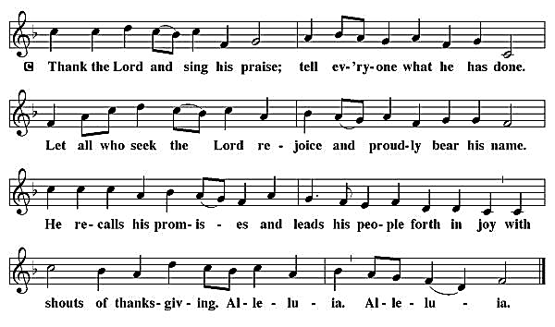
POST COMMUNION CANTACLE

Slide 52
POST COMMUNION PRAYER
P: Let us pray… Jesus, Bread of life, we have received from your table more than we could ever ask. As you have nourished us in this meal, now strengthen us to love the world with your own life. In your name we pray.
C: Amen

Slide 53

ANNOUNCEMENTS
Notes:
Image: Five Loaves by Caroline Coolidge Brown. Copyright © Caroline Coolidge Brown. All rights reserved. Used by permission of the artist.

Slide 54
SENDING BLESSING
P: The blessing of God, who provides for us, feeds us, and journeys with us, ☩ be upon you now and forever.
C: Amen.

Slide 55

Sending Song
“My Faith Looks Up To Thee” LBW 479
Notes:
Image: Five Loaves by Caroline Coolidge Brown. Copyright © Caroline Coolidge Brown. All rights reserved. Used by permission of the artist.

Slide 56
“My Faith Looks Up To Thee” LBW 479
1 My faith looks up to thee,
thou Lamb of Calvary,
Savior divine!
Now hear me while I pray,
take all my guilt away,
oh, let me from this day
be wholly thine!
Notes:
Image: Preparing yeast dough. Copyright © tomasworks/iStock/Thinkstock. Used by permission.

Slide 57
“My Faith Looks Up To Thee” LBW 479
2 May thy rich grace impart
strength to my fainting heart,
my zeal inspire;
as thou hast died for me,
oh, may my love to thee
pure, warm, and changeless be,
a living fire!
Notes:
Image: Preparing yeast dough. Copyright © tomasworks/iStock/Thinkstock. Used by permission.

Slide 58
“My Faith Looks Up To Thee” LBW 479
3 While life's dark maze I tread
and griefs around me spread,
be thou my guide;
bid darkness turn to day,
wipe sorrow's tears away,
nor let me ever stray
from thee aside.
Notes:
Image: Preparing yeast dough. Copyright © tomasworks/iStock/Thinkstock. Used by permission.

Slide 59
“My Faith Looks Up To Thee” LBW 479
4 When ends life's transient dream,
when death's cold, sullen stream
shall o'er me roll;
blest Savior, then, in love
fear and distrust remove;
oh, bear me safe above,
a ransomed soul!
Notes:
Image: Preparing yeast dough. Copyright © tomasworks/iStock/Thinkstock. Used by permission.

Slide 60
DISMISSAL
P: … Depart in Christ’s Love.
C: Seeking, welcoming, and serving all. Amen!
POSTLUDE
By Roxanne Groff
From sundaysandseasons.com. Copyright © 2024 Augsburg Fortress. All rights reserved. Reprinted by permission under Augsburg Fortress Liturgies Annual License #SAS023830. New Revised Standard Version Bible, Copyright © 1989, Division of Christian Education of the National Council of the Churches of Christ in the United States of America. Used by permission. All rights reserved. Revised Common Lectionary, Copyright © 1992 Consultation on Common Texts, admin Augsburg Fortress. Used by permission.

