Slide 1
February 11, 2024
WELCOME!
Trinity
Lutheran Church
Notes:
Image: Five Loaves by Caroline Coolidge Brown. Copyright © Caroline Coolidge Brown. All rights reserved. Used by permission of the artist.

Slide 2
= Please stand if able
= Please be seated
Prelude - By Roxanne Groff
Office of the Acolyte
Ringing of the Bell
Welcome

Slide 3
THANKSGIVING FOR BAPTISM
All may make the sign of the cross, the sign marked at baptism, as the presiding minister begins.
P: Blessed be the holy Trinity, ☩ one God, the fountain of living water, the rock who gave us birth, our light and our salvation.
C: Amen.
Notes:
Image: Preparing yeast dough. Copyright © tomasworks/iStock/Thinkstock. Used by permission.

Slide 4
P: Joined to Christ in the waters of baptism, we are clothed with God's mercy and forgiveness. Let us give thanks for the gift of baptism. Water may be poured into the font as the presiding minister gives thanks.
THANKSGIVING FOR BAPTISM
Notes:
Image: Preparing yeast dough. Copyright © tomasworks/iStock/Thinkstock. Used by permission.

Slide 5
P: We give you thanks, O God, for in the beginning your Spirit moved over the waters and by your Word you created the world, calling forth life in which you took delight. Through the waters of the flood you delivered Noah and his family. Through the sea you led your people Israel from slavery into freedom.
THANKSGIVING FOR BAPTISM
Notes:
Image: Preparing yeast dough. Copyright © tomasworks/iStock/Thinkstock. Used by permission.

Slide 6
P: At the river your Son was baptized by John and anointed with the Holy Spirit. By water and your Word you claim us as daughters and sons, making us heirs of your promise and servants of all. We praise you for the gift of water that sustains life, and above all we praise you for the gift of new life in Jesus Christ.
THANKSGIVING FOR BAPTISM
Notes:
Image: Preparing yeast dough. Copyright © tomasworks/iStock/Thinkstock. Used by permission.

Slide 7
P: Shower us with your Spirit, and renew our lives with your forgiveness, grace, and love. To you be given honor and praise through Jesus Christ our Lord in the unity of the Holy Spirit, now and forever.
THANKSGIVING FOR BAPTISM
C: Amen.
Notes:
Image: Preparing yeast dough. Copyright © tomasworks/iStock/Thinkstock. Used by permission.

Slide 8
CONFESSION AND FORGIVENESS
All may make the sign of the cross, the sign marked at baptism…
L: We confess our sins before God and one another.
Pause for silence and reflection.
L: Guiding God,
Notes:
Image: Five Loaves by Caroline Coolidge Brown. Copyright © Caroline Coolidge Brown. All rights reserved. Used by permission of the artist.

Slide 9
CONFESSION AND FORGIVENESS
C: We have failed to follow you as we ought. We have not reached out to our neighbors with the selfless and sacrificial love you modeled for us. We have caused harm to others and your creation by our actions and by our unwillingness to act.
Notes:
Image: Five Loaves by Caroline Coolidge Brown. Copyright © Caroline Coolidge Brown. All rights reserved. Used by permission of the artist.

Slide 10
CONFESSION AND FORGIVENESS
C: Forgive us our sins and lead us back onto the path you have trod for the sake of others.
Notes:
Image: Five Loaves by Caroline Coolidge Brown. Copyright © Caroline Coolidge Brown. All rights reserved. Used by permission of the artist.

Slide 11
CONFESSION AND FORGIVENESS
L: In Christ, God meets us where we are and as we are and for his sake, God makes us whole and holy. ☩ Go forth to follow Jesus in the knowledge that your sins are forgiven.
C: Amen.
Notes:
Image: Five Loaves by Caroline Coolidge Brown. Copyright © Caroline Coolidge Brown. All rights reserved. Used by permission of the artist.

Slide 12
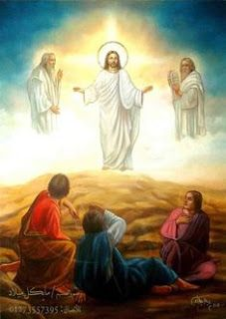
Gathering Song
“How Good Lord To Be Here”
LBW 89

Slide 13
“How Good Lord To Be Here” LBW 89
1 How good, Lord, to be here!
Your glory fills the night;
your face and garments, like the sun,
shine with unborrowed light.
2 How good, Lord, to be here!
your beauty to behold
where Moses and Elijah stand,
your messengers of old.
Notes:
Image: Five Loaves by Caroline Coolidge Brown. Copyright © Caroline Coolidge Brown. All rights reserved. Used by permission of the artist.

Slide 14
“How Good Lord To Be Here” LBW 89
3 Fulfiller of the past
and hope of things to be,
we hail your body glorified
and our redemption see.
4 Before we taste of death,
we see your kingdom come;
we long to hold the vision bright
and make this hill our home.
Notes:
Image: Five Loaves by Caroline Coolidge Brown. Copyright © Caroline Coolidge Brown. All rights reserved. Used by permission of the artist.

Slide 15
“How Good Lord To Be Here” LBW 89
5 How good, Lord, to be here!
Yet we may not remain;
but since you bid us leave the mount,
come with us to the plain.
Notes:
Image: Five Loaves by Caroline Coolidge Brown. Copyright © Caroline Coolidge Brown. All rights reserved. Used by permission of the artist.

Slide 16
APOSTOLIC GREETING
P: The grace of our Lord Jesus Christ, the love of God, and the communion of the Holy Spirit be with you all.
C: And also with you.
Notes:
Image: Five Loaves by Caroline Coolidge Brown. Copyright © Caroline Coolidge Brown. All rights reserved. Used by permission of the artist.

Slide 17
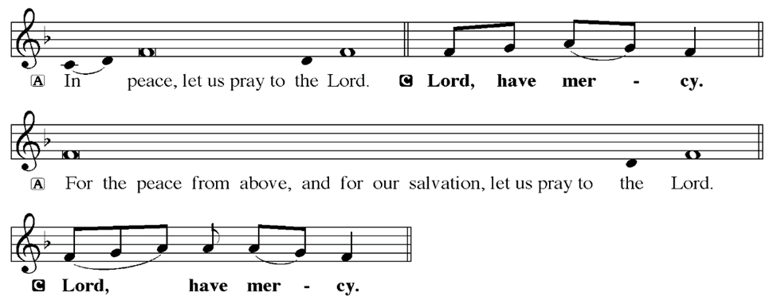
KYRIE
Notes:
Image: Five Loaves by Caroline Coolidge Brown. Copyright © Caroline Coolidge Brown. All rights reserved. Used by permission of the artist.

Slide 18
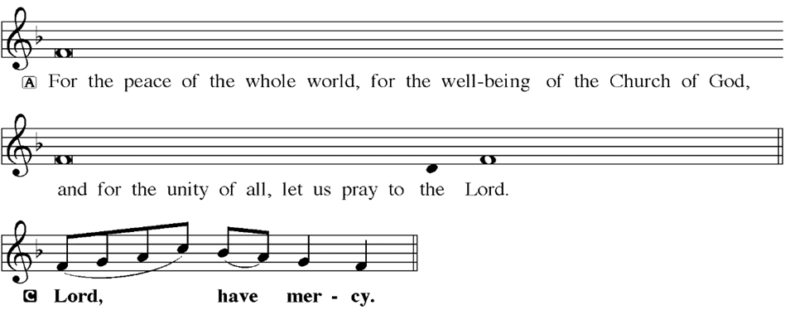
KYRIE
Notes:
Image: Five Loaves by Caroline Coolidge Brown. Copyright © Caroline Coolidge Brown. All rights reserved. Used by permission of the artist.

Slide 19
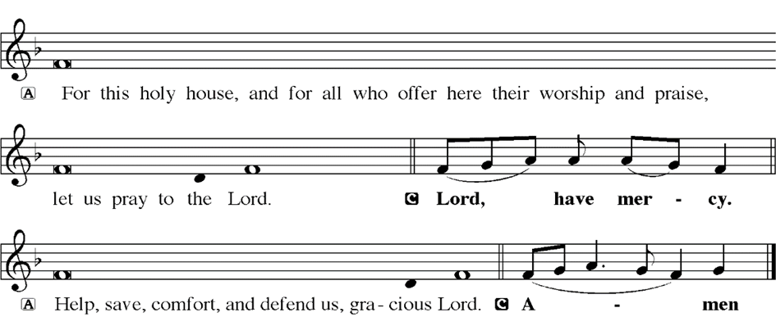
KYRIE
Notes:
Image: Five Loaves by Caroline Coolidge Brown. Copyright © Caroline Coolidge Brown. All rights reserved. Used by permission of the artist.

Slide 20
HYMN OF PRAISE
Glory be to God in heaven;
peace, goodwill to all the earth.
Mighty God of all creation,
Father of surpassing worth:
we exalt you, we adore you,
we lift high our thanks and praise.
Saints and angels bow before you; here on earth our songs we raise.
Notes:
Image: Five Loaves by Caroline Coolidge Brown. Copyright © Caroline Coolidge Brown. All rights reserved. Used by permission of the artist.

Slide 21
HYMN OF PRAISE
Glory be to Christ forever,
Lamb of God and Lord of love.
Son of God and gracious Savior, you have come from heav’n above;
on the cross you died to save us; now you reign at God’s right hand.
Hear our prayer; restore, forgive us; in your promise firm we stand.
Notes:
Image: Five Loaves by Caroline Coolidge Brown. Copyright © Caroline Coolidge Brown. All rights reserved. Used by permission of the artist.

Slide 22
HYMN OF PRAISE
Holy One we now acclaim you;
Lord alone, to you we call;
Holy One in faith we name you,
God most high, yet near to all:
Jesus Christ, with God the Spirit,
in the Father’s splendor bright.
For the peace that we inherit,
glory be to God on high!
Notes:
Image: Five Loaves by Caroline Coolidge Brown. Copyright © Caroline Coolidge Brown. All rights reserved. Used by permission of the artist.

Slide 23
PRAYER OF THE DAY
P: Let us pray… Holy God, you reveal yourself to us in the person of Jesus Christ, yet he, and you, remain a mystery. Invite us into that mystery, drawing us into relationship, calling us to know you better each day, and walking side by side with us through our lives. In Jesus’ name we pray.
C: Amen
Notes:
Image: Five Loaves by Caroline Coolidge Brown. Copyright © Caroline Coolidge Brown. All rights reserved. Used by permission of the artist.

Slide 24
Notes:
Image: Five Loaves by Caroline Coolidge Brown. Copyright © Caroline Coolidge Brown. All rights reserved. Used by permission of the artist.

Slide 25
Scripture Reading
L: Our scripture reading for this day is from the Gospel of Mark, the 8th and 9th Chapters.
C: Glory to you O’ Lord!
Notes:
Image: Five Loaves by Caroline Coolidge Brown. Copyright © Caroline Coolidge Brown. All rights reserved. Used by permission of the artist.

Slide 26
Mark 8:27 – 9:8
Chapter 8
²⁷ Jesus went on with his disciples to the villages of Caesarea Philippi; and on the way he asked his disciples, “Who do people say that I am?” ²⁸ And they answered him, “John the Baptist; and others, Elijah; and still others, one of the prophets.” ²⁹ He asked them, “But who do you say that I am?” Peter answered him, “You are the Messiah.”
Notes:
Image: Five Loaves by Caroline Coolidge Brown. Copyright © Caroline Coolidge Brown. All rights reserved. Used by permission of the artist.

Slide 27
Mark 8:27 – 9:8
³⁰ And he sternly ordered them not to tell anyone about him.
³¹ Then he began to teach them that the Son of Man must undergo great suffering, and be rejected by the elders, the chief priests, and the scribes, and be killed, and after three days rise again. ³² He said all this quite openly. And Peter took him aside and began to rebuke him. ³³ But turning and
Notes:
Image: Five Loaves by Caroline Coolidge Brown. Copyright © Caroline Coolidge Brown. All rights reserved. Used by permission of the artist.

Slide 28
Mark 8:27 – 9:8
looking at his disciples, he rebuked Peter and said, “Get behind me, Satan! For you are setting your mind not on divine things but on human things.”
³⁴ He called the crowd with his disciples, and said to them, “If any want to become my followers, let them deny themselves and take up their cross and follow me. ³⁵ For those who want to save their life will lose it, and
Notes:
Image: Five Loaves by Caroline Coolidge Brown. Copyright © Caroline Coolidge Brown. All rights reserved. Used by permission of the artist.

Slide 29
Mark 8:27 – 9:8
those who lose their life for my sake, and for the sake of the gospel, will save it. ³⁶ For what will it profit them to gain the whole world and forfeit their life? ³⁷Indeed, what can they give in return for their life? ³⁸Those who are ashamed of me and of my words in this adulterous and sinful generation, of them the Son of Man will also be ashamed when he comes in the glory
Notes:
Image: Five Loaves by Caroline Coolidge Brown. Copyright © Caroline Coolidge Brown. All rights reserved. Used by permission of the artist.

Slide 30
Mark 8:27 – 9:8
of his Father with the holy angels.”
Chapter 9
And he said to them, “Truly I tell you, there are some standing here who will not taste death until they see that the kingdom of God has come with power.”
² Six days later, Jesus took with him Peter and James and John, and led them up a high mountain apart, by themselves. And he was transfigured
Notes:
Image: Five Loaves by Caroline Coolidge Brown. Copyright © Caroline Coolidge Brown. All rights reserved. Used by permission of the artist.

Slide 31
Mark 8:27 – 9:8
before them, ³and his clothes became dazzling white, such as no one on earth could bleach them. ⁴ And there appeared to them Elijah with Moses, who were talking with Jesus. ⁵ Then Peter said to Jesus, “Rabbi, it is good for us to be here; let us make three dwellings, one for you, one for Moses, and one for Elijah.” ⁶ He did not know what to say, for they were terrified.
Notes:
Image: Five Loaves by Caroline Coolidge Brown. Copyright © Caroline Coolidge Brown. All rights reserved. Used by permission of the artist.

Slide 32
Mark 8:27 – 9:8
⁷ Then a cloud overshadowed them, and from the cloud there came a voice, “This is my Son, the Beloved; listen to him!” ⁸Suddenly when they looked around, they saw no one with them any more, but only Jesus.
Notes:
Image: Five Loaves by Caroline Coolidge Brown. Copyright © Caroline Coolidge Brown. All rights reserved. Used by permission of the artist.

Slide 33
Mark 8:27 – 9:8
R: This is the Word of the Lord.
C: Praise to You, O Christ
Notes:
Image: Five Loaves by Caroline Coolidge Brown. Copyright © Caroline Coolidge Brown. All rights reserved. Used by permission of the artist.

Slide 34
Sermon

Slide 35
Sermon

Slide 36
Sermon
Transformers Franchise
15th Highest Grossing Movie Series, ever…

Slide 37
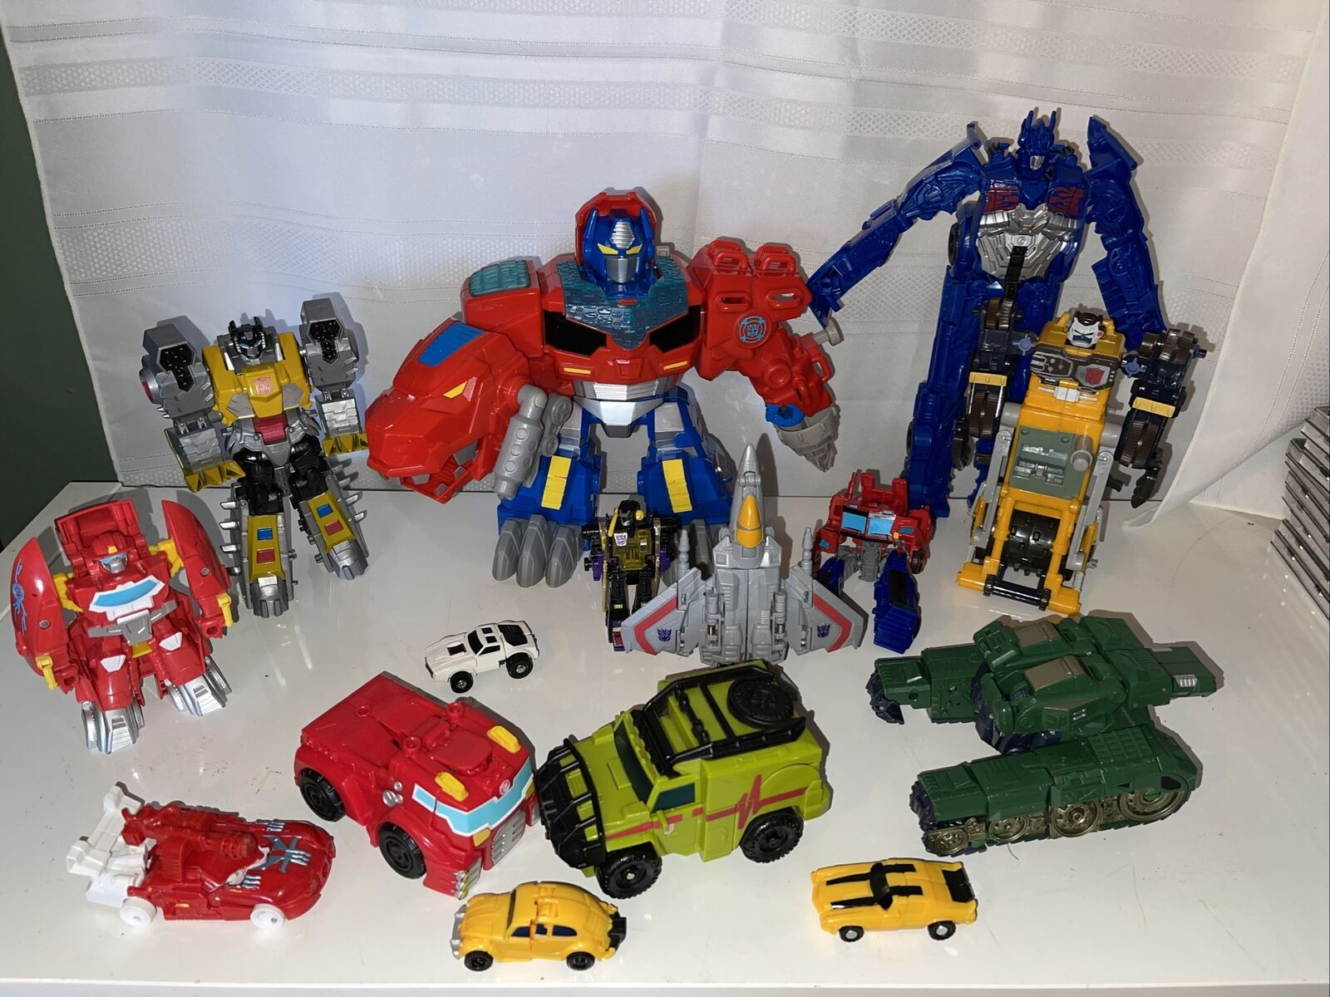
Sermon

Slide 38
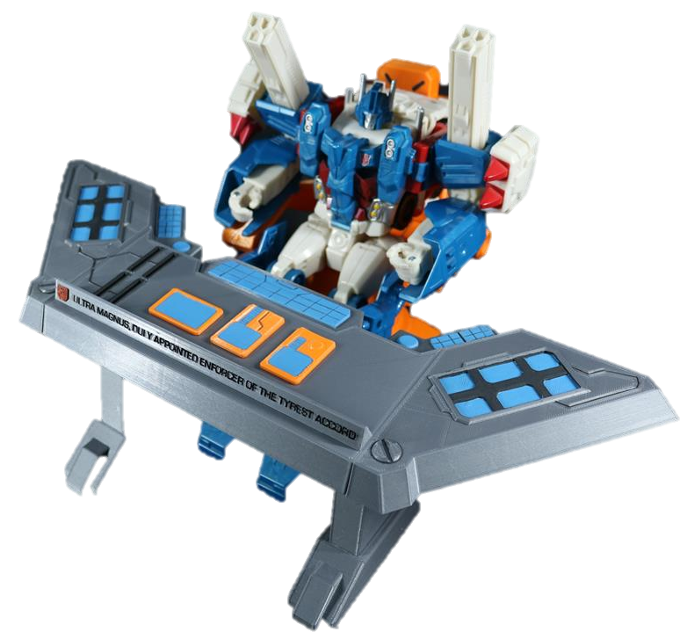
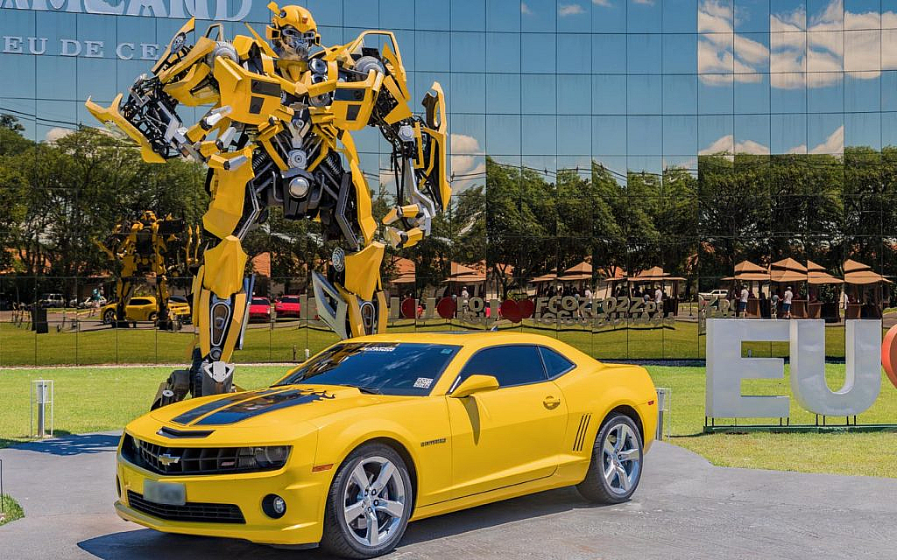
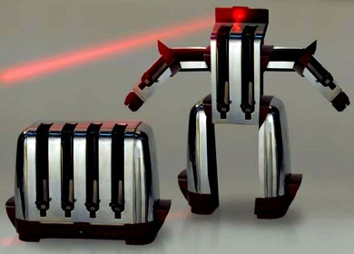
Sermon

Slide 39
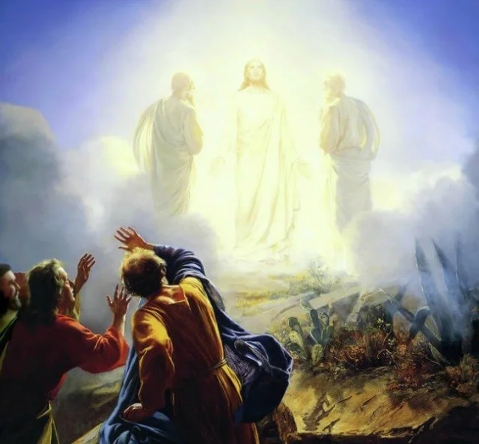
Sermon

Slide 40
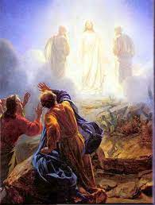
Sermon

Slide 41
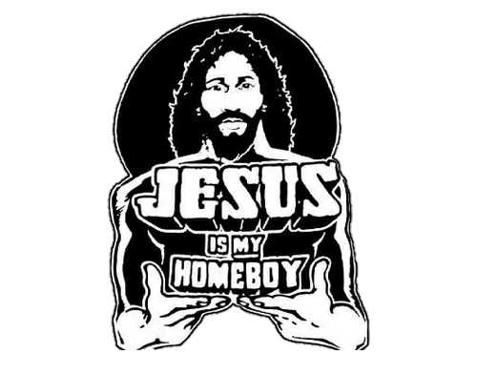
Sermon

Slide 42
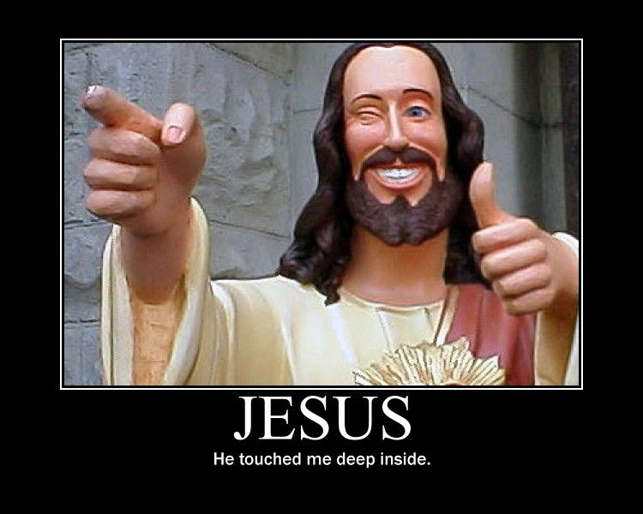
Sermon

Slide 43
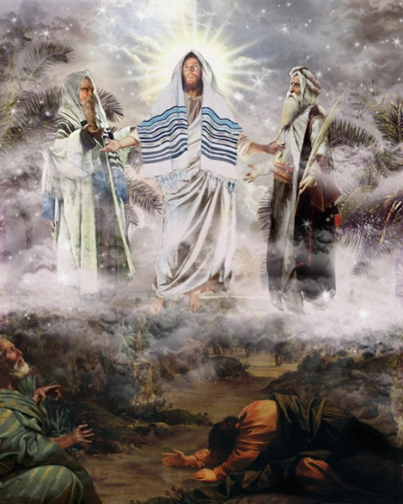
Sermon

Slide 44
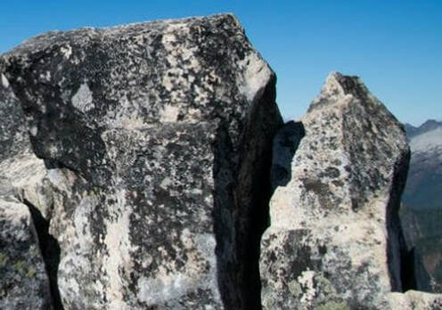
HYMN OF THE DAY
“XXX”
LBW XXX

Slide 45
“XXX” LBW XXX

Slide 46
APOSTLE’S CREED
C: I believe in God, the Father almighty, creator of heaven and earth.

Slide 47
APOSTLE’S CREED
C: I believe in Jesus Christ, his only Son, our Lord. He was conceived by the power of the Holy Spirit and born of the virgin Mary. He suffered under Pontius Pilate, was crucified, died, and was buried.

Slide 48
APOSTLE’S CREED
C: He descended into hell. On the third day he rose again. He ascended into heaven, and is seated at the right hand of the Father. He will come again to judge the living and the dead.

Slide 49
APOSTLE’S CREED
C: I believe in the Holy Spirit, the holy catholic Church, the communion of saints, the forgiveness of sins, the resurrection of the body, and the life everlasting. Amen.

Slide 50
NICENE CREED
C: We believe in one God, the Father, the Almighty, maker of heaven and earth, of all that is, seen and unseen.

Slide 51
NICENE CREED
C: We believe in one Lord, Jesus Christ, the only Son of God, eternally begotten of the Father, God from God, Light from Light, true God from true God, begotten, not made, of one Being with the Father.

Slide 52
NICENE CREED
C: Through him all things were made. For us and for our salvation he came down from heaven; by the power of the Holy Spirit he became incarnate from the virgin Mary, and was made man. For our sake he was crucified under Pontius Pilate;

Slide 53
NICENE CREED
C: he suffered death and was buried. On the third day he rose again in accordance with the Scriptures; he ascended into heaven and is seated at the right hand of the Father. He will come again in glory to judge the living and the dead, and his kingdom will have no end.

Slide 54
NICENE CREED
C: We believe in the Holy Spirit, the Lord, the giver of life, who proceeds from the Father and the Son. With the Father and the Son he is worshiped and glorified. He has spoken through the prophets. We believe in one holy catholic and apostolic Church.

Slide 55
NICENE CREED
C: We acknowledge one Baptism for the forgiveness of sins. We look for the resurrection of the dead, and the life of the world to come. Amen.

Slide 56
QUILT TYING AND PRESENTATION
This Quilt was lovingly crafted for recovery and healing especially the Trinity Prayers and Squares Quilting Ministry…
Let us pray…

Slide 57
PRAYERS OF INTERCESSION
Each petition will end with the words,
A: God our teacher and healer,
The congregation will respond with:
C: In mercy, hear our prayer.

Slide 58
PRAYERS OF INTERCESSION
The prayer concludes…
P: Confident that in Christ Jesus you answer prayer, we lift to you all for whom pray, aloud and in our hearts, through Jesus Christ, our savior.
C: Amen.

Slide 59
OFFERING
Notes:
Image: Five Loaves by Caroline Coolidge Brown. Copyright © Caroline Coolidge Brown. All rights reserved. Used by permission of the artist.

Slide 60
OFFERING PRAYER
Notes:
Image: Five Loaves by Caroline Coolidge Brown. Copyright © Caroline Coolidge Brown. All rights reserved. Used by permission of the artist.

Slide 61
THE GREAT THANKSGIVING
All the Baptized are welcome to celebrate this Holy Meal.

Slide 62
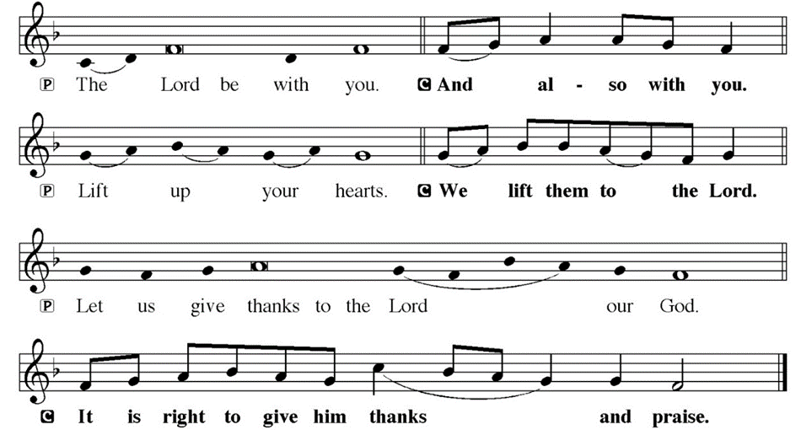
DIALOGUE

Slide 63
THE PREFACE
P: It is indeed right and salutary…
… we praise your name and join their unending hymn.

Slide 64
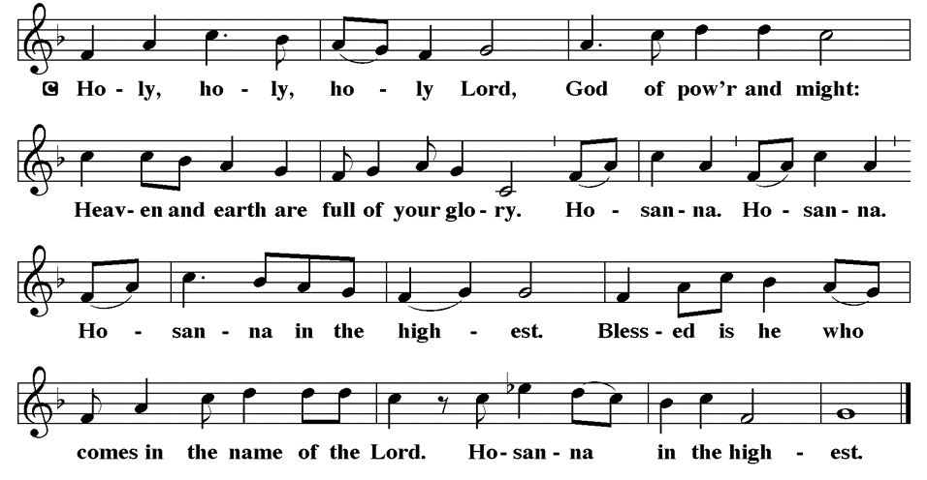
THE SANCTUS

Slide 65
EUCHARISTIC PRAYER
P: Blessed are you, O holy God…
…both now and forever.
C: Amen.

Slide 66
THE LORD’S PRAYER
C: Our Father, who art in heaven, hallowed be thy name, thy kingdom come, thy will be done, on earth as it is in heaven. Give us this day our daily bread; and forgive us our trespasses, as we forgive those who trespass against us; and lead us not into temptation, but deliver us from evil.

Slide 67
THE LORD’S PRAYER
C: For thine is the kingdom, and the power, and the glory, forever and ever. Amen.

Slide 68
INVITATION TO COMMUNION
P: Jesus, our messiah and savior, God’s beloved with whom God is well pleased, now invites you to this holy banquet where all can partake of his very real presence, and be strengthened for the journey ahead. Come, for all is prepared.

Slide 69
COMMUNION DISTRIBUTION
All will commune “By Station”.
The bread may be broken for distribution. As the ministers give the bread and wine, they say these words :
The body of Christ, given for you.
The blood of Christ, shed for you.
The communicant may say: Amen.

Slide 70
POST COMMUNION CANTACLE

Slide 71
POST COMMUNION CANTACLE

Slide 72
POST COMMUNION BLESSING
P: May this body and blood of our Lord and Savior, Jesus Christ, strengthen, keep, and unity us, ☩ now and forever,
C: Amen.

Slide 73
POST COMMUNION PRAYER
P: Let us pray… Giver of every gift, Christ’s body is our food, and we are Christ’s body. Raise us to life by your power for the benefit of all and to your glory, now and forever.
C: Amen

Slide 74
ANNOUNCEMENTS
Notes:
Image: Five Loaves by Caroline Coolidge Brown. Copyright © Caroline Coolidge Brown. All rights reserved. Used by permission of the artist.

Slide 75
SENDING BLESSING
P: God who names you, Christ who claims you, and the Holy Spirit who dwells in you, ☩ bless you and remain with you always.
C: Amen.

Slide 76
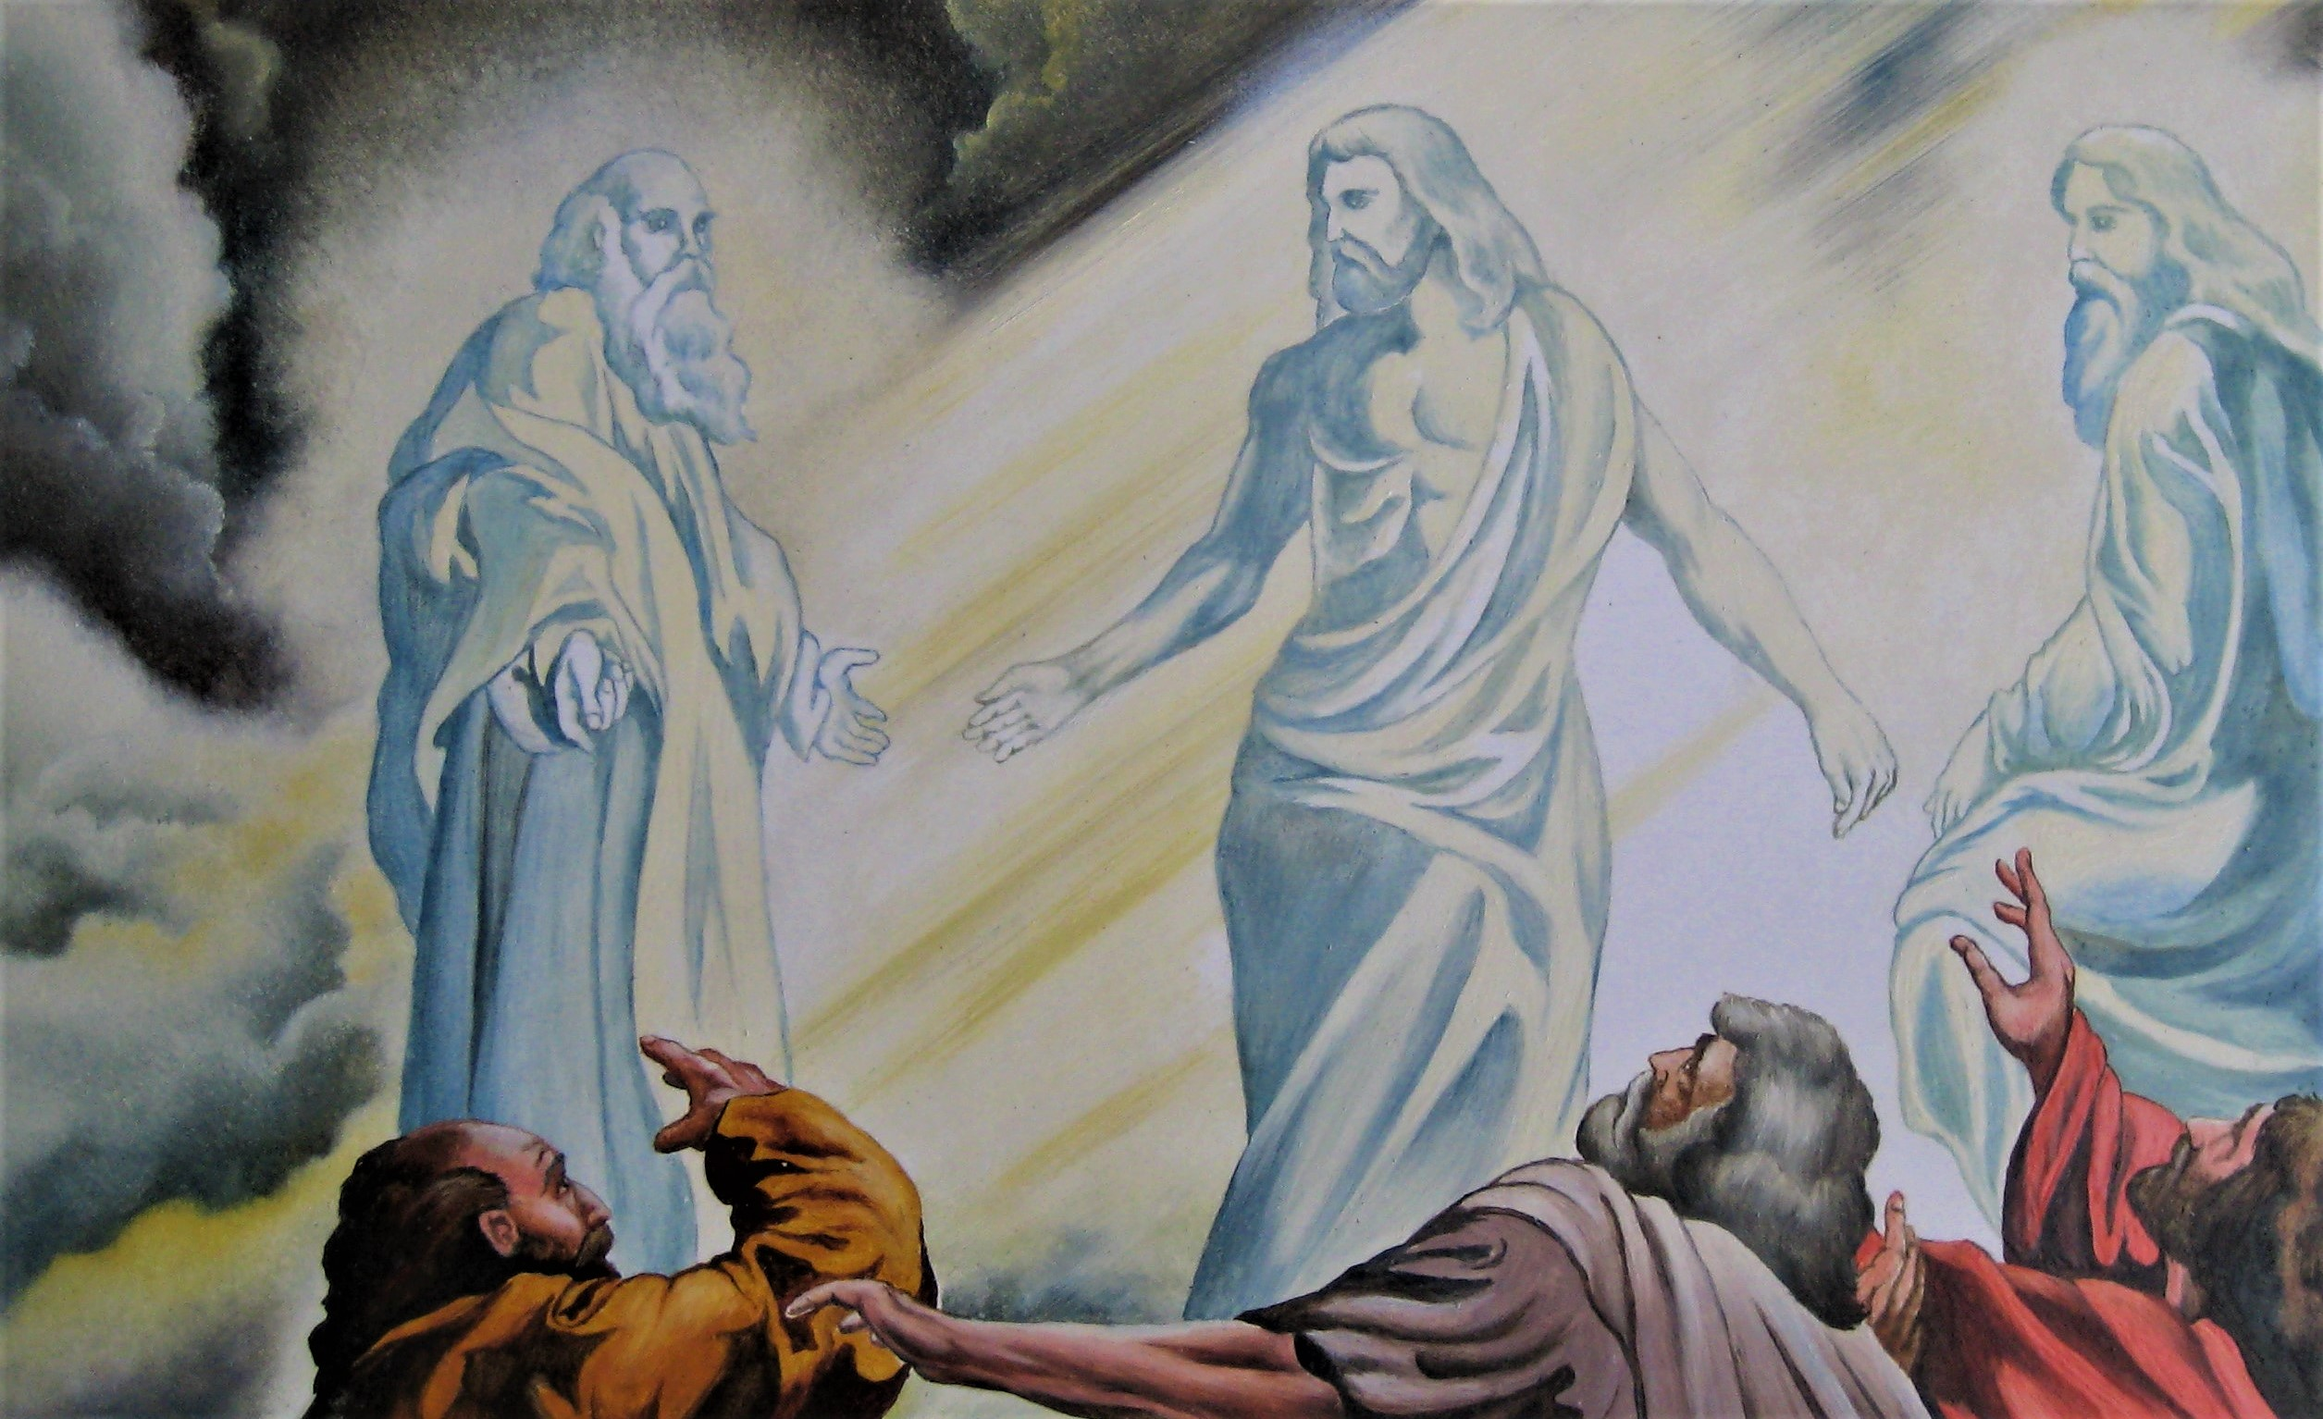
Sending Song
“O Zion, Haste”
LBW 397
Notes:
Image: Five Loaves by Caroline Coolidge Brown. Copyright © Caroline Coolidge Brown. All rights reserved. Used by permission of the artist.

Slide 77
“O Zion, Haste” LBW 397
1 O Zion, haste, your mission high fulfilling,
to tell to all the world that God is light;
that he who made all nations is not willing
one soul should perish, lost in shades of night.
Notes:
Image: Preparing yeast dough. Copyright © tomasworks/iStock/Thinkstock. Used by permission.

Slide 78
“O Zion, Haste” LBW 397
Refrain
Publish glad tidings, tidings of peace,
tidings of Jesus, redemption, and release.
Notes:
Image: Preparing yeast dough. Copyright © tomasworks/iStock/Thinkstock. Used by permission.

Slide 79
“O Zion, Haste” LBW 397
2 Publish to ev’ry people, tongue, and nation
that God, in whom they live and move, is love;
tell how he stooped to save his lost creation
and died on earth that we might live above.
Notes:
Image: Preparing yeast dough. Copyright © tomasworks/iStock/Thinkstock. Used by permission.

Slide 80
“O Zion, Haste” LBW 397
Refrain
Publish glad tidings, tidings of peace,
tidings of Jesus, redemption, and release.
Notes:
Image: Preparing yeast dough. Copyright © tomasworks/iStock/Thinkstock. Used by permission.

Slide 81
“O Zion, Haste” LBW 397
3 Give of your own to bear the message glorious,
give of your wealth to speed them on their way,
pour out your soul for them in prayer victorious,
and haste the coming of the glorious day.
Notes:
Image: Preparing yeast dough. Copyright © tomasworks/iStock/Thinkstock. Used by permission.

Slide 82
“O Zion, Haste” LBW 397
Refrain
Publish glad tidings, tidings of peace,
tidings of Jesus, redemption, and release.
Notes:
Image: Preparing yeast dough. Copyright © tomasworks/iStock/Thinkstock. Used by permission.

Slide 83
“O Zion, Haste” LBW 397
4 He comes again! O Zion, ere you meet him,
make known to ev’ry heart his saving grace;
let none whom he has ransomed fail to greet him,
through your neglect, unfit to see his face.
Notes:
Image: Preparing yeast dough. Copyright © tomasworks/iStock/Thinkstock. Used by permission.

Slide 84
“O Zion, Haste” LBW 397
Refrain
Publish glad tidings, tidings of peace,
tidings of Jesus, redemption, and release.
Notes:
Image: Preparing yeast dough. Copyright © tomasworks/iStock/Thinkstock. Used by permission.

Slide 85
DISMISSAL
P: … Depart in Christ’s Love.
C: Seeking, welcoming, and serving all. Amen!
POSTLUDE
By
Roxanne Groff
From sundaysandseasons.com. Copyright © 2024 Augsburg Fortress. All rights reserved. Reprinted by permission under Augsburg Fortress Liturgies Annual License #SAS023830. New Revised Standard Version Bible, Copyright © 1989, Division of Christian Education of the National Council of the Churches of Christ in the United States of America. Used by permission. All rights reserved. Revised Common Lectionary, Copyright © 1992 Consultation on Common Texts, admin Augsburg Fortress. Used by permission.

