Slide 1
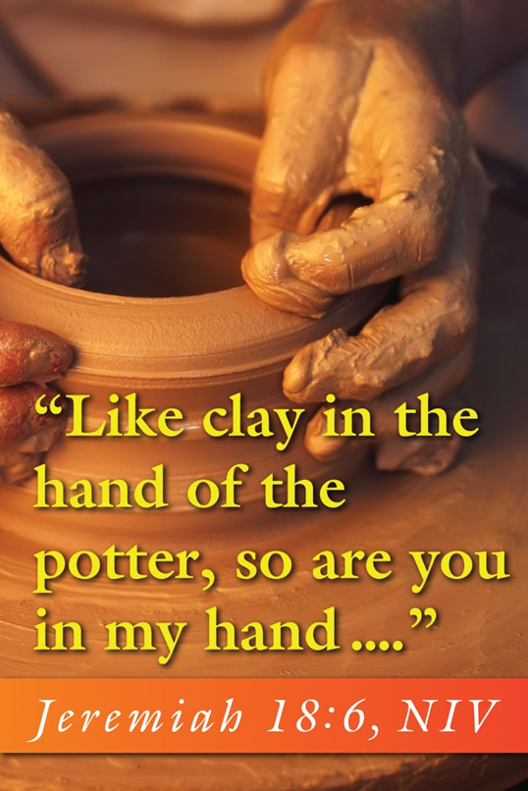
June 15, 2025
WELCOME!
Trinity Lutheran Church
Notes:
Image: Five Loaves by Caroline Coolidge Brown. Copyright © Caroline Coolidge Brown. All rights reserved. Used by permission of the artist.

Slide 2
= Please stand if able
= Please be seated
Prelude - By Roxanne Groff
Office of the Acolyte
Ringing of the Bell
Welcome
Notes:
Image: Five Loaves by Caroline Coolidge Brown. Copyright © Caroline Coolidge Brown. All rights reserved. Used by permission of the artist.

Slide 3
CONFESSION AND FORGIVENESS
All may make the sign of the cross, the sign marked at baptism…
L: We confess our sins before God and one another.
Pause for silence and reflection.
L: Holy and Gracious God,
Notes:
Image: Five Loaves by Caroline Coolidge Brown. Copyright © Caroline Coolidge Brown. All rights reserved. Used by permission of the artist.

Slide 4
CONFESSION AND FORGIVENESS
C: We have ignored your call to the hard work of justice. In our fears of not having or being enough, we have sought after the easier, more comfortable ways in life. We have neglected the needs of our neighbors.
Notes:
Image: Five Loaves by Caroline Coolidge Brown. Copyright © Caroline Coolidge Brown. All rights reserved. Used by permission of the artist.

Slide 5
CONFESSION AND FORGIVENESS
C: We have closed our ears to the cries of creation. We have thrown in our lot with the wealthy and powerful at the expense of the widow and the orphan.
Notes:
Image: Five Loaves by Caroline Coolidge Brown. Copyright © Caroline Coolidge Brown. All rights reserved. Used by permission of the artist.

Slide 6
CONFESSION AND FORGIVENESS
C: Forgive us for where our natural instinct for self-preservation has become self-absorption, where our sacred call to self-love has become self-obsession. Make us new in the image of the one who gave all for the redemption of creation.
Notes:
Image: Five Loaves by Caroline Coolidge Brown. Copyright © Caroline Coolidge Brown. All rights reserved. Used by permission of the artist.

Slide 7
CONFESSION AND FORGIVENESS
L: The God who formed you in the womb and knew you before you drew breath also loves you beyond comprehension, and forgives you all your sin. In wholeness and joy, go forth to proclaim the good news of redemption for the sake of Jesus Christ, our savior and friend.
C: Amen.
Notes:
Image: Five Loaves by Caroline Coolidge Brown. Copyright © Caroline Coolidge Brown. All rights reserved. Used by permission of the artist.

Slide 8
THANKSGIVING FOR BAPTISM
All may make the sign of the cross, the sign marked at baptism, as the presiding minister begins.
P: Blessed be the holy Trinity, ☩ one God, the fountain of living water, the rock who gave us birth, our light and our salvation.
C: Amen.
Notes:
Image: Preparing yeast dough. Copyright © tomasworks/iStock/Thinkstock. Used by permission.

Slide 9
P: Joined to Christ in the waters of baptism, we are clothed with God's mercy and forgiveness. Let us give thanks for the gift of baptism.
Water may be poured into the font as the presiding minister gives thanks.
THANKSGIVING FOR BAPTISM
Notes:
Image: Preparing yeast dough. Copyright © tomasworks/iStock/Thinkstock. Used by permission.

Slide 10
P: We give you thanks, O God, for in the beginning your Spirit moved over the waters and by your Word you created the world, calling forth life in which you took delight. Through the waters of the flood you delivered Noah and his family. Through the sea you led your people Israel from slavery into freedom.
THANKSGIVING FOR BAPTISM
Notes:
Image: Preparing yeast dough. Copyright © tomasworks/iStock/Thinkstock. Used by permission.

Slide 11
P: At the river your Son was baptized by John and anointed with the Holy Spirit. By water and your Word you claim us as daughters and sons, making us heirs of your promise and servants of all. We praise you for the gift of water that sustains life, and above all we praise you for the gift of new life in Jesus Christ.
THANKSGIVING FOR BAPTISM
Notes:
Image: Preparing yeast dough. Copyright © tomasworks/iStock/Thinkstock. Used by permission.

Slide 12
P: Shower us with your Spirit, and renew our lives with your forgiveness, grace, and love. To you be given honor and praise through Jesus Christ our Lord in the unity of the Holy Spirit, now and forever.
THANKSGIVING FOR BAPTISM
C: Amen.
Notes:
Image: Preparing yeast dough. Copyright © tomasworks/iStock/Thinkstock. Used by permission.

Slide 13
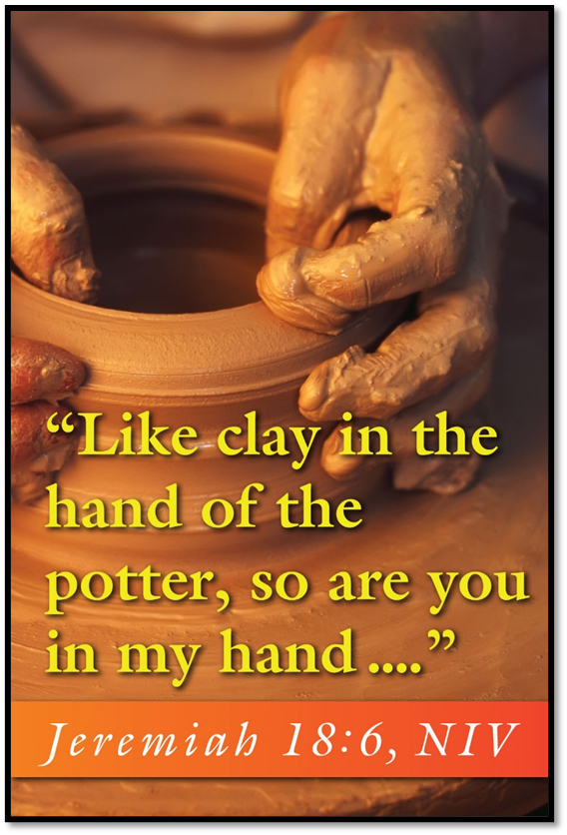
Gathering Song
“Son of God, Eternal Savior”
LBW 364

Slide 14
“Son of God, Eternal Savior” LBW 364
1 Son of God, eternal Savior,
source of life and truth and grace,
Word made flesh, whose birth among us
hallows all our human race,
you our head, who, throned in glory,
for your own will ever plead:
fill us with your love and pity,
heal our wrong, and help our need.
Notes:
Image: Five Loaves by Caroline Coolidge Brown. Copyright © Caroline Coolidge Brown. All rights reserved. Used by permission of the artist.

Slide 15
“Son of God, Eternal Savior” LBW 364
2 As you, Lord, have lived for others,
so may we for others live.
Freely have your gifts been granted;
freely may your servants give.
Yours the gold and yours the silver,
yours the wealth of land and sea;
we but stewards of your bounty
held in solemn trust will be.
Notes:
Image: Five Loaves by Caroline Coolidge Brown. Copyright © Caroline Coolidge Brown. All rights reserved. Used by permission of the artist.

Slide 16
“Son of God, Eternal Savior” LBW 364
3 Come, O Christ, and reign among us,
King of love and Prince of peace;
hush the storm of strife and passion,
bid its cruel discords cease.
By your patient years of toiling,
by your silent hours of pain,
quench our fevered thirst of pleasure,
stem our selfish greed of gain.
Notes:
Image: Five Loaves by Caroline Coolidge Brown. Copyright © Caroline Coolidge Brown. All rights reserved. Used by permission of the artist.

Slide 17
“Son of God, Eternal Savior” LBW 364
4 Son of God, eternal Savior,
source of life and truth and grace,
Word made flesh, whose birth among us
hallows all our human race:
by your praying, by your willing
that your people should be one,
grant, oh, grant our hope's fruition:
here on earth your will be done.
Notes:
Image: Five Loaves by Caroline Coolidge Brown. Copyright © Caroline Coolidge Brown. All rights reserved. Used by permission of the artist.

Slide 18
APOSTOLIC GREETING
P: The grace of our Lord Jesus Christ, the love of God, and the communion of the Holy Spirit be with you all.
C: And also with you.
Notes:
Image: Five Loaves by Caroline Coolidge Brown. Copyright © Caroline Coolidge Brown. All rights reserved. Used by permission of the artist.

Slide 19
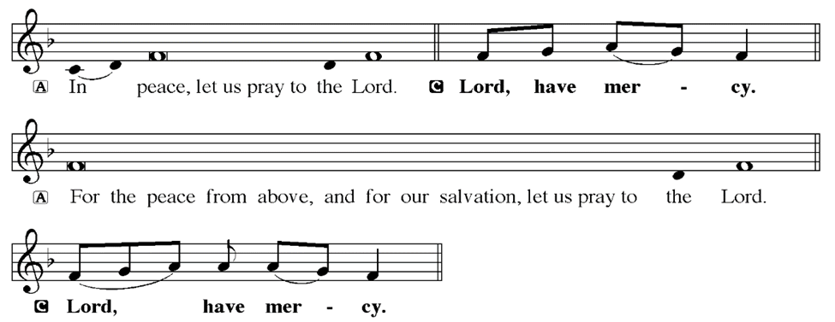
KYRIE
Notes:
Image: Five Loaves by Caroline Coolidge Brown. Copyright © Caroline Coolidge Brown. All rights reserved. Used by permission of the artist.

Slide 20
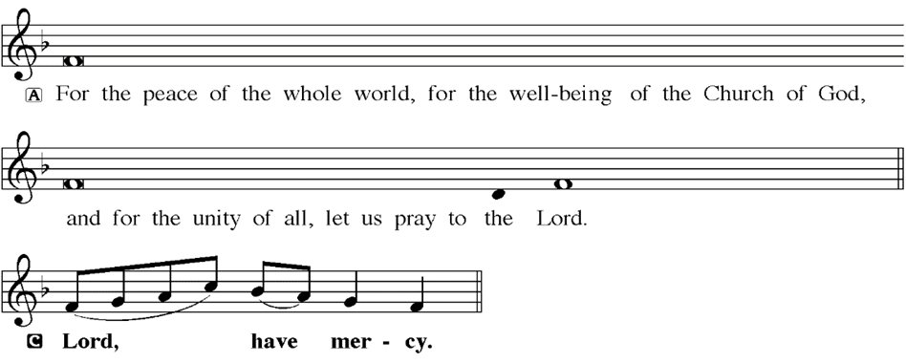
KYRIE
Notes:
Image: Five Loaves by Caroline Coolidge Brown. Copyright © Caroline Coolidge Brown. All rights reserved. Used by permission of the artist.

Slide 21
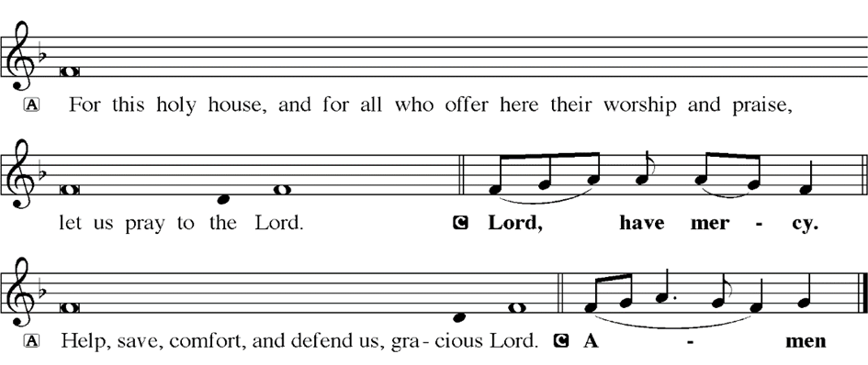
KYRIE
Notes:
Image: Five Loaves by Caroline Coolidge Brown. Copyright © Caroline Coolidge Brown. All rights reserved. Used by permission of the artist.

Slide 22
HYMN OF PRAISE
Glory be to God in heaven;
peace, goodwill to all the earth.
Mighty God of all creation,
Father of surpassing worth:
we exalt you, we adore you,
we lift high our thanks and praise.
Saints and angels bow before you; here on earth our songs we raise.
Notes:
Image: Five Loaves by Caroline Coolidge Brown. Copyright © Caroline Coolidge Brown. All rights reserved. Used by permission of the artist.

Slide 23
HYMN OF PRAISE
Glory be to Christ forever,
Lamb of God and Lord of love.
Son of God and gracious Savior, you have come from heav’n above;
on the cross you died to save us; now you reign at God’s right hand.
Hear our prayer; restore, forgive us; in your promise firm we stand.
Notes:
Image: Five Loaves by Caroline Coolidge Brown. Copyright © Caroline Coolidge Brown. All rights reserved. Used by permission of the artist.

Slide 24
HYMN OF PRAISE
Holy One we now acclaim you;
Lord alone, to you we call;
Holy One in faith we name you,
God most high, yet near to all:
Jesus Christ, with God the Spirit,
in the Father’s splendor bright.
For the peace that we inherit,
glory be to God on high!
Notes:
Image: Five Loaves by Caroline Coolidge Brown. Copyright © Caroline Coolidge Brown. All rights reserved. Used by permission of the artist.

Slide 25
PRAYER OF THE DAY
P: Let us pray… Creator God, you have formed us out of the dust of the earth itself. Help us to love these earthly forms, and to care for them and for one another as you do. Mold our hearts and our spirits that we might live in love and service to our neighbors out of gratitude for the gift of life you have given us. In Jesus’ name we pray.
C: Amen
Notes:
Image: Five Loaves by Caroline Coolidge Brown. Copyright © Caroline Coolidge Brown. All rights reserved. Used by permission of the artist.

Slide 26

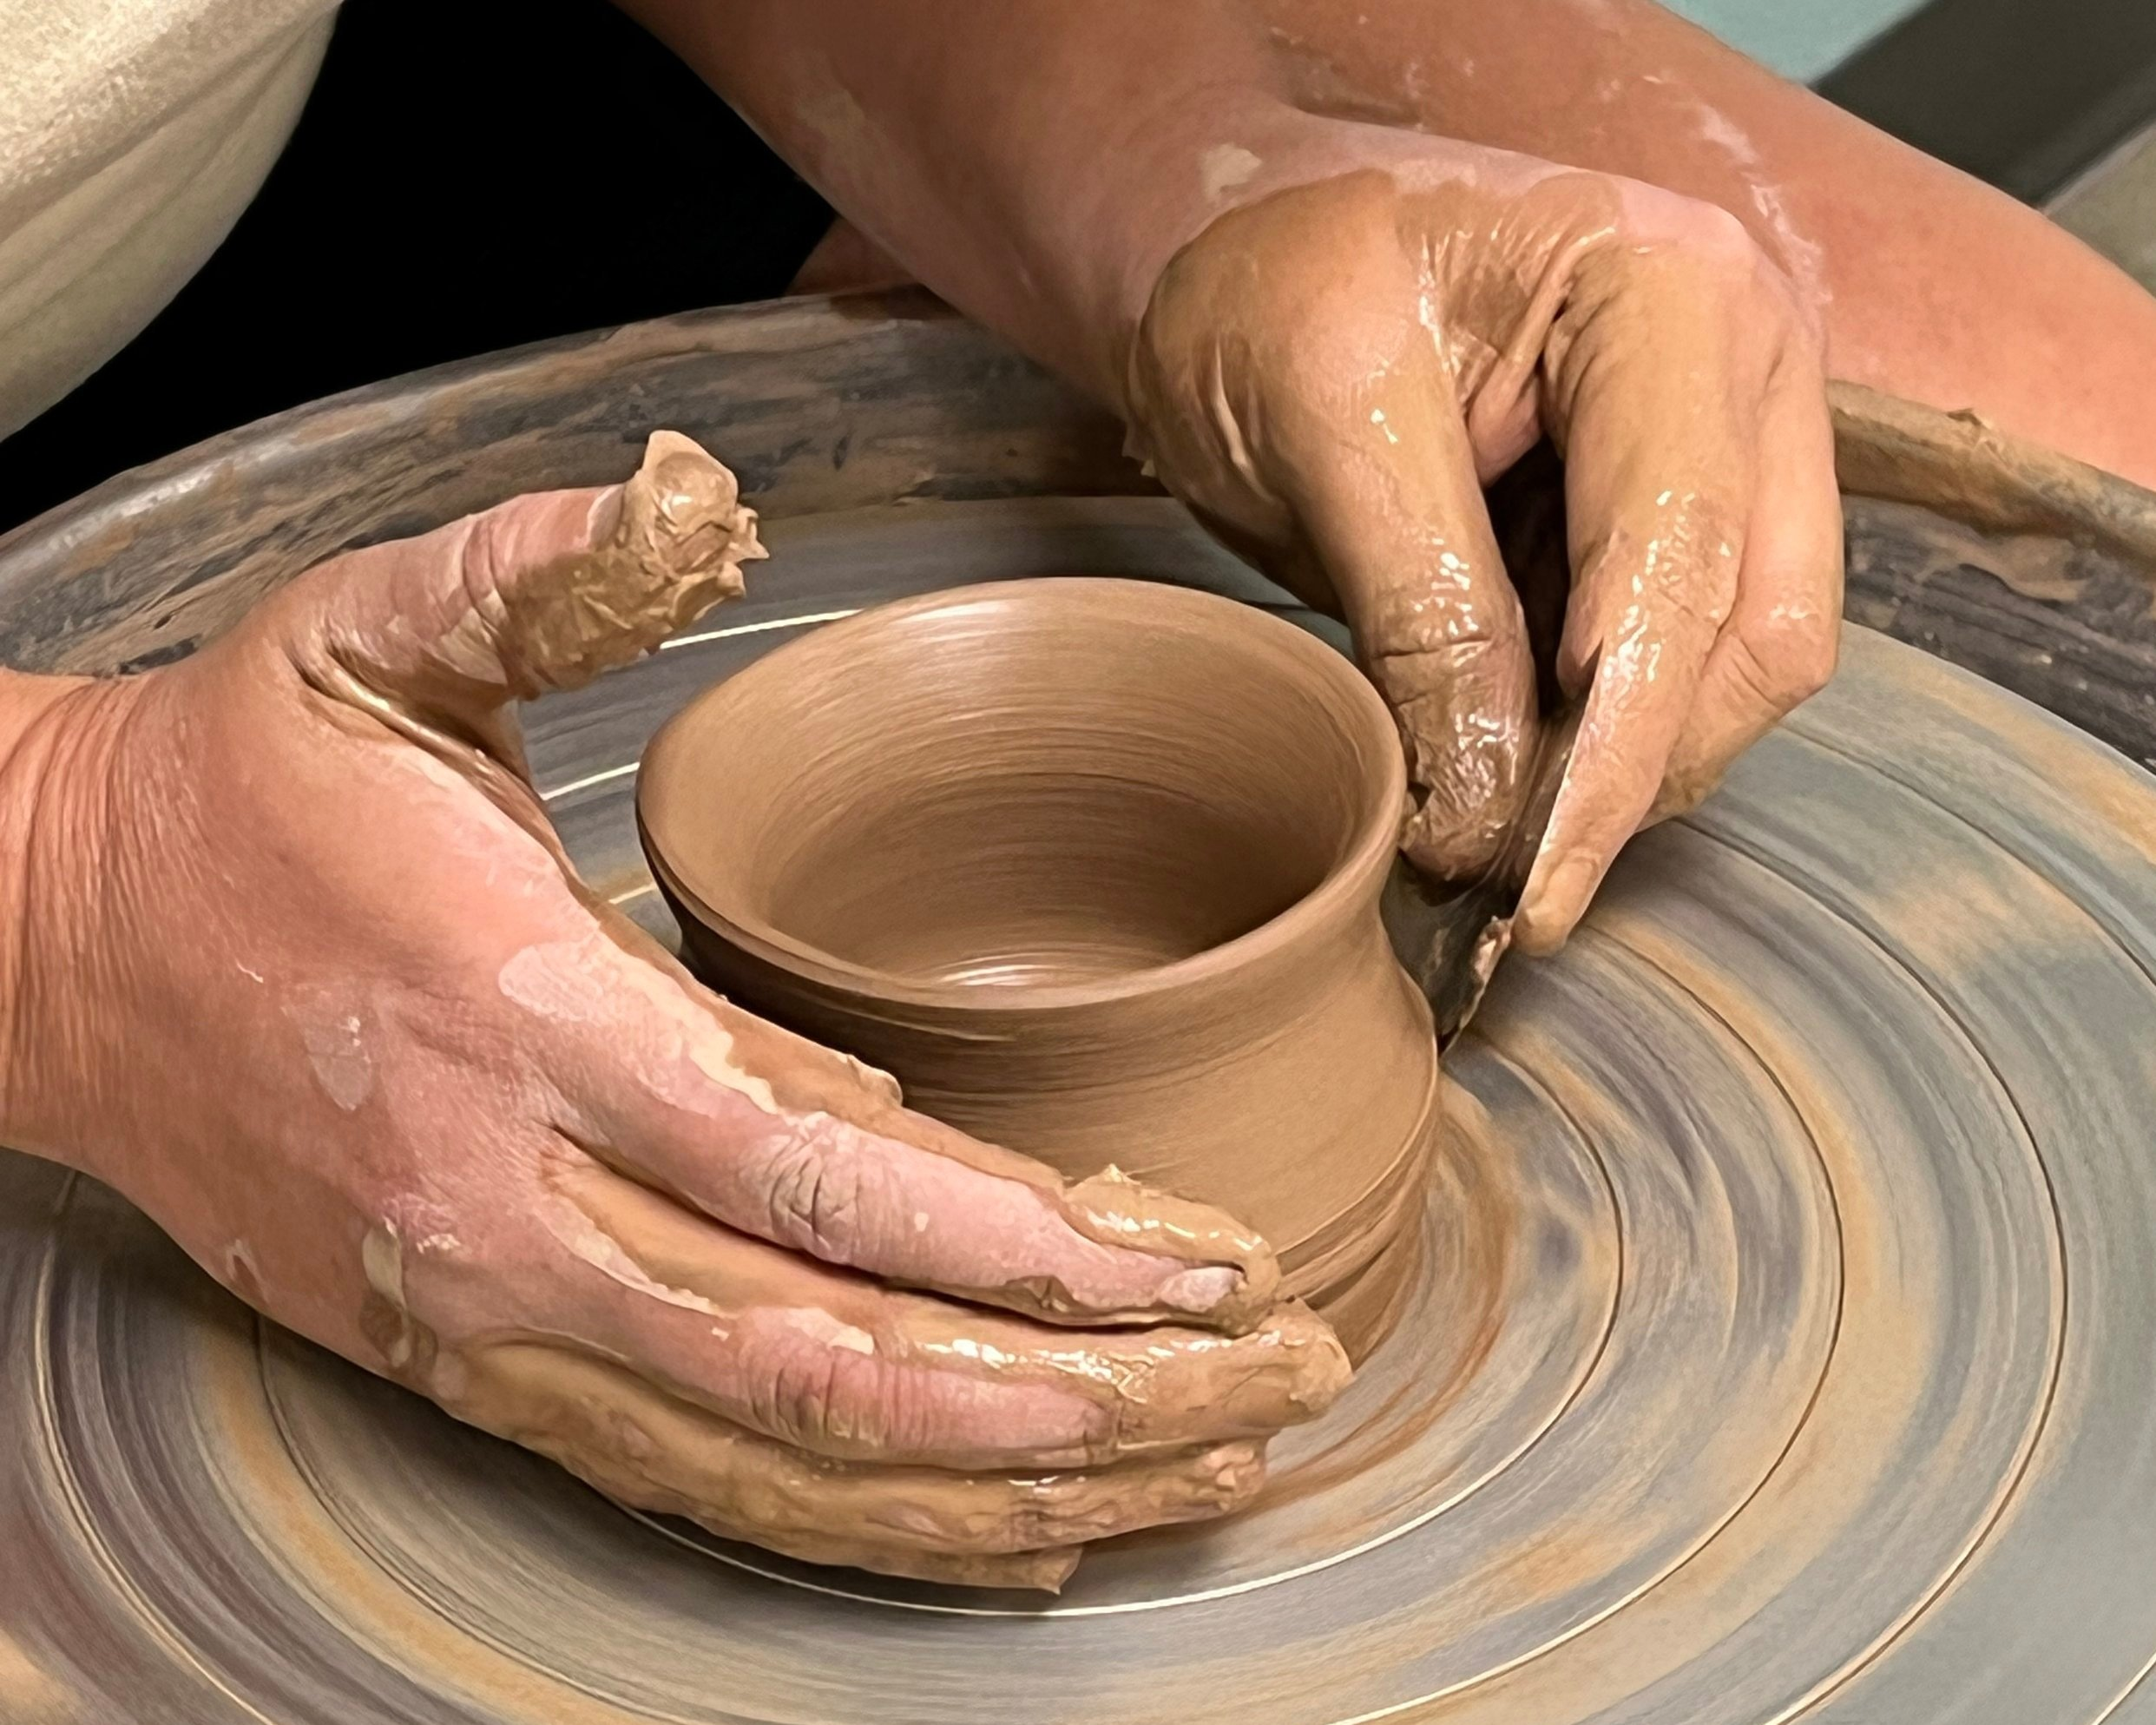
God is the “Potter”
We are the “Clay”
Notes:
Image: Preparing yeast dough. Copyright © tomasworks/iStock/Thinkstock. Used by permission.

Slide 27
Scripture Reading
R: Our scripture reading is from the Book of Jeremiah, Chapter 18.
C: Glory to you O’ Lord!
Notes:
Image: Five Loaves by Caroline Coolidge Brown. Copyright © Caroline Coolidge Brown. All rights reserved. Used by permission of the artist.

Slide 28
Jeremiah 18:1-11
The word that came to Jeremiah from the Lord: ²‘Come, go down to the potter’s house, and there I will let you hear my words.’ ³So I went down to the potter’s house, and there he was working at his wheel. ⁴The vessel he was making of clay was spoiled in the potter’s hand, and he reworked it into another vessel, as seemed good to him.
Notes:
Image: Five Loaves by Caroline Coolidge Brown. Copyright © Caroline Coolidge Brown. All rights reserved. Used by permission of the artist.

Slide 29
Jeremiah 18:1-11
⁵Then the word of the Lord came to me: ⁶Can I not do with you, O house of Israel, just as this potter has done? says the Lord. Just like the clay in the potter’s hand, so are you in my hand, O house of Israel. ⁷At one moment I may declare concerning a nation or a kingdom, that I will pluck up and break down and destroy it, ⁸but if that nation,
Notes:
Image: Five Loaves by Caroline Coolidge Brown. Copyright © Caroline Coolidge Brown. All rights reserved. Used by permission of the artist.

Slide 30
Jeremiah 18:1-11
concerning which I have spoken, turns from its evil, I will change my mind about the disaster that I intended to bring on it. ⁹And at another moment I may declare concerning a nation or a kingdom that I will build and plant it, ¹⁰but if it does evil in my sight, not listening to my voice, then I will change my mind about the good that I had intended to do to it.
Notes:
Image: Five Loaves by Caroline Coolidge Brown. Copyright © Caroline Coolidge Brown. All rights reserved. Used by permission of the artist.

Slide 31
Jeremiah 18:1-11
¹¹Now, therefore, say to the people of Judah and the inhabitants of Jerusalem: Thus says the Lord: Look, I am a potter shaping evil against you and devising a plan against you. Turn now, all of you from your evil way, and amend your ways and your doings.
Notes:
Image: Five Loaves by Caroline Coolidge Brown. Copyright © Caroline Coolidge Brown. All rights reserved. Used by permission of the artist.

Slide 32
Jeremiah 18:1-11
R: This is the Word of the Lord.
C: Praise to You, O Christ
Notes:
Image: Five Loaves by Caroline Coolidge Brown. Copyright © Caroline Coolidge Brown. All rights reserved. Used by permission of the artist.

Slide 33

Sermon
Notes:
Image: Five Loaves by Caroline Coolidge Brown. Copyright © Caroline Coolidge Brown. All rights reserved. Used by permission of the artist.

Slide 34
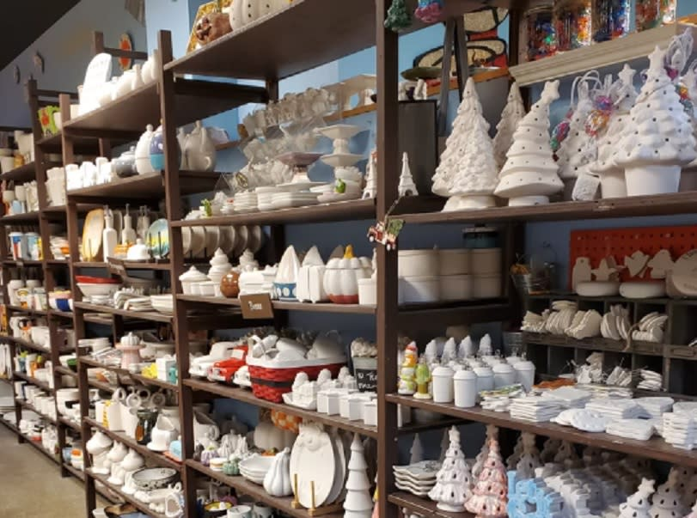
Sermon
Notes:
Image: Five Loaves by Caroline Coolidge Brown. Copyright © Caroline Coolidge Brown. All rights reserved. Used by permission of the artist.

Slide 35
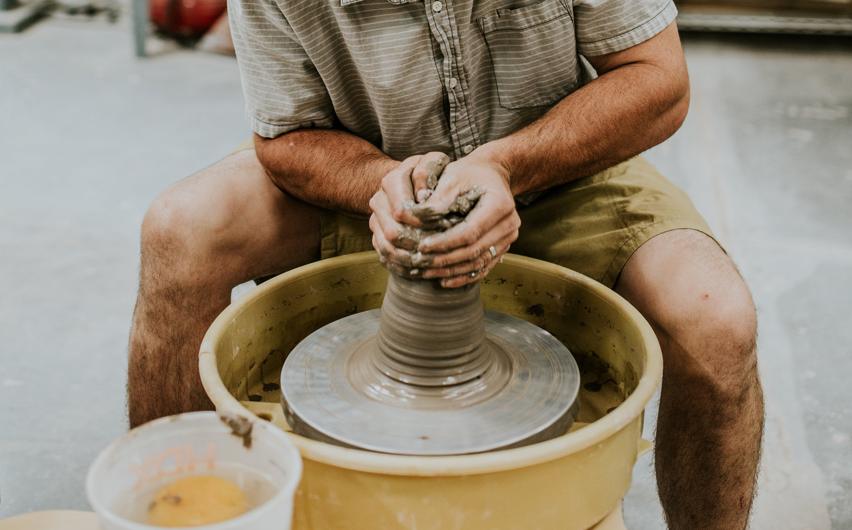
Sermon
Notes:
Image: Five Loaves by Caroline Coolidge Brown. Copyright © Caroline Coolidge Brown. All rights reserved. Used by permission of the artist.

Slide 36
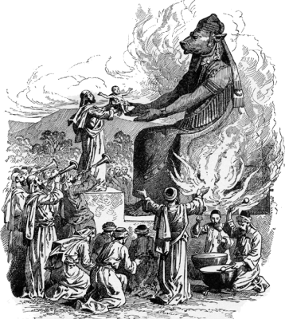
Sermon
Notes:
Image: Five Loaves by Caroline Coolidge Brown. Copyright © Caroline Coolidge Brown. All rights reserved. Used by permission of the artist.

Slide 37
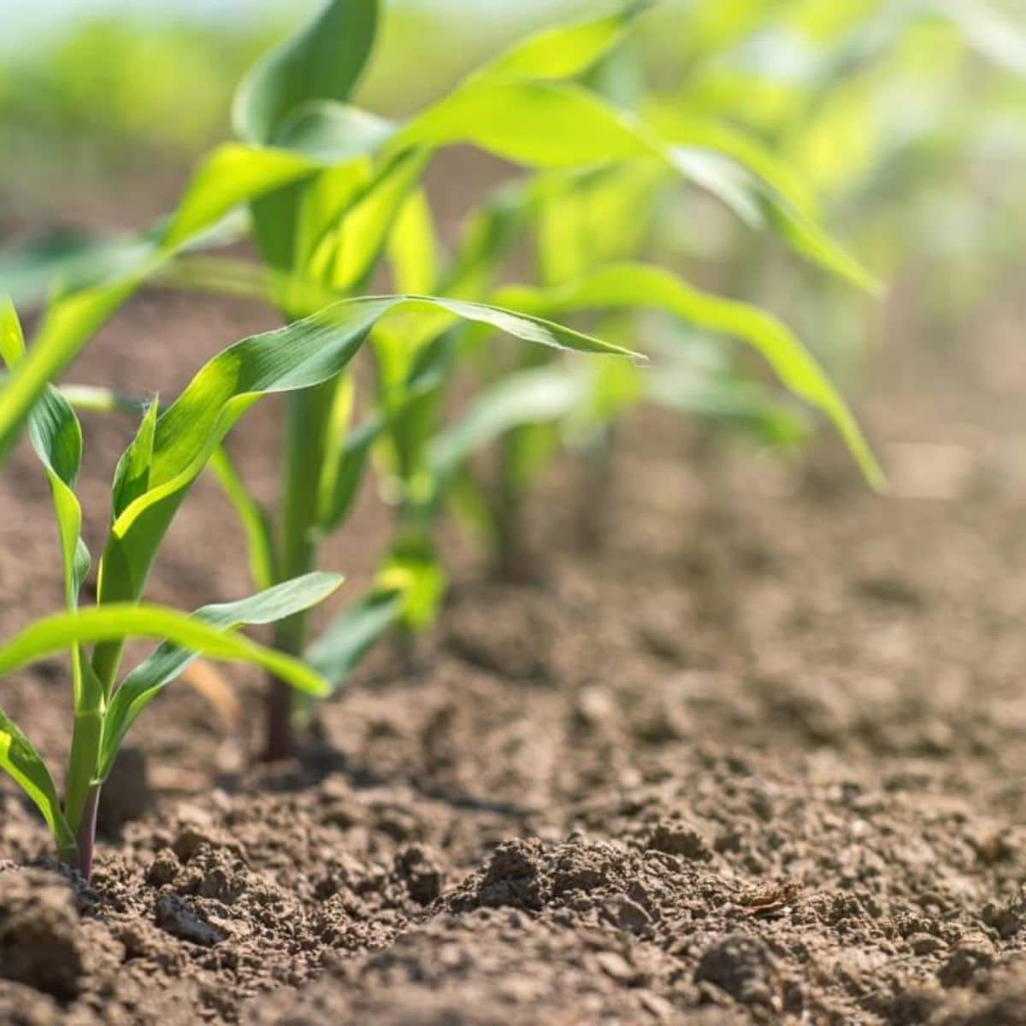
Sermon
Notes:
Image: Five Loaves by Caroline Coolidge Brown. Copyright © Caroline Coolidge Brown. All rights reserved. Used by permission of the artist.

Slide 38
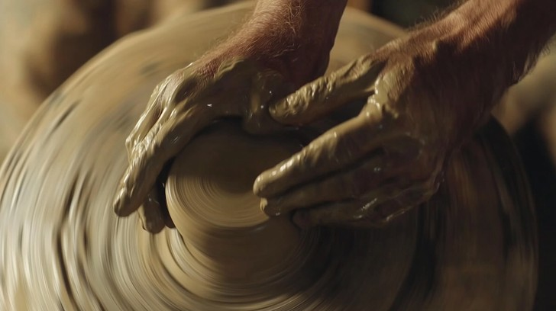
Sermon
Notes:
Image: Five Loaves by Caroline Coolidge Brown. Copyright © Caroline Coolidge Brown. All rights reserved. Used by permission of the artist.

Slide 39
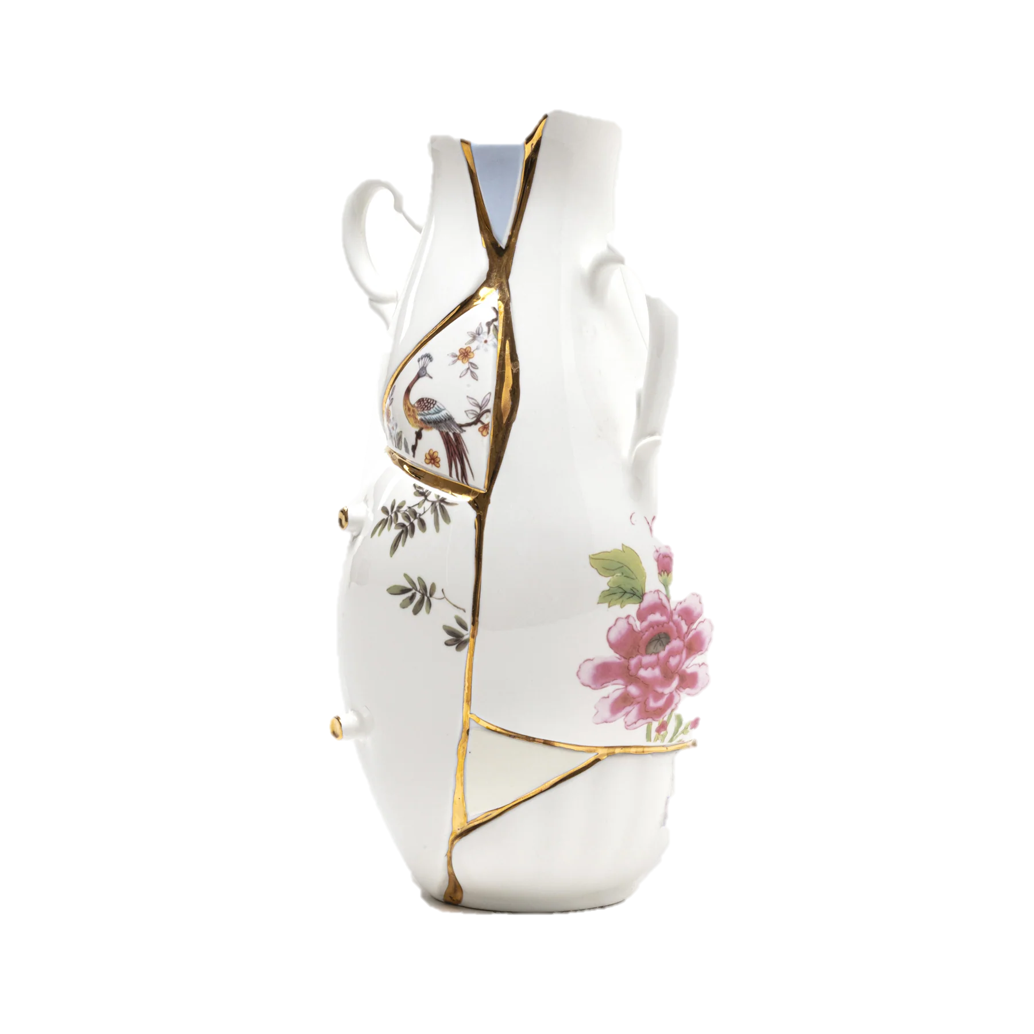
Sermon
Notes:
Image: Five Loaves by Caroline Coolidge Brown. Copyright © Caroline Coolidge Brown. All rights reserved. Used by permission of the artist.

Slide 40
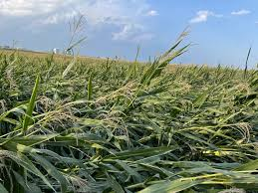
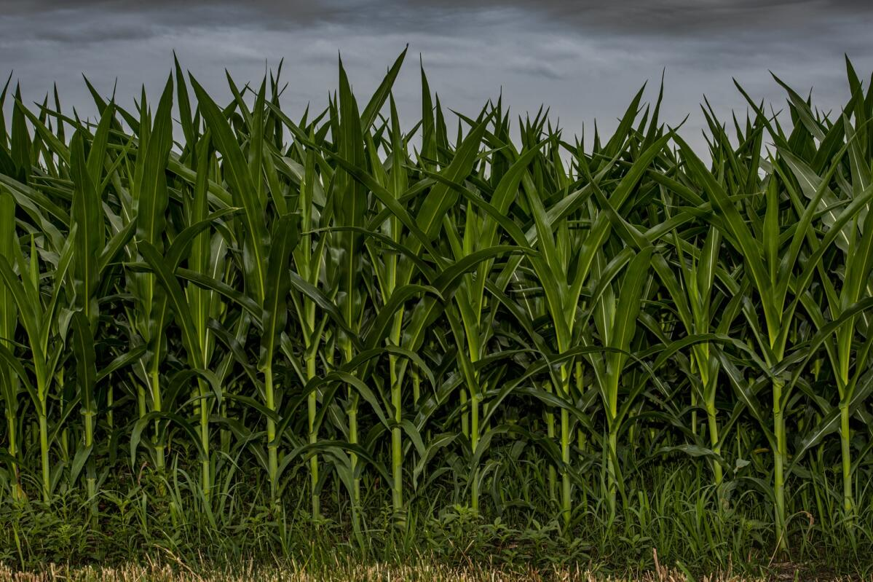
Sermon
Notes:
Image: Five Loaves by Caroline Coolidge Brown. Copyright © Caroline Coolidge Brown. All rights reserved. Used by permission of the artist.

Slide 41
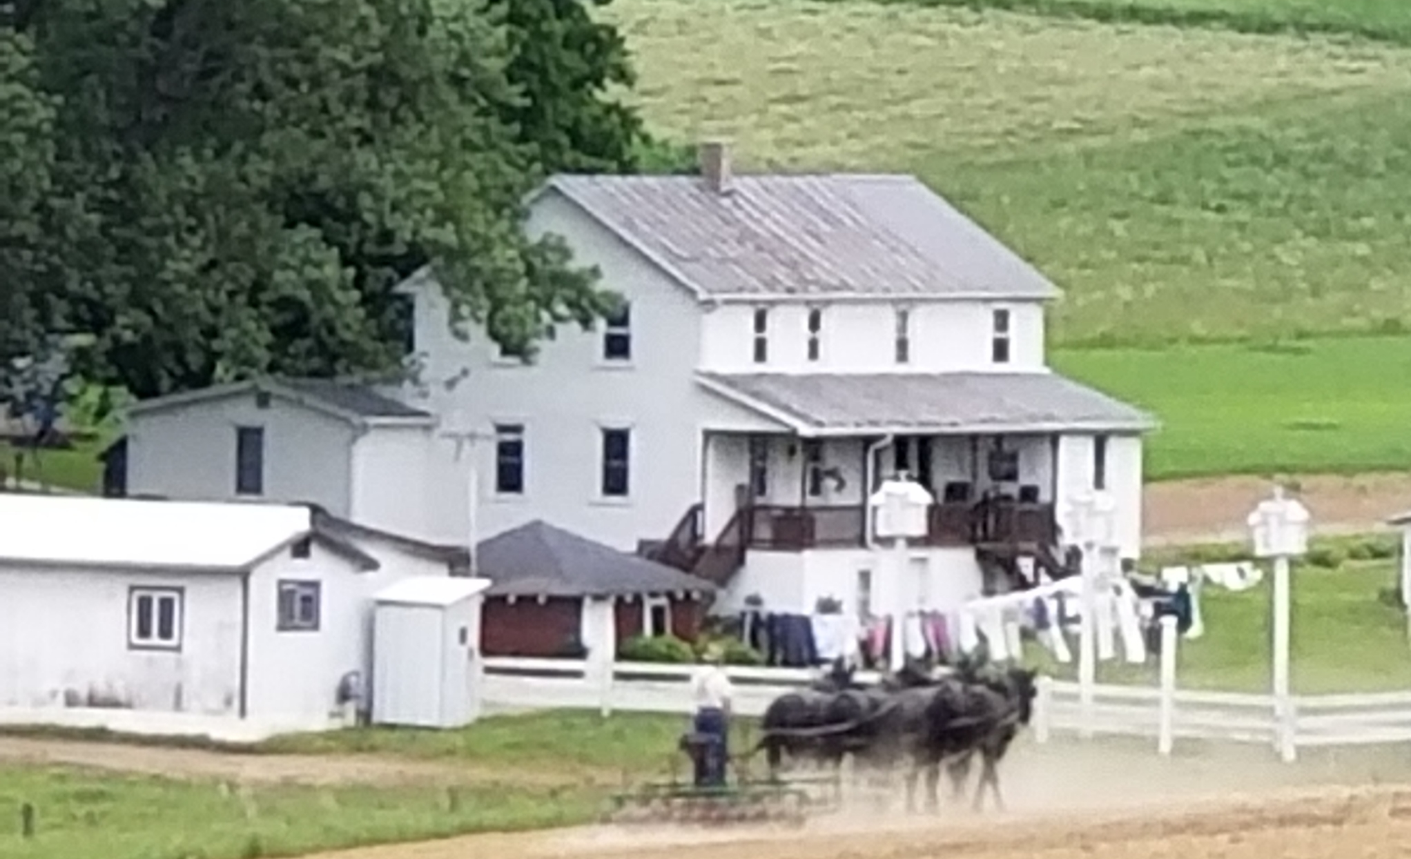
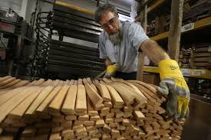
Sermon
Notes:
Image: Five Loaves by Caroline Coolidge Brown. Copyright © Caroline Coolidge Brown. All rights reserved. Used by permission of the artist.

Slide 42


Sermon
Notes:
Image: Five Loaves by Caroline Coolidge Brown. Copyright © Caroline Coolidge Brown. All rights reserved. Used by permission of the artist.

Slide 43
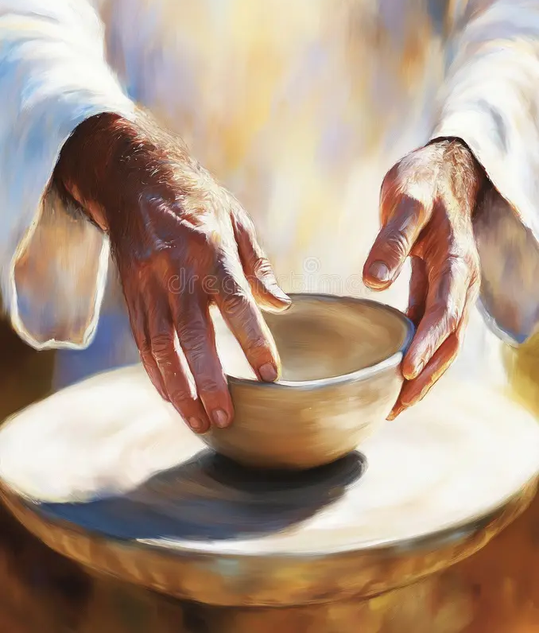
Sermon
Notes:
Image: Five Loaves by Caroline Coolidge Brown. Copyright © Caroline Coolidge Brown. All rights reserved. Used by permission of the artist.

Slide 44
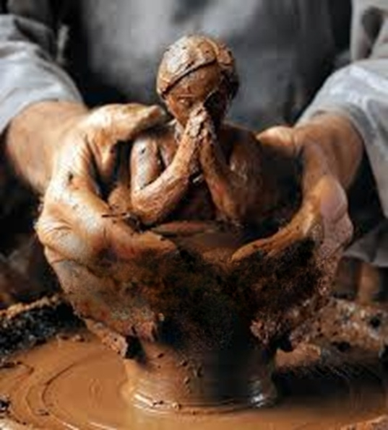
Sermon
Notes:
Image: Five Loaves by Caroline Coolidge Brown. Copyright © Caroline Coolidge Brown. All rights reserved. Used by permission of the artist.

Slide 45
Hymn of the Day
“Change My Heart O God”
ELW 801
Notes:
Image: Five Loaves by Caroline Coolidge Brown. Copyright © Caroline Coolidge Brown. All rights reserved. Used by permission of the artist.

Slide 46
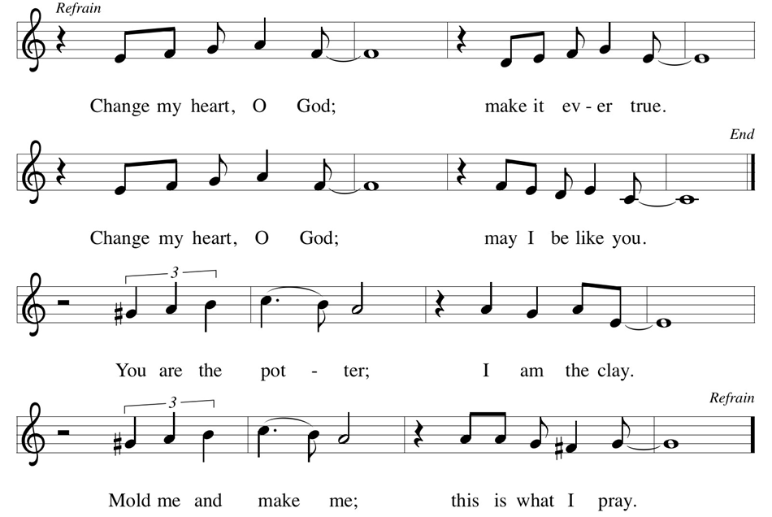
“Change My Heart O God” ELW 801
Notes:
Image: Five Loaves by Caroline Coolidge Brown. Copyright © Caroline Coolidge Brown. All rights reserved. Used by permission of the artist.

Slide 47
APOSTLE’S CREED
C: I believe in God, the Father almighty, creator of heaven and earth.

Slide 48
APOSTLE’S CREED
C: I believe in Jesus Christ, his only Son, our Lord. He was conceived by the power of the Holy Spirit and born of the virgin Mary. He suffered under Pontius Pilate, was crucified, died, and was buried.

Slide 49
APOSTLE’S CREED
C: He descended into hell. On the third day he rose again. He ascended into heaven, and is seated at the right hand of the Father. He will come again to judge the living and the dead.

Slide 50
APOSTLE’S CREED
C: I believe in the Holy Spirit, the holy catholic Church, the communion of saints, the forgiveness of sins, the resurrection of the body, and the life everlasting. Amen.

Slide 51
NICENE CREED
C: We believe in one God, the Father, the Almighty, maker of heaven and earth, of all that is, seen and unseen.

Slide 52
NICENE CREED
C: We believe in one Lord, Jesus Christ, the only Son of God, eternally begotten of the Father, God from God, Light from Light, true God from true God, begotten, not made, of one Being with the Father.

Slide 53
NICENE CREED
C: Through him all things were made. For us and for our salvation he came down from heaven; by the power of the Holy Spirit he became incarnate from the virgin Mary, and was made man. For our sake he was crucified under Pontius Pilate;

Slide 54
NICENE CREED
C: he suffered death and was buried. On the third day he rose again in accordance with the Scriptures; he ascended into heaven and is seated at the right hand of the Father. He will come again in glory to judge the living and the dead, and his kingdom will have no end.

Slide 55
NICENE CREED
C: We believe in the Holy Spirit, the Lord, the giver of life, who proceeds from the Father and the Son. With the Father and the Son he is worshiped and glorified. He has spoken through the prophets. We believe in one holy catholic and apostolic Church.

Slide 56
NICENE CREED
C: We acknowledge one Baptism for the forgiveness of sins. We look for the resurrection of the dead, and the life of the world to come. Amen.

Slide 57

Quilt Tying For Kaitlyn Triplett

Slide 58
PRAYERS OF INTERCESSION
Each petition will end with the words,
A: God, in your mercy
The congregation will respond with:
C: Hear our prayer.

Slide 59
PRAYERS OF INTERCESSION
The prayer concludes…
P: Trusting in your unending grace for all that you have made, we lift these and the prayers of our hearts to your loving care.
C: Amen.

Slide 60
OFFERING
Notes:
Image: Five Loaves by Caroline Coolidge Brown. Copyright © Caroline Coolidge Brown. All rights reserved. Used by permission of the artist.

Slide 61
OFFERING PRAYER
Notes:
Image: Five Loaves by Caroline Coolidge Brown. Copyright © Caroline Coolidge Brown. All rights reserved. Used by permission of the artist.

Slide 62
THE GREAT THANKSGIVING
All the Baptized are welcome to celebrate this Holy Meal.

Slide 63
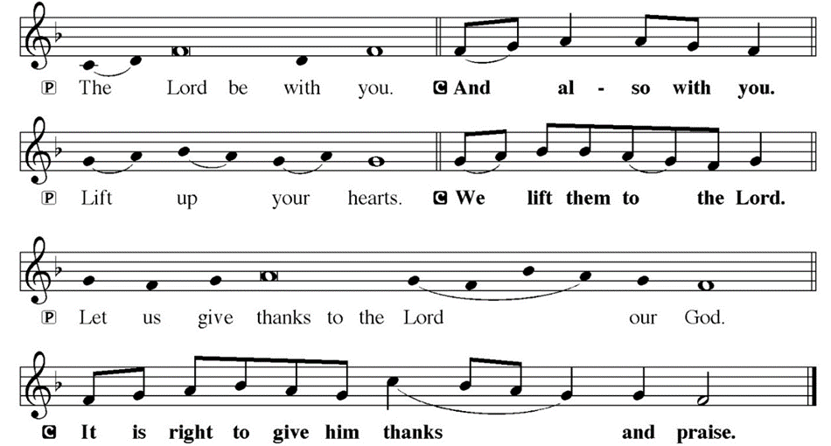
DIALOGUE

Slide 64
THE PREFACE
P: It is indeed right and salutary…
… we praise your name and join their unending hymn.

Slide 65
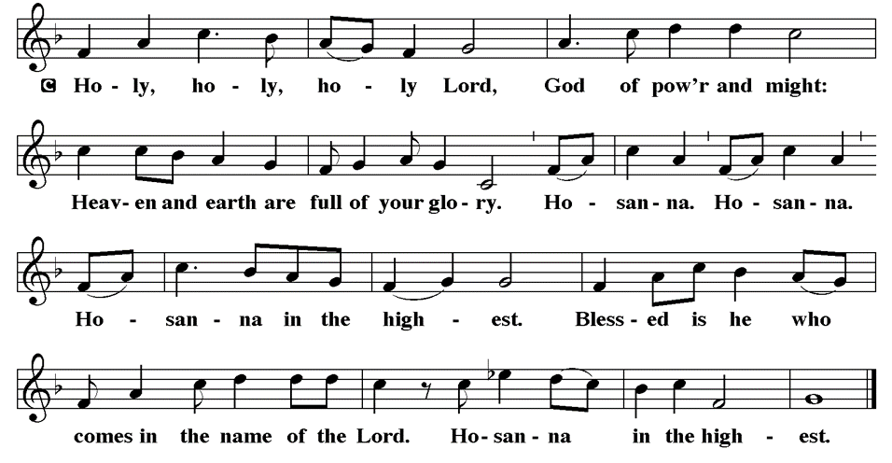
THE SANCTUS

Slide 66
EUCHARISTIC PRAYER
P: Holy God, Holy One, Holy Three! Before all that is, you were God. Outside all we know, you are God. After all is finished, you will be God. Archangels sound the trumpets, angels teach us their song, saints pull us into your presence. And this is our song:
C: Holy, holy, holy . . .

Slide 67
EUCHARISTIC PRAYER
P: Holy God, Holy One, Holy Three! You beyond the galaxies, you under the oceans, you inside the leaves, you pouring down rain, you opening the flowers, you feeding the insects, you giving us your image, you carrying us through the waters, you holding us in the night; your smile on Sarah and Abraham, your hand with Moses and Miriam, your words through Deborah

Slide 68
EUCHARISTIC PRAYER
P: and Isaiah; you lived as Jesus among us, healing, teaching, dying, rising, inviting us all to your feast.
P: In the night in which he was betrayed, he took bread, and gave thanks; broke it, and gave it to his disciples, saying: Take and eat; this is my body, given for you. Do this for the remembrance of me.

Slide 69
EUCHARISTIC PRAYER
P: Again, after supper, he took the cup, gave thanks, and gave it for all to drink, saying: This cup is the new covenant in my blood, shed for you and for all people for the forgiveness of sin. Do this for the remembrance of me.

Slide 70
EUCHARISTIC PRAYER
P: Holy God, we remember your Son, his life with the humble, his death among the wretched, his resurrection for us all: Your wisdom our guide, your justice our strength, your grace our path to rebirth. And so we cry, Mercy:
C: Mercy!

Slide 71
EUCHARISTIC PRAYER
P: And so we cry, Glory:
C: Glory!
P: And so we cry, Blessing:
C: Blessing!
P: Holy God, we beg for your Spirit: Enliven this bread, awaken this body, pour us out for each other. Transfigure our minds, ignite your church, nourish the life of the earth.

Slide 72
EUCHARISTIC PRAYER
P: Make us, while many, united, make us, though broken, whole, make us, despite death, alive. And so we cry, Come, Holy Spirit:
C: Come, Holy Spirit!
P: And so the church shouts, Come, Holy Spirit:
C: Come, Holy Spirit!
P: And so the earth pleads, Come, Holy Spirit:
C: Come, Holy Spirit!

Slide 73
EUCHARISTIC PRAYER
P: You, Holy God, Holy One, Holy Three, our Life, our Mercy, our Might, our Table, our Food, our Server, our Rainbow, our Ark, our Dove, our Sovereign, our Water, our Wine, our Light, our Treasure, our Tree, our Way, our Truth, our Life. You, Holy God, Holy One, Holy Three! Praise now, praise tomorrow, praise forever. And so we cry, Amen, amen:
C: Amen, amen!

Slide 74
THE LORD’S PRAYER
C: Our Father, who art in heaven, hallowed be thy name, thy kingdom come, thy will be done, on earth as it is in heaven. Give us this day our daily bread; and forgive us our trespasses, as we forgive those who trespass against us; and lead us not into temptation, but deliver us from evil.

Slide 75
THE LORD’S PRAYER
C: For thine is the kingdom, and the power, and the glory, forever and ever. Amen.

Slide 76
INVITATION TO COMMUNION
P: Our savior, Jesus Christ, stands at the door of the temple and calls one and all into his presence here at this holy meal. Receive bread and wine for the forgiveness of sin and new life in his name.

Slide 77
COMMUNION DISTRIBUTION
All will commune “By Station”.
The bread may be broken for distribution. As the ministers give the bread and wine, they say these words :
The body of Christ, given for you.
The blood of Christ, shed for you.
The communicant may say: Amen.

Slide 78
POST COMMUNION BLESSING
P: May this Body and Blood of our Lord and Savior, Jesus Christ, strengthen, keep, and unite us ☩ now and forever.
C: Amen.

Slide 79
POST COMMUNION CANTACLE

Slide 80
POST COMMUNION CANTACLE

Slide 81
POST COMMUNION PRAYER
P: Let us pray… Pour out upon us the spirit of your love, O Lord, and unite the wills of those whom you have fed with one heavenly food; through Jesus Christ our Lord.
C: Amen

Slide 82

ANNOUNCEMENTS
Notes:
Image: Five Loaves by Caroline Coolidge Brown. Copyright © Caroline Coolidge Brown. All rights reserved. Used by permission of the artist.

Slide 83
SENDING BLESSING
P: The Spirit of the triune God bless you with joy, anoint you with compassion, and ☩ send you in love.
C: Amen.

Slide 84
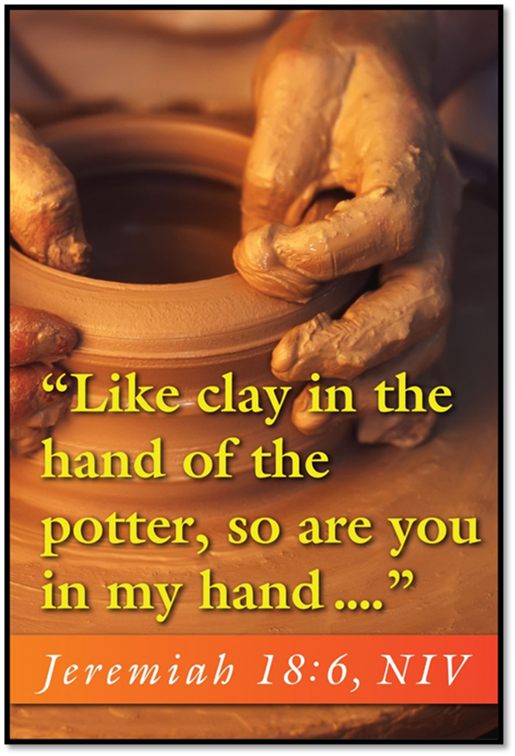
Sending Song
“My Faith Looks Up to Thee” LBW 479
Notes:
Image: Five Loaves by Caroline Coolidge Brown. Copyright © Caroline Coolidge Brown. All rights reserved. Used by permission of the artist.

Slide 85
“My Faith Looks Up to Thee” LBW 479
1 My faith looks up to thee,
thou Lamb of Calvary,
Savior divine!
Now hear me while I pray,
take all my guilt away,
oh, let me from this day
be wholly thine!
Notes:
Image: Preparing yeast dough. Copyright © tomasworks/iStock/Thinkstock. Used by permission.

Slide 86
“My Faith Looks Up to Thee” LBW 479
2 May thy rich grace impart
strength to my fainting heart,
my zeal inspire;
as thou hast died for me,
oh, may my love to thee
pure, warm, and changeless be,
a living fire!
Notes:
Image: Preparing yeast dough. Copyright © tomasworks/iStock/Thinkstock. Used by permission.

Slide 87
“My Faith Looks Up to Thee” LBW 479
3 While life's dark maze I tread
and griefs around me spread,
be thou my guide;
bid darkness turn to day,
wipe sorrow's tears away,
nor let me ever stray
from thee aside.
Notes:
Image: Preparing yeast dough. Copyright © tomasworks/iStock/Thinkstock. Used by permission.

Slide 88
“My Faith Looks Up to Thee” LBW 479
4 When ends life's transient dream,
when death's cold, sullen stream
shall o'er me roll;
blest Savior, then, in love
fear and distrust remove;
oh, bear me safe above,
a ransomed soul!
Notes:
Image: Preparing yeast dough. Copyright © tomasworks/iStock/Thinkstock. Used by permission.

Slide 89
DISMISSAL
P: … Depart in Christ’s Love.
C: Seeking, welcoming, and serving all. Amen!
POSTLUDE
By Roxanne Groff
From sundaysandseasons.com. Copyright © 2025 Augsburg Fortress. All rights reserved. Reprinted by permission under Augsburg Fortress Liturgies Annual License #SAS023830. New Revised Standard Version Bible, Copyright © 1989, Division of Christian Education of the National Council of the Churches of Christ in the United States of America. Used by permission. All rights reserved. Revised Common Lectionary, Copyright © 1992 Consultation on Common Texts, admin Augsburg Fortress. Used by permission.

