Slide 1
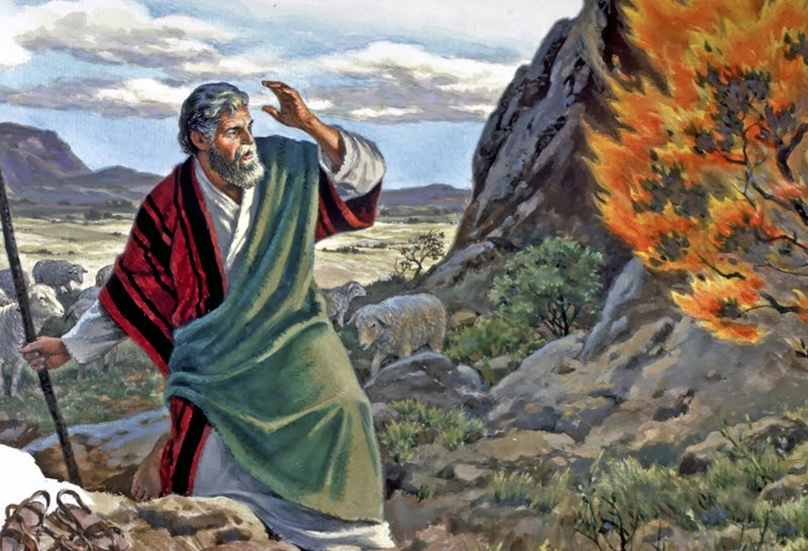
September 28, 2025
WELCOME!
Trinity Lutheran Church
Notes:
Image: Five Loaves by Caroline Coolidge Brown. Copyright © Caroline Coolidge Brown. All rights reserved. Used by permission of the artist.

Slide 2
= Please stand if able
= Please be seated
Prelude - By Roxanne Groff
Office of the Acolyte
Ringing of the Bell
Welcome
Notes:
Image: Five Loaves by Caroline Coolidge Brown. Copyright © Caroline Coolidge Brown. All rights reserved. Used by permission of the artist.

Slide 3
THANKSGIVING FOR BAPTISM
All may make the sign of the cross, the sign marked at baptism, as the presiding minister begins.
P: Blessed be the holy Trinity, ☩ one God, the fountain of living water, the rock who gave us birth, our light and our salvation.
C: Amen.
Notes:
Image: Preparing yeast dough. Copyright © tomasworks/iStock/Thinkstock. Used by permission.

Slide 4
P: Joined to Christ in the waters of baptism, we are clothed with God's mercy and forgiveness. Let us give thanks for the gift of baptism.
Water may be poured into the font as the presiding minister gives thanks.
THANKSGIVING FOR BAPTISM
Notes:
Image: Preparing yeast dough. Copyright © tomasworks/iStock/Thinkstock. Used by permission.

Slide 5
P: We give you thanks, O God, for in the beginning your Spirit moved over the waters and by your Word you created the world, calling forth life in which you took delight. Through the waters of the flood you delivered Noah and his family. Through the sea you led your people Israel from slavery into freedom.
THANKSGIVING FOR BAPTISM
Notes:
Image: Preparing yeast dough. Copyright © tomasworks/iStock/Thinkstock. Used by permission.

Slide 6
P: At the river your Son was baptized by John and anointed with the Holy Spirit. By water and your Word you claim us as daughters and sons, making us heirs of your promise and servants of all. We praise you for the gift of water that sustains life, and above all we praise you for the gift of new life in Jesus Christ.
THANKSGIVING FOR BAPTISM
Notes:
Image: Preparing yeast dough. Copyright © tomasworks/iStock/Thinkstock. Used by permission.

Slide 7
P: Shower us with your Spirit, and renew our lives with your forgiveness, grace, and love. To you be given honor and praise through Jesus Christ our Lord in the unity of the Holy Spirit, now and forever.
THANKSGIVING FOR BAPTISM
C: Amen.
Notes:
Image: Preparing yeast dough. Copyright © tomasworks/iStock/Thinkstock. Used by permission.

Slide 8
Gathering Song
“Take My Life, That I May Be”
LBW 406

Slide 9
“Take My Life, That I May Be” -- LBW 406
1 Take my life, that I may be
consecrated, Lord, to thee;
take my moments and my days;
let them flow in ceaseless praise.
2 Take my hands and let them move
at the impulse of thy love;
take my feet and let them be
swift and beautiful for thee.
Notes:
Image: Five Loaves by Caroline Coolidge Brown. Copyright © Caroline Coolidge Brown. All rights reserved. Used by permission of the artist.

Slide 10
“Take My Life, That I May Be” -- LBW 406
3 Take my voice and let me sing
always, only, for my King;
take my lips and let them be
filled with messages from thee.
4 Take my silver and my gold,
not a mite would I withhold;
take my intellect and use
ev'ry pow'r as thou shall choose.
Notes:
Image: Five Loaves by Caroline Coolidge Brown. Copyright © Caroline Coolidge Brown. All rights reserved. Used by permission of the artist.

Slide 11
“Take My Life, That I May Be” -- LBW 406
5 Take my will and make it thine,
it shall be no longer mine.
Take my heart, it is thine own,
it shall be thy royal throne.
6 Take my love; my Lord, I pour
at thy feet its treasure store;
take myself, and I will be
ever, only, all for thee.
Notes:
Image: Five Loaves by Caroline Coolidge Brown. Copyright © Caroline Coolidge Brown. All rights reserved. Used by permission of the artist.

Slide 12
APOSTOLIC GREETING
P: The grace of our Lord Jesus Christ, the love of God, and the communion of the Holy Spirit be with you all.
C: And also with you.
Notes:
Image: Five Loaves by Caroline Coolidge Brown. Copyright © Caroline Coolidge Brown. All rights reserved. Used by permission of the artist.

Slide 13
PRAYER OF THE DAY
P: God of promise, you call us into your holy presence and entrust us with the work of caring for your beloved children—all of humanity and all of creation. Guide us, equip us, and inspire us to follow in your way, through Jesus Christ.
C: Amen.
Notes:
Image: Five Loaves by Caroline Coolidge Brown. Copyright © Caroline Coolidge Brown. All rights reserved. Used by permission of the artist.

Slide 14

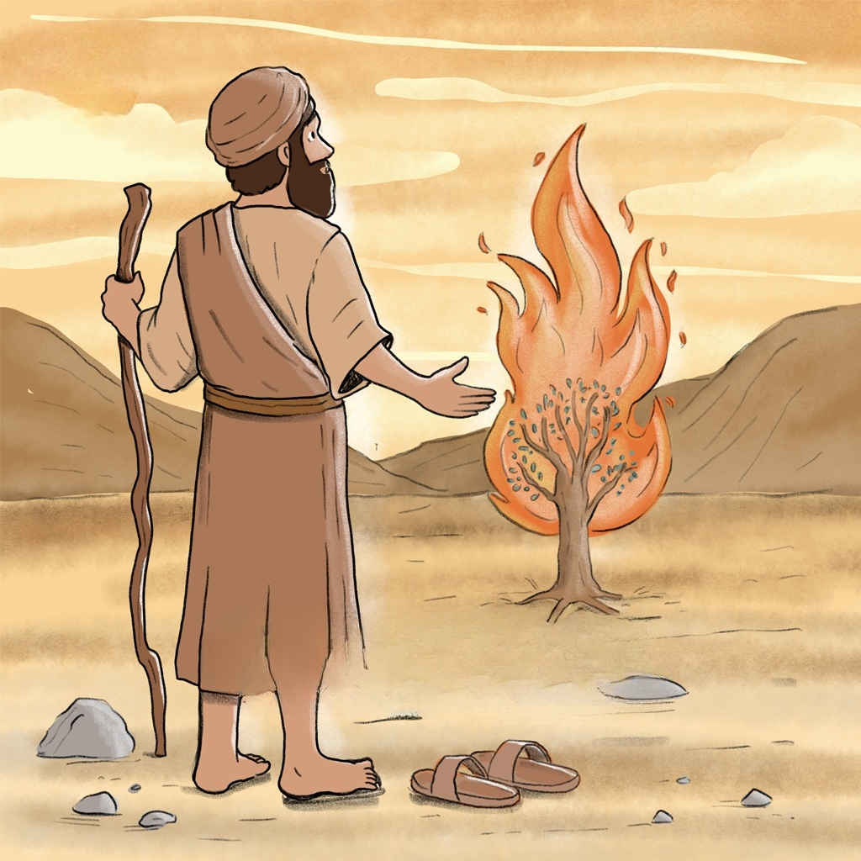
Notes:
Image: Five Loaves by Caroline Coolidge Brown. Copyright © Caroline Coolidge Brown. All rights reserved. Used by permission of the artist.

Slide 15
Scripture Reading
L: Our scripture reading is from Exodus, Chapters 2, 3, and 4.
C: Glory to you O’ Lord!
Notes:
Image: Five Loaves by Caroline Coolidge Brown. Copyright © Caroline Coolidge Brown. All rights reserved. Used by permission of the artist.

Slide 16
Exodus 2:23-25; 3:1-15; 4:10-17
Chapter 2
²³After a long time the king of Egypt died. The Israelites groaned under their slavery, and cried out. Out of the slavery their cry for help rose up to God. ²⁴God heard their groaning, and God remembered his covenant with Abraham, Isaac, and Jacob. ²⁵God looked upon the
Notes:
Image: Five Loaves by Caroline Coolidge Brown. Copyright © Caroline Coolidge Brown. All rights reserved. Used by permission of the artist.

Slide 17
Exodus 2:23-25; 3:1-15; 4:10-17
Chapter 2
Israelites, and God took notice of them.
Chapter 3
Moses was keeping the flock of his father-in-law Jethro, the priest of Midian; he led his flock beyond the wilderness, and came to Horeb, the mountain of God. ²There the angel of
Notes:
Image: Five Loaves by Caroline Coolidge Brown. Copyright © Caroline Coolidge Brown. All rights reserved. Used by permission of the artist.

Slide 18
Exodus 2:23-25; 3:1-15; 4:10-17
Chapter 3
the Lord appeared to him in a flame of fire out of a bush; he looked, and the bush was blazing, yet it was not consumed. ³Then Moses said, “I must turn aside and look at this great sight, and see why the bush is not burned up.” ⁴When the Lord saw that he had turned aside to see, God
Notes:
Image: Five Loaves by Caroline Coolidge Brown. Copyright © Caroline Coolidge Brown. All rights reserved. Used by permission of the artist.

Slide 19
Exodus 2:23-25; 3:1-15; 4:10-17
Chapter 3
called to him out of the bush, “Moses, Moses!” And he said, “Here I am.” ⁵Then he said, “Come no closer! Remove the sandals from your feet, for the place on which you are standing is holy ground.” ⁶He said further, “I am the God of your father, the God of Abraham, the God
Notes:
Image: Five Loaves by Caroline Coolidge Brown. Copyright © Caroline Coolidge Brown. All rights reserved. Used by permission of the artist.

Slide 20
Exodus 2:23-25; 3:1-15; 4:10-17
Chapter 3
of Isaac, and the God of Jacob.” And Moses hid his face, for he was afraid to look at God.
⁷Then the Lord said, “I have observed the misery of my people who are in Egypt; I have heard their cry on account of their taskmasters. Indeed, I know their sufferings, ⁸and
Notes:
Image: Five Loaves by Caroline Coolidge Brown. Copyright © Caroline Coolidge Brown. All rights reserved. Used by permission of the artist.

Slide 21
Exodus 2:23-25; 3:1-15; 4:10-17
Chapter 3
I have come down to deliver them from the Egyptians, and to bring them up out of that land to a good and broad land, a land flowing with milk and honey, to the country of the Canaanites, the Hittites, the Amorites, the Perizzites, the Hivites, and the Jebusites. ⁹The cry of the
Notes:
Image: Five Loaves by Caroline Coolidge Brown. Copyright © Caroline Coolidge Brown. All rights reserved. Used by permission of the artist.

Slide 22
Exodus 2:23-25; 3:1-15; 4:10-17
Chapter 3
Israelites has now come to me; I have also seen how the Egyptians oppress them. ¹⁰So come, I will send you to Pharaoh to bring my people, the Israelites, out of Egypt.”
¹¹But Moses said to God, “Who am I that I should go to Pharaoh, and bring the Israelites out of
Notes:
Image: Five Loaves by Caroline Coolidge Brown. Copyright © Caroline Coolidge Brown. All rights reserved. Used by permission of the artist.

Slide 23
Exodus 2:23-25; 3:1-15; 4:10-17
Chapter 3
Egypt?” ¹²He said, “I will be with you; and this shall be the sign for you that it is I who sent you: when you have brought the people out of Egypt, you shall worship God on this mountain.” ¹³But Moses said to God, “If I come to the Israelites and say to them, ‘The God of your ancestors has sent me to you,’ and they ask
Notes:
Image: Five Loaves by Caroline Coolidge Brown. Copyright © Caroline Coolidge Brown. All rights reserved. Used by permission of the artist.

Slide 24
Exodus 2:23-25; 3:1-15; 4:10-17
Chapter 3
me, ‘What is his name?’ what shall I say to them?” ¹⁴God said to Moses, “I am who I am.” He said further, “Thus you shall say to the Israelites, ‘I Am has sent me to you.’” ¹⁵God also said to Moses, “Thus you shall say to the Israelites, ‘The Lord, the God of your ancestors, the God of Abraham, the God of Isaac, and the God of Jacob,
Notes:
Image: Five Loaves by Caroline Coolidge Brown. Copyright © Caroline Coolidge Brown. All rights reserved. Used by permission of the artist.

Slide 25
Exodus 2:23-25; 3:1-15; 4:10-17
Chapter 3
has sent me to you’: This is my name forever, and this my title for all generations.
Chapter 4
¹⁰But Moses said to the Lord, “O my Lord, I have never been eloquent, neither in the past nor even now that you have spoken to your servant; but
Notes:
Image: Five Loaves by Caroline Coolidge Brown. Copyright © Caroline Coolidge Brown. All rights reserved. Used by permission of the artist.

Slide 26
Exodus 2:23-25; 3:1-15; 4:10-17
Chapter 4
I am slow of speech and slow of tongue.” ¹¹Then the Lord said to him, “Who gives speech to mortals? Who makes them mute or deaf, seeing or blind? Is it not I, the Lord? ¹²Now go, and I will be with your mouth and teach you what you are to speak.” ¹³But he said, “O my Lord, please send someone else.” ¹⁴Then
Notes:
Image: Five Loaves by Caroline Coolidge Brown. Copyright © Caroline Coolidge Brown. All rights reserved. Used by permission of the artist.

Slide 27
Exodus 2:23-25; 3:1-15; 4:10-17
Chapter 4
the anger of the Lord was kindled against Moses and he said, “What of your brother Aaron, the Levite? I know that he can speak fluently; even now he is coming out to meet you, and when he sees you his heart will be glad. ¹⁵You shall speak to him and put the words in his mouth;
Notes:
Image: Five Loaves by Caroline Coolidge Brown. Copyright © Caroline Coolidge Brown. All rights reserved. Used by permission of the artist.

Slide 28
Exodus 2:23-25; 3:1-15; 4:10-17
Chapter 4
and I will be with your mouth and with his mouth, and will teach you what you shall do. ¹⁶He indeed shall speak for you to the people; he shall serve as a mouth for you, and you shall serve as God for him. ¹⁷Take in your hand this staff, with which you shall perform the signs.”
Notes:
Image: Five Loaves by Caroline Coolidge Brown. Copyright © Caroline Coolidge Brown. All rights reserved. Used by permission of the artist.

Slide 29
Exodus 2:23-25; 3:1-15; 4:10-17
R: This is the Word of the Lord!
C: Praise to You, O Christ
Notes:
Image: Five Loaves by Caroline Coolidge Brown. Copyright © Caroline Coolidge Brown. All rights reserved. Used by permission of the artist.

Slide 30
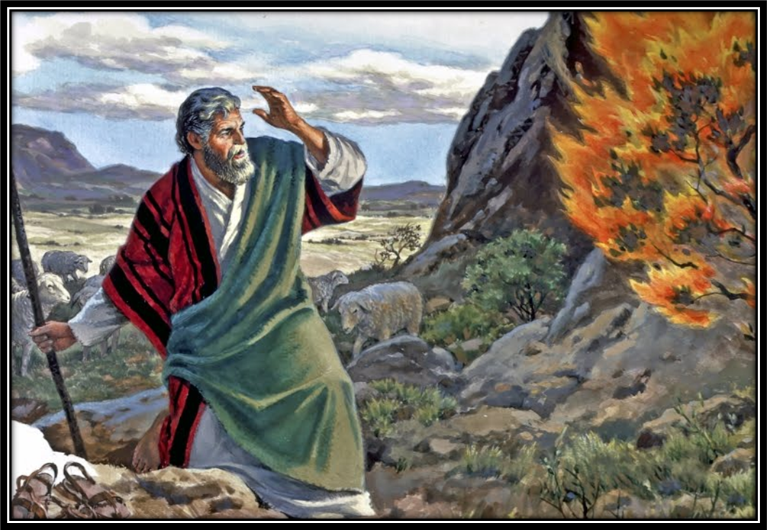
Sermon

Slide 31
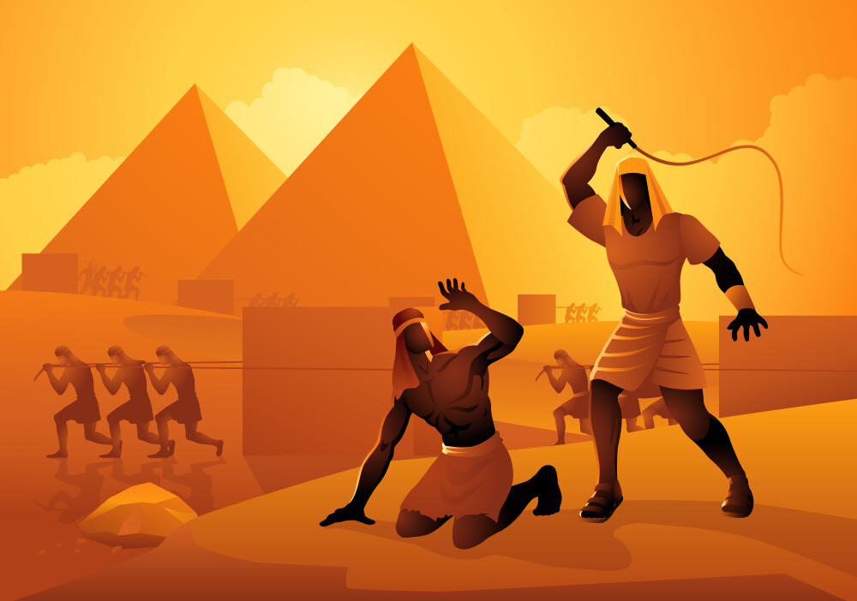
Sermon

Slide 32
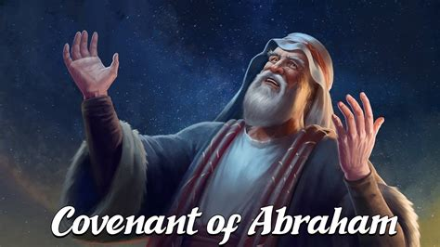
Sermon

Slide 33
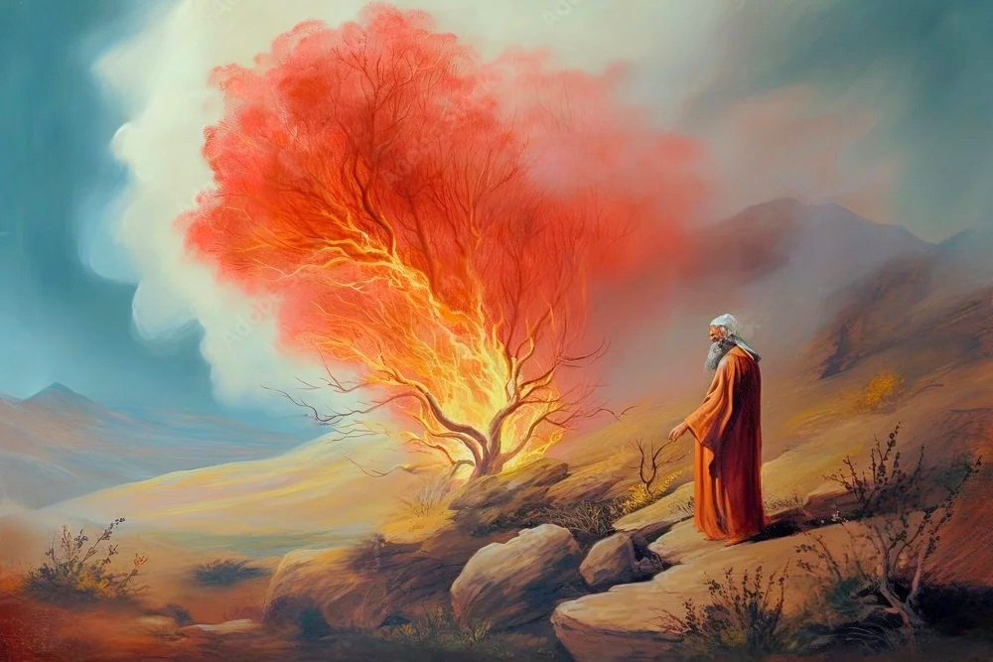
Sermon

Slide 34
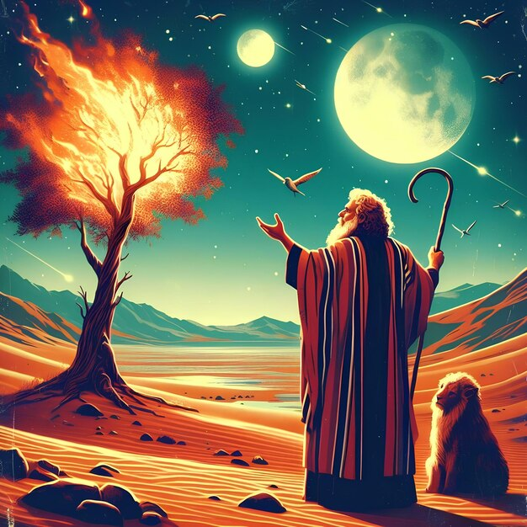
Sermon

Slide 35
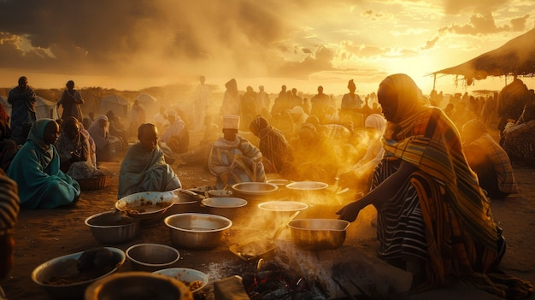
Sermon

Slide 36
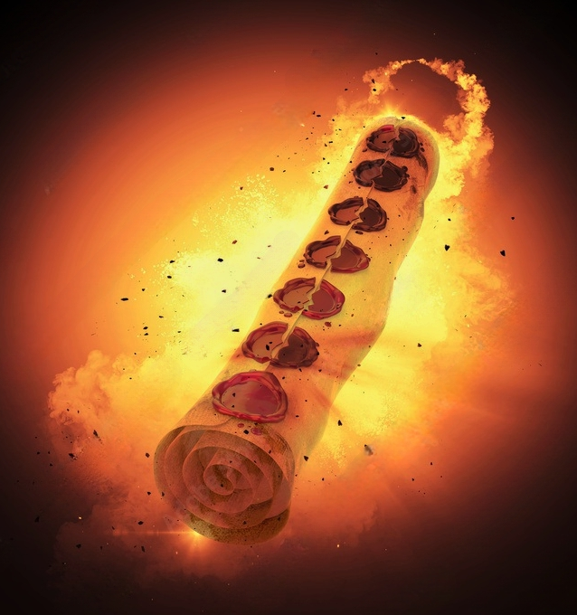
Sermon

Slide 37

Sermon

Slide 38
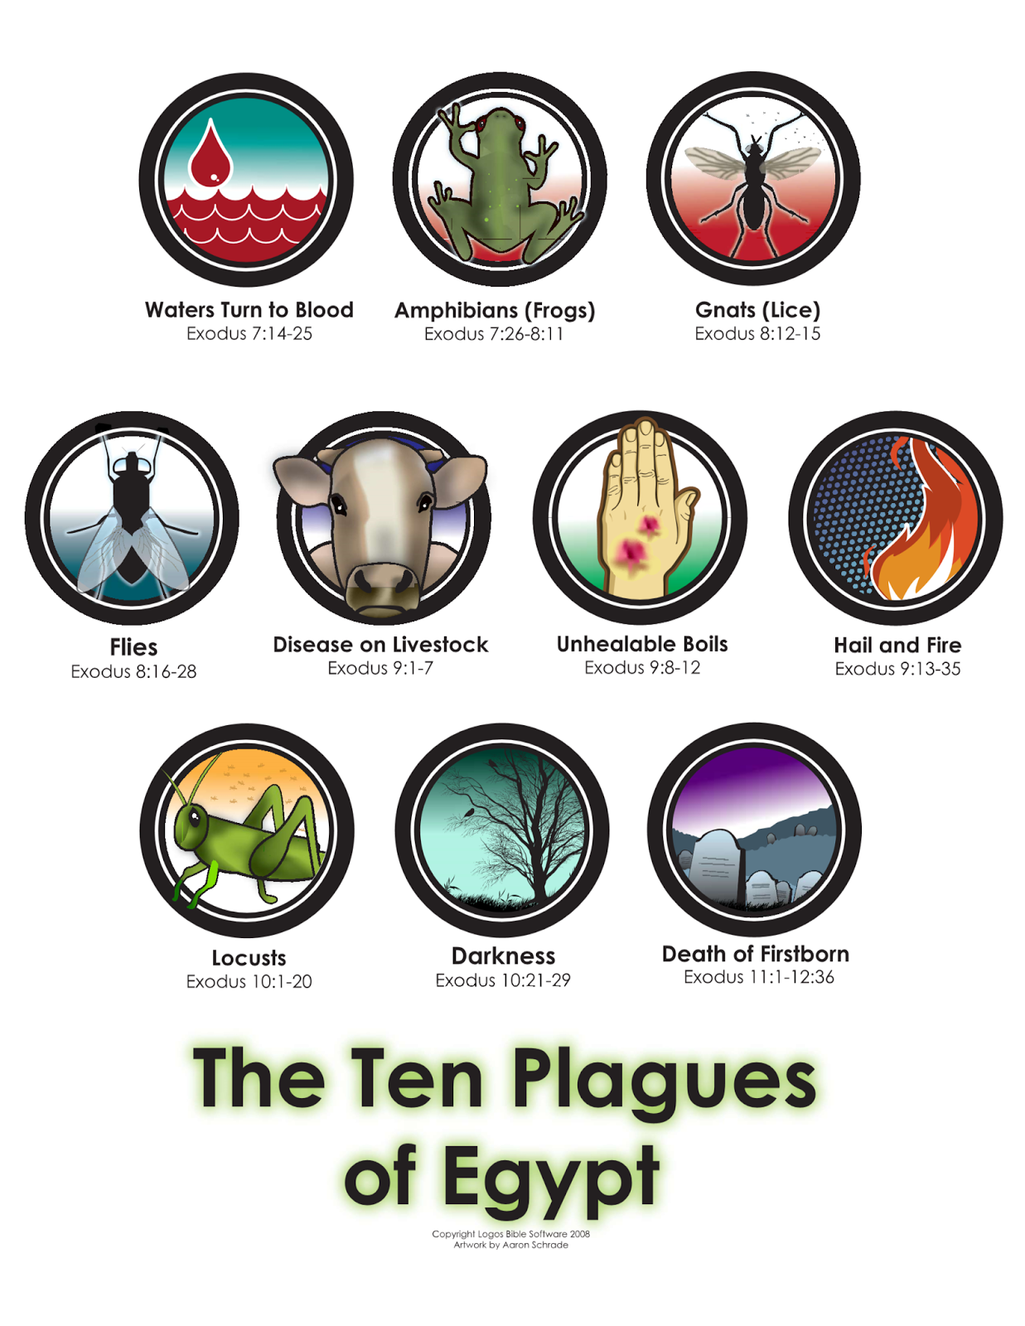
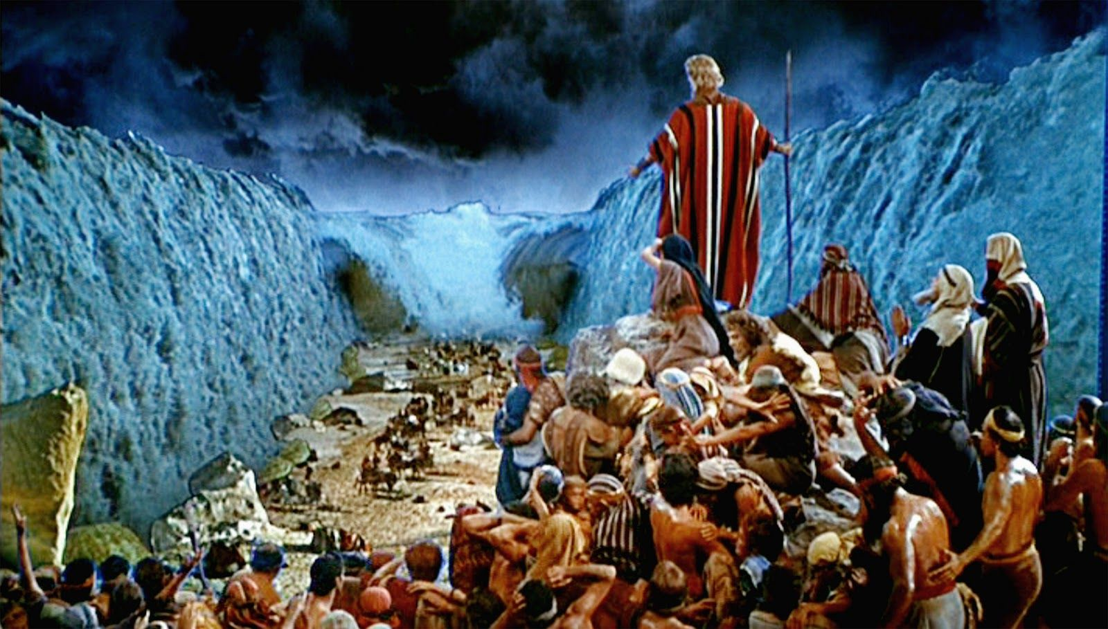
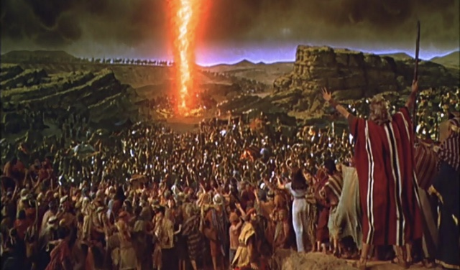
Sermon

Slide 39
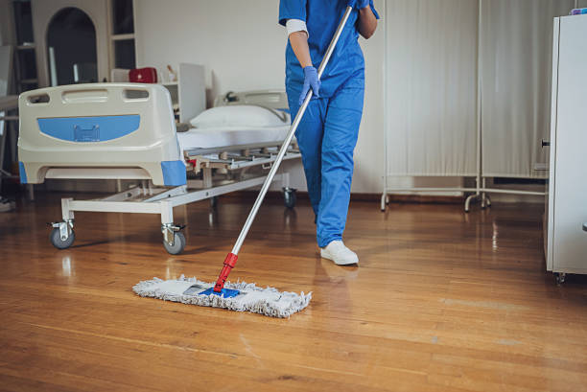
Sermon

Slide 40
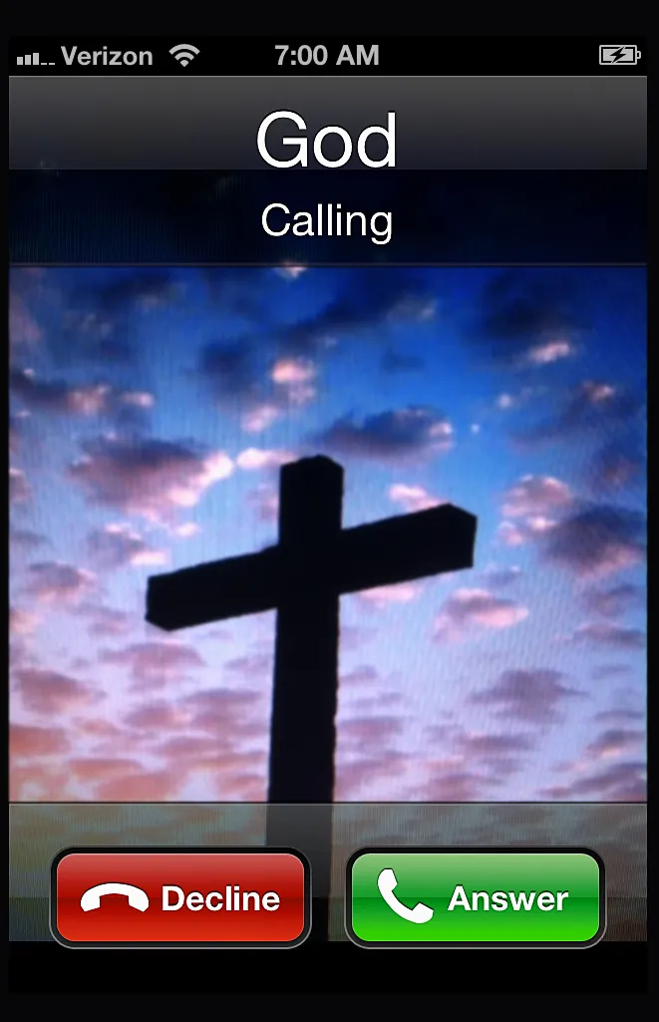
Sermon
It’s for you…

Slide 41
Hymn of the Day
“Holy, Holy, Holy”
LBW 165

Slide 42
“Holy, Holy, Holy” LBW 165
1 Holy, holy, holy, Lord God Almighty!
Early in the morning our song shall rise to thee.
Holy, holy, holy, merciful and mighty!
God in three Persons, blessed Trinity!

Slide 43
“Holy, Holy, Holy” LBW 165
2 Holy, holy, holy! All the saints adore thee,
casting down their golden crowns around the glassy sea;
cherubim and seraphim falling down before thee,
which wert and art and evermore shalt be.

Slide 44
“Holy, Holy, Holy” LBW 165
3 Holy, holy, holy! Though the darkness hide thee,
though the eye made blind by sin thy glory may not see,
only thou art holy; there is none beside thee,
perfect in pow’r, in love and purity.

Slide 45
“Holy, Holy, Holy” LBW 165
4 Holy, holy, holy! Lord God Almighty!
All thy works shall praise thy name in earth and sky and sea.
Holy, holy, holy, merciful and mighty!
God in three Persons, blessed Trinity!

Slide 46
APOSTLE’S CREED
C: I believe in God, the Father almighty, creator of heaven and earth.

Slide 47
APOSTLE’S CREED
C: I believe in Jesus Christ, his only Son, our Lord. He was conceived by the power of the Holy Spirit and born of the virgin Mary. He suffered under Pontius Pilate, was crucified, died, and was buried.

Slide 48
APOSTLE’S CREED
C: He descended into hell. On the third day he rose again. He ascended into heaven, and is seated at the right hand of the Father. He will come again to judge the living and the dead.

Slide 49
APOSTLE’S CREED
C: I believe in the Holy Spirit, the holy catholic Church, the communion of saints, the forgiveness of sins, the resurrection of the body, and the life everlasting. Amen.

Slide 50
BLESSING OF OUR QUILTS AND KITS
P: O God, our neighbors around the world are in need of hope. Your Spirit is a mighty force, your whispers of hope bring light into the world. Open our hearts and hands to see your presence in our neighborhoods and across the world.
C: Jesus, help us reach out in hope to our neighbors.

Slide 51
BLESSING OF OUR QUILTS AND KITS
P: God, we give you thanks for the pieces of fabric, thread, sewing machines, and the items collected for the kits. May their presence be a sign of hope, may these quilts wrap our neighbors in unending love, and may these kits offer dignity and healing.
C: Jesus, help us reach out in hope to our neighbors.

Slide 52
BLESSING OF OUR QUILTS AND KITS
P: God, we give thanks for all the hands that fashioned hope into a quilt, for the hands that collected and sorted, for the hands that continually open wider so that no one feels left out.
C: Jesus, help us see hope in our neighbors.

Slide 53
BLESSING OF OUR QUILTS AND KITS
P: God, we ask you to guide the staff and partners at LWR. May their voices and hands be a beacon of hope. Keep them safe. Keep them filled with your strength and perseverance.
C: Jesus, help us share a taste of hope with our neighbors.

Slide 54
BLESSING OF OUR QUILTS AND KITS
P: God, be with our neighbors who will receive these gifts. May they be wrapped in love, may they taste your goodness, may they touch signs of your hope. Whether or not we know their names or where they live, they are our neighbors, all children of our heavenly Father. We pray all this in the name of Jesus, the One who is our hope.
C: Amen.

Slide 55
BLESSING OF OUR QUILTS AND KITS
Sending
P: I sprinkle these kits and quilts with the water of hope from our Baptismal font to carry the gift of God’s Holy Spirit to people in desperate need. May these kits and quilts be a sign of that hope to our neighbors near and far: offering a sweet scent of justice, and a feast of God’s goodness. In the name of the Father, ☩ the Son, and the Holy Spirit.
C: Amen.

Slide 56
PRAYERS OF INTERCESSION
Each petition will end with the words,
A: God of promise,
The congregation will respond with:
C: Hear our prayer.

Slide 57
PRAYERS OF INTERCESSION
The prayer concludes…
P: We lift all these prayers, and those of our hearts, to your loving care, O God. Receive them and restore our hope in your promises. In Jesus’ name.
C: Amen.

Slide 58

OFFERING/OFFERING PRAYER
Notes:
Image: Five Loaves by Caroline Coolidge Brown. Copyright © Caroline Coolidge Brown. All rights reserved. Used by permission of the artist.

Slide 59
THE LORD’S PRAYER
C: Our Father, who art in heaven, hallowed be thy name, thy kingdom come, thy will be done, on earth as it is in heaven. Give us this day our daily bread; and forgive us our trespasses, as we forgive those who trespass against us; and lead us not into temptation, but deliver us from evil.

Slide 60
THE LORD’S PRAYER
C: For thine is the kingdom, and the power, and the glory, forever and ever. Amen.

Slide 61

ANNOUNCEMENTS
Notes:
Image: Five Loaves by Caroline Coolidge Brown. Copyright © Caroline Coolidge Brown. All rights reserved. Used by permission of the artist.

Slide 62
SENDING BLESSING
P: The God of righteousness, who gives justice to the oppressed, who gives food to the hungry, who sets the prisoners free, ☩ bless you now and forever.
C: Amen.

Slide 63
SENDING HYMN
“Jesus Shall Reign”
LBW 530

Slide 64
“Jesus Shall Reign” LBW 530
1 Jesus shall reign where'er the sun
does its successive journeys run;
his kingdom stretch from shore to shore,
till moons shall wax and wane no more.

Slide 65
“Jesus Shall Reign” LBW 530
2 To him shall endless prayer be made,
and praises throng to crown his head;
his name like sweet perfume shall rise
with ev'ry morning sacrifice.

Slide 66
“Jesus Shall Reign” LBW 530
3 People and realms of ev'ry tongue
dwell on his love with sweetest song;
and infant voices shall proclaim
their early blessings on his name.

Slide 67
“Jesus Shall Reign” LBW 530
4 Blessings abound where'er he reigns:
the pris'ners leap to lose their chains,
the weary find eternal rest,
and all who suffer want are blest.

Slide 68
“Jesus Shall Reign” LBW 530
5 Let ev'ry creature rise and bring
peculiar honors to our king;
angels descend with songs again,
and earth repeat the loud amen.

Slide 69
DISMISSAL
P: … Depart in Christ’s Love.
C: Seeking, welcoming, and serving all. Amen!
POSTLUDE
By
Roxanne Groff
From sundaysandseasons.com. Copyright © 2025 Augsburg Fortress. All rights reserved. Reprinted by permission under Augsburg Fortress Liturgies Annual License #SAS023830. New Revised Standard Version Bible, Copyright © 1989, Division of Christian Education of the National Council of the Churches of Christ in the United States of America. Used by permission. All rights reserved. Revised Common Lectionary, Copyright © 1992 Consultation on Common Texts, admin Augsburg Fortress. Used by permission.

