Slide 1

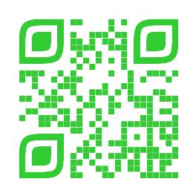
Announcements
Trinity Lutheran Church
January 18, 2026
Scan Me!

Slide 2


Slide 3

Body, Mind, Spirit
MIND: Declutter one small space (drawer, purse, email inbox).
BODY: Focus on posture throughout the day.
SPIRIT: Write a prayer asking God to renew your strength.
.

Slide 4


Our Office Secretary Is Sharon Fourman
Church Office Schedule
Tuesday-Thursday 8am – 12 noon
Office Phone: (937) 692-5670
Pastor’s Phone: (937) 626-7100
Email: secretary@pitsburgtlc.org

Slide 5

The Trinity Trumpet
A Monthly Newsletter
Published by Trinity Lutheran Church,
Pitsburg, OH
We’re looking for stories and pictures of Trinity people in action!
Submit to Secretary, Sharon Fourman at secretary@pitsburgtlc.org
Articles and Info due on or about the 3rd Tuesday of each month

Slide 6

Trinity Trumpet
    Your Trinity Trumpet Newsletter for January 2026 is available!
    Please take your copy before you leave today!

Slide 7
Trinity Trumpet
    Newsletter Deadline is Tuesday, January 20, 2026!!!
    Please turn in all your newsworthy items to Sharon Fourman at:
    secretary@pitsburgtlc.org

Slide 8

We’re Online!
www.pitsburgtlc.org
Sermons, Bulletins (Worship Books), Worship Slides, and announcements are posted weekly
Trinity Trumpet and ‘Official’ Trinity Calendar are also available
Pictures, Videos and more!
Also, like us on FaceBook at
facebook.com/pitsburgtrinitylutheran.church

Slide 9
We’re Online!
www.pitsburgtlc.org
We have our own QR Code!
Scan this code with your Smartphone and you will connect to all our Online media (Facebook, YouTube, and our own Church Website)

Slide 10

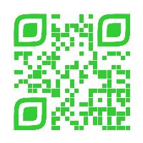
Online Giving
www.pitsburgtlc.org
Click the “Give to Trinity” Button
Stay current in your giving even when you can’t make it to Worship!
Separate Giving Categories for:
    General Treasury
    Benevolence/Mission Support
    Building Fund
    Annual Christmas Auction
    Memorial Funds
    Thrive Capital Campaign

Slide 11

    If you would like to sponsor the Altar Flowers, see PJ to Sign Up!
    Please let our Church Secretary, Sharon, know so she can put it in the Bulletin!

Slide 12


Church
Council
Trinity Church Council
Next Meeting is …
TBD

Slide 13


Choice FISH Pantry
Please join us every Friday @ 3:30 pm
400 Markwith Dr, Greenville OH
Most Needed Items
Kidney Beans
Canned Peas
Hamburger Helper
Pork & Beans
Canned Mixed Veggies
Large Cans of Soups
Applesauce
Boxed Meals
(i.e. Rice a Roni)

Slide 14
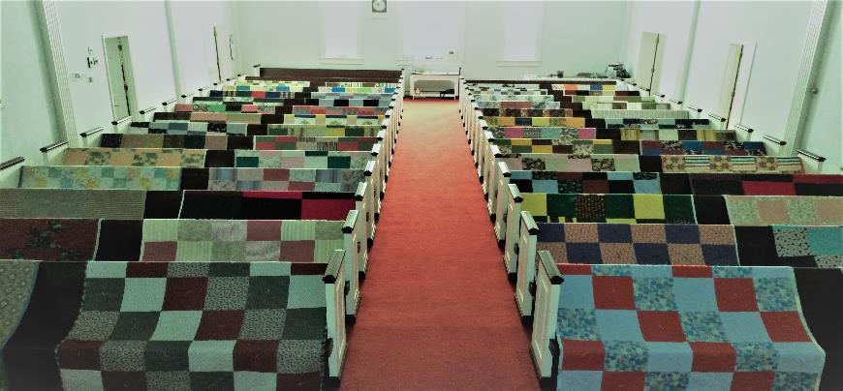
Prayers and Squares
Quilting Ministry
January 27th @ 10:00 am
February 8 @ 10:00 am

Slide 15

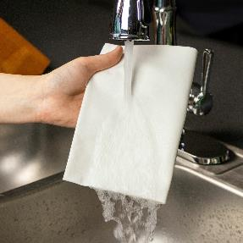
ULTIMATE CLEANING CLOTH SALE
1 for $7.00
2 for $10.00
5 for $20.00
See
  Portia Boord or Diane Warner

Slide 16


Ladies and Gents Luncheon
Date: February 19th @ 11:30 am
Where: TBD
For Reservations/Questions:
        See Linda Baker or call her @ 937 545-8410

Slide 17

Confirmation Program
(7th and 8th Graders)
    Class on most Sunday mornings @ 9 am
    Weekly Worship attendance is required in person or via FaceBook
    Worship Notes may be emailed to pastor@pitsburgtlc.org or placed in Pr Mel’s mailbox outside the Church Office
    Confirmands are HIGHLY encouraged to take turns as Acolyte

Slide 18

YOUTH QUAKE-CINCINNATI
(6th and 12th Graders)
Please continue to pray for our Youth who attended this event!
Stephan
Lexi
Allison
Micah
Jackson

Slide 19

    Who can be an Acolyte? YOU CAN!!!
    Acolyte Training – As Needed
    Please sign up for Acolyte Duty on the chart by the Church Office!
    Confirmation Students are Highly Encouraged to perform Acolyte duty…
    Please sign up today!

Slide 20

New Member Class
We are forming a “New Member” Class for anyone who wants to learn more about Being Lutheran and what being a member of Trinity entails…
    Classes will begin in Soon!
    Class time and Dates are TBD
    Please see Pastor Mel if Interested in attending

Slide 21
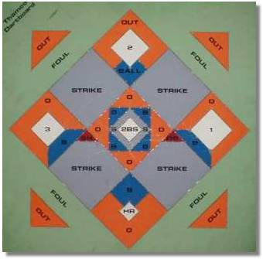


Monday
January 19, 2026
No Games Due to NCAA Championship

Slide 22

Next Regular Meeting
February 5, 2026 @ 10:00 am
Purpose – Plan for Bingo Tournament, Shrove Tuesday, Lent, Easter, and beyond…
Please come if you can!

Slide 23

Calling all Adults!
Join Us For “Christian Conversations”
Not Your Ordinary Adult Sunday School
Sharing – Discussion - Prayer
Every Sunday @
9:30 am
Notes:
Cover: Sermon on the Mount by Laura James. Copyright © Laura James. All rights reserved. Used by permission of the artist.

Slide 24

The Chosen
Season 3, Episode 2
Video Discussion Group
January 25 @ 6 pm
Notes:
Cover: Sermon on the Mount by Laura James. Copyright © Laura James. All rights reserved. Used by permission of the artist.

Slide 25
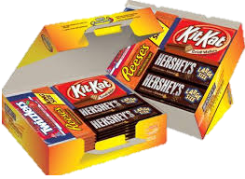
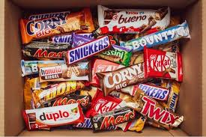
Trinity Youth
Fun (d) Raiser!
Candy Bar Sales!
Large Selection
$2 Each
Supports Our Youth
Notes:
Cover: Sermon on the Mount by Laura James. Copyright © Laura James. All rights reserved. Used by permission of the artist.

Slide 26

Trinity Troops
Date: TODAY!!!
Who: Youth 4th – 6th Grades and families
What: Fun, Snacks, Blanket Tying!
Where: @ Trinity
When: After Worship
Trinity Troops!

Slide 27

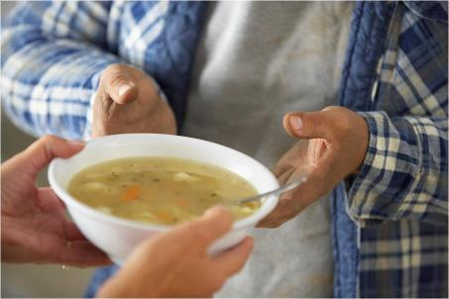
Grace Resurrection Community Center
Soup Kitchen Meal
When: Wednesday, December 17, 2025
10:00 am to 1:00 pm.
Where: 433 Water Street in Greenville

Slide 28

Advent
And Beyond!
Soup Suppers @ 6:30 pm
  3 Wednesdays in Jan
    Starting Jan 14th
Dealing with difficult people.
Coping with tough circumstances.
Overcoming low self-esteem.
Managing stress.
Notes:
Cover: Sermon on the Mount by Laura James. Copyright © Laura James. All rights reserved. Used by permission of the artist.

Slide 29
Save the Dates(Lent and Easter)
Shrove Tuesday – Feb 17 @ 6 pm
Ash Wednesday – Feb 18 @ 7 pm
Lent Soup Suppers @ 6 pm
    Feb 25, Mar 4, Mar 11, Mar 18, Mar 25
Maundy Thursday Sedar Meal
    Apr 2 @ 6 pm
Good Friday – Apr 3 @ 7 pm
Easter Sunday – Apr 5 (All Day!)
Notes:
Cover: Sermon on the Mount by Laura James. Copyright © Laura James. All rights reserved. Used by permission of the artist.

