Slide 1
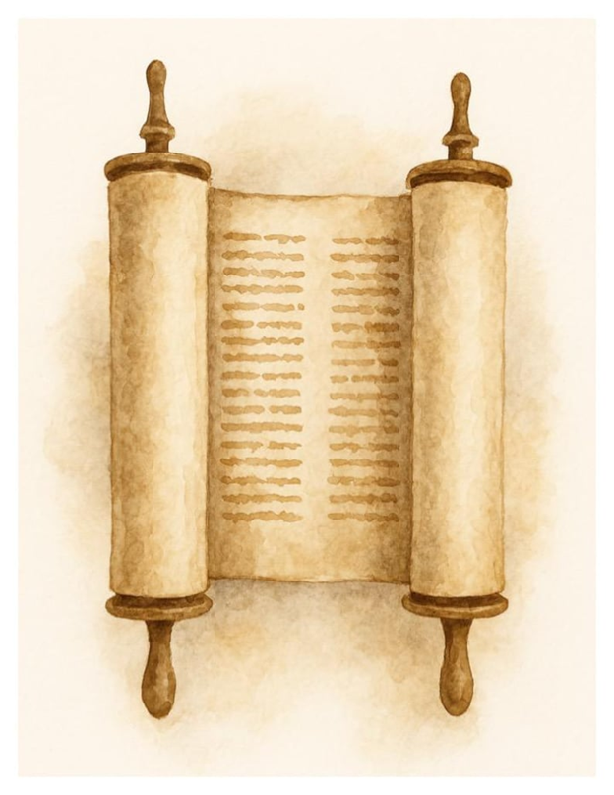
June 29, 2025
WELCOME!
Trinity Lutheran Church
Notes:
Image: Five Loaves by Caroline Coolidge Brown. Copyright © Caroline Coolidge Brown. All rights reserved. Used by permission of the artist.

Slide 2
= Please stand if able
= Please be seated
Prelude - By Pam Sherman
Office of the Acolyte
Ringing of the Bell
Welcome
Notes:
Image: Five Loaves by Caroline Coolidge Brown. Copyright © Caroline Coolidge Brown. All rights reserved. Used by permission of the artist.

Slide 3

Baptismal Hymn
“Borning Cry” - ELW 732
(Verses 1 & 2)
Baptismal party gathers at the font.
This Photo by Unknown Author is licensed under CC BY-SA
Notes:
Image: Five Loaves by Caroline Coolidge Brown. Copyright © Caroline Coolidge Brown. All rights reserved. Used by permission of the artist.

Slide 4

Borning Cry
1 "I was there to hear your borning cry,
I'll be there when you are old.
I rejoiced the day you were baptized
to see your life unfold.
I was there when
you were but a child,
with a faith to suit you well;
in a blaze of light you wandered off
to find where demons dwell."
Notes:
Image: Five Loaves by Caroline Coolidge Brown. Copyright © Caroline Coolidge Brown. All rights reserved. Used by permission of the artist.

Slide 5
Borning Cry
"When you heard
the wonder of the Word
I was there to cheer you on;
you were raised to praise
the living Lord,
to whom you now belong.
If you find someone to share your time
and you join your hearts as one,
I'll be there to make your verses rhyme
from dusk till rising sun."
Notes:
Image: Five Loaves by Caroline Coolidge Brown. Copyright © Caroline Coolidge Brown. All rights reserved. Used by permission of the artist.

Slide 6
HOLY BAPTISM - PRESENTATION
P: In Holy Baptism our gracious heavenly Father liberates us from sin and death by joining us to the death and resurrection of our Lord Jesus Christ. We are born children of a fallen humanity; in the waters of Baptism, we are reborn children of God and inheritors of eternal life. By water and the Holy Spirit, we are made members of the Church which is the body of Christ.

Slide 7
HOLY BAPTISM
P: As we live with him and with his people, we grow in faith, love, and obedience to the will of God.
Sponsors and Parents present Candidates for Baptism
Sponsors and Parents:
We present Asher Reign Musser to receive the Sacrament of Holy Baptism.

Slide 8
HOLY BAPTISM
The minister addresses the sponsors and parents.
P: Trevor and Alexis, do you desire to have your son, Asher baptized into Christ Jesus? If so, say we do.
Sponsors and Parents reply: We do.

Slide 9
HOLY BAPTISM
P: As you come to receive the gift of baptism, you are entrusted with responsibilities: to live with your child among God's faithful people, bring him to the word of God and the Holy Supper, teach him the Lord's Prayer, the Creed, and the Ten Commandments, place in his hands the holy scriptures, and nurture him in faith and prayer, so Asher may learn to trust God,

Slide 10
HOLY BAPTISM
P: proclaim Christ through word and deed, care for others and the world God made, and work for justice and peace in all the world.
P: Do you promise to live according to these promises and help each other grow in the Christian faith and life?
Sponsors and Parents: We do.

Slide 11
HOLY BAPTISM
P: Congregation of Trinity Lutheran Church, do you promise to assist these sponsors and parents to fulfill these obligations?
C: We do and we ask God to help and guide us.

Slide 12
HOLY BAPTISM - THANKSGIVING
P: The Lord be with you.
C: And also with you.
P: Let us give thanks to the Lord our God.
C: It is right to give him thanks and praise.
Water is poured into the Baptismal Font as the prayer is said.
P: Holy God, mighty Lord, gracious Father: We give you thanks, for in the beginning your Spirit moved over the waters and you created heaven and earth.

Slide 13
HOLY BAPTISM
P: By the gift of water, you nourish and sustain us and all living things.
  By the waters of the flood, you condemned the wicked and saved those whom you had chosen, Noah and his family. You led Israel by the pillar of cloud and fire through the sea, out of slavery into the freedom of the promised land.

Slide 14
HOLY BAPTISM
P: In the waters of the Jordan your Son was baptized by John and anointed with the Spirit. By the baptism of his own death and resurrection your beloved Son has set us free from the bondage to sin and death, and has opened the way to the joy and freedom of everlasting life. He made water a sign of the kingdom and of cleansing and rebirth.

Slide 15
HOLY BAPTISM
P: In obedience to his command, we make disciples of all nations, baptizing them in the name of the Father, and of the Son, and of the Holy Spirit.
Pour out your Holy Spirit, so that Asher Reign Musser who is about to be here baptized, may be given new life.

Slide 16
HOLY BAPTISM
P: Wash away his sins, cleans him by this water, and bring him forth as an heir of your glorious kingdom. To you be given praise and honor and worship through your Son, Jesus Christ our Lord, in the unity of the Holy Spirit, now and forever.
C: Amen

Slide 17
Profession of Faith
The minister addresses the baptismal group and the congregation.
P: I ask you to profess your faith in Christ Jesus, reject sin, and confess the faith of the church, the faith in which we baptize. Do you renounce all the forces of evil, the devil, and all his empty promises?
C: I do.

Slide 18
Profession of Faith
P: Do you believe in God the Father?
C: I believe in God, the Father almighty, creator of heaven and earth.

Slide 19
Profession of Faith
P: Do you believe in Jesus Christ, the Son of God?
C: I believe in Jesus Christ, his only Son, our Lord. He was conceived by the power of the Holy Spirit and born of the virgin Mary. He suffered under Pontius Pilate, was crucified, died, and was buried. He descended into hell.*
*Or, He descended to the dead.

Slide 20
Profession of Faith
C: On the third day he rose again. He ascended into heaven, and is seated at the right hand of the Father. He will come again to judge the living and the dead.

Slide 21
Profession of Faith
P: Do you believe in God the Holy Spirit?
C: I believe in the Holy Spirit, the holy catholic church, the communion of saints, the forgiveness of sins, the resurrection of the body, and the life everlasting. Amen

Slide 22
BAPTISM
The minister baptizes each Baptismal Candidate.
P: Asher Reign Musser, I baptize you in the name of the Father, and of the Son, and of the Holy Spirit. Amen.

Slide 23
BAPTISM
P: The Lord be with you.
C: And also with you.
The minister lays both hands on the head of each of the baptized and prays for the Holy Spirit:

Slide 24
BAPTISM
P: God, the Father of our Lord Jesus Christ, we give you thanks for freeing your sons and daughters from the power of sin and for raising them up to a new life through this holy sacrament. Pour your Holy Spirit upon Asher : the spirit of wisdom and understanding, the spirit of counsel and might, the spirit of knowledge and the fear of the Lord, the spirit of joy in your presence.
C: Amen

Slide 25
BAPTISM
(The newly Baptized is anointed with Crism, which is oil that has been previously blessed)
P: Asher Reign Musser, child of God, you have been sealed by the Holy Spirit and marked with the cross of Christ forever.
C: Amen

Slide 26
BAPTISM
A lighted candle is given to the baptized (to the sponsor of a young child) by a representative of the congregation who says:
R: Let your light so shine before others that they may see your good works and glorify your Father in heaven.

Slide 27
BAPTISM
P: Let us pray… O God, the giver of all life, look with kindness upon Trevor and Alexis. Let them ever rejoice in the gift you have given them. Make them teachers and examples of righteousness for both Asher and Emery. Strengthen them in their own Baptism so they may share eternally with both of their children, the salvation you have given them, through Jesus Christ our Lord.
C: Amen.

Slide 28
Welcome
The ministers and the baptismal group turn toward the congregation:
P: Through Baptism God has made Asher our new brother in Christ and fellow member of the priesthood we all share in Christ Jesus, that together we may proclaim the praise of God and bear his creative and redeeming Word to all the world.

Slide 29
Welcome
C: We welcome you into the Lord’s family. We receive you as a fellow member of the body of Christ, child of the same heavenly Father, and a worker with us in the kingdom of God.
Applause is appropriate as the pastor presents the newly Baptized to the congregation. All return to their places.

Slide 30
Borning Cry
3 "In the middle ages of your life,
not too old, no longer young,
I'll be there to guide you
through the night,
complete what I've begun.
When the evening gently closes in
and you shut your weary eyes,
I'll be there as I have always been,
with just one more surprise."
Notes:
Image: Five Loaves by Caroline Coolidge Brown. Copyright © Caroline Coolidge Brown. All rights reserved. Used by permission of the artist.

Slide 31
Borning Cry
"I was there to hear
your borning cry,
I'll be there when you are old.
I rejoiced the day
you were baptized
to see your life unfold."
Notes:
Image: Five Loaves by Caroline Coolidge Brown. Copyright © Caroline Coolidge Brown. All rights reserved. Used by permission of the artist.

Slide 32
Apostolic Greeting
P: The grace of our Lord Jesus Christ, the love of God, and the communion of the Holy Spirit be with you all.
C: And also with you.
Notes:
Image: Five Loaves by Caroline Coolidge Brown. Copyright © Caroline Coolidge Brown. All rights reserved. Used by permission of the artist.

Slide 33
PRAYER OF THE DAY
P: Let us pray… Holy God, in scripture we have heard and continue to hear over and over your call to do justice, love kindness, and walk humbly with you. Awaken us again each day to hear your voice and prioritize your call in our lives, that we might be beacons of hope in an often challenging and frightening world. In Jesus’ name we pray.
C: Amen
Notes:
Image: Five Loaves by Caroline Coolidge Brown. Copyright © Caroline Coolidge Brown. All rights reserved. Used by permission of the artist.

Slide 34

Notes:
Image: Preparing yeast dough. Copyright © tomasworks/iStock/Thinkstock. Used by permission.

Slide 35
Scripture Reading
R: Our scripture reading is from the Book of Jeremiah, Chapter 36.
C: Glory to you O’ Lord!
Notes:
Image: Five Loaves by Caroline Coolidge Brown. Copyright © Caroline Coolidge Brown. All rights reserved. Used by permission of the artist.

Slide 36
Jeremiah 36:1-8, 21-23, 27-31
In the fourth year of King Jehoiakim son of Josiah of Judah, this word came to Jeremiah from the Lord: ²Take a scroll and write on it all the words that I have spoken to you against Israel and Judah and all the nations, from the day I spoke to you, from the days of Josiah until today. ³It may be that when the house of
Notes:
Image: Five Loaves by Caroline Coolidge Brown. Copyright © Caroline Coolidge Brown. All rights reserved. Used by permission of the artist.

Slide 37
Jeremiah 36:1-8, 21-23, 27-31
Judah hears of all the disasters that I intend to do to them, all of them may turn from their evil ways, so that I may forgive their iniquity and their sin.
⁴Then Jeremiah called Baruch son of Neriah, and Baruch wrote on a scroll at Jeremiah’s dictation all the words of the Lord that he had spoken to
Notes:
Image: Five Loaves by Caroline Coolidge Brown. Copyright © Caroline Coolidge Brown. All rights reserved. Used by permission of the artist.

Slide 38
Jeremiah 36:1-8, 21-23, 27-31
him. ⁵And Jeremiah ordered Baruch, saying, ‘I am prevented from entering the house of the Lord; ⁶so you go yourself, and on a fast day in the hearing of the people in the Lord’s house you shall read the words of the Lord from the scroll that you have written at my dictation. You shall read them also in the hearing of
Notes:
Image: Five Loaves by Caroline Coolidge Brown. Copyright © Caroline Coolidge Brown. All rights reserved. Used by permission of the artist.

Slide 39
Jeremiah 36:1-8, 21-23, 27-31
all the people of Judah who come up from their towns. ⁷It may be that their plea will come before the Lord, and that all of them will turn from their evil ways, for great is the anger and wrath that the Lord has pronounced against this people.’ ⁸And Baruch son of Neriah did all that the prophet Jeremiah ordered him about reading
Notes:
Image: Five Loaves by Caroline Coolidge Brown. Copyright © Caroline Coolidge Brown. All rights reserved. Used by permission of the artist.

Slide 40
Jeremiah 36:1-8, 21-23, 27-31
from the scroll the words of the Lord in the Lord’s house. ²¹Then the king sent Jehudi to get the scroll, and he took it from the chamber of Elishama the secretary; and Jehudi read it to the king and all the officials who stood beside the king. ²²Now the king was sitting in his winter apartment (it was the ninth month), and there was
Notes:
Image: Five Loaves by Caroline Coolidge Brown. Copyright © Caroline Coolidge Brown. All rights reserved. Used by permission of the artist.

Slide 41
Jeremiah 36:1-8, 21-23, 27-31
a fire burning in the brazier before him. ²³As Jehudi read three or four columns, the king would cut them off with a penknife and throw them into the fire in the brazier, until the entire scroll was consumed in the fire that was in the brazier.
²⁷Now, after the king had burned the scroll with the words that Baruch
Notes:
Image: Five Loaves by Caroline Coolidge Brown. Copyright © Caroline Coolidge Brown. All rights reserved. Used by permission of the artist.

Slide 42
Jeremiah 36:1-8, 21-23, 27-31
wrote at Jeremiah’s dictation, the word of the Lord came to Jeremiah: ²⁸Take another scroll and write on it all the former words that were in the first scroll, which King Jehoiakim of Judah has burned. ²⁹And concerning King Jehoiakim of Judah you shall say: Thus says the Lord, You have dared to burn this scroll, saying, Why
Notes:
Image: Five Loaves by Caroline Coolidge Brown. Copyright © Caroline Coolidge Brown. All rights reserved. Used by permission of the artist.

Slide 43
Jeremiah 36:1-8, 21-23, 27-31
have you written in it that the king of Babylon will certainly come and destroy this land, and will cut off from it human beings and animals? ³⁰Therefore thus says the Lord concerning King Jehoiakim of Judah: He shall have no one to sit upon the throne of David, and his dead body shall be cast out to the
Notes:
Image: Five Loaves by Caroline Coolidge Brown. Copyright © Caroline Coolidge Brown. All rights reserved. Used by permission of the artist.

Slide 44
Jeremiah 36:1-8, 21-23, 27-31
heat by day and the frost by night. ³¹And I will punish him and his offspring and his servants for their iniquity; I will bring on them, and on the inhabitants of Jerusalem, and on the people of Judah, all the disasters with which I have threatened them—but they would not listen.
Notes:
Image: Five Loaves by Caroline Coolidge Brown. Copyright © Caroline Coolidge Brown. All rights reserved. Used by permission of the artist.

Slide 45
Jeremiah 36:1-8, 21-23, 27-31
R: This is the Word of the Lord.
C: Praise to You, O Christ
Notes:
Image: Five Loaves by Caroline Coolidge Brown. Copyright © Caroline Coolidge Brown. All rights reserved. Used by permission of the artist.

Slide 46
Sermon
Notes:
Image: Five Loaves by Caroline Coolidge Brown. Copyright © Caroline Coolidge Brown. All rights reserved. Used by permission of the artist.

Slide 47
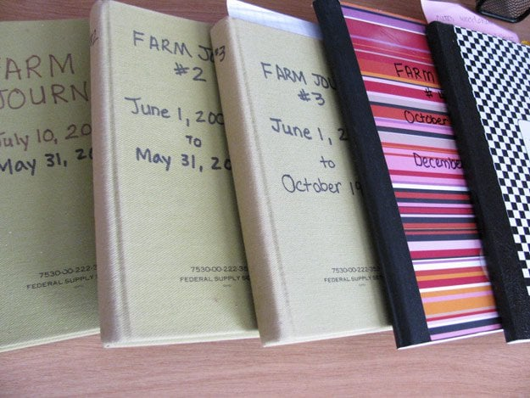
Sermon
Notes:
Image: Five Loaves by Caroline Coolidge Brown. Copyright © Caroline Coolidge Brown. All rights reserved. Used by permission of the artist.

Slide 48
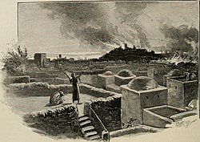
Sermon
Notes:
Image: Five Loaves by Caroline Coolidge Brown. Copyright © Caroline Coolidge Brown. All rights reserved. Used by permission of the artist.

Slide 49
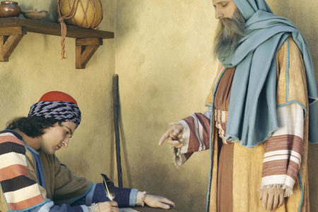
Sermon
Notes:
Image: Five Loaves by Caroline Coolidge Brown. Copyright © Caroline Coolidge Brown. All rights reserved. Used by permission of the artist.

Slide 50
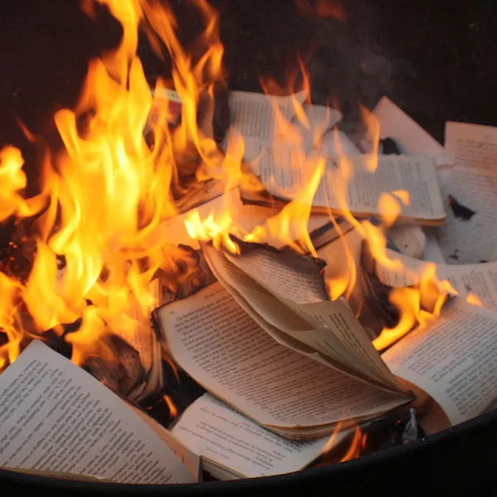
Sermon
Notes:
Image: Five Loaves by Caroline Coolidge Brown. Copyright © Caroline Coolidge Brown. All rights reserved. Used by permission of the artist.

Slide 51
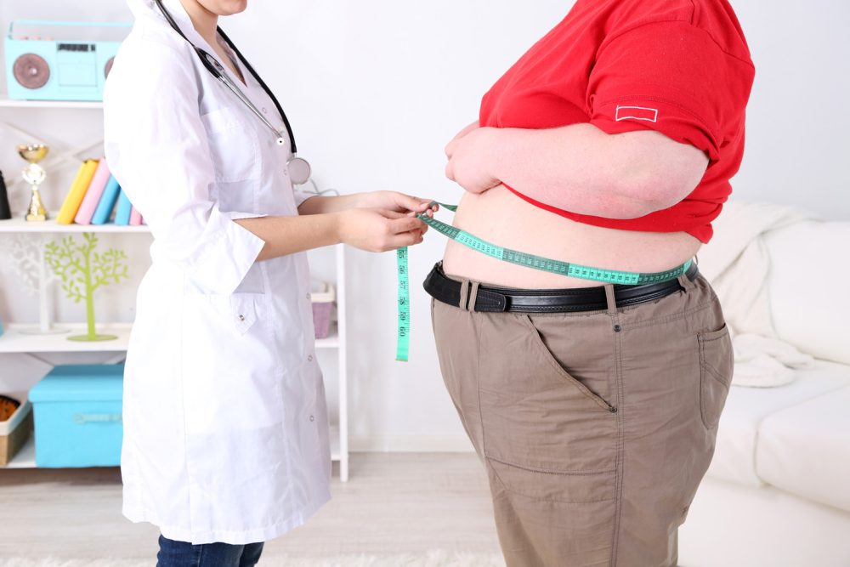
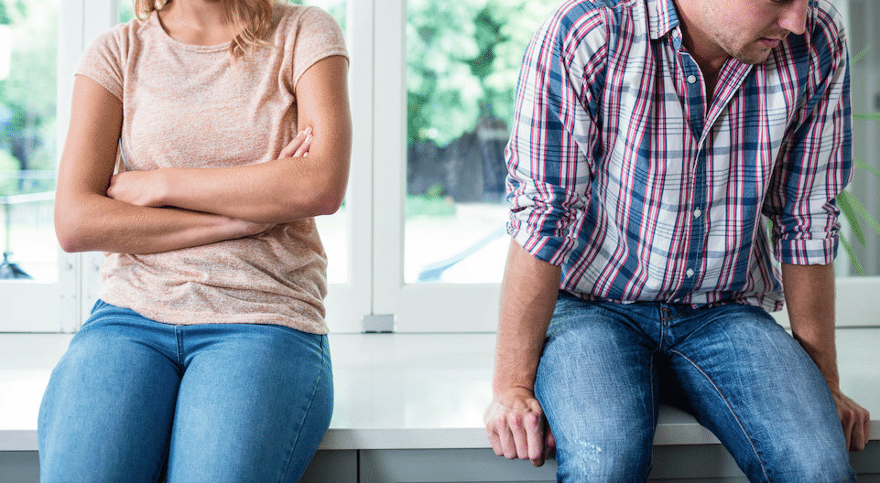
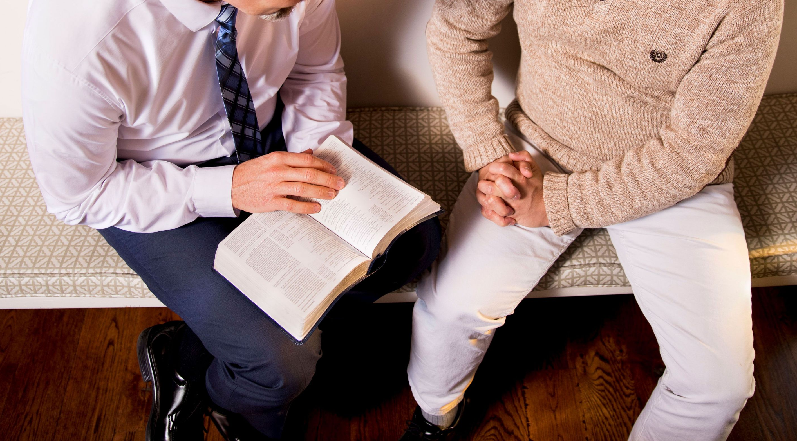
Sermon
Notes:
Image: Five Loaves by Caroline Coolidge Brown. Copyright © Caroline Coolidge Brown. All rights reserved. Used by permission of the artist.

Slide 52
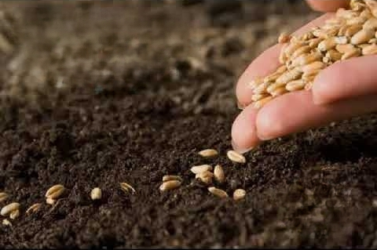
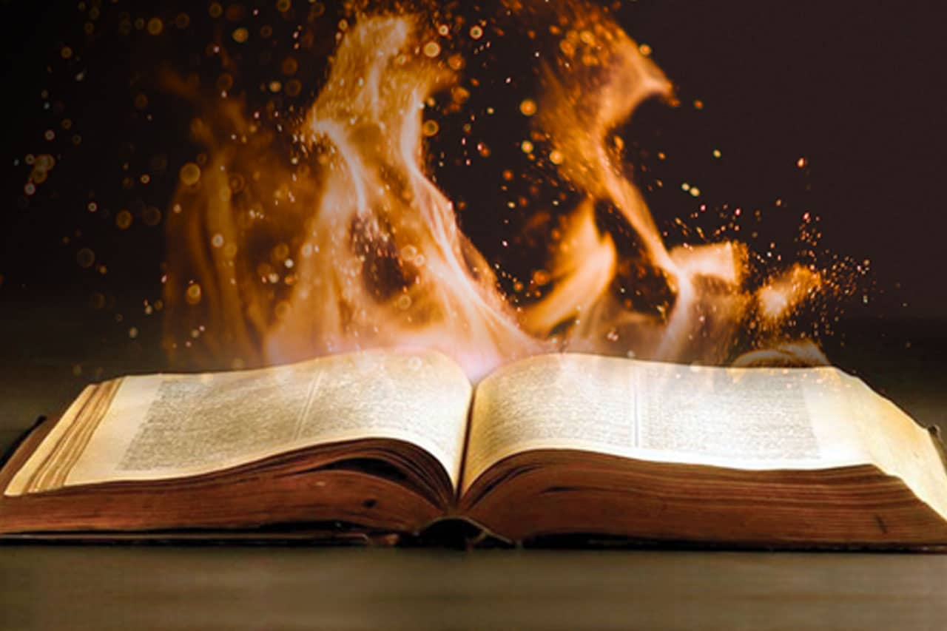
Sermon
Notes:
Image: Five Loaves by Caroline Coolidge Brown. Copyright © Caroline Coolidge Brown. All rights reserved. Used by permission of the artist.

Slide 53
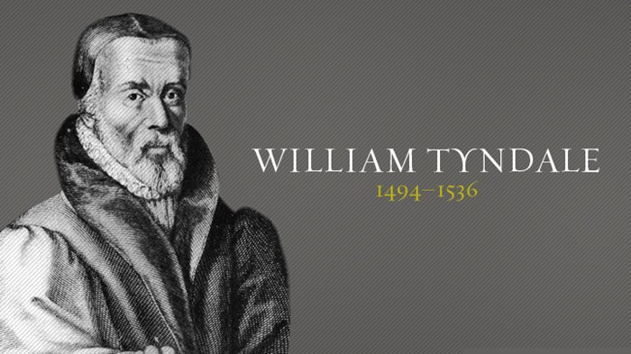
Sermon
Notes:
Image: Five Loaves by Caroline Coolidge Brown. Copyright © Caroline Coolidge Brown. All rights reserved. Used by permission of the artist.

Slide 54

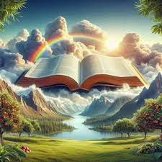
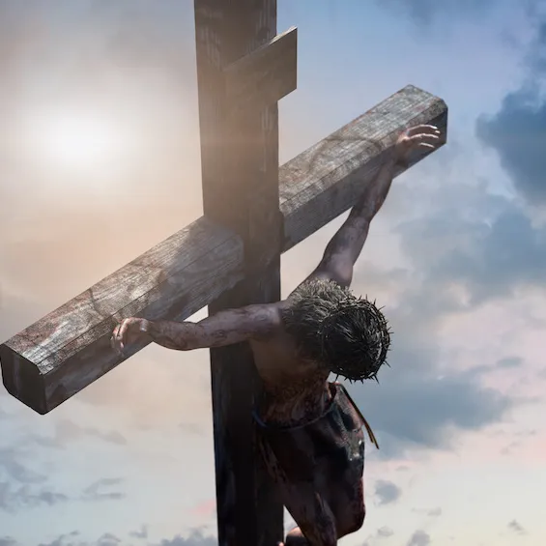
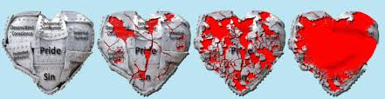
Sermon
Trust God’s Word
Keep Planting
God’s Word Breaks Hardened Hearts
Remember Jesus
Notes:
Image: Five Loaves by Caroline Coolidge Brown. Copyright © Caroline Coolidge Brown. All rights reserved. Used by permission of the artist.

Slide 55
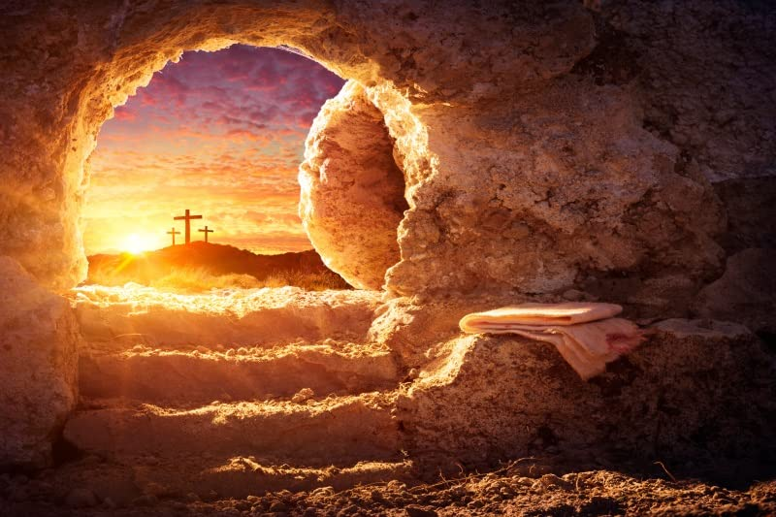
Sermon
Notes:
Image: Five Loaves by Caroline Coolidge Brown. Copyright © Caroline Coolidge Brown. All rights reserved. Used by permission of the artist.

Slide 56
RITE OF HEALING
Each petition will end with the words,
A: In your compassion,
The congregation will respond with:
C: heal us O God.
Notes:
Image: Five Loaves by Caroline Coolidge Brown. Copyright © Caroline Coolidge Brown. All rights reserved. Used by permission of the artist.

Slide 57
RITE OF HEALING
The prayer concludes…
P: Friends in Christ, I invite you to come and receive a sign of healing and wholeness in the name of the triune God.
Notes:
Image: Five Loaves by Caroline Coolidge Brown. Copyright © Caroline Coolidge Brown. All rights reserved. Used by permission of the artist.

Slide 58
Hymn of the Day
“O Master, Let Me Walk with You”
LBW 492
Notes:
Image: Five Loaves by Caroline Coolidge Brown. Copyright © Caroline Coolidge Brown. All rights reserved. Used by permission of the artist.

Slide 59
“O Master, Let Me Walk with You” LBW 492
1 O Master, let me walk with you
in lowly paths of service true;
tell me your secret; help me bear
the strain of toil, the fret of care.
Notes:
Image: Five Loaves by Caroline Coolidge Brown. Copyright © Caroline Coolidge Brown. All rights reserved. Used by permission of the artist.

Slide 60
“O Master, Let Me Walk with You” LBW 492
2 Help me the slow of heart to move
by some clear, winning word of love;
teach me the wayward feet to stay,
and guide them in the homeward way.
Notes:
Image: Five Loaves by Caroline Coolidge Brown. Copyright © Caroline Coolidge Brown. All rights reserved. Used by permission of the artist.

Slide 61
“O Master, Let Me Walk with You” LBW 492
3 Teach me your patience; share with me
a closer, dearer company,
in work that keeps faith sweet and strong,
in trust that triumphs over wrong,
Notes:
Image: Five Loaves by Caroline Coolidge Brown. Copyright © Caroline Coolidge Brown. All rights reserved. Used by permission of the artist.

Slide 62
“O Master, Let Me Walk with You” LBW 492
4 In hope that sends a shining ray
far down the future’s broad'ning way,
in peace that only you can give;
with you, O Master, let me live.
Notes:
Image: Five Loaves by Caroline Coolidge Brown. Copyright © Caroline Coolidge Brown. All rights reserved. Used by permission of the artist.

Slide 63
PRAYERS OF INTERCESSION
Each petition will end with the words,
A: God, in your mercy
The congregation will respond with:
C: Hear our prayer.

Slide 64
PRAYERS OF INTERCESSION
The prayer concludes…
P: Trusting in your unending grace for all that you have made, we lift these and the prayers of our hearts to your loving care.
C: Amen.

Slide 65
OFFERING
Notes:
Image: Five Loaves by Caroline Coolidge Brown. Copyright © Caroline Coolidge Brown. All rights reserved. Used by permission of the artist.

Slide 66
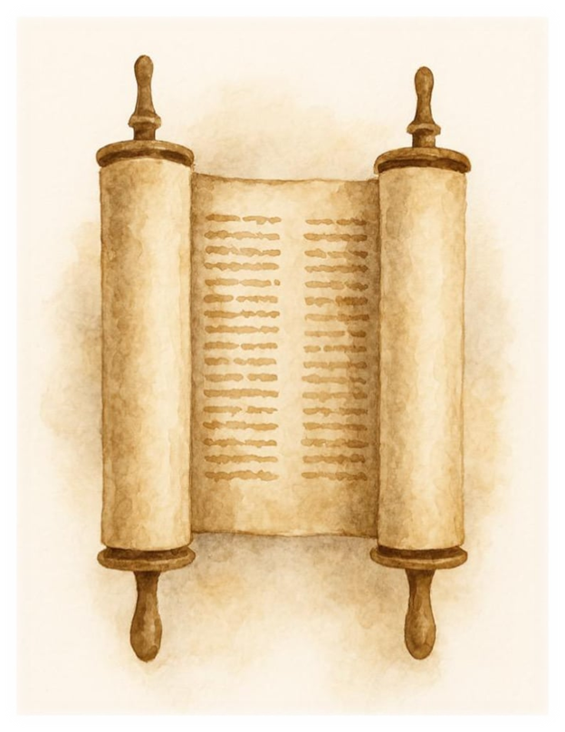
OFFERING PRAYER
Notes:
Image: Five Loaves by Caroline Coolidge Brown. Copyright © Caroline Coolidge Brown. All rights reserved. Used by permission of the artist.

Slide 67
THE LORD’S PRAYER
C: Our Father, who art in heaven, hallowed be thy name, thy kingdom come, thy will be done, on earth as it is in heaven. Give us this day our daily bread; and forgive us our trespasses, as we forgive those who trespass against us; and lead us not into temptation, but deliver us from evil.

Slide 68
THE LORD’S PRAYER
C: For thine is the kingdom, and the power, and the glory, forever and ever. Amen.

Slide 69

ANNOUNCEMENTS
Notes:
Image: Five Loaves by Caroline Coolidge Brown. Copyright © Caroline Coolidge Brown. All rights reserved. Used by permission of the artist.

Slide 70
SENDING BLESSING
P: The love of God abound in you; the grace of our Savior Jesus Christ fill your hearts; and the life of the Spirit bless you ☩ and give you peace.
C: Amen.

Slide 71
Sending Song
“God of Grace and God of Glory”
LBW 415
Notes:
Image: Five Loaves by Caroline Coolidge Brown. Copyright © Caroline Coolidge Brown. All rights reserved. Used by permission of the artist.

Slide 72
“God of Grace and God of Glory”
LBW 415
1 God of grace and God of glory,
on your people pour your pow’r;
crown your ancient church’s story;
bring its bud to glorious flow’r.
Grant us wisdom, grant us courage
for the facing of this hour,
for the facing of this hour.
Notes:
Image: Preparing yeast dough. Copyright © tomasworks/iStock/Thinkstock. Used by permission.

Slide 73
“God of Grace and God of Glory”
LBW 415
2 Lo! The hosts of evil round us
scorn the Christ, assail his ways!
From the fears that long have bound us
free our hearts to faith and praise.
Grant us wisdom, grant us courage
for the living of these days,
for the living of these days,
Notes:
Image: Preparing yeast dough. Copyright © tomasworks/iStock/Thinkstock. Used by permission.

Slide 74
“God of Grace and God of Glory”
LBW 415
3 Cure your children’s warring madness;
bend our pride to your control;
shame our wanton, selfish gladness,
rich in things and poor in soul.
Grant us wisdom, grant us courage,
lest we miss your kingdom’s goal,
let we miss your kingdom’s goal.
Notes:
Image: Preparing yeast dough. Copyright © tomasworks/iStock/Thinkstock. Used by permission.

Slide 75
“God of Grace and God of Glory”
LBW 415
3 Cure your children’s warring madness;
bend our pride to your control;
shame our wanton, selfish gladness,
rich in things and poor in soul.
Grant us wisdom, grant us courage,
lest we miss your kingdom’s goal,
let we miss your kingdom’s goal.
4 Save us from weak resignation
to the evils we deplore;
let the gift of your salvation
be our glory evermore.
Grant us wisdom, grant us courage,
serving you whom we adore,
serving you whom we adore.
Notes:
Image: Preparing yeast dough. Copyright © tomasworks/iStock/Thinkstock. Used by permission.

Slide 76
DISMISSAL
P: … Depart in Christ’s Love.
C: Seeking, welcoming, and serving all. Amen!
POSTLUDE
By Pam Sherman
From sundaysandseasons.com. Copyright © 2025 Augsburg Fortress. All rights reserved. Reprinted by permission under Augsburg Fortress Liturgies Annual License #SAS023830. New Revised Standard Version Bible, Copyright © 1989, Division of Christian Education of the National Council of the Churches of Christ in the United States of America. Used by permission. All rights reserved. Revised Common Lectionary, Copyright © 1992 Consultation on Common Texts, admin Augsburg Fortress. Used by permission.

