Slide 1
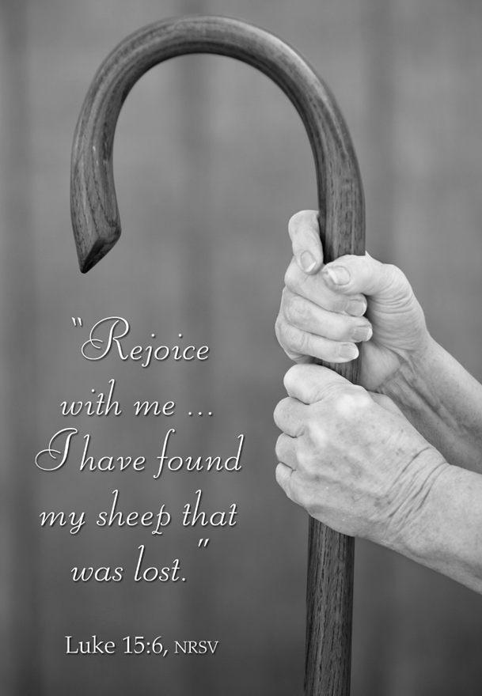
March 23, 2025
WELCOME!
Trinity Lutheran Church
Notes:
Image: Five Loaves by Caroline Coolidge Brown. Copyright © Caroline Coolidge Brown. All rights reserved. Used by permission of the artist.

Slide 2
= Please stand if able
= Please be seated
Prelude - By Pam Sherman
Office of the Acolyte
Ringing of the Bell
Welcome

Slide 3
THANKSGIVING FOR BAPTISM
All may make the sign of the cross, the sign marked at baptism, as the presiding minister begins.
P: Blessed be the holy Trinity, ☩ one God, the fountain of living water, the rock who gave us birth, our light and our salvation.
C: Amen.
Notes:
Image: Preparing yeast dough. Copyright © tomasworks/iStock/Thinkstock. Used by permission.

Slide 4
P: Joined to Christ in the waters of baptism, we are clothed with God's mercy and forgiveness. Let us give thanks for the gift of baptism.
Water may be poured into the font as the presiding minister gives thanks.
THANKSGIVING FOR BAPTISM
Notes:
Image: Preparing yeast dough. Copyright © tomasworks/iStock/Thinkstock. Used by permission.

Slide 5
P: We give you thanks, O God, for in the beginning your Spirit moved over the waters and by your Word you created the world, calling forth life in which you took delight. Through the waters of the flood you delivered Noah and his family. Through the sea you led your people Israel from slavery into freedom.
THANKSGIVING FOR BAPTISM
Notes:
Image: Preparing yeast dough. Copyright © tomasworks/iStock/Thinkstock. Used by permission.

Slide 6
P: At the river your Son was baptized by John and anointed with the Holy Spirit. By water and your Word you claim us as daughters and sons, making us heirs of your promise and servants of all. We praise you for the gift of water that sustains life, and above all we praise you for the gift of new life in Jesus Christ.
THANKSGIVING FOR BAPTISM
Notes:
Image: Preparing yeast dough. Copyright © tomasworks/iStock/Thinkstock. Used by permission.

Slide 7
P: Shower us with your Spirit, and renew our lives with your forgiveness, grace, and love. To you be given honor and praise through Jesus Christ our Lord in the unity of the Holy Spirit, now and forever.
THANKSGIVING FOR BAPTISM
C: Amen.
Notes:
Image: Preparing yeast dough. Copyright © tomasworks/iStock/Thinkstock. Used by permission.

Slide 8
Gathering Song
“Amazing Grace”
LBW 448

Slide 9
“Amazing Grace” LBW 448
1 Amazing grace, how sweet the sound,
that saved a wretch like me!
I once was lost, but now am found;
was blind, but now I see.
Notes:
Image: Five Loaves by Caroline Coolidge Brown. Copyright © Caroline Coolidge Brown. All rights reserved. Used by permission of the artist.

Slide 10
“Amazing Grace” LBW 448
2 ’Twas grace that taught my heart to fear,
and grace my fears relieved;
how precious did that grace appear
the hour I first believed!
Notes:
Image: Five Loaves by Caroline Coolidge Brown. Copyright © Caroline Coolidge Brown. All rights reserved. Used by permission of the artist.

Slide 11
“Amazing Grace” LBW 448
3 Through many dangers, toils, and snares
I have already come;
’tis grace has brought me safe thus far,
and grace will lead me home.
Notes:
Image: Five Loaves by Caroline Coolidge Brown. Copyright © Caroline Coolidge Brown. All rights reserved. Used by permission of the artist.

Slide 12
“Amazing Grace” LBW 448
4 The Lord has promised good to me;
his word my hope secures;
he will my shield and portion be
as long as life endures.
Notes:
Image: Five Loaves by Caroline Coolidge Brown. Copyright © Caroline Coolidge Brown. All rights reserved. Used by permission of the artist.

Slide 13
APOSTOLIC GREETING
P: The grace of our Lord Jesus Christ, the love of God, and the communion of the Holy Spirit be with you all.
C: And also with you.
Notes:
Image: Five Loaves by Caroline Coolidge Brown. Copyright © Caroline Coolidge Brown. All rights reserved. Used by permission of the artist.

Slide 14
PRAYER OF THE DAY
P: Let us pray… Holy God, you travel down any path and go to any lengths to find us, and you rejoice when we are back in your loving arms. Keep us ever mindful of your endless mercy and grace, that we might release our shame when we once again wander from your loving care. In Jesus’ name we pray.
C: Amen
Notes:
Image: Five Loaves by Caroline Coolidge Brown. Copyright © Caroline Coolidge Brown. All rights reserved. Used by permission of the artist.

Slide 15

Notes:
Image: Five Loaves by Caroline Coolidge Brown. Copyright © Caroline Coolidge Brown. All rights reserved. Used by permission of the artist.

Slide 16
Luke 15:1-32
L: Our scripture reading is from Luke, Chapter 15.
C: Glory to you O’ Lord!
Notes:
Image: Five Loaves by Caroline Coolidge Brown. Copyright © Caroline Coolidge Brown. All rights reserved. Used by permission of the artist.

Slide 17
Luke 15:1-32
Now all the tax collectors and sinners were coming near to listen to him. ²And the Pharisees and the scribes were grumbling and saying, “This fellow welcomes sinners and eats with them.” ³So he told them this parable: ⁴“Which one of you, having a hundred sheep and losing one of them, does not leave the ninety-nine in the wilderness and go after the one that is
Notes:
Image: Five Loaves by Caroline Coolidge Brown. Copyright © Caroline Coolidge Brown. All rights reserved. Used by permission of the artist.

Slide 18
Luke 15:1-32
lost until he finds it? ⁵When he has found it, he lays it on his shoulders and rejoices. ⁶And when he comes home, he calls together his friends and neighbors, saying to them, ‘Rejoice with me, for I have found my sheep that was lost.’ ⁷Just so, I tell you, there will be more joy in heaven over one sinner who repents than over ninety-nine righteous persons
Notes:
Image: Five Loaves by Caroline Coolidge Brown. Copyright © Caroline Coolidge Brown. All rights reserved. Used by permission of the artist.

Slide 19
Luke 15:1-32
who need no repentance. ⁸“Or what woman having ten silver coins, if she loses one of them, does not light a lamp, sweep the house, and search carefully until she finds it? ⁹When she has found it, she calls together her friends and neighbors, saying, ‘Rejoice with me, for I have found the coin that I had lost.’ ¹⁰Just so, I tell you, there is joy in the presence of the
Notes:
Image: Five Loaves by Caroline Coolidge Brown. Copyright © Caroline Coolidge Brown. All rights reserved. Used by permission of the artist.

Slide 20
Luke 15:1-32
angels of God over one sinner who repents.”
¹¹Then Jesus said, “There was a man who had two sons. ¹²The younger of them said to his father, ‘Father, give me the share of the property that will belong to me.’ So he divided his property between them. ¹³A few days later the younger son gathered all he had and traveled to a distant country,
Notes:
Image: Five Loaves by Caroline Coolidge Brown. Copyright © Caroline Coolidge Brown. All rights reserved. Used by permission of the artist.

Slide 21
Luke 15:1-32
and there he squandered his property in dissolute living. ¹⁴When he had spent everything, a severe famine took place throughout that country, and he began to be in need. ¹⁵So he went and hired himself out to one of the citizens of that country, who sent him to his fields to feed the pigs. ¹⁶He would gladly have filled himself with the pods that the pigs were eating;
Notes:
Image: Five Loaves by Caroline Coolidge Brown. Copyright © Caroline Coolidge Brown. All rights reserved. Used by permission of the artist.

Slide 22
Luke 15:1-32
and no one gave him anything. ¹⁷But when he came to himself he said, ‘How many of my father’s hired hands have bread enough and to spare, but here I am dying of hunger! ¹⁸I will get up and go to my father, and I will say to him, ‘Father, I have sinned against heaven and before you; ¹⁹I am no longer worthy to be called your son; treat me like one of your hired hands.’
Notes:
Image: Five Loaves by Caroline Coolidge Brown. Copyright © Caroline Coolidge Brown. All rights reserved. Used by permission of the artist.

Slide 23
Luke 15:1-32
²⁰So he set off and went to his father. But while he was still far off, his father saw him and was filled with compassion; he ran and put his arms around him and kissed him. ²¹Then the son said to him, ‘Father, I have sinned against heaven and before you; I am no longer worthy to be called your son.’ ²²But the father said to his slaves, ‘Quickly, bring out a robe—the
Notes:
Image: Five Loaves by Caroline Coolidge Brown. Copyright © Caroline Coolidge Brown. All rights reserved. Used by permission of the artist.

Slide 24
Luke 15:1-32
best one—and put it on him; put a ring on his finger and sandals on his feet. ²³And get the fatted calf and kill it, and let us eat and celebrate; ²⁴for this son of mine was dead and is alive again; he was lost and is found!’ And they began to celebrate. ²⁵Now his elder son was in the field; and when he came and approached the house, he heard music and dancing. ²⁶He called
Notes:
Image: Five Loaves by Caroline Coolidge Brown. Copyright © Caroline Coolidge Brown. All rights reserved. Used by permission of the artist.

Slide 25
Luke 15:1-32
one of the slaves and asked what was going on. ²⁷He replied, ‘Your brother has come, and your father has killed the fatted calf, because he has got him back safe and sound.’ ²⁸Then he became angry and refused to go in. His father came out and began to plead with him. ²⁹But he answered his father, ‘Listen! For all these years I have been working like a slave for you,
Notes:
Image: Five Loaves by Caroline Coolidge Brown. Copyright © Caroline Coolidge Brown. All rights reserved. Used by permission of the artist.

Slide 26
Luke 15:1-32
and I have never disobeyed your command; yet you have never given me even a young goat so that I might celebrate with my friends. ³⁰But when this son of yours came back, who has devoured your property with prostitutes, you killed the fatted calf for him!’ ³¹Then the father said to him, ‘Son, you are always with me, and all that is mine is yours.
Notes:
Image: Five Loaves by Caroline Coolidge Brown. Copyright © Caroline Coolidge Brown. All rights reserved. Used by permission of the artist.

Slide 27
Luke 15:1-32
³²But we had to celebrate and rejoice, because this brother of yours was dead and has come to life; he was lost and has been found.’”
Notes:
Image: Five Loaves by Caroline Coolidge Brown. Copyright © Caroline Coolidge Brown. All rights reserved. Used by permission of the artist.

Slide 28
Luke 15:1-32
R: This is the Word of the Lord.
C: Praise to You, O Christ
Notes:
Image: Five Loaves by Caroline Coolidge Brown. Copyright © Caroline Coolidge Brown. All rights reserved. Used by permission of the artist.

Slide 29
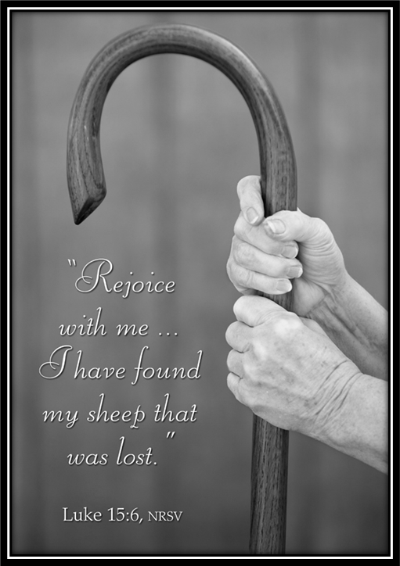
Sermon

Slide 30

Sermon

Slide 31
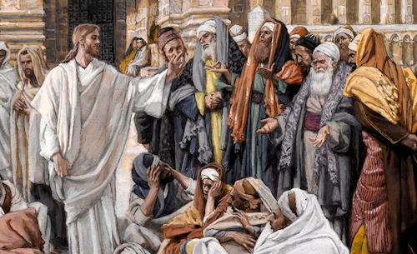
Sermon

Slide 32
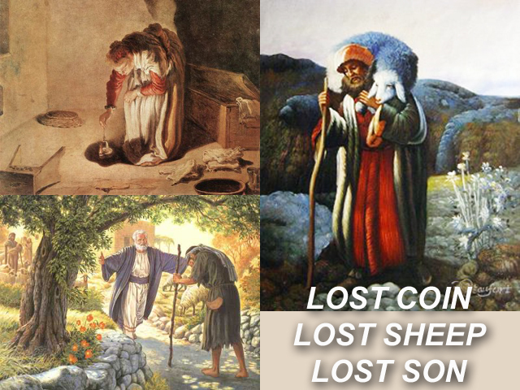
Sermon

Slide 33
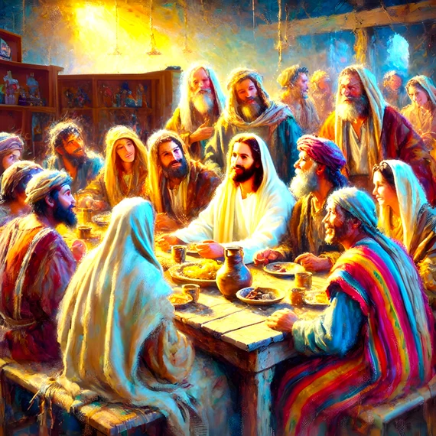
Sermon

Slide 34
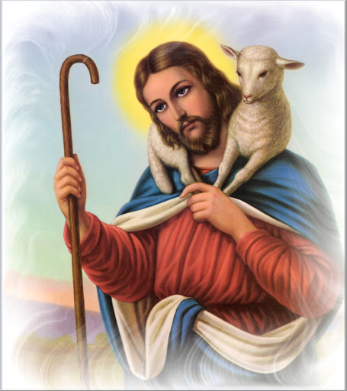
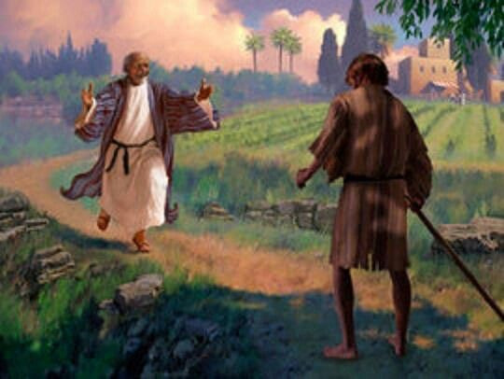
Sermon

Slide 35
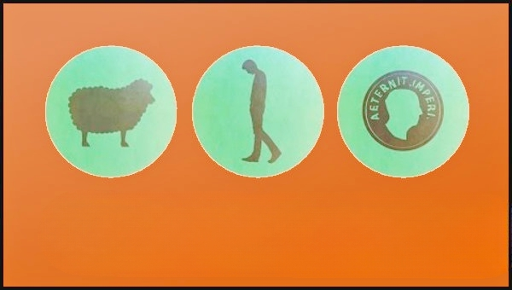
Sermon

Slide 36
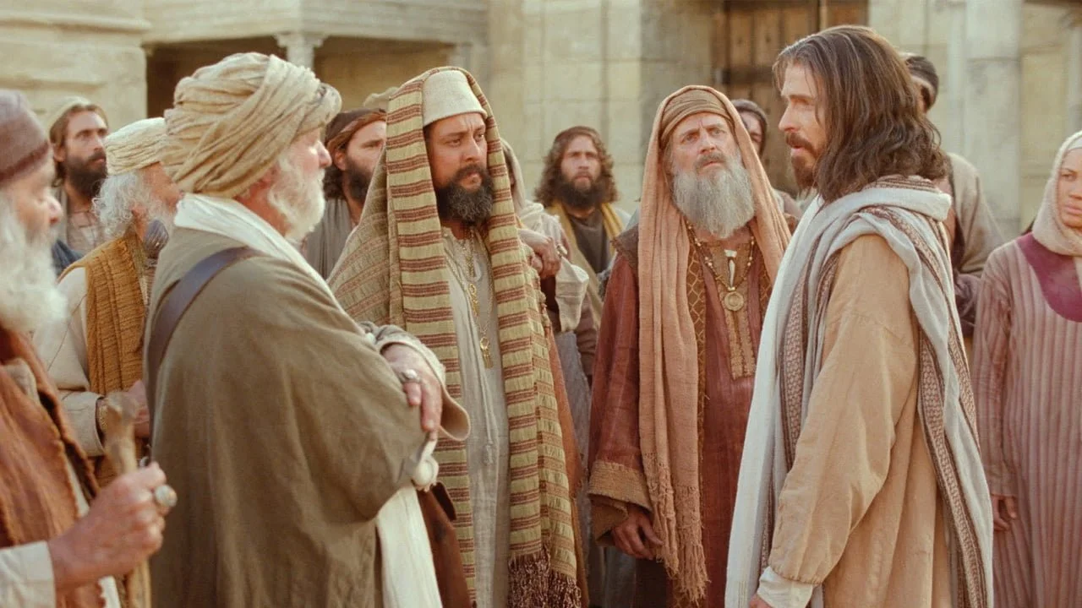
Sermon

Slide 37


Sermon

Slide 38
HYMN OF THE DAY
“Children of the Heavenly Father”
LBW 474

Slide 39
“Children of the Heavenly Father” LBW 474
1 Children of the heav'nly Father
safely in his bosom gather;
nestling bird nor star in heaven
such a refuge e'er was given.
2 God his own doth tend and nourish,
in his holy courts they flourish.
From all evil things he spares them,
in his mighty arms he bears them.

Slide 40
“Children of the Heavenly Father” LBW 474
3 Neither life nor death shall ever
from the Lord his children sever;
unto them his grace he showeth,
and their sorrows all he knoweth.
4 Though he giveth or he taketh,
God his children ne'er forsaketh;
his the loving purpose solely
to preserve them pure and holy.

Slide 41
NICENE CREED
C: We believe in one God, the Father, the Almighty, maker of heaven and earth, of all that is, seen and unseen.

Slide 42
NICENE CREED
C: We believe in one Lord, Jesus Christ, the only Son of God, eternally begotten of the Father, God from God, Light from Light, true God from true God, begotten, not made, of one Being with the Father.

Slide 43
NICENE CREED
C: Through him all things were made. For us and for our salvation he came down from heaven; by the power of the Holy Spirit he became incarnate from the virgin Mary, and was made man. For our sake he was crucified under Pontius Pilate;

Slide 44
NICENE CREED
C: he suffered death and was buried. On the third day he rose again in accordance with the Scriptures; he ascended into heaven and is seated at the right hand of the Father. He will come again in glory to judge the living and the dead, and his kingdom will have no end.

Slide 45
NICENE CREED
C: We believe in the Holy Spirit, the Lord, the giver of life, who proceeds from the Father and the Son. With the Father and the Son he is worshiped and glorified. He has spoken through the prophets. We believe in one holy catholic and apostolic Church.

Slide 46
NICENE CREED
C: We acknowledge one Baptism for the forgiveness of sins. We look for the resurrection of the dead, and the life of the world to come. Amen.

Slide 47
APOSTLE’S CREED
C: I believe in God, the Father almighty, creator of heaven and earth.

Slide 48
APOSTLE’S CREED
C: I believe in Jesus Christ, his only Son, our Lord. He was conceived by the power of the Holy Spirit and born of the virgin Mary. He suffered under Pontius Pilate, was crucified, died, and was buried.

Slide 49
APOSTLE’S CREED
C: He descended into hell. On the third day he rose again. He ascended into heaven, and is seated at the right hand of the Father. He will come again to judge the living and the dead.

Slide 50
APOSTLE’S CREED
C: I believe in the Holy Spirit, the holy catholic Church, the communion of saints, the forgiveness of sins, the resurrection of the body, and the life everlasting. Amen.

Slide 51
PRAYERS
Each petition will end with the words,
  A: Merciful God,
  C: Hear our prayer.

Slide 52
PRAYERS OF INTERCESSION
The prayer concludes…
P: We entrust all these prayers and those of our hearts to you, O God. In Jesus name we pray.
C: Amen.

Slide 53
OFFERING
Notes:
Image: Five Loaves by Caroline Coolidge Brown. Copyright © Caroline Coolidge Brown. All rights reserved. Used by permission of the artist.

Slide 54
OFFERING PRAYER
Notes:
Image: Five Loaves by Caroline Coolidge Brown. Copyright © Caroline Coolidge Brown. All rights reserved. Used by permission of the artist.

Slide 55
THE LORD’S PRAYER
C: Our Father, who art in heaven, hallowed be thy name, thy kingdom come, thy will be done, on earth as it is in heaven. Give us this day our daily bread; and forgive us our trespasses, as we forgive those who trespass against us; and lead us not into temptation, but deliver us from evil.

Slide 56
THE LORD’S PRAYER
C: For thine is the kingdom, and the power, and the glory, forever and ever. Amen.

Slide 57

ANNOUNCEMENTS
Notes:
Image: Five Loaves by Caroline Coolidge Brown. Copyright © Caroline Coolidge Brown. All rights reserved. Used by permission of the artist.

Slide 58
SENDING BLESSING
P: God our tender parent, God the crucified one, God the reconciling Spirit, ☩ bless you now and forever.
C: Amen.

Slide 59
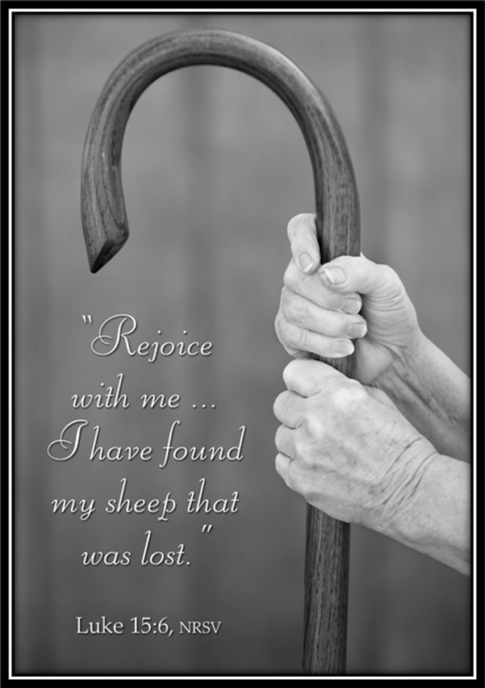
Sending Song
“Oh, For A Thousand Tongues to Sing”
LBW 559
Notes:
Image: Five Loaves by Caroline Coolidge Brown. Copyright © Caroline Coolidge Brown. All rights reserved. Used by permission of the artist.

Slide 60
“Oh, For A Thousand Tongues to Sing” LBW 559
1 Oh, for a thousand tongues to sing
my great Redeemer’s praise,
the glories of my God and King,
the triumphs of his grace!
Notes:
Image: Preparing yeast dough. Copyright © tomasworks/iStock/Thinkstock. Used by permission.

Slide 61
“Oh, For A Thousand Tongues to Sing” LBW 559
2 My gracious Master and my God,
assist me to proclaim,
to spread through all the earth abroad
the honors of your name.
Notes:
Image: Preparing yeast dough. Copyright © tomasworks/iStock/Thinkstock. Used by permission.

Slide 62
“Oh, For A Thousand Tongues to Sing” LBW 559
3 The name of Jesus charms our fears
and bids our sorrows cease,
sings music in the sinner’s ears,
brings life and health and peace.
Notes:
Image: Preparing yeast dough. Copyright © tomasworks/iStock/Thinkstock. Used by permission.

Slide 63
“Oh, For A Thousand Tongues to Sing” LBW 559
4 He breaks the pow’r of canceled sin;
he sets the pris’ner free.
His blood can make the foulest clean;
his blood avails for me.
Notes:
Image: Preparing yeast dough. Copyright © tomasworks/iStock/Thinkstock. Used by permission.

Slide 64
“Oh, For A Thousand Tongues to Sing” LBW 559
5 To God all glory, praise, and love
be now and ever giv’n
by saints below and saints above,
the church in earth and heav’n.
Notes:
Image: Preparing yeast dough. Copyright © tomasworks/iStock/Thinkstock. Used by permission.

Slide 65
DISMISSAL
P: … Depart in Christ’s Love.
C: Seeking, welcoming, and serving all. Amen!
POSTLUDE
By
Pam Sherman
From sundaysandseasons.com. Copyright © 2025 Augsburg Fortress. All rights reserved. Reprinted by permission under Augsburg Fortress Liturgies Annual License #SAS023830. New Revised Standard Version Bible, Copyright © 1989, Division of Christian Education of the National Council of the Churches of Christ in the United States of America. Used by permission. All rights reserved. Revised Common Lectionary, Copyright © 1992 Consultation on Common Texts, admin Augsburg Fortress. Used by permission.

