Slide 1
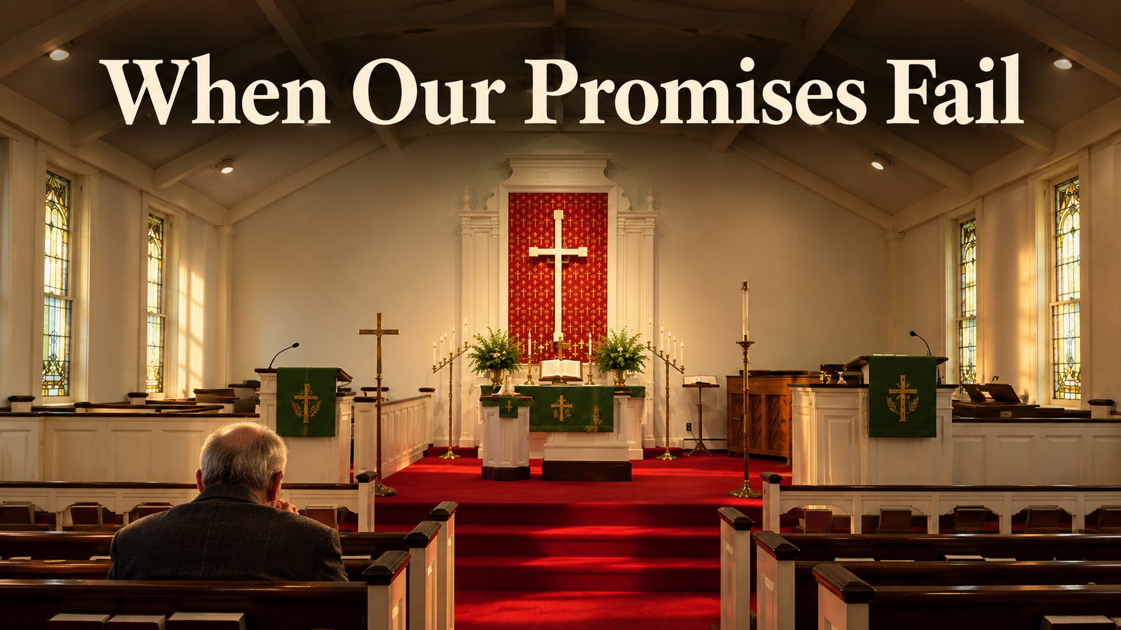
Trinity Evangelical Lutheran Church
October 18, 2026
WELCOME!

Slide 2
= Please stand if able
= Please be seated
  Prelude by Roxanne Groff
  Office of the Acolyte
  Ringing of the Bell
  Welcome

Slide 3
CONFESSION AND FORGIVENESS
All may make the sign of the cross, the sign marked at baptism…
L: We confess our sins before God and one another.
Pause for silence and reflection.
L: Creating and renewing God,

Slide 4
CONFESSION AND FORGIVENESS
C: You have made us in your image to carry your life-giving love as a blessing to all the world. Yet we fail again and again to live out your call. We place our trust in money and possessions, in flawed people and broken relationships, in the things that cannot sustain us.

Slide 5
CONFESSION AND FORGIVENESS
C: We do the things we do not want to do, and we fail to do the things we know you would have us do. Forgive us for all the ways we fall short. Open our eyes, hearts, and minds to your presence, and re-create us in your image each day, for the good of all that you have made.

Slide 6
CONFESSION AND FORGIVENESS
L: The God whose love outpoured caused the world to be, continues to pour this creative love on us. The God whose love outpoured in the life, death, and resurrection of Jesus Christ continues to pour this redeeming love upon us. Children of God, know that you are forgiven, and go forth refreshed and ready to answer God’s call to love and serve the whole of creation. In Jesus’ holy name.
C: Amen.

Slide 7
Gathering Song
“O Jesus, I Have Promised”
LBW 503

Slide 8
“O Jesus, I Have Promised” LBW 503
1 O Jesus, I have promised
to serve you to the end;
remain forever near me,
my master and my friend.
I shall not fear the battle
if you are by my side,
nor wander from the pathway
if you will be my guide.

Slide 9
“O Jesus, I Have Promised” LBW 503
2 Oh, let me feel you near me;
the world is ever near.
I see the sights that dazzle,
the tempting sounds I hear.
My foes are ever near me,
around me and within;
but, Jesus, then draw nearer
to shield my soul from sin.

Slide 10
“O Jesus, I Have Promised” LBW 503
3 Oh, let me hear you speaking
in accents clear and still
above the storms of passion,
the murmurs of self-will.
Now speak to reassure me,
to hasten or control;
now speak and make me listen,
O Guardian of my soul.

Slide 11
“O Jesus, I Have Promised” LBW 503
4 O Jesus, you have promised
to all who follow you
that where you are in glory
your servant shall be too.
And Jesus, I have promised
to serve you to the end;
oh, give me grace to follow,
my master and my friend.

Slide 12
APOSTOLIC GREETING
P: The grace of our Lord Jesus Christ, the love of God, and the communion of the Holy Spirit be with you all.
C: And also with you.

Slide 13
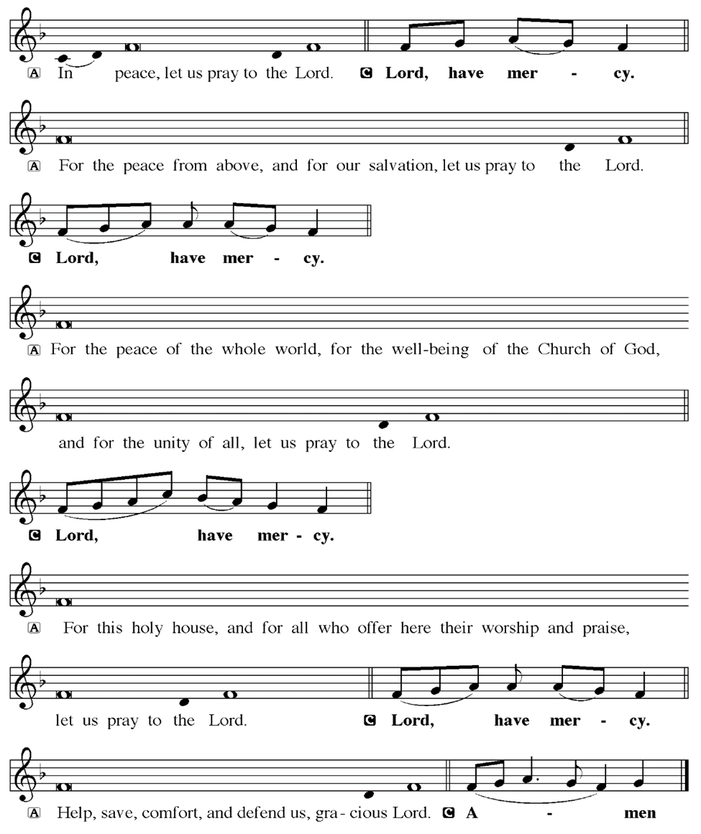
KYRIE

Slide 14
KYRIE

Slide 15
KYRIE

Slide 16
HYMN OF PRAISE
Glory be to God in heaven;
peace, goodwill to all the earth.
Mighty God of all creation,
Father of surpassing worth:
we exalt you, we adore you,
we lift high our thanks and praise.
Saints and angels bow before you; here on earth our songs we raise.

Slide 17
HYMN OF PRAISE
Glory be to Christ forever,
Lamb of God and Lord of love.
Son of God and gracious Savior, you have come from heav’n above;
on the cross you died to save us; now you reign at God’s right hand.
Hear our prayer; restore, forgive us; in your promise firm we stand.

Slide 18
HYMN OF PRAISE
Holy One we now acclaim you;
Lord alone, to you we call;
Holy One in faith we name you,
God most high, yet near to all:
Jesus Christ, with God the Spirit,
in the Father’s splendor bright.
For the peace that we inherit,
glory be to God on high!

Slide 19
PRAYER OF THE DAY
P: Let us pray… God of promise, renew in us each day your covenant with us—that you will be our God and we will be your people. Open our hearts to your call to be your hands and feet in the world, to love, serve, and do justice for the flourishing of all creation. Guide us in all we do and say this day and every day. In Jesus’ name we pray.
C: Amen

Slide 20


Slide 21
Scripture Reading
R: Our scripture reading is from the Book of Joshua, Chapter 24.
C: Glory to you O’ Lord!

Slide 22
Joshua 24:1-26
Then Joshua gathered all the tribes of Israel to Shechem, and summoned the elders, the heads, the judges, and the officers of Israel; and they presented themselves before God. ²And Joshua said to all the people, “Thus says the Lord, the God of Israel: Long ago your ancestors—Terah and his sons Abraham and Nahor—

Slide 23
Joshua 24:1-26
lived beyond the Euphrates and served other gods. ³Then I took your father Abraham from beyond the River and led him through all the land of Canaan and made his offspring many. I gave him Isaac; ⁴and to Isaac I gave Jacob and Esau. I gave Esau the hill country of Seir to possess, but Jacob and his children went down to Egypt.

Slide 24
Joshua 24:1-26
⁵Then I sent Moses and Aaron, and I plagued Egypt with what I did in its midst; and afterwards I brought you out. ⁶When I brought your ancestors out of Egypt, you came to the sea; and the Egyptians pursued your ancestors with chariots and horsemen to the Red Sea. ⁷When they cried out to the Lord, he put darkness between you

Slide 25
Joshua 24:1-26
and the Egyptians, and made the sea come upon them and cover them; and your eyes saw what I did to Egypt. Afterwards you lived in the wilderness a long time. ⁸Then I brought you to the land of the Amorites, who lived on the other side of the Jordan; they fought with you, and I handed them over to you, and you took possession of their

Slide 26
Joshua 24:1-26
land, and I destroyed them before you. ⁹Then King Balak son of Zippor of Moab, set out to fight against Israel. He sent and invited Balaam son of Beor to curse you, ¹⁰but I would not listen to Balaam; therefore he blessed you; so I rescued you out of his hand. ¹¹When you went over the Jordan and came to Jericho, the citizens

Slide 27
Joshua 24:1-26
of Jericho fought against you, and also the Amorites, the Perizzites, the Canaanites, the Hittites, the Girgashites, the Hivites, and the Jebusites; and I handed them over to you. ¹²I sent the hornet ahead of you, which drove out before you the two kings of the Amorites; it was not by your sword or by your bow.

Slide 28
Joshua 24:1-26
¹³I gave you a land on which you had not labored, and towns that you had not built, and you live in them; you eat the fruit of vineyards and oliveyards that you did not plant. ¹⁴“Now therefore revere the Lord, and serve him in sincerity and in faithfulness; put away the gods that your ancestors served beyond the River and in Egypt, and

Slide 29
Joshua 24:1-26
serve the Lord. ¹⁵Now if you are unwilling to serve the Lord, choose this day whom you will serve, whether the gods your ancestors served in the region beyond the River or the gods of the Amorites in whose land you are living; but as for me and my household, we will serve the Lord.”
¹⁶Then the people answered, “Far

Slide 30
Joshua 24:1-26
be it from us that we should forsake the Lord to serve other gods; ¹⁷for it is the Lord our God who brought us and our ancestors up from the land of Egypt, out of the house of slavery, and who did those great signs in our sight. He protected us along all the way that we went, and among all the peoples through whom we passed; ¹⁸and the Lord

Slide 31
Joshua 24:1-26
drove out before us all the peoples, the Amorites who lived in the land. Therefore we also will serve the Lord, for he is our God.” ¹⁹But Joshua said to the people, “You cannot serve the Lord, for he is a holy God. He is a jealous God; he will not forgive your transgressions or your sins. ²⁰If you forsake the Lord and serve foreign gods, then

Slide 32
Joshua 24:1-26
he will turn and do you harm, and consume you, after having done you good.” ²¹And the people said to Joshua, “No, we will serve the Lord!” ²²Then Joshua said to the people, “You are witnesses against yourselves that you have chosen the Lord, to serve him.” And they said, “We are witnesses.” ²³He said, “Then put away the foreign

Slide 33
Joshua 24:1-26
gods that are among you, and incline your hearts to the Lord, the God of Israel.” ²⁴The people said to Joshua, “The Lord our God we will serve, and him we will obey.”

Slide 34
Joshua 24:1-26
²⁵So Joshua made a covenant with the people that day, and made statutes and ordinances for them at Shechem. ²⁶Joshua wrote these words in the book of the law of God; and he took a large stone, and set it up there under the oak in the sanctuary of the Lord.

Slide 35
Joshua 24:1-26
R: This is the Word of the Lord.
C: Praise to You, O Christ

Slide 36
Sermon

Slide 37
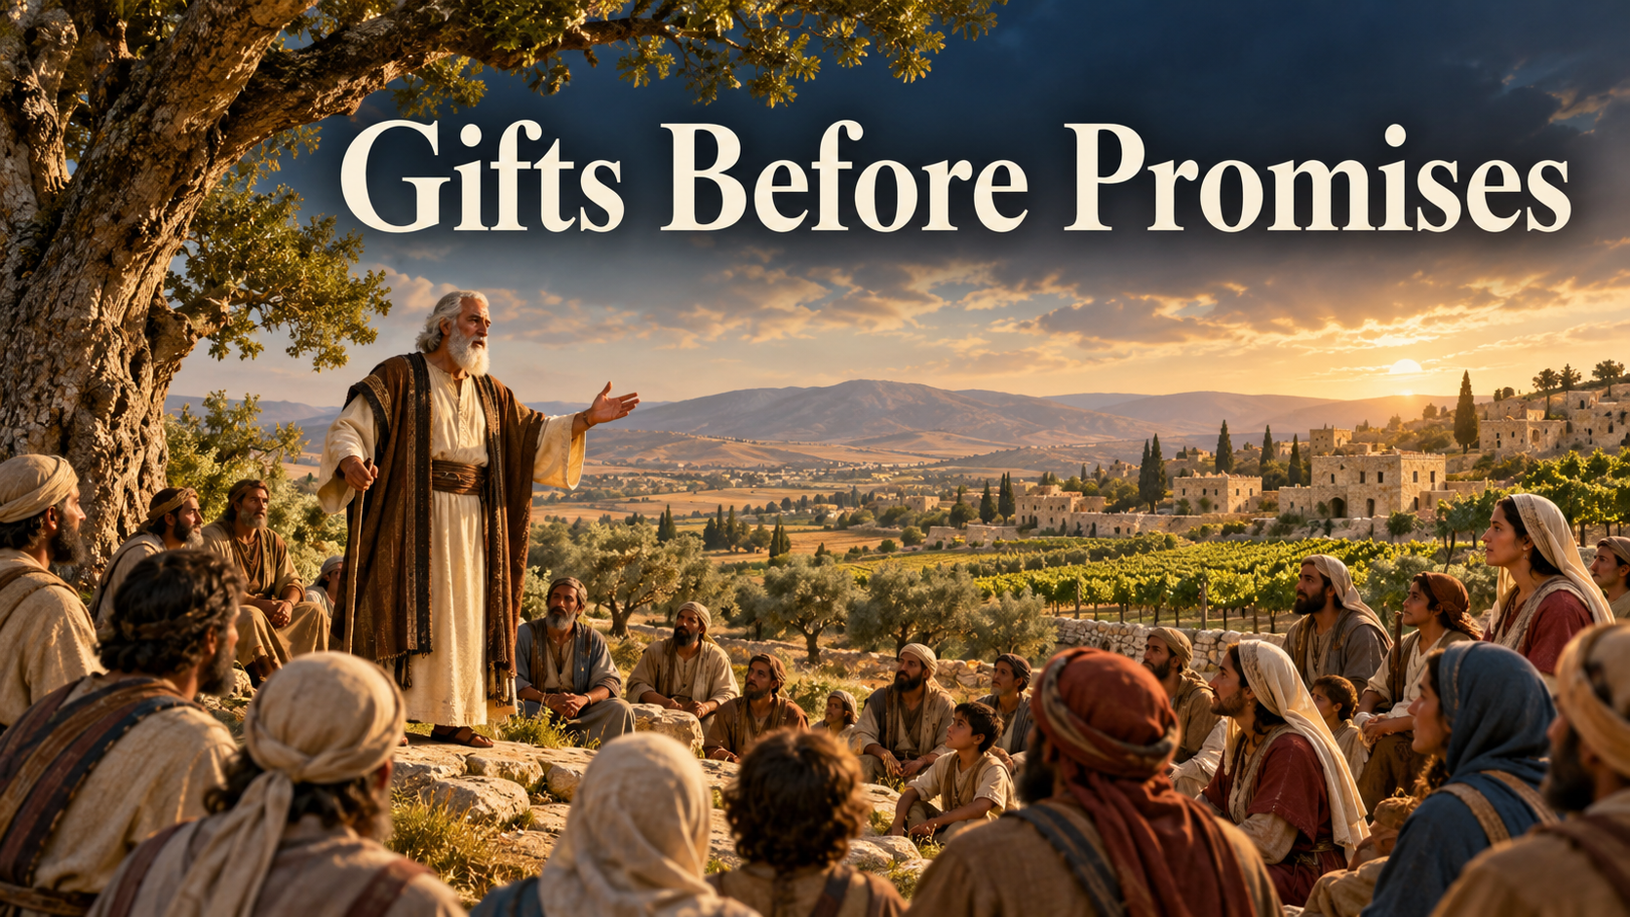
Sermon
Notes:
.

Slide 38
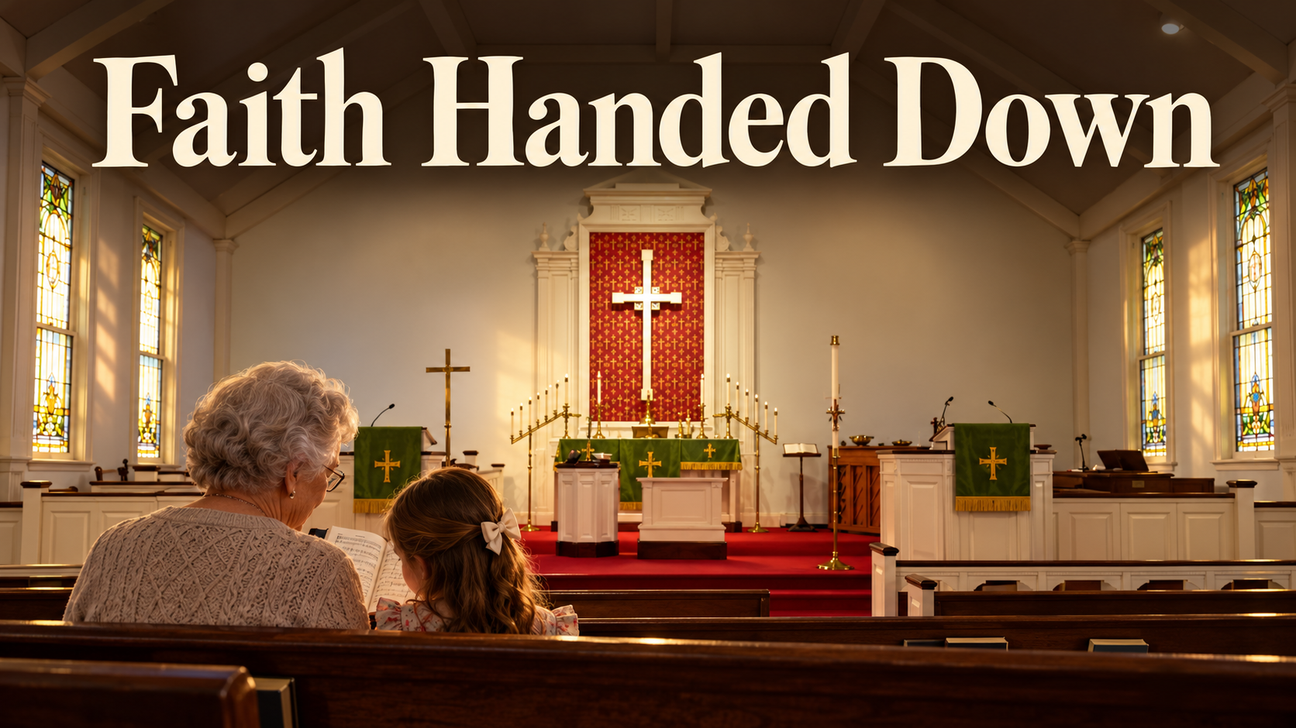
Sermon

Slide 39
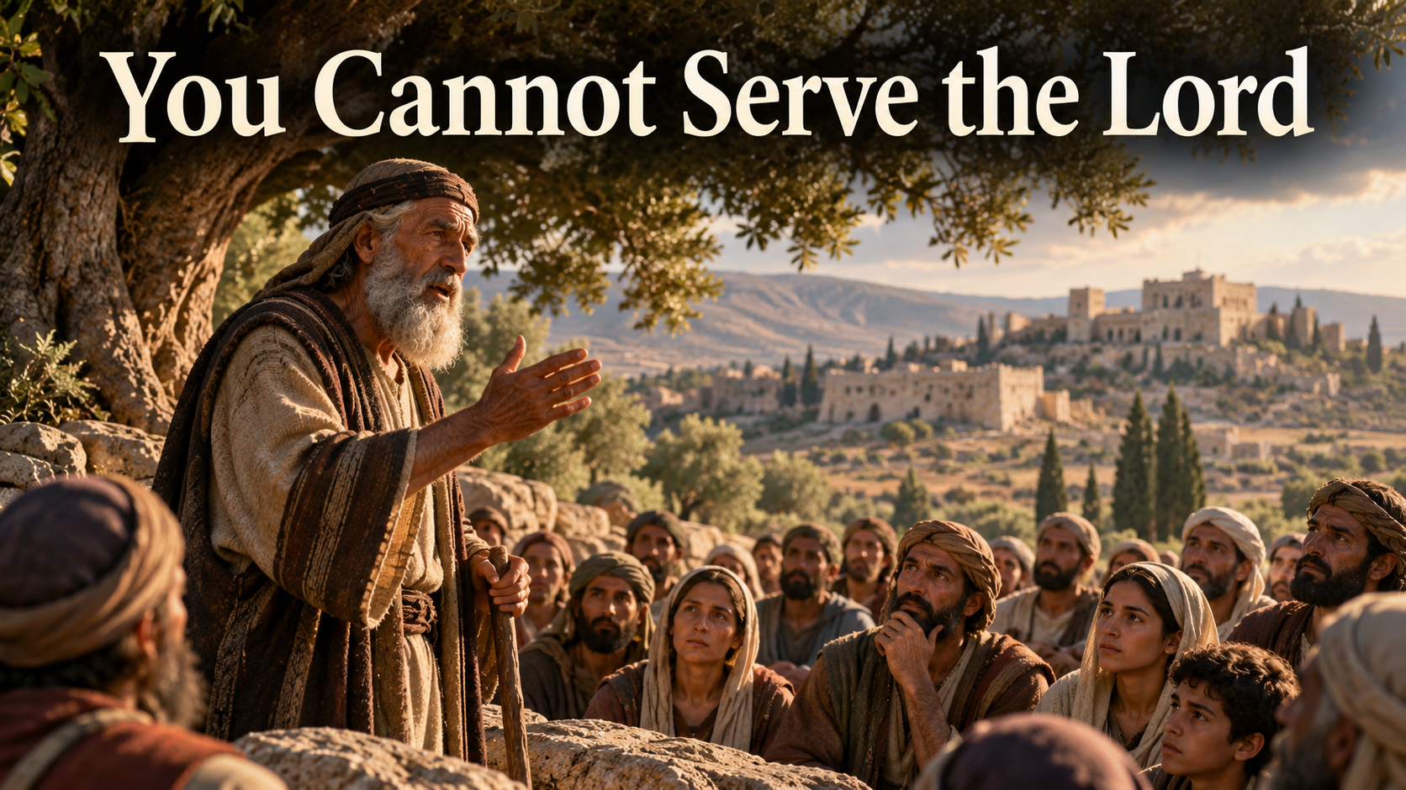
Sermon

Slide 40
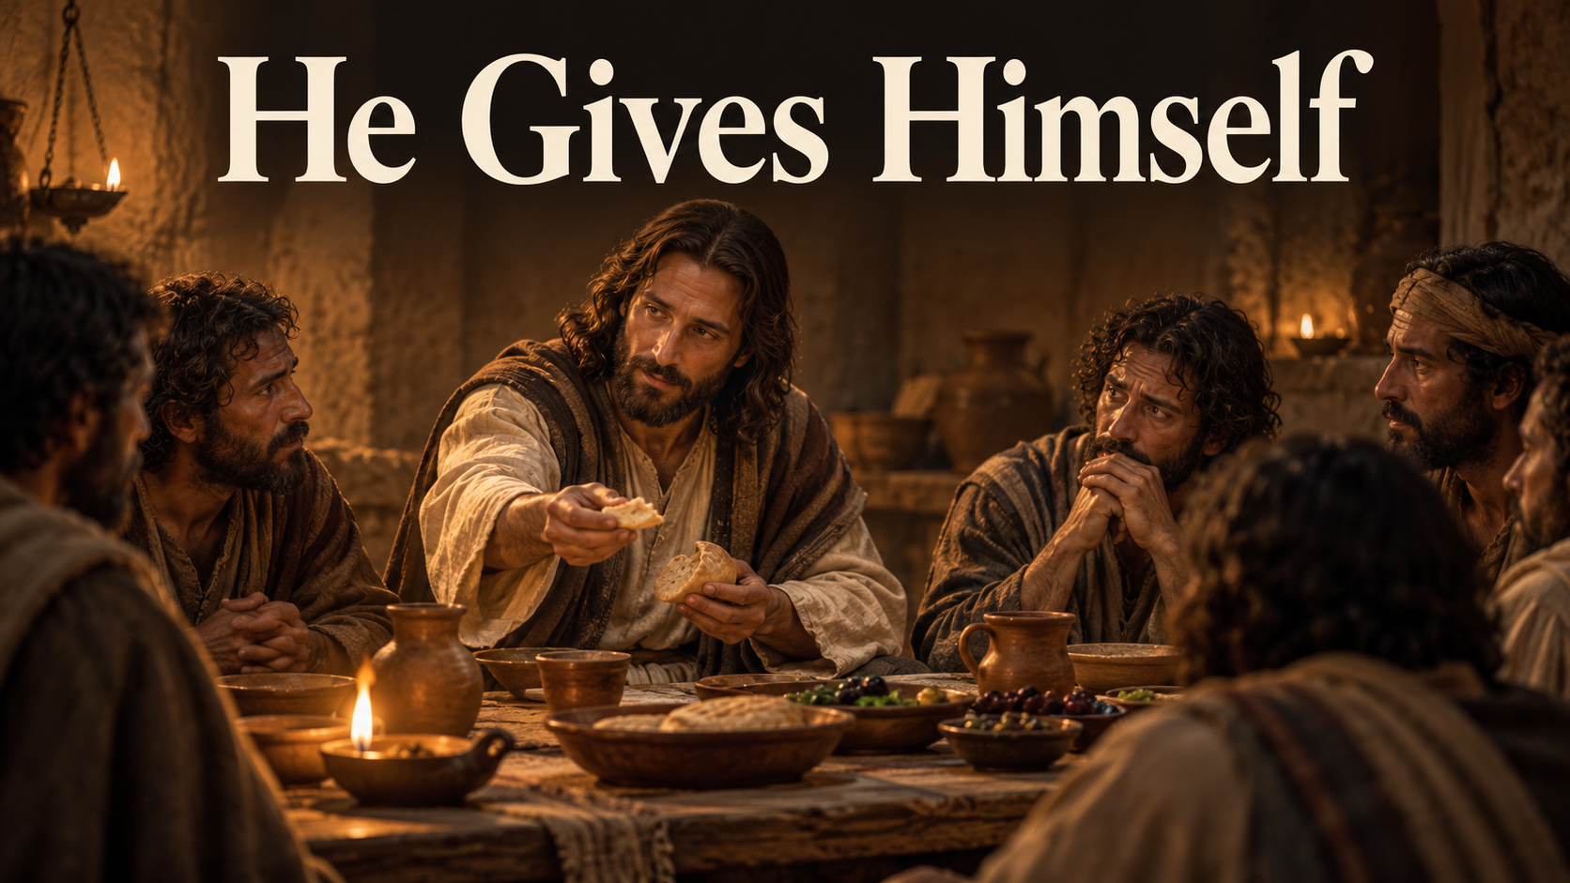
Sermon

Slide 41

Sermon

Slide 42

Sermon

Slide 43
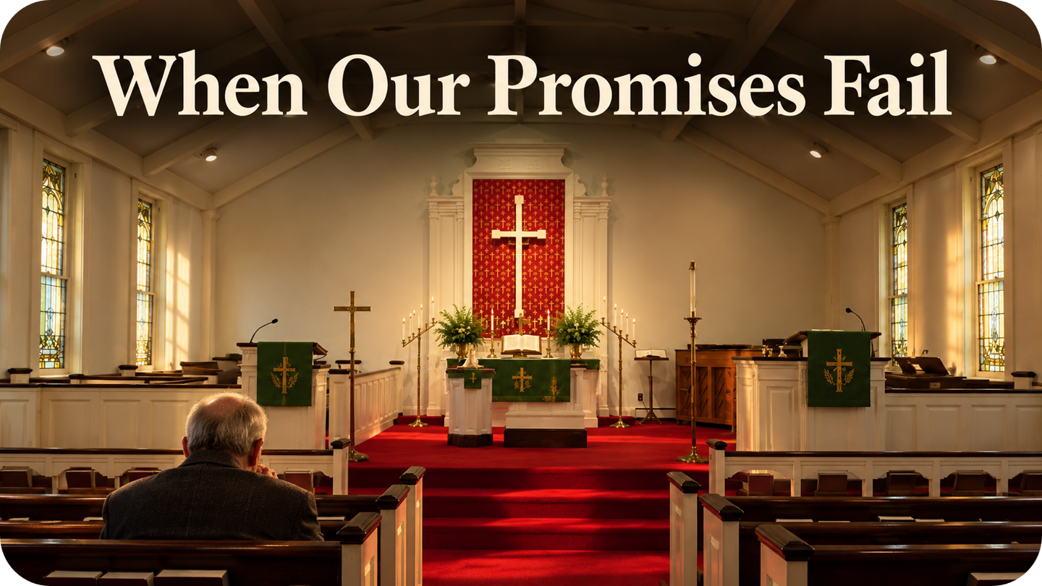

Sermon
Our Life of Repentance

Slide 44
APOSTLE’S CREED
C: I believe in God, the Father almighty, creator of heaven and earth.

Slide 45
APOSTLE’S CREED
C: I believe in Jesus Christ, his only Son, our Lord. He was conceived by the power of the Holy Spirit and born of the virgin Mary. He suffered under Pontius Pilate, was crucified, died, and was buried.

Slide 46
APOSTLE’S CREED
C: He descended into hell. On the third day he rose again. He ascended into heaven, and is seated at the right hand of the Father. He will come again to judge the living and the dead.

Slide 47
APOSTLE’S CREED
C: I believe in the Holy Spirit, the holy catholic Church, the communion of saints, the forgiveness of sins, the resurrection of the body, and the life everlasting. Amen.

Slide 48
NICENE CREED
C: We believe in one God, the Father, the Almighty, maker of heaven and earth, of all that is, seen and unseen.

Slide 49
NICENE CREED
C: We believe in one Lord, Jesus Christ, the only Son of God, eternally begotten of the Father, God from God, Light from Light, true God from true God, begotten, not made, of one Being with the Father.

Slide 50
NICENE CREED
C: Through him all things were made. For us and for our salvation he came down from heaven; by the power of the Holy Spirit he became incarnate from the virgin Mary, and was made man. For our sake he was crucified under Pontius Pilate;

Slide 51
NICENE CREED
C: he suffered death and was buried. On the third day he rose again in accordance with the Scriptures; he ascended into heaven and is seated at the right hand of the Father. He will come again in glory to judge the living and the dead, and his kingdom will have no end.

Slide 52
NICENE CREED
C: We believe in the Holy Spirit, the Lord, the giver of life, who proceeds from the Father and the Son. With the Father and the Son he is worshiped and glorified. He has spoken through the prophets. We believe in one holy catholic and apostolic Church.

Slide 53
NICENE CREED
C: We acknowledge one Baptism for the forgiveness of sins. We look for the resurrection of the dead, and the life of the world to come. Amen.

Slide 54
PRAYERS OF INTERCESSION
L: Confident that our Creator God listens and answers prayer, we pray for the church, the world, and all who are in need.
A brief silence.

Slide 55
PRAYERS
Each petition will end with the words,
A: God of mercy and grace,
C: We lift our prayers to you.

Slide 56
PRAYERS OF INTERCESSION
The prayer concludes…
P: God who created all that is, we place all for whom we pray, both aloud and in the silence of our hearts, into your loving arms.
C: Amen.

Slide 57
OFFERING/OFFERING PRAYER

Slide 58
THE GREAT THANKSGIVING
Communion is “Continuous-By Station”.
All the Baptized are welcome to celebrate this Holy Meal.

Slide 59
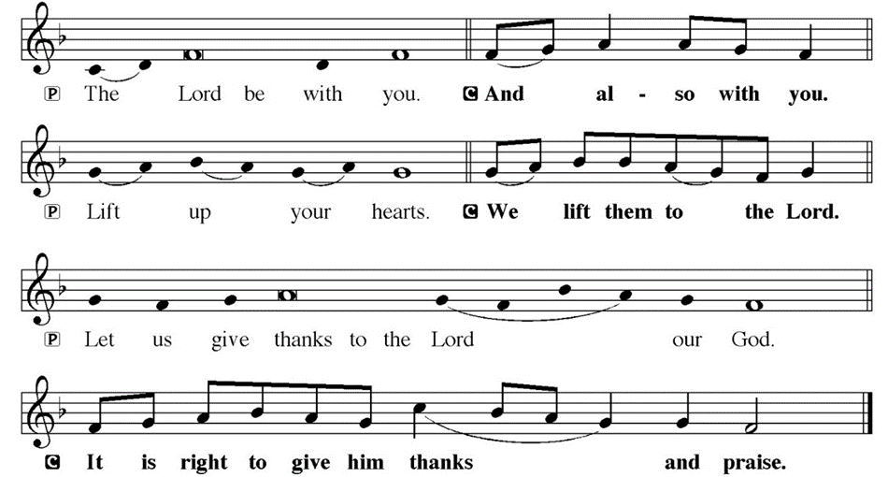
DIALOGUE

Slide 60
THE PREFACE
P: It is indeed right and salutary…
… we praise your name and join their unending hymn.

Slide 61
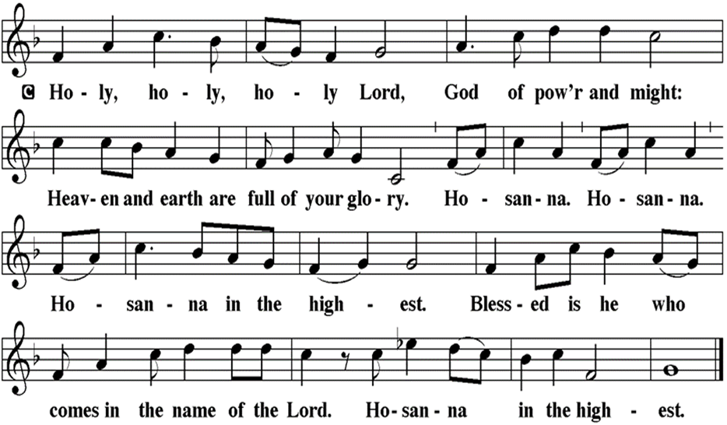
THE SANCTUS

Slide 62
EUCHARISTIC PRAYER
P: Holy God, our Maker, Redeemer…
…Both now and forever.
C: Amen.

Slide 63
THE LORD’S PRAYER
C: Our Father, who art in heaven, hallowed be thy name, thy kingdom come, thy will be done, on earth as it is in heaven. Give us this day our daily bread; and forgive us our trespasses, as we forgive those who trespass against us; and lead us not into temptation, but deliver us from evil.

Slide 64
THE LORD’S PRAYER
C: For thine is the kingdom, and the power, and the glory, forever and ever. Amen.

Slide 65
INVITATION TO COMMUNION
P: The God of the covenant invites you to this table of promises kept, where Jesus meets us in bread and wine and strengthens us for our new life in him. Come and be fed, for all is prepared for you.

Slide 66
COMMUNION DISTRIBUTION
All may commune “Continuously, By Station”. The bread may be broken for distribution. As the ministers give the bread and wine, they say these words :
The body of Christ, given for you.
The blood of Christ, shed for you.
The communicant may say: Amen.

Slide 67
POST COMMUNION BLESSING
P: May this Body and Blood of our Lord and Savior, Jesus Christ, strengthen, keep, and unite us, ☩ now and forever.
C: Amen.

Slide 68
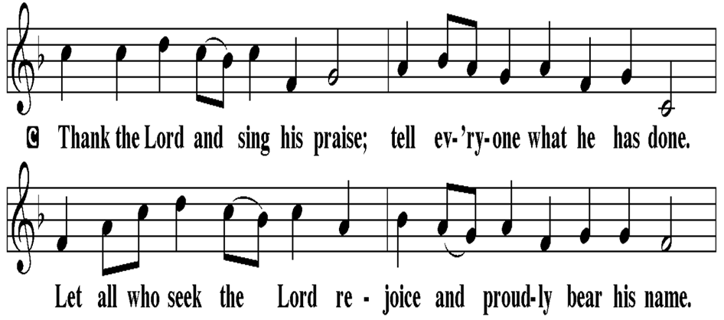
POST COMMUNION CANTACLE

Slide 69
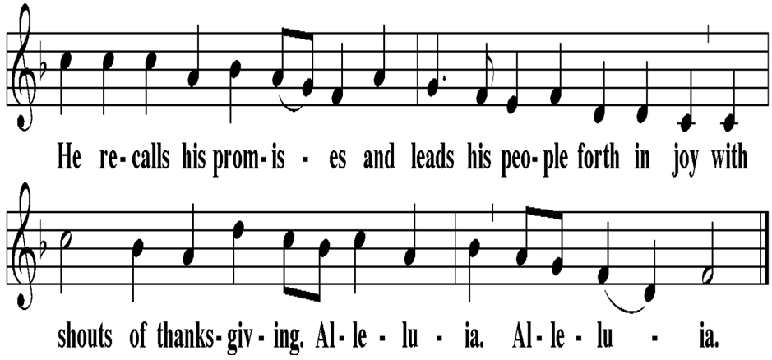
POST COMMUNION CANTACLE

Slide 70
POST COMMUNION PRAYER
P: Let us pray… Sustaining God, with this bread and cup, you nourish us with mercy and abundant life. By your Spirit, send us from this table to serve a needy world. Make us living signs of your liberation, healing, and love, following the way of Jesus, in whose name we pray.
C: Amen

Slide 71
SENDING OF HOMEBOUND COMMUNION
P: Gracious God, whose mercy endures from generation to generation: bless those who go forth to share your word and sacrament with our sisters and brothers who are sick or homebound.

Slide 72
SENDING OF HOMEBOUND COMMUNION
P: In your love and care, nourish and strengthen those to whom we bring this communion, that through the body and blood of your Son we may all know the hope of your promised coming in Jesus Christ our Lord.
C: Amen.

Slide 73
ANNOUNCEMENTS

Slide 74
SENDING BLESSING

Slide 75
SENDING SONG
“We Give Thee but Thine Own”
LBW 410

Slide 76
“We Give Thee but Thine Own”
LBW 410
1 We give thee but thine own,
whate’er the gift may be;
all that we have is thine alone,
a trust, O Lord, from thee.
2 May we thy bounties thus
as stewards true receive,
and gladly, as thou blessest us,
to thee our firstfruits give.

Slide 77
“We Give Thee but Thine Own”
LBW 410
3 Hearts still are bruised and dead,
and homes are bare and cold,
and lambs for whom the Shepherd bled
are straying from the fold.
4 To comfort and to bless,
to find a balm for woe,
to tend those lost in loneliness,
is angels’ work below.

Slide 78
“We Give Thee but Thine Own”
LBW 410
5 The captive to release,
the lost to God to bring,
to teach the way of life and peace
it is a Christlike thing.
6 And we believe thy word,
though dim our faith may be:
whate’er we do for thine, O Lord,
we do it unto thee.

Slide 79
DISMISSAL
P: Depart in Christ’s Love.
C: Seeking, welcoming, and serving all. Amen!
POSTLUDE
By Roxanne Groff
From sundaysandseasons.com. Copyright © 2026 Augsburg Fortress. All rights reserved. Reprinted by permission under Augsburg Fortress Liturgies Annual License #SAS023830. New Revised Standard Version Bible, Copyright © 1989, Division of Christian Education of the National Council of the Churches of Christ in the United States of America. Used by permission. All rights reserved. Revised Common Lectionary, Copyright © 1992 Consultation on Common Texts, admin Augsburg Fortress. Used by permission. Some images generated with ChatGPT (“Theo”) using OpenAI.

