Slide 1

October 26, 2025
WELCOME!
Trinity Lutheran Church
REFORMATION SUNDAY
Notes:
Image: Five Loaves by Caroline Coolidge Brown. Copyright © Caroline Coolidge Brown. All rights reserved. Used by permission of the artist.

Slide 2
= Please stand if able
= Please be seated
Prelude - By Roxanne Groff
Office of the Acolyte
Ringing of the Bell
Welcome

Slide 3
CONFESSION AND FORGIVENESS
All may make the sign of the cross, the sign marked at baptism…
L: We confess our sins before God and one another.
Pause for silence and reflection.
L: Holy God,
Notes:
Image: Five Loaves by Caroline Coolidge Brown. Copyright © Caroline Coolidge Brown. All rights reserved. Used by permission of the artist.

Slide 4
CONFESSION AND FORGIVENESS
C: You have created us in your image, protected and nourished us, and called us into your work of justice. Yet while we profess these truths, we forget who we are and whose we are.
Notes:
Image: Five Loaves by Caroline Coolidge Brown. Copyright © Caroline Coolidge Brown. All rights reserved. Used by permission of the artist.

Slide 5
CONFESSION AND FORGIVENESS
C: We put our trust in ourselves, in material goods, and in worldly powers instead of trusting you. We prioritize our comfort over our neighbor’s needs.
Notes:
Image: Five Loaves by Caroline Coolidge Brown. Copyright © Caroline Coolidge Brown. All rights reserved. Used by permission of the artist.

Slide 6
CONFESSION AND FORGIVENESS
C: Call us back to you, God. Forgive us our failings, and direct us back onto the path you would have us tread.
Notes:
Image: Five Loaves by Caroline Coolidge Brown. Copyright © Caroline Coolidge Brown. All rights reserved. Used by permission of the artist.

Slide 7
CONFESSION AND FORGIVENESS
P: Hear the good news, siblings in Christ. You have been created in wholeness, claimed in love, and forgiven according to God’s boundless grace. Nothing—even the worst we do or fail to do—can separate us from the love of our God. Receive this forgiveness with joy, in the name of Jesus, ☩ our savior and friend.
C: Amen.
Notes:
Image: Five Loaves by Caroline Coolidge Brown. Copyright © Caroline Coolidge Brown. All rights reserved. Used by permission of the artist.

Slide 8

Gathering Song/Hymn of Praise
“A Mighty Fortress Is Our God”
LBW 229

Slide 9
A Mighty Fortress Is Our God--LBW 229
1 A mighty fortress is our God,
a sword and shield victorious;
he breaks the cruel oppressor's rod
and wins salvation glorious.
The old satanic foe
has sworn to work us woe!
With craft and dreadful might
he arms himself to fight.
On earth he has no equal.
Notes:
Image: Five Loaves by Caroline Coolidge Brown. Copyright © Caroline Coolidge Brown. All rights reserved. Used by permission of the artist.

Slide 10
A Mighty Fortress Is Our God--LBW 229
2 No strength of ours can match his might!
We would be lost, rejected.
But now a champion comes to fight,
whom God himself elected.
You ask who this may be?
The Lord of hosts is he!
Christ Jesus, mighty Lord,
God's only Son, adored.
He holds the field victorious.
Notes:
Image: Five Loaves by Caroline Coolidge Brown. Copyright © Caroline Coolidge Brown. All rights reserved. Used by permission of the artist.

Slide 11
A Mighty Fortress Is Our God--LBW 229
3 Though hordes of devils fill the land
all threat'ning to devour us,
we tremble not, unmoved we stand;
they cannot overpow'r us.
Let this world's tyrant rage;
in battle we'll engage!
His might is doomed to fail;
God's judgment must prevail!
One little word subdues him.
Notes:
Image: Five Loaves by Caroline Coolidge Brown. Copyright © Caroline Coolidge Brown. All rights reserved. Used by permission of the artist.

Slide 12
A Mighty Fortress Is Our God--LBW 229
4 God's Word forever shall abide,
no thanks to foes, who fear it;
for God himself fights by our side
with weapons of the Spirit.
Were they to take our house,
goods, honor, child, or spouse,
though life be wrenched away,
they cannot win the day.
The kingdom's ours forever!
Notes:
Image: Five Loaves by Caroline Coolidge Brown. Copyright © Caroline Coolidge Brown. All rights reserved. Used by permission of the artist.

Slide 13
APOSTOLIC GREETING
P: The grace of our Lord Jesus Christ, the love of God, and the communion of the Holy Spirit be with you all.
C: And also with you.
Notes:
Image: Five Loaves by Caroline Coolidge Brown. Copyright © Caroline Coolidge Brown. All rights reserved. Used by permission of the artist.

Slide 14
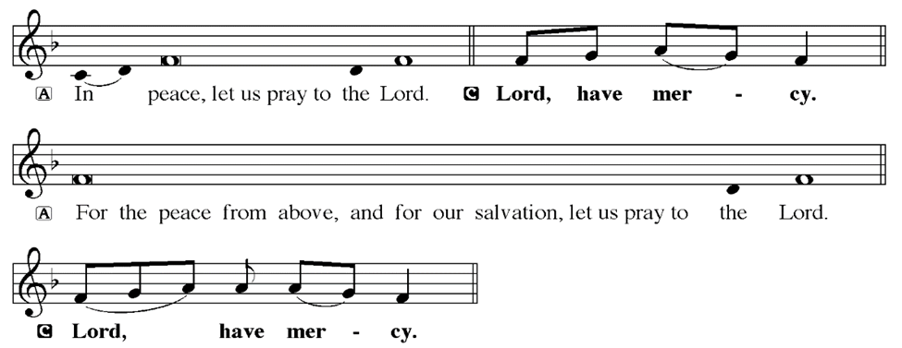
KYRIE
Notes:
Image: Five Loaves by Caroline Coolidge Brown. Copyright © Caroline Coolidge Brown. All rights reserved. Used by permission of the artist.

Slide 15
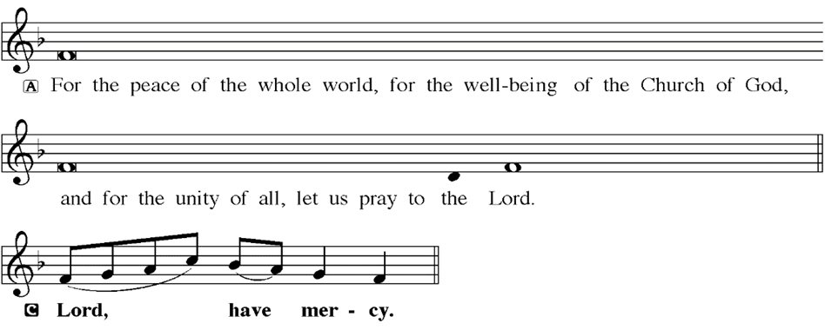
KYRIE
Notes:
Image: Five Loaves by Caroline Coolidge Brown. Copyright © Caroline Coolidge Brown. All rights reserved. Used by permission of the artist.

Slide 16
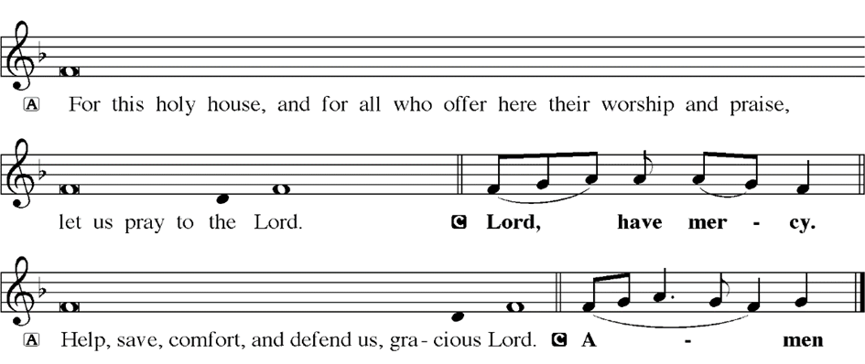
KYRIE
Notes:
Image: Five Loaves by Caroline Coolidge Brown. Copyright © Caroline Coolidge Brown. All rights reserved. Used by permission of the artist.

Slide 17
HYMN OF PRAISE
Glory be to God in heaven;
peace, goodwill to all the earth.
Mighty God of all creation,
Father of surpassing worth:
we exalt you, we adore you,
we lift high our thanks and praise.
Saints and angels bow before you; here on earth our songs we raise.
Notes:
Image: Five Loaves by Caroline Coolidge Brown. Copyright © Caroline Coolidge Brown. All rights reserved. Used by permission of the artist.

Slide 18
HYMN OF PRAISE
Glory be to Christ forever,
Lamb of God and Lord of love.
Son of God and gracious Savior, you have come from heav’n above;
on the cross you died to save us; now you reign at God’s right hand.
Hear our prayer; restore, forgive us; in your promise firm we stand.
Notes:
Image: Five Loaves by Caroline Coolidge Brown. Copyright © Caroline Coolidge Brown. All rights reserved. Used by permission of the artist.

Slide 19
HYMN OF PRAISE
Holy One we now acclaim you;
Lord alone, to you we call;
Holy One in faith we name you,
God most high, yet near to all:
Jesus Christ, with God the Spirit,
in the Father’s splendor bright.
For the peace that we inherit,
glory be to God on high!
Notes:
Image: Five Loaves by Caroline Coolidge Brown. Copyright © Caroline Coolidge Brown. All rights reserved. Used by permission of the artist.

Slide 20
PRAYER OF THE DAY
P: Let us pray… Unbounded God, all of creation is your temple and your dwelling place. Fill us with wonder and joy at your presence in all that you have made. Help us to treat the natural world and all that is in it with respect and care, that all might dwell here together in peace. In Jesus’ name we pray.
C: Amen
Notes:
Image: Five Loaves by Caroline Coolidge Brown. Copyright © Caroline Coolidge Brown. All rights reserved. Used by permission of the artist.

Slide 21

Notes:
Image: Five Loaves by Caroline Coolidge Brown. Copyright © Caroline Coolidge Brown. All rights reserved. Used by permission of the artist.

Slide 22
Scripture Reading
L: Our scripture reading for this day is from 1st Kings, Chapters 5 and 8.
C: Glory to you O’ Lord!
Notes:
Image: Five Loaves by Caroline Coolidge Brown. Copyright © Caroline Coolidge Brown. All rights reserved. Used by permission of the artist.

Slide 23
1 Kings 5:1-5; 8:1-13
Chapter 5
Now King Hiram of Tyre sent his servants to Solomon, when he heard that they had anointed him king in place of his father; for Hiram had always been a friend to David. ²Solomon sent word to Hiram, saying, ³‘You know that my father David could not build a house for the name of the Lord his God because of the warfare
Notes:
Image: Five Loaves by Caroline Coolidge Brown. Copyright © Caroline Coolidge Brown. All rights reserved. Used by permission of the artist.

Slide 24
1 Kings 5:1-5; 8:1-13
Chapter 5
with which his enemies surrounded him, until the Lord put them under the soles of his feet. ⁴But now the Lord my God has given me rest on every side; there is neither adversary nor misfortune. ⁵So I intend to build a house for the name of the Lord my God, as the Lord said to my father David, “Your son, whom I will set on
Notes:
Image: Five Loaves by Caroline Coolidge Brown. Copyright © Caroline Coolidge Brown. All rights reserved. Used by permission of the artist.

Slide 25
1 Kings 5:1-5; 8:1-13
Chapter 5
your throne in your place, shall build the house for my name.”
Chapter 8
Then Solomon assembled the elders of Israel and all the heads of the tribes, the leaders of the ancestral houses of the Israelites, before King Solomon in Jerusalem,
Notes:
Image: Five Loaves by Caroline Coolidge Brown. Copyright © Caroline Coolidge Brown. All rights reserved. Used by permission of the artist.

Slide 26
1 Kings 5:1-5; 8:1-13
Chapter 8
to bring up the ark of the covenant of the Lord out of the city of David, which is Zion. ²All the people of Israel assembled to King Solomon at the festival in the month Ethanim, which is the seventh month. ³And all the elders of Israel came, and the priests carried the ark. ⁴So they brought up the ark of the Lord, the tent
Notes:
Image: Five Loaves by Caroline Coolidge Brown. Copyright © Caroline Coolidge Brown. All rights reserved. Used by permission of the artist.

Slide 27
1 Kings 5:1-5; 8:1-13
Chapter 8
of meeting, and all the holy vessels that were in the tent; the priests and the Levites brought them up. ⁵King Solomon and all the congregation of Israel, who had assembled before him, were with him before the ark, sacrificing so many sheep and oxen that they could not be counted or numbered. ⁶Then the priests brought
Notes:
Image: Five Loaves by Caroline Coolidge Brown. Copyright © Caroline Coolidge Brown. All rights reserved. Used by permission of the artist.

Slide 28
1 Kings 5:1-5; 8:1-13
Chapter 8
the ark of the covenant of the Lord to its place, in the inner sanctuary of the house, in the most holy place, underneath the wings of the cherubim. ⁷For the cherubim spread out their wings over the place of the ark, so that the cherubim made a covering above the ark and its poles.
Notes:
Image: Five Loaves by Caroline Coolidge Brown. Copyright © Caroline Coolidge Brown. All rights reserved. Used by permission of the artist.

Slide 29
1 Kings 5:1-5; 8:1-13
Chapter 8
⁸The poles were so long that the ends of the poles were seen from the holy place in front of the inner sanctuary; but they could not be seen from outside; they are there to this day. ⁹There was nothing in the ark except the two tablets of stone that Moses had placed there at Horeb, where the
Notes:
Image: Five Loaves by Caroline Coolidge Brown. Copyright © Caroline Coolidge Brown. All rights reserved. Used by permission of the artist.

Slide 30
1 Kings 5:1-5; 8:1-13
Chapter 8
Lord made a covenant with the Israelites, when they came out of the land of Egypt. ¹⁰And when the priests came out of the holy place, a cloud filled the house of the Lord, ¹¹so that the priests could not stand to minister because of the cloud; for the glory of the Lord filled the house of the Lord.
Notes:
Image: Five Loaves by Caroline Coolidge Brown. Copyright © Caroline Coolidge Brown. All rights reserved. Used by permission of the artist.

Slide 31
1 Kings 5:1-5; 8:1-13
Chapter 8
¹²Then Solomon said, “The Lord has said that he would dwell in thick darkness. ¹³I have built you an exalted house, a place for you to dwell in forever.”
Notes:
Image: Five Loaves by Caroline Coolidge Brown. Copyright © Caroline Coolidge Brown. All rights reserved. Used by permission of the artist.

Slide 32
1 Kings 5:1-5; 8:1-13
R: This is the Word of the Lord.
C: Praise to You, O Christ
Notes:
Image: Five Loaves by Caroline Coolidge Brown. Copyright © Caroline Coolidge Brown. All rights reserved. Used by permission of the artist.

Slide 33

Sermon

Slide 34
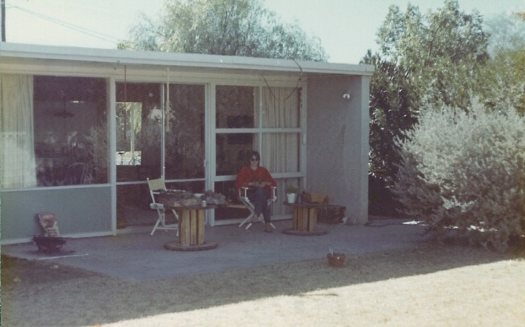
Sermon

Slide 35
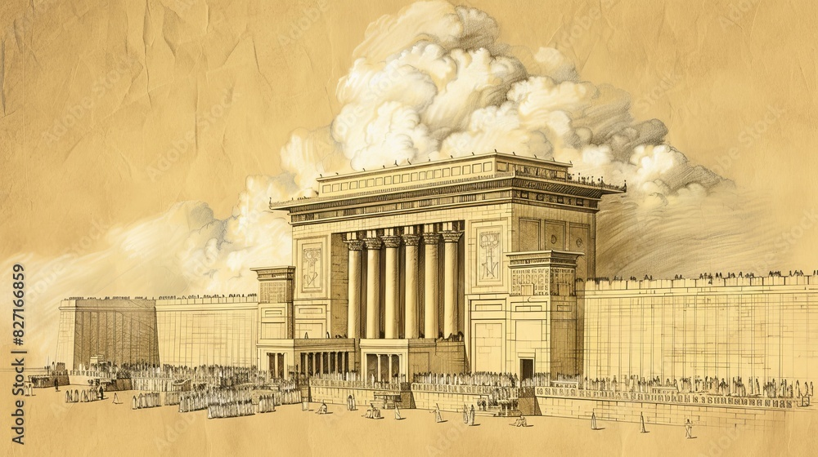
Sermon

Slide 36
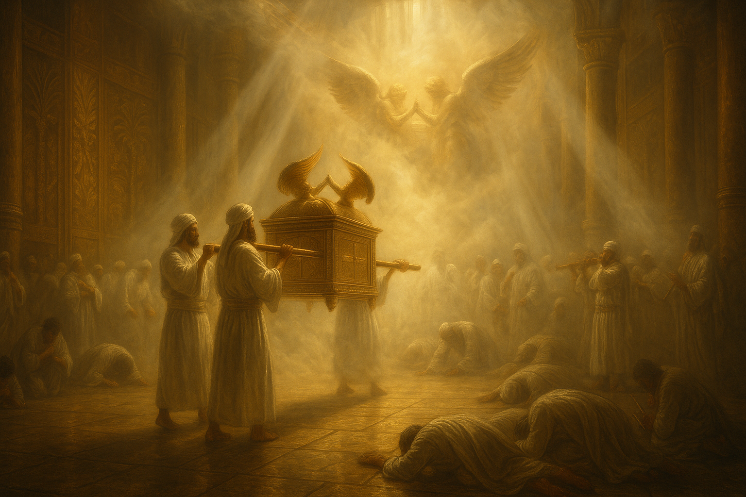
Sermon

Slide 37
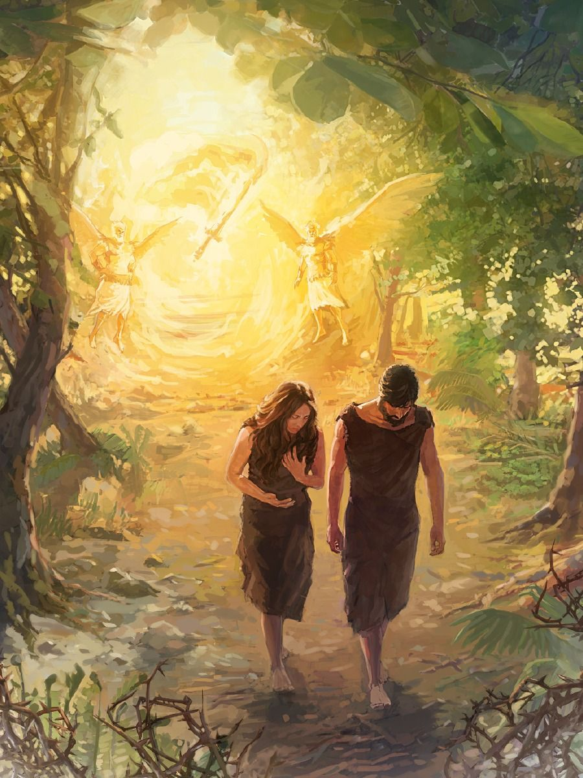
Sermon

Slide 38
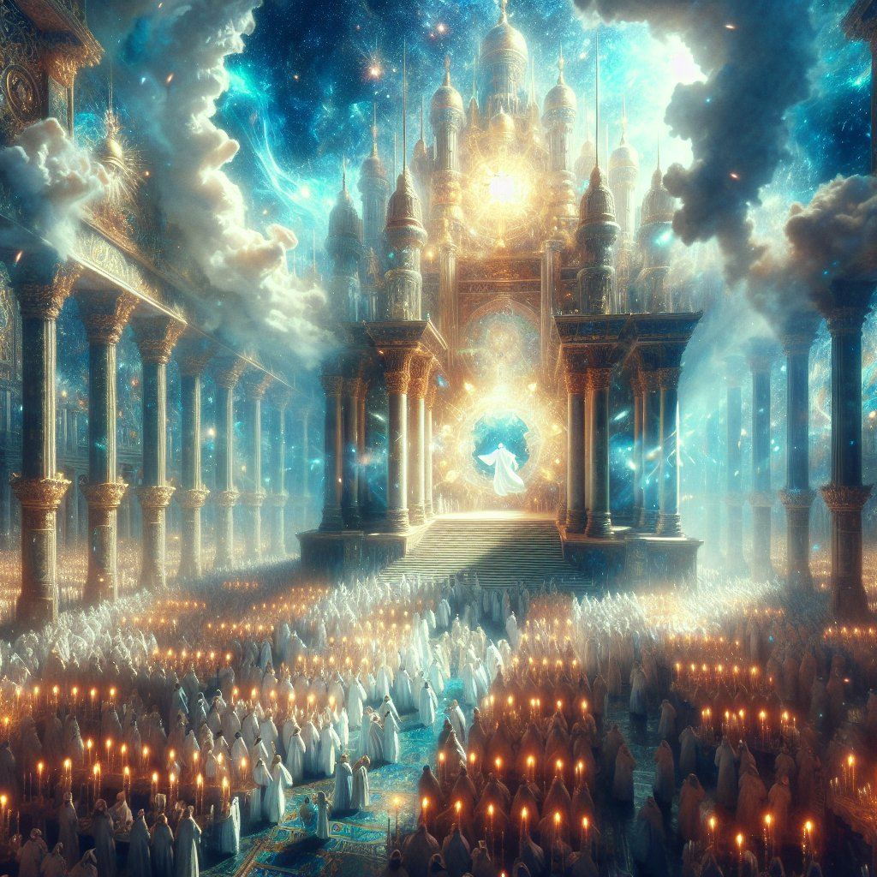
Sermon

Slide 39
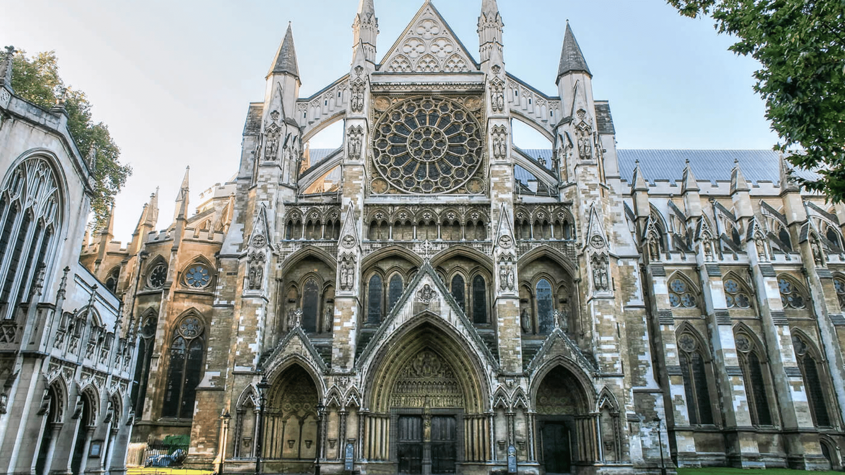
Sermon
Cologne Cathedral

Slide 40
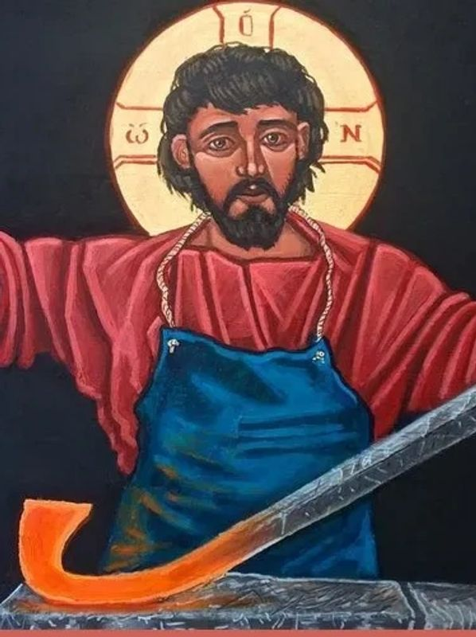
Sermon

Slide 41
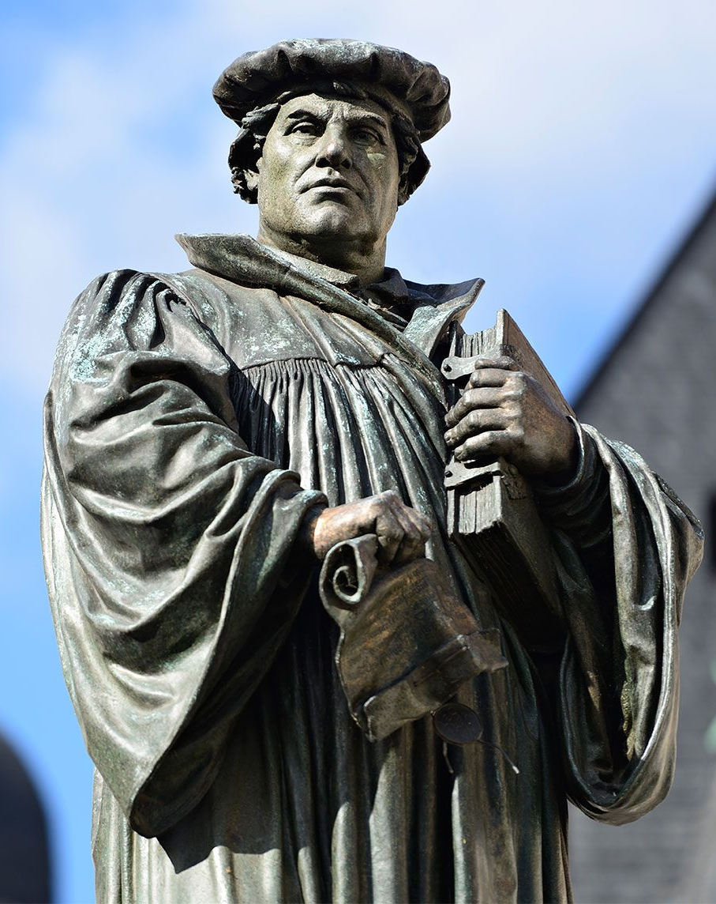
Sermon

Slide 42
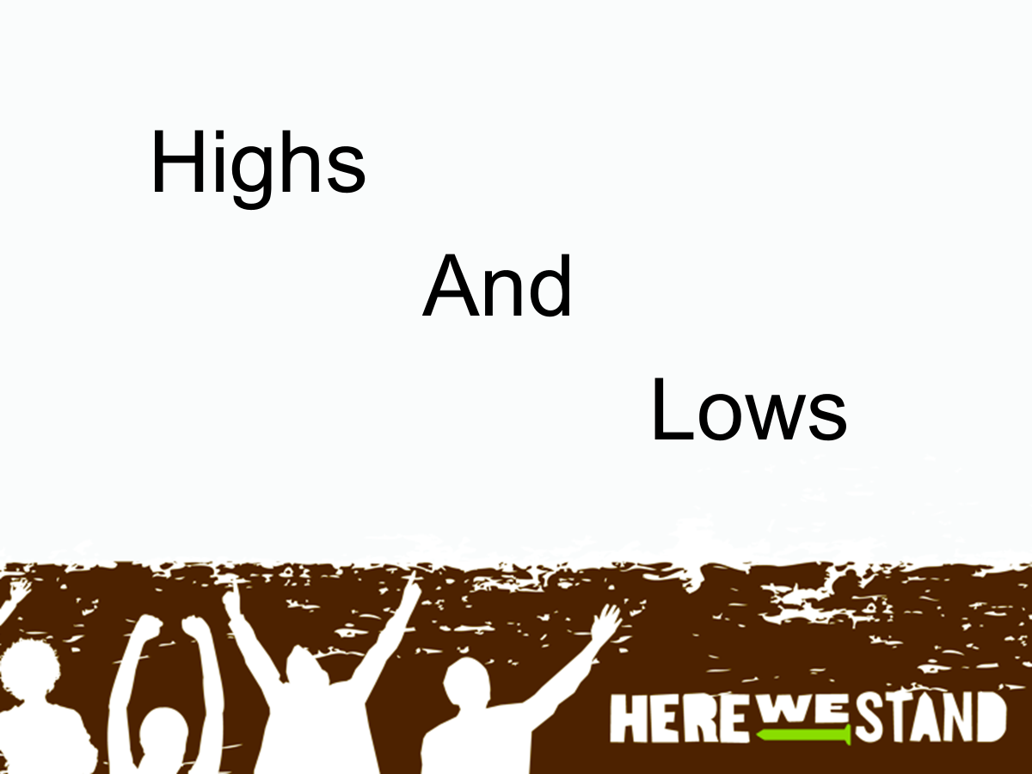
Sermon

Slide 43

Sermon
YES!!!

Slide 44
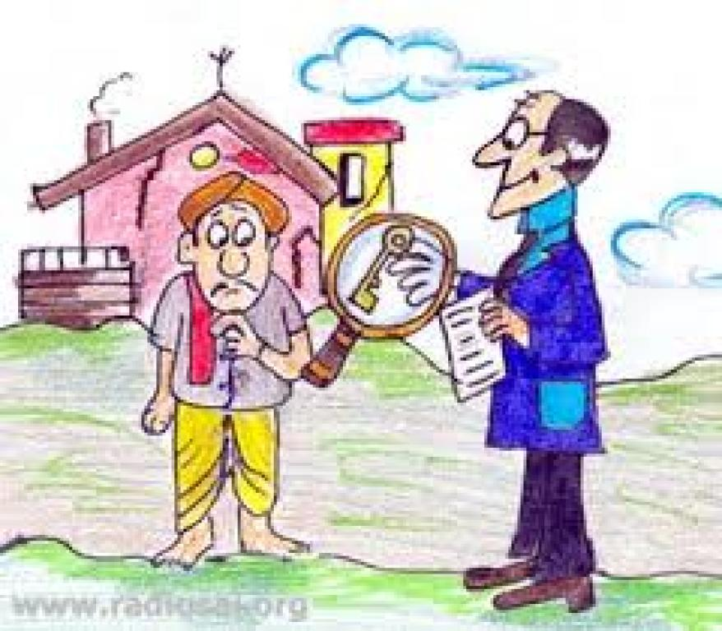
Sermon

Slide 45

Sermon

Slide 46
AFFIRMATION OF BAPTISM
PRESENTATION OF CONFIRMANDS
Callie Schmitmeyer
Micah Angles
RENUNCIATION OF EVIL

Slide 47
PROFESSION OF FAITH
P: Do you believe in God the Father?
C: I believe in God, the Father almighty, creator of heaven and earth.

Slide 48
PROFESSION OF FAITH
P: Do you believe in Jesus Christ, the Son of God?
C: I believe in Jesus Christ, his only Son, our Lord. He was conceived by the power of the Holy Spirit and born of the virgin Mary. He suffered under Pontius Pilate, was crucified, died, and was buried. He descended into hell.*

Slide 49
PROFESSION OF FAITH
C: On the third day he rose again. He ascended into heaven, and is seated at the right hand of the Father. He will come again to judge the living and the dead.

Slide 50
PROFESSION OF FAITH
P: Do you believe in God the Holy Spirit?
C: I believe in the Holy Spirit, the holy catholic Church, the communion of saints, the forgiveness of sins, the resurrection of the body, and the life everlasting. Amen

Slide 51
PRAYERS
Each petition will end with the words,
A: God of promise,
C: Hear our prayer.

Slide 52
PRAYERS OF INTERCESSION
The prayer concludes…
P: We lift all these prayers, and those of our hearts, to your loving care, O God. Receive them and restore our hope in your promises. In Jesus’ name.
C: Amen.

Slide 53
AFFIRMATION OF BAPTISM
COMMITMENT
PRAYER OF BLESSING
LAYING ON OF HANDS
MENTOR COMMENTS
QUILT SQUARE PRESENTATION

Slide 54
OFFERING
Notes:
Image: Five Loaves by Caroline Coolidge Brown. Copyright © Caroline Coolidge Brown. All rights reserved. Used by permission of the artist.

Slide 55
OFFERING PRAYER
Notes:
Image: Five Loaves by Caroline Coolidge Brown. Copyright © Caroline Coolidge Brown. All rights reserved. Used by permission of the artist.

Slide 56
THE GREAT THANKSGIVING
All the Baptized are welcome to celebrate this Holy Meal.

Slide 57
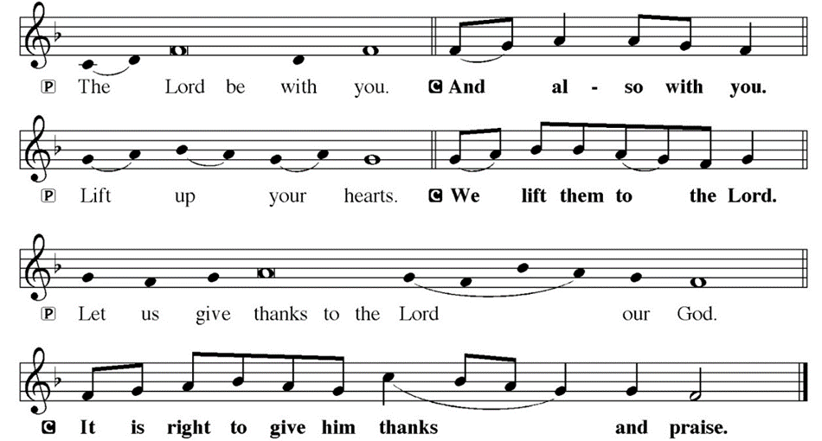
DIALOGUE

Slide 58
THE PREFACE
P: It is indeed truly good, right and salutary…
… we praise your name and join their unending hymn.

Slide 59
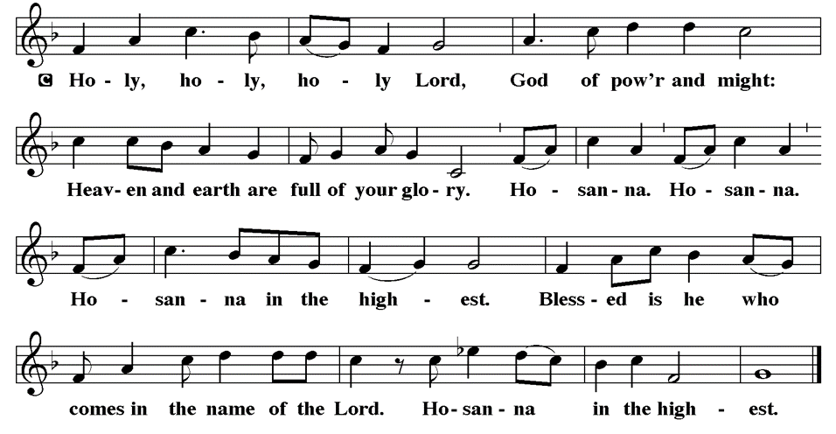
THE SANCTUS

Slide 60
EUCHARISTIC PRAYER
P: We praise you, all Holy God…
…and we proclaim the mystery of our faith.
C: Christ has died.
C: Christ is risen.
C: Christ will come again.
P: We pray O God…
… today, tomorrow, and forever.
C: Amen

Slide 61
THE LORD’S PRAYER
C: Our Father, who art in heaven, hallowed be thy name, thy kingdom come, thy will be done, on earth as it is in heaven. Give us this day our daily bread; and forgive us our trespasses, as we forgive those who trespass against us; and lead us not into temptation, but deliver us from evil.

Slide 62
THE LORD’S PRAYER
C: For thine is the kingdom, and the power, and the glory, forever and ever. Amen.

Slide 63
INVITATION TO COMMUNION
P: Jesus, who is God with us, present in this holy house, calls you now to this table, where all of creation shares in his body and blood for the redemption of the world. Come with your siblings in Christ to be fed.

Slide 64
COMMUNION DISTRIBUTION
All will commune “By Station”.
The bread may be broken for distribution. As the ministers give the bread and wine, they say these words :
The body of Christ, given for you.
The blood of Christ, shed for you.
The communicant may say: Amen.

Slide 65
POST COMMUNION BLESSING
P: May this body and blood of our Lord and Savior, Jesus Christ, strengthen, keep, and unity us, ☩ now and forever,
C: Amen.

Slide 66
POST COMMUNION CANTACLE

Slide 67
POST COMMUNION CANTACLE

Slide 68
POST COMMUNION PRAYER
P: Let us pray… O God, through this meal you have strengthened us and appointed us to be your servants. Send us to do good and to share our possessions with all in need. We ask this in Jesus’ name.
C: Amen.

Slide 69
ANNOUNCEMENTS
Notes:
Image: Five Loaves by Caroline Coolidge Brown. Copyright © Caroline Coolidge Brown. All rights reserved. Used by permission of the artist.

Slide 70
SENDING BLESSING
P: The God of righteousness, who gives justice to the oppressed, who gives food to the hungry, who sets the prisoners free, ☩ bless you now and forever.
C: Amen.

Slide 71
Sending Song
“The Church’s One Foundation”
LBW 369
Notes:
Image: Five Loaves by Caroline Coolidge Brown. Copyright © Caroline Coolidge Brown. All rights reserved. Used by permission of the artist.

Slide 72
“The Church’s One Foundation” LBW 369
1 The church's one foundation
is Jesus Christ, her Lord;
she is his new creation
by water and the word.
From heav'n he came and sought her
to be his holy bride;
with his own blood he bought her,
and for her life he died.
Notes:
Image: Preparing yeast dough. Copyright © tomasworks/iStock/Thinkstock. Used by permission.

Slide 73
“The Church’s One Foundation” LBW 369
2 Elect from ev'ry nation,
yet one o'er all the earth,
her charter of salvation
one Lord, one faith, one birth:
one holy name she blesses,
partakes one holy food,
and to one hope she presses,
with ev'ry grace endued.
Notes:
Image: Preparing yeast dough. Copyright © tomasworks/iStock/Thinkstock. Used by permission.

Slide 74
“The Church’s One Foundation” LBW 369
3 Though with a scornful wonder
this world sees her oppressed,
by schisms rent asunder,
by heresies distressed,
yet saints their watch are keeping;
their cry goes up: "How long?"
And soon the night of weeping
shall be the morn of song.
Notes:
Image: Preparing yeast dough. Copyright © tomasworks/iStock/Thinkstock. Used by permission.

Slide 75
“The Church’s One Foundation” LBW 369
4 Through toil and tribulation
and tumult of her war,
she waits the consummation
of peace forevermore;
till with the vision glorious
her longing eyes are blest,
and the great church victorious
shall be the church at rest.
Notes:
Image: Preparing yeast dough. Copyright © tomasworks/iStock/Thinkstock. Used by permission.

Slide 76
“The Church’s One Foundation” LBW 369
5 Yet she on earth has union
with God, the Three in One,
and mystic sweet communion
with those whose rest is won.
Oh, blessed heav'nly chorus!
Lord, save us by your grace,
that we, like saints before us,
may see you face to face.
Notes:
Image: Preparing yeast dough. Copyright © tomasworks/iStock/Thinkstock. Used by permission.

Slide 77
DISMISSAL
P: … Depart in Christ’s Love.
C: Seeking, welcoming, and serving all. Amen!
POSTLUDE
By
Roxanne Groff
From sundaysandseasons.com. Copyright © 2025 Augsburg Fortress. All rights reserved. Reprinted by permission under Augsburg Fortress Liturgies Annual License #SAS023830. New Revised Standard Version Bible, Copyright © 1989, Division of Christian Education of the National Council of the Churches of Christ in the United States of America. Used by permission. All rights reserved. Revised Common Lectionary, Copyright © 1992 Consultation on Common Texts, admin Augsburg Fortress. Used by permission.

