Slide 1

Trinity Evangelical Lutheran Church
June 16, 2024
WELCOME!
Notes:
Image: Five Loaves by Caroline Coolidge Brown. Copyright © Caroline Coolidge Brown. All rights reserved. Used by permission of the artist.

Slide 2
Prelude By Roxanne Groff
= Please stand if able
= Please be seated
Office of the Acolyte and Ringing of the Bell
Welcome
Notes:
Image: Five Loaves by Caroline Coolidge Brown. Copyright © Caroline Coolidge Brown. All rights reserved. Used by permission of the artist.

Slide 3
CONFESSION AND FORGIVENESS
All may make the sign of the cross, the sign marked at baptism…
L: We confess our sins before God and one another.
Pause for silence and reflection.
L: Merciful God,
Notes:
Image: Five Loaves by Caroline Coolidge Brown. Copyright © Caroline Coolidge Brown. All rights reserved. Used by permission of the artist.

Slide 4
CONFESSION AND FORGIVENESS
C: Like willful children, we have turned away from you, we have refused to heed your call to love you and our neighbors as ourselves. We have wandered after other gods, and squandered your extravagant gifts to us. We have been ungrateful for all that you have provided, and refused to share these things with others.
Notes:
Image: Five Loaves by Caroline Coolidge Brown. Copyright © Caroline Coolidge Brown. All rights reserved. Used by permission of the artist.

Slide 5
CONFESSION AND FORGIVENESS
C: Draw us back into your embrace. Cleanse us by your unconditional love and mercy, that we might live in a state of complete trust in you, and act out of that trust on behalf of others.
Notes:
Image: Five Loaves by Caroline Coolidge Brown. Copyright © Caroline Coolidge Brown. All rights reserved. Used by permission of the artist.

Slide 6
CONFESSION AND FORGIVENESS
L: Beloved children of God, your heavenly Father throws open His arms like the father of the prodigal son and welcomes you back always. For the sake of Jesus, your brother, ☩ God forgives you all your sins.
C: Amen.
Notes:
Image: Five Loaves by Caroline Coolidge Brown. Copyright © Caroline Coolidge Brown. All rights reserved. Used by permission of the artist.

Slide 7
Gathering Song
“O Master, Let Me Walk with You”
LBW 492
Notes:
Image: Five Loaves by Caroline Coolidge Brown. Copyright © Caroline Coolidge Brown. All rights reserved. Used by permission of the artist.

Slide 8
“O Master, Let Me Walk with You” LBW 492
1 O Master, let me walk with you
in lowly paths of service true;
tell me your secret; help me bear
the strain of toil, the fret of care.
Notes:
Image: Five Loaves by Caroline Coolidge Brown. Copyright © Caroline Coolidge Brown. All rights reserved. Used by permission of the artist.

Slide 9
“O Master, Let Me Walk with You” LBW 492
2 Help me the slow of heart to move
by some clear, winning word of love;
teach me the wayward feet to stay,
and guide them in the homeward way.
Notes:
Image: Five Loaves by Caroline Coolidge Brown. Copyright © Caroline Coolidge Brown. All rights reserved. Used by permission of the artist.

Slide 10
“O Master, Let Me Walk with You” LBW 492
3 Teach me your patience; share with me
a closer, dearer company,
in work that keeps faith sweet and strong,
in trust that triumphs over wrong,
Notes:
Image: Five Loaves by Caroline Coolidge Brown. Copyright © Caroline Coolidge Brown. All rights reserved. Used by permission of the artist.

Slide 11
“O Master, Let Me Walk with You” LBW 492
4 In hope that sends a shining ray
far down the future’s broad'ning way,
in peace that only you can give;
with you, O Master, let me live.
Notes:
Image: Five Loaves by Caroline Coolidge Brown. Copyright © Caroline Coolidge Brown. All rights reserved. Used by permission of the artist.

Slide 12
APOSTOLIC GREETING
P: The grace of our Lord Jesus Christ, the love of God, and the communion of the Holy Spirit be with you all.
C: And also with you.
Notes:
Image: Five Loaves by Caroline Coolidge Brown. Copyright © Caroline Coolidge Brown. All rights reserved. Used by permission of the artist.

Slide 13
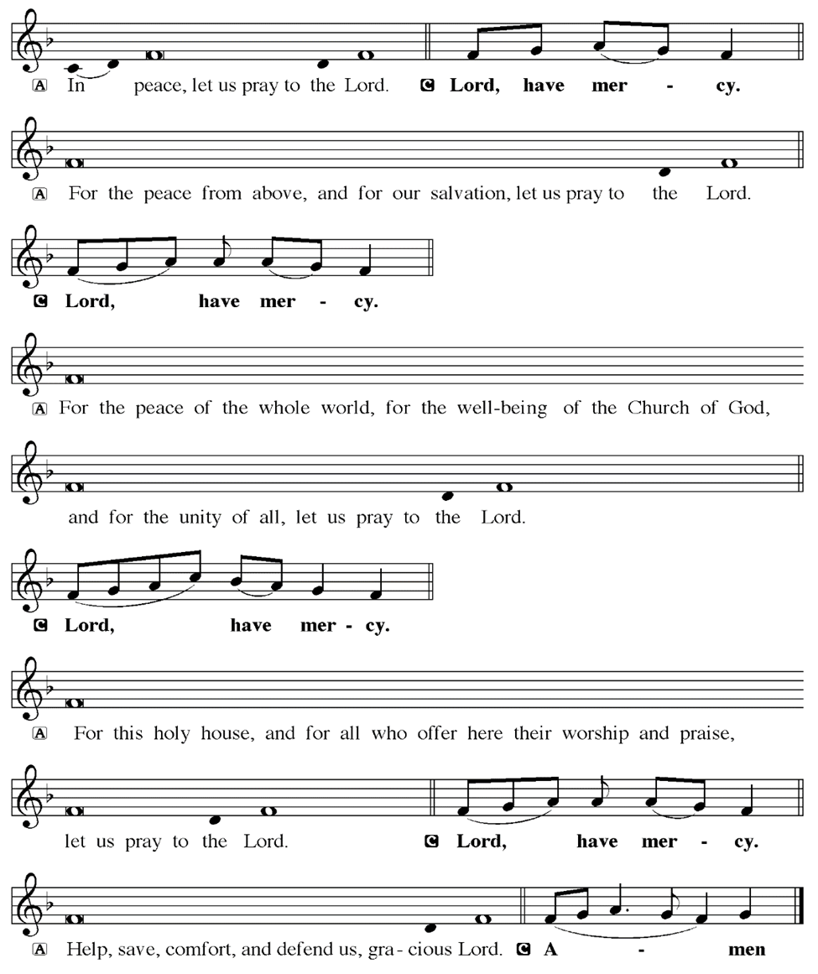
KYRIE
Notes:
Image: Five Loaves by Caroline Coolidge Brown. Copyright © Caroline Coolidge Brown. All rights reserved. Used by permission of the artist.

Slide 14
KYRIE
Notes:
Image: Five Loaves by Caroline Coolidge Brown. Copyright © Caroline Coolidge Brown. All rights reserved. Used by permission of the artist.

Slide 15
KYRIE
Notes:
Image: Five Loaves by Caroline Coolidge Brown. Copyright © Caroline Coolidge Brown. All rights reserved. Used by permission of the artist.

Slide 16
HYMN OF PRAISE
Glory be to God in heaven;
peace, goodwill to all the earth.
Mighty God of all creation,
Father of surpassing worth:
we exalt you, we adore you,
we lift high our thanks and praise.
Saints and angels bow before you; here on earth our songs we raise.
Notes:
Image: Five Loaves by Caroline Coolidge Brown. Copyright © Caroline Coolidge Brown. All rights reserved. Used by permission of the artist.

Slide 17
HYMN OF PRAISE
Glory be to Christ forever,
Lamb of God and Lord of love.
Son of God and gracious Savior, you have come from heav’n above;
on the cross you died to save us; now you reign at God’s right hand.
Hear our prayer; restore, forgive us; in your promise firm we stand.
Notes:
Image: Five Loaves by Caroline Coolidge Brown. Copyright © Caroline Coolidge Brown. All rights reserved. Used by permission of the artist.

Slide 18
HYMN OF PRAISE
Holy One we now acclaim you;
Lord alone, to you we call;
Holy One in faith we name you,
God most high, yet near to all:
Jesus Christ, with God the Spirit,
in the Father’s splendor bright.
For the peace that we inherit,
glory be to God on high!
Notes:
Image: Five Loaves by Caroline Coolidge Brown. Copyright © Caroline Coolidge Brown. All rights reserved. Used by permission of the artist.

Slide 19
PRAYER OF THE DAY
P: Let us pray…
…In Jesus’ name we pray.
C: Amen
Notes:
Image: Five Loaves by Caroline Coolidge Brown. Copyright © Caroline Coolidge Brown. All rights reserved. Used by permission of the artist.

Slide 20

Notes:
Image: Preparing yeast dough. Copyright © tomasworks/iStock/Thinkstock. Used by permission.

Slide 21
Scripture Reading
R: Our scripture reading for today is from the Gospel according to Luke, the 11th chapter.
C: Glory to you O’ Lord! (Spoken)
Notes:
Image: Five Loaves by Caroline Coolidge Brown. Copyright © Caroline Coolidge Brown. All rights reserved. Used by permission of the artist.

Slide 22
Luke 11:2-4
²He said to them, “When you pray, say: Father, hallowed be your name. Your kingdom come. ³Give us each day our daily bread. ⁴And forgive us our sins, for we ourselves forgive everyone indebted to us. And do not bring us to the time of trial.”
Notes:
Image: Five Loaves by Caroline Coolidge Brown. Copyright © Caroline Coolidge Brown. All rights reserved. Used by permission of the artist.

Slide 23
Luke 11:2-4
R: This is the Word of the Lord.
C: Praise to You, O Christ (Spoken)
Notes:
Image: Five Loaves by Caroline Coolidge Brown. Copyright © Caroline Coolidge Brown. All rights reserved. Used by permission of the artist.

Slide 24
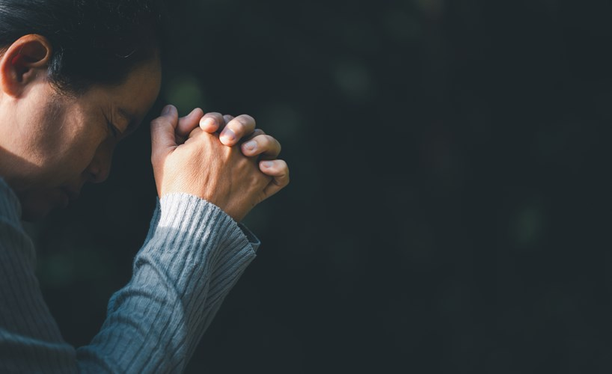
SERMON
Notes:
Image: Five Loaves by Caroline Coolidge Brown. Copyright © Caroline Coolidge Brown. All rights reserved. Used by permission of the artist.

Slide 25

SERMON
Notes:
Image: Five Loaves by Caroline Coolidge Brown. Copyright © Caroline Coolidge Brown. All rights reserved. Used by permission of the artist.

Slide 26
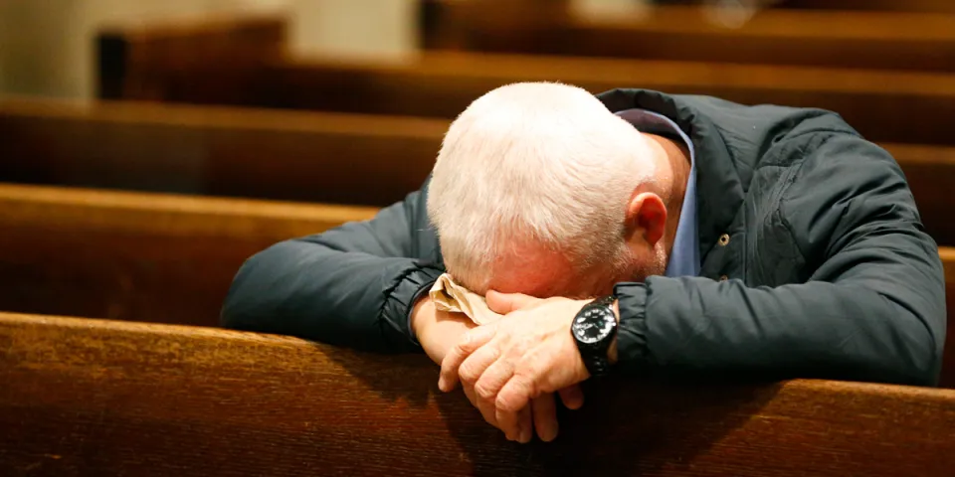
SERMON
Notes:
Image: Five Loaves by Caroline Coolidge Brown. Copyright © Caroline Coolidge Brown. All rights reserved. Used by permission of the artist.

Slide 27
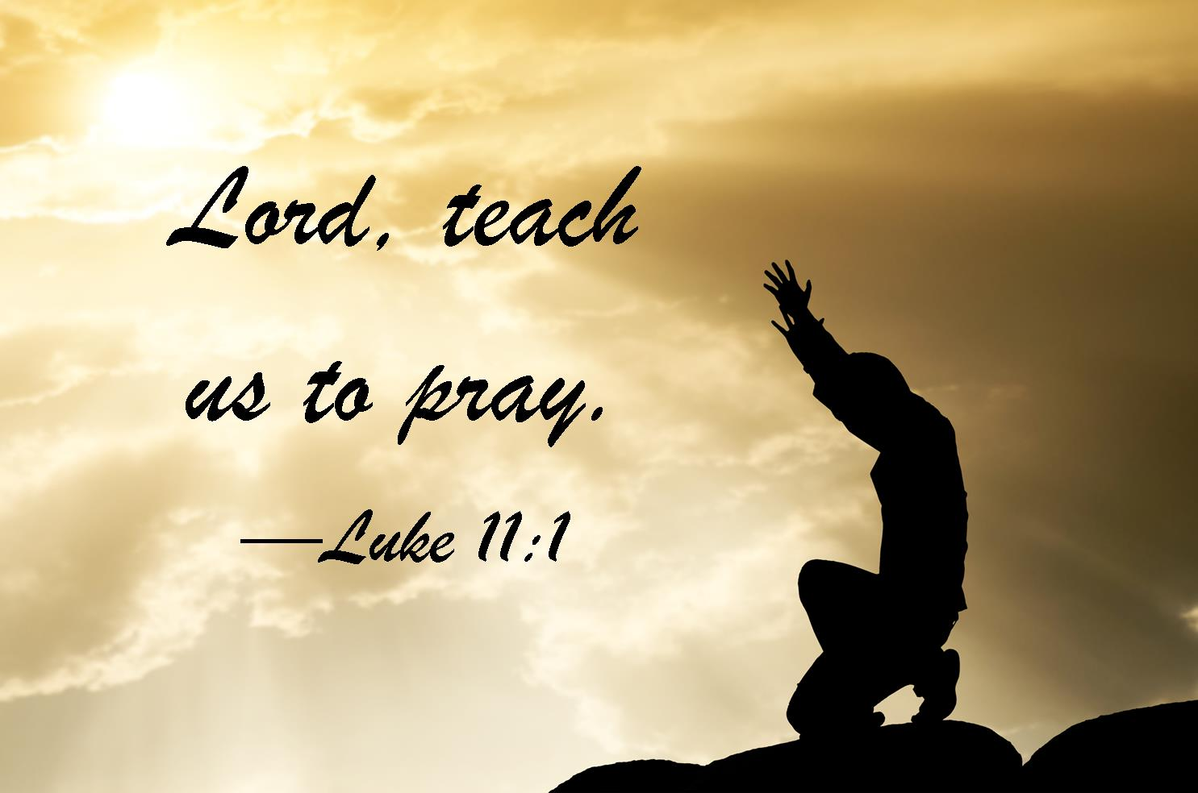
SERMON
Notes:
Image: Five Loaves by Caroline Coolidge Brown. Copyright © Caroline Coolidge Brown. All rights reserved. Used by permission of the artist.

Slide 28

SERMON
Notes:
Image: Five Loaves by Caroline Coolidge Brown. Copyright © Caroline Coolidge Brown. All rights reserved. Used by permission of the artist.

Slide 29

SERMON
Notes:
Image: Five Loaves by Caroline Coolidge Brown. Copyright © Caroline Coolidge Brown. All rights reserved. Used by permission of the artist.

Slide 30
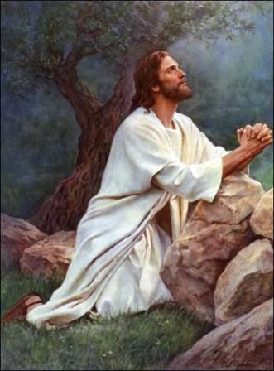
SERMON
Notes:
Image: Five Loaves by Caroline Coolidge Brown. Copyright © Caroline Coolidge Brown. All rights reserved. Used by permission of the artist.

Slide 31
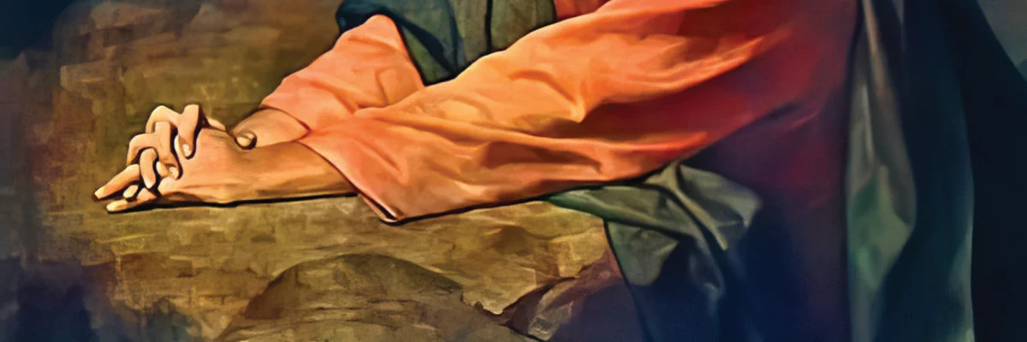
SERMON
Notes:
Image: Five Loaves by Caroline Coolidge Brown. Copyright © Caroline Coolidge Brown. All rights reserved. Used by permission of the artist.

Slide 32

SERMON
Notes:
Image: Five Loaves by Caroline Coolidge Brown. Copyright © Caroline Coolidge Brown. All rights reserved. Used by permission of the artist.

Slide 33

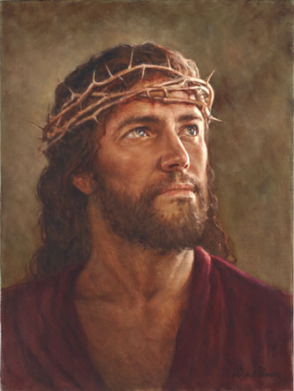
SERMON
Notes:
Image: Five Loaves by Caroline Coolidge Brown. Copyright © Caroline Coolidge Brown. All rights reserved. Used by permission of the artist.

Slide 34
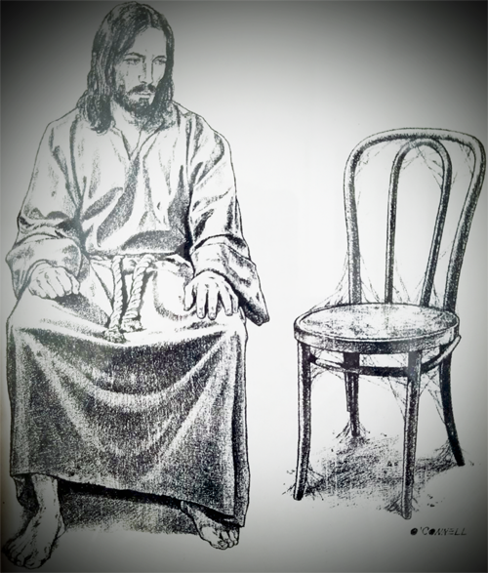
SERMON
SERMON
Notes:
Image: Five Loaves by Caroline Coolidge Brown. Copyright © Caroline Coolidge Brown. All rights reserved. Used by permission of the artist.

Slide 35
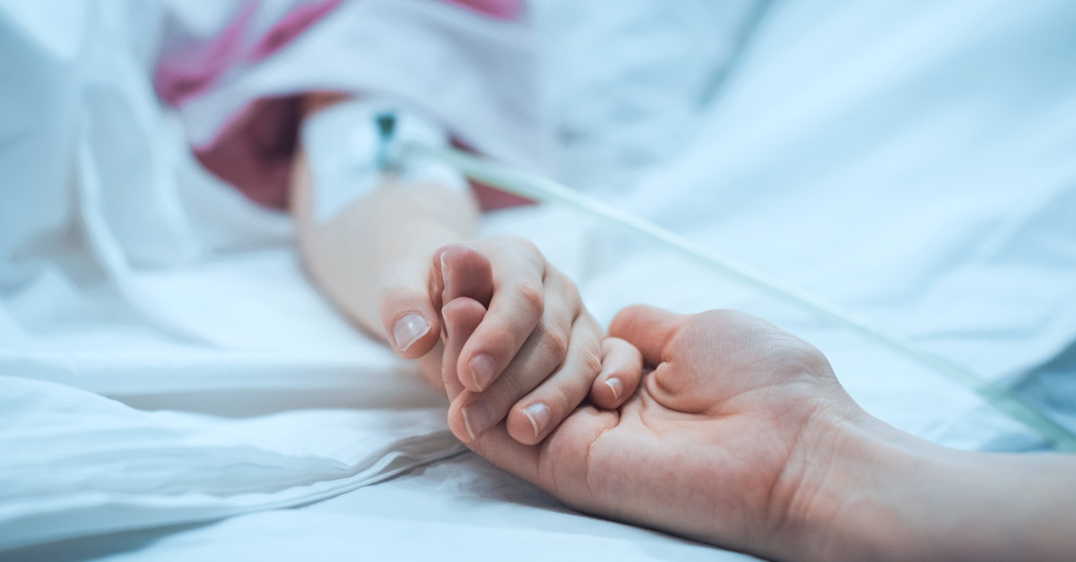
SERMON
SERMON
Notes:
Image: Five Loaves by Caroline Coolidge Brown. Copyright © Caroline Coolidge Brown. All rights reserved. Used by permission of the artist.

Slide 36
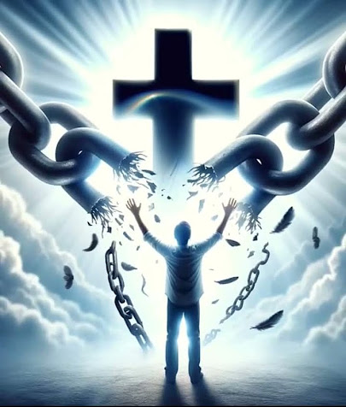
SERMON
Notes:
Image: Five Loaves by Caroline Coolidge Brown. Copyright © Caroline Coolidge Brown. All rights reserved. Used by permission of the artist.

Slide 37
APOSTLE’S CREED
C: I believe in God, the Father almighty, creator of heaven and earth.

Slide 38
APOSTLE’S CREED
C: I believe in Jesus Christ, his only Son, our Lord. He was conceived by the power of the Holy Spirit and born of the virgin Mary. He suffered under Pontius Pilate, was crucified, died, and was buried.

Slide 39
APOSTLE’S CREED
C: He descended into hell. On the third day he rose again. He ascended into heaven, and is seated at the right hand of the Father. He will come again to judge the living and the dead.

Slide 40
APOSTLE’S CREED
C: I believe in the Holy Spirit, the holy catholic Church, the communion of saints, the forgiveness of sins, the resurrection of the body, and the life everlasting. Amen.

Slide 41
NICENE CREED
C: We believe in one God, the Father, the Almighty, maker of heaven and earth, of all that is, seen and unseen.

Slide 42
NICENE CREED
C: We believe in one Lord, Jesus Christ, the only Son of God, eternally begotten of the Father, God from God, Light from Light, true God from true God, begotten, not made, of one Being with the Father.

Slide 43
NICENE CREED
C: Through him all things were made. For us and for our salvation he came down from heaven; by the power of the Holy Spirit he became incarnate from the virgin Mary, and was made man. For our sake he was crucified under Pontius Pilate;

Slide 44
NICENE CREED
C: he suffered death and was buried. On the third day he rose again in accordance with the Scriptures; he ascended into heaven and is seated at the right hand of the Father. He will come again in glory to judge the living and the dead, and his kingdom will have no end.

Slide 45
NICENE CREED
C: We believe in the Holy Spirit, the Lord, the giver of life, who proceeds from the Father and the Son. With the Father and the Son he is worshiped and glorified. He has spoken through the prophets. We believe in one holy catholic and apostolic Church.

Slide 46
NICENE CREED
C: We acknowledge one Baptism for the forgiveness of sins. We look for the resurrection of the dead, and the life of the world to come. Amen.

Slide 47
PRAYERS OF INTERCESSION
Each petition will end with the words,
A: God our shepherd,
The congregation will respond with:
C: Hear our prayer.

Slide 48
PRAYERS OF INTERCESSION
The prayer concludes…
P: Confident that you care for all our needs, we lift these prayers, spoken and unspoken, into your loving hands.
C: Amen.

Slide 49
OFFERING
Notes:
Image: Five Loaves by Caroline Coolidge Brown. Copyright © Caroline Coolidge Brown. All rights reserved. Used by permission of the artist.

Slide 50
OFFERING PRAYER
Notes:
Image: Five Loaves by Caroline Coolidge Brown. Copyright © Caroline Coolidge Brown. All rights reserved. Used by permission of the artist.

Slide 51
THE GREAT THANKSGIVING
All the Baptized are welcome to celebrate this Holy Meal.

Slide 52
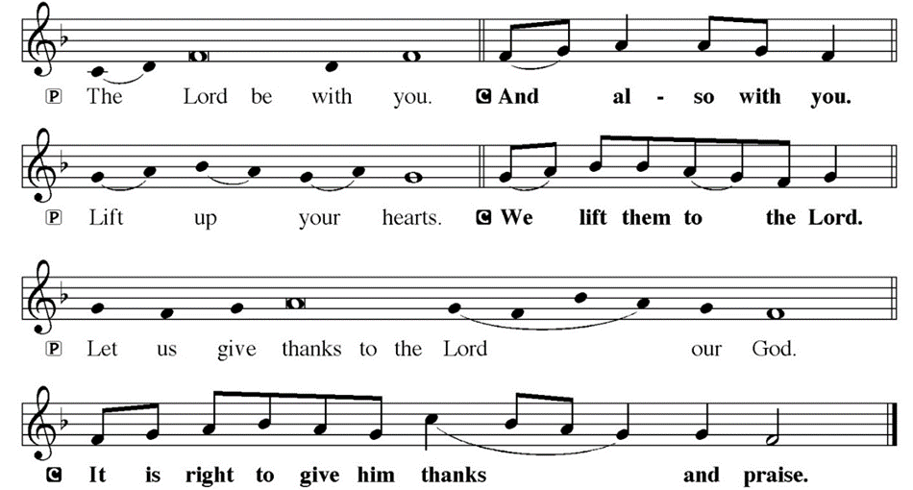
DIALOGUE

Slide 53
THE PREFACE
P: It is indeed right and salutary…
… we praise your name and join their unending hymn.

Slide 54
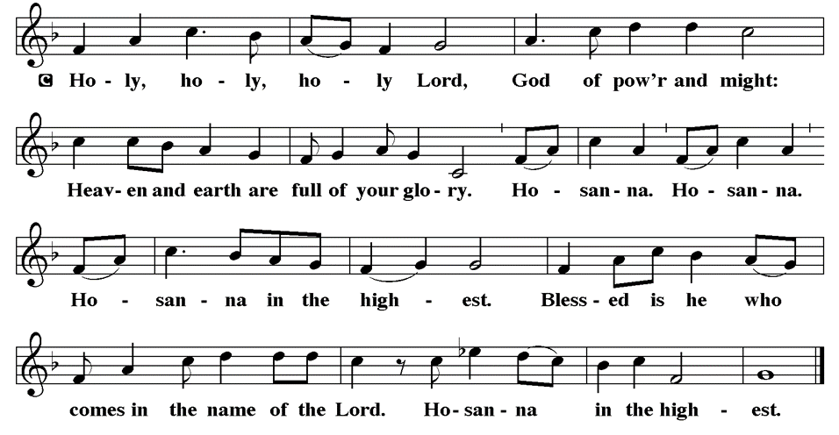
THE SANCTUS

Slide 55
EUCHARISTIC PRAYER
P: Holy God, our maker and redeemer…
…both now and forever.
C: Amen.

Slide 56
THE LORD’S PRAYER
C: Our Father, who art in heaven, hallowed be thy name, thy kingdom come, thy will be done, on earth as it is in heaven. Give us this day our daily bread; and forgive us our trespasses, as we forgive those who trespass against us; and lead us not into temptation, but deliver us from evil.

Slide 57
THE LORD’S PRAYER
C: For thine is the kingdom, and the power, and the glory, forever and ever. Amen.

Slide 58
INVITATION TO COMMUNION
P: Jesus, who is to be found fully present in this bread and wine, now invites you to be nourished on it at this table. Come and be joined with your siblings in Christ throughout time and space in this holy meal.

Slide 59
COMMUNION DISTRIBUTION
All will commune “by Station”.
The bread may be broken for distribution. As the ministers give the bread and wine, they say these words :
The body of Christ, given for you.
The blood of Christ, shed for you.
The communicant may say: Amen.

Slide 60
POST COMMUNION BLESSING
P: May this body and blood of our Lord and Savior, Jesus Christ, strengthen, keep and unite us, ☩ now and forever, amen.
C: Amen.

Slide 61
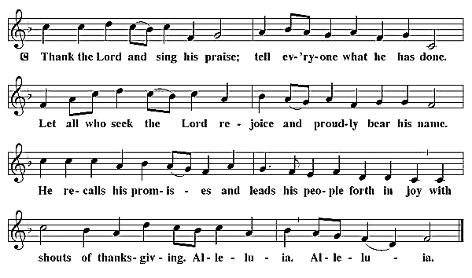
POST COMMUNION CANTACLE

Slide 62
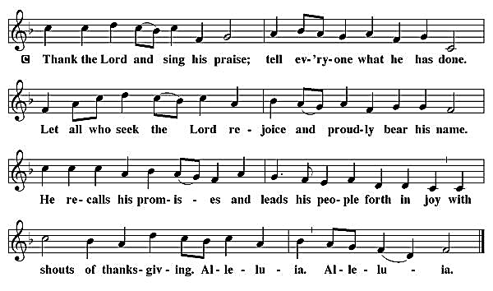
POST COMMUNION CANTACLE

Slide 63
POST COMMUNION PRAYER
P: Let us pray… Jesus, Bread of life, we have received from your table more than we could ever ask. As you have nourished us in this meal, now strengthen us to love the world with your own life. In your name we pray.
C: Amen

Slide 64

ANNOUNCEMENTS
Notes:
Image: Five Loaves by Caroline Coolidge Brown. Copyright © Caroline Coolidge Brown. All rights reserved. Used by permission of the artist.

Slide 65
SENDING BLESSING
P: The blessing of God, who provides for us, feeds us, and journeys with us, ☩ be upon you now and forever.
C: Amen.

Slide 66
Sending Song
“Sent Forth by God’s Blessing”
LBW 221
Notes:
Image: Five Loaves by Caroline Coolidge Brown. Copyright © Caroline Coolidge Brown. All rights reserved. Used by permission of the artist.

Slide 67
“Sent Forth by God’s Blessing” LBW 221
1 Sent forth by God's blessing,
our true faith confessing,
the people of God from this dwelling take leave.
The supper is ended.
Oh, now be extended
the fruits of this service in all who believe.
Notes:
Image: Preparing yeast dough. Copyright © tomasworks/iStock/Thinkstock. Used by permission.

Slide 68
“Sent Forth by God’s Blessing” LBW 221
1 The seed of Christ's teaching,
receptive souls reaching,
shall blossom in action for God and for all.
Your grace shall incite us,
your love shall unite us
to work for your kingdom and answer your call.
Notes:
Image: Preparing yeast dough. Copyright © tomasworks/iStock/Thinkstock. Used by permission.

Slide 69
“Sent Forth by God’s Blessing” LBW 221
2 With praise and thanksgiving
to God ever-living,
the tasks of our ev'ryday life we will face—
our faith ever sharing,
in love ever caring,
embracing God's children, the whole human race.
Notes:
Image: Preparing yeast dough. Copyright © tomasworks/iStock/Thinkstock. Used by permission.

Slide 70
“Sent Forth by God’s Blessing” LBW 221
2 With your feast you feed us,
with your light now lead us;
unite us as one in this life that we share.
Then may all the living
with praise and thanksgiving
give honor to Christ and his name that we bear.
Notes:
Image: Preparing yeast dough. Copyright © tomasworks/iStock/Thinkstock. Used by permission.

Slide 71
DISMISSAL
P: … Depart in Christ’s Love.
C: Seeking, welcoming, and serving all. Amen!
POSTLUDE
By Roxanne Groff
From sundaysandseasons.com. Copyright © 2024 Augsburg Fortress. All rights reserved. Reprinted by permission under Augsburg Fortress Liturgies Annual License #SAS023830. New Revised Standard Version Bible, Copyright © 1989, Division of Christian Education of the National Council of the Churches of Christ in the United States of America. Used by permission. All rights reserved. Revised Common Lectionary, Copyright © 1992 Consultation on Common Texts, admin Augsburg Fortress. Used by permission.

