Slide 1

Trinity Evangelical Lutheran Church
Announcements
December 10, 2023

Slide 2

Body, Mind, Spirit
MIND: Make a Christmas craft.
BODY: Smile
SPIRIT: Sing Christmas Carols

Slide 3


Our Office Secretary Is Sharon Fourman
Church Office Schedule
Tues, Wed, & Thurs
  8:00 am – 12:00 noon
Church Office: 937 692-5670
Email: secretary@pitsburgtlc.org

Slide 4


The Trinity Trumpet
A Monthly Newsletter
Published by Trinity Lutheran Church,
Pitsburg, OH
We’re looking for stories and pictures of Trinity people in action!
Submit to Secretary, Sharon Fourman at secretary@pitsburgtlc.org
Articles and Info due on or about the 15th of each month

Slide 5

Trinity Trumpet
    Your Trinity Trumpet Newsletter for November is available!
    Please take your copy before you leave today!

Slide 6
Trinity Trumpet
    Newsletter Deadline is Tuesday, December 19th
    Please turn in all your newsworthy items to Sharon Fourman at:
    secretary@pitsburgtlc.org

Slide 7

We’re Online!
www.pitsburgtlc.org
Sermons and announcements are posted weekly
Trinity Trumpet is Posted here too!
The ‘Official’ Trinity Calendar is available for you to see!
Pictures, Videos and more!
Also, like us on FaceBook at
facebook.com/pitsburgtrinitylutheran.church

Slide 8

We’re Online!
www.pitsburgtlc.org
We now have our own QR Code!
Scan this code with your Smartphone and you will connect to all our Online media (Facebook, YouTube, and our own Church Website)

Slide 9
Online Giving
www.pitsburgtlc.org
Click the “Give to Trinity” Button
Stay current in your giving even when you can’t make it to Worship!
Separate Giving Categories for:
    General Treasury
    Benevolence/Mission Support
    Building Fund
    Annual Christmas Auction
    Memorial Funds
    Thrive Capital Campaign
    Tyler Norris Fund

Slide 10


Church
Council
Trinity Church Council
Next Meeting:
January 17th
@ 7:00 pm

Slide 11


Trinity’s Team Meetings
Next Meeting
TBD
@ 6:00 pm
On the Agenda – Preparing the proposed 2023 budget

Slide 12
Please Pass the Pew Pads
(We now track Communion on the Pads)

Slide 13

Worship Team
Next Meeting:
  TBD

Slide 14

Mutual Ministry Team
  Julie Kossler
  VACANT
  Peggy Didier
  Please see one of them with your comments and suggestions
  Next Meeting - TBD

Slide 15


Choice FISH Pantry
Please join us every Friday @ 3:30 pm
400 Markwith Dr, Greenville OH
Most Needed Items
Kidney Beans
Canned Peas
Hamburger Helper
Pork & Beans
Canned Mixed Veggies
Large Cans of Soups
Applesauce
Boxed Meals
(i.e. Rice a Roni)

Slide 16
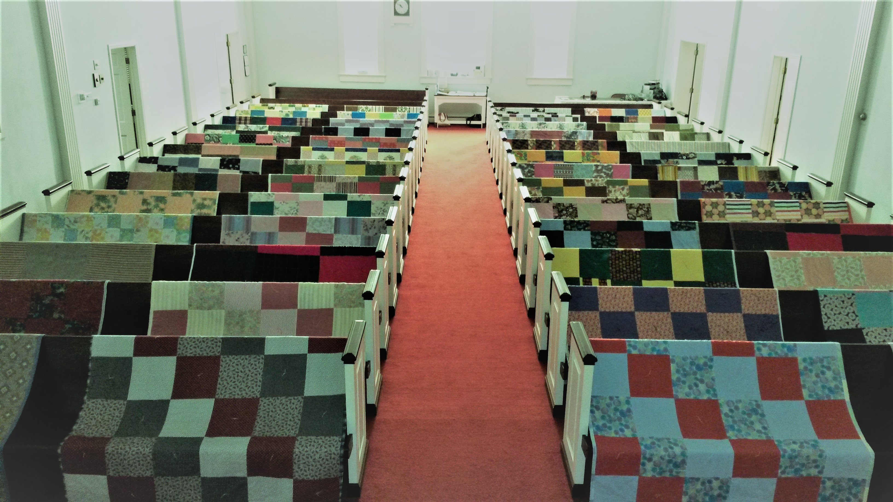
Prayers and Squares
Quilting Ministry
Taking December off…
Merry Christmas!!!

Slide 17


Ladies and Gents Luncheon
Date: December 18th @ 11:30 am
Where: Company 7 Bar-B-Que
1001 S Main St, Englewood, OH For Reservations/Questions:
        See Linda Baker or call her @ 937 545-0975

Slide 18

Confirmation Program
    Next Class – Attend Advent Soup Suppers and Devotions
    Weekly Worship attendance is required (In person or via FaceBook)
    Worship Notes may be emailed to pastor@pitsburgtlc.org or placed in Pr Mel’s mailbox outside the Church Office
    Confirmands are HIGHLY encouraged to take turns as Acolyte

Slide 19

    Who can be an Acolyte? YOU CAN!!!
    Training will be rescheduled for January
    Please sign up for Acolyte Duty on the chart by the Church Office!
    Confirmation Students are Highly Encouraged to perform Acolyte duty…
    Please sign up today!

Slide 20
New Member Class
We are forming a “New Member” Class for anyone who wants to learn more about Being Lutheran and what Being a member of Trinity entails
    Classes will begin January 8th
    Classes start at 12:00 Noon or as soon after Worship as possible
    Please see Pastor Mel if Interested in attending

Slide 21

    Commemorate special days like Anniversaries, Birthdays, Baptisms and more…
    See PJ to Sign Up!

Slide 22
Trinity’s Team Meetings
Youth and Family Ministry Team
Next Meeting
December 7th @ 10:00 am
Purpose -- plan for Christmas Events
Please come if you can!

Slide 23

Blood Pressure Screening
BP Screening
By Appointment
In The Nursery
Notes:
Cover: Sermon on the Mount by Laura James. Copyright © Laura James. All rights reserved. Used by permission of the artist.

Slide 24


Holy Communion – Today!
Communion Today is “At the Railing”
Safe for all humans (Especially sinners)
Holy Communion Schedule
    First and Third Sundays each month
    All White and Red Sundays of the Church Year

Slide 25

Calling all Adults!
Join Us For “Christian Conversations”
Not Your Ordinary Adult Sunday School
Sharing – Discussion - Prayer
Free Donuts, Juice, and Coffee
Every Sunday @
9:30 am
Notes:
Cover: Sermon on the Mount by Laura James. Copyright © Laura James. All rights reserved. Used by permission of the artist.

Slide 26
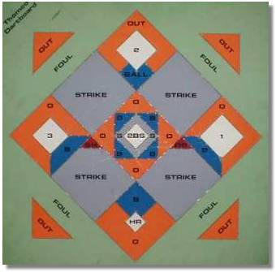


DARTBALL
Monday, December 11th @ 7:30 pm
First UMC
202 W 4th St.
Greenville , OH, 45331

Slide 27

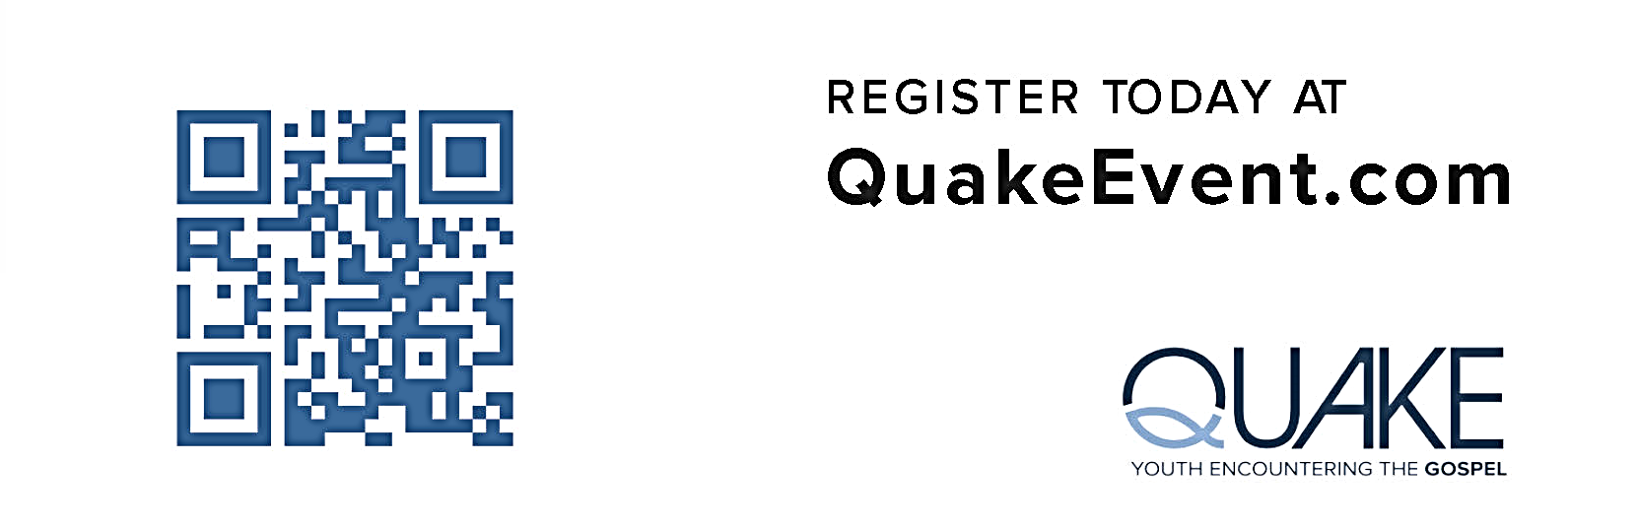
Trinity Youth (7th – 12th Grades)
  If Interested, please see Pr Mel or PJ
  Deadline is December 14th
  Ages: 7th – 12th Grades

Slide 28

Trinity Troops
Date: November 19th -- After Worship
Where: Trinity Fellowship Hall
Who: Youth 4th – 6th Grades
What: Service Project—Fleece Blankets for Comfort Kids Ministry
Trinity Troops!

Slide 29

Open House
  Wednesday, December 13, 2023
  Noon to 2:00 PM
  Hors d'oeuvres
  Hot Chocolate
  Christmas Cookies
  Meet the new Director - Maria Vail

Slide 30


ADVENT SOUP SUPPERS DEVOTIONS
Dates: All Wednesdays @ 6:30 pm
        Dec 6, 13, & 20
Enjoy
Delicious soup
30 minute Video
Great Conversation

Slide 31
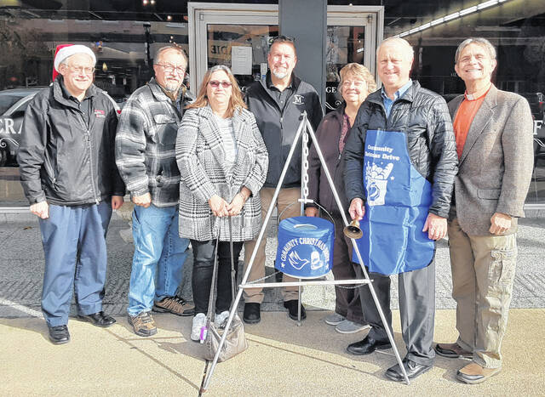
Darke County Christmas Fund Drive
(Christmas Bell Ringers)
Dates: December 16, 21
Times: From 10:00 am – 8:00 pm
Where: Walmart (South Entrance)
Who: Everyone!!!
Check your email for sign-up link or sign up on the sheet on the Communications Table across from the Church Office

Slide 32

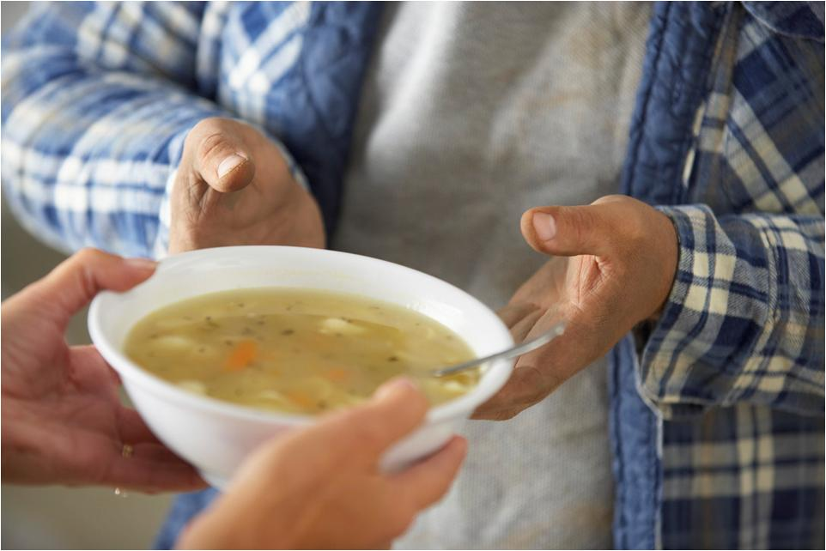
Grace Resurrection Community Center
Soup Kitchen Meal
When: Wednesday, December 20 @ 10:00 am to 1:00 pm.
Where: 433 Water Street in Greenville
If you can help in any way, please contact Katherine Jump at 937-423-2333.

Slide 33
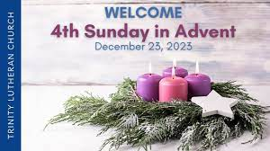

Sunday, December 24th – Christmas Eve
Three Worship Opportunities!
Early Service @ 4:00 pm
Midnight Service @ 10:00 pm
Morning Worship Service
10:30 am
Notes:
Cover: Sermon on the Mount by Laura James. Copyright © Laura James. All rights reserved. Used by permission of the artist.

Slide 34


New Year’s Eve
December 31st – 10:30 am
Notes:
Cover: Sermon on the Mount by Laura James. Copyright © Laura James. All rights reserved. Used by permission of the artist.

