Slide 1


Trinity Evangelical Lutheran Church
July 26, 2026
WELCOME!
Notes:
Image: Five Loaves by Caroline Coolidge Brown. Copyright © Caroline Coolidge Brown. All rights reserved. Used by permission of the artist.

Slide 2
= Please stand if able
= Please be seated
  Prelude by Pam Sherman
  Office of the Acolyte
  Ringing of the Bell
  Welcome
Notes:
Image: Five Loaves by Caroline Coolidge Brown. Copyright © Caroline Coolidge Brown. All rights reserved. Used by permission of the artist.

Slide 3
THANKSGIVING FOR BAPTISM
All may make the sign of the cross, the sign marked at baptism, as the presiding minister begins.
P: Blessed be the holy Trinity, ☩ one God, the fountain of living water, the rock who gave us birth, our light and our salvation.
C: Amen.
Notes:
Image: Preparing yeast dough. Copyright © tomasworks/iStock/Thinkstock. Used by permission.

Slide 4
P: Joined to Christ in the waters of baptism, we are clothed with God's mercy and forgiveness. Let us give thanks for the gift of baptism.
Water may be poured into the font as the presiding minister gives thanks.
THANKSGIVING FOR BAPTISM
Notes:
Image: Preparing yeast dough. Copyright © tomasworks/iStock/Thinkstock. Used by permission.

Slide 5
P: We give you thanks, O God, for in the beginning your Spirit moved over the waters and by your Word you created the world, calling forth life in which you took delight. Through the waters of the flood you delivered Noah and his family. Through the sea you led your people Israel from slavery into freedom.
THANKSGIVING FOR BAPTISM
Notes:
Image: Preparing yeast dough. Copyright © tomasworks/iStock/Thinkstock. Used by permission.

Slide 6
P: At the river your Son was baptized by John and anointed with the Holy Spirit. By water and your Word you claim us as daughters and sons, making us heirs of your promise and servants of all. We praise you for the gift of water that sustains life, and above all we praise you for the gift of new life in Jesus Christ.
THANKSGIVING FOR BAPTISM
Notes:
Image: Preparing yeast dough. Copyright © tomasworks/iStock/Thinkstock. Used by permission.

Slide 7
P: Shower us with your Spirit, and renew our lives with your forgiveness, grace, and love. To you be given honor and praise through Jesus Christ our Lord in the unity of the Holy Spirit, now and forever.
THANKSGIVING FOR BAPTISM
C: Amen.
Notes:
Image: Preparing yeast dough. Copyright © tomasworks/iStock/Thinkstock. Used by permission.

Slide 8

Gathering Song
“Crown Him with Many Crowns”
LBW 170
(Verses 1-4 Only)

Slide 9
“Crown Him with Many Crowns” LBW 170
1 Crown him with many crowns,
the Lamb upon his throne;
hark, how the heav’nly anthem drowns
all music but its own.
Awake, my soul, and sing
of him who died for thee,
and hail him as thy matchless king
through all eternity.
Notes:
Image: Preparing yeast dough. Copyright © tomasworks/iStock/Thinkstock. Used by permission.

Slide 10
“Crown Him with Many Crowns” LBW 170
2 Crown him the virgin’s Son,
the God incarnate born,
whose arm those crimson trophies won
which now his brow adorn;
fruit of the mystic rose,
yet of that rose the stem,
the root whence mercy ever flows,
the babe of Bethlehem.
Notes:
Image: Preparing yeast dough. Copyright © tomasworks/iStock/Thinkstock. Used by permission.

Slide 11
“Crown Him with Many Crowns” LBW 170
3 Crown him the Lord of love--
behold his hands and side,
rich wounds, yet visible above,
in beauty glorified.
No angels in the sky
can fully bear that sight,
but downward bend their burning eyes
at mysteries so bright.
Notes:
Image: Preparing yeast dough. Copyright © tomasworks/iStock/Thinkstock. Used by permission.

Slide 12
“Crown Him with Many Crowns” LBW 170
4 Crown him the Lord of life,
who triumphed o’er the grave
and rose victorious in the strife
for those he came to save.
His glories now we sing,
who died and rose on high,
who died, eternal life to bring,
and lives that death may die.
Notes:
Image: Preparing yeast dough. Copyright © tomasworks/iStock/Thinkstock. Used by permission.

Slide 13
APOSTOLIC GREETING
P: The grace of our Lord Jesus Christ, the love of God, and the communion of the Holy Spirit be with you all.
C: And also with you.
Notes:
Image: Five Loaves by Caroline Coolidge Brown. Copyright © Caroline Coolidge Brown. All rights reserved. Used by permission of the artist.

Slide 14
PRAYER OF THE DAY
P: Let us pray… Holy Spirit, you do not give us a spirit of cowardice, but rather a spirit of love, power, and self-discipline. Help us to lean into you and this beloved community here at Trinity, that we might be refreshed for your work in the world. In Jesus’ name we pray.
C: Amen
Notes:
Image: Five Loaves by Caroline Coolidge Brown. Copyright © Caroline Coolidge Brown. All rights reserved. Used by permission of the artist.

Slide 15

Notes:
Image: Five Loaves by Caroline Coolidge Brown. Copyright © Caroline Coolidge Brown. All rights reserved. Used by permission of the artist.

Slide 16

Scripture Reading
R: Our scripture reading is from Second Timothy, chapter 1.
C: Glory to you O’ Lord!
Notes:
Image: Five Loaves by Caroline Coolidge Brown. Copyright © Caroline Coolidge Brown. All rights reserved. Used by permission of the artist.

Slide 17
2 Tim 1:1-14
Paul, an apostle of Christ Jesus by the will of God, for the sake of the promise of life that is in Christ Jesus, ²To Timothy, my beloved child: Grace, mercy, and peace from God the Father and Christ Jesus our Lord. ³I am grateful to God—whom I worship with a clear conscience, as my ancestors did—when I remember you constantly in my prayers night
Notes:
Image: Five Loaves by Caroline Coolidge Brown. Copyright © Caroline Coolidge Brown. All rights reserved. Used by permission of the artist.

Slide 18
2 Tim 1:1-14
and day. ⁴Recalling your tears, I long to see you so that I may be filled with joy. ⁵I am reminded of your sincere faith, a faith that lived first in your grandmother Lois and your mother Eunice and now, I am sure, lives in you.
⁶For this reason I remind you to rekindle the gift of God that is within you through the laying on of my
Notes:
Image: Five Loaves by Caroline Coolidge Brown. Copyright © Caroline Coolidge Brown. All rights reserved. Used by permission of the artist.

Slide 19
2 Tim 1:1-14
hands; ⁷for God did not give us a spirit of cowardice, but rather a spirit of power and of love and of self-discipline. ⁸Do not be ashamed, then, of the testimony about our Lord or of me his prisoner, but join with me in suffering for the gospel, relying on the power of God, ⁹who saved us and called us with a holy calling, not according to our works
Notes:
Image: Five Loaves by Caroline Coolidge Brown. Copyright © Caroline Coolidge Brown. All rights reserved. Used by permission of the artist.

Slide 20
2 Tim 1:1-14
but according to his own purpose and grace. This grace was given to us in Christ Jesus before the ages began, ¹⁰but it has now been revealed through the appearing of our Savior Christ Jesus, who abolished death and brought life and immortality to light through the gospel. ¹¹For this gospel I was appointed a herald and an apostle
Notes:
Image: Five Loaves by Caroline Coolidge Brown. Copyright © Caroline Coolidge Brown. All rights reserved. Used by permission of the artist.

Slide 21
2 Tim 1:1-14
and a teacher, ¹²and for this reason I suffer as I do. But I am not ashamed, for I know the one in whom I have put my trust, and I am sure that he is able to guard until that day what I have entrusted to him.
Notes:
Image: Five Loaves by Caroline Coolidge Brown. Copyright © Caroline Coolidge Brown. All rights reserved. Used by permission of the artist.

Slide 22
2 Tim 1:1-14
¹³Hold to the standard of sound teaching that you have heard from me, in the faith and love that are in Christ Jesus. ¹⁴Guard the good treasure entrusted to you, with the help of the Holy Spirit living in us.
Notes:
Image: Five Loaves by Caroline Coolidge Brown. Copyright © Caroline Coolidge Brown. All rights reserved. Used by permission of the artist.

Slide 23
2 Tim 1:1-14
R: This is the Word of the Lord.
C: Praise to You, O Christ
Notes:
Image: Five Loaves by Caroline Coolidge Brown. Copyright © Caroline Coolidge Brown. All rights reserved. Used by permission of the artist.

Slide 24

Sermon
Notes:
Image: Five Loaves by Caroline Coolidge Brown. Copyright © Caroline Coolidge Brown. All rights reserved. Used by permission of the artist.

Slide 25
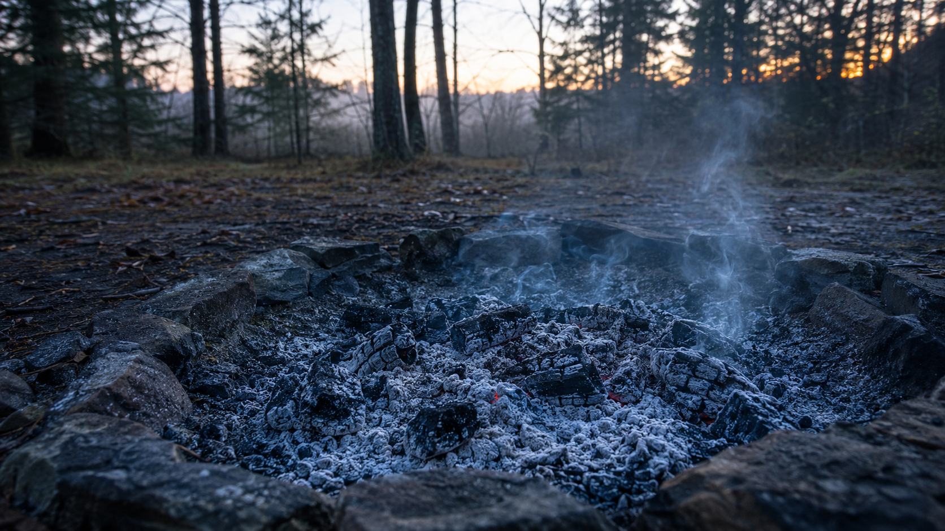
Sermon
Notes:
Image: Five Loaves by Caroline Coolidge Brown. Copyright © Caroline Coolidge Brown. All rights reserved. Used by permission of the artist.

Slide 26

Sermon
Notes:
Image: Five Loaves by Caroline Coolidge Brown. Copyright © Caroline Coolidge Brown. All rights reserved. Used by permission of the artist.

Slide 27

Sermon
Notes:
Image: Five Loaves by Caroline Coolidge Brown. Copyright © Caroline Coolidge Brown. All rights reserved. Used by permission of the artist.

Slide 28
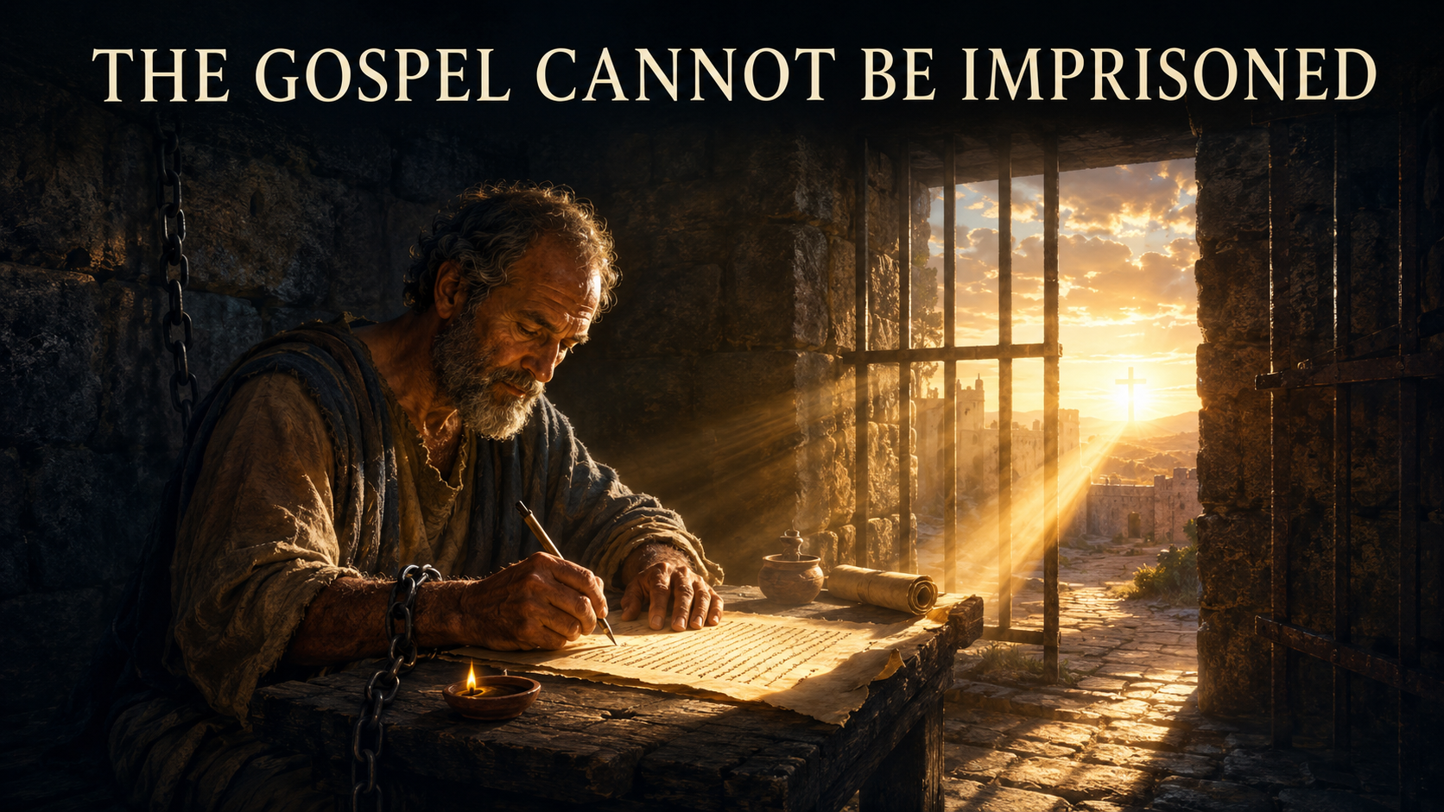
Sermon
Notes:
Image: Five Loaves by Caroline Coolidge Brown. Copyright © Caroline Coolidge Brown. All rights reserved. Used by permission of the artist.

Slide 29
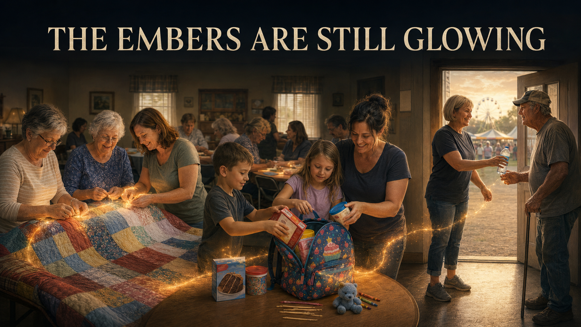
Sermon
Notes:
Image: Five Loaves by Caroline Coolidge Brown. Copyright © Caroline Coolidge Brown. All rights reserved. Used by permission of the artist.

Slide 30

Sermon
Notes:
Image: Five Loaves by Caroline Coolidge Brown. Copyright © Caroline Coolidge Brown. All rights reserved. Used by permission of the artist.

Slide 31
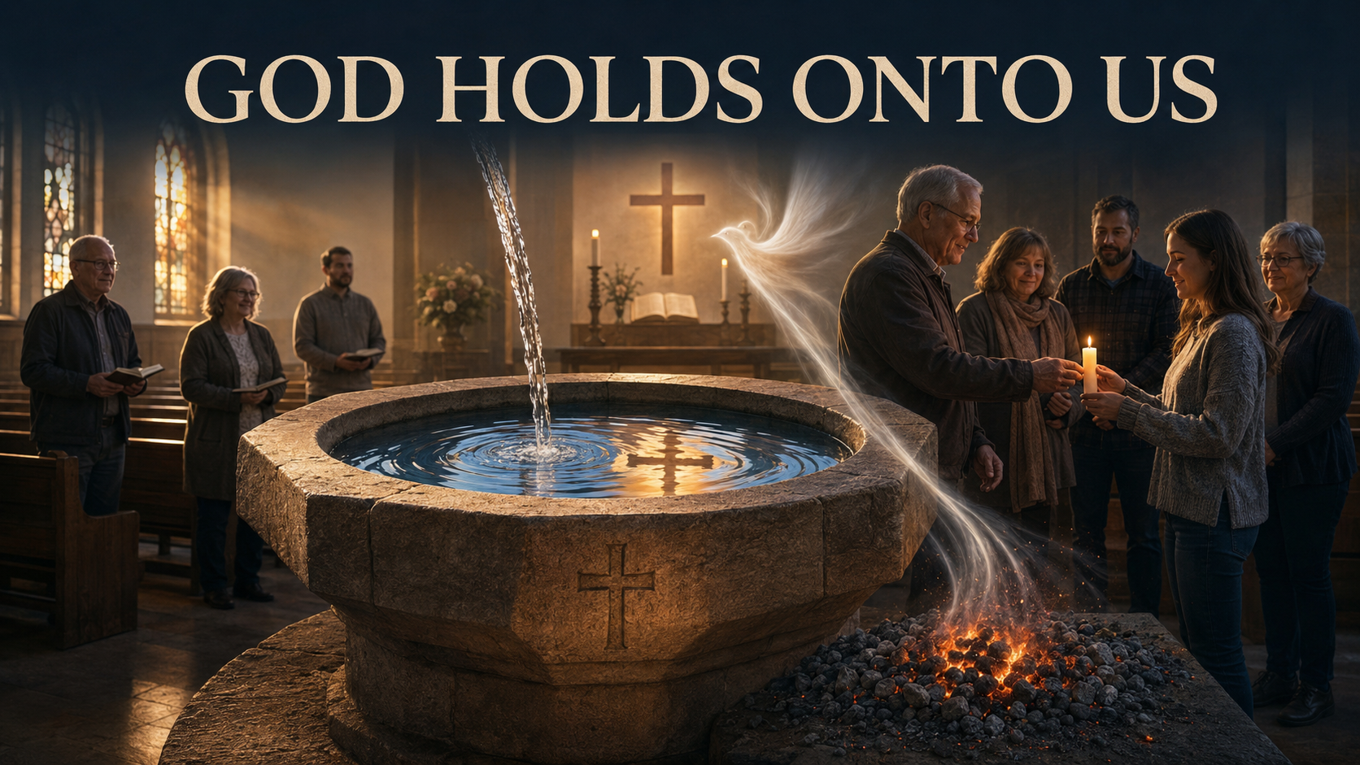
Sermon
Notes:
Image: Five Loaves by Caroline Coolidge Brown. Copyright © Caroline Coolidge Brown. All rights reserved. Used by permission of the artist.

Slide 32
Hymn of the Day
“When Peace Like A River”
LBW 346
Notes:
Image: Five Loaves by Caroline Coolidge Brown. Copyright © Caroline Coolidge Brown. All rights reserved. Used by permission of the artist.

Slide 33
“When Peace Like A River” LBW 346
1 When peace, like a river, attendeth my way;
when sorrows, like sea billows, roll;
whatever my lot, thou hast taught me to say,
it is well, it is well with my soul.
Notes:
Image: Five Loaves by Caroline Coolidge Brown. Copyright © Caroline Coolidge Brown. All rights reserved. Used by permission of the artist.

Slide 34
“When Peace Like A River” LBW 346
Refrain
It is well (it is well)
with my soul, (with my soul,)
it is well, it is well with my soul.
Notes:
Image: Five Loaves by Caroline Coolidge Brown. Copyright © Caroline Coolidge Brown. All rights reserved. Used by permission of the artist.

Slide 35
“When Peace Like A River” LBW 346
2 Though Satan should buffet, though trials should come,
let this blest assurance control,
that Christ hath regarded my helpless estate,
and hath shed his own blood for my soul.
Notes:
Image: Five Loaves by Caroline Coolidge Brown. Copyright © Caroline Coolidge Brown. All rights reserved. Used by permission of the artist.

Slide 36
“When Peace Like A River” LBW 346
Refrain
It is well (it is well)
with my soul, (with my soul,)
it is well, it is well with my soul.
Notes:
Image: Five Loaves by Caroline Coolidge Brown. Copyright © Caroline Coolidge Brown. All rights reserved. Used by permission of the artist.

Slide 37
“When Peace Like A River” LBW 346
3 He lives--oh, the bliss of this glorious thought;
my sin, not in part, but the whole,
is nailed to his cross and I bear it no more.
Praise the Lord, praise the Lord, O my soul!
Notes:
Image: Five Loaves by Caroline Coolidge Brown. Copyright © Caroline Coolidge Brown. All rights reserved. Used by permission of the artist.

Slide 38
“When Peace Like A River” LBW 346
Refrain
It is well (it is well)
with my soul, (with my soul,)
it is well, it is well with my soul.
Notes:
Image: Five Loaves by Caroline Coolidge Brown. Copyright © Caroline Coolidge Brown. All rights reserved. Used by permission of the artist.

Slide 39
“When Peace Like A River” LBW 346
4 And Lord, haste the day when our faith shall be sight,
the clouds be rolled back as a scroll,
the trumpet shall sound and the Lord shall descend;
even so it is well with my soul.
Notes:
Image: Five Loaves by Caroline Coolidge Brown. Copyright © Caroline Coolidge Brown. All rights reserved. Used by permission of the artist.

Slide 40
“When Peace Like A River” LBW 346
Refrain
It is well (it is well)
with my soul, (with my soul,)
it is well, it is well with my soul.
Notes:
Image: Five Loaves by Caroline Coolidge Brown. Copyright © Caroline Coolidge Brown. All rights reserved. Used by permission of the artist.

Slide 41
APOSTLE’S CREED
C: I believe in God, the Father almighty, creator of heaven and earth.

Slide 42
APOSTLE’S CREED
C: I believe in Jesus Christ, his only Son, our Lord. He was conceived by the power of the Holy Spirit and born of the virgin Mary. He suffered under Pontius Pilate, was crucified, died, and was buried.

Slide 43
APOSTLE’S CREED
C: He descended into hell. On the third day he rose again. He ascended into heaven, and is seated at the right hand of the Father. He will come again to judge the living and the dead.

Slide 44
APOSTLE’S CREED
C: I believe in the Holy Spirit, the holy catholic Church, the communion of saints, the forgiveness of sins, the resurrection of the body, and the life everlasting. Amen.

Slide 45
NICENE CREED
C: We believe in one God, the Father, the Almighty, maker of heaven and earth, of all that is, seen and unseen.

Slide 46
NICENE CREED
C: We believe in one Lord, Jesus Christ, the only Son of God, eternally begotten of the Father, God from God, Light from Light, true God from true God, begotten, not made, of one Being with the Father.

Slide 47
NICENE CREED
C: Through him all things were made. For us and for our salvation he came down from heaven; by the power of the Holy Spirit he became incarnate from the virgin Mary, and was made man. For our sake he was crucified under Pontius Pilate;

Slide 48
NICENE CREED
C: he suffered death and was buried. On the third day he rose again in accordance with the Scriptures; he ascended into heaven and is seated at the right hand of the Father. He will come again in glory to judge the living and the dead, and his kingdom will have no end.

Slide 49
NICENE CREED
C: We believe in the Holy Spirit, the Lord, the giver of life, who proceeds from the Father and the Son. With the Father and the Son he is worshiped and glorified. He has spoken through the prophets. We believe in one holy catholic and apostolic Church.

Slide 50
NICENE CREED
C: We acknowledge one Baptism for the forgiveness of sins. We look for the resurrection of the dead, and the life of the world to come. Amen.

Slide 51
PRAYERS OF INTERCESSION
Each petition will end with the words,
A: God of all that is,
The congregation will respond with:
C: hear our prayer.

Slide 52
PRAYERS OF INTERCESSION
The prayer concludes…
P: We lift these prayers to you, Gracious God, in the name of your son, Jesus Christ, our savior.
C: Amen.

Slide 53
OFFERING/OFFERING PRAYER
Notes:
Image: Five Loaves by Caroline Coolidge Brown. Copyright © Caroline Coolidge Brown. All rights reserved. Used by permission of the artist.

Slide 54
THE LORD’S PRAYER
C: Our Father, who art in heaven, hallowed be thy name, thy kingdom come, thy will be done, on earth as it is in heaven. Give us this day our daily bread; and forgive us our trespasses, as we forgive those who trespass against us; and lead us not into temptation, but deliver us from evil.

Slide 55
THE LORD’S PRAYER
C: For thine is the kingdom, and the power, and the glory, forever and ever. Amen.

Slide 56

ANNOUNCEMENTS
Notes:
Image: Five Loaves by Caroline Coolidge Brown. Copyright © Caroline Coolidge Brown. All rights reserved. Used by permission of the artist.

Slide 57
SENDING BLESSING

Slide 58
SENDING SONG
“Come, Thou Fount of Every Blessing”
LBW 499

Slide 59
“Come, Thou Fount of Every Blessing” LBW 499
1 Come, thou Fount of ev'ry blessing,
tune my heart to sing thy grace;
streams of mercy, never ceasing,
call for songs of loudest praise.
While the hope of endless glory
fills my heart with joy and love,
teach me ever to adore thee;
may I still thy goodness prove.
Notes:
Image: Five Loaves by Caroline Coolidge Brown. Copyright © Caroline Coolidge Brown. All rights reserved. Used by permission of the artist.

Slide 60
“Come, Thou Fount of Every Blessing” LBW 499
2 Here I raise my Ebenezer:
"Hither by thy help I've come";
and I hope, by thy good pleasure,
safely to arrive at home.
Jesus sought me when a stranger,
wand'ring from the fold of God;
he, to rescue me from danger,
interposed his precious blood.
Notes:
Image: Five Loaves by Caroline Coolidge Brown. Copyright © Caroline Coolidge Brown. All rights reserved. Used by permission of the artist.

Slide 61
“Come, Thou Fount of Every Blessing” LBW 499
3 Oh, to grace how great a debtor
daily I'm constrained to be;
let that grace now like a fetter
bind my wand'ring heart to thee.
Prone to wander, Lord, I feel it;
prone to leave the God I love.
Here's my heart, oh, take and seal it;
seal it for thy courts above.
Notes:
Image: Five Loaves by Caroline Coolidge Brown. Copyright © Caroline Coolidge Brown. All rights reserved. Used by permission of the artist.

Slide 62
DISMISSAL
P: Depart in Christ’s Love.
C: Seeking, welcoming, and serving all. Amen!
POSTLUDE
By Pam Sherman
From sundaysandseasons.com. Copyright © 2026 Augsburg Fortress. All rights reserved. Reprinted by permission under Augsburg Fortress Liturgies Annual License #SAS023830. New Revised Standard Version Bible, Copyright © 1989, Division of Christian Education of the National Council of the Churches of Christ in the United States of America. Used by permission. All rights reserved. Revised Common Lectionary, Copyright © 1992 Consultation on Common Texts, admin Augsburg Fortress. Used by permission. Some images generated with ChatGPT (“Theo”) using OpenAI.

