Slide 1

December 7, 2025
WELCOME!
Trinity Lutheran Church
Notes:
Image: Five Loaves by Caroline Coolidge Brown. Copyright © Caroline Coolidge Brown. All rights reserved. Used by permission of the artist.

Slide 2
= Please stand if able
= Please be seated
Prelude - By Roxanne Groff
Office of the Acolyte
Ringing of the Bell
Welcome

Slide 3
Lighting the Advent Candles
R: Ezekiel wrote of a people given new life.
C: Jesus, you are the source of this new life for us. We cry to you to heal our brokenness, and revive our spirits.
R: We light the first candle in expectation of your coming.
C: We light the second candle in hope of new life in you.
Notes:
Image: Preparing yeast dough. Copyright © tomasworks/iStock/Thinkstock. Used by permission.

Slide 4
CONFESSION AND FORGIVENESS
All may make the sign of the cross, the sign marked at baptism…
L: We confess our sins before God and one another.
Pause for silence and reflection.
L: God who was and is and is to come,
Notes:
Image: Five Loaves by Caroline Coolidge Brown. Copyright © Caroline Coolidge Brown. All rights reserved. Used by permission of the artist.

Slide 5
CONFESSION AND FORGIVENESS
C: Despite our best intentions, even our deepest desires, we find ourselves time and again turning away from you to follow after other gods—possessions, people, comforts—in an effort to fill the hole that only you can.
Notes:
Image: Five Loaves by Caroline Coolidge Brown. Copyright © Caroline Coolidge Brown. All rights reserved. Used by permission of the artist.

Slide 6
CONFESSION AND FORGIVENESS
C: In so doing we have harmed ourselves, others, and your holy creation by what we have said and done, and by the things we have neglected to do.
Notes:
Image: Five Loaves by Caroline Coolidge Brown. Copyright © Caroline Coolidge Brown. All rights reserved. Used by permission of the artist.

Slide 7
CONFESSION AND FORGIVENESS
C: Open our eyes to see that you alone are the source of our wholeness. Forgive us our wrongs and inspire us to the work of making them right, for the sake of your son, Jesus Christ.
Notes:
Image: Five Loaves by Caroline Coolidge Brown. Copyright © Caroline Coolidge Brown. All rights reserved. Used by permission of the artist.

Slide 8
CONFESSION AND FORGIVENESS
P: Beloved of God, like the prodigal son, you are always received with great joy, and your sins are forgiven you. ☩ Go forth in newness of life.
C: Amen.
Notes:
Image: Five Loaves by Caroline Coolidge Brown. Copyright © Caroline Coolidge Brown. All rights reserved. Used by permission of the artist.

Slide 9

Gathering Song/Hymn of Praise
“Breathe On Me, Breath of God”
LBW 488

Slide 10
“Breathe On Me, Breath of God” LBW 488
1 Breathe on me, breath of God;
fill me with life anew,
that I may love all that you love
and do what you would do.
Notes:
Image: Five Loaves by Caroline Coolidge Brown. Copyright © Caroline Coolidge Brown. All rights reserved. Used by permission of the artist.

Slide 11
“Breathe On Me, Breath of God” LBW 488
2 Breathe on me, breath of God,
until my heart is pure,
until with you I will one will
to do and to endure.
Notes:
Image: Five Loaves by Caroline Coolidge Brown. Copyright © Caroline Coolidge Brown. All rights reserved. Used by permission of the artist.

Slide 12
“Breathe On Me, Breath of God” LBW 488
3 Breathe on me, breath of God;
so shall I never die,
but live with you the perfect life
of your eternity.
Notes:
Image: Five Loaves by Caroline Coolidge Brown. Copyright © Caroline Coolidge Brown. All rights reserved. Used by permission of the artist.

Slide 13
APOSTOLIC GREETING
P: The grace of our Lord Jesus Christ, the love of God, and the communion of the Holy Spirit be with you all.
C: And also with you.
Notes:
Image: Five Loaves by Caroline Coolidge Brown. Copyright © Caroline Coolidge Brown. All rights reserved. Used by permission of the artist.

Slide 14
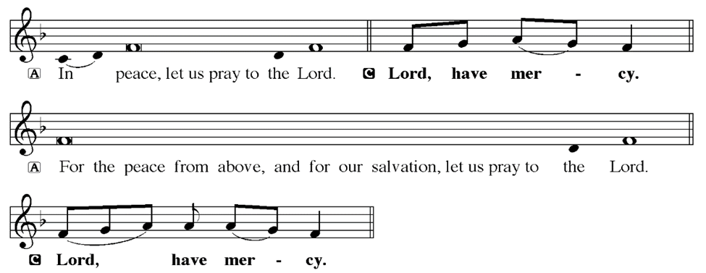
KYRIE
Notes:
Image: Five Loaves by Caroline Coolidge Brown. Copyright © Caroline Coolidge Brown. All rights reserved. Used by permission of the artist.

Slide 15
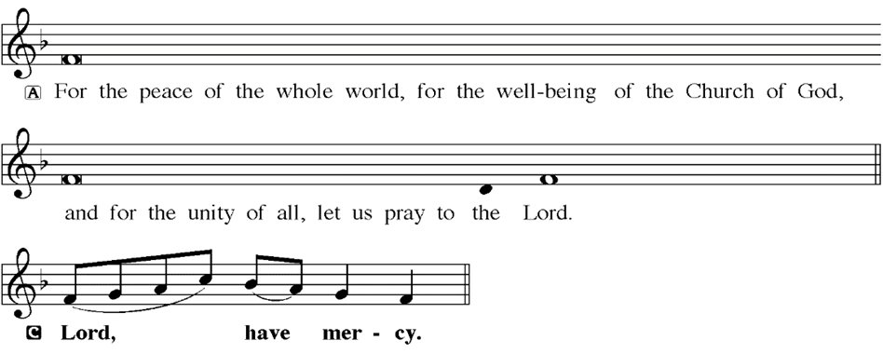
KYRIE
Notes:
Image: Five Loaves by Caroline Coolidge Brown. Copyright © Caroline Coolidge Brown. All rights reserved. Used by permission of the artist.

Slide 16
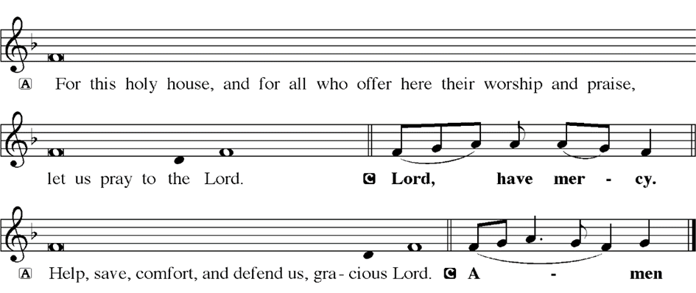
KYRIE
Notes:
Image: Five Loaves by Caroline Coolidge Brown. Copyright © Caroline Coolidge Brown. All rights reserved. Used by permission of the artist.

Slide 17
HYMN OF PRAISE
Glory be to God in heaven;
peace, goodwill to all the earth.
Mighty God of all creation,
Father of surpassing worth:
we exalt you, we adore you,
we lift high our thanks and praise.
Saints and angels bow before you; here on earth our songs we raise.
Notes:
Image: Five Loaves by Caroline Coolidge Brown. Copyright © Caroline Coolidge Brown. All rights reserved. Used by permission of the artist.

Slide 18
HYMN OF PRAISE
Glory be to Christ forever,
Lamb of God and Lord of love.
Son of God and gracious Savior, you have come from heav’n above;
on the cross you died to save us; now you reign at God’s right hand.
Hear our prayer; restore, forgive us; in your promise firm we stand.
Notes:
Image: Five Loaves by Caroline Coolidge Brown. Copyright © Caroline Coolidge Brown. All rights reserved. Used by permission of the artist.

Slide 19
HYMN OF PRAISE
Holy One we now acclaim you;
Lord alone, to you we call;
Holy One in faith we name you,
God most high, yet near to all:
Jesus Christ, with God the Spirit,
in the Father’s splendor bright.
For the peace that we inherit,
glory be to God on high!
Notes:
Image: Five Loaves by Caroline Coolidge Brown. Copyright © Caroline Coolidge Brown. All rights reserved. Used by permission of the artist.

Slide 20
PRAYER OF THE DAY
P: Let us pray… Sustaining God, we often grow weary of trying to serve you, frustrated by our lack of success, dismayed by the continued turmoil that swirls around us in our lives and in the world. Reground us in your holy presence, renew our commitment, and send us back into the world with trust that all is in your hands. In Jesus’ name we pray.
C: Amen
Notes:
Image: Five Loaves by Caroline Coolidge Brown. Copyright © Caroline Coolidge Brown. All rights reserved. Used by permission of the artist.

Slide 21

Notes:
Image: Five Loaves by Caroline Coolidge Brown. Copyright © Caroline Coolidge Brown. All rights reserved. Used by permission of the artist.

Slide 22
Scripture Reading
L: Our scripture reading is from 1st Ezekiel chapter 37.
C: Glory to you O’ Lord!
Notes:
Image: Five Loaves by Caroline Coolidge Brown. Copyright © Caroline Coolidge Brown. All rights reserved. Used by permission of the artist.

Slide 23
Ezekiel 37:1-14
The hand of the Lord came upon me, and he brought me out by the spirit of the Lord and set me down in the middle of a valley; it was full of bones. ²He led me all around them; there were very many lying in the valley, and they were very dry. ³He said to me, “Mortal, can these bones live?” I answered, “O Lord God, you know.” ⁴Then he said to
Notes:
Image: Five Loaves by Caroline Coolidge Brown. Copyright © Caroline Coolidge Brown. All rights reserved. Used by permission of the artist.

Slide 24
Ezekiel 37:1-14
me, “Prophesy to these bones, and say to them: O dry bones, hear the word of the Lord. ⁵Thus says the Lord God to these bones: I will cause breath to enter you, and you shall live. ⁶I will lay sinews on you, and will cause flesh to come upon you, and cover you with skin, and put breath in you, and you shall live; and you shall know that I am the
Notes:
Image: Five Loaves by Caroline Coolidge Brown. Copyright © Caroline Coolidge Brown. All rights reserved. Used by permission of the artist.

Slide 25
Ezekiel 37:1-14
Lord.” ⁷So I prophesied as I had been commanded; and as I prophesied, suddenly there was a noise, a rattling, and the bones came together, bone to its bone. ⁸I looked, and there were sinews on them, and flesh had come upon them, and skin had covered them; but there was no breath in them. ⁹Then he said to me, “Prophesy to
Notes:
Image: Five Loaves by Caroline Coolidge Brown. Copyright © Caroline Coolidge Brown. All rights reserved. Used by permission of the artist.

Slide 26
Ezekiel 37:1-14
the breath, prophesy, mortal, and say to the breath: Thus says the Lord God: Come from the four winds, O breath, and breathe upon these slain, that they may live.” ¹⁰I prophesied as he commanded me, and the breath came into them, and they lived, and stood on their feet, a vast multitude. ¹¹Then he said to me, “Mortal, these bones are the
Notes:
Image: Five Loaves by Caroline Coolidge Brown. Copyright © Caroline Coolidge Brown. All rights reserved. Used by permission of the artist.

Slide 27
Ezekiel 37:1-14
whole house of Israel. They say, ‘Our bones are dried up, and our hope is lost; we are cut off completely.’ ¹²Therefore prophesy, and say to them, Thus says the Lord God: I am going to open your graves, and bring you up from your graves, O my people; and I will bring you back to the land of Israel.
Notes:
Image: Five Loaves by Caroline Coolidge Brown. Copyright © Caroline Coolidge Brown. All rights reserved. Used by permission of the artist.

Slide 28
Ezekiel 37:1-14
¹³And you shall know that I am the Lord, when I open your graves, and bring you up from your graves, O my people. ¹⁴I will put my spirit within you, and you shall live, and I will place you on your own soil; then you shall know that I, the Lord, have spoken and will act,” says the Lord.
Notes:
Image: Five Loaves by Caroline Coolidge Brown. Copyright © Caroline Coolidge Brown. All rights reserved. Used by permission of the artist.

Slide 29
Ezekiel 37:1-14
R: This is the Word of the Lord.
C: Praise to You, O Christ
Notes:
Image: Five Loaves by Caroline Coolidge Brown. Copyright © Caroline Coolidge Brown. All rights reserved. Used by permission of the artist.

Slide 30

Sermon

Slide 31
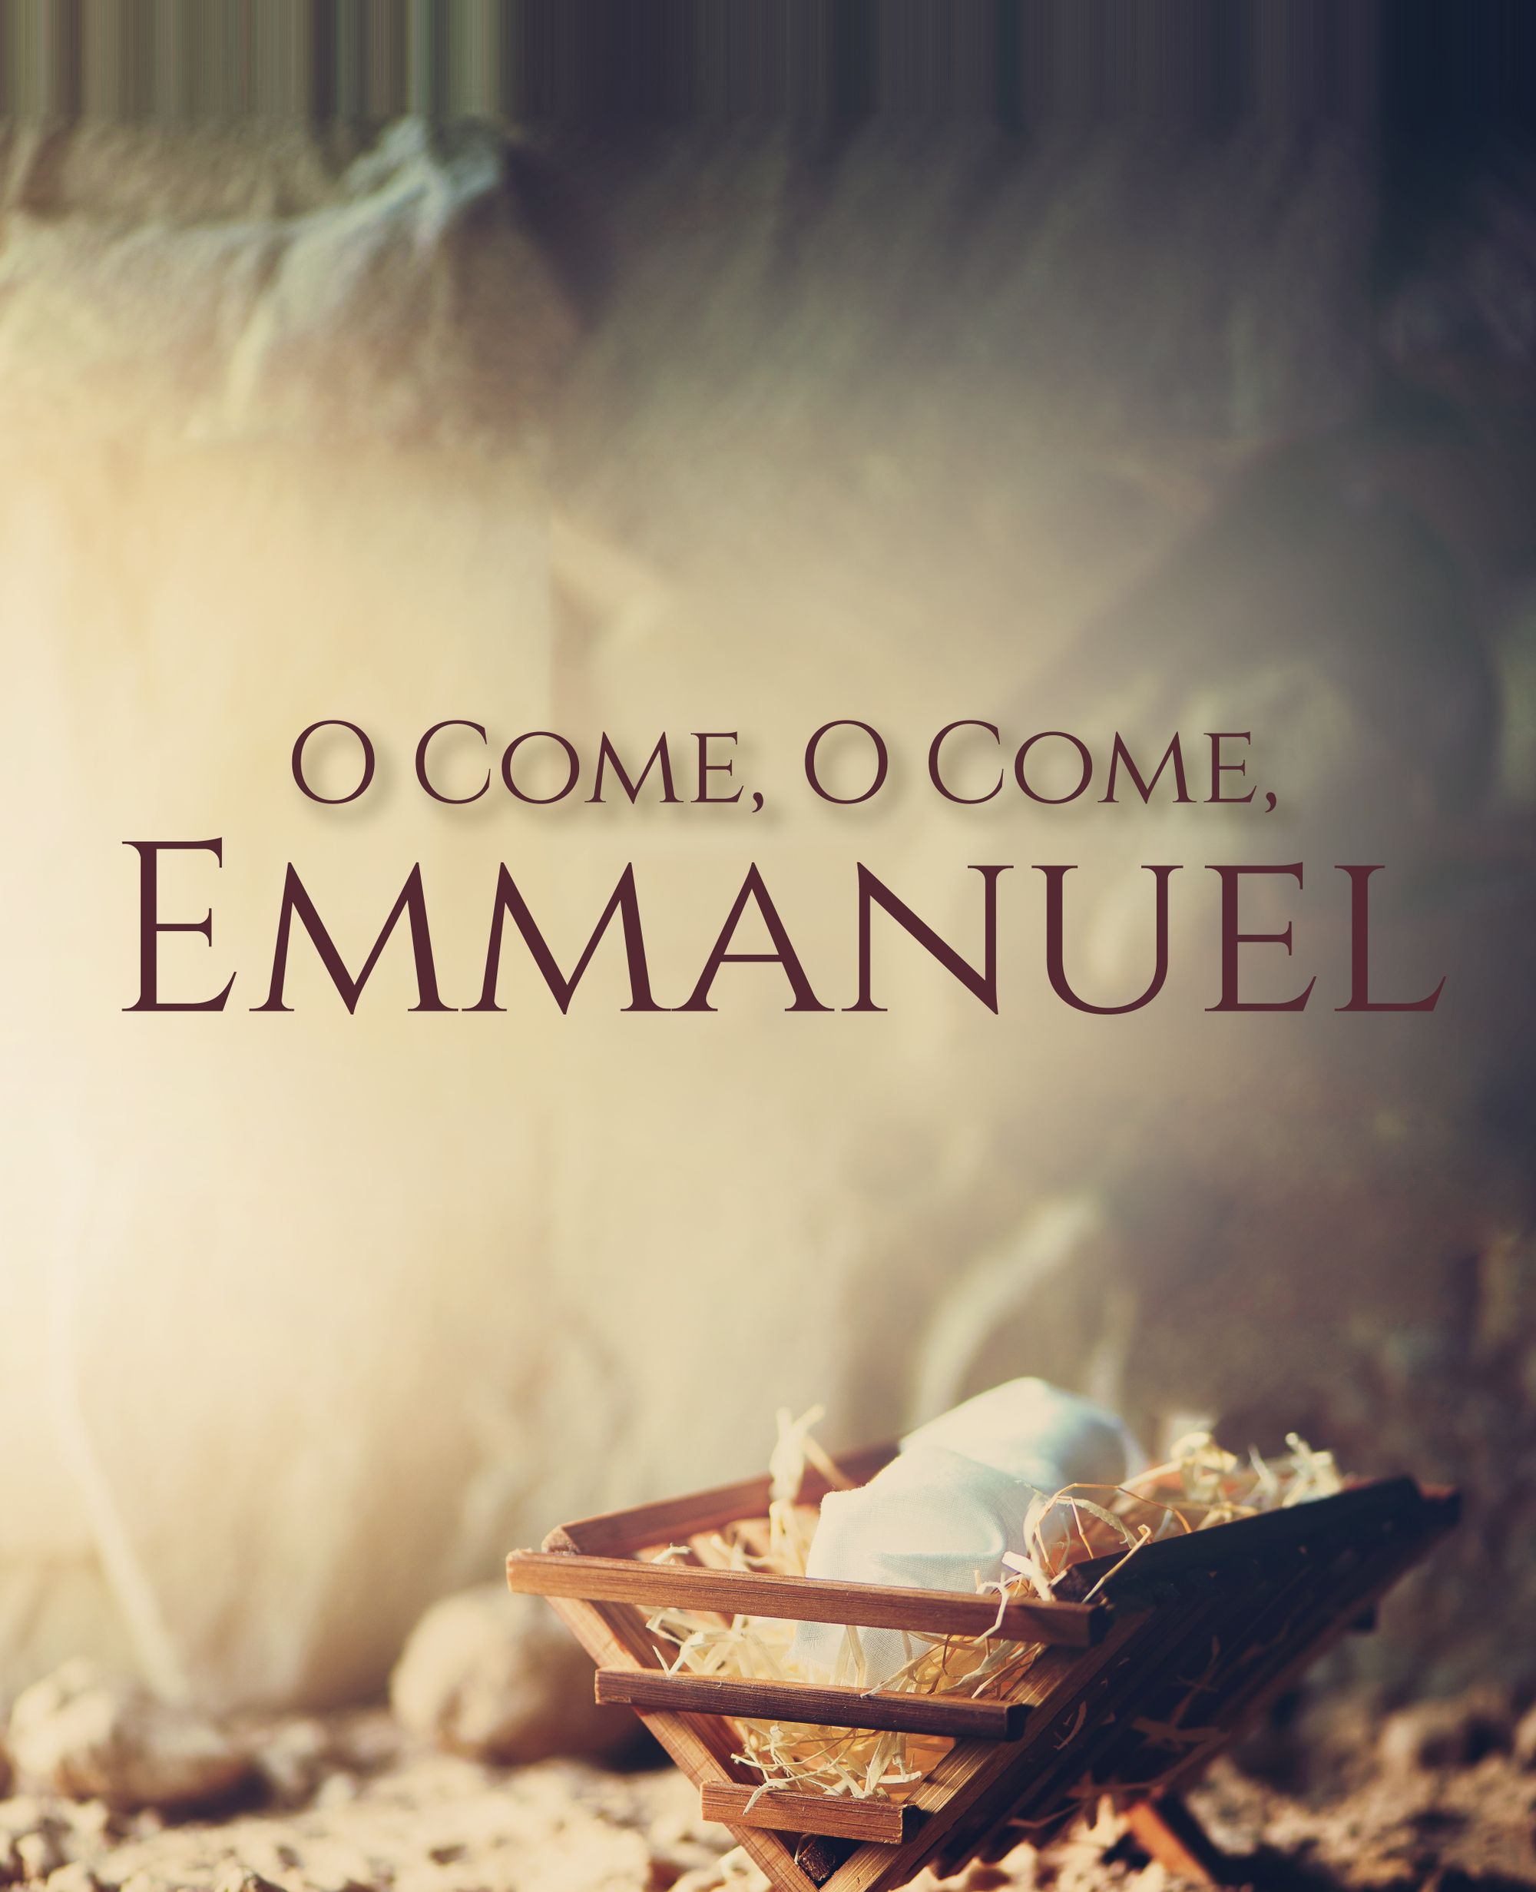
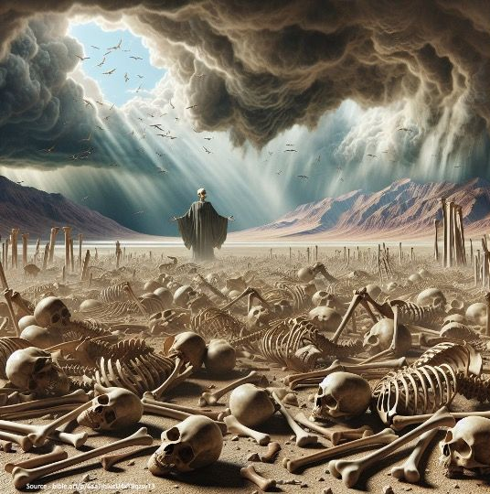
Sermon

Slide 32
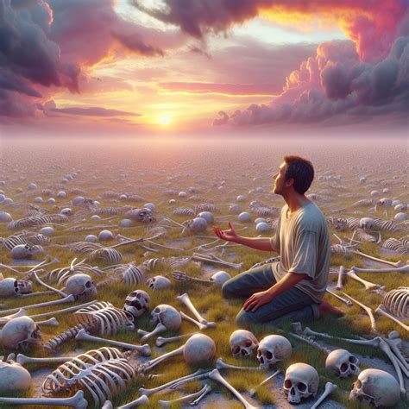
Sermon
Mortal, can these bones live?

Slide 33
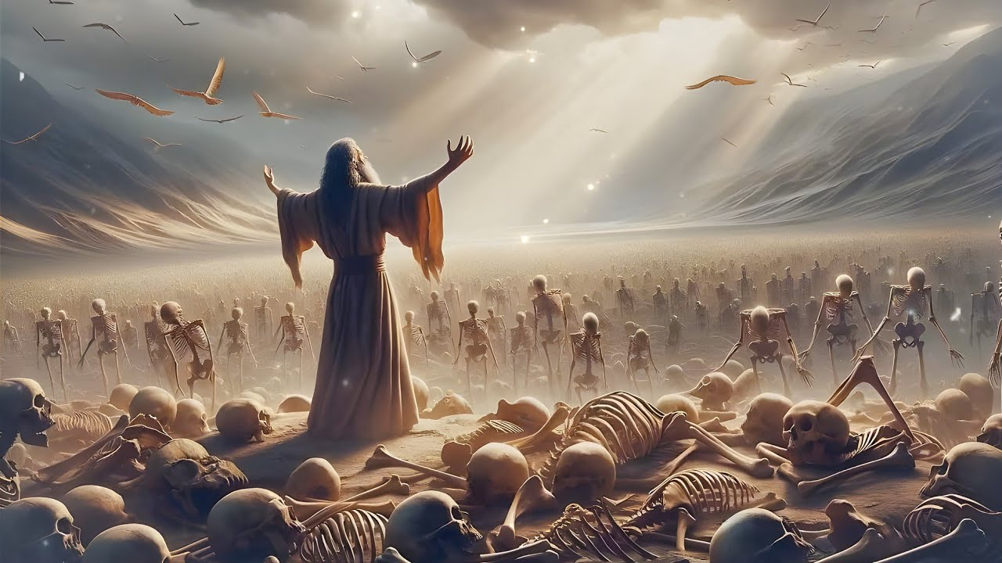
Sermon

Slide 34
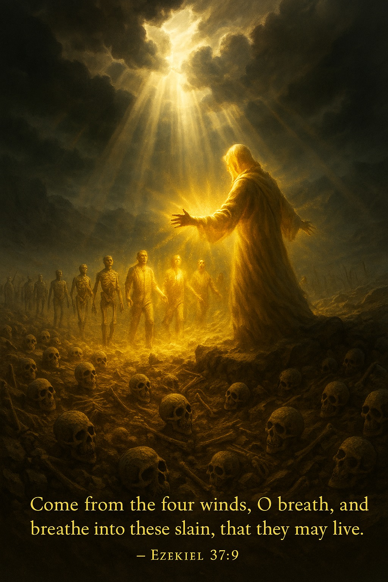
Sermon

Slide 35
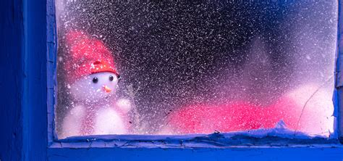
Sermon

Slide 36
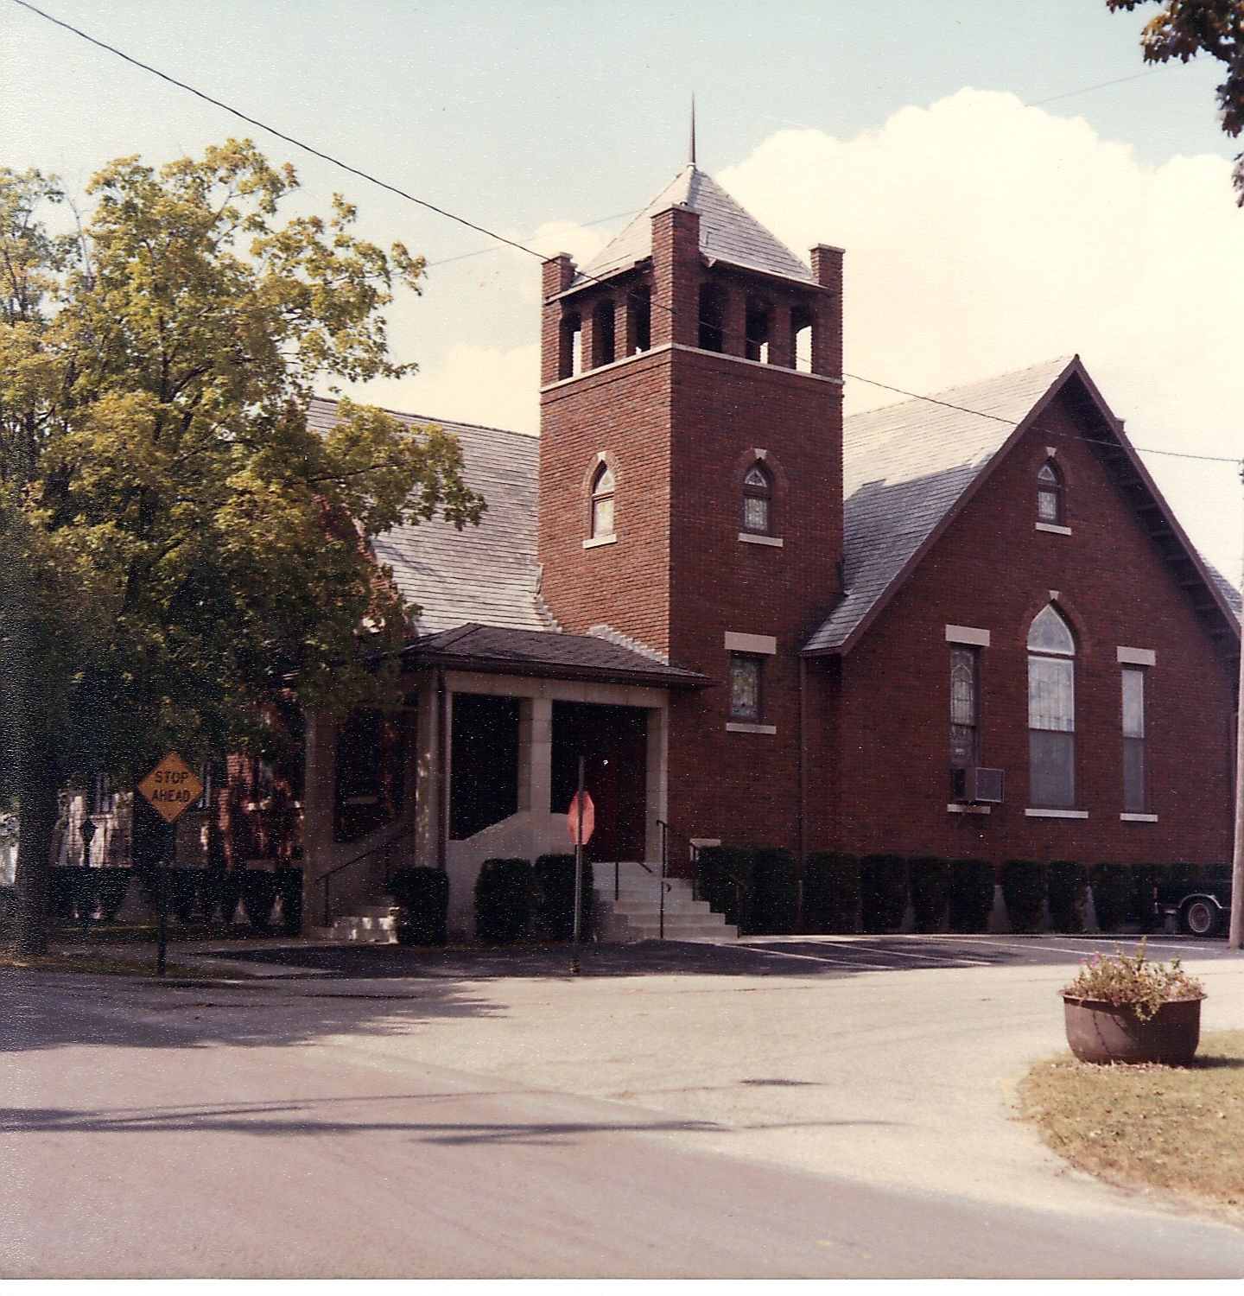
Sermon

Slide 37
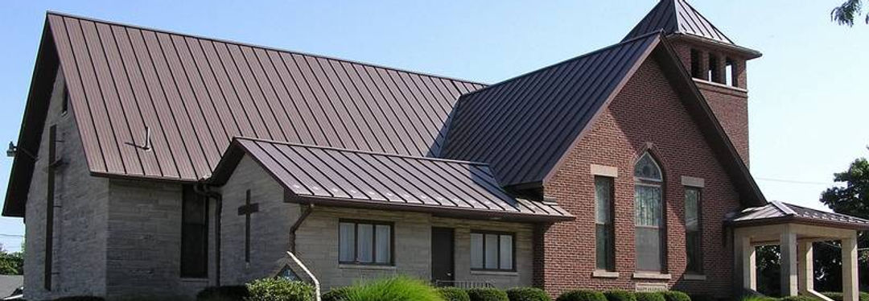
Sermon

Slide 38
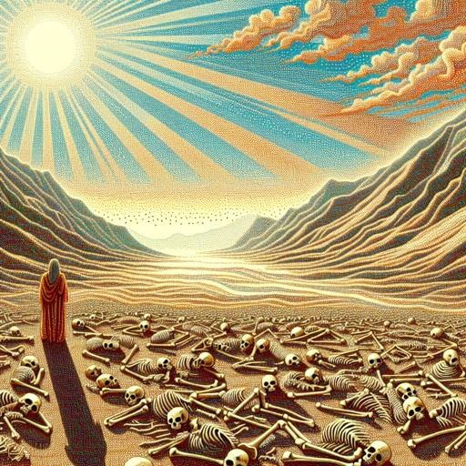
Sermon

Slide 39
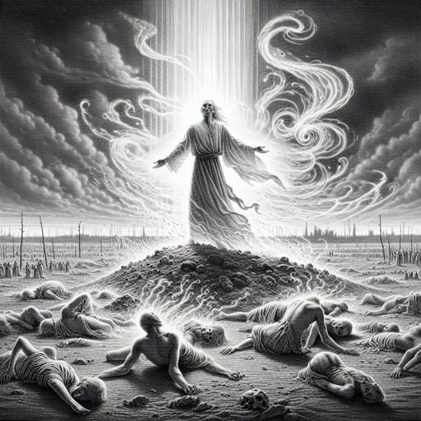
Sermon

Slide 40

Sermon

Slide 41
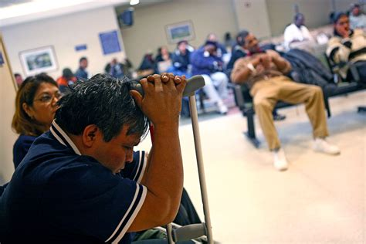
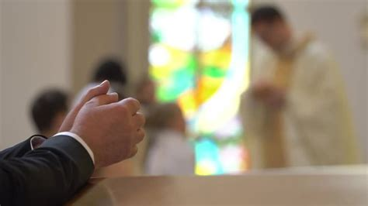
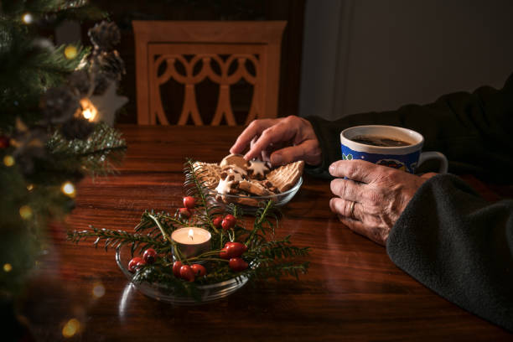
Sermon

Slide 42
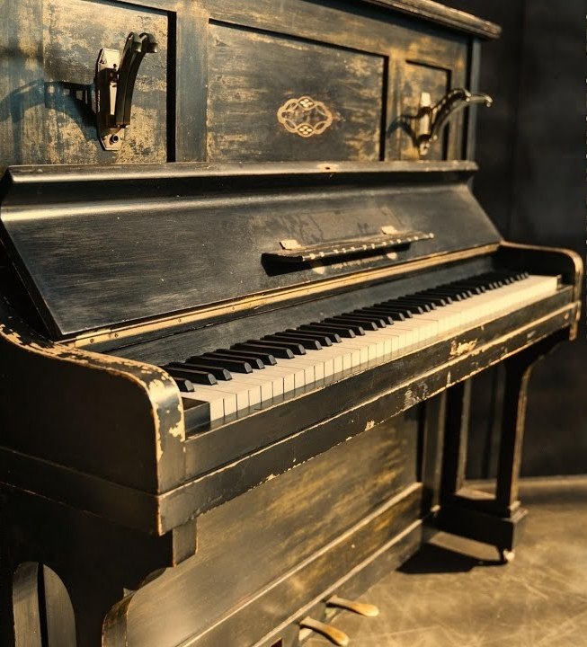
Sermon

Slide 43
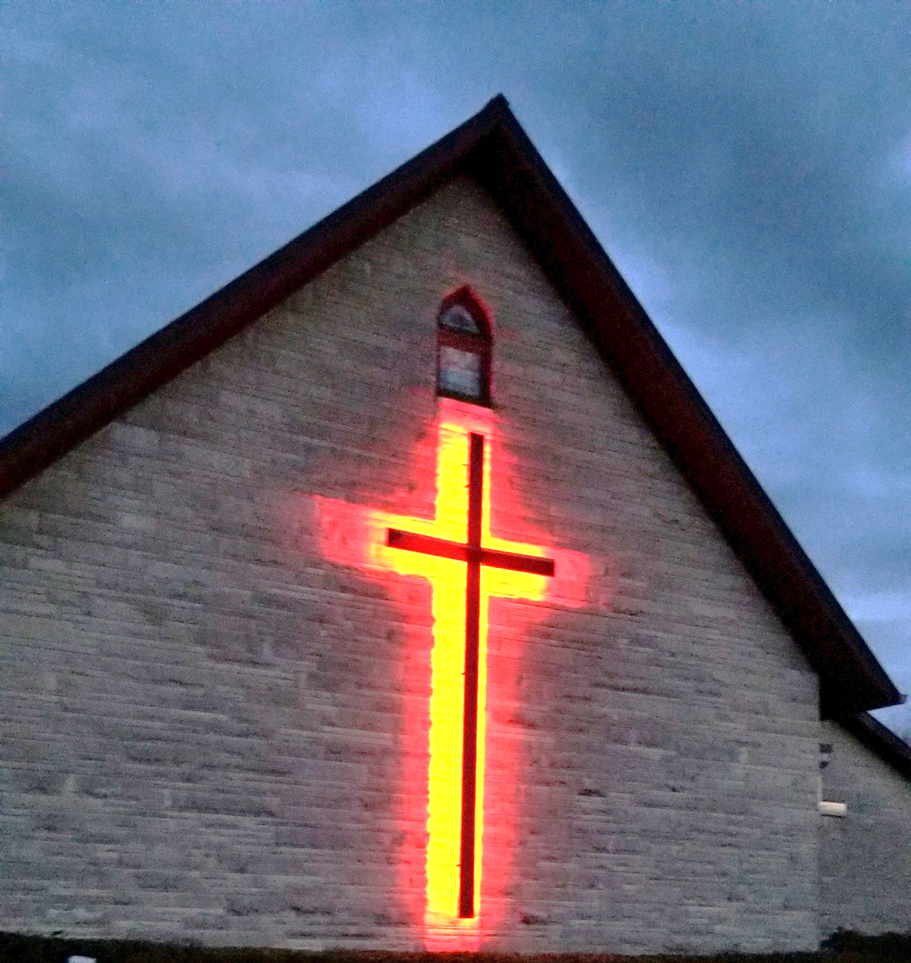
Sermon

Slide 44
NICENE CREED
C: We believe in one God, the Father, the Almighty, maker of heaven and earth, of all that is, seen and unseen.

Slide 45
NICENE CREED
C: We believe in one Lord, Jesus Christ, the only Son of God, eternally begotten of the Father, God from God, Light from Light, true God from true God, begotten, not made, of one Being with the Father.

Slide 46
NICENE CREED
C: Through him all things were made. For us and for our salvation he came down from heaven; by the power of the Holy Spirit he became incarnate from the virgin Mary, and was made man. For our sake he was crucified under Pontius Pilate;

Slide 47
NICENE CREED
C: he suffered death and was buried. On the third day he rose again in accordance with the Scriptures; he ascended into heaven and is seated at the right hand of the Father. He will come again in glory to judge the living and the dead, and his kingdom will have no end.

Slide 48
NICENE CREED
C: We believe in the Holy Spirit, the Lord, the giver of life, who proceeds from the Father and the Son. With the Father and the Son he is worshiped and glorified. He has spoken through the prophets. We believe in one holy catholic and apostolic Church.

Slide 49
NICENE CREED
C: We acknowledge one Baptism for the forgiveness of sins. We look for the resurrection of the dead, and the life of the world to come. Amen.

Slide 50
PRAYERS
Each petition will end with the words,
A: God who was, and is, and is to come,
C: We lift our prayers to You.

Slide 51
PRAYERS OF INTERCESSION
The prayer concludes…
P: Steadfast and loving God, gather these prayers we have offered, both aloud and silent, into your loving arms, for we know that you are faithful and will never abandon us. In Jesus’ name we pray.
C: Amen.

Slide 52
OFFERING - OFFERING PRAYER
Notes:
Image: Five Loaves by Caroline Coolidge Brown. Copyright © Caroline Coolidge Brown. All rights reserved. Used by permission of the artist.

Slide 53
THE GREAT THANKSGIVING
All the Baptized are welcome to celebrate this Holy Meal.

Slide 54
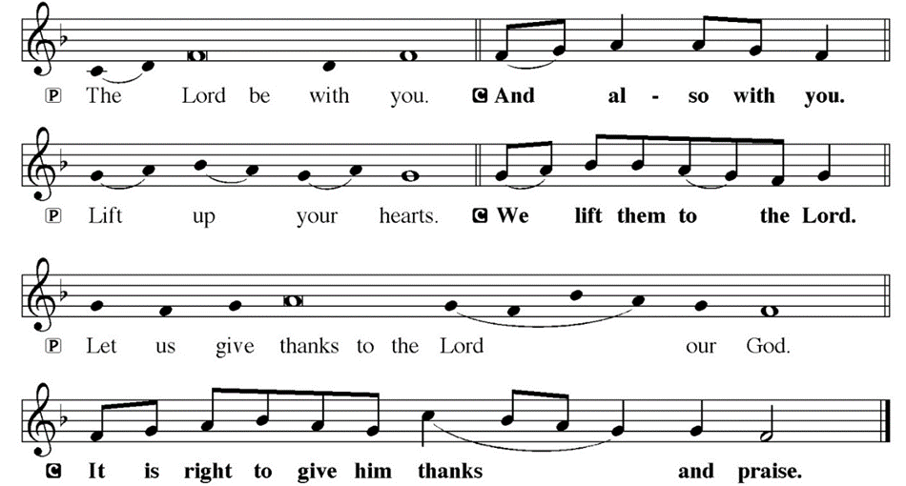
DIALOGUE

Slide 55
THE PREFACE
P: It is indeed right and salutary…
… we praise your name and join their unending hymn.

Slide 56
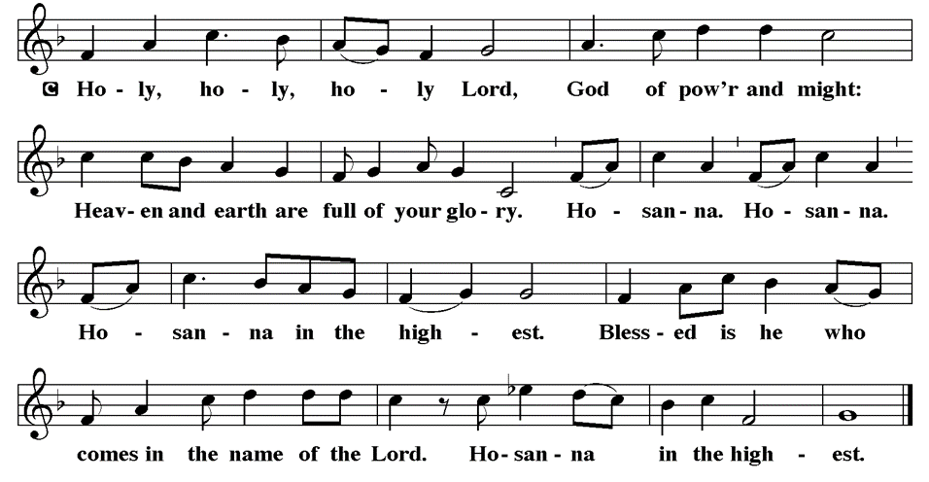
THE SANCTUS

Slide 57
EUCHARISTIC PRAYER
P: Holy God, the Beginning and the End…
…both now and forever.
C: Amen.

Slide 58
THE LORD’S PRAYER
C: Our Father, who art in heaven, hallowed be thy name, thy kingdom come, thy will be done, on earth as it is in heaven. Give us this day our daily bread; and forgive us our trespasses, as we forgive those who trespass against us; and lead us not into temptation, but deliver us from evil.

Slide 59
THE LORD’S PRAYER
C: For thine is the kingdom, and the power, and the glory, forever and ever. Amen.

Slide 60
INVITATION TO COMMUNION
P: Jesus, who breathes new life into all things, invites you to this holy table, where he offers his own body and blood to give you life—and that abundantly! Come to the meal where our friend and sibling, Jesus Christ, is fully present, and be made new.

Slide 61
COMMUNION DISTRIBUTION
All will commune “At the Railing”.
The bread may be broken for distribution. As the ministers give the bread and wine, they say these words :
The body of Christ, given for you.
The blood of Christ, shed for you.
The communicant may say: Amen.

Slide 62
POST COMMUNION CANTACLE

Slide 63
POST COMMUNION CANTACLE

Slide 64
POST COMMUNION PRAYER
P: Let us pray… God our host, at this table you have fed us with joy and gladness. Send us forth, eager to share the feast, welcome the stranger, and bear good fruit in the name of Jesus.
C: Amen.

Slide 65
SENDING OF HOMEBOUND COMMUNION
P: Gracious God, whose mercy endures from generation to generation: bless those who go forth to share your word and sacrament with our sisters and brothers who are sick or homebound.

Slide 66
SENDING OF HOMEBOUND COMMUNION
P: In your love and care, nourish and strengthen those to whom we bring this communion, that through the body and blood of your Son we may all know the hope of your promised coming in Jesus Christ our Lord.
C: Amen.

Slide 67
ANNOUNCEMENTS
Notes:
Image: Five Loaves by Caroline Coolidge Brown. Copyright © Caroline Coolidge Brown. All rights reserved. Used by permission of the artist.

Slide 68
SENDING BLESSING
P: May God who comes among us, Father, Son, and Holy Spirit, ☩ grant you patience in waiting, peace in the darkness, and good news to share today and always.
C: Amen.

Slide 69
Sending Song
“Holy Spirit, Ever Dwelling”
LBW 523
Notes:
Image: Five Loaves by Caroline Coolidge Brown. Copyright © Caroline Coolidge Brown. All rights reserved. Used by permission of the artist.

Slide 70
“Holy Spirit, Ever Dwelling” LBW 523
1 Holy Spirit, ever dwelling
in the holiest realms of light;
Holy Spirit, ever brooding
o'er a world of gloom and night;
Holy Spirit, ever raising
those of earth to thrones on high;
living, life-imparting Spirit,
you we praise and magnify.
Notes:
Image: Preparing yeast dough. Copyright © tomasworks/iStock/Thinkstock. Used by permission.

Slide 71
“Holy Spirit, Ever Dwelling” LBW 523
2 Holy Spirit, ever living
as the church's very life;
Holy Spirit, ever striving
through us in a ceaseless strife;
Holy Spirit, ever forming
in the church the mind of Christ:
you we praise with endless worship
for your gifts and fruits unpriced.
Notes:
Image: Preparing yeast dough. Copyright © tomasworks/iStock/Thinkstock. Used by permission.

Slide 72
“Holy Spirit, Ever Dwelling” LBW 523
3 Holy Spirit, ever working
through the church's ministry;
quick'ning, strength'ning, and absolving,
setting captive sinners free;
Holy Spirit, ever binding
age to age and soul to soul
in communion never ending,
you we worship and extol.
Notes:
Image: Preparing yeast dough. Copyright © tomasworks/iStock/Thinkstock. Used by permission.

Slide 73
DISMISSAL
P: … Depart in Christ’s Love.
C: Seeking, welcoming, and serving all. Amen!
POSTLUDE
By
Roxanne Groff
From sundaysandseasons.com. Copyright © 2025 Augsburg Fortress. All rights reserved. Reprinted by permission under Augsburg Fortress Liturgies Annual License #SAS023830. New Revised Standard Version Bible, Copyright © 1989, Division of Christian Education of the National Council of the Churches of Christ in the United States of America. Used by permission. All rights reserved. Revised Common Lectionary, Copyright © 1992 Consultation on Common Texts, admin Augsburg Fortress. Used by permission.

