Slide 1
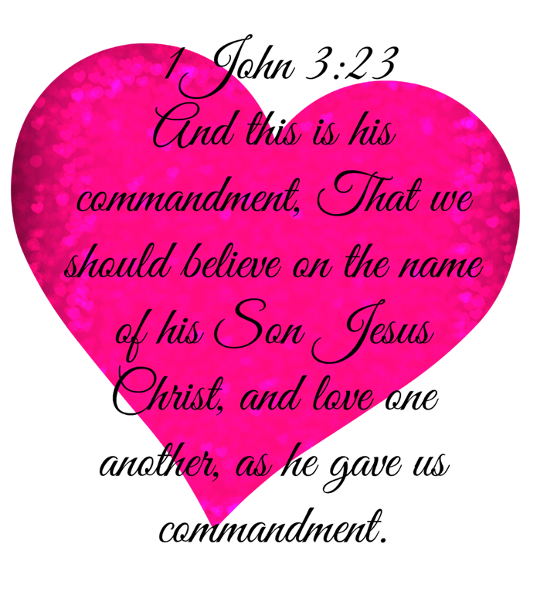
Trinity Evangelical Lutheran Church
July 7, 2024
WELCOME!
Notes:
Image: Five Loaves by Caroline Coolidge Brown. Copyright © Caroline Coolidge Brown. All rights reserved. Used by permission of the artist.

Slide 2
Prelude By Pam Sherman
= Please stand if able
= Please be seated
Office of the Acolyte and Ringing of the Bell
Welcome
Notes:
Image: Five Loaves by Caroline Coolidge Brown. Copyright © Caroline Coolidge Brown. All rights reserved. Used by permission of the artist.

Slide 3
CONFESSION AND FORGIVENESS
All may make the sign of the cross, the sign marked at baptism…
L: We confess our sins before God and one another.
Pause for silence and reflection.
L: Merciful God,
Notes:
Image: Five Loaves by Caroline Coolidge Brown. Copyright © Caroline Coolidge Brown. All rights reserved. Used by permission of the artist.

Slide 4
CONFESSION AND FORGIVENESS
C: As we stand before you in the all-revealing light of your eternal love, we cannot help but see all the ways we have sinned and fallen short. We have done and said things that have caused harm to others. We have failed to do and say things for the sake of peace and justice. We have continuously sought after our own
Notes:
Image: Five Loaves by Caroline Coolidge Brown. Copyright © Caroline Coolidge Brown. All rights reserved. Used by permission of the artist.

Slide 5
CONFESSION AND FORGIVENESS
C: comfort, rather than your world-transforming love. Forgive us for our selfishness and shortsightedness, and bring us into the way of active love of you and neighbor each new day.
Notes:
Image: Five Loaves by Caroline Coolidge Brown. Copyright © Caroline Coolidge Brown. All rights reserved. Used by permission of the artist.

Slide 6
CONFESSION AND FORGIVENESS
L: The good news is that Jesus died to cleanse us from sin, and because of this, our joy can be complete. ☩ Receive the forgiveness of all your sins, for the sake of Jesus Christ.
C: Amen.
Notes:
Image: Five Loaves by Caroline Coolidge Brown. Copyright © Caroline Coolidge Brown. All rights reserved. Used by permission of the artist.

Slide 7
Gathering Song
“Lord, Whose Love in Humble Service”
LBW 423
Notes:
Image: Five Loaves by Caroline Coolidge Brown. Copyright © Caroline Coolidge Brown. All rights reserved. Used by permission of the artist.

Slide 8
“Lord, Whose Love in Humble Service” LBW 423
1 Lord, whose love in humble service
bore the weight of human need,
who upon the cross, forsaken,
worked your mercy's perfect deed:
we, your servants, bring the worship
not of voice alone, but heart;
consecrating to your purpose
ev'ry gift which you impart.
Notes:
Image: Five Loaves by Caroline Coolidge Brown. Copyright © Caroline Coolidge Brown. All rights reserved. Used by permission of the artist.

Slide 9
“Lord, Whose Love in Humble Service” LBW 423
2 Still your children wander homeless;
still the hungry cry for bread;
still the captives long for freedom;
still in grief we mourn our dead.
As you, Lord, in deep compassion
healed the sick and freed the soul,
by your Spirit send your power
to our world to make it whole.
Notes:
Image: Five Loaves by Caroline Coolidge Brown. Copyright © Caroline Coolidge Brown. All rights reserved. Used by permission of the artist.

Slide 10
“Lord, Whose Love in Humble Service” LBW 423
3 As we worship, grant us vision,
till your love's revealing light
in its height and depth and greatness
dawns upon our quickened sight,
making known the needs and burdens
your compassion bids us bear,
stirring us to ardent service,
your abundant life to share.
Notes:
Image: Five Loaves by Caroline Coolidge Brown. Copyright © Caroline Coolidge Brown. All rights reserved. Used by permission of the artist.

Slide 11
“Lord, Whose Love in Humble Service” LBW 423
4 Called by worship to your service,
forth in your dear name we go,
to the child, the youth, the aged,
love in living deeds to show;
hope and health, good will and comfort,
counsel, aid and peace we give,
that your servants, Lord, in freedom
may your mercy know and live.
Notes:
Image: Five Loaves by Caroline Coolidge Brown. Copyright © Caroline Coolidge Brown. All rights reserved. Used by permission of the artist.

Slide 12
APOSTOLIC GREETING
P: The grace of our Lord Jesus Christ, the love of God, and the communion of the Holy Spirit be with you all.
C: And also with you.
Notes:
Image: Five Loaves by Caroline Coolidge Brown. Copyright © Caroline Coolidge Brown. All rights reserved. Used by permission of the artist.

Slide 13
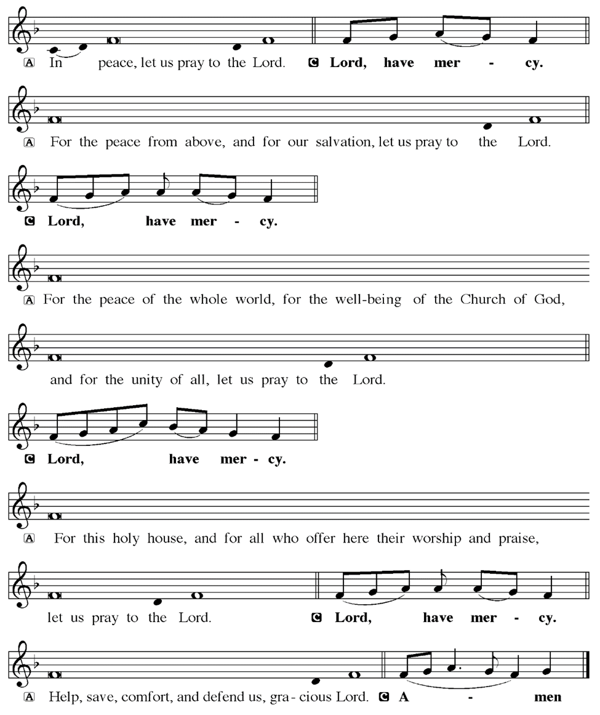
KYRIE
Notes:
Image: Five Loaves by Caroline Coolidge Brown. Copyright © Caroline Coolidge Brown. All rights reserved. Used by permission of the artist.

Slide 14
KYRIE
Notes:
Image: Five Loaves by Caroline Coolidge Brown. Copyright © Caroline Coolidge Brown. All rights reserved. Used by permission of the artist.

Slide 15
KYRIE
Notes:
Image: Five Loaves by Caroline Coolidge Brown. Copyright © Caroline Coolidge Brown. All rights reserved. Used by permission of the artist.

Slide 16
HYMN OF PRAISE
Glory be to God in heaven;
peace, goodwill to all the earth.
Mighty God of all creation,
Father of surpassing worth:
we exalt you, we adore you,
we lift high our thanks and praise.
Saints and angels bow before you; here on earth our songs we raise.
Notes:
Image: Five Loaves by Caroline Coolidge Brown. Copyright © Caroline Coolidge Brown. All rights reserved. Used by permission of the artist.

Slide 17
HYMN OF PRAISE
Glory be to Christ forever,
Lamb of God and Lord of love.
Son of God and gracious Savior, you have come from heav’n above;
on the cross you died to save us; now you reign at God’s right hand.
Hear our prayer; restore, forgive us; in your promise firm we stand.
Notes:
Image: Five Loaves by Caroline Coolidge Brown. Copyright © Caroline Coolidge Brown. All rights reserved. Used by permission of the artist.

Slide 18
HYMN OF PRAISE
Holy One we now acclaim you;
Lord alone, to you we call;
Holy One in faith we name you,
God most high, yet near to all:
Jesus Christ, with God the Spirit,
in the Father’s splendor bright.
For the peace that we inherit,
glory be to God on high!
Notes:
Image: Five Loaves by Caroline Coolidge Brown. Copyright © Caroline Coolidge Brown. All rights reserved. Used by permission of the artist.

Slide 19
PRAYER OF THE DAY
P: Let us pray… Holy God, you came to us in love, and then in love died to release us from our slavery to sin and death. Teach us this sacrificial love for you and for one another, not that we might literally die, though we should be willing, but that we might surrender ourselves completely to you, trusting in the life-giving, life-sustaining, and life-restoring power of your love.
C: Amen
Notes:
Image: Five Loaves by Caroline Coolidge Brown. Copyright © Caroline Coolidge Brown. All rights reserved. Used by permission of the artist.

Slide 20

Notes:
Image: Preparing yeast dough. Copyright © tomasworks/iStock/Thinkstock. Used by permission.

Slide 21
Scripture Reading
R: Our scripture reading for today is from First John, Chapter 3.
C: Glory to you O’ Lord! (Spoken)
Notes:
Image: Five Loaves by Caroline Coolidge Brown. Copyright © Caroline Coolidge Brown. All rights reserved. Used by permission of the artist.

Slide 22
1 John 3:16-24
¹⁶We know love by this, that he laid down his life for us—and we ought to lay down our lives for one another. ¹⁷How does God’s love abide in anyone who has the world’s goods and sees a brother or sister in need and yet refuses help? ¹⁸Little children, let us love, not in word or speech, but in truth and action. ¹⁹And by this we will know that we are from the truth and will
Notes:
Image: Five Loaves by Caroline Coolidge Brown. Copyright © Caroline Coolidge Brown. All rights reserved. Used by permission of the artist.

Slide 23
1 John 3:16-24
reassure our hearts before him ²⁰whenever our hearts condemn us; for God is greater than our hearts, and he knows everything. ²¹Beloved, if our hearts do not condemn us, we have boldness before God; ²²and we receive from him whatever we ask, because we obey his commandments and do what pleases him.
Notes:
Image: Five Loaves by Caroline Coolidge Brown. Copyright © Caroline Coolidge Brown. All rights reserved. Used by permission of the artist.

Slide 24
1 John 3:16-24
²³And this is his commandment, that we should believe in the name of his Son Jesus Christ and love one another, just as he has commanded us. ²⁴All who obey his commandments abide in him, and he abides in them. And by this we know that he abides in us, by the Spirit that he has given us.
Notes:
Image: Five Loaves by Caroline Coolidge Brown. Copyright © Caroline Coolidge Brown. All rights reserved. Used by permission of the artist.

Slide 25
1 John 3:16-24
R: This is the Word of the Lord.
C: Praise to You, O Christ (Spoken)
Notes:
Image: Five Loaves by Caroline Coolidge Brown. Copyright © Caroline Coolidge Brown. All rights reserved. Used by permission of the artist.

Slide 26
SERMON
Notes:
Image: Five Loaves by Caroline Coolidge Brown. Copyright © Caroline Coolidge Brown. All rights reserved. Used by permission of the artist.

Slide 27
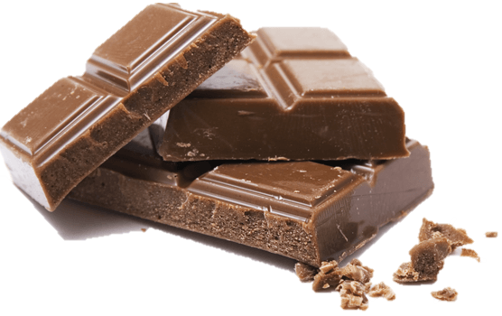
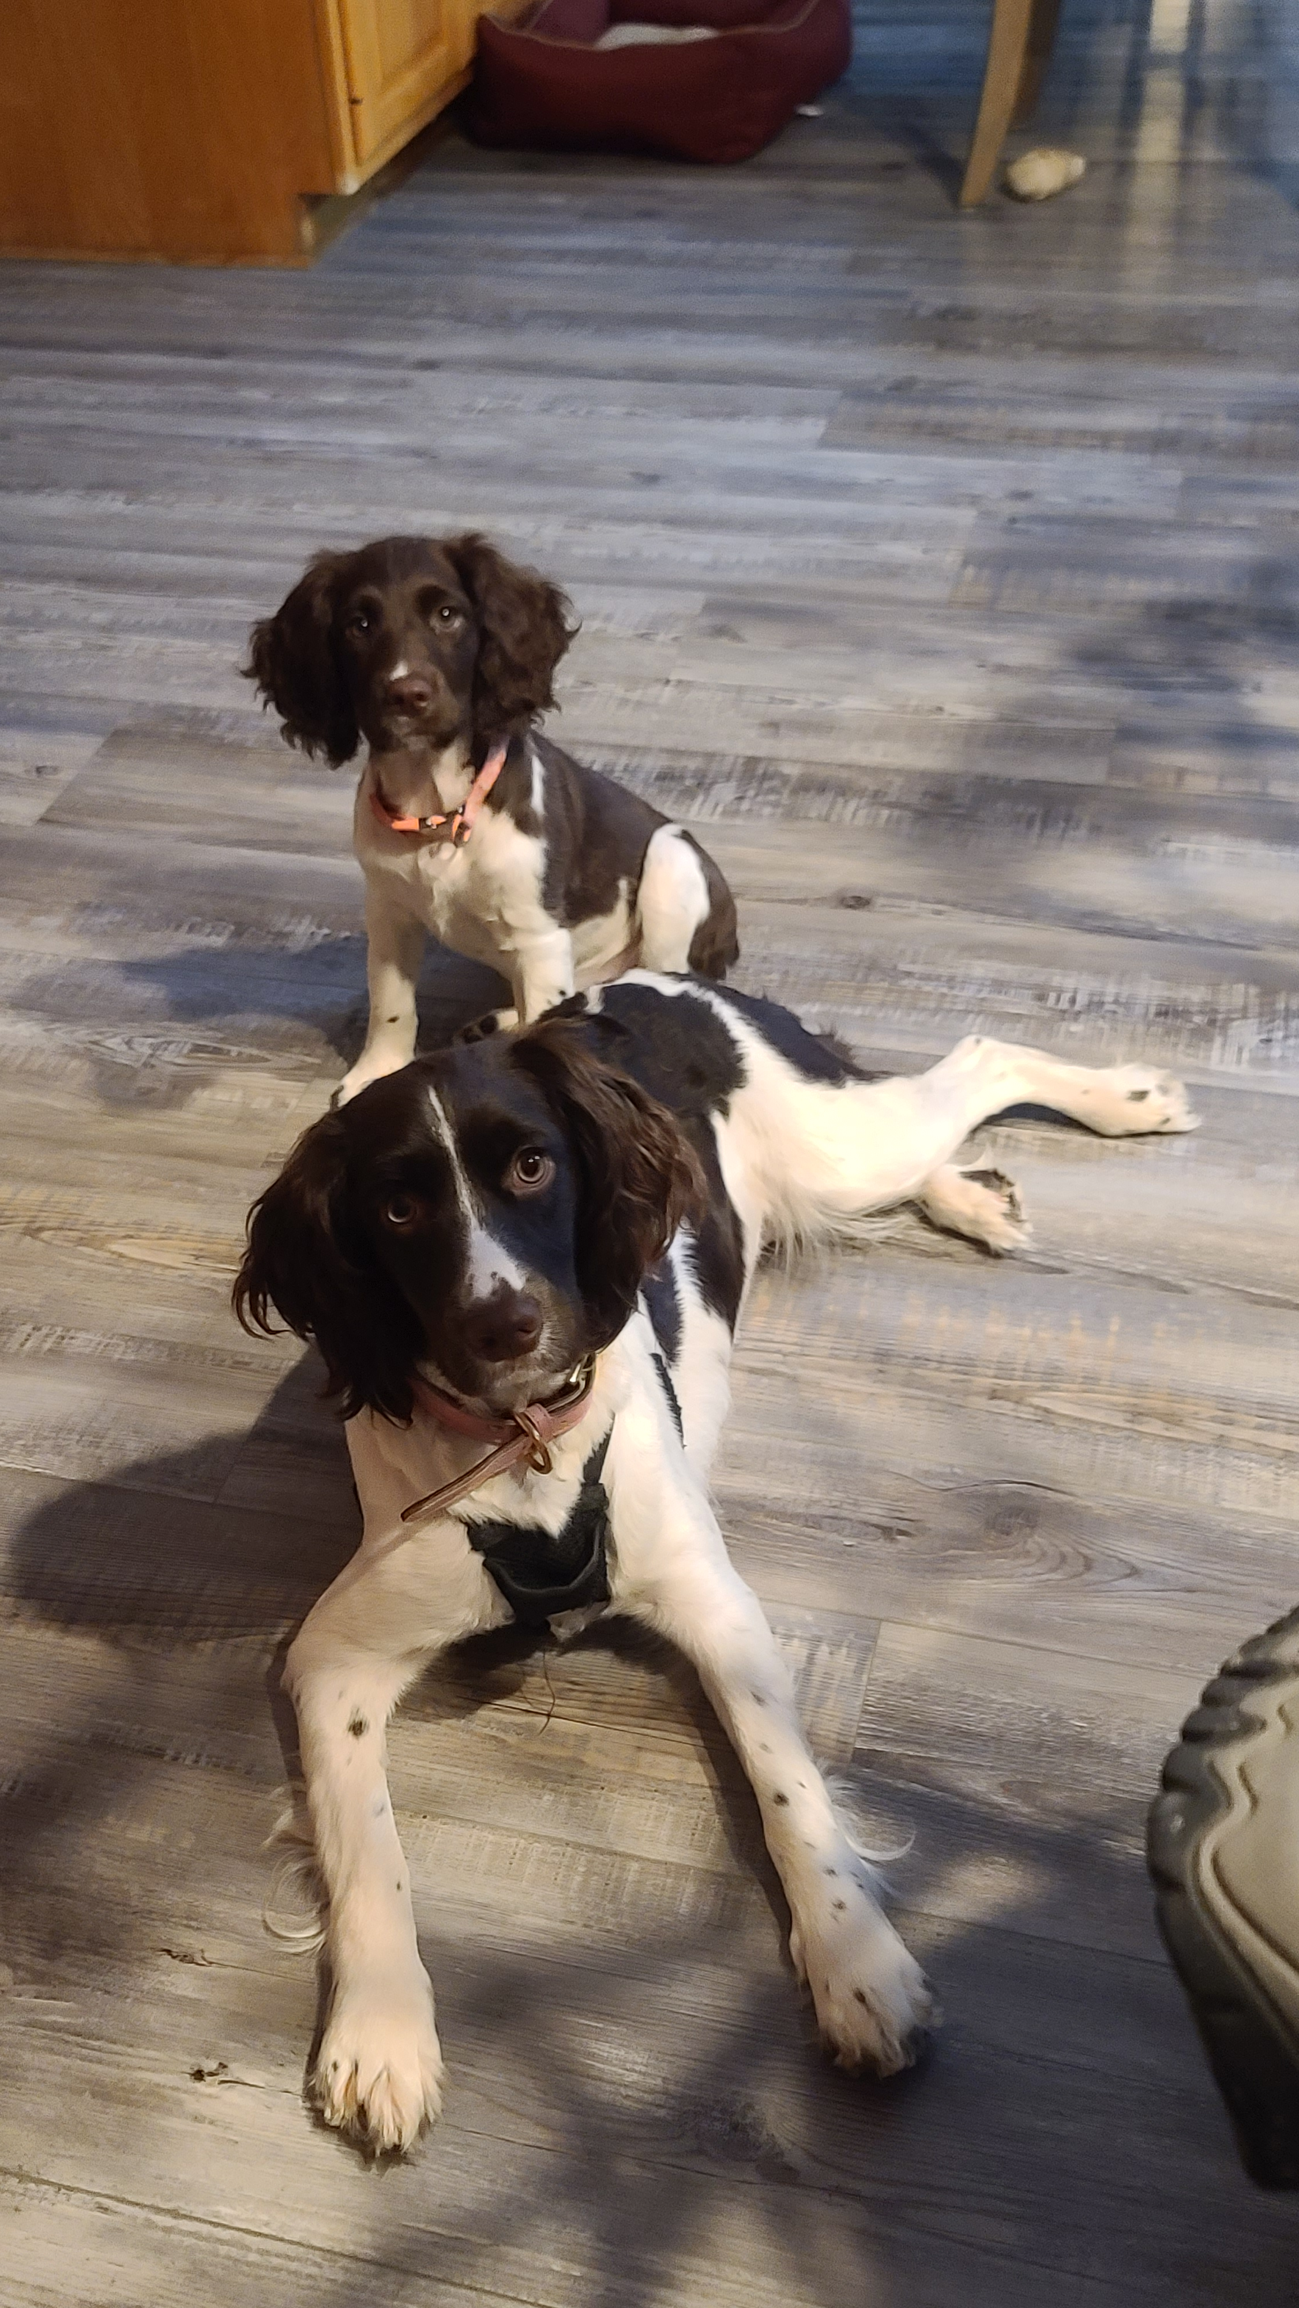
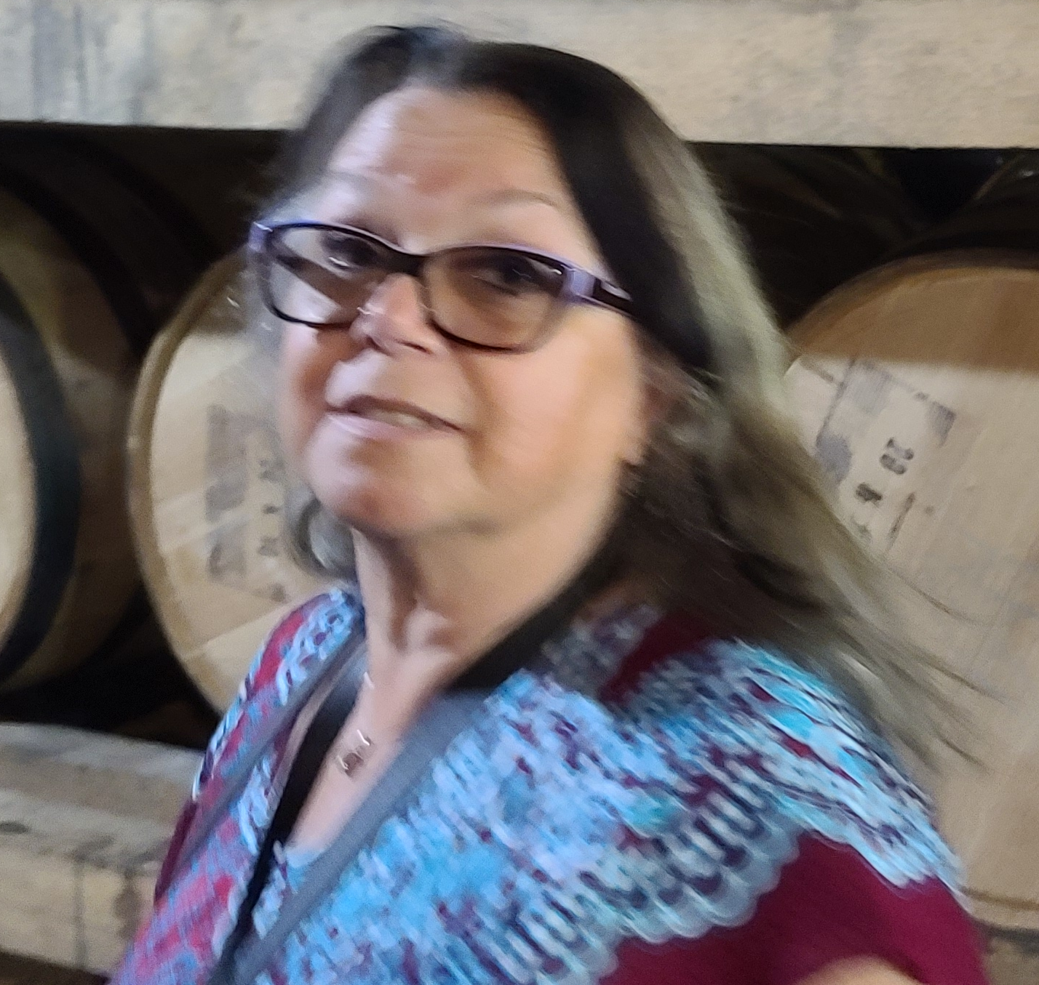
SERMON
Notes:
Image: Five Loaves by Caroline Coolidge Brown. Copyright © Caroline Coolidge Brown. All rights reserved. Used by permission of the artist.

Slide 28
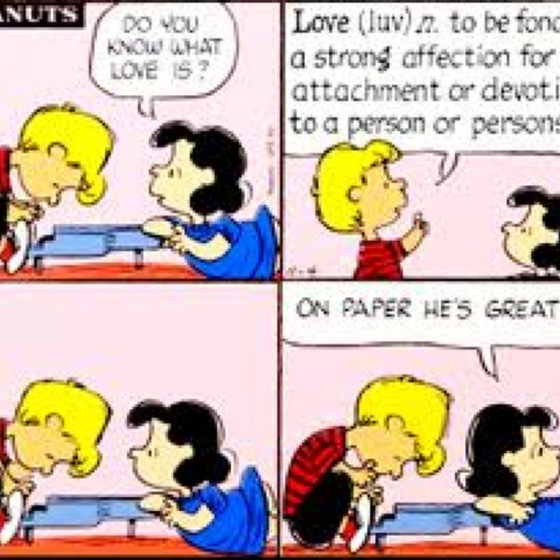
SERMON
Notes:
Image: Five Loaves by Caroline Coolidge Brown. Copyright © Caroline Coolidge Brown. All rights reserved. Used by permission of the artist.

Slide 29
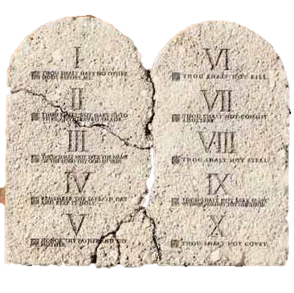
SERMON
Notes:
Image: Five Loaves by Caroline Coolidge Brown. Copyright © Caroline Coolidge Brown. All rights reserved. Used by permission of the artist.

Slide 30
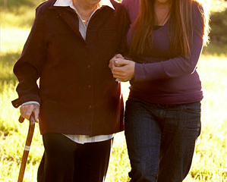

SERMON
Notes:
Image: Five Loaves by Caroline Coolidge Brown. Copyright © Caroline Coolidge Brown. All rights reserved. Used by permission of the artist.

Slide 31

SERMON
Notes:
Image: Five Loaves by Caroline Coolidge Brown. Copyright © Caroline Coolidge Brown. All rights reserved. Used by permission of the artist.

Slide 32

SERMON
Notes:
Image: Five Loaves by Caroline Coolidge Brown. Copyright © Caroline Coolidge Brown. All rights reserved. Used by permission of the artist.

Slide 33

SERMON
Notes:
Image: Five Loaves by Caroline Coolidge Brown. Copyright © Caroline Coolidge Brown. All rights reserved. Used by permission of the artist.

Slide 34
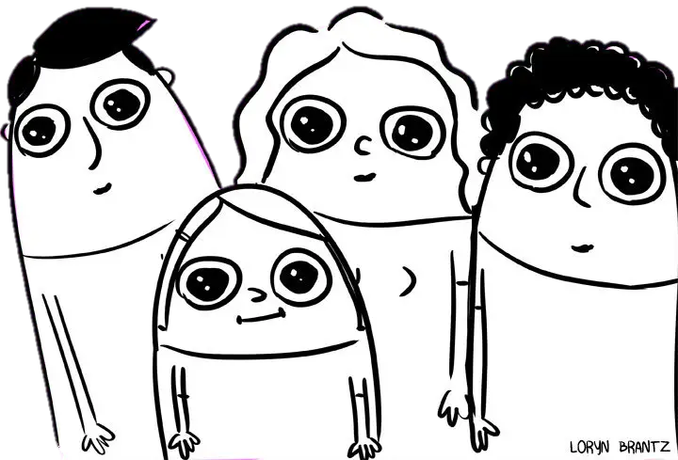
SERMON
Notes:
Image: Five Loaves by Caroline Coolidge Brown. Copyright © Caroline Coolidge Brown. All rights reserved. Used by permission of the artist.

Slide 35
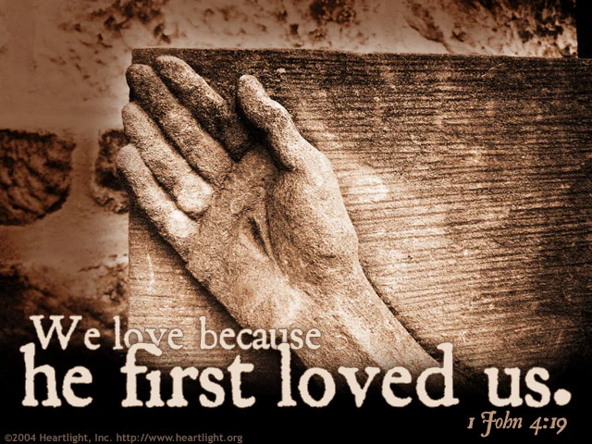
SERMON
Notes:
Image: Five Loaves by Caroline Coolidge Brown. Copyright © Caroline Coolidge Brown. All rights reserved. Used by permission of the artist.

Slide 36
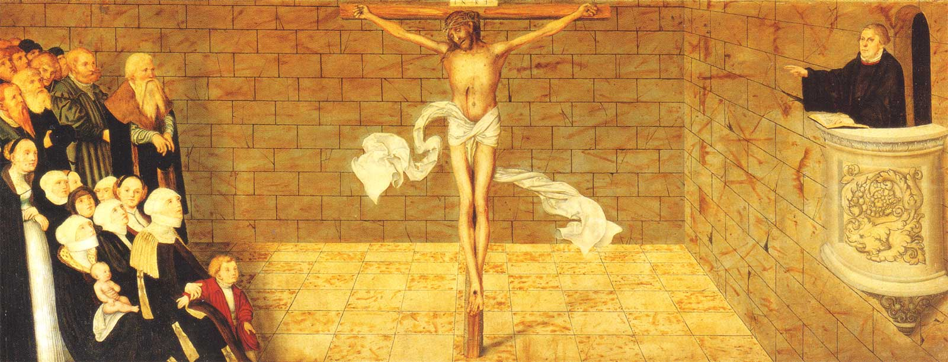
SERMON
Notes:
Image: Five Loaves by Caroline Coolidge Brown. Copyright © Caroline Coolidge Brown. All rights reserved. Used by permission of the artist.

Slide 37
SERMON
Dictionary
Definitions from Oxford Languages
a·gape -- adjective
(of the mouth) wide open, especially with surprise or wonder.
Notes:
Image: Five Loaves by Caroline Coolidge Brown. Copyright © Caroline Coolidge Brown. All rights reserved. Used by permission of the artist.

Slide 38
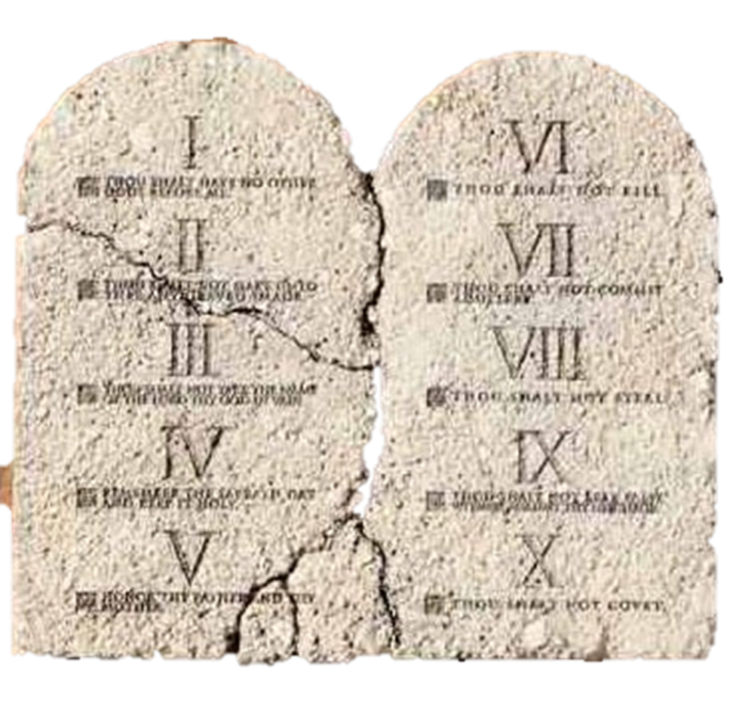
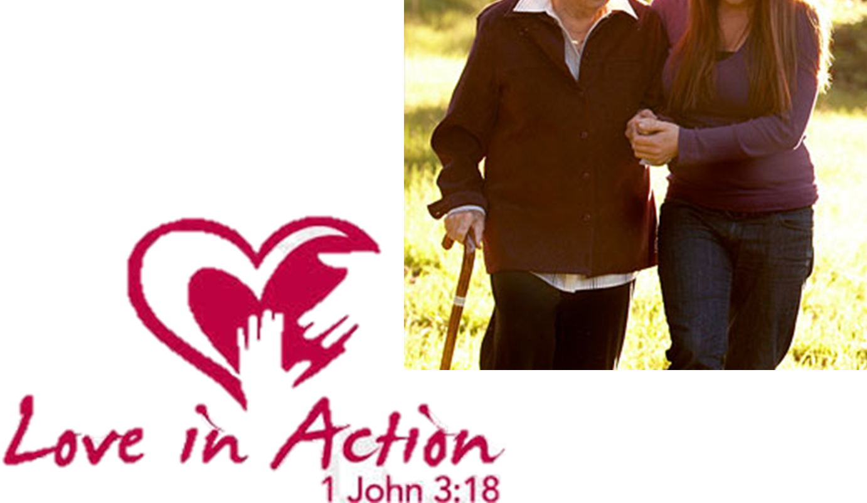
SERMON
Notes:
Image: Five Loaves by Caroline Coolidge Brown. Copyright © Caroline Coolidge Brown. All rights reserved. Used by permission of the artist.

Slide 39
APOSTLE’S CREED
C: I believe in God, the Father almighty, creator of heaven and earth.

Slide 40
APOSTLE’S CREED
C: I believe in Jesus Christ, his only Son, our Lord. He was conceived by the power of the Holy Spirit and born of the virgin Mary. He suffered under Pontius Pilate, was crucified, died, and was buried.

Slide 41
APOSTLE’S CREED
C: He descended into hell. On the third day he rose again. He ascended into heaven, and is seated at the right hand of the Father. He will come again to judge the living and the dead.

Slide 42
APOSTLE’S CREED
C: I believe in the Holy Spirit, the holy catholic Church, the communion of saints, the forgiveness of sins, the resurrection of the body, and the life everlasting. Amen.

Slide 43
NICENE CREED
C: We believe in one God, the Father, the Almighty, maker of heaven and earth, of all that is, seen and unseen.

Slide 44
NICENE CREED
C: We believe in one Lord, Jesus Christ, the only Son of God, eternally begotten of the Father, God from God, Light from Light, true God from true God, begotten, not made, of one Being with the Father.

Slide 45
NICENE CREED
C: Through him all things were made. For us and for our salvation he came down from heaven; by the power of the Holy Spirit he became incarnate from the virgin Mary, and was made man. For our sake he was crucified under Pontius Pilate;

Slide 46
NICENE CREED
C: he suffered death and was buried. On the third day he rose again in accordance with the Scriptures; he ascended into heaven and is seated at the right hand of the Father. He will come again in glory to judge the living and the dead, and his kingdom will have no end.

Slide 47
NICENE CREED
C: We believe in the Holy Spirit, the Lord, the giver of life, who proceeds from the Father and the Son. With the Father and the Son he is worshiped and glorified. He has spoken through the prophets. We believe in one holy catholic and apostolic Church.

Slide 48
NICENE CREED
C: We acknowledge one Baptism for the forgiveness of sins. We look for the resurrection of the dead, and the life of the world to come. Amen.

Slide 49
PRAYERS OF INTERCESSION
Each petition will end with the words,
A: God of love,
The congregation will respond with:
C: We lift our prayers to you.

Slide 50
PRAYERS OF INTERCESSION
The prayer concludes…
P: With all our siblings in Christ here and around the world, we lift all our prayers to you, through Jesus Christ our savior and friend.
C: Amen.

Slide 51
OFFERING
Notes:
Image: Five Loaves by Caroline Coolidge Brown. Copyright © Caroline Coolidge Brown. All rights reserved. Used by permission of the artist.

Slide 52
OFFERING PRAYER
Notes:
Image: Five Loaves by Caroline Coolidge Brown. Copyright © Caroline Coolidge Brown. All rights reserved. Used by permission of the artist.

Slide 53
THE GREAT THANKSGIVING
All the Baptized are welcome to celebrate this Holy Meal.

Slide 54
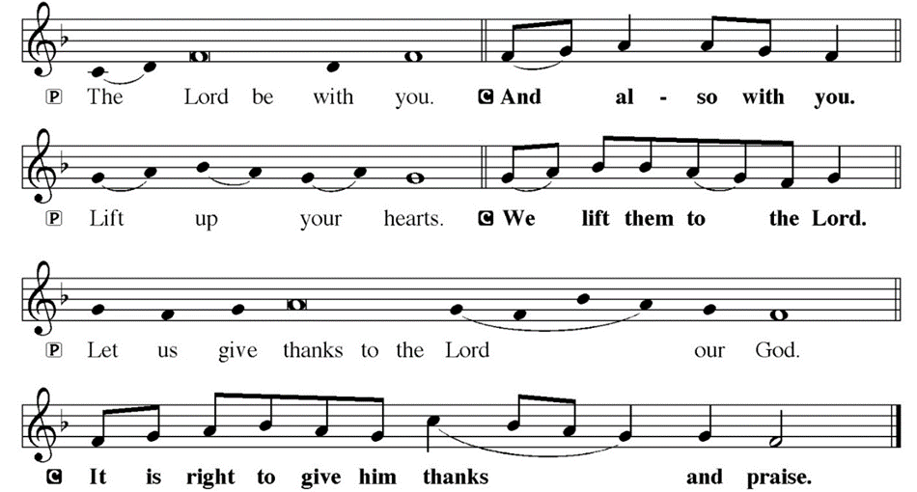
DIALOGUE

Slide 55
THE PREFACE
P: It is indeed right and salutary…
… we praise your name and join their unending hymn.

Slide 56
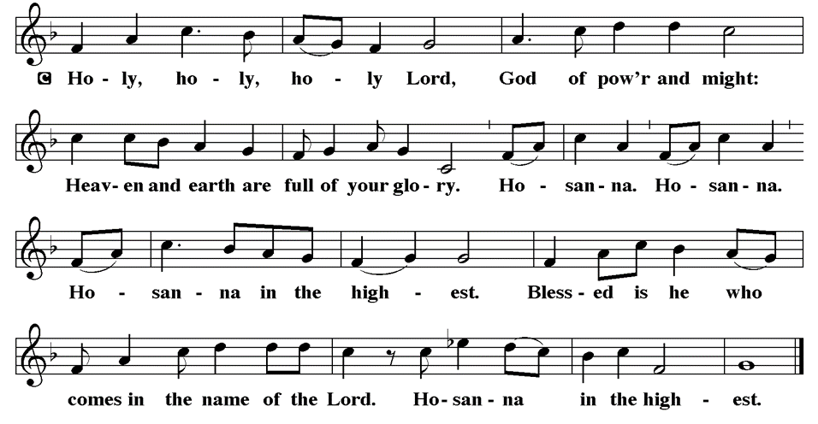
THE SANCTUS

Slide 57
EUCHARISTIC PRAYER
P: Holy God, our maker and redeemer…
…both now and forever.
C: Amen.

Slide 58
THE LORD’S PRAYER
C: Our Father, who art in heaven, hallowed be thy name, thy kingdom come, thy will be done, on earth as it is in heaven. Give us this day our daily bread; and forgive us our trespasses, as we forgive those who trespass against us; and lead us not into temptation, but deliver us from evil.

Slide 59
THE LORD’S PRAYER
C: For thine is the kingdom, and the power, and the glory, forever and ever. Amen.

Slide 60
INVITATION TO COMMUNION
P: Jesus, who laid down his life for you, now invites you to the feast of remembrance of his ultimate sacrifice, which was an act of incomprehensible love. Come, beloved of God, saved and released, and share in this meal with Jesus and with one another.

Slide 61
COMMUNION DISTRIBUTION
All will commune “at the railing”.
The bread may be broken for distribution. As the ministers give the bread and wine, they say these words :
The body of Christ, given for you.
The blood of Christ, shed for you.
The communicant may say: Amen.

Slide 62
POST COMMUNION BLESSING
P: May this body and blood of our Lord and Savior, Jesus Christ, strengthen, keep and unite us, ☩ now and forever, amen.
C: Amen.

Slide 63
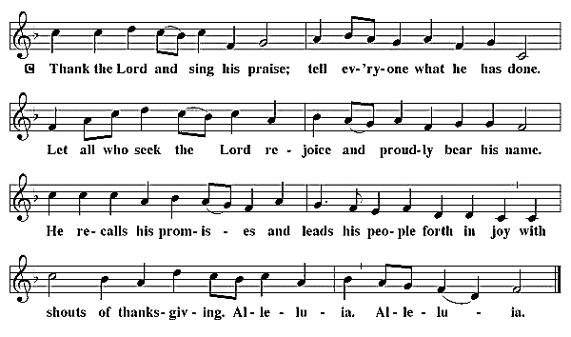
POST COMMUNION CANTACLE

Slide 64
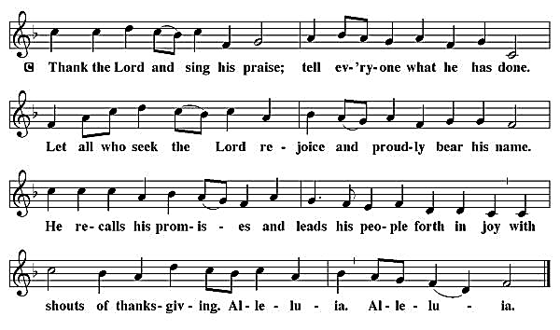
POST COMMUNION CANTACLE

Slide 65
POST COMMUNION PRAYER
P: Let us pray… Jesus, Bread of life, we have received from your table more than we could ever ask. As you have nourished us in this meal, now strengthen us to love the world with your own life. In your name we pray.
C: Amen

Slide 66

ANNOUNCEMENTS
Notes:
Image: Five Loaves by Caroline Coolidge Brown. Copyright © Caroline Coolidge Brown. All rights reserved. Used by permission of the artist.

Slide 67
SENDING BLESSING
P: The blessing of God, who provides for us, feeds us, and journeys with us, ☩ be upon you now and forever.
C: Amen.

Slide 68
Sending Song
“Blest Be the Tie That Binds”
LBW 370
Notes:
Image: Five Loaves by Caroline Coolidge Brown. Copyright © Caroline Coolidge Brown. All rights reserved. Used by permission of the artist.

Slide 69
“Blest Be the Tie That Binds” LBW 370
1 Blest be the tie that binds
our hearts in Christian love;
the unity of heart and mind
is like to that above.
2 Before our Father’s throne
we pour our ardent prayers;
our fears, our hopes, our aims are one,
our comforts and our cares.
Notes:
Image: Preparing yeast dough. Copyright © tomasworks/iStock/Thinkstock. Used by permission.

Slide 70
“Blest Be the Tie That Binds” LBW 370
3 We share our mutual woes,
our mutual burdens bear,
and often for each other flows
the sympathizing tear.
4 From sorrow, toil, and pain,
and sin we shall be free;
and perfect love and friendship reign
through all eternity.
Notes:
Image: Preparing yeast dough. Copyright © tomasworks/iStock/Thinkstock. Used by permission.

Slide 71
DISMISSAL
P: … Depart in Christ’s Love.
C: Seeking, welcoming, and serving all. Amen!
POSTLUDE
By Pam Sherman
From sundaysandseasons.com. Copyright © 2024 Augsburg Fortress. All rights reserved. Reprinted by permission under Augsburg Fortress Liturgies Annual License #SAS023830. New Revised Standard Version Bible, Copyright © 1989, Division of Christian Education of the National Council of the Churches of Christ in the United States of America. Used by permission. All rights reserved. Revised Common Lectionary, Copyright © 1992 Consultation on Common Texts, admin Augsburg Fortress. Used by permission.

