Slide 1
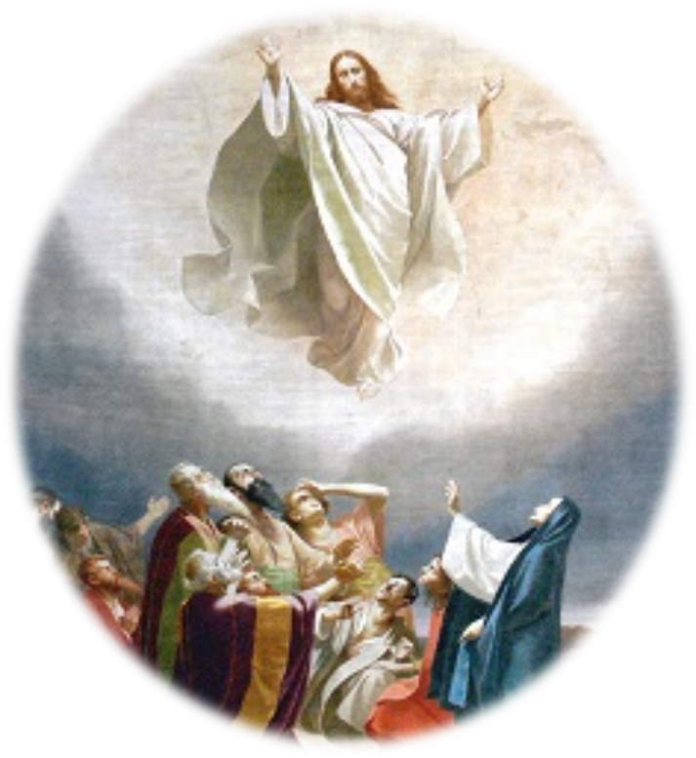
Trinity Evangelical Lutheran Church April 7, 2024
WELCOME!
Notes:
Image: Five Loaves by Caroline Coolidge Brown. Copyright © Caroline Coolidge Brown. All rights reserved. Used by permission of the artist.

Slide 2
Prelude By Pam Sherman
= Please stand if able
= Please be seated
Office of the Acolyte
Ringing of the Bell
Welcome
Notes:
Image: Five Loaves by Caroline Coolidge Brown. Copyright © Caroline Coolidge Brown. All rights reserved. Used by permission of the artist.

Slide 3
THANKSGIVING FOR BAPTISM
The assembly stands. All may make the sign of the cross, the sign marked at baptism, as the presiding minister begins.
P: Blessed be the holy Trinity, ☩ one God, the fountain of living water, the rock who gave us birth, our light and our salvation.
C: Amen.
Notes:
Image: Five Loaves by Caroline Coolidge Brown. Copyright © Caroline Coolidge Brown. All rights reserved. Used by permission of the artist.

Slide 4
THANKSGIVING FOR BAPTISM
The presiding minister addresses the assembly.
P: Joined to Christ in the waters of baptism, we are clothed with God’s mercy and forgiveness. Let us give thanks for the gift of baptism.
Water may be poured into the font as the presiding minister gives thanks.
Notes:
Image: Five Loaves by Caroline Coolidge Brown. Copyright © Caroline Coolidge Brown. All rights reserved. Used by permission of the artist.

Slide 5
THANKSGIVING FOR BAPTISM
P: We give you thanks, O God, for in the beginning your Spirit moved over the waters and by your Word you created the world, calling forth life in which you took delight. Through the waters of the flood you delivered Noah and his family. Through the sea you led your people Israel from slavery into freedom. At the river your Son was baptized by John and anointed with the Holy Spirit.
Notes:
Image: Five Loaves by Caroline Coolidge Brown. Copyright © Caroline Coolidge Brown. All rights reserved. Used by permission of the artist.

Slide 6
THANKSGIVING FOR BAPTISM
P: By water and your Word you claim us as daughters and sons, making us heirs of your promise and servants of all. We praise you for the gift of water that sustains life, and above all we praise you for the gift of new life in Jesus Christ.
Notes:
Image: Five Loaves by Caroline Coolidge Brown. Copyright © Caroline Coolidge Brown. All rights reserved. Used by permission of the artist.

Slide 7
THANKSGIVING FOR BAPTISM
P: Shower us with your Spirit, and renew our lives with your forgiveness, grace, and love. To you be given honor and praise through Jesus Christ our Lord in the unity of the Holy Spirit, now and forever.
C: Amen.
Notes:
Image: Five Loaves by Caroline Coolidge Brown. Copyright © Caroline Coolidge Brown. All rights reserved. Used by permission of the artist.

Slide 8
Gathering Song
“Alleluia! Sing to Jesus”
LBW 158
Notes:
Image: Five Loaves by Caroline Coolidge Brown. Copyright © Caroline Coolidge Brown. All rights reserved. Used by permission of the artist.

Slide 9
“Alleluia! Sing to Jesus LBW 158
1 Alleluia! Sing to Jesus;
his the scepter, his the throne;
Alleluia! his the triumph,
his the victory alone.
Hark! The songs of peaceful Zion
thunder like a mighty flood:
"Jesus out of ev'ry nation
has redeemed us by his blood."
Notes:
Image: Five Loaves by Caroline Coolidge Brown. Copyright © Caroline Coolidge Brown. All rights reserved. Used by permission of the artist.

Slide 10
“Alleluia! Sing to Jesus LBW 158
2 Alleluia! Not as orphans
are we left in sorrow now;
Alleluia! he is near us;
faith believes, nor questions how.
Though the cloud from sight received him
when the forty days were o'er,
shall our hearts forget his promise:
"I am with you evermore"?
Notes:
Image: Five Loaves by Caroline Coolidge Brown. Copyright © Caroline Coolidge Brown. All rights reserved. Used by permission of the artist.

Slide 11
“Alleluia! Sing to Jesus LBW 158
3 Alleluia! Bread of heaven,
here on earth our food, our stay;
Alleluia! here the sinful
flee to you from day to day.
Intercessor, friend of sinners,
earth's redeemer, hear our plea
where the songs of all the sinless
sweep across the crystal sea.
Notes:
Image: Five Loaves by Caroline Coolidge Brown. Copyright © Caroline Coolidge Brown. All rights reserved. Used by permission of the artist.

Slide 12
“Alleluia! Sing to Jesus LBW 158
4 Alleluia! King eternal,
Lord omnipotent we own;
Alleluia! born of Mary,
earth your footstool, heav'n your throne.
As within the veil you entered,
robed in flesh, our great high priest,
here on earth both priest and victim
in the eucharistic feast.
Notes:
Image: Five Loaves by Caroline Coolidge Brown. Copyright © Caroline Coolidge Brown. All rights reserved. Used by permission of the artist.

Slide 13
“Alleluia! Sing to Jesus LBW 158
5 Alleluia! Sing to Jesus;
his the scepter, his the throne;
Alleluia! his the triumph,
his the victory alone.
Hark! The songs of peaceful Zion
thunder like a mighty flood:
"Jesus out of ev'ry nation
has redeemed us by his blood."
Notes:
Image: Five Loaves by Caroline Coolidge Brown. Copyright © Caroline Coolidge Brown. All rights reserved. Used by permission of the artist.

Slide 14
APOSTOLIC GREETING
P: The grace of our Lord Jesus Christ, the love of God, and the communion of the Holy Spirit be with you all.
C: And also with you.
Notes:
Image: Five Loaves by Caroline Coolidge Brown. Copyright © Caroline Coolidge Brown. All rights reserved. Used by permission of the artist.

Slide 15
KYRIE
Notes:
Image: Five Loaves by Caroline Coolidge Brown. Copyright © Caroline Coolidge Brown. All rights reserved. Used by permission of the artist.

Slide 16
KYRIE
Notes:
Image: Five Loaves by Caroline Coolidge Brown. Copyright © Caroline Coolidge Brown. All rights reserved. Used by permission of the artist.

Slide 17
KYRIE
Notes:
Image: Five Loaves by Caroline Coolidge Brown. Copyright © Caroline Coolidge Brown. All rights reserved. Used by permission of the artist.

Slide 18
HYMN OF PRAISE
Glory be to God in heaven;
peace, goodwill to all the earth.
Mighty God of all creation,
Father of surpassing worth:
we exalt you, we adore you,
we lift high our thanks and praise.
Saints and angels bow before you; here on earth our songs we raise.
Notes:
Image: Five Loaves by Caroline Coolidge Brown. Copyright © Caroline Coolidge Brown. All rights reserved. Used by permission of the artist.

Slide 19
HYMN OF PRAISE
Glory be to Christ forever,
Lamb of God and Lord of love.
Son of God and gracious Savior, you have come from heav’n above;
on the cross you died to save us; now you reign at God’s right hand.
Hear our prayer; restore, forgive us; in your promise firm we stand.
Notes:
Image: Five Loaves by Caroline Coolidge Brown. Copyright © Caroline Coolidge Brown. All rights reserved. Used by permission of the artist.

Slide 20
HYMN OF PRAISE
Holy One we now acclaim you;
Lord alone, to you we call;
Holy One in faith we name you,
God most high, yet near to all:
Jesus Christ, with God the Spirit,
in the Father’s splendor bright.
For the peace that we inherit,
glory be to God on high!
Notes:
Image: Five Loaves by Caroline Coolidge Brown. Copyright © Caroline Coolidge Brown. All rights reserved. Used by permission of the artist.

Slide 21
PRAYER OF THE DAY
P: Let us pray… Gracious God, you call us together in your presence and charge us with the task of bearing your love into a suffering world. Strengthen us for this work, that all might share equally in your reign of justice and peace. In Jesus’ name we pray.
C: Amen
Notes:
Image: Five Loaves by Caroline Coolidge Brown. Copyright © Caroline Coolidge Brown. All rights reserved. Used by permission of the artist.

Slide 22
Notes:
Image: Preparing yeast dough. Copyright © tomasworks/iStock/Thinkstock. Used by permission.

Slide 23
Scripture Reading
R: The Scripture reading is from the Book of Acts, the 1st chapter.
C: Glory to you O’ Lord! (Spoken)
Notes:
Image: Five Loaves by Caroline Coolidge Brown. Copyright © Caroline Coolidge Brown. All rights reserved. Used by permission of the artist.

Slide 24
Acts 1:1-14
In the first book, Theophilus, I wrote about all that Jesus did and taught from the beginning ² until the day when he was taken up to heaven, after giving instructions through the Holy Spirit to the apostles whom he had chosen. ³ After his suffering he presented himself alive to them by many convincing proofs, appearing to them
Notes:
Image: Five Loaves by Caroline Coolidge Brown. Copyright © Caroline Coolidge Brown. All rights reserved. Used by permission of the artist.

Slide 25
Acts 1:1-14
during forty days and speaking about the kingdom of God. ⁴ While staying with them, he ordered them not to leave Jerusalem, but to wait there for the promise of the Father. “This,” he said, “is what you have heard from me; ⁵for John baptized with water, but you will be baptized with the Holy Spirit not many days from now.”
Notes:
Image: Five Loaves by Caroline Coolidge Brown. Copyright © Caroline Coolidge Brown. All rights reserved. Used by permission of the artist.

Slide 26
Acts 1:1-14
⁶ So when they had come together, they asked him, “Lord, is this the time when you will restore the kingdom to Israel?” ⁷ He replied, “It is not for you to know the times or periods that the Father has set by his own authority. ⁸ But you will receive power when the Holy Spirit has come upon you; and you will be my witnesses in Jerusalem,
Notes:
Image: Five Loaves by Caroline Coolidge Brown. Copyright © Caroline Coolidge Brown. All rights reserved. Used by permission of the artist.

Slide 27
Acts 1:1-14
in all Judea and Samaria, and to the ends of the earth.” ⁹ When he had said this, as they were watching, he was lifted up, and a cloud took him out of their sight. ¹⁰ While he was going and they were gazing up toward heaven, suddenly two men in white robes stood by them. ¹¹ They said, “Men of Galilee, why do you stand looking up toward
Notes:
Image: Five Loaves by Caroline Coolidge Brown. Copyright © Caroline Coolidge Brown. All rights reserved. Used by permission of the artist.

Slide 28
Acts 1:1-14
heaven? This Jesus, who has been taken up from you into heaven, will come in the same way as you saw him go into heaven.”
¹² Then they returned to Jerusalem from the mount called Olivet, which is near Jerusalem, a sabbath day’s journey away. ¹³ When they had entered the city, they went to the room
Notes:
Image: Five Loaves by Caroline Coolidge Brown. Copyright © Caroline Coolidge Brown. All rights reserved. Used by permission of the artist.

Slide 29
Acts 1:1-14
upstairs where they were staying, Peter, and John, and James, and Andrew, Philip and Thomas, Bartholomew and Matthew, James son of Alphaeus, and Simon the Zealot, and Judas son of James. ¹⁴ All these were constantly devoting themselves to prayer, together with certain women, including Mary the mother of Jesus, as well as his brothers.
Notes:
Image: Five Loaves by Caroline Coolidge Brown. Copyright © Caroline Coolidge Brown. All rights reserved. Used by permission of the artist.

Slide 30
Mark 16:1-8
R: This is the Word of the Lord.
C: Praise to You, O Christ (Spoken)
Notes:
Image: Five Loaves by Caroline Coolidge Brown. Copyright © Caroline Coolidge Brown. All rights reserved. Used by permission of the artist.

Slide 31
Sermon
Sandra Combs
Notes:
Image: Five Loaves by Caroline Coolidge Brown. Copyright © Caroline Coolidge Brown. All rights reserved. Used by permission of the artist.

Slide 32
SPECIAL MUSIC
“Jesus Messiah”
Larry Harter
Notes:
Image: Five Loaves by Caroline Coolidge Brown. Copyright © Caroline Coolidge Brown. All rights reserved. Used by permission of the artist.

Slide 33
NICENE CREED
C: We believe in one God, the Father, the Almighty, maker of heaven and earth, of all that is, seen and unseen.

Slide 34
NICENE CREED
C: We believe in one Lord, Jesus Christ, the only Son of God, eternally begotten of the Father, God from God, Light from Light, true God from true God, begotten, not made, of one Being with the Father.

Slide 35
NICENE CREED
C: Through him all things were made. For us and for our salvation he came down from heaven; by the power of the Holy Spirit he became incarnate from the virgin Mary, and was made man. For our sake he was crucified under Pontius Pilate;

Slide 36
NICENE CREED
C: he suffered death and was buried. On the third day he rose again in accordance with the Scriptures; he ascended into heaven and is seated at the right hand of the Father. He will come again in glory to judge the living and the dead, and his kingdom will have no end.

Slide 37
NICENE CREED
C: We believe in the Holy Spirit, the Lord, the giver of life, who proceeds from the Father and the Son. With the Father and the Son he is worshiped and glorified. He has spoken through the prophets. We believe in one holy catholic and apostolic Church.

Slide 38
NICENE CREED
C: We acknowledge one Baptism for the forgiveness of sins. We look for the resurrection of the dead, and the life of the world to come. Amen.

Slide 39
PRAYERS OF INTERCESSION
Each petition will end with the words,
A: God of new life,
The congregation will respond with:
C: In mercy, hear our prayer.

Slide 40
PRAYERS OF INTERCESSION
The prayer concludes…
P: We place in your arms all for whom we pray, out loud or in our hearts, confident in your mercy and grace, through Jesus Christ, our savior.
C: Amen.

Slide 41
OFFERING
Notes:
Image: Five Loaves by Caroline Coolidge Brown. Copyright © Caroline Coolidge Brown. All rights reserved. Used by permission of the artist.

Slide 42
OFFERING PRAYER
Notes:
Image: Five Loaves by Caroline Coolidge Brown. Copyright © Caroline Coolidge Brown. All rights reserved. Used by permission of the artist.

Slide 43
THE GREAT THANKSGIVING
All the Baptized are welcome to celebrate this Holy Meal.

Slide 44
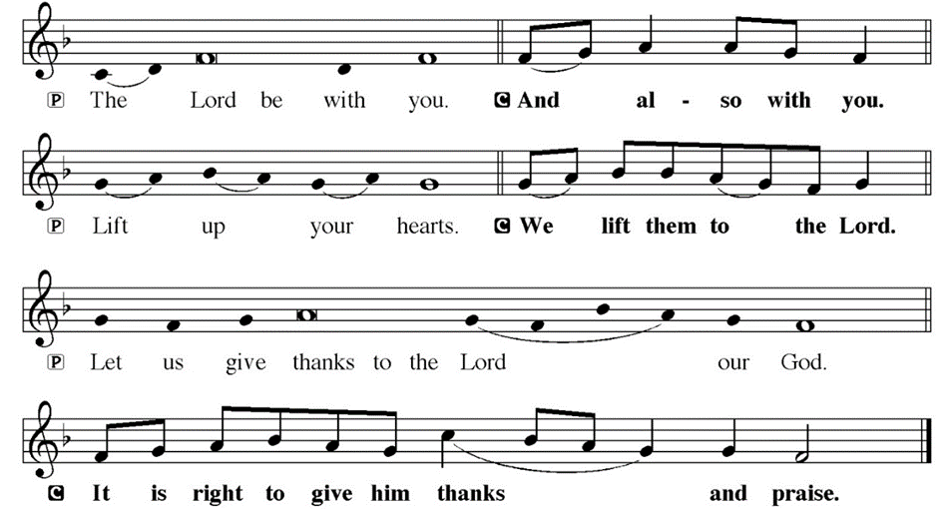
DIALOGUE

Slide 45
THE PREFACE
P: It is indeed right and salutary…
… we praise your name and join their unending hymn.

Slide 46
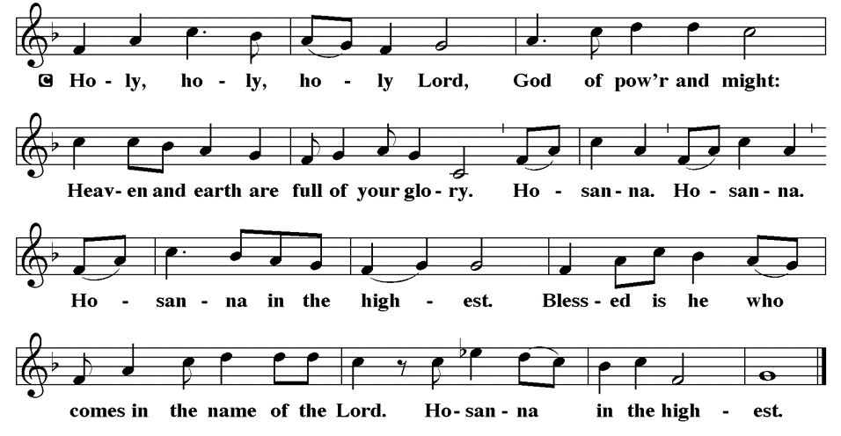
THE SANCTUS

Slide 47
EUCHARISTIC PRAYER
P: Holy, living, and loving God…
…both now and forever.
C: Amen.

Slide 48
THE LORD’S PRAYER
C: Our Father, who art in heaven, hallowed be thy name, thy kingdom come, thy will be done, on earth as it is in heaven. Give us this day our daily bread; and forgive us our trespasses, as we forgive those who trespass against us; and lead us not into temptation, but deliver us from evil.

Slide 49
THE LORD’S PRAYER
C: For thine is the kingdom, and the power, and the glory, forever and ever. Amen.

Slide 50
INVITATION TO COMMUNION
P: Christ who is alive in this place now invites you to the table to share in the bread and wine that is his own holy presence and a foretaste of the heavenly feast that has no end. All is prepared—come and eat.

Slide 51
COMMUNION DISTRIBUTION
Each First Communion family will Commune “At the Rail” with their First Communicant.
After all First Communion Families have Communed, the remaining assembly will commune “By Station”.
The bread may be broken for distribution. As the ministers give the bread and wine, they say these words :
The body of Christ, given for you.
The blood of Christ, shed for you.
The communicant may say: Amen.

Slide 52
POST COMMUNION BLESSING
P: May this Body and Blood of our Lord and Savior, Jesus Christ, strengthen, keep, and unite us ☩ now and forever.
C: Amen.

Slide 53
POST COMMUNION CANTACLE

Slide 54
POST COMMUNION CANTACLE

Slide 55
POST COMMUNION PRAYER
P: Let us pray… Shepherding God, you have prepared a table before us and nourished us with your love. Send us forth from this banquet to proclaim your goodness and share the abundant mercy of Jesus, our redeemer and friend.
C: Amen

Slide 56
ANNOUNCEMENTS
Notes:
Image: Five Loaves by Caroline Coolidge Brown. Copyright © Caroline Coolidge Brown. All rights reserved. Used by permission of the artist.

Slide 57
SENDING BLESSING
P: Beloved, we are God’s own people, holy, washed, renewed. God bless you and keep you, shower you with mercy, fill you with courage, and ☩ give you peace.
C: Amen.

Slide 58
Sending Song
“Beautiful Savior”
LBW 518
Notes:
Image: Five Loaves by Caroline Coolidge Brown. Copyright © Caroline Coolidge Brown. All rights reserved. Used by permission of the artist.

Slide 59
“Beautiful Savior” LBW 518
1 Beautiful Savior,
King of creation,
Son of God and Son of Man!
Truly I'd love thee,
truly I'd serve thee,
light of my soul, my joy, my crown.
Notes:
Image: Preparing yeast dough. Copyright © tomasworks/iStock/Thinkstock. Used by permission.

Slide 60
“Beautiful Savior” LBW 518
2 Fair are the meadows,
fair are the woodlands,
robed in flow'rs of blooming spring;
Jesus is fairer,
Jesus is purer,
he makes our sorrowing spirit sing.
Notes:
Image: Preparing yeast dough. Copyright © tomasworks/iStock/Thinkstock. Used by permission.

Slide 61
“Beautiful Savior” LBW 518
3 Fair is the sunshine,
fair is the moonlight,
bright the sparkling stars on high;
Jesus shines brighter,
Jesus shines purer
than all the angels in the sky.
Notes:
Image: Preparing yeast dough. Copyright © tomasworks/iStock/Thinkstock. Used by permission.

Slide 62
“Beautiful Savior” LBW 518
4 Beautiful Savior,
Lord of the nations,
Son of God and Son of Man!
Glory and honor,
praise, adoration,
now and forevermore be thine!
Notes:
Image: Preparing yeast dough. Copyright © tomasworks/iStock/Thinkstock. Used by permission.

Slide 63
DISMISSAL
P: … Depart in Christ’s Love.
C: Seeking, welcoming, and serving all. Amen!
POSTLUDE
By Pam Sherman
From sundaysandseasons.com. Copyright © 2024 Augsburg Fortress. All rights reserved. Reprinted by permission under Augsburg Fortress Liturgies Annual License #SAS023830. New Revised Standard Version Bible, Copyright © 1989, Division of Christian Education of the National Council of the Churches of Christ in the United States of America. Used by permission. All rights reserved. Revised Common Lectionary, Copyright © 1992 Consultation on Common Texts, admin Augsburg Fortress. Used by permission.

