Slide 1
October 15, 2023
WELCOME!
Trinity Lutheran Church
Notes:
Image: Five Loaves by Caroline Coolidge Brown. Copyright © Caroline Coolidge Brown. All rights reserved. Used by permission of the artist.

Slide 2
= Please stand if able
= Please be seated
Prelude - By Roxanne Groff
Office of the Acolyte
Ringing of the Bell
Welcome

Slide 3
THANKSGIVING FOR BAPTISM
All may make the sign of the cross, the sign marked at baptism, as the presiding minister begins.
P: Blessed be the holy Trinity, ☩ one God, the fountain of living water, the rock who gave us birth, our light and our salvation.
C: Amen.
Notes:
Image: Preparing yeast dough. Copyright © tomasworks/iStock/Thinkstock. Used by permission.

Slide 4
P: Joined to Christ in the waters of baptism, we are clothed with God's mercy and forgiveness. Let us give thanks for the gift of baptism. Water may be poured into the font as the presiding minister gives thanks.
THANKSGIVING FOR BAPTISM
Notes:
Image: Preparing yeast dough. Copyright © tomasworks/iStock/Thinkstock. Used by permission.

Slide 5
P: We give you thanks, O God, for in the beginning your Spirit moved over the waters and by your Word you created the world, calling forth life in which you took delight. Through the waters of the flood you delivered Noah and his family. Through the sea you led your people Israel from slavery into freedom.
THANKSGIVING FOR BAPTISM
Notes:
Image: Preparing yeast dough. Copyright © tomasworks/iStock/Thinkstock. Used by permission.

Slide 6
P: At the river your Son was baptized by John and anointed with the Holy Spirit. By water and your Word you claim us as daughters and sons, making us heirs of your promise and servants of all. We praise you for the gift of water that sustains life, and above all we praise you for the gift of new life in Jesus Christ.
THANKSGIVING FOR BAPTISM
Notes:
Image: Preparing yeast dough. Copyright © tomasworks/iStock/Thinkstock. Used by permission.

Slide 7
P: Shower us with your Spirit, and renew our lives with your forgiveness, grace, and love. To you be given honor and praise through Jesus Christ our Lord in the unity of the Holy Spirit, now and forever.
THANKSGIVING FOR BAPTISM
C: Amen.
Notes:
Image: Preparing yeast dough. Copyright © tomasworks/iStock/Thinkstock. Used by permission.

Slide 8
CONFESSION AND FORGIVENESS
All may make the sign of the cross, the sign marked at baptism…
L: We confess our sins before God and one another.
Pause for silence and reflection.
L: God of all that is,
Notes:
Image: Five Loaves by Caroline Coolidge Brown. Copyright © Caroline Coolidge Brown. All rights reserved. Used by permission of the artist.

Slide 9
CONFESSION AND FORGIVENESS
C: We have failed to trust you to care for us. We have tried to be our own god in our lives and the lives of others. We have not listened to your call, nor lived in faithfulness to you. We have caused harm directly and indirectly to ourselves, our neighbors, and your creation.
Notes:
Image: Five Loaves by Caroline Coolidge Brown. Copyright © Caroline Coolidge Brown. All rights reserved. Used by permission of the artist.

Slide 10
CONFESSION AND FORGIVENESS
C: In your infinite grace and mercy, forgive and restore us, so that with your help, we might become the people you created us to be.
Notes:
Image: Five Loaves by Caroline Coolidge Brown. Copyright © Caroline Coolidge Brown. All rights reserved. Used by permission of the artist.

Slide 11
CONFESSION AND FORGIVENESS
L: Hear the good news: By the power of the Holy Spirit we are made new creations in Christ Jesus, and through his selfless sacrifice, God forgives us all our sin. ☩ Walk with God in this newness of life.
C: Amen.
Notes:
Image: Five Loaves by Caroline Coolidge Brown. Copyright © Caroline Coolidge Brown. All rights reserved. Used by permission of the artist.

Slide 12
Gathering Song/Hymn of Praise
“There’s A Wideness in God’s Mercy”
LBW 290

Slide 13
“There’s A Wideness in God’s Mercy” LBW 290
1 There’s a wideness in God’s mercy,
like the wideness of the sea;
there’s a kindness in his justice
which is more than liberty.
There is no place where earth’s sorrows
are more felt than up in heav’n.
There is no place where earth’s failings
have such kindly judgment giv’n.
Notes:
Image: Five Loaves by Caroline Coolidge Brown. Copyright © Caroline Coolidge Brown. All rights reserved. Used by permission of the artist.

Slide 14
“There’s A Wideness in God’s Mercy” LBW 290
2 There is welcome for the sinner,
and a promised grace made good;
there is mercy with the Savior;
there is healing in his blood.
There is grace enough for thousands
of new worlds as great as this;
there is room for fresh creations
in that upper home of bliss.
Notes:
Image: Five Loaves by Caroline Coolidge Brown. Copyright © Caroline Coolidge Brown. All rights reserved. Used by permission of the artist.

Slide 15
“There’s A Wideness in God’s Mercy” LBW 290
3 For the love of God is broader
than the measures of our mind;
and the heart of the eternal
is most wonderfully kind.
There is plentiful redemption
in the blood that has been shed;
there is joy for all the members
in the sorrows of the head.
Notes:
Image: Five Loaves by Caroline Coolidge Brown. Copyright © Caroline Coolidge Brown. All rights reserved. Used by permission of the artist.

Slide 16
“There’s A Wideness in God’s Mercy” LBW 290
4 ’Tis not all we owe to Jesus;
it is something more than all:
greater good because of evil,
larger mercy through the fall.
If our love were but more simple,
we should take him at his word;
and our lives would be all sunshine
in the sweetness of our Lord.
Notes:
Image: Five Loaves by Caroline Coolidge Brown. Copyright © Caroline Coolidge Brown. All rights reserved. Used by permission of the artist.

Slide 17
APOSTOLIC GREETING
P: The grace of our Lord Jesus Christ, the love of God, and the communion of the Holy Spirit be with you all.
C: And also with you.
Notes:
Image: Five Loaves by Caroline Coolidge Brown. Copyright © Caroline Coolidge Brown. All rights reserved. Used by permission of the artist.

Slide 18
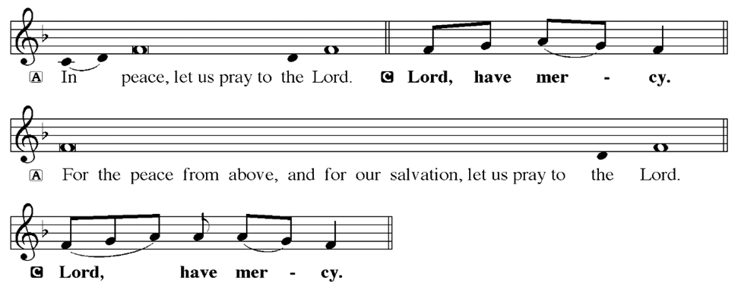
KYRIE
Notes:
Image: Five Loaves by Caroline Coolidge Brown. Copyright © Caroline Coolidge Brown. All rights reserved. Used by permission of the artist.

Slide 19
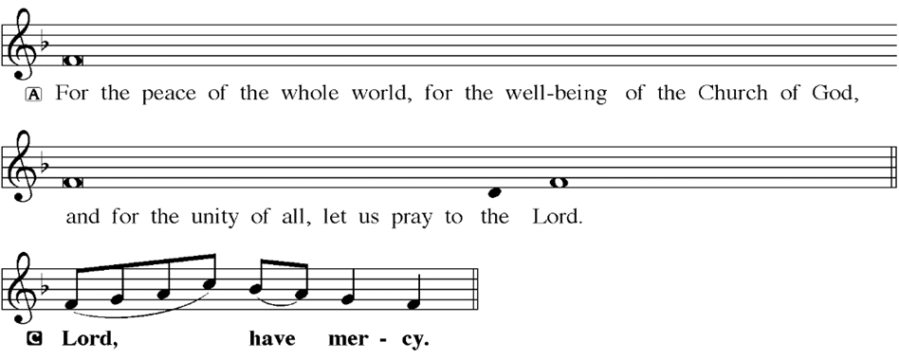
KYRIE
Notes:
Image: Five Loaves by Caroline Coolidge Brown. Copyright © Caroline Coolidge Brown. All rights reserved. Used by permission of the artist.

Slide 20
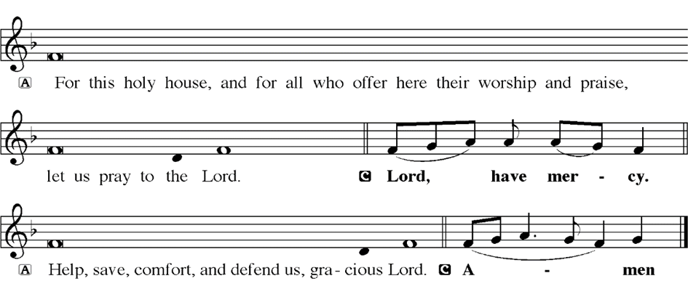
KYRIE
Notes:
Image: Five Loaves by Caroline Coolidge Brown. Copyright © Caroline Coolidge Brown. All rights reserved. Used by permission of the artist.

Slide 21
HYMN OF PRAISE
Glory be to God in heaven;
peace, goodwill to all the earth.
Mighty God of all creation,
Father of surpassing worth:
we exalt you, we adore you,
we lift high our thanks and praise.
Saints and angels bow before you; here on earth our songs we raise.
Notes:
Image: Five Loaves by Caroline Coolidge Brown. Copyright © Caroline Coolidge Brown. All rights reserved. Used by permission of the artist.

Slide 22
HYMN OF PRAISE
Glory be to Christ forever,
Lamb of God and Lord of love.
Son of God and gracious Savior, you have come from heav’n above;
on the cross you died to save us; now you reign at God’s right hand.
Hear our prayer; restore, forgive us; in your promise firm we stand.
Notes:
Image: Five Loaves by Caroline Coolidge Brown. Copyright © Caroline Coolidge Brown. All rights reserved. Used by permission of the artist.

Slide 23
HYMN OF PRAISE
Holy One we now acclaim you;
Lord alone, to you we call;
Holy One in faith we name you,
God most high, yet near to all:
Jesus Christ, with God the Spirit,
in the Father’s splendor bright.
For the peace that we inherit,
glory be to God on high!
Notes:
Image: Five Loaves by Caroline Coolidge Brown. Copyright © Caroline Coolidge Brown. All rights reserved. Used by permission of the artist.

Slide 24
PRAYER OF THE DAY
P: Let us pray… God of the journey, give us the commitment of Ruth, that we might follow your call, no matter how challenging it may seem. Open our ears to hear your words now and always, in Jesus name.
C: Amen
Notes:
Image: Five Loaves by Caroline Coolidge Brown. Copyright © Caroline Coolidge Brown. All rights reserved. Used by permission of the artist.

Slide 25
Notes:
Image: Five Loaves by Caroline Coolidge Brown. Copyright © Caroline Coolidge Brown. All rights reserved. Used by permission of the artist.

Slide 26
Scripture Reading
L: Our scripture reading for this day is from Ruth, Chapter 1.
C: Glory to you O’ Lord! (Spoken)
Notes:
Image: Five Loaves by Caroline Coolidge Brown. Copyright © Caroline Coolidge Brown. All rights reserved. Used by permission of the artist.

Slide 27
Ruth 1:1-17
¹In the days when the judges ruled, there was a famine in the land, and a certain man of Bethlehem in Judah went to live in the country of Moab, he and his wife and two sons. ²The name of the man was Elimelech and the name of his wife Naomi, and the names of his two sons were Mahlon and Chilion; they were Ephrathites from Bethlehem in Judah. They went into the
Notes:
Image: Five Loaves by Caroline Coolidge Brown. Copyright © Caroline Coolidge Brown. All rights reserved. Used by permission of the artist.

Slide 28
Ruth 1:1-17
country of Moab and remained there. ³But Elimelech, the husband of Naomi, died, and she was left with her two sons. ⁴These took Moabite wives; the name of the one was Orpah and the name of the other Ruth. When they had lived there about ten years, ⁵both Mahlon and Chilion also died, so that the woman was left without her two sons and her husband.
Notes:
Image: Five Loaves by Caroline Coolidge Brown. Copyright © Caroline Coolidge Brown. All rights reserved. Used by permission of the artist.

Slide 29
Ruth 1:1-17
⁶Then she started to return with her daughters-in-law from the country of Moab, for she had heard in the country of Moab that the LORD had considered his people and given them food. ⁷So she set out from the place where she had been living, she and her two daughters-in- law, and they went on their way to go back to the land of Judah. ⁸But Naomi said to her two
Notes:
Image: Five Loaves by Caroline Coolidge Brown. Copyright © Caroline Coolidge Brown. All rights reserved. Used by permission of the artist.

Slide 30
Ruth 1:1-17
daughters-in-law, "Go back each of you to your mother's house. May the LORD deal kindly with you, as you have dealt with the dead and with me. ⁹The LORD grant that you may find security, each of you in the house of your husband." Then she kissed them, and they wept aloud. ¹⁰They said to her, "No, we will return with you to your people." ¹¹But Naomi said, "Turn back, my daughters,
Notes:
Image: Five Loaves by Caroline Coolidge Brown. Copyright © Caroline Coolidge Brown. All rights reserved. Used by permission of the artist.

Slide 31
Ruth 1:1-17
why will you go with me? Do I still have sons in my womb that they may become your husbands? ¹²Turn back, my daughters, go your way, for I am too old to have a husband. Even if I thought there was hope for me, even if I should have a husband tonight and bear sons, ¹³would you then wait until they were grown? Would you then refrain from marrying? No, my daughters, it
Notes:
Image: Five Loaves by Caroline Coolidge Brown. Copyright © Caroline Coolidge Brown. All rights reserved. Used by permission of the artist.

Slide 32
Ruth 1:1-17
has been far more bitter for me than for you, because the hand of the LORD has turned against me." ¹⁴Then they wept aloud again. Orpah kissed her mother-in-law, but Ruth clung to her. ¹⁵So she said, "See, your sister-in-law has gone back to her people and to her gods; return after your sister-in-law." ¹⁶But Ruth said, "Do not press me to leave you
Notes:
Image: Five Loaves by Caroline Coolidge Brown. Copyright © Caroline Coolidge Brown. All rights reserved. Used by permission of the artist.

Slide 33
Ruth 1:1-17
or to turn back from following you! Where you go, I will go; where you lodge, I will lodge, your people shall be my people, and your God my God. ¹⁷Where you die, I will die — there will I be buried. May the LORD do thus and so to me, and more as well, if even death parts me from you!"
Notes:
Image: Five Loaves by Caroline Coolidge Brown. Copyright © Caroline Coolidge Brown. All rights reserved. Used by permission of the artist.

Slide 34
Ruth 1:1-17
R: This is the Word of the Lord.
C: Praise to You, O Christ (Spoken)
Notes:
Image: Five Loaves by Caroline Coolidge Brown. Copyright © Caroline Coolidge Brown. All rights reserved. Used by permission of the artist.

Slide 35
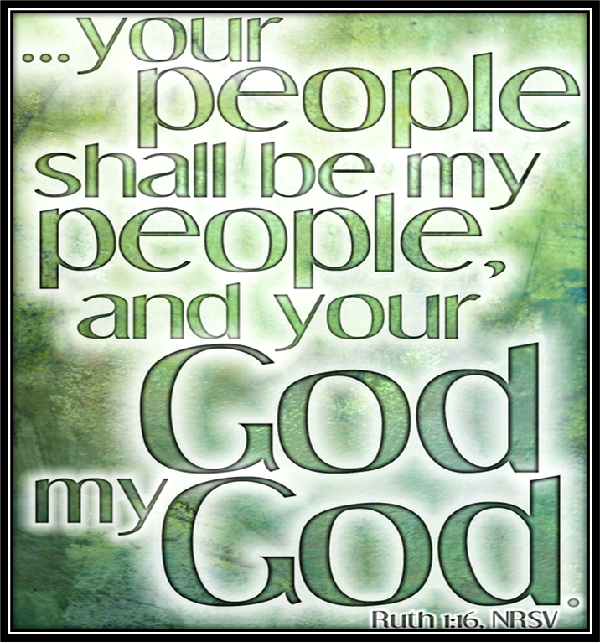
Sermon

Slide 36
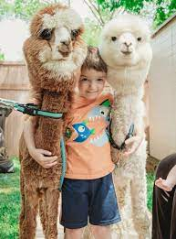
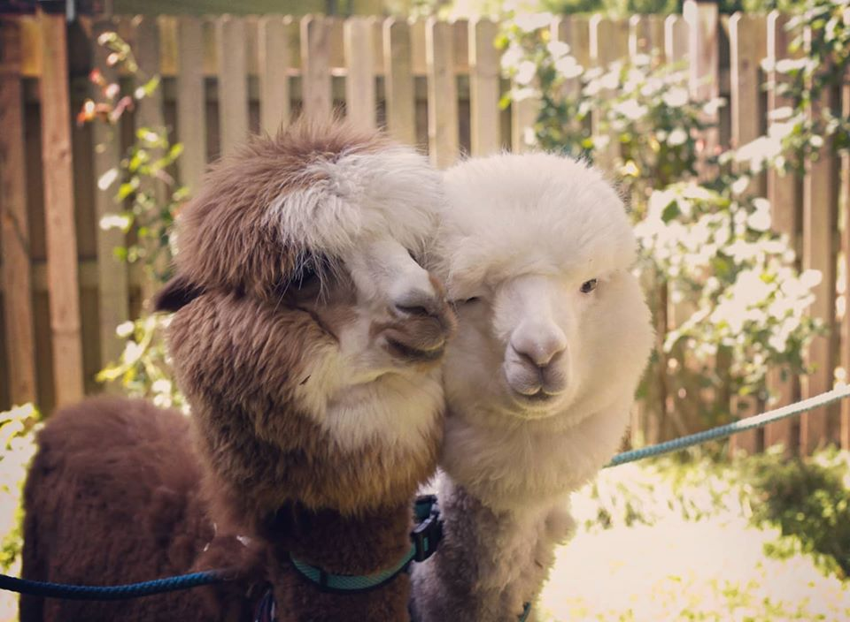
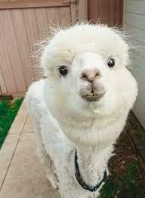
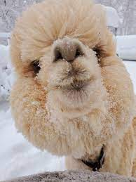
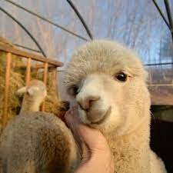
Sermon
Happily, Ever After…

Slide 37
Sermon
The Setting of Ruth
in the time of the Judges

Slide 38
Sermon
The Writing of Ruth
After the Return of the Exiles

Slide 39
Sermon

Slide 40
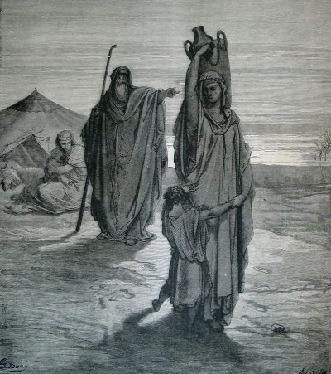
Sermon

Slide 41
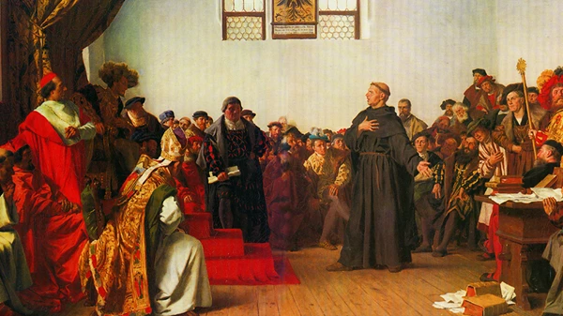
Sermon

Slide 42
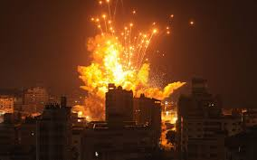
Sermon

Slide 43
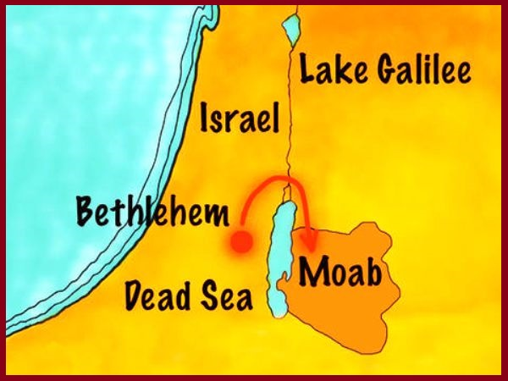
Sermon

Slide 44
Sermon
Ruth’s Family Tree
Naomi
Ruth
Boaz
Obed
Jesse
David
Jesus

Slide 45
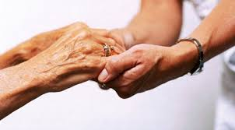
Sermon

Slide 46
Sermon

Slide 47
Hymn of the Day
XXX
XX

Slide 48
XXXX

Slide 49
APOSTLE’S CREED
C: I believe in God, the Father almighty, creator of heaven and earth.

Slide 50
APOSTLE’S CREED
C: I believe in Jesus Christ, his only Son, our Lord. He was conceived by the power of the Holy Spirit and born of the virgin Mary. He suffered under Pontius Pilate, was crucified, died, and was buried.

Slide 51
APOSTLE’S CREED
C: He descended into hell. On the third day he rose again. He ascended into heaven, and is seated at the right hand of the Father. He will come again to judge the living and the dead.

Slide 52
APOSTLE’S CREED
C: I believe in the Holy Spirit, the holy catholic Church, the communion of saints, the forgiveness of sins, the resurrection of the body, and the life everlasting. Amen.

Slide 53
NICENE CREED
C: We believe in one God, the Father, the Almighty, maker of heaven and earth, of all that is, seen and unseen.

Slide 54
NICENE CREED
C: We believe in one Lord, Jesus Christ, the only Son of God, eternally begotten of the Father, God from God, Light from Light, true God from true God, begotten, not made, of one Being with the Father.

Slide 55
NICENE CREED
C: Through him all things were made. For us and for our salvation he came down from heaven; by the power of the Holy Spirit he became incarnate from the virgin Mary, and was made man. For our sake he was crucified under Pontius Pilate;

Slide 56
NICENE CREED
C: he suffered death and was buried. On the third day he rose again in accordance with the Scriptures; he ascended into heaven and is seated at the right hand of the Father. He will come again in glory to judge the living and the dead, and his kingdom will have no end.

Slide 57
NICENE CREED
C: We believe in the Holy Spirit, the Lord, the giver of life, who proceeds from the Father and the Son. With the Father and the Son he is worshiped and glorified. He has spoken through the prophets. We believe in one holy catholic and apostolic Church.

Slide 58
NICENE CREED
C: We acknowledge one Baptism for the forgiveness of sins. We look for the resurrection of the dead, and the life of the world to come. Amen.

Slide 59
QUILT TYING AND PRESENTATION
This Quilt was lovingly crafted for recovery and healing especially for XXX.
Let us pray…

Slide 60
PRAYERS OF INTERCESSION
Each petition will end with the words,
A: Eternal God,
The congregation will respond with:
C: In mercy, hear our prayer.

Slide 61
PRAYERS OF INTERCESSION
The prayer concludes…
P: We place in your loving arms these, our prayers, spoken and unspoken, trusting in your boundless mercy, though Jesus Christ our Savior.
C: Amen.

Slide 62
SHARING OF THE Peace
The Sharing of the Peace that began when the congregation arrived is now shared with the Pastor at this time...
P: The peace of the Lord be with you always.
C: And also with you.

Slide 63
OFFERING
Notes:
Image: Five Loaves by Caroline Coolidge Brown. Copyright © Caroline Coolidge Brown. All rights reserved. Used by permission of the artist.

Slide 64
OFFERING PRAYER
Notes:
Image: Five Loaves by Caroline Coolidge Brown. Copyright © Caroline Coolidge Brown. All rights reserved. Used by permission of the artist.

Slide 65
THE GREAT THANKSGIVING
All the Baptized are welcome to celebrate this Holy Meal.

Slide 66
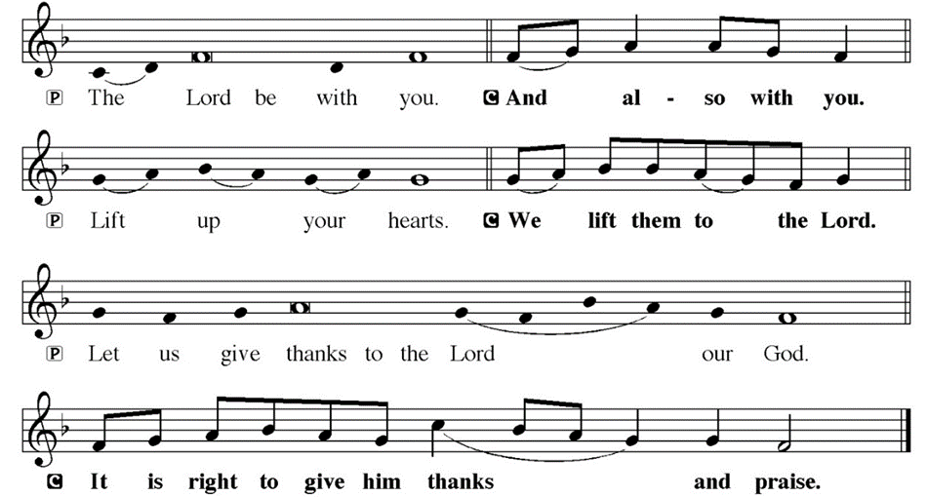
DIALOGUE

Slide 67
THE PREFACE
P: It is indeed right and salutary…
… we praise your name and join their unending hymn.

Slide 68
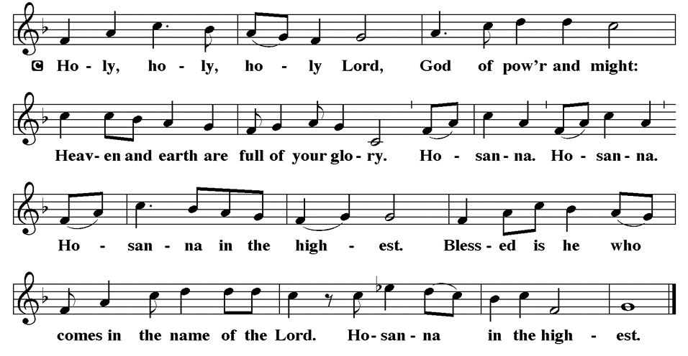
THE SANCTUS

Slide 69
EUCHARISTIC PRAYER
P: Holy God…
…both now and forever.
C: Amen.

Slide 70
THE LORD’S PRAYER
C: Our Father, who art in heaven, hallowed be thy name, thy kingdom come, thy will be done, on earth as it is in heaven. Give us this day our daily bread; and forgive us our trespasses, as we forgive those who trespass against us; and lead us not into temptation, but deliver us from evil.

Slide 71
THE LORD’S PRAYER
C: For thine is the kingdom, and the power, and the glory, forever and ever. Amen.

Slide 72
INVITATION TO COMMUNION
P: Jesus who will never leave us now invites us to the table to share in the feast of life. Come and dine, for all is prepared for you.

Slide 73
COMMUNION DISTRIBUTION
All will commune “By Station”.
The bread may be broken for distribution. As the ministers give the bread and wine, they say these words :
The body of Christ, given for you.
The blood of Christ, shed for you.
The communicant may say: Amen.

Slide 74
POST COMMUNION BLESSING
P: May this body and blood of our Lord and Savior, Jesus Christ, strengthen, keep, and unity us, ☩ now and forever,
C: Amen.

Slide 75
POST COMMUNION CANTACLE

Slide 76
POST COMMUNION CANTACLE

Slide 77
POST COMMUNION PRAYER
P: Let us pray… Blessed be your name, O God, for we have feasted on your Word, Christ Jesus, the joy and delight of our hearts. Strengthened by this food, send us to gather the world to your banquet, where none are left out and all are satisfied. In Jesus’ name we pray.
C: Amen

Slide 78
ANNOUNCEMENTS
Notes:
Image: Five Loaves by Caroline Coolidge Brown. Copyright © Caroline Coolidge Brown. All rights reserved. Used by permission of the artist.

Slide 79
SENDING BLESSING
P: The God of glory, Jesus Christ, name above all names, and the Spirit who lives in you, bless you † now and forever.
C: Amen.

Slide 80
Sending Song
“Abide with Me”
LBW 272
Notes:
Image: Five Loaves by Caroline Coolidge Brown. Copyright © Caroline Coolidge Brown. All rights reserved. Used by permission of the artist.

Slide 81
“Abide with Me” LBW 272
1 Abide with me, fast falls the eventide.
The darkness deepens; Lord, with me abide.
When other helpers fail and comforts flee,
help of the helpless, oh, abide with me.
Notes:
Image: Preparing yeast dough. Copyright © tomasworks/iStock/Thinkstock. Used by permission.

Slide 82
“Abide with Me” LBW 272
2 I need thy presence ev’ry passing hour;
what but thy grace can foil the tempter’s pow’r?
Who like thyself my guide and stay can be?
Through cloud and sunshine, oh, abide with me.
Notes:
Image: Preparing yeast dough. Copyright © tomasworks/iStock/Thinkstock. Used by permission.

Slide 83
“Abide with Me” LBW 272
3 Swift to its close ebbs out life’s little day;
earth’s joys grow dim, its glories pass away;
change and decay in all around I see;
O thou who changest not, abide with me.
Notes:
Image: Preparing yeast dough. Copyright © tomasworks/iStock/Thinkstock. Used by permission.

Slide 84
“Abide with Me” LBW 272
4 I fear no foe, with thee at hand to bless;
ills have no weight, and tears no bitterness.
Where is death’s sting? Where, grave, thy victory?
I triumph still, if thou abide with me!
Notes:
Image: Preparing yeast dough. Copyright © tomasworks/iStock/Thinkstock. Used by permission.

Slide 85
“Abide with Me” LBW 272
5 Hold thou thy cross before my closing eyes,
shine through the gloom, and point me to the skies;
heav’n’s morning breaks, and earth’s vain shadows flee;
in life, in death, O Lord, abide with me.
Notes:
Image: Preparing yeast dough. Copyright © tomasworks/iStock/Thinkstock. Used by permission.

Slide 86
DISMISSAL
P: … Depart in Christ’s Love.
C: Seeking, welcoming, and serving all. Amen!
POSTLUDE
By
Roxanne Groff
From sundaysandseasons.com. Copyright © 2023 Augsburg Fortress. All rights reserved. Reprinted by permission under Augsburg Fortress Liturgies Annual License #SAS023830. New Revised Standard Version Bible, Copyright © 1989, Division of Christian Education of the National Council of the Churches of Christ in the United States of America. Used by permission. All rights reserved. Revised Common Lectionary, Copyright © 1992 Consultation on Common Texts, admin Augsburg Fortress. Used by permission.

