Slide 1
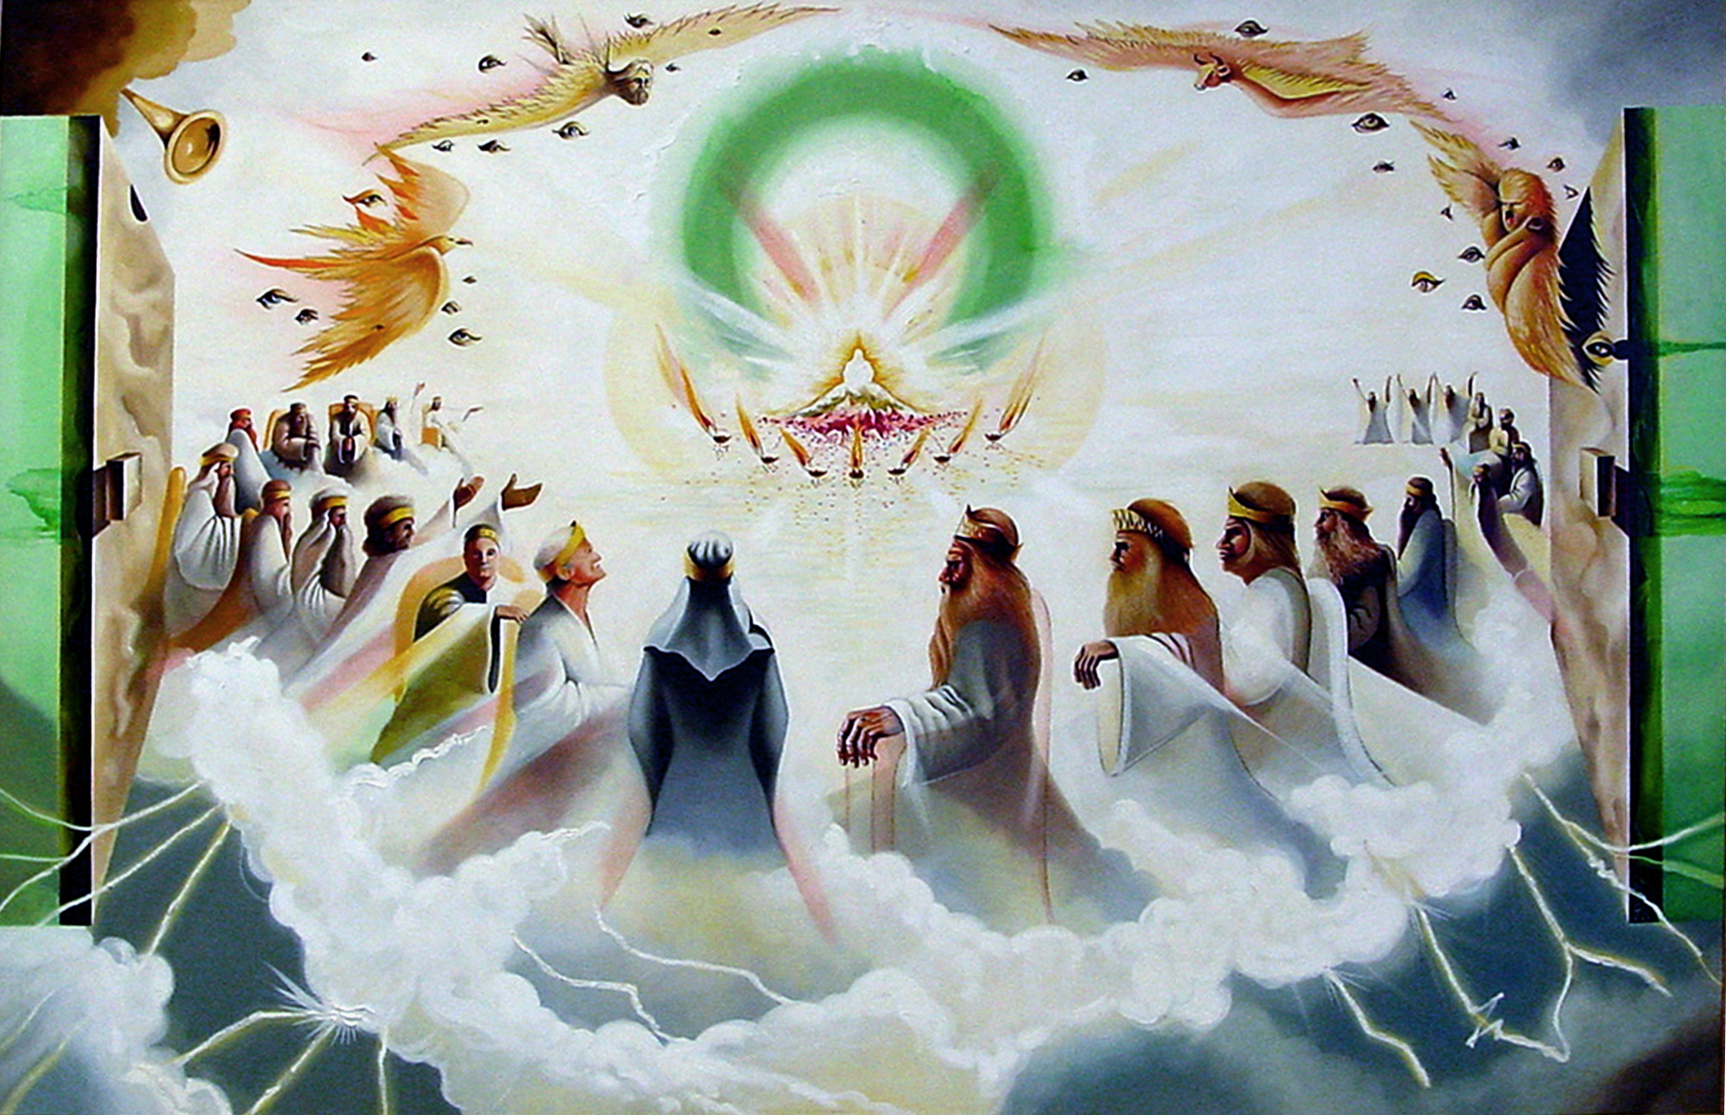
August 3, 2025
WELCOME!
Trinity Lutheran Church
Notes:
Image: Five Loaves by Caroline Coolidge Brown. Copyright © Caroline Coolidge Brown. All rights reserved. Used by permission of the artist.

Slide 2
= Please stand if able
= Please be seated
Prelude - By Pam Sherman
Office of the Acolyte
Ringing of the Bell
Welcome

Slide 3
CONFESSION AND FORGIVENESS
All may make the sign of the cross, the sign marked at baptism…
P: We confess our sins before God and one another.
Pause for silence and reflection.
P: Merciful and Holy God,
Notes:
Image: Five Loaves by Caroline Coolidge Brown. Copyright © Caroline Coolidge Brown. All rights reserved. Used by permission of the artist.

Slide 4
CONFESSION AND FORGIVENESS
C: We confess to you our deep and unrelenting fears about the state of our world. We confess that we let these fears paralyze us, so that we do not do what you have called us to do. We confess that we let these fears drive us, so that we act out against you, ourselves, and our neighbors.
Notes:
Image: Five Loaves by Caroline Coolidge Brown. Copyright © Caroline Coolidge Brown. All rights reserved. Used by permission of the artist.

Slide 5
CONFESSION AND FORGIVENESS
C: Forgive us for our unfaithfulness. Call us back into your loving arms and remind us that you are our God and we are your children. Restore us to sanity and inspire us to live out your will in our lives each day, for the sake of all creation.
Notes:
Image: Five Loaves by Caroline Coolidge Brown. Copyright © Caroline Coolidge Brown. All rights reserved. Used by permission of the artist.

Slide 6
CONFESSION AND FORGIVENESS
P: The one who is seated on the throne proclaims, “See, I make all things new!” God claims you in unfailing love and in Jesus you are a new creation. Know that you are forgiven, and go forth strengthened in that knowledge, in the name of Jesus, our savior and friend.
C: Amen.
Notes:
Image: Five Loaves by Caroline Coolidge Brown. Copyright © Caroline Coolidge Brown. All rights reserved. Used by permission of the artist.

Slide 7
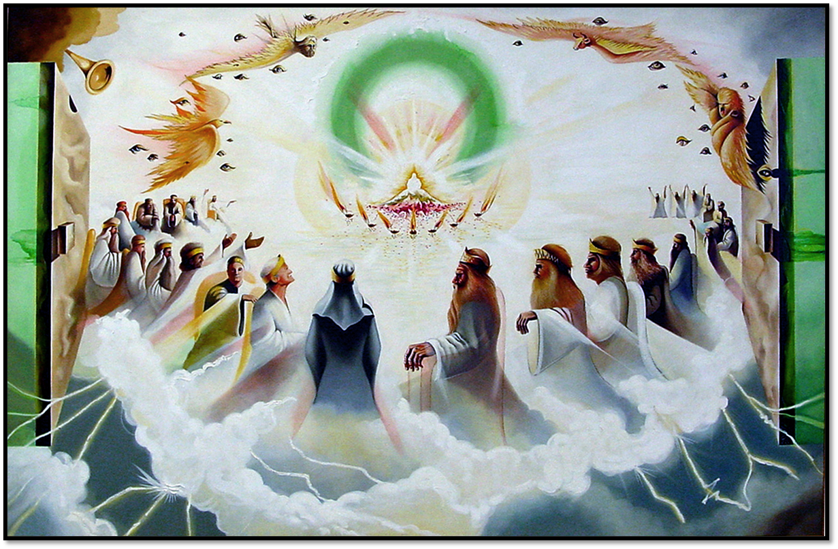
Gathering Song
“Earth and All Stars!”
LBW 558
(Vs 1-4 Only)

Slide 8
“Earth and All Stars!”
LBW 558 (Vs 1-4 Only)
1 Earth and all stars! Loud rushing planets!
Sing to the Lord a new song!
Oh, victory! Loud shouting army!
Sing to the Lord a new song!
Refrain
He has done marvelous things.
I too will praise him with a new song!
Notes:
Image: Five Loaves by Caroline Coolidge Brown. Copyright © Caroline Coolidge Brown. All rights reserved. Used by permission of the artist.

Slide 9
“Earth and All Stars!”
LBW 558 (Vs 1-4 Only)
2 Hail, wind, and rain! Loud blowing snowstorm!
Sing to the Lord a new song!
Flowers and trees! Loud rustling dry leaves!
Sing to the Lord a new song! Refrain
He has done marvelous things.
I too will praise him with a new song!
Notes:
Image: Five Loaves by Caroline Coolidge Brown. Copyright © Caroline Coolidge Brown. All rights reserved. Used by permission of the artist.

Slide 10
“Earth and All Stars!”
LBW 558 (Vs 1-4 Only)
3 Trumpet and pipes! Loud clashing cymbals!
Sing to the Lord a new song!
Harp, lute, and lyre! Loud humming cellos!
Sing to the Lord a new song! Refrain
He has done marvelous things.
I too will praise him with a new song!
Notes:
Image: Five Loaves by Caroline Coolidge Brown. Copyright © Caroline Coolidge Brown. All rights reserved. Used by permission of the artist.

Slide 11
“Earth and All Stars!”
LBW 558 (Vs 1-4 Only)
4 Engines and steel! Loud pounding hammers!
Sing to the Lord a new song!
Limestone and beams! Loud building workers!
Sing to the Lord a new song! Refrain
He has done marvelous things.
I too will praise him with a new song!
Notes:
Image: Five Loaves by Caroline Coolidge Brown. Copyright © Caroline Coolidge Brown. All rights reserved. Used by permission of the artist.

Slide 12
APOSTOLIC GREETING
P: The grace of our Lord Jesus Christ, the love of God, and the communion of the Holy Spirit be with you all.
C: And also with you.
Notes:
Image: Five Loaves by Caroline Coolidge Brown. Copyright © Caroline Coolidge Brown. All rights reserved. Used by permission of the artist.

Slide 13
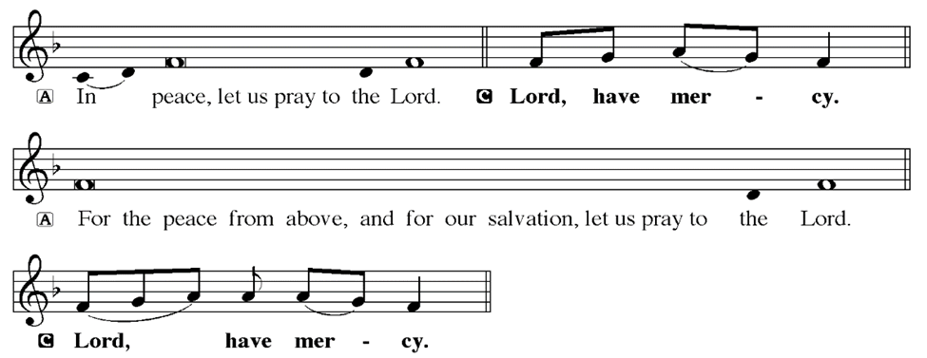
KYRIE
Notes:
Image: Five Loaves by Caroline Coolidge Brown. Copyright © Caroline Coolidge Brown. All rights reserved. Used by permission of the artist.

Slide 14
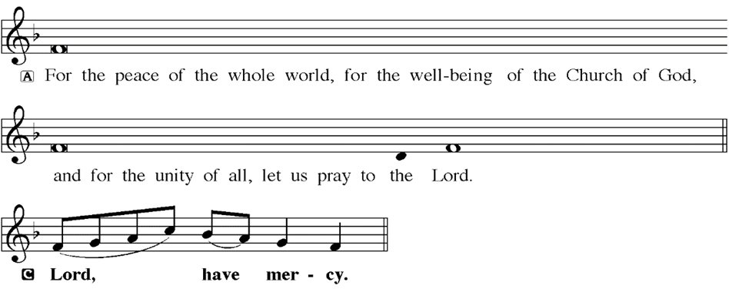
KYRIE
Notes:
Image: Five Loaves by Caroline Coolidge Brown. Copyright © Caroline Coolidge Brown. All rights reserved. Used by permission of the artist.

Slide 15
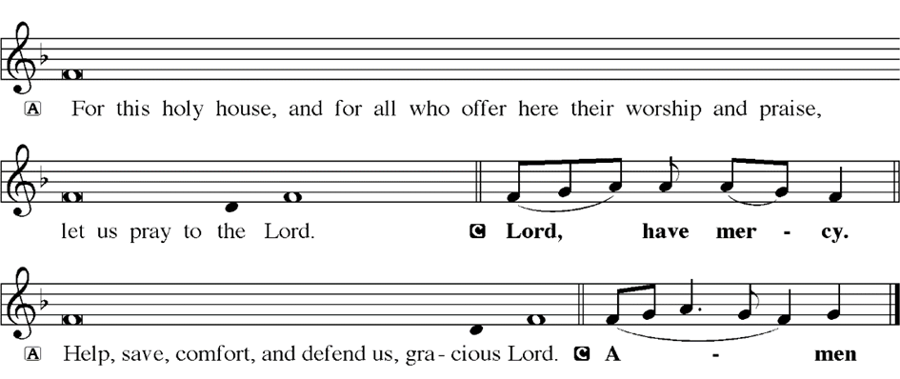
KYRIE
Notes:
Image: Five Loaves by Caroline Coolidge Brown. Copyright © Caroline Coolidge Brown. All rights reserved. Used by permission of the artist.

Slide 16
HYMN OF PRAISE
Glory be to God in heaven;
peace, goodwill to all the earth.
Mighty God of all creation,
Father of surpassing worth:
we exalt you, we adore you,
we lift high our thanks and praise.
Saints and angels bow before you; here on earth our songs we raise.
Notes:
Image: Five Loaves by Caroline Coolidge Brown. Copyright © Caroline Coolidge Brown. All rights reserved. Used by permission of the artist.

Slide 17
HYMN OF PRAISE
Glory be to Christ forever,
Lamb of God and Lord of love.
Son of God and gracious Savior, you have come from heav’n above;
on the cross you died to save us; now you reign at God’s right hand.
Hear our prayer; restore, forgive us; in your promise firm we stand.
Notes:
Image: Five Loaves by Caroline Coolidge Brown. Copyright © Caroline Coolidge Brown. All rights reserved. Used by permission of the artist.

Slide 18
HYMN OF PRAISE
Holy One we now acclaim you;
Lord alone, to you we call;
Holy One in faith we name you,
God most high, yet near to all:
Jesus Christ, with God the Spirit,
in the Father’s splendor bright.
For the peace that we inherit,
glory be to God on high!
Notes:
Image: Five Loaves by Caroline Coolidge Brown. Copyright © Caroline Coolidge Brown. All rights reserved. Used by permission of the artist.

Slide 19
PRAYER OF THE DAY
P: Let us pray… Incomprehensible God, we gather to dive deep into the mystery and wonder of your love and presence in our lives. Shake us out of our complacency and half-hearted attention, and wake us fully to the reality that you are here among us, working in and through us, giving us life and that abundantly. Light a fire in our hearts that we might worship you in joy, and then carry that joy out into a world deeply in need of it. In Jesus’ holy name we pray.
C: Amen
Notes:
Image: Five Loaves by Caroline Coolidge Brown. Copyright © Caroline Coolidge Brown. All rights reserved. Used by permission of the artist.

Slide 20

Notes:
Image: Five Loaves by Caroline Coolidge Brown. Copyright © Caroline Coolidge Brown. All rights reserved. Used by permission of the artist.

Slide 21
Scripture Reading
L: Our scripture reading is from Revelation, Chapter 4.
C: Glory to you O’ Lord!
Notes:
Image: Five Loaves by Caroline Coolidge Brown. Copyright © Caroline Coolidge Brown. All rights reserved. Used by permission of the artist.

Slide 22
Revelation 4:1-11
After this I looked, and there in heaven a door stood open! And the first voice, which I had heard speaking to me like a trumpet, said, ‘Come up here, and I will show you what must take place after this.’ ²At once I was in the spirit, and there in heaven stood a throne, with one seated on the throne! ³And the one seated there looks like jasper and
Notes:
Image: Five Loaves by Caroline Coolidge Brown. Copyright © Caroline Coolidge Brown. All rights reserved. Used by permission of the artist.

Slide 23
Revelation 4:1-11
cornelian, and around the throne is a rainbow that looks like an emerald. ⁴Around the throne are twenty-four thrones, and seated on the thrones are twenty-four elders, dressed in white robes, with golden crowns on their heads. ⁵Coming from the throne are flashes of lightning, and rumblings and peals of thunder, and in front of the throne burn seven
Notes:
Image: Five Loaves by Caroline Coolidge Brown. Copyright © Caroline Coolidge Brown. All rights reserved. Used by permission of the artist.

Slide 24
Revelation 4:1-11
flaming torches, which are the seven spirits of God; ⁶and in front of the throne there is something like a sea of glass, like crystal.
Around the throne, and on each side of the throne, are four living creatures, full of eyes in front and behind: ⁷the first living creature like a lion, the second living creature like an ox, the third living creature with a
Notes:
Image: Five Loaves by Caroline Coolidge Brown. Copyright © Caroline Coolidge Brown. All rights reserved. Used by permission of the artist.

Slide 25
Revelation 4:1-11
face like a human face, and the fourth living creature like a flying eagle. ⁸And the four living creatures, each of them with six wings, are full of eyes all around and inside. Day and night without ceasing they sing,
‘Holy, holy, holy,
the Lord God the Almighty,
who was and is and is to come.’
⁹And whenever the living creatures
Notes:
Image: Five Loaves by Caroline Coolidge Brown. Copyright © Caroline Coolidge Brown. All rights reserved. Used by permission of the artist.

Slide 26
Revelation 4:1-11
give glory and honor and thanks to the one who is seated on the throne, who lives for ever and ever, ¹⁰the twenty-four elders fall before the one who is seated on the throne and worship the one who lives for ever and ever; they cast their crowns before the throne, singing,
Notes:
Image: Five Loaves by Caroline Coolidge Brown. Copyright © Caroline Coolidge Brown. All rights reserved. Used by permission of the artist.

Slide 27
Revelation 4:1-11
¹¹‘You are worthy, our Lord and God, to receive glory and honor and power, for you created all things, and by your will they existed and were created.’
Notes:
Image: Five Loaves by Caroline Coolidge Brown. Copyright © Caroline Coolidge Brown. All rights reserved. Used by permission of the artist.

Slide 28
Revelation 4:1-11
R: This is the Word of the Lord.
C: Praise to You, O Christ
Notes:
Image: Five Loaves by Caroline Coolidge Brown. Copyright © Caroline Coolidge Brown. All rights reserved. Used by permission of the artist.

Slide 29

Sermon

Slide 30
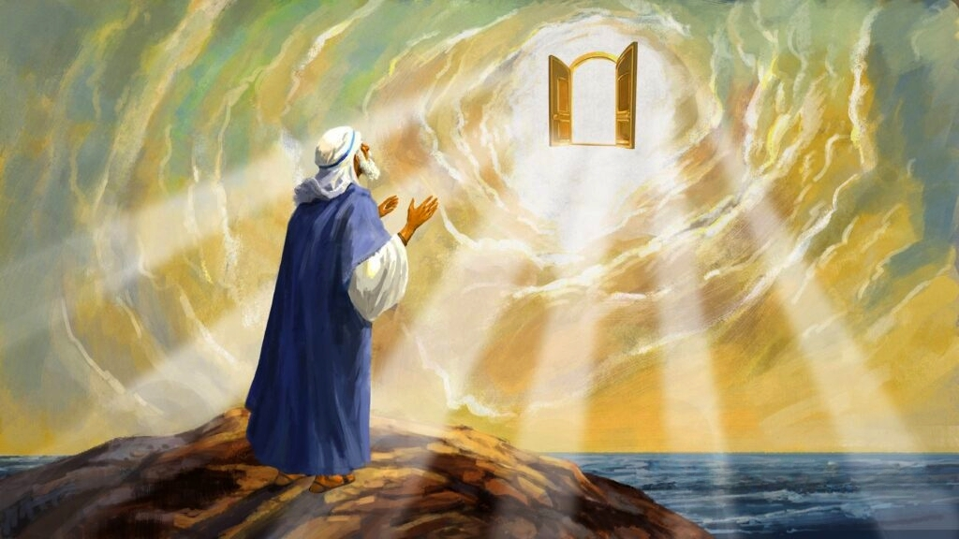
Sermon

Slide 31
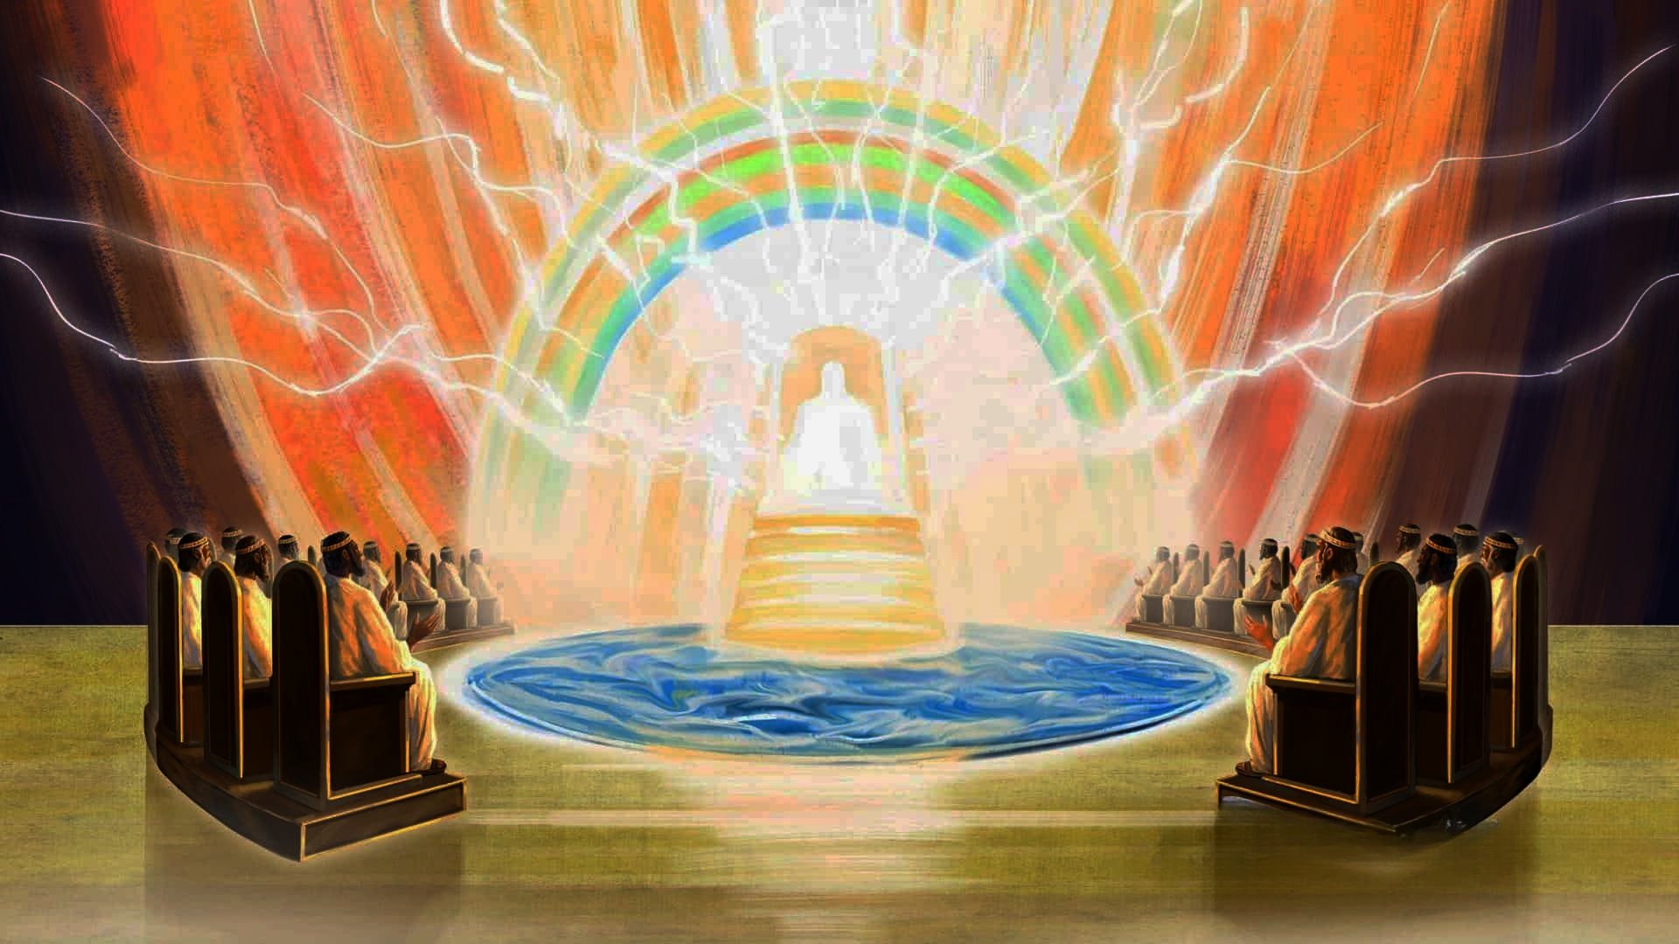
Sermon

Slide 32
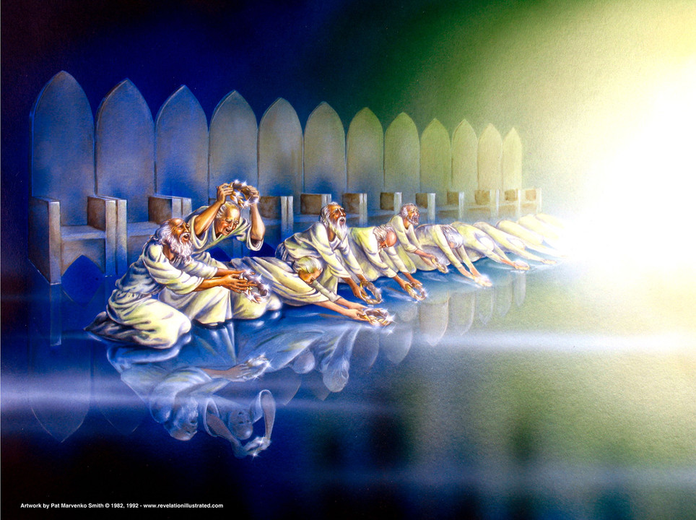
Sermon

Slide 33




Sermon

Slide 34

Sermon

Slide 35
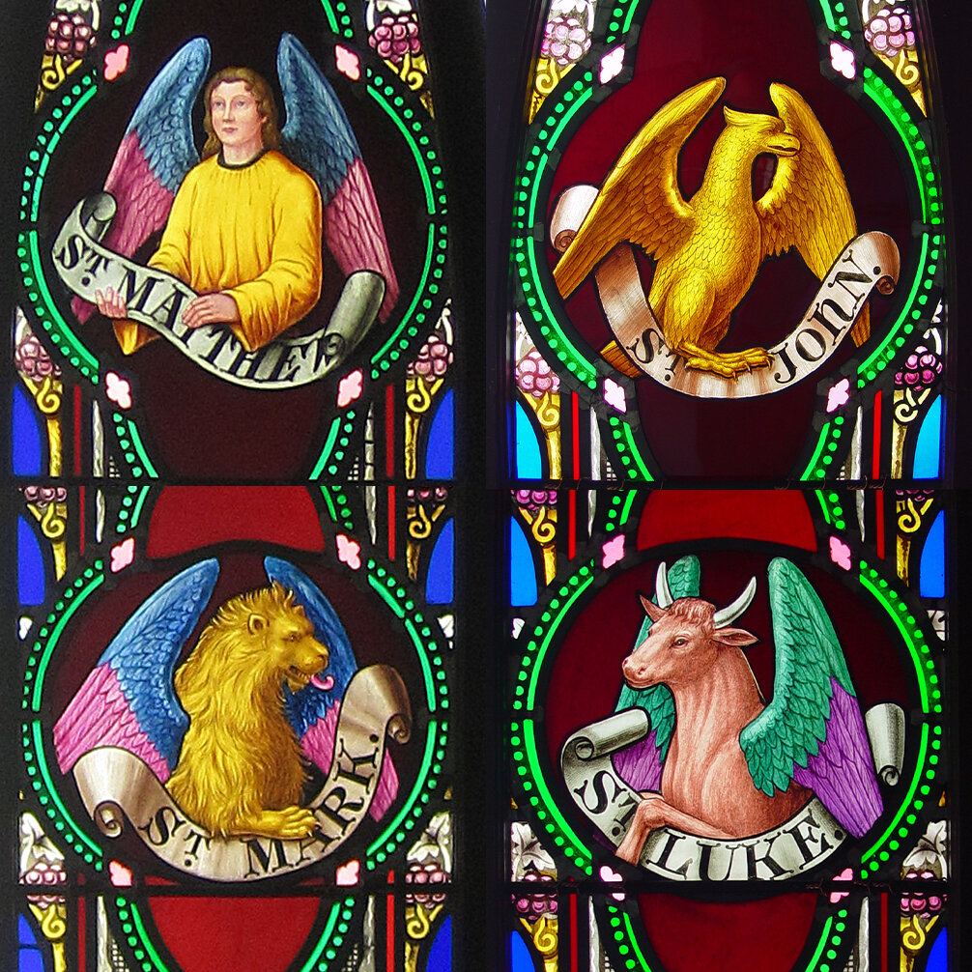
The Four Living Creatures
Singing Holy, Holy, Holy

Slide 36
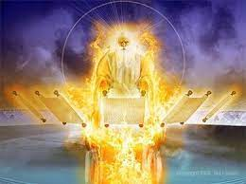

Slide 37
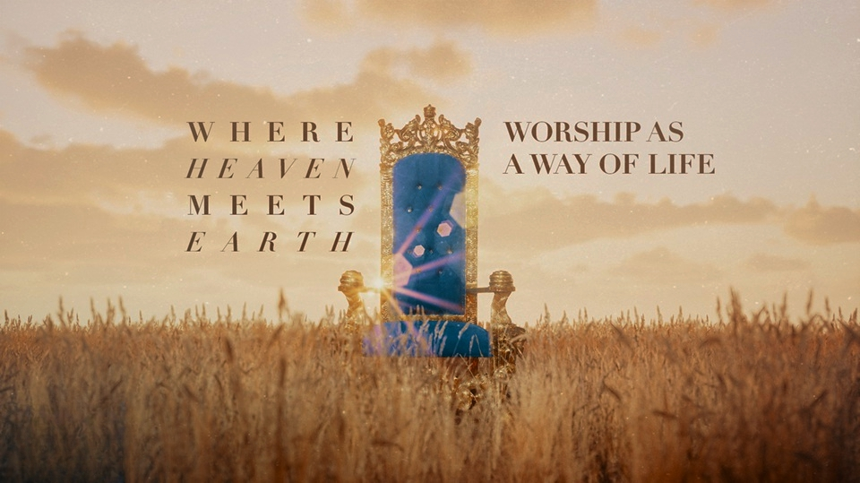
Sermon

Slide 38
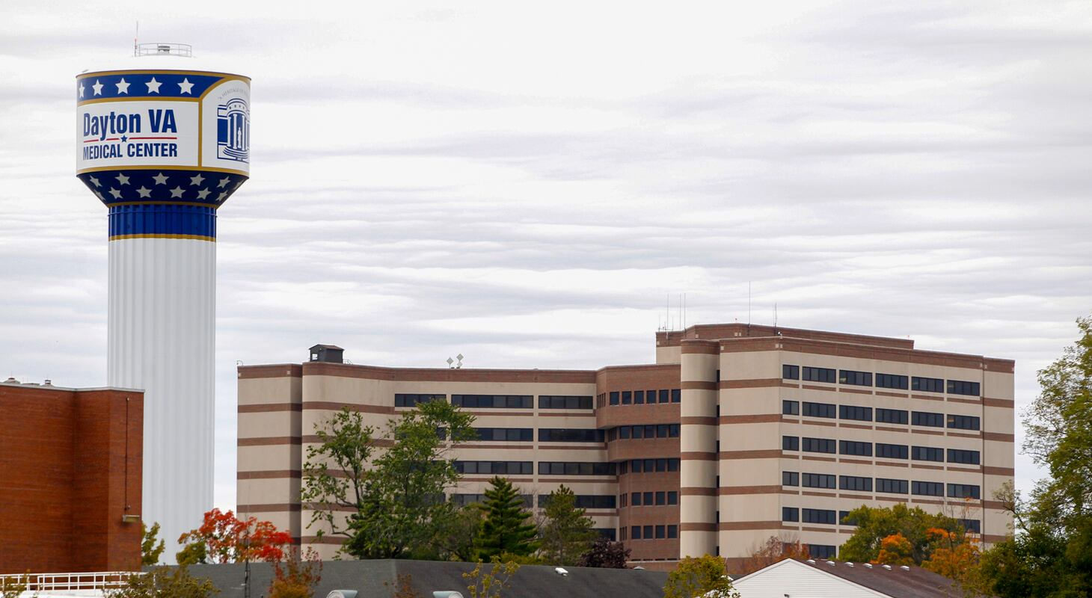
Sermon

Slide 39
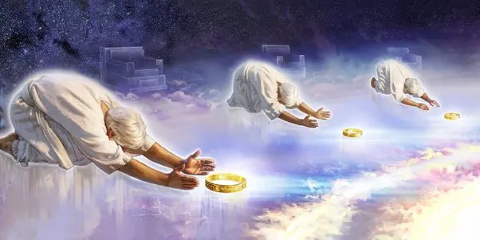
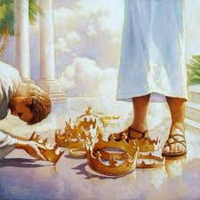
Sermon

Slide 40
APOSTLE’S CREED
C: I believe in God, the Father almighty, creator of heaven and earth.

Slide 41
APOSTLE’S CREED
C: I believe in Jesus Christ, his only Son, our Lord. He was conceived by the power of the Holy Spirit and born of the virgin Mary. He suffered under Pontius Pilate, was crucified, died, and was buried.

Slide 42
APOSTLE’S CREED
C: He descended into hell. On the third day he rose again. He ascended into heaven, and is seated at the right hand of the Father. He will come again to judge the living and the dead.

Slide 43
APOSTLE’S CREED
C: I believe in the Holy Spirit, the holy catholic Church, the communion of saints, the forgiveness of sins, the resurrection of the body, and the life everlasting. Amen.

Slide 44
NICENE CREED
C: We believe in one God, the Father, the Almighty, maker of heaven and earth, of all that is, seen and unseen.

Slide 45
NICENE CREED
C: We believe in one Lord, Jesus Christ, the only Son of God, eternally begotten of the Father, God from God, Light from Light, true God from true God, begotten, not made, of one Being with the Father.

Slide 46
NICENE CREED
C: Through him all things were made. For us and for our salvation he came down from heaven; by the power of the Holy Spirit he became incarnate from the virgin Mary, and was made man. For our sake he was crucified under Pontius Pilate;

Slide 47
NICENE CREED
C: he suffered death and was buried. On the third day he rose again in accordance with the Scriptures; he ascended into heaven and is seated at the right hand of the Father. He will come again in glory to judge the living and the dead, and his kingdom will have no end.

Slide 48
NICENE CREED
C: We believe in the Holy Spirit, the Lord, the giver of life, who proceeds from the Father and the Son. With the Father and the Son he is worshiped and glorified. He has spoken through the prophets. We believe in one holy catholic and apostolic Church.

Slide 49
NICENE CREED
C: We acknowledge one Baptism for the forgiveness of sins. We look for the resurrection of the dead, and the life of the world to come. Amen.

Slide 50
PRAYERS
Each petition will end with the words,
A: Alpha and Omega,
C: Hear our prayer.

Slide 51
PRAYERS OF INTERCESSION
The prayer concludes…
P: All things exist in and through you, loving God. Therefore we entrust our prayers, our faith, and our lives to you, in the name of Jesus.
C: Amen.

Slide 52

OFFERING/PRAYER
Notes:
Image: Five Loaves by Caroline Coolidge Brown. Copyright © Caroline Coolidge Brown. All rights reserved. Used by permission of the artist.

Slide 53
THE GREAT THANKSGIVING
All the Baptized are welcome to celebrate this Holy Meal.

Slide 54
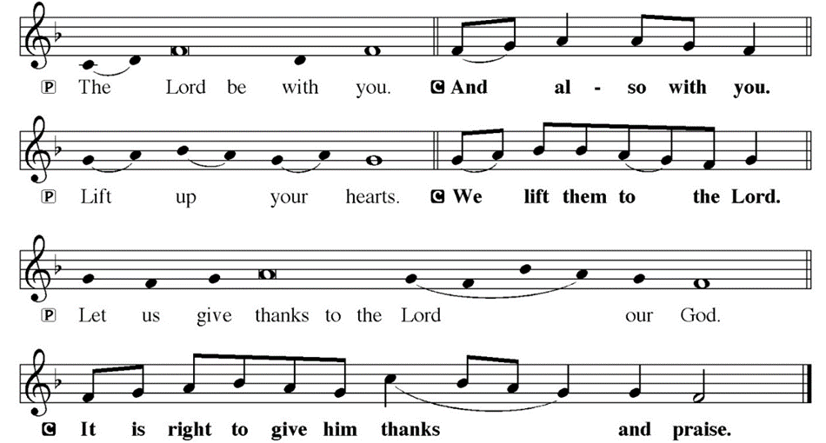
DIALOGUE

Slide 55
THE PREFACE
P: It is indeed right and salutary…
… we praise your name and join their unending hymn.

Slide 56
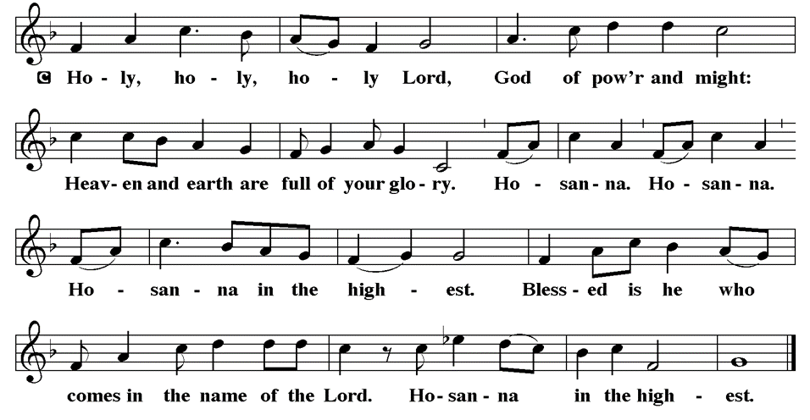
THE SANCTUS

Slide 57
EUCHARISTIC PRAYER
P: Holy God, our maker and redeemer…
…both now and forever.
C: Amen.

Slide 58
THE LORD’S PRAYER
C: Our Father, who art in heaven, hallowed be thy name, thy kingdom come, thy will be done, on earth as it is in heaven. Give us this day our daily bread; and forgive us our trespasses, as we forgive those who trespass against us; and lead us not into temptation, but deliver us from evil.

Slide 59
THE LORD’S PRAYER
C: For thine is the kingdom, and the power, and the glory, forever and ever. Amen.

Slide 60
INVITATION TO COMMUNION
P: The one who was, and who is, and who is to come, is here at this table, and invites you into his presence at this holy meal. Come and be fed on the body and blood of Jesus, that you might be strengthened for the work of revealing his reign.

Slide 61
COMMUNION DISTRIBUTION
All will commune “At the Railing”.
The bread may be broken for distribution. As the ministers give the bread and wine, they say these words :
The body of Christ, given for you.
The blood of Christ, shed for you.
The communicant may say: Amen.

Slide 62
POST COMMUNION CANTACLE

Slide 63
POST COMMUNION CANTACLE

Slide 64
POST COMMUNION PRAYER
P: Holy God, you gathered us to your table and we drank deeply of your grace. Send us out by your Spirit to love our neighbors as ourselves and proclaim your love in Jesus’ name.
C: Amen.

Slide 65
SENDING OF HOMEBOUND COMMUNION
P: Gracious God, whose mercy endures from generation to generation: bless those who go forth to share your word and sacrament with our sisters and brothers who are sick or homebound.

Slide 66
SENDING OF HOMEBOUND COMMUNION
P: In your love and care, nourish and strengthen those to whom we bring this communion, that through the body and blood of your Son we may all know the hope of your promised coming in Jesus Christ our Lord.
C: Amen.

Slide 67

ANNOUNCEMENTS
Notes:
Image: Five Loaves by Caroline Coolidge Brown. Copyright © Caroline Coolidge Brown. All rights reserved. Used by permission of the artist.

Slide 68
SENDING BLESSING
P: The love of God abound in you; the grace of our Savior Jesus Christ fill your hearts; and the life of the Spirit bless you ☩ and give you peace.
C: Amen.

Slide 69

Sending Song
“Immortal, Invisible, God Only Wise”
LBW 526
Notes:
Image: Five Loaves by Caroline Coolidge Brown. Copyright © Caroline Coolidge Brown. All rights reserved. Used by permission of the artist.

Slide 70
“Immortal, Invisible, God Only Wise”
LBW 526
1 Immortal, invisible, God only wise,
in light inaccessible hid from our eyes,
most blessed, most glorious, the Ancient of Days,
almighty, victorious, thy great name we praise!
Notes:
Image: Preparing yeast dough. Copyright © tomasworks/iStock/Thinkstock. Used by permission.

Slide 71
“Immortal, Invisible, God Only Wise”
LBW 526
2 Unresting, unhasting, and silent as light,
nor wanting, nor wasting, thou rulest in might;
thy justice like mountains high soaring above
thy clouds which are fountains of goodness and love.
Notes:
Image: Preparing yeast dough. Copyright © tomasworks/iStock/Thinkstock. Used by permission.

Slide 72
“Immortal, Invisible, God Only Wise”
LBW 526
3 To all, life thou givest, to both great and small;
in all life thou livest, the true life of all;
we blossom and flourish like leaves on the tree,
and wither and perish, but naught changeth thee.
Notes:
Image: Preparing yeast dough. Copyright © tomasworks/iStock/Thinkstock. Used by permission.

Slide 73
“Immortal, Invisible, God Only Wise”
LBW 526
4 Thou reignest in glory; thou dwellest in light;
thine angels adore thee, all veiling their sight;
all laud we would render; oh, help us to see
'tis only the splendor of light hideth thee!
Notes:
Image: Preparing yeast dough. Copyright © tomasworks/iStock/Thinkstock. Used by permission.

Slide 74
DISMISSAL
P: … Depart in Christ’s Love.
C: Seeking, welcoming, and serving all. Amen!
POSTLUDE
By
Pam Sherman
From sundaysandseasons.com. Copyright © 2025 Augsburg Fortress. All rights reserved. Reprinted by permission under Augsburg Fortress Liturgies Annual License #SAS023830. New Revised Standard Version Bible, Copyright © 1989, Division of Christian Education of the National Council of the Churches of Christ in the United States of America. Used by permission. All rights reserved. Revised Common Lectionary, Copyright © 1992 Consultation on Common Texts, admin Augsburg Fortress. Used by permission.

