Slide 1

Announcements
Trinity Lutheran Church
October 18, 2026

Slide 2


Slide 3

Body, Mind, Spirit
MIND: Volunteer in the community.
BODY: Walk a corn maze or trail.
SPIRIT: Pray for youth ministries.

Slide 4


Our Office Secretary Is Sharon Fourman
Church Office Schedule
Sharon will on Vacation 10/19-10/23
Please make sure all your Annual Reports are submitted No Later Than October 25th
Office Phone: (937) 692-5670
Pastor’s Phone: (937) 626-7100
Email: secretary@pitsburgtlc.org

Slide 5

The Trinity Trumpet
A Monthly Newsletter
Published by Trinity Lutheran Church,
Pitsburg, OH
We’re looking for stories and pictures of Trinity people in action!
Submit to Secretary, Sharon Fourman at secretary@pitsburgtlc.org
Articles and Info due on or about the 3rd Tuesday of each month

Slide 6

Trinity Trumpet
    Newsletter Deadline is October 12, 2026
    Please turn in all your newsworthy items to Sharon Fourman at:
    secretary@pitsburgtlc.org

Slide 7
Trinity Trumpet
    Your Trinity Trumpet Newsletter for November 2026 is available!
    Please take your copy before you leave today!

Slide 8

We’re Online!
www.pitsburgtlc.org
Sermons, Bulletins (Worship Books), Worship Slides, and announcements are posted weekly
Trinity Trumpet and ‘Official’ Trinity Calendar are also available
Pictures, Videos and more!
Also, like us on FaceBook at
facebook.com/pitsburgtrinitylutheran.church

Slide 9

Online Giving
www.pitsburgtlc.org
Click the “Give to Trinity” Button
Stay current in your giving even when you can’t make it to Worship!
Separate Giving Categories for:
    General Treasury
    Benevolence/Mission Support
    Building Fund
    Annual Christmas Auction
    Memorial Funds
    Thrive Capital Campaign

Slide 10

    If you would like to sponsor the Altar Flowers, see PJ to Sign Up!
    Please let our Church Secretary, Sharon, know so she can put it in the Bulletin!

Slide 11


Church
Council
Trinity Church Council
Next Meeting is …
Wednesday, October 21
@ 7:00 pm

Slide 12


Choice FISH Pantry
Please join us every Friday @ 3:30 pm
400 Markwith Dr, Greenville OH
Most Needed Items
Kidney Beans
Canned Peas
Hamburger Helper
Pork & Beans
Canned Mixed Veggies
Large Cans of Soups
Applesauce
Boxed Meals
(i.e. Rice a Roni)

Slide 13
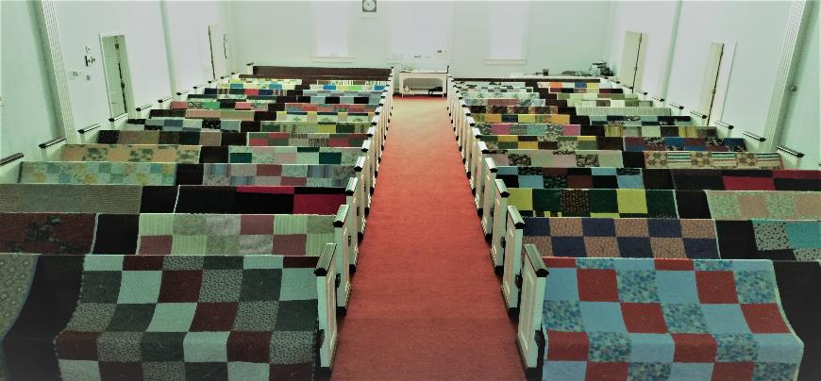
Prayers and Squares
Quilting Ministry
October 27 @ 10:00 am
November 12 @ 10:00 am

Slide 14

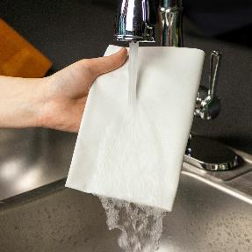
ULTIMATE CLEANING CLOTH SALE
1 for $7.00
2 for $10.00
5 for $20.00
See
  Portia Boord or Diane Warner

Slide 15

Next WELCA Meeting
November 4, 2026 @ 11:30 am

Slide 16
SAVE THE DATE!
Women’s Thankoffering Sunday
November 8th
Women Lead Worship Service
Fair Trade Merch

Slide 17


Ladies and Gents Luncheon
Date: November 19 @ 11:30 am
Where: ???
For Reservations/Questions:
        See Linda Baker or call her @ 937 545-8410

Slide 18

2026-2027
Confirmation Program
(7th and 8th Graders)
    Confirmation Classes (@ 9:00 am (ish…)
      Requirements:
        Weekly Attendance or Make-Up Work
        Weekly Sermon Notes (or Make-Up Work)
        Service Projects (Trash Bash, Christmas Shopping etc.)
        Final Oral Exam with Pr Mel

Slide 19
Confirmation Program
(7th and 8th Graders)
    For all Confirmation Students:
    Summer Assignments are PAST DUE NOW!!!
    Weekly Worship attendance is required in person or via FaceBook
    Worship Notes may be emailed to pastor@pitsburgtlc.org or placed in Pr Mel’s mailbox outside the Church Office
    Confirmands are HIGHLY encouraged to take turns as Acolyte

Slide 20

    Who can be an Acolyte? YOU CAN!!!
    Acolyte Training – As Needed
    Please sign up for Acolyte Duty on the chart by the Church Office!
    Confirmation Students are Highly Encouraged to perform Acolyte duty…
    Please sign up today!

Slide 21

Next Regular Meeting – Thursday, November 8th @ 10 am
Purpose – Plan for Christmas Program and more!!!
Please come if you can!

Slide 22

Calling all Adults!
Join Us For “Christian Conversations”
Not Your Ordinary Adult Sunday School
Sharing – Discussion - Prayer
Every Sunday @
9:30 am
Notes:
Cover: Sermon on the Mount by Laura James. Copyright © Laura James. All rights reserved. Used by permission of the artist.

Slide 23

The Chosen
Video Discussion Group
Next Meeting November 8, 2026
@ 6:00 pm

Slide 24
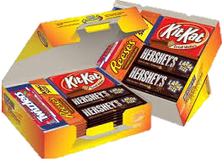
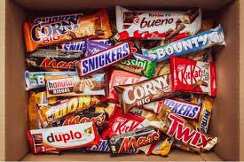
Trinity Youth
Fun (d) Raiser!
Candy Bar Sales!
Large Selection
$2 Each
Supports Our Youth
Notes:
Cover: Sermon on the Mount by Laura James. Copyright © Laura James. All rights reserved. Used by permission of the artist.

Slide 25

Trinity Troops
Date: TODAY!!!
Who: Youth 4th – 6th Grades and families
What: Fun, Snacks, Blanket Tying!
Where: @ Trinity
When: After Worship
Trinity Troops!

Slide 26

12th Annual
Trinity Fall Festival!
Save the Date: October 18, 2026
Time 3:00 – 5:00 pm
Food, Games, Prizes, & lots of fun!
Bring your Friends!

Slide 27
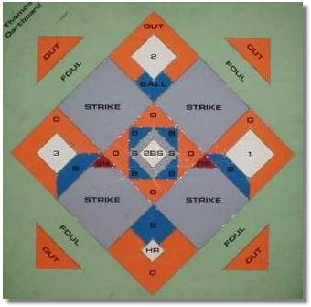


Monday
October 19, 2026
7:30 pm
Home Game vs St John’s Lutheran Church
Come Early to Help Set Up!!!

Slide 28


Slide 29
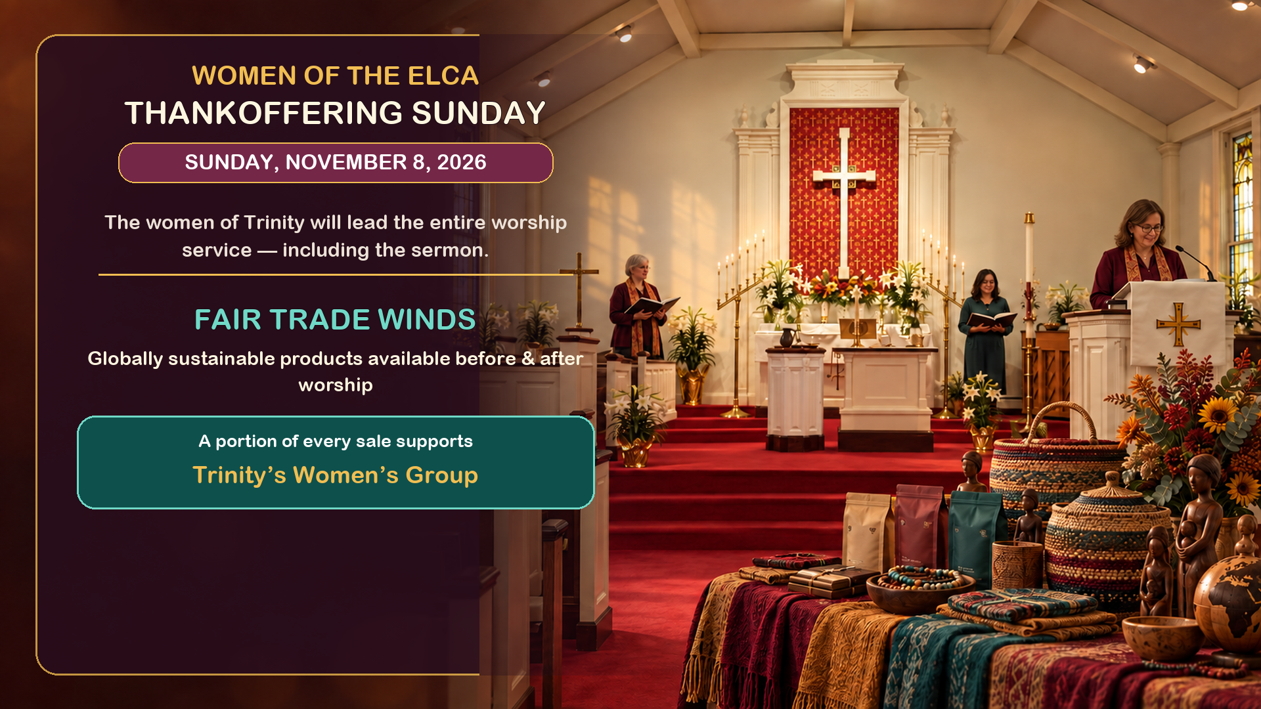

Slide 30
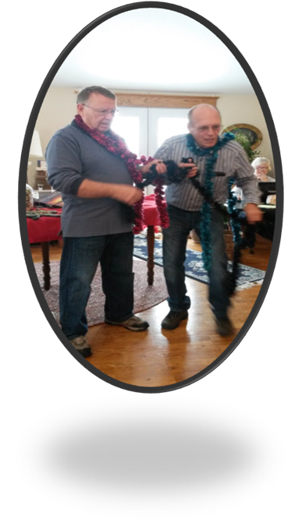
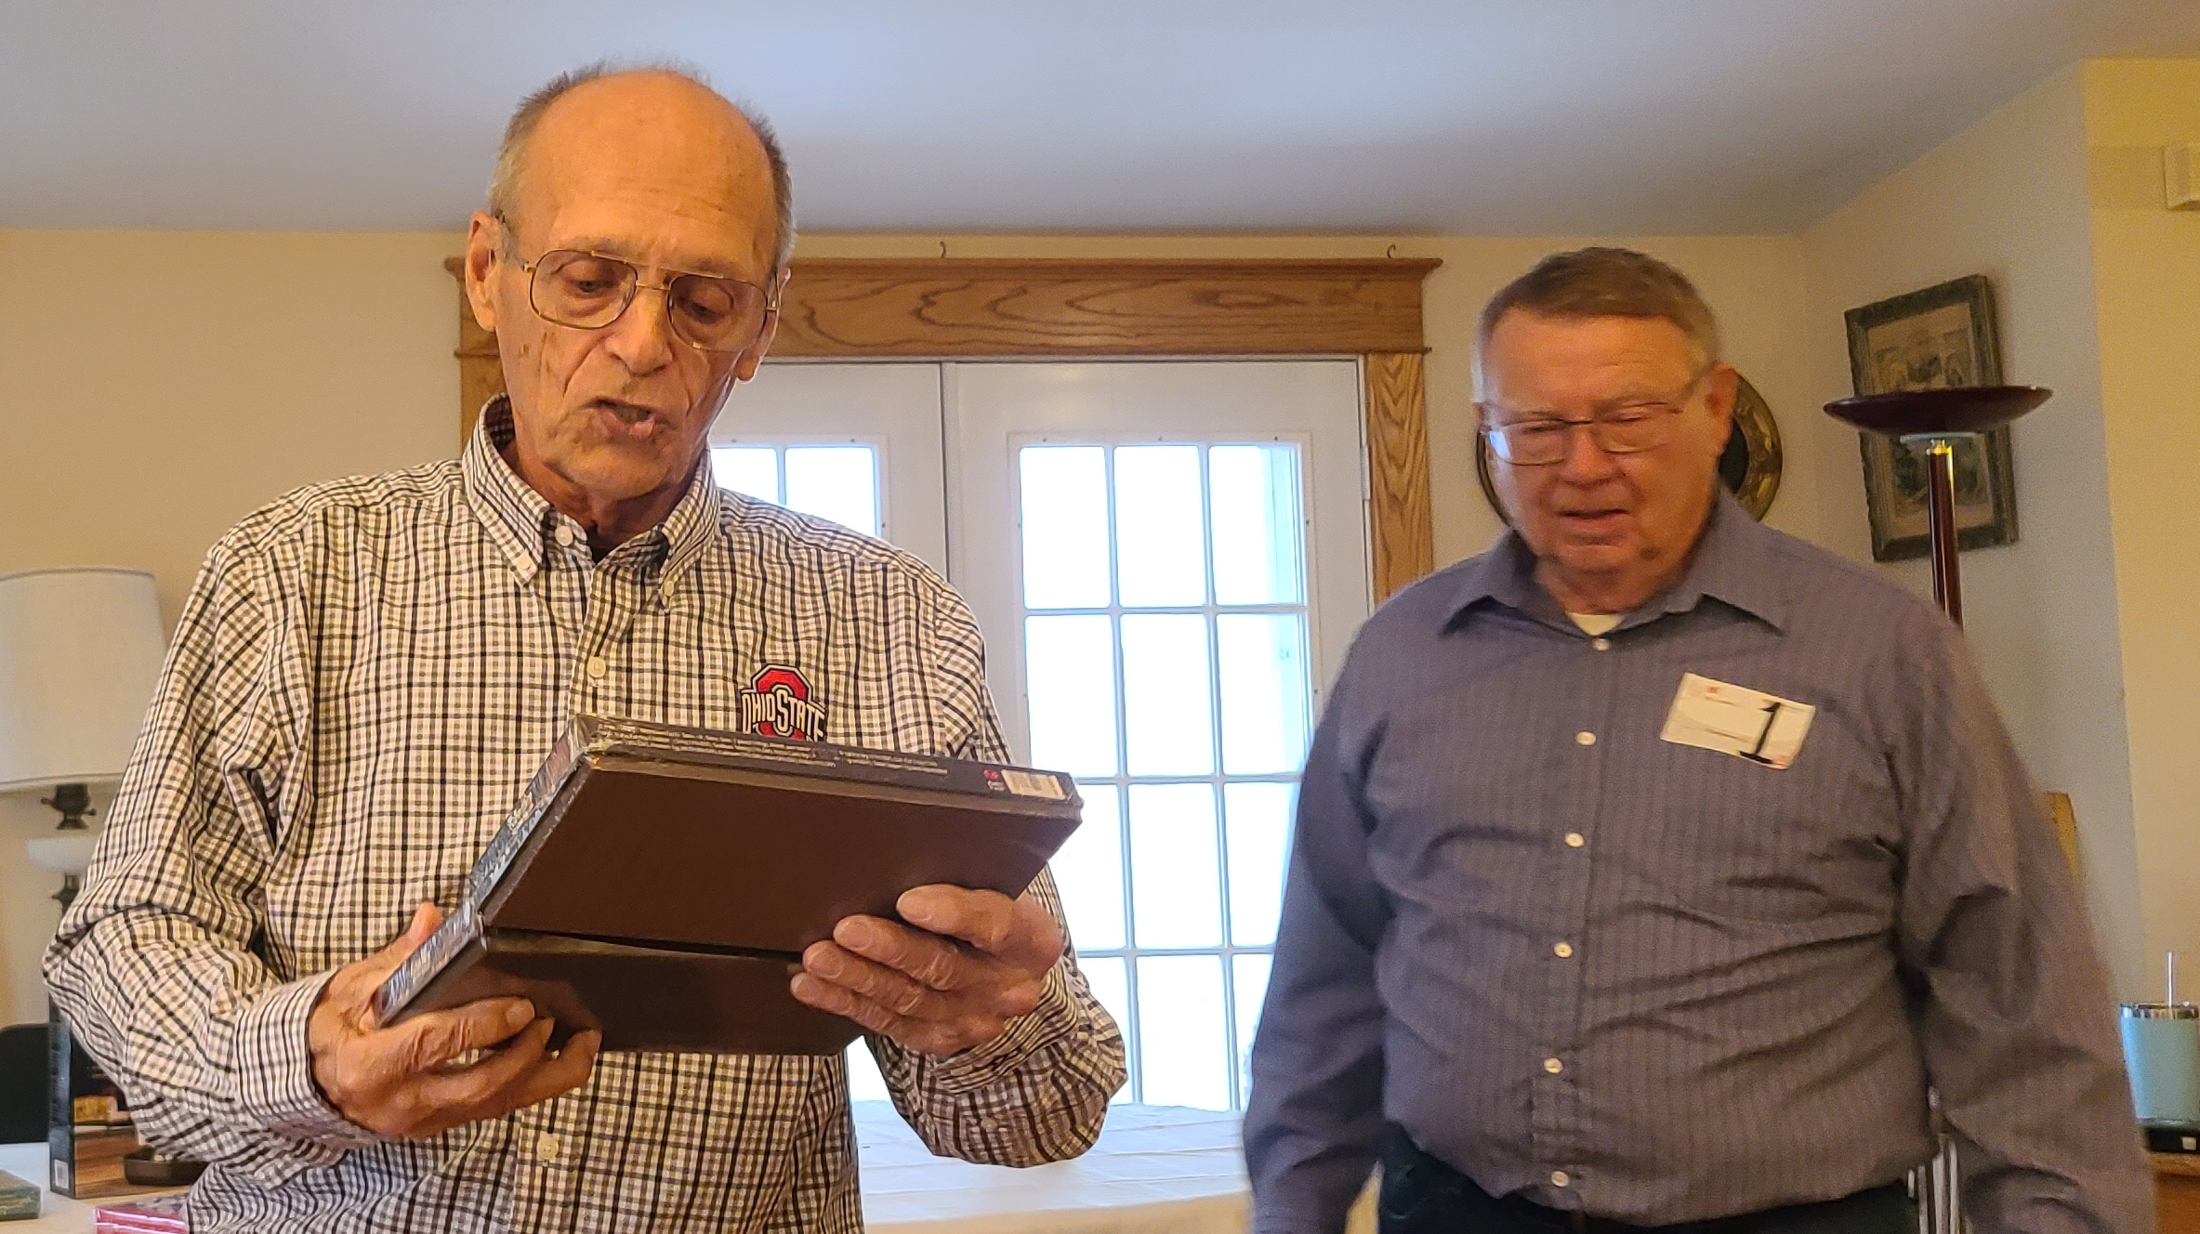
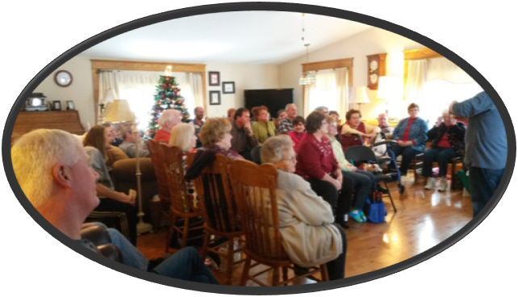
Annual Christmas Auction
  November 15th @ 2:30 pm
  At Bev & Eldon’s Home
  1385 Littles Rd., Arcanum
  Bring an appetizer and an item or two to auction off

Slide 31

Date: November 25th
When: 7:00 pm
Service of Holy Communion
What are you thankful for this year?

Slide 32
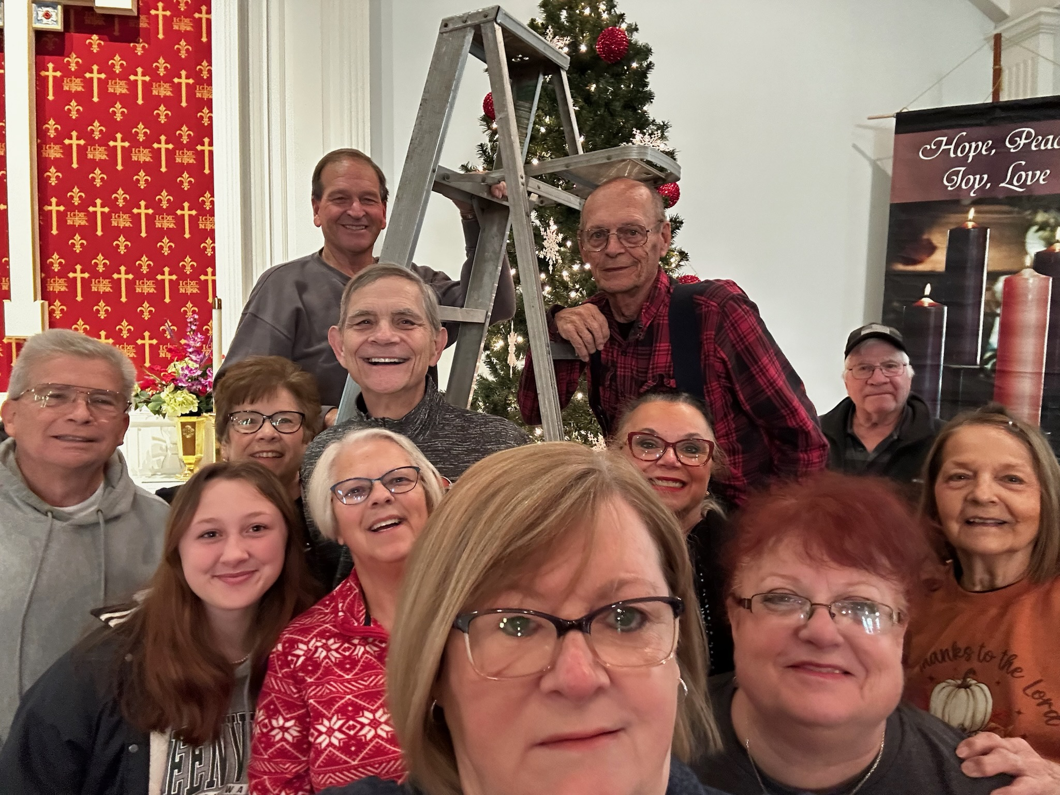

What: Decorate the Church for Advent/Christmas
When: November 28, 2026
Time: 10:00 am

Slide 33

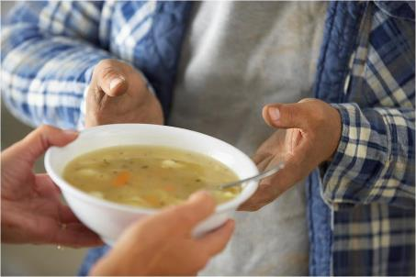
Grace Resurrection Community Center
Soup Kitchen Meal
When: Wednesday, September 16, 2026
10:00 am to 1:00 pm.
Where: 433 Water Street in Greenville

Slide 34
Christmas Program
Date: December 13, 2026
Time: 10:30 am

Slide 35
Christmas Program Practices
Saturday, Dec 5
  10:00 am
Sunday , Dec 6
  After Worship ≈ 11:45 am
Saturday, Dec 12
  10:00 am

Slide 36
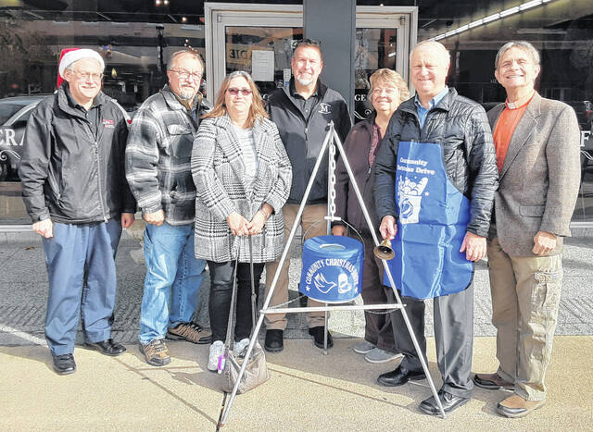
Darke County Christmas Fund Drive
(Christmas Bell Ringers)
Dates: December 5 & 12
Times: From 10:00 am – 8:00 pm
Where: Eikenberry’s (Indoors!)
Who: Everyone!!!
Sign up on the sheet on the Communications Table across from the Church Office

Slide 37

Advent
And Beyond!
Soup Suppers @ 6:30 pm
  3 Wednesdays in Dec
    Starting Dec 3rd
  3 Wednesdays in Jan
    Starting Jan 7th
Dealing with difficult people.
Coping with tough circumstances.
Overcoming low self-esteem.
Managing stress.
Notes:
Cover: Sermon on the Mount by Laura James. Copyright © Laura James. All rights reserved. Used by permission of the artist.

Slide 38

Sunday, December 21, 2025
@ 10:30 am

