Slide 1
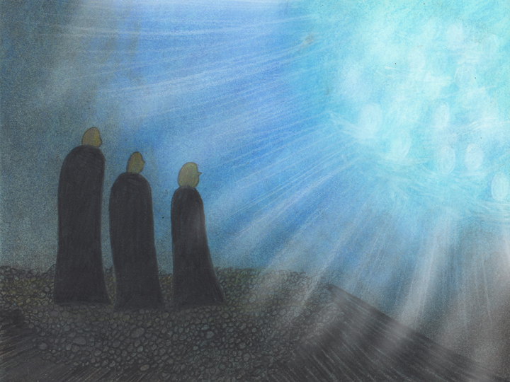
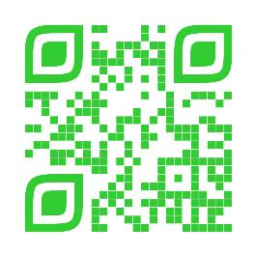
Announcements
Trinity Lutheran Church
November 16, 2025
Thankoffering Sunday
Scan Me!
People walking in darkness have seen a great light! (Isaiah 9:2)

Slide 2


Slide 3

Body, Mind, Spirit
MIND: Put out your Thanksgiving decorations
BODY: No snacks after 8 pm
SPIRIT: Learn a new prayer that could be said on Thanksgiving

Slide 4


Our Office Secretary Is Sharon Fourman
Church Office Schedule
Tues, Wed, Thurs – 8-11:30 am
Office Phone: (937) 692-5670
Pastor’s Phone: (937) 626-7100
Email: secretary@pitsburgtlc.org

Slide 5

The Trinity Trumpet
A Monthly Newsletter
Published by Trinity Lutheran Church,
Pitsburg, OH
We’re looking for stories and pictures of Trinity people in action!
Submit to Secretary, Sharon Fourman at secretary@pitsburgtlc.org
Articles and Info due on or about the 3rd Tuesday of each month

Slide 6

Trinity Trumpet
    Your Trinity Trumpet Newsletter for November is available!
    Please take your copy before you leave today!

Slide 7
Trinity Trumpet
    Newsletter Deadline is Tuesday, November 18, 2025!!!
    Please turn in all your newsworthy items to Sharon Fourman at:
    secretary@pitsburgtlc.org

Slide 8

We’re Online!
www.pitsburgtlc.org
Sermons, Bulletins (Worship Books), Worship Slides, and announcements are posted weekly
Trinity Trumpet and ‘Official’ Trinity Calendar are also available
Pictures, Videos and more!
Also, like us on FaceBook at
facebook.com/pitsburgtrinitylutheran.church

Slide 9
We’re Online!
www.pitsburgtlc.org
We have our own QR Code!
Scan this code with your Smartphone and you will connect to all our Online media (Facebook, YouTube, and our own Church Website)

Slide 10

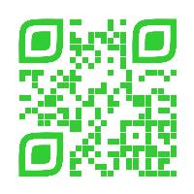
Online Giving
www.pitsburgtlc.org
Click the “Give to Trinity” Button
Stay current in your giving even when you can’t make it to Worship!
Separate Giving Categories for:
    General Treasury
    Benevolence/Mission Support
    Building Fund
    Annual Christmas Auction
    Memorial Funds
    Thrive Capital Campaign

Slide 11

Here’s what Lutheran congregations made possible in 2025:
803,181 quilts and kits
  Delivered to 15 countries
In the U.S. reached coast-to-coast
  Hurricanes Helene and Milton
  California wildfires
  Flooding in Central Texas
Over $1 million in cash grants distributed to local partners

Slide 12

    If you would like to sponsor the Altar Flowers, see PJ to Sign Up!
    Please let our Church Secretary, Sharon, know so she can put it in the Bulletin!

Slide 13


Church
Council
Trinity Church Council
Next Meeting is …
November 19th @ 7:00 pm

Slide 14


Trinity’s Team Meetings
Next Meeting
TBD
@ 6:00 pm
On the Agenda – Preparing the proposed 2023 budget

Slide 15
Please Pass the Pew Pads
(We now track Communion on the Pads)

Slide 16

Worship Team
Next Meeting:
  TBD

Slide 17

Mutual Ministry Team
  Julie Kossler
  VACANT
  Peggy Didier
  Please see one of them with your comments and suggestions
  Next Meeting - TBD

Slide 18


Choice FISH Pantry
Please join us every Friday @ 3:30 pm
400 Markwith Dr, Greenville OH
Most Needed Items
Kidney Beans
Canned Peas
Hamburger Helper
Pork & Beans
Canned Mixed Veggies
Large Cans of Soups
Applesauce
Boxed Meals
(i.e. Rice a Roni)

Slide 19
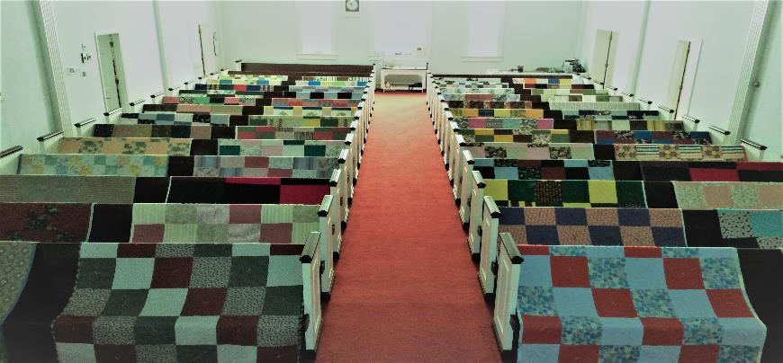
Prayers and Squares
Quilting Ministry
November 25 @ 10:00 am
December 11 @ 10:00 am

Slide 20


Wednesday, December 3, 2025
@ 11:30 am
Appetizer to share
Gift Exchange ($15 max)

Slide 21

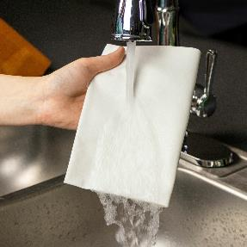
ULTIMATE CLEANING CLOTH SALE
1 for $7.00
2 for $10.00
5 for $20.00
See
  Portia Boord or Diane Warner

Slide 22


Ladies and Gents Luncheon
Date: November 20th @ 11:30 am
Where: 19th Hole Turtle Creek Golf Course
For Reservations/Questions:
        See Linda Baker or call her @ 937 545-8410

Slide 23

Confirmation Program
(7th and 8th Graders)
    Class on most Sunday mornings @ 9 am
    Weekly Worship attendance is required in person or via FaceBook
    Worship Notes may be emailed to pastor@pitsburgtlc.org or placed in Pr Mel’s mailbox outside the Church Office
    Confirmands are HIGHLY encouraged to take turns as Acolyte

Slide 24

YOUTH QUAKE-CINCINNATI
(6th and 12th Graders)
See Pastor Mel or PJ if you haven’t already!
More Info Coming Soon!!!

Slide 25

YOUTH QUAKE-CINCINNATI
(6th and 12th Graders)

Slide 26

    Who can be an Acolyte? YOU CAN!!!
    Acolyte Training – November 23 & 30, 2025
    Please sign up for Acolyte Duty on the chart by the Church Office!
    Confirmation Students are Highly Encouraged to perform Acolyte duty…
    Please sign up today!

Slide 27

New Member Class
We are forming a “New Member” Class for anyone who wants to learn more about Being Lutheran and what being a member of Trinity entails…
    Classes will begin in January
    Class time and Dates are TBD
    Please see Pastor Mel if Interested in attending

Slide 28
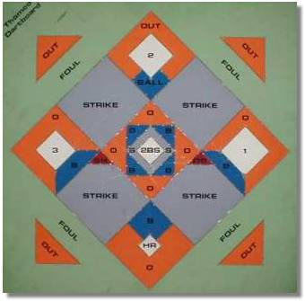


Monday
NOVEMBER 17, 2025
7:30 pm
St. John Lutheran Church
7418 OH-121, Greenville

Slide 29

Next Regular Meeting
December 4, 2025 @ 10:00 am Purpose - Plan for the Children’s Christmas Program!
Please come if you can!

Slide 30

Blood Pressure Screening
BP Screening
By Appointment (See PJ Musser)
In The Nursery
Notes:
Cover: Sermon on the Mount by Laura James. Copyright © Laura James. All rights reserved. Used by permission of the artist.

Slide 31

Calling all Adults!
Join Us For “Christian Conversations”
Not Your Ordinary Adult Sunday School
Sharing – Discussion - Prayer
Every Sunday @
9:30 am
Notes:
Cover: Sermon on the Mount by Laura James. Copyright © Laura James. All rights reserved. Used by permission of the artist.

Slide 32

The Chosen
On Hiatus until 2026!
Video Discussion Group
Upcoming - Season 3
Notes:
Cover: Sermon on the Mount by Laura James. Copyright © Laura James. All rights reserved. Used by permission of the artist.

Slide 33

Trinity Troops
Date: TODAY!!!
Who: Youth 4th – 6th Grades and families
What: Fun, Snacks, Blanket Tying!
Where: @ Trinity
When: After Worship
Trinity Troops!

Slide 34
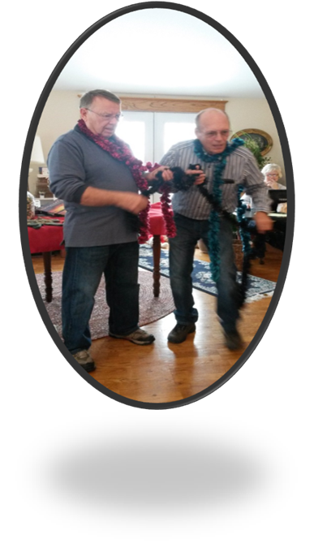
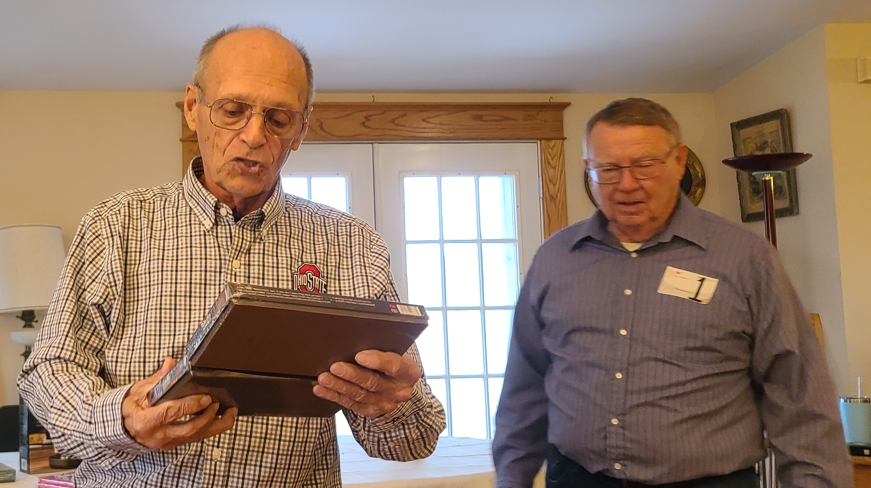
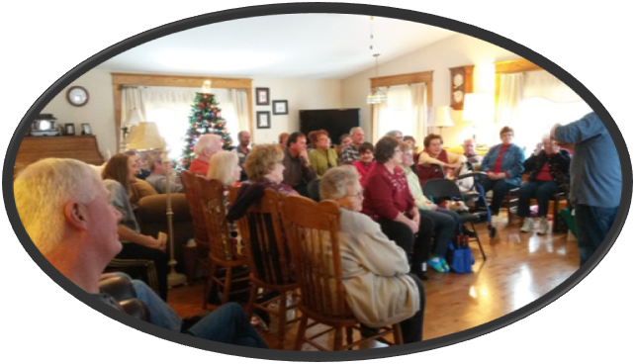
Annual Christmas Auction
  TODAY!!! @ 2:30 pm
  At Bev & Eldon’s Home
  1385 Littles Rd., Arcanum
  Bring an appetizer and an item or two to auction off

Slide 35
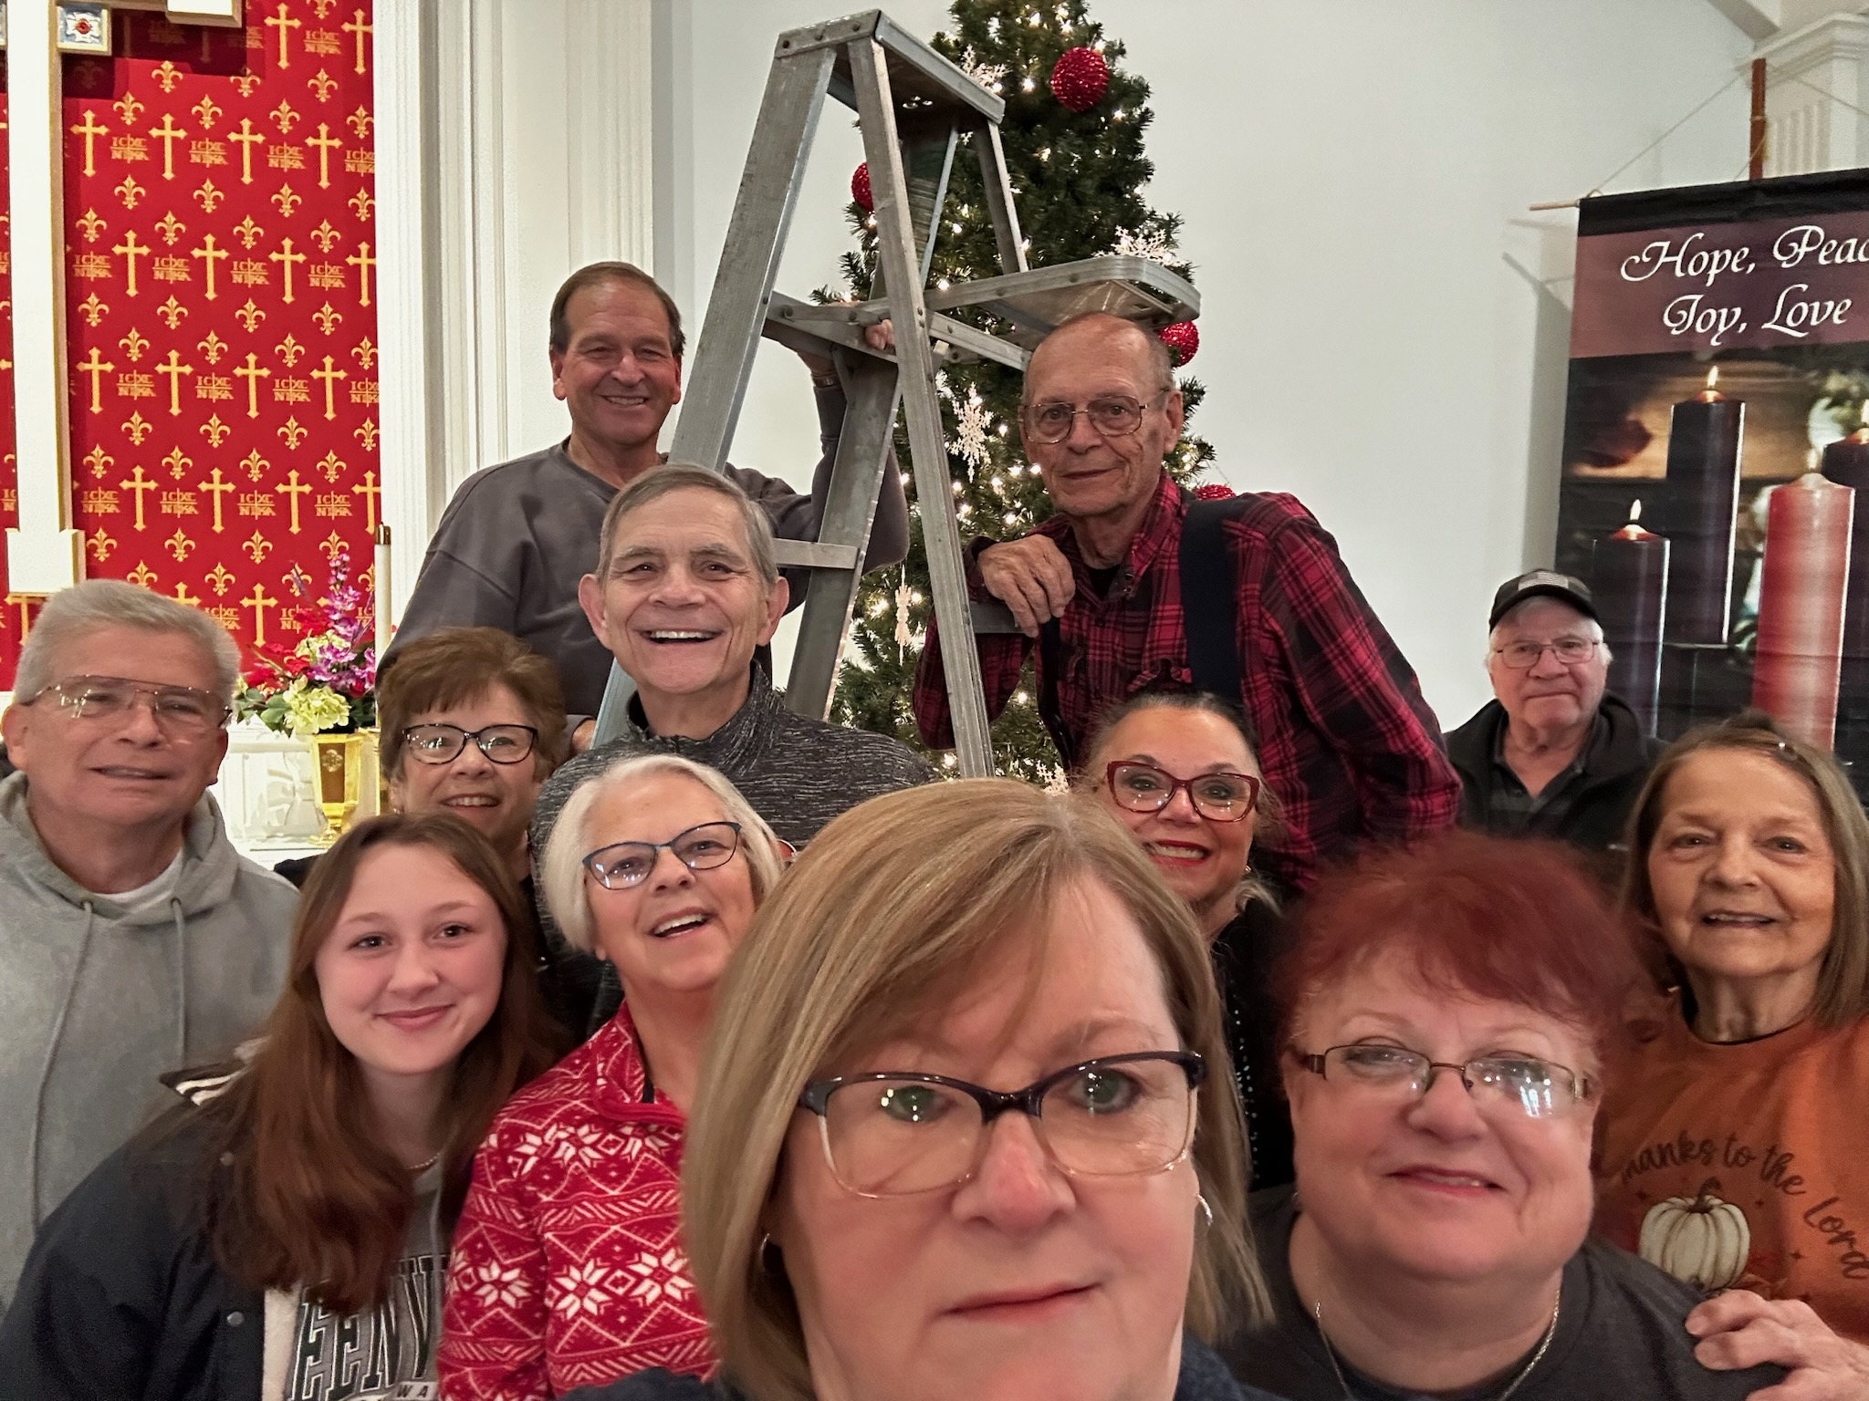
Kick off the Advent/Christmas Season
Help decorate your Church Sanctuary!
When? November 25th @ 6 pm
Notes:
Cover: Sermon on the Mount by Laura James. Copyright © Laura James. All rights reserved. Used by permission of the artist.

Slide 36

Date: November 26th
When: 7:00 pm
Service of Holy Communion
What are you thankful for this year?

Slide 37

Christmas Program
Date: December 14, 2025
Time: 10:30 am

Slide 38
Christmas Program Practices
Saturday, Dec 6
  10:00 am
Sunday , Dec 7
  After Worship ≈ 11:45 am
Saturday, Dec 13
  10:00 am

Slide 39

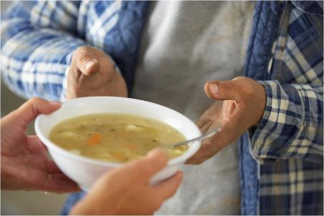
Grace Resurrection Community Center
Soup Kitchen Meal
When: Wednesday, December 17, 2025
10:00 am to 1:00 pm.
Where: 433 Water Street in Greenville

Slide 40
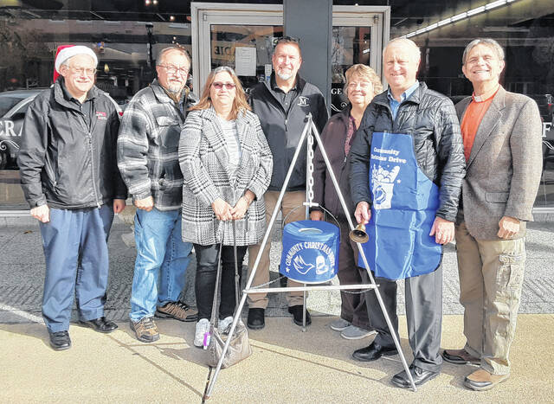
Darke County Christmas Fund Drive
(Christmas Bell Ringers)
Dates: December 5 & 12
Times: From 10:00 am – 8:00 pm
Where: Eikenberry’s (Indoors!)
Who: Everyone!!!
Sign up on the sheet on the Communications Table across from the Church Office

Slide 41

Advent
And Beyond!
Soup Suppers @ 6:30 pm
  3 Wednesdays in Dec
    Starting Dec 3rd
  3 Wednesdays in Jan
    Starting Jan 7th
Dealing with difficult people.
Coping with tough circumstances.
Overcoming low self-esteem.
Managing stress.
Notes:
Cover: Sermon on the Mount by Laura James. Copyright © Laura James. All rights reserved. Used by permission of the artist.

Slide 42

Sunday, December 21, 2025
@ 10:30 am

Slide 43
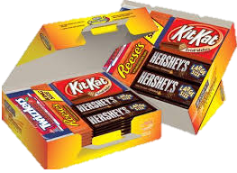
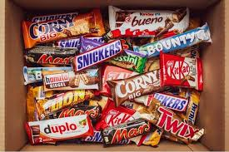
Trinity Youth
Fun (d) Raiser!
Candy Bar Sales!
Large Selection
$2 Each
Supports Our Youth
Notes:
Cover: Sermon on the Mount by Laura James. Copyright © Laura James. All rights reserved. Used by permission of the artist.

