Slide 1
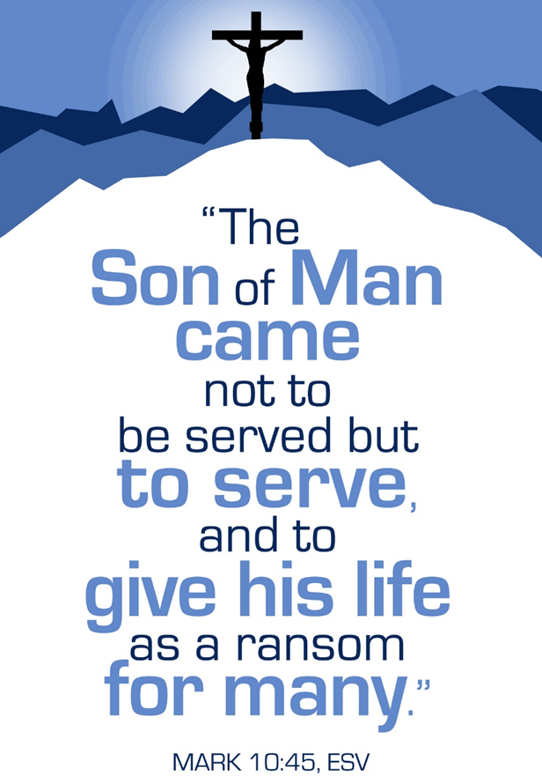
February 18, 2024
WELCOME!
Trinity Lutheran Church
Notes:
Image: Five Loaves by Caroline Coolidge Brown. Copyright © Caroline Coolidge Brown. All rights reserved. Used by permission of the artist.

Slide 2
= Please stand if able
= Please be seated
Prelude - By Pan Sherman
Office of the Acolyte
Ringing of the Bell
Welcome

Slide 3
THANKSGIVING FOR BAPTISM
All may make the sign of the cross, the sign marked at baptism, as the presiding minister begins.
P: Blessed be the holy Trinity, ☩ one God, the fountain of living water, the rock who gave us birth, our light and our salvation.
C: Amen.
Notes:
Image: Preparing yeast dough. Copyright © tomasworks/iStock/Thinkstock. Used by permission.

Slide 4
P: Joined to Christ in the waters of baptism, we are clothed with God's mercy and forgiveness. Let us give thanks for the gift of baptism. Water may be poured into the font as the presiding minister gives thanks.
THANKSGIVING FOR BAPTISM
Notes:
Image: Preparing yeast dough. Copyright © tomasworks/iStock/Thinkstock. Used by permission.

Slide 5
P: We give you thanks, O God, for in the beginning your Spirit moved over the waters and by your Word you created the world, calling forth life in which you took delight. Through the waters of the flood you delivered Noah and his family. Through the sea you led your people Israel from slavery into freedom.
THANKSGIVING FOR BAPTISM
Notes:
Image: Preparing yeast dough. Copyright © tomasworks/iStock/Thinkstock. Used by permission.

Slide 6
P: At the river your Son was baptized by John and anointed with the Holy Spirit. By water and your Word you claim us as daughters and sons, making us heirs of your promise and servants of all. We praise you for the gift of water that sustains life, and above all we praise you for the gift of new life in Jesus Christ.
THANKSGIVING FOR BAPTISM
Notes:
Image: Preparing yeast dough. Copyright © tomasworks/iStock/Thinkstock. Used by permission.

Slide 7
P: Shower us with your Spirit, and renew our lives with your forgiveness, grace, and love. To you be given honor and praise through Jesus Christ our Lord in the unity of the Holy Spirit, now and forever.
THANKSGIVING FOR BAPTISM
C: Amen.
Notes:
Image: Preparing yeast dough. Copyright © tomasworks/iStock/Thinkstock. Used by permission.

Slide 8
CONFESSION AND FORGIVENESS
All may make the sign of the cross, the sign marked at baptism…
L: We confess our sins before God and one another.
Pause for silence and reflection.
L: God of love,
Notes:
Image: Five Loaves by Caroline Coolidge Brown. Copyright © Caroline Coolidge Brown. All rights reserved. Used by permission of the artist.

Slide 9
CONFESSION AND FORGIVENESS
C: When we look inward and are honest with ourselves, we see where we have lived as though you are not our God. We have sought after our own gain rather than the good of all. We have not loved you or our neighbors as ourselves. We have betrayed and denied you in what we have done and not done.
Notes:
Image: Five Loaves by Caroline Coolidge Brown. Copyright © Caroline Coolidge Brown. All rights reserved. Used by permission of the artist.

Slide 10
CONFESSION AND FORGIVENESS
C: Create in us clean hearts, O God, that we might become what you have called us to be.
Notes:
Image: Five Loaves by Caroline Coolidge Brown. Copyright © Caroline Coolidge Brown. All rights reserved. Used by permission of the artist.

Slide 11
CONFESSION AND FORGIVENESS
L: God whose unfathomable love went to the cross for our sake now forgives us all our sins and welcomes us all over again into the promise of eternal life in ☩ Christ’s name.
C: Amen.
Notes:
Image: Five Loaves by Caroline Coolidge Brown. Copyright © Caroline Coolidge Brown. All rights reserved. Used by permission of the artist.

Slide 12
GATHERING SONG
“Softly and Tenderly Jesus Is Calling”
ELW 608
Notes:
Image: Five Loaves by Caroline Coolidge Brown. Copyright © Caroline Coolidge Brown. All rights reserved. Used by permission of the artist.

Slide 13
“Softly and Tenderly Jesus Is Calling” ELW 608
1 Softly and tenderly Jesus is calling,
calling for you and for me.
See, on the portals he's waiting and watching,
watching for you and for me.
Notes:
Image: Five Loaves by Caroline Coolidge Brown. Copyright © Caroline Coolidge Brown. All rights reserved. Used by permission of the artist.

Slide 14
“Softly and Tenderly Jesus Is Calling” ELW 608
Refrain
"Come home, (Come home,)
come home! (come home!)
You who are weary, come home."
Earnestly, tenderly, Jesus is calling,
calling, "O sinner, come home!"
Notes:
Image: Five Loaves by Caroline Coolidge Brown. Copyright © Caroline Coolidge Brown. All rights reserved. Used by permission of the artist.

Slide 15
“Softly and Tenderly Jesus Is Calling” ELW 608
2 Why should we tarry when Jesus is pleading,
pleading for you and for me?
Why should we linger and heed not his mercies,
mercies for you and for me?
Notes:
Image: Five Loaves by Caroline Coolidge Brown. Copyright © Caroline Coolidge Brown. All rights reserved. Used by permission of the artist.

Slide 16
“Softly and Tenderly Jesus Is Calling” ELW 608
Refrain
"Come home, (Come home,)
come home! (come home!)
You who are weary, come home."
Earnestly, tenderly, Jesus is calling,
calling, "O sinner, come home!"
Notes:
Image: Five Loaves by Caroline Coolidge Brown. Copyright © Caroline Coolidge Brown. All rights reserved. Used by permission of the artist.

Slide 17
“Softly and Tenderly Jesus Is Calling” ELW 608
3 Oh, for the wonderful love he has promised,
promised for you and for me!
Though we have sinned, he has mercy and pardon,
pardon for you and for me.
Notes:
Image: Five Loaves by Caroline Coolidge Brown. Copyright © Caroline Coolidge Brown. All rights reserved. Used by permission of the artist.

Slide 18
“Softly and Tenderly Jesus Is Calling” ELW 608
Refrain
"Come home, (Come home,)
come home! (come home!)
You who are weary, come home."
Earnestly, tenderly, Jesus is calling,
calling, "O sinner, come home!"
Notes:
Image: Five Loaves by Caroline Coolidge Brown. Copyright © Caroline Coolidge Brown. All rights reserved. Used by permission of the artist.

Slide 19
APOSTOLIC GREETING
P: The grace of our Lord Jesus Christ, the love of God, and the communion of the Holy Spirit be with you all.
C: And also with you.
Notes:
Image: Five Loaves by Caroline Coolidge Brown. Copyright © Caroline Coolidge Brown. All rights reserved. Used by permission of the artist.

Slide 20
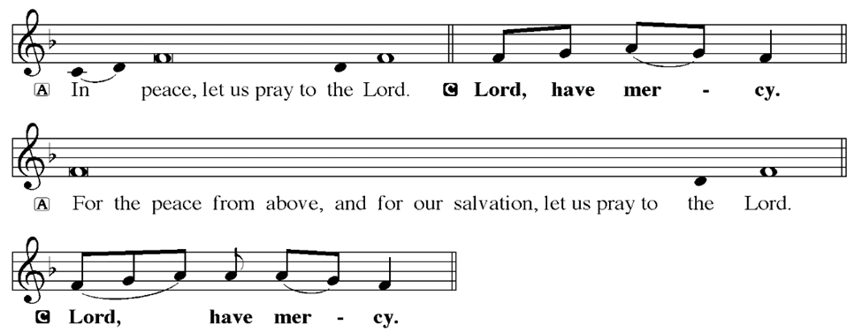
KYRIE
Notes:
Image: Five Loaves by Caroline Coolidge Brown. Copyright © Caroline Coolidge Brown. All rights reserved. Used by permission of the artist.

Slide 21
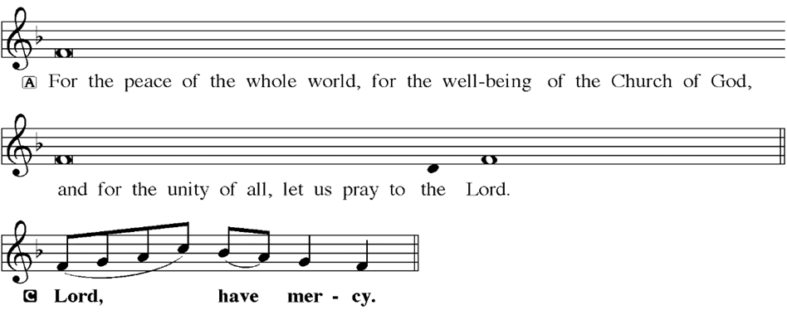
KYRIE
Notes:
Image: Five Loaves by Caroline Coolidge Brown. Copyright © Caroline Coolidge Brown. All rights reserved. Used by permission of the artist.

Slide 22
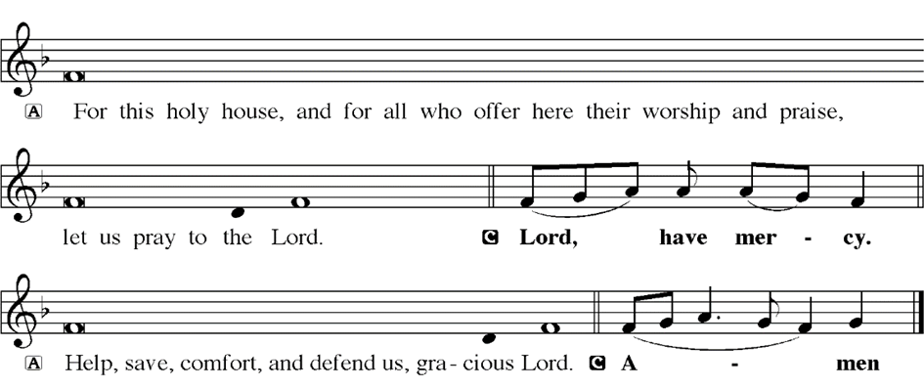
KYRIE
Notes:
Image: Five Loaves by Caroline Coolidge Brown. Copyright © Caroline Coolidge Brown. All rights reserved. Used by permission of the artist.

Slide 23
HYMN OF PRAISE
Glory be to God in heaven;
peace, goodwill to all the earth.
Mighty God of all creation,
Father of surpassing worth:
we exalt you, we adore you,
we lift high our thanks and praise.
Saints and angels bow before you; here on earth our songs we raise.
Notes:
Image: Five Loaves by Caroline Coolidge Brown. Copyright © Caroline Coolidge Brown. All rights reserved. Used by permission of the artist.

Slide 24
HYMN OF PRAISE
Glory be to Christ forever,
Lamb of God and Lord of love.
Son of God and gracious Savior, you have come from heav’n above;
on the cross you died to save us; now you reign at God’s right hand.
Hear our prayer; restore, forgive us; in your promise firm we stand.
Notes:
Image: Five Loaves by Caroline Coolidge Brown. Copyright © Caroline Coolidge Brown. All rights reserved. Used by permission of the artist.

Slide 25
HYMN OF PRAISE
Holy One we now acclaim you;
Lord alone, to you we call;
Holy One in faith we name you,
God most high, yet near to all:
Jesus Christ, with God the Spirit,
in the Father’s splendor bright.
For the peace that we inherit,
glory be to God on high!
Notes:
Image: Five Loaves by Caroline Coolidge Brown. Copyright © Caroline Coolidge Brown. All rights reserved. Used by permission of the artist.

Slide 26
PRAYER OF THE DAY
P: Let us pray… Holy God, in your blessed reign, the first are last and the last first. Remind us as often as it takes that we ought to seek greatness not through our own efforts, but as an extension of your healing arms reaching out in service to our neighbors. In Jesus’ name we pray.
C: Amen
Notes:
Image: Five Loaves by Caroline Coolidge Brown. Copyright © Caroline Coolidge Brown. All rights reserved. Used by permission of the artist.

Slide 27
Notes:
Image: Five Loaves by Caroline Coolidge Brown. Copyright © Caroline Coolidge Brown. All rights reserved. Used by permission of the artist.

Slide 28
Scripture Reading
L: Our scripture reading for this day is from the Gospel of Mark, the 10th Chapter.
C: Glory to you O’ Lord!
Notes:
Image: Five Loaves by Caroline Coolidge Brown. Copyright © Caroline Coolidge Brown. All rights reserved. Used by permission of the artist.

Slide 29
Mark 10:32-52
³² They were on the road, going up to Jerusalem, and Jesus was walking ahead of them; they were amazed, and those who followed were afraid. He took the twelve aside again and began to tell them what was to happen to him, ³³ saying, “See, we are going up to Jerusalem, and the Son of Man will be handed over to the chief priests and the scribes, and they will condemn him
Notes:
Image: Five Loaves by Caroline Coolidge Brown. Copyright © Caroline Coolidge Brown. All rights reserved. Used by permission of the artist.

Slide 30
Mark 10:32-52
to death; then they will hand him over to the Gentiles; ³⁴ they will mock him, and spit upon him, and flog him, and kill him; and after three days he will rise again.”
³⁵ James and John, the sons of Zebedee, came forward to him and said to him, “Teacher, we want you to do for us whatever we ask of you.” ³⁶ And he said to them, “What is it you
Notes:
Image: Five Loaves by Caroline Coolidge Brown. Copyright © Caroline Coolidge Brown. All rights reserved. Used by permission of the artist.

Slide 31
Mark 10:32-52
want me to do for you?” ³⁷ And they said to him, “Grant us to sit, one at your right hand and one at your left, in your glory.” ³⁸ But Jesus said to them, “You do not know what you are asking. Are you able to drink the cup that I drink, or be baptized with the baptism that I am baptized with?” ³⁹They replied, “We are able.” Then Jesus said to them, “The cup that I drink you will
Notes:
Image: Five Loaves by Caroline Coolidge Brown. Copyright © Caroline Coolidge Brown. All rights reserved. Used by permission of the artist.

Slide 32
Mark 10:32-52
drink; and with the baptism with which I am baptized, you will be baptized; ⁴⁰ but to sit at my right hand or at my left is not mine to grant, but it is for those for whom it has been prepared.”
⁴¹ When the ten heard this, they began to be angry with James and John. ⁴² So Jesus called them and said to them, “You know that among the Gentiles those whom they recognize as their
Notes:
Image: Five Loaves by Caroline Coolidge Brown. Copyright © Caroline Coolidge Brown. All rights reserved. Used by permission of the artist.

Slide 33
Mark 10:32-52
rulers lord it over them, and their great ones are tyrants over them. ⁴³ But it is not so among you; but whoever wishes to become great among you must be your servant, ⁴⁴ and whoever wishes to be first among you must be slave of all. ⁴⁵For the Son of Man came not to be served but to serve, and to give his life a ransom for many.”
Notes:
Image: Five Loaves by Caroline Coolidge Brown. Copyright © Caroline Coolidge Brown. All rights reserved. Used by permission of the artist.

Slide 34
Mark 10:32-52
⁴⁶ They came to Jericho. As he and his
disciples and a large crowd were leaving Jericho, Bartimaeus son of Timaeus, a blind beggar, was sitting by the roadside. ⁴⁷When he heard that it was Jesus of Nazareth, he began to shout out and say, “Jesus, Son of David, have mercy on me!”
Notes:
Image: Five Loaves by Caroline Coolidge Brown. Copyright © Caroline Coolidge Brown. All rights reserved. Used by permission of the artist.

Slide 35
Mark 10:32-52
⁴⁸ Many sternly ordered him to be quiet, but he cried out even more loudly, “Son of David, have mercy on me!” ⁴⁹ Jesus stood still and said, “Call him here.” And they called the blind man, saying to him, “Take heart; get up, he is calling you.” ⁵⁰ So throwing off his cloak, he sprang up and came to Jesus.
Notes:
Image: Five Loaves by Caroline Coolidge Brown. Copyright © Caroline Coolidge Brown. All rights reserved. Used by permission of the artist.

Slide 36
Mark 10:32-52
⁵¹ Then Jesus said to him, “What do you want me to do for you?” The blind man said to him, “My teacher, let me see again.” ⁵² Jesus said to him, “Go; your faith has made you well.” Immediately he regained his sight and followed him on the way.
Notes:
Image: Five Loaves by Caroline Coolidge Brown. Copyright © Caroline Coolidge Brown. All rights reserved. Used by permission of the artist.

Slide 37
Mark 10:32-52
R: This is the Word of the Lord.
C: Praise to You, O Christ
Notes:
Image: Five Loaves by Caroline Coolidge Brown. Copyright © Caroline Coolidge Brown. All rights reserved. Used by permission of the artist.

Slide 38
Sermon

Slide 39
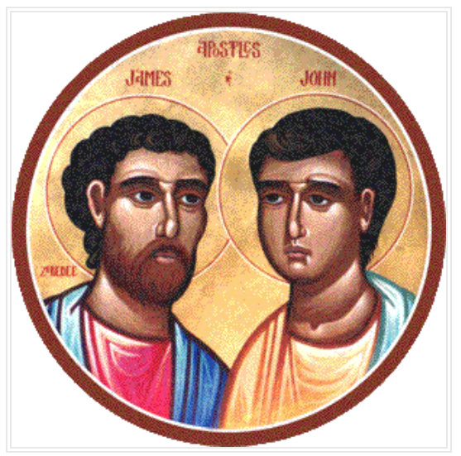
Sermon

Slide 40
Sermon

Slide 41
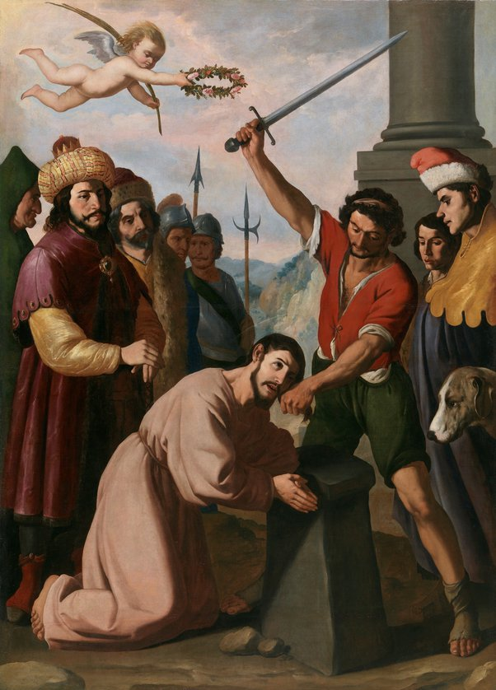
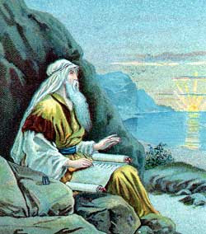
Sermon

Slide 42
Sermon

Slide 43
Sermon

Slide 44
Sermon

Slide 45
Sermon

Slide 46
HYMN OF THE DAY
“Precious Lord, Take My Hand”
ELW 773

Slide 47
“Precious Lord, Take My Hand” ELW 773
Precious Lord, take my hand Lead me on, let me stand I'm tired, I’m weak, I’m lone Through the storm, through the night Lead me on to the light Take my hand precious Lord, lead me home

Slide 48
“Precious Lord, Take My Hand” ELW 773
When my way grows drear precious Lord linger near When my light is almost gone Hear my cry, hear my call Hold my hand lest I fall Take my hand precious Lord, lead me home

Slide 49
“Precious Lord, Take My Hand” ELW 773
When the darkness appears and the night draws near And the day is past and gone At the river I stand Guide my feet, hold my hand Take my hand precious Lord, lead me home

Slide 50
APOSTLE’S CREED
C: I believe in God, the Father almighty, creator of heaven and earth.

Slide 51
APOSTLE’S CREED
C: I believe in Jesus Christ, his only Son, our Lord. He was conceived by the power of the Holy Spirit and born of the virgin Mary. He suffered under Pontius Pilate, was crucified, died, and was buried.

Slide 52
APOSTLE’S CREED
C: He descended into hell. On the third day he rose again. He ascended into heaven, and is seated at the right hand of the Father. He will come again to judge the living and the dead.

Slide 53
APOSTLE’S CREED
C: I believe in the Holy Spirit, the holy catholic Church, the communion of saints, the forgiveness of sins, the resurrection of the body, and the life everlasting. Amen.

Slide 54
NICENE CREED
C: We believe in one God, the Father, the Almighty, maker of heaven and earth, of all that is, seen and unseen.

Slide 55
NICENE CREED
C: We believe in one Lord, Jesus Christ, the only Son of God, eternally begotten of the Father, God from God, Light from Light, true God from true God, begotten, not made, of one Being with the Father.

Slide 56
NICENE CREED
C: Through him all things were made. For us and for our salvation he came down from heaven; by the power of the Holy Spirit he became incarnate from the virgin Mary, and was made man. For our sake he was crucified under Pontius Pilate;

Slide 57
NICENE CREED
C: he suffered death and was buried. On the third day he rose again in accordance with the Scriptures; he ascended into heaven and is seated at the right hand of the Father. He will come again in glory to judge the living and the dead, and his kingdom will have no end.

Slide 58
NICENE CREED
C: We believe in the Holy Spirit, the Lord, the giver of life, who proceeds from the Father and the Son. With the Father and the Son he is worshiped and glorified. He has spoken through the prophets. We believe in one holy catholic and apostolic Church.

Slide 59
NICENE CREED
C: We acknowledge one Baptism for the forgiveness of sins. We look for the resurrection of the dead, and the life of the world to come. Amen.

Slide 60
QUILT TYING AND PRESENTATION
This Quilt was lovingly crafted for recovery and healing especially the Trinity Prayers and Squares Quilting Ministry…
Let us pray…

Slide 61
PRAYERS OF INTERCESSION
Each petition will end with the words,
A: God of the journey,
The congregation will respond with:
C: In mercy, hear our prayer.

Slide 62
PRAYERS OF INTERCESSION
The prayer concludes…
P: Confident that you walk alongside us in our need, we lift to you all our prayers, spoken and unspoken, through Jesus Christ our savior.
C: Amen.

Slide 63
OFFERING
Notes:
Image: Five Loaves by Caroline Coolidge Brown. Copyright © Caroline Coolidge Brown. All rights reserved. Used by permission of the artist.

Slide 64
OFFERING PRAYER
Notes:
Image: Five Loaves by Caroline Coolidge Brown. Copyright © Caroline Coolidge Brown. All rights reserved. Used by permission of the artist.

Slide 65
THE GREAT THANKSGIVING
All the Baptized are welcome to celebrate this Holy Meal.

Slide 66
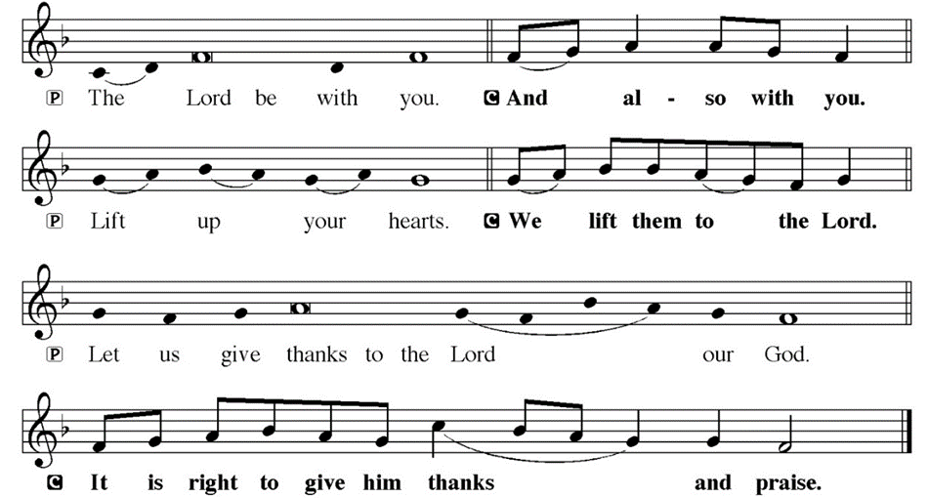
DIALOGUE

Slide 67
THE PREFACE
P: It is indeed right and salutary…
… we praise your name and join their unending hymn.

Slide 68
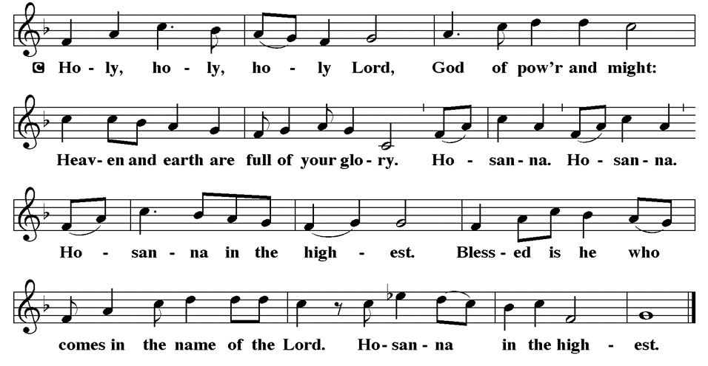
THE SANCTUS

Slide 69
EUCHARISTIC PRAYER
P: Holy God, our living Water…
…both now and forever.
C: Amen.

Slide 70
THE LORD’S PRAYER
C: Our Father, who art in heaven, hallowed be thy name, thy kingdom come, thy will be done, on earth as it is in heaven. Give us this day our daily bread; and forgive us our trespasses, as we forgive those who trespass against us; and lead us not into temptation, but deliver us from evil.

Slide 71
THE LORD’S PRAYER
C: For thine is the kingdom, and the power, and the glory, forever and ever. Amen.

Slide 72
INVITATION TO COMMUNION
P: You are invited now to the feast in which Jesus meets us and strengthens us for the work of the gospel. Come and be fed, for all is prepared.

Slide 73
COMMUNION DISTRIBUTION
All will commune “By Station”.
The bread may be broken for distribution. As the ministers give the bread and wine, they say these words :
The body of Christ, given for you.
The blood of Christ, shed for you.
The communicant may say: Amen.

Slide 74
POST COMMUNION BLESSING
P: May this body and blood of our Lord and Savior, Jesus Christ, strengthen, keep, and unity us, ☩ now and forever,
C: Amen.

Slide 75
POST COMMUNION CANTACLE

Slide 76
POST COMMUNION CANTACLE

Slide 77
POST COMMUNION PRAYER
P: Let us pray… Giver of every gift, Christ’s body is our food, and we are Christ’s body. Raise us to life by your power for the benefit of all and to your glory, now and forever.
C: Amen

Slide 78
ANNOUNCEMENTS
Notes:
Image: Five Loaves by Caroline Coolidge Brown. Copyright © Caroline Coolidge Brown. All rights reserved. Used by permission of the artist.

Slide 79
SENDING BLESSING
P: God who names you, Christ who claims you, and the Holy Spirit who dwells in you, ☩ bless you and remain with you always.
C: Amen.

Slide 80
Sending Song
“Love Divine, All Loves Excelling”
LBW 315
Notes:
Image: Five Loaves by Caroline Coolidge Brown. Copyright © Caroline Coolidge Brown. All rights reserved. Used by permission of the artist.

Slide 81
“Love Divine, All Loves Excelling” LBW 315
1 Love divine, all loves excelling,
Joy of heav’n, to earth come down!
Fix in us thy humble dwelling,
all thy faithful mercies crown.
Jesus, thou art all compassion,
pure, unbounded love thou art;
visit us with thy salvation,
enter ev’ry trembling heart.
Notes:
Image: Preparing yeast dough. Copyright © tomasworks/iStock/Thinkstock. Used by permission.

Slide 82
“Love Divine, All Loves Excelling” LBW 315
2 Breathe, oh, breathe thy loving Spirit
into ev’ry troubled breast;
let us all in thee inherit;
let us find thy promised rest.
Take away the love of sinning;
Alpha and Omega be;
end of faith, as its beginning,
set our hearts at liberty.
Notes:
Image: Preparing yeast dough. Copyright © tomasworks/iStock/Thinkstock. Used by permission.

Slide 83
“Love Divine, All Loves Excelling” LBW 315
3 Come, Almighty, to deliver;
let us all thy life receive;
suddenly return, and never,
nevermore thy temples leave.
Thee we would be always blessing,
serve thee as thy hosts above,
pray, and praise thee without ceasing,
glory in thy perfect love.
Notes:
Image: Preparing yeast dough. Copyright © tomasworks/iStock/Thinkstock. Used by permission.

Slide 84
“Love Divine, All Loves Excelling” LBW 315
4 Finish then thy new creation,
pure and spotless let us be;
let us see thy great salvation
perfectly restored in thee!
Changed from glory into glory,
till in heav’n we take our place,
till we cast our crowns before thee,
lost in wonder, love, and praise!
Notes:
Image: Preparing yeast dough. Copyright © tomasworks/iStock/Thinkstock. Used by permission.

Slide 85
DISMISSAL
P: … Depart in Christ’s Love.
C: Seeking, welcoming, and serving all. Amen!
POSTLUDE
By
Pam Sherman
From sundaysandseasons.com. Copyright © 2024 Augsburg Fortress. All rights reserved. Reprinted by permission under Augsburg Fortress Liturgies Annual License #SAS023830. New Revised Standard Version Bible, Copyright © 1989, Division of Christian Education of the National Council of the Churches of Christ in the United States of America. Used by permission. All rights reserved. Revised Common Lectionary, Copyright © 1992 Consultation on Common Texts, admin Augsburg Fortress. Used by permission.

