Slide 1
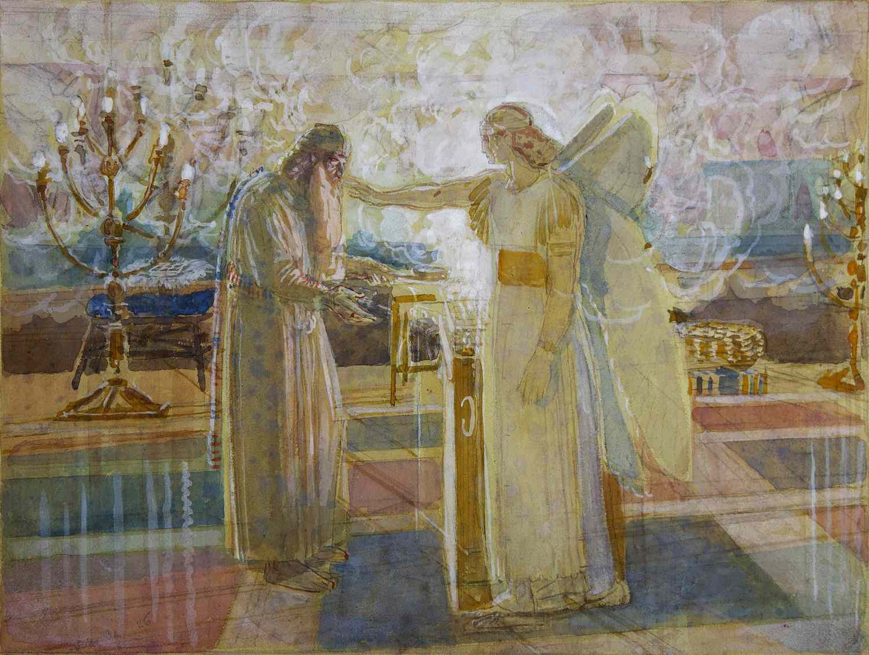
Fourth Sunday of Advent December 24, 2023
WELCOME!
Trinity Lutheran Church
Notes:
Image: Five Loaves by Caroline Coolidge Brown. Copyright © Caroline Coolidge Brown. All rights reserved. Used by permission of the artist.

Slide 2
= Please stand if able
= Please be seated
Prelude – Pre-recorded by Roxanne Groff
Office of the Acolyte
Ringing of the Bell
Welcome

Slide 3
Lighting of the Advent Wreath
R: This day, Elizabeth and Zechariah welcome their son, John, who will be a prophet to the promised messiah.
C: (light candle 1) This is the candle of hope, and it illuminates God’s promise.
Notes:
Image: Preparing yeast dough. Copyright © tomasworks/iStock/Thinkstock. Used by permission.

Slide 4
Lighting of the Advent Wreath
R: (light candle 2) This is the candle of love, and its light leads us in God’s way.
C: (light candle 3) This is the candle of joy, and it shows us God’s healing and wholeness.
Notes:
Image: Preparing yeast dough. Copyright © tomasworks/iStock/Thinkstock. Used by permission.

Slide 5
Lighting of the Advent Wreath
R: (light candle 4) This is the candle of peace, and it proclaims Christ’s coming reign of justice, when we will make war no more.
Notes:
Image: Preparing yeast dough. Copyright © tomasworks/iStock/Thinkstock. Used by permission.

Slide 6
THANKSGIVING FOR BAPTISM
All may make the sign of the cross, the sign marked at baptism, as the presiding minister begins.
P: Blessed be the holy Trinity, ☩ one God, the fountain of living water, the rock who gave us birth, our light and our salvation.
C: Amen.
Notes:
Image: Preparing yeast dough. Copyright © tomasworks/iStock/Thinkstock. Used by permission.

Slide 7
P: Joined to Christ in the waters of baptism, we are clothed with God's mercy and forgiveness. Let us give thanks for the gift of baptism. Water may be poured into the font as the presiding minister gives thanks.
THANKSGIVING FOR BAPTISM
Notes:
Image: Preparing yeast dough. Copyright © tomasworks/iStock/Thinkstock. Used by permission.

Slide 8
P: We give you thanks, O God, for in the beginning your Spirit moved over the waters and by your Word you created the world, calling forth life in which you took delight. Through the waters of the flood you delivered Noah and his family. Through the sea you led your people Israel from slavery into freedom.
THANKSGIVING FOR BAPTISM
Notes:
Image: Preparing yeast dough. Copyright © tomasworks/iStock/Thinkstock. Used by permission.

Slide 9
P: At the river your Son was baptized by John and anointed with the Holy Spirit. By water and your Word you claim us as daughters and sons, making us heirs of your promise and servants of all. We praise you for the gift of water that sustains life, and above all we praise you for the gift of new life in Jesus Christ.
THANKSGIVING FOR BAPTISM
Notes:
Image: Preparing yeast dough. Copyright © tomasworks/iStock/Thinkstock. Used by permission.

Slide 10
P: Shower us with your Spirit, and renew our lives with your forgiveness, grace, and love. To you be given honor and praise through Jesus Christ our Lord in the unity of the Holy Spirit, now and forever.
THANKSGIVING FOR BAPTISM
C: Amen.
Notes:
Image: Preparing yeast dough. Copyright © tomasworks/iStock/Thinkstock. Used by permission.

Slide 11
CONFESSION AND FORGIVENESS
All may make the sign of the cross, the sign marked at baptism…
P: We confess our sins before God and one another.
Pause for silence and reflection.
P: Ever-present God,
Notes:
Image: Five Loaves by Caroline Coolidge Brown. Copyright © Caroline Coolidge Brown. All rights reserved. Used by permission of the artist.

Slide 12
CONFESSION AND FORGIVENESS
C: We come before you in need of grace. Too often our thoughts are judgmental and condemning of others. Too often our words are sarcastic or harsh, as harmful as weapons. Too often our actions are motivated by selfishness and we do not recognize the hurt or need in others.
Notes:
Image: Five Loaves by Caroline Coolidge Brown. Copyright © Caroline Coolidge Brown. All rights reserved. Used by permission of the artist.

Slide 13
CONFESSION AND FORGIVENESS
C: Forgive us, O God, and draw us back into right relationship with you, our neighbors, and your creation.
Notes:
Image: Five Loaves by Caroline Coolidge Brown. Copyright © Caroline Coolidge Brown. All rights reserved. Used by permission of the artist.

Slide 14
CONFESSION AND FORGIVENESS
P: The promise is sure: Christ’s advent is near, and in Christ we are forgiven all our sin. Know that you are a beloved child of God, and be strengthened in all goodness.
C: Amen.
Notes:
Image: Five Loaves by Caroline Coolidge Brown. Copyright © Caroline Coolidge Brown. All rights reserved. Used by permission of the artist.

Slide 15
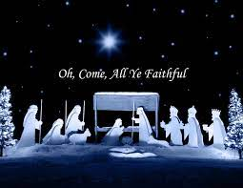
Gathering Song/Hymn of Praise
“O Come, All Ye Faithful”
LBW 45

Slide 16
“O Come All Ye Faithful” LBW 45
1 O come, all ye faithful,
joyful and triumphant!
O come ye, O come ye to Bethlehem;
come and behold him,
born the king of angels:

Slide 17
“O Come All Ye Faithful” LBW 45
Refrain
O come, let us adore him,
O come, let us adore him,
O come, let us adore him,
Christ the Lord!

Slide 18
“O Come All Ye Faithful” LBW 45
2 The highest, most holy,
light of light eternal,
born of a virgin, a mortal he comes;
Son of the Father
now in flesh appearing!

Slide 19
“O Come All Ye Faithful” LBW 45
Refrain
O come, let us adore him,
O come, let us adore him,
O come, let us adore him,
Christ the Lord!

Slide 20
“O Come All Ye Faithful” LBW 45
3 Sing, choirs of angels,
sing in exultation,
sing, all ye citizens of heaven above!
Glory to God
in the highest:

Slide 21
“O Come All Ye Faithful” LBW 45
Refrain
O come, let us adore him,
O come, let us adore him,
O come, let us adore him,
Christ the Lord!

Slide 22
“O Come All Ye Faithful” LBW 45
4 Yea, Lord, we greet thee,
born this happy morning;
Jesus, to thee be glory giv'n!
Word of the Father,
now in flesh appearing:

Slide 23
“O Come All Ye Faithful” LBW 45
Refrain
O come, let us adore him,
O come, let us adore him,
O come, let us adore him,
Christ the Lord!

Slide 24
APOSTOLIC GREETING
P: The grace of our Lord Jesus Christ, the love of God, and the communion of the Holy Spirit be with you all.
C: And also with you.
Notes:
Image: Five Loaves by Caroline Coolidge Brown. Copyright © Caroline Coolidge Brown. All rights reserved. Used by permission of the artist.

Slide 25
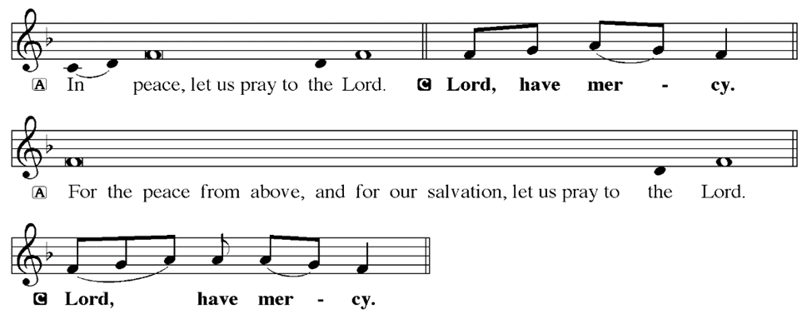
KYRIE
Notes:
Image: Five Loaves by Caroline Coolidge Brown. Copyright © Caroline Coolidge Brown. All rights reserved. Used by permission of the artist.

Slide 26
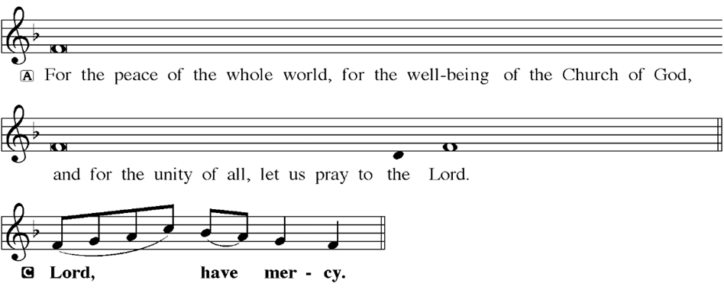
KYRIE
Notes:
Image: Five Loaves by Caroline Coolidge Brown. Copyright © Caroline Coolidge Brown. All rights reserved. Used by permission of the artist.

Slide 27
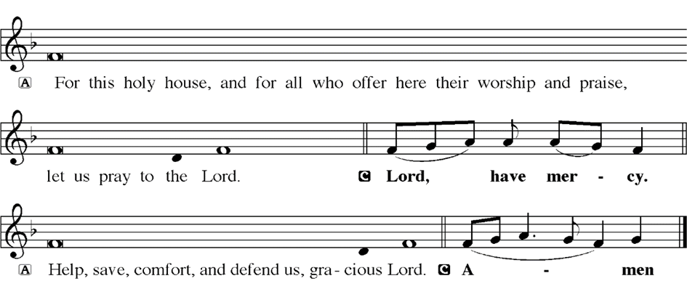
KYRIE
Notes:
Image: Five Loaves by Caroline Coolidge Brown. Copyright © Caroline Coolidge Brown. All rights reserved. Used by permission of the artist.

Slide 28
HYMN OF PRAISE
Glory be to God in heaven;
peace, goodwill to all the earth.
Mighty God of all creation,
Father of surpassing worth:
we exalt you, we adore you,
we lift high our thanks and praise.
Saints and angels bow before you; here on earth our songs we raise.
Notes:
Image: Five Loaves by Caroline Coolidge Brown. Copyright © Caroline Coolidge Brown. All rights reserved. Used by permission of the artist.

Slide 29
HYMN OF PRAISE
Glory be to Christ forever,
Lamb of God and Lord of love.
Son of God and gracious Savior, you have come from heav’n above;
on the cross you died to save us; now you reign at God’s right hand.
Hear our prayer; restore, forgive us; in your promise firm we stand.
Notes:
Image: Five Loaves by Caroline Coolidge Brown. Copyright © Caroline Coolidge Brown. All rights reserved. Used by permission of the artist.

Slide 30
HYMN OF PRAISE
Holy One we now acclaim you;
Lord alone, to you we call;
Holy One in faith we name you,
God most high, yet near to all:
Jesus Christ, with God the Spirit,
in the Father’s splendor bright.
For the peace that we inherit,
glory be to God on high!
Notes:
Image: Five Loaves by Caroline Coolidge Brown. Copyright © Caroline Coolidge Brown. All rights reserved. Used by permission of the artist.

Slide 31
PRAYER OF THE DAY
P: Let us pray… God of all, you call us into one Body of Christ for the good of the world. Strengthen us through your Word, that we might support and sustain one another in all that you call us to do. In Jesus’ name we pray.
C: Amen
Notes:
Image: Five Loaves by Caroline Coolidge Brown. Copyright © Caroline Coolidge Brown. All rights reserved. Used by permission of the artist.

Slide 32
Notes:
Image: Five Loaves by Caroline Coolidge Brown. Copyright © Caroline Coolidge Brown. All rights reserved. Used by permission of the artist.

Slide 33
Scripture Reading
L: Our scripture reading for this day is from Luke, Chapter 1.
C: Glory to you O’ Lord!
Notes:
Image: Five Loaves by Caroline Coolidge Brown. Copyright © Caroline Coolidge Brown. All rights reserved. Used by permission of the artist.

Slide 34
Luke 1:5-13, 57-80
⁵ In the days of King Herod of Judea, there was a priest named Zechariah, who belonged to the priestly order of Abijah. His wife was a descendant of Aaron, and her name was Elizabeth. ⁶ Both of them were righteous before God, living blamelessly according to all the commandments and regulations of the Lord. ⁷But they had no children, because Elizabeth was
Notes:
Image: Five Loaves by Caroline Coolidge Brown. Copyright © Caroline Coolidge Brown. All rights reserved. Used by permission of the artist.

Slide 35
Luke 1:5-13, 57-80
barren, and both were getting on in years.
⁸ Once when he was serving as priest before God and his section was on duty, ⁹ he was chosen by lot, according to the custom of the priesthood, to enter the sanctuary of the Lord and offer incense. ¹⁰ Now at the time of the incense offering, the whole assembly of the people was
Notes:
Image: Five Loaves by Caroline Coolidge Brown. Copyright © Caroline Coolidge Brown. All rights reserved. Used by permission of the artist.

Slide 36
Luke 1:5-13, 57-80
praying outside. ¹¹ Then there appeared to him an angel of the Lord, standing at the right side of the altar of incense. ¹² When Zechariah saw him, he was terrified; and fear overwhelmed him. ¹³ But the angel said to him, “Do not be afraid, Zechariah, for your prayer has been heard. Your wife Elizabeth will bear you a son, and you will name him John.”
Notes:
Image: Five Loaves by Caroline Coolidge Brown. Copyright © Caroline Coolidge Brown. All rights reserved. Used by permission of the artist.

Slide 37
Luke 1:5-13, 57-80
⁵⁷ Now the time came for Elizabeth to give birth, and she bore a son. ⁵⁸ Her neighbors and relatives heard that the Lord had shown his great mercy to her, and they rejoiced with her.
⁵⁹ On the eighth day they came to circumcise the child, and they were going to name him Zechariah after his father. ⁶⁰ But his mother said, “No; he is to be called John.” ⁶¹ They said to her,
Notes:
Image: Five Loaves by Caroline Coolidge Brown. Copyright © Caroline Coolidge Brown. All rights reserved. Used by permission of the artist.

Slide 38
Luke 1:5-13, 57-80
“None of your relatives has this name.” ⁶² Then they began motioning to his father to find out what name he wanted to give him. ⁶³ He asked for a writing tablet and wrote, “His name is John.” And all of them were amazed. ⁶⁴ Immediately his mouth was opened and his tongue freed, and he began to speak, praising God. ⁶⁵ Fear came over all their neighbors, and all these things
Notes:
Image: Five Loaves by Caroline Coolidge Brown. Copyright © Caroline Coolidge Brown. All rights reserved. Used by permission of the artist.

Slide 39
Luke 1:5-13, 57-80
were talked about throughout the entire hill country of Judea. ⁶⁶ All who heard them pondered them and said, “What then will this child become?” For, indeed, the hand of the Lord was with him.
⁶⁷ Then his father Zechariah was filled with the Holy Spirit and spoke this prophecy:
⁶⁸ “Blessed be the Lord God of Israel,
Notes:
Image: Five Loaves by Caroline Coolidge Brown. Copyright © Caroline Coolidge Brown. All rights reserved. Used by permission of the artist.

Slide 40
Luke 1:5-13, 57-80
for he has looked favorably on his people and redeemed them. ⁶⁹ He has raised up a mighty savior for us in the house of his servant David, ⁷⁰ as he spoke through the mouth of his holy prophets from of old, ⁷¹ that we would be saved from our enemies and from the hand of all who hate us. ⁷² Thus he has shown the mercy promised to our ancestors, and
Notes:
Image: Five Loaves by Caroline Coolidge Brown. Copyright © Caroline Coolidge Brown. All rights reserved. Used by permission of the artist.

Slide 41
Luke 1:5-13, 57-80
has remembered his holy covenant, ⁷³ the oath that he swore to our ancestor Abraham, to grant us ⁷⁴ that we, being rescued from the hands of our enemies, might serve him without fear, ⁷⁵ in holiness and righteousness before him all our days. ⁷⁶ And you, child, will be called the prophet of the Most High; for you will go before the Lord to prepare his ways, ⁷⁷ to give knowledge
Notes:
Image: Five Loaves by Caroline Coolidge Brown. Copyright © Caroline Coolidge Brown. All rights reserved. Used by permission of the artist.

Slide 42
Luke 1:5-13, 57-80
of salvation to his people by the forgiveness of their sins. ⁷⁸ By the tender mercy of our God, the dawn from on high will break upon us, ⁷⁹ to give light to those who sit in darkness and in the shadow of death, to guide our feet into the way of peace.” ⁸⁰ The child grew and became strong in spirit, and he was in the wilderness until the day he appeared publicly to Israel.
Notes:
Image: Five Loaves by Caroline Coolidge Brown. Copyright © Caroline Coolidge Brown. All rights reserved. Used by permission of the artist.

Slide 43
Luke 1:5-13, 57-80
R: This is the Word of the Lord.
C: Praise to You, O Christ (Spoken)
Notes:
Image: Five Loaves by Caroline Coolidge Brown. Copyright © Caroline Coolidge Brown. All rights reserved. Used by permission of the artist.

Slide 44
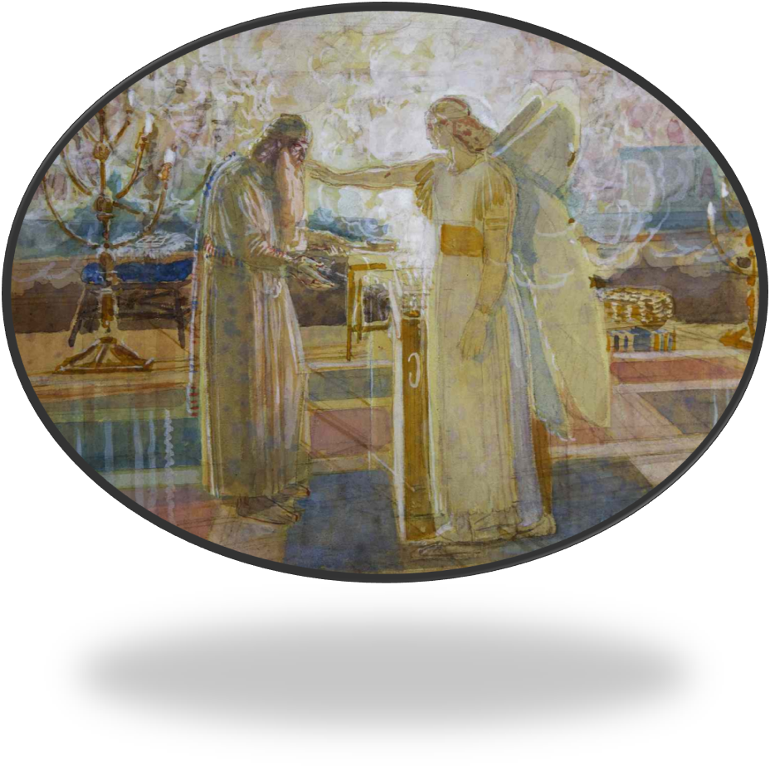
Sermon

Slide 45
Sermon

Slide 46
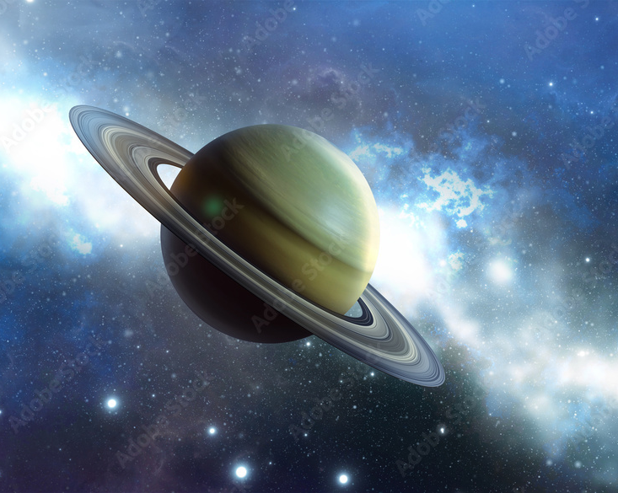
Sermon
Saturn

Slide 47
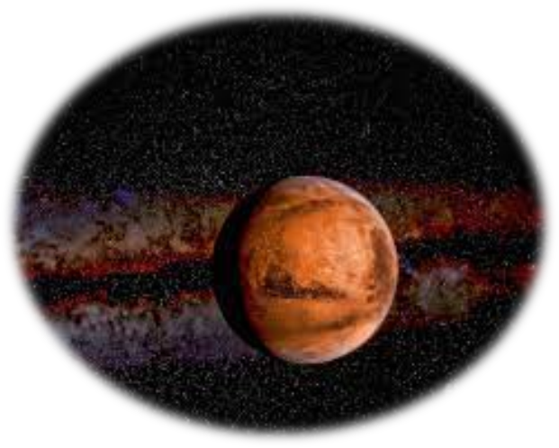
Sermon
Mars

Slide 48
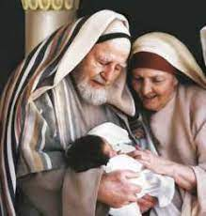
Sermon
Zechariah, Elizabeth and John

Slide 49
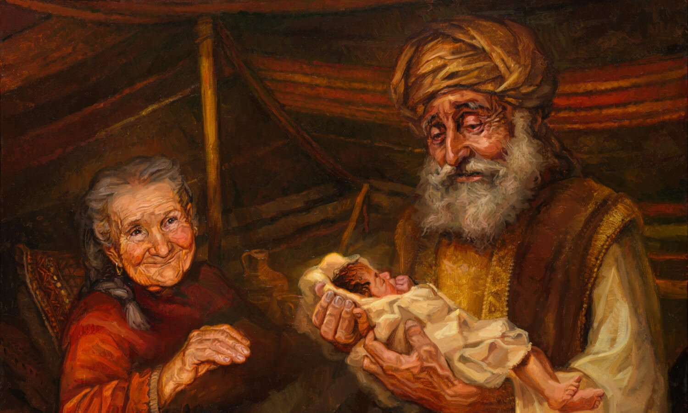
Sermon

Slide 50
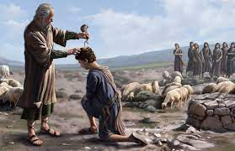
Sermon
Samuel Anointing David

Slide 51
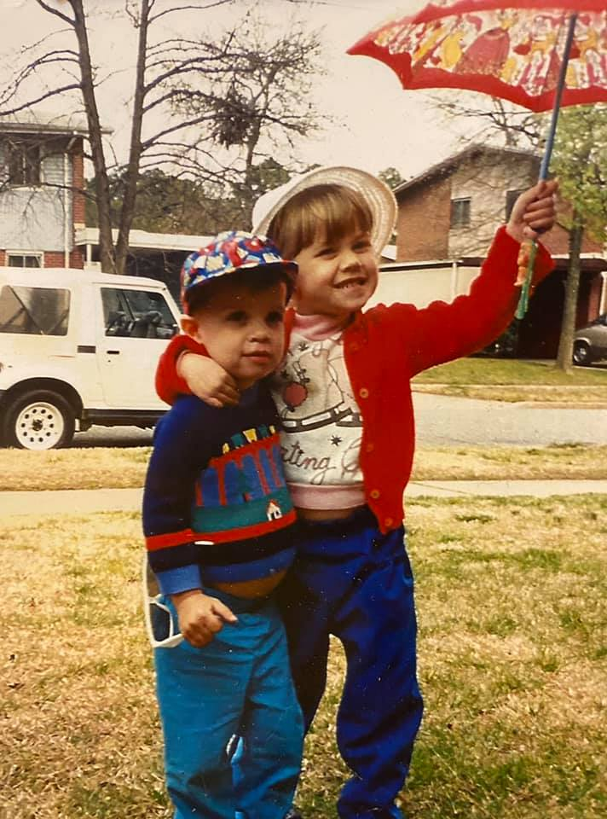
Sermon

Slide 52
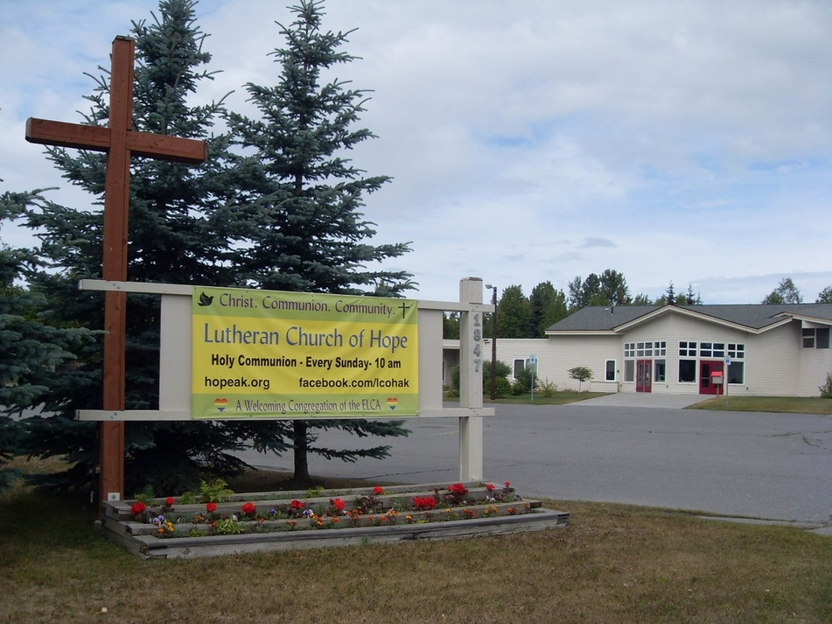
Sermon

Slide 53
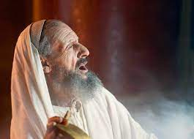
Sermon

Slide 54
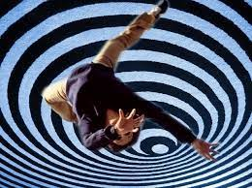
Sermon

Slide 55
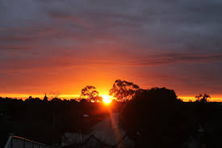
Sermon

Slide 56
Sermon

Slide 57
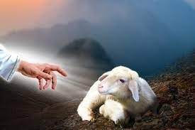
Sermon

Slide 58
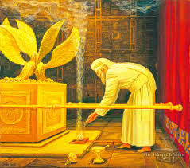
Sermon

Slide 59
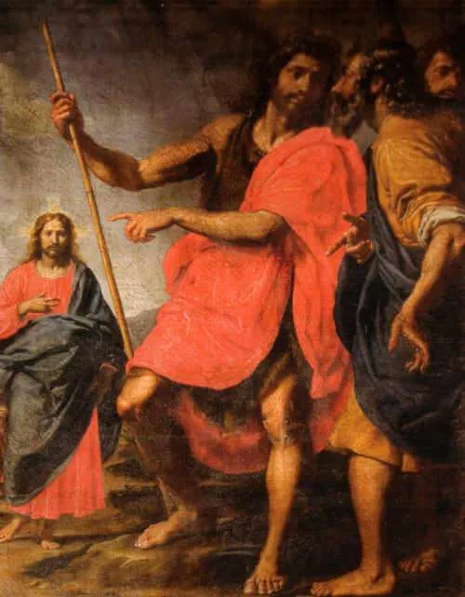
Sermon

Slide 60
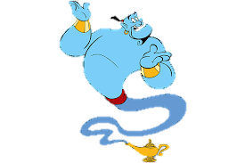
Sermon

Slide 61
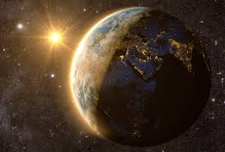
Sermon

Slide 62
Sermon

Slide 63
SPECIAL MUSIC
“Would I Know My Savior?”
by
Larry Harter

Slide 64
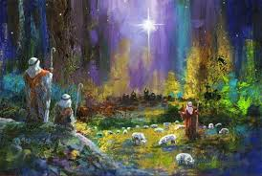
Hymn of the Day
“The First Noel”
LBW 56
(Verses 1-4 Only)

Slide 65
“The First Noel”
LBW 56
1 The first Noel the angel did say
was to certain poor shepherds in fields as they lay;
in fields where they lay, keeping their sheep,
on a cold winter's night that was so deep.

Slide 66
“The First Noel”
LBW 56
Refrían
Noel, Noel, Noel, Noel!
Born is the King of Israel.

Slide 67
“The First Noel”
LBW 56
2 They looked up and saw a star
shining in the east beyond them far;
and to the earth it gave great light,
and so it continued both day and night.

Slide 68
“The First Noel”
LBW 56
Refrían
Noel, Noel, Noel, Noel!
Born is the King of Israel.

Slide 69
“The First Noel”
LBW 56
4 This star drew near to the northwest,
o'er Bethlehem it took its rest;
and there it did both stop and stay
right over the place where Jesus lay.

Slide 70
“The First Noel”
LBW 56
Refrían
Noel, Noel, Noel, Noel!
Born is the King of Israel.

Slide 71
“The First Noel”
LBW 56
3 And by the light of that same star
three wise men came from country far;
to seek for a king was their intent,
and to follow the star wherever it went.

Slide 72
“The First Noel”
LBW 56
Refrían
Noel, Noel, Noel, Noel!
Born is the King of Israel.

Slide 73
APOSTLE’S CREED
C: I believe in God, the Father almighty, creator of heaven and earth.

Slide 74
APOSTLE’S CREED
C: I believe in Jesus Christ, his only Son, our Lord. He was conceived by the power of the Holy Spirit and born of the virgin Mary. He suffered under Pontius Pilate, was crucified, died, and was buried.

Slide 75
APOSTLE’S CREED
C: He descended into hell. On the third day he rose again. He ascended into heaven, and is seated at the right hand of the Father. He will come again to judge the living and the dead.

Slide 76
APOSTLE’S CREED
C: I believe in the Holy Spirit, the holy catholic Church, the communion of saints, the forgiveness of sins, the resurrection of the body, and the life everlasting. Amen.

Slide 77
NICENE CREED
C: We believe in one God, the Father, the Almighty, maker of heaven and earth, of all that is, seen and unseen.

Slide 78
NICENE CREED
C: We believe in one Lord, Jesus Christ, the only Son of God, eternally begotten of the Father, God from God, Light from Light, true God from true God, begotten, not made, of one Being with the Father.

Slide 79
NICENE CREED
C: Through him all things were made. For us and for our salvation he came down from heaven; by the power of the Holy Spirit he became incarnate from the virgin Mary, and was made man. For our sake he was crucified under Pontius Pilate;

Slide 80
NICENE CREED
C: he suffered death and was buried. On the third day he rose again in accordance with the Scriptures; he ascended into heaven and is seated at the right hand of the Father. He will come again in glory to judge the living and the dead, and his kingdom will have no end.

Slide 81
NICENE CREED
C: We believe in the Holy Spirit, the Lord, the giver of life, who proceeds from the Father and the Son. With the Father and the Son he is worshiped and glorified. He has spoken through the prophets. We believe in one holy catholic and apostolic Church.

Slide 82
NICENE CREED
C: We acknowledge one Baptism for the forgiveness of sins. We look for the resurrection of the dead, and the life of the world to come. Amen.

Slide 83
PRAYERS OF INTERCESSION
Each petition will end with the words,
A: God of Promise,
The congregation will respond with:
C: In mercy, hear our prayer.

Slide 84
PRAYERS OF INTERCESSION
The prayer concludes…
P: We lift all our prayers, spoken and unspoken, into your loving arms, trusting in your love and mercy, through Jesus Christ, our Savior.
C: Amen.

Slide 85
SHARING OF THE Peace
The Sharing of the Peace that began when the congregation arrived is now shared with the Pastor at this time...
P: The peace of the Lord be with you always.
C: And also with you.

Slide 86
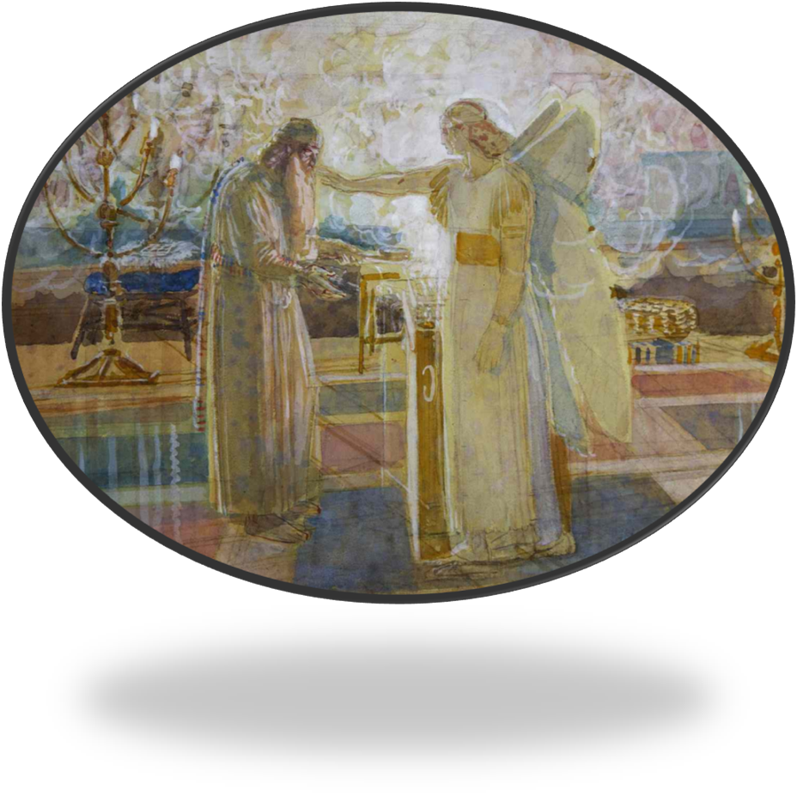
OFFERING
Notes:
Image: Five Loaves by Caroline Coolidge Brown. Copyright © Caroline Coolidge Brown. All rights reserved. Used by permission of the artist.

Slide 87
OFFERING PRAYER
Notes:
Image: Five Loaves by Caroline Coolidge Brown. Copyright © Caroline Coolidge Brown. All rights reserved. Used by permission of the artist.

Slide 88
THE GREAT THANKSGIVING
All the Baptized are welcome to celebrate this Holy Meal.

Slide 89
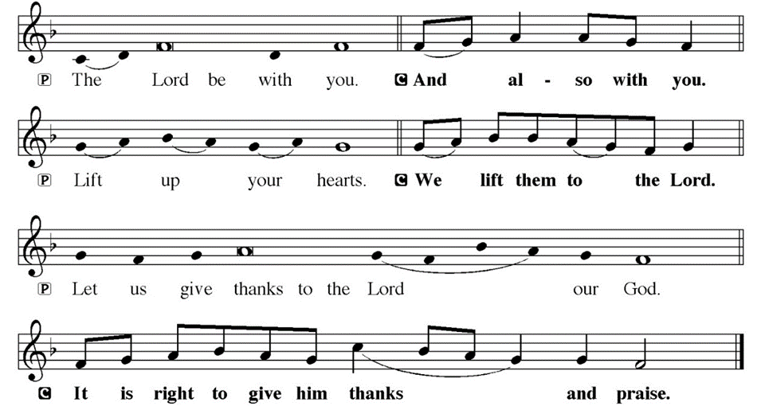
DIALOGUE

Slide 90
THE PREFACE
P: It is indeed right and salutary…
… we praise your name and join their unending hymn.

Slide 91
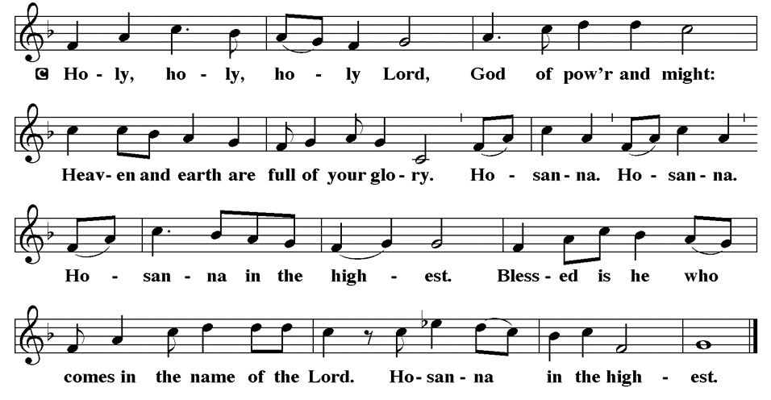
THE SANCTUS

Slide 92
EUCHARISTIC PRAYER
P: Holy God, the beginning and the end…
…both now and forever,
C: Amen.

Slide 93
THE LORD’S PRAYER
C: Our Father, who art in heaven, hallowed be thy name, thy kingdom come, thy will be done, on earth as it is in heaven. Give us this day our daily bread; and forgive us our trespasses, as we forgive those who trespass against us; and lead us not into temptation, but deliver us from evil.

Slide 94
THE LORD’S PRAYER
C: For thine is the kingdom, and the power, and the glory, forever and ever. Amen.

Slide 95
INVITATION TO COMMUNION
P: Come feast at the table of life, where Jesus meets us in the bread and wine, and rejoices with us in his promise of everlasting life. All is prepared for you. Receive this gift of love.

Slide 96
COMMUNION DISTRIBUTION
All will commune “At the Rail”.
The bread may be broken for distribution. As the ministers give the bread and wine, they say these words :
The body of Christ, given for you.
The blood of Christ, shed for you.
The communicant may say: Amen.

Slide 97
POST COMMUNION BLESSING
P: May this body and blood of our Lord and Savior, Jesus Christ, strengthen, keep, and unity us, ☩ now and forever,
C: Amen.

Slide 98
POST COMMUNION CANTACLE

Slide 99
POST COMMUNION CANTACLE

Slide 100
POST COMMUNION PRAYER
P: Let us pray… Generous God, in bread and cup you have revealed your glory for all people to see together. Nourished by this meal, send us out to proclaim your good news of liberation and release, brought to birth in Jesus Christ our Savior.
C: Amen.

Slide 101
ANNOUNCEMENTS
Notes:
Image: Five Loaves by Caroline Coolidge Brown. Copyright © Caroline Coolidge Brown. All rights reserved. Used by permission of the artist.

Slide 102
SENDING BLESSING
P: The God of peace bless you, the love of Christ sustain you in hope, and the anointing of the Spirit ☩ remain upon you now and forever.
C: Amen.

Slide 103
Sending Song
“Joy to the World”
LBW 39
Notes:
Image: Five Loaves by Caroline Coolidge Brown. Copyright © Caroline Coolidge Brown. All rights reserved. Used by permission of the artist.

Slide 104
“Joy to the World” LBW 39
1 Joy to the world, the Lord is come!
Let earth receive her king;
let ev'ry heart prepare him room
and heav'n and nature sing,
and heav'n and nature sing,
and heav'n, and heav’n and nature sing.
Notes:
Image: Preparing yeast dough. Copyright © tomasworks/iStock/Thinkstock. Used by permission.

Slide 105
“Joy to the World” LBW 39
2 Joy to the earth, the Savior reigns!
Let all their songs employ,
while fields and floods, rocks, hills, and plains
repeat the sounding joy,
repeat the sounding joy,
repeat, repeat the sounding joy.
Notes:
Image: Preparing yeast dough. Copyright © tomasworks/iStock/Thinkstock. Used by permission.

Slide 106
“Joy to the World” LBW 39
3 No more let sin and sorrow grow
nor thorns infest the ground;
he comes to make his blessings flow
far as the curse is found,
far as the curse is found,
far as, far as the curse is found.
Notes:
Image: Preparing yeast dough. Copyright © tomasworks/iStock/Thinkstock. Used by permission.

Slide 107
“Joy to the World” LBW 39
4 He rules the world with truth and grace
and makes the nations prove
the glories of his righteousness
and wonders of his love,
and wonders of his love,
and wonders, wonders of his love.
Notes:
Image: Preparing yeast dough. Copyright © tomasworks/iStock/Thinkstock. Used by permission.

Slide 108
DISMISSAL
P: … Depart in Christ’s Love.
C: Seeking, welcoming, and serving all. Amen!
POSTLUDE
Pre-Recorded By
Roxanne Groff
From sundaysandseasons.com. Copyright © 2023 Augsburg Fortress. All rights reserved. Reprinted by permission under Augsburg Fortress Liturgies Annual License #SAS023830. New Revised Standard Version Bible, Copyright © 1989, Division of Christian Education of the National Council of the Churches of Christ in the United States of America. Used by permission. All rights reserved. Revised Common Lectionary, Copyright © 1992 Consultation on Common Texts, admin Augsburg Fortress. Used by permission.

