Slide 1
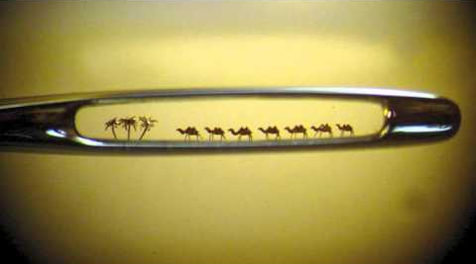
February 11, 2024
WELCOME!
Trinity Lutheran Church
It is easier for a camel …
Notes:
Image: Five Loaves by Caroline Coolidge Brown. Copyright © Caroline Coolidge Brown. All rights reserved. Used by permission of the artist.

Slide 2
= Please stand if able
= Please be seated
Prelude - By Pan Sherman
Office of the Acolyte
Ringing of the Bell
Welcome

Slide 3
THANKSGIVING FOR BAPTISM
All may make the sign of the cross, the sign marked at baptism, as the presiding minister begins.
P: Blessed be the holy Trinity, ☩ one God, the fountain of living water, the rock who gave us birth, our light and our salvation.
C: Amen.
Notes:
Image: Preparing yeast dough. Copyright © tomasworks/iStock/Thinkstock. Used by permission.

Slide 4
P: Joined to Christ in the waters of baptism, we are clothed with God's mercy and forgiveness. Let us give thanks for the gift of baptism.
Water may be poured into the font as the presiding minister gives thanks.
THANKSGIVING FOR BAPTISM
Notes:
Image: Preparing yeast dough. Copyright © tomasworks/iStock/Thinkstock. Used by permission.

Slide 5
P: We give you thanks, O God, for in the beginning your Spirit moved over the waters and by your Word you created the world, calling forth life in which you took delight. Through the waters of the flood you delivered Noah and his family. Through the sea you led your people Israel from slavery into freedom.
THANKSGIVING FOR BAPTISM
Notes:
Image: Preparing yeast dough. Copyright © tomasworks/iStock/Thinkstock. Used by permission.

Slide 6
P: At the river your Son was baptized by John and anointed with the Holy Spirit. By water and your Word you claim us as daughters and sons, making us heirs of your promise and servants of all. We praise you for the gift of water that sustains life, and above all we praise you for the gift of new life in Jesus Christ.
THANKSGIVING FOR BAPTISM
Notes:
Image: Preparing yeast dough. Copyright © tomasworks/iStock/Thinkstock. Used by permission.

Slide 7
P: Shower us with your Spirit, and renew our lives with your forgiveness, grace, and love. To you be given honor and praise through Jesus Christ our Lord in the unity of the Holy Spirit, now and forever.
THANKSGIVING FOR BAPTISM
C: Amen.
Notes:
Image: Preparing yeast dough. Copyright © tomasworks/iStock/Thinkstock. Used by permission.

Slide 8
CONFESSION AND FORGIVENESS
All may make the sign of the cross, the sign marked at baptism…
L: We confess our sins before God and one another.
Pause for silence and reflection.
L: God of love,
Notes:
Image: Five Loaves by Caroline Coolidge Brown. Copyright © Caroline Coolidge Brown. All rights reserved. Used by permission of the artist.

Slide 9
CONFESSION AND FORGIVENESS
C: When we look inward and are honest with ourselves, we see where we have lived as though you are not our God. We have sought after our own gain rather than the good of all. We have not loved you or our neighbors as ourselves. We have betrayed and denied you in what we have done and not done.
Notes:
Image: Five Loaves by Caroline Coolidge Brown. Copyright © Caroline Coolidge Brown. All rights reserved. Used by permission of the artist.

Slide 10
CONFESSION AND FORGIVENESS
C: Create in us clean hearts, O God, that we might become what you have called us to be.
Notes:
Image: Five Loaves by Caroline Coolidge Brown. Copyright © Caroline Coolidge Brown. All rights reserved. Used by permission of the artist.

Slide 11
CONFESSION AND FORGIVENESS
L: God whose unfathomable love went to the cross for our sake now forgives us all our sins and welcomes us all over again into the promise of eternal life in ☩ Christ’s name.
C: Amen.
Notes:
Image: Five Loaves by Caroline Coolidge Brown. Copyright © Caroline Coolidge Brown. All rights reserved. Used by permission of the artist.

Slide 12
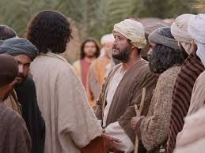
GATHERING SONG
“Let Us Tongues and Talents Employ”
ELW 674
Notes:
Image: Five Loaves by Caroline Coolidge Brown. Copyright © Caroline Coolidge Brown. All rights reserved. Used by permission of the artist.

Slide 13
“Let Us Tongues and Talents Employ” ELW 674
1 Let us talents and tongues employ,
reaching out with a shout of joy:
bread is broken, the wine is poured,
Christ is spoken and seen and heard.
Notes:
Image: Five Loaves by Caroline Coolidge Brown. Copyright © Caroline Coolidge Brown. All rights reserved. Used by permission of the artist.

Slide 14
“Let Us Tongues and Talents Employ” ELW 674
Refrain
Jesus lives again, earth can breathe again,
pass the Word around: loaves abound!
Jesus lives again, earth can breathe again,
pass the Word around: loaves abound!
Notes:
Image: Five Loaves by Caroline Coolidge Brown. Copyright © Caroline Coolidge Brown. All rights reserved. Used by permission of the artist.

Slide 15
“Let Us Tongues and Talents Employ” ELW 674
2 Christ is able to make us one,
at the table he sets the tone,
teaching people to live to bless,
love in word and in deed express.
Notes:
Image: Five Loaves by Caroline Coolidge Brown. Copyright © Caroline Coolidge Brown. All rights reserved. Used by permission of the artist.

Slide 16
“Let Us Tongues and Talents Employ” ELW 674
Refrain
Jesus lives again, earth can breathe again,
pass the Word around: loaves abound!
Jesus lives again, earth can breathe again,
pass the Word around: loaves abound!
Notes:
Image: Five Loaves by Caroline Coolidge Brown. Copyright © Caroline Coolidge Brown. All rights reserved. Used by permission of the artist.

Slide 17
“Let Us Tongues and Talents Employ” ELW 674
3 Jesus calls us in, sends us out
bearing fruit in a world of doubt,
gives us love to tell, bread to share:
God (Immanuel) ev'rywhere!
Notes:
Image: Five Loaves by Caroline Coolidge Brown. Copyright © Caroline Coolidge Brown. All rights reserved. Used by permission of the artist.

Slide 18
“Let Us Tongues and Talents Employ” ELW 674
Refrain
Jesus lives again, earth can breathe again,
pass the Word around: loaves abound!
Jesus lives again, earth can breathe again,
pass the Word around: loaves abound!
Notes:
Image: Five Loaves by Caroline Coolidge Brown. Copyright © Caroline Coolidge Brown. All rights reserved. Used by permission of the artist.

Slide 19
APOSTOLIC GREETING
P: The grace of our Lord Jesus Christ, the love of God, and the communion of the Holy Spirit be with you all.
C: And also with you.
Notes:
Image: Five Loaves by Caroline Coolidge Brown. Copyright © Caroline Coolidge Brown. All rights reserved. Used by permission of the artist.

Slide 20
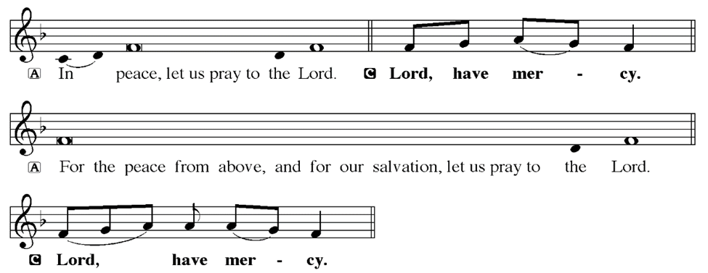
KYRIE
Notes:
Image: Five Loaves by Caroline Coolidge Brown. Copyright © Caroline Coolidge Brown. All rights reserved. Used by permission of the artist.

Slide 21
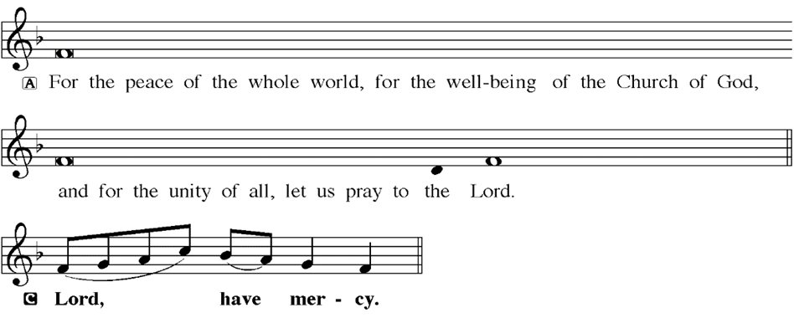
KYRIE
Notes:
Image: Five Loaves by Caroline Coolidge Brown. Copyright © Caroline Coolidge Brown. All rights reserved. Used by permission of the artist.

Slide 22
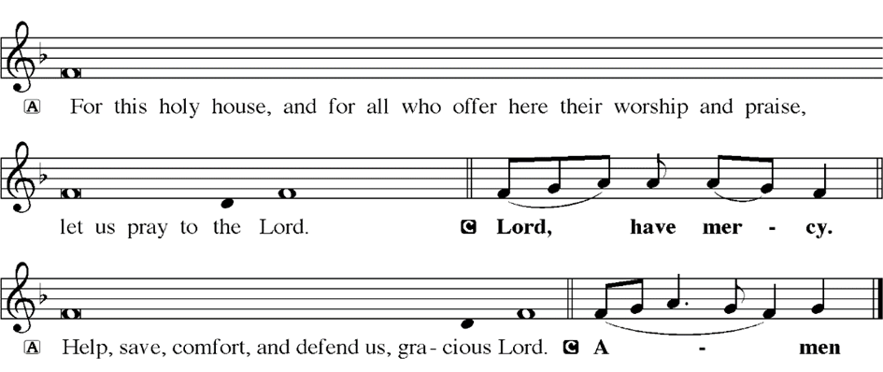
KYRIE
Notes:
Image: Five Loaves by Caroline Coolidge Brown. Copyright © Caroline Coolidge Brown. All rights reserved. Used by permission of the artist.

Slide 23
HYMN OF PRAISE
Glory be to God in heaven;
peace, goodwill to all the earth.
Mighty God of all creation,
Father of surpassing worth:
we exalt you, we adore you,
we lift high our thanks and praise.
Saints and angels bow before you; here on earth our songs we raise.
Notes:
Image: Five Loaves by Caroline Coolidge Brown. Copyright © Caroline Coolidge Brown. All rights reserved. Used by permission of the artist.

Slide 24
HYMN OF PRAISE
Glory be to Christ forever,
Lamb of God and Lord of love.
Son of God and gracious Savior, you have come from heav’n above;
on the cross you died to save us; now you reign at God’s right hand.
Hear our prayer; restore, forgive us; in your promise firm we stand.
Notes:
Image: Five Loaves by Caroline Coolidge Brown. Copyright © Caroline Coolidge Brown. All rights reserved. Used by permission of the artist.

Slide 25
HYMN OF PRAISE
Holy One we now acclaim you;
Lord alone, to you we call;
Holy One in faith we name you,
God most high, yet near to all:
Jesus Christ, with God the Spirit,
in the Father’s splendor bright.
For the peace that we inherit,
glory be to God on high!
Notes:
Image: Five Loaves by Caroline Coolidge Brown. Copyright © Caroline Coolidge Brown. All rights reserved. Used by permission of the artist.

Slide 26
PRAYER OF THE DAY
P: Let us pray… Holy God, You speak to us and guide our ways through your word. Inspire us by the Holy Spirit to dig deep and be transformed by the love, grace, power, and wisdom we find in your scriptures, that we might, as changed people, carry forth your vision of peace and justice into our community and the world. In Jesus’ name we pray.
C: Amen
Notes:
Image: Five Loaves by Caroline Coolidge Brown. Copyright © Caroline Coolidge Brown. All rights reserved. Used by permission of the artist.

Slide 27

Notes:
Image: Five Loaves by Caroline Coolidge Brown. Copyright © Caroline Coolidge Brown. All rights reserved. Used by permission of the artist.

Slide 28
Scripture Reading
L: Our scripture reading for this day is from the Gospel of Mark, the 10th Chapter.
C: Glory to you O’ Lord!
Notes:
Image: Five Loaves by Caroline Coolidge Brown. Copyright © Caroline Coolidge Brown. All rights reserved. Used by permission of the artist.

Slide 29
Mark 10:17-31
¹⁷ As he was setting out on a journey, a man ran up and knelt before him, and asked him, “Good Teacher, what must I do to inherit eternal life?” ¹⁸ Jesus said to him, “Why do you call me good? No one is good but God alone. ¹⁹ You know the commandments: ‘You shall not murder; You shall not commit adultery; You shall not steal; You shall not bear false witness; You shall not defraud; Honor your father and
Notes:
Image: Five Loaves by Caroline Coolidge Brown. Copyright © Caroline Coolidge Brown. All rights reserved. Used by permission of the artist.

Slide 30
Mark 10:17-31
mother.’” ²⁰He said to him, “Teacher, I have kept all these since my youth.” ²¹ Jesus, looking at him, loved him and said, “You lack one thing; go, sell what you own, and give the money to the poor, and you will have treasure in heaven; then come, follow me.” ²² When he heard this, he was shocked and went away grieving, for he had many possessions.
Notes:
Image: Five Loaves by Caroline Coolidge Brown. Copyright © Caroline Coolidge Brown. All rights reserved. Used by permission of the artist.

Slide 31
Mark 10:17-31
²³ Then Jesus looked around and said to his disciples, “How hard it will be for those who have wealth to enter the kingdom of God!” ²⁴ And the disciples were perplexed at these words. But Jesus said to them again, “Children, how hard it is to enter the kingdom of God! ²⁵ It is easier for a camel to go through the eye of a needle than for someone who is rich to enter the kingdom of God.” ²⁶ They were greatly
Notes:
Image: Five Loaves by Caroline Coolidge Brown. Copyright © Caroline Coolidge Brown. All rights reserved. Used by permission of the artist.

Slide 32
Mark 10:17-31
astounded and said to one another, “Then who can be saved?” ²⁷Jesus looked at them and said, “For mortals it is impossible, but not for God; for God all things are possible.”
²⁸ Peter began to say to him, “Look, we have left everything and followed you.” ²⁹ Jesus said, “Truly I tell you, there is no one who has left house or brothers or sisters or mother or father or
Notes:
Image: Five Loaves by Caroline Coolidge Brown. Copyright © Caroline Coolidge Brown. All rights reserved. Used by permission of the artist.

Slide 33
Mark 10:17-31
children or fields, for my sake and for the sake of the good news, ³⁰ who will not receive a hundredfold now in this age—houses, brothers and sisters, mothers and children, and fields, with persecutions—and in the age to come eternal life. ³¹ But many who are first will be last, and the last will be first.”
Notes:
Image: Five Loaves by Caroline Coolidge Brown. Copyright © Caroline Coolidge Brown. All rights reserved. Used by permission of the artist.

Slide 34
Mark 10:17-31
R: This is the Word of the Lord.
C: Praise to You, O Christ
Notes:
Image: Five Loaves by Caroline Coolidge Brown. Copyright © Caroline Coolidge Brown. All rights reserved. Used by permission of the artist.

Slide 35
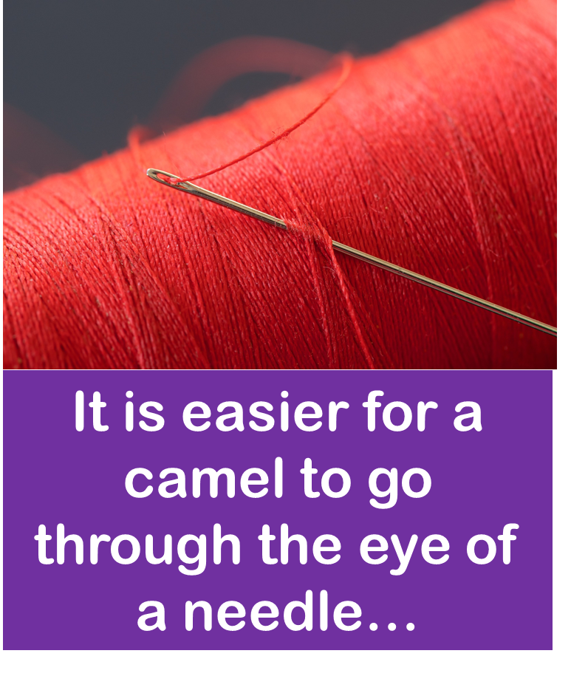
Sermon

Slide 36
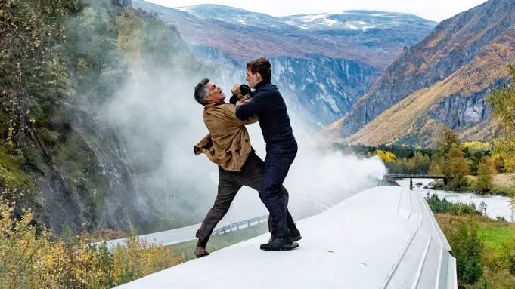
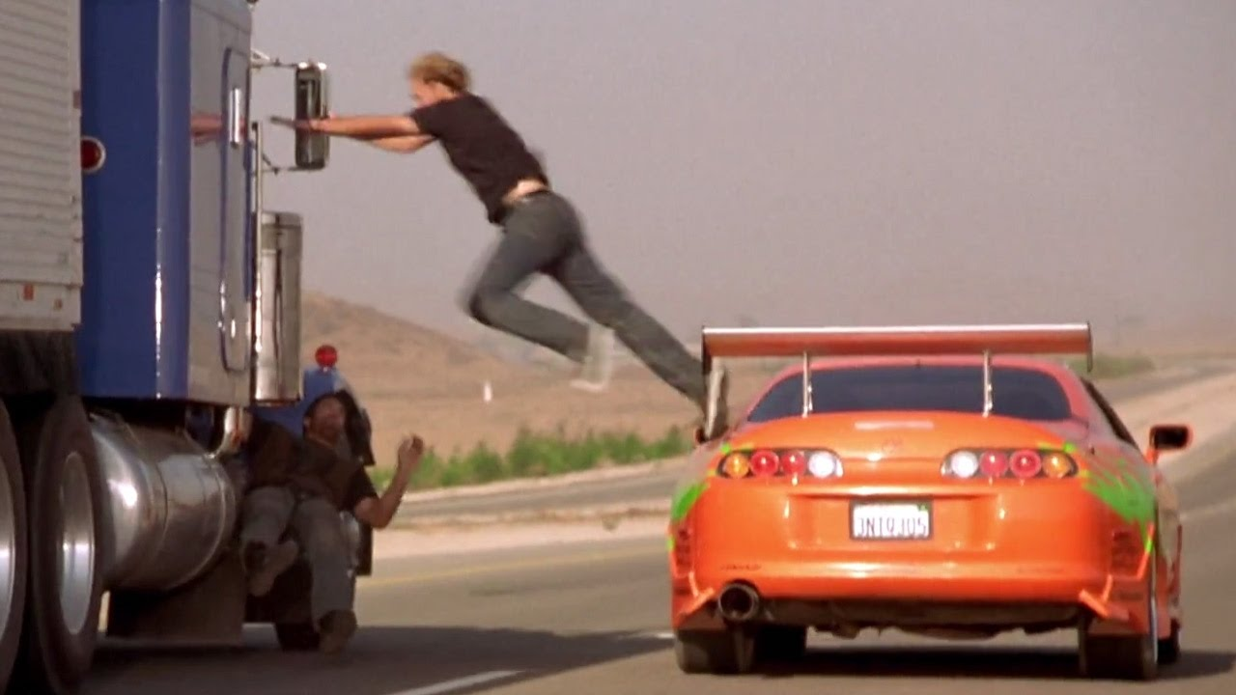
Sermon
Don’t Try This At Home!

Slide 37
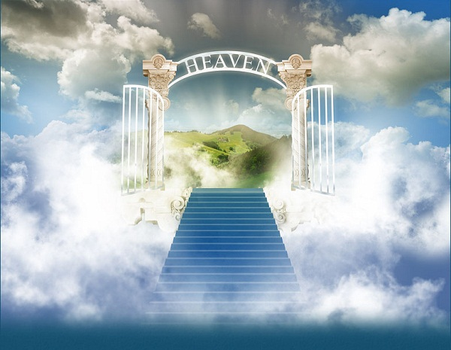
Sermon

Slide 38
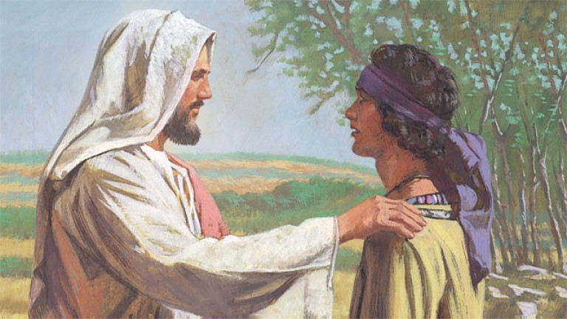
Sermon

Slide 39
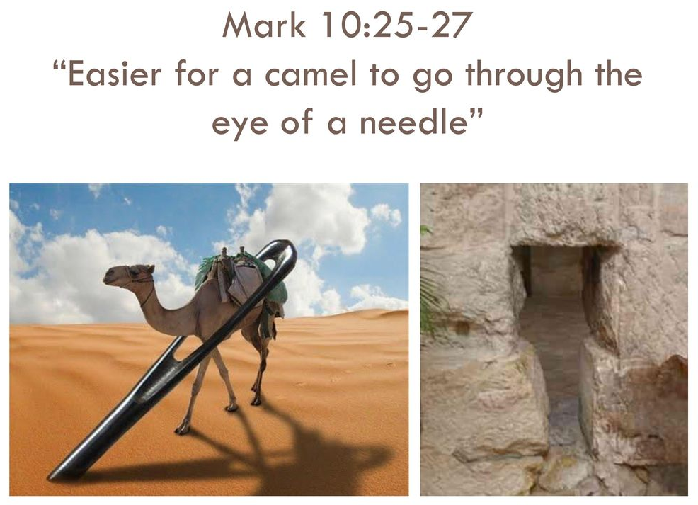
Sermon

Slide 40
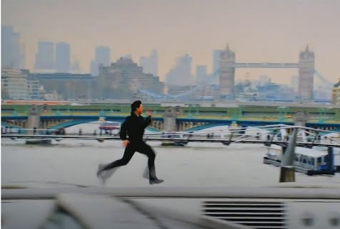
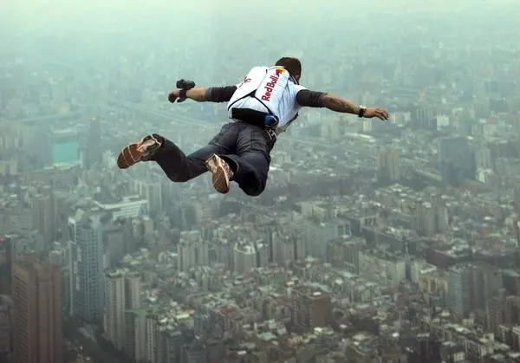
Sermon

Slide 41
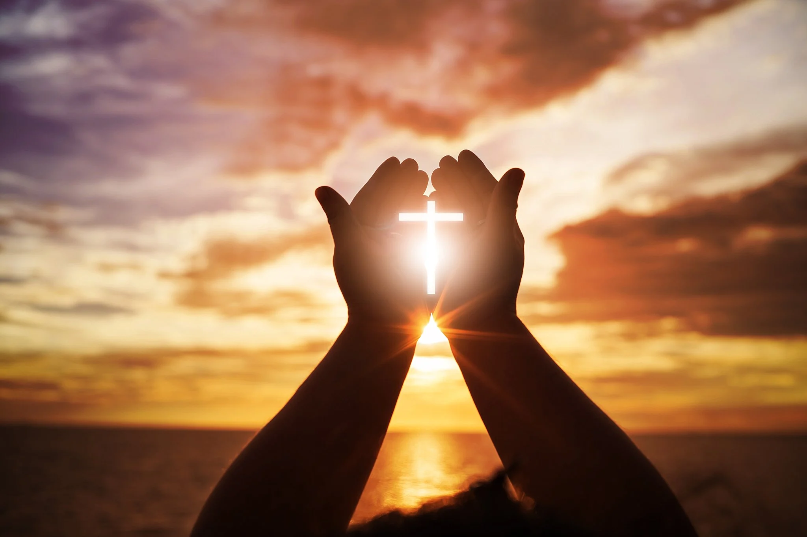
Sermon

Slide 42
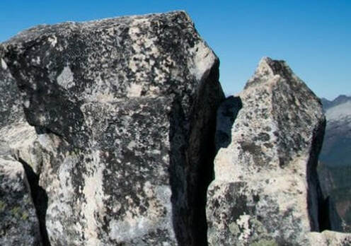
HYMN OF THE DAY
“XXX”
LBW XXX

Slide 43
“XXX” LBW XXX

Slide 44
APOSTLE’S CREED
C: I believe in God, the Father almighty, creator of heaven and earth.

Slide 45
APOSTLE’S CREED
C: I believe in Jesus Christ, his only Son, our Lord. He was conceived by the power of the Holy Spirit and born of the virgin Mary. He suffered under Pontius Pilate, was crucified, died, and was buried.

Slide 46
APOSTLE’S CREED
C: He descended into hell. On the third day he rose again. He ascended into heaven, and is seated at the right hand of the Father. He will come again to judge the living and the dead.

Slide 47
APOSTLE’S CREED
C: I believe in the Holy Spirit, the holy catholic Church, the communion of saints, the forgiveness of sins, the resurrection of the body, and the life everlasting. Amen.

Slide 48
NICENE CREED
C: We believe in one God, the Father, the Almighty, maker of heaven and earth, of all that is, seen and unseen.

Slide 49
NICENE CREED
C: We believe in one Lord, Jesus Christ, the only Son of God, eternally begotten of the Father, God from God, Light from Light, true God from true God, begotten, not made, of one Being with the Father.

Slide 50
NICENE CREED
C: Through him all things were made. For us and for our salvation he came down from heaven; by the power of the Holy Spirit he became incarnate from the virgin Mary, and was made man. For our sake he was crucified under Pontius Pilate;

Slide 51
NICENE CREED
C: he suffered death and was buried. On the third day he rose again in accordance with the Scriptures; he ascended into heaven and is seated at the right hand of the Father. He will come again in glory to judge the living and the dead, and his kingdom will have no end.

Slide 52
NICENE CREED
C: We believe in the Holy Spirit, the Lord, the giver of life, who proceeds from the Father and the Son. With the Father and the Son he is worshiped and glorified. He has spoken through the prophets. We believe in one holy catholic and apostolic Church.

Slide 53
NICENE CREED
C: We acknowledge one Baptism for the forgiveness of sins. We look for the resurrection of the dead, and the life of the world to come. Amen.

Slide 54
QUILT TYING AND PRESENTATION
This Quilt was lovingly crafted for recovery and healing especially the Trinity Prayers and Squares Quilting Ministry…
Let us pray…

Slide 55
PRAYERS OF INTERCESSION
Each petition will end with the words,
A: God of the journey,
The congregation will respond with:
C: In mercy, hear our prayer.

Slide 56
PRAYERS OF INTERCESSION
The prayer concludes…
P: Confident that you walk alongside us in our need, we lift to you all our prayers, spoken and unspoken, through Jesus Christ our savior.
C: Amen.

Slide 57

OFFERING
Notes:
Image: Five Loaves by Caroline Coolidge Brown. Copyright © Caroline Coolidge Brown. All rights reserved. Used by permission of the artist.

Slide 58
OFFERING PRAYER
Notes:
Image: Five Loaves by Caroline Coolidge Brown. Copyright © Caroline Coolidge Brown. All rights reserved. Used by permission of the artist.

Slide 59
THE GREAT THANKSGIVING
All the Baptized are welcome to celebrate this Holy Meal.

Slide 60
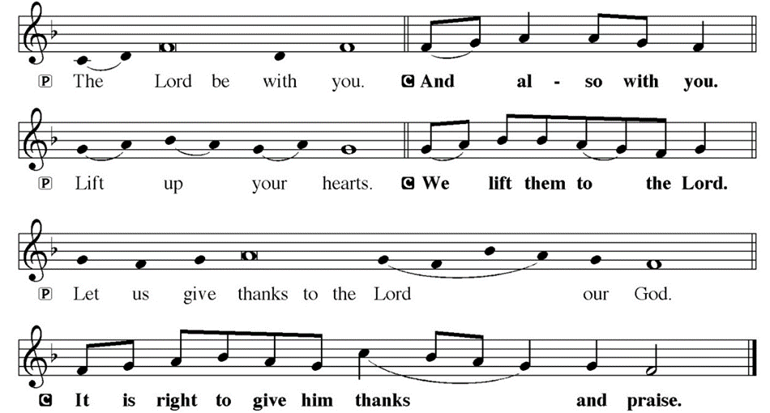
DIALOGUE

Slide 61
THE PREFACE
P: It is indeed right and salutary…
… we praise your name and join their unending hymn.

Slide 62
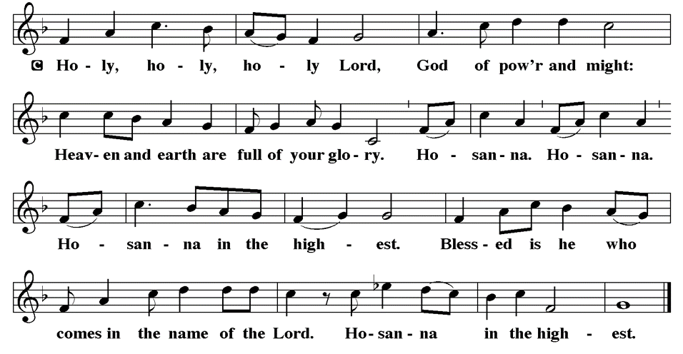
THE SANCTUS

Slide 63
EUCHARISTIC PRAYER
P: Holy God, our living Water…
…both now and forever.
C: Amen.

Slide 64
THE LORD’S PRAYER
C: Our Father, who art in heaven, hallowed be thy name, thy kingdom come, thy will be done, on earth as it is in heaven. Give us this day our daily bread; and forgive us our trespasses, as we forgive those who trespass against us; and lead us not into temptation, but deliver us from evil.

Slide 65
THE LORD’S PRAYER
C: For thine is the kingdom, and the power, and the glory, forever and ever. Amen.

Slide 66
INVITATION TO COMMUNION
P: You are invited now to the feast in which Jesus meets us and strengthens us for the work of the gospel. Come and be fed, for all is prepared.

Slide 67
COMMUNION DISTRIBUTION
All will commune “By Station”.
The bread may be broken for distribution. As the ministers give the bread and wine, they say these words :
The body of Christ, given for you.
The blood of Christ, shed for you.
The communicant may say: Amen.

Slide 68
POST COMMUNION BLESSING
P: May this body and blood of our Lord and Savior, Jesus Christ, strengthen, keep, and unity us, ☩ now and forever,
C: Amen.

Slide 69
POST COMMUNION CANTACLE

Slide 70
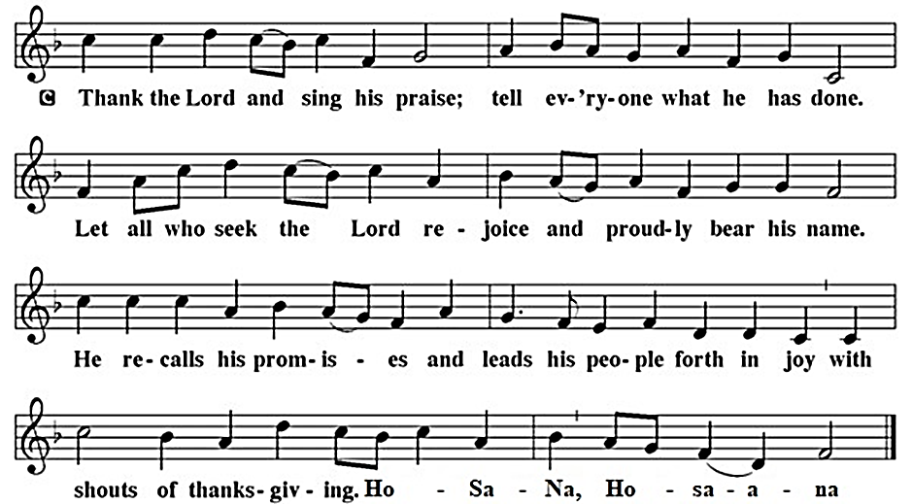
POST COMMUNION CANTACLE

Slide 71
POST COMMUNION PRAYER
P: Let us pray… Giver of every gift, Christ’s body is our food, and we are Christ’s body. Raise us to life by your power for the benefit of all and to your glory, now and forever.
C: Amen

Slide 72

ANNOUNCEMENTS
Notes:
Image: Five Loaves by Caroline Coolidge Brown. Copyright © Caroline Coolidge Brown. All rights reserved. Used by permission of the artist.

Slide 73
SENDING BLESSING
P: God who names you, Christ who claims you, and the Holy Spirit who dwells in you, ☩ bless you and remain with you always.
C: Amen.

Slide 74
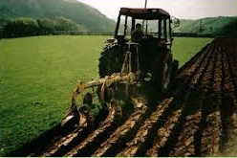
Sending Song
“We Plow the Fields and Scatter”
LBW 362
Notes:
Image: Five Loaves by Caroline Coolidge Brown. Copyright © Caroline Coolidge Brown. All rights reserved. Used by permission of the artist.

Slide 75
“We Plow the Fields and Scatter” LBW 362
1 We plow the fields and scatter
the good seed on the land,
but it is fed and watered
by God's almighty hand,
who sends the snow in winter,
the warmth to swell the grain,
the breezes and the sunshine,
and soft refreshing rain.
Notes:
Image: Preparing yeast dough. Copyright © tomasworks/iStock/Thinkstock. Used by permission.

Slide 76
“We Plow the Fields and Scatter” LBW 362
Refrain
All good gifts around us
are sent from heav'n above.
We thank you, Lord,
we thank you, Lord,
for all your love.
Notes:
Image: Preparing yeast dough. Copyright © tomasworks/iStock/Thinkstock. Used by permission.

Slide 77
“We Plow the Fields and Scatter” LBW 362
2 You only are the maker
of all things near and far.
You paint the wayside flower,
you light the evening star.
The winds and waves obey you,
by you the birds are fed;
much more to us, your children,
you give our daily bread.
Notes:
Image: Preparing yeast dough. Copyright © tomasworks/iStock/Thinkstock. Used by permission.

Slide 78
“We Plow the Fields and Scatter” LBW 362
Refrain
All good gifts around us
are sent from heav'n above.
We thank you, Lord,
we thank you, Lord,
for all your love.
Notes:
Image: Preparing yeast dough. Copyright © tomasworks/iStock/Thinkstock. Used by permission.

Slide 79
“We Plow the Fields and Scatter” LBW 362
3 We thank you, our creator,
for all things bright and good,
the seedtime and the harvest,
our life, our health, our food.
No gifts have we to offer
for all your love imparts,
but what you most would treasure—
our humble, thankful hearts
Notes:
Image: Preparing yeast dough. Copyright © tomasworks/iStock/Thinkstock. Used by permission.

Slide 80
“We Plow the Fields and Scatter” LBW 362
Refrain
All good gifts around us
are sent from heav'n above.
We thank you, Lord,
we thank you, Lord,
for all your love.
Notes:
Image: Preparing yeast dough. Copyright © tomasworks/iStock/Thinkstock. Used by permission.

Slide 81
DISMISSAL
P: … Depart in Christ’s Love.
C: Seeking, welcoming, and serving all. Amen!
POSTLUDE
By
Roxanne Groff
From sundaysandseasons.com. Copyright © 2024 Augsburg Fortress. All rights reserved. Reprinted by permission under Augsburg Fortress Liturgies Annual License #SAS023830. New Revised Standard Version Bible, Copyright © 1989, Division of Christian Education of the National Council of the Churches of Christ in the United States of America. Used by permission. All rights reserved. Revised Common Lectionary, Copyright © 1992 Consultation on Common Texts, admin Augsburg Fortress. Used by permission.

