Slide 1
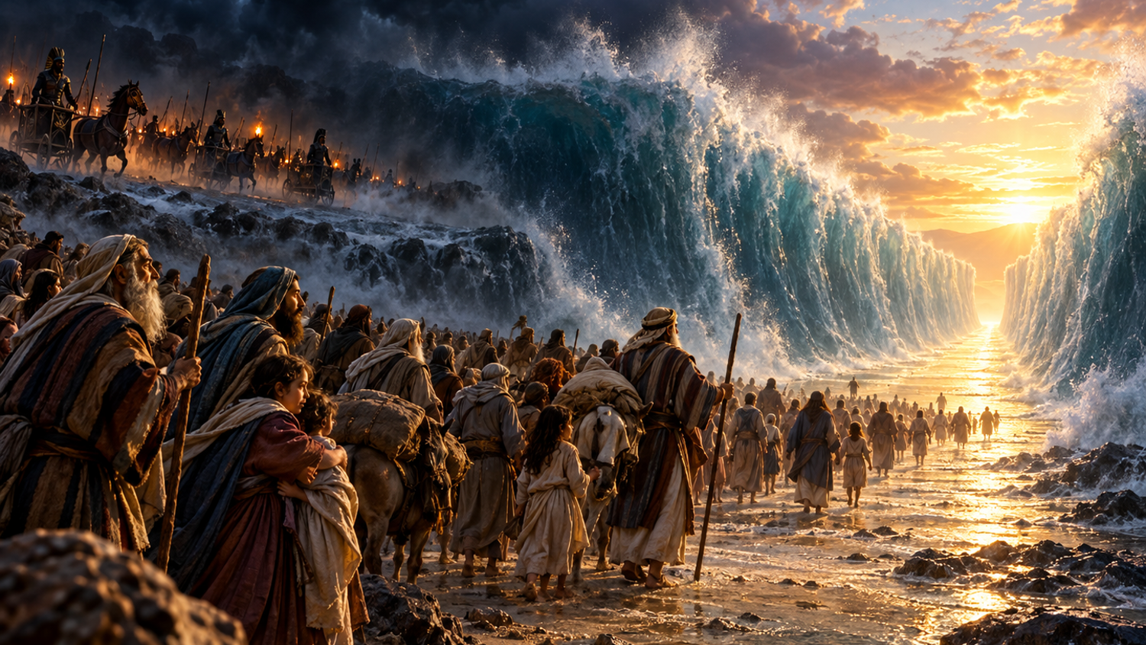
Trinity Evangelical Lutheran Church
October 4, 2026
WELCOME!
RESCUE AT THE SEA
EXODUS 14
FROM FEAR TO FREEDOM

Slide 2
= Please stand if able
= Please be seated
  Prelude by Pam Sherman
  Office of the Acolyte
  Ringing of the Bell
  Welcome

Slide 3
CONFESSION AND FORGIVENESS
All may make the sign of the cross, the sign marked at baptism…
L: We confess our sins before God and one another.
Pause for silence and reflection.
L: Creating and renewing God,

Slide 4
CONFESSION AND FORGIVENESS
C: You have made us in your image to carry your life-giving love as a blessing to all the world. Yet we fail again and again to live out your call. We place our trust in money and possessions, in flawed people and broken relationships, in the things that cannot sustain us.

Slide 5
CONFESSION AND FORGIVENESS
C: We do the things we do not want to do, and we fail to do the things we know you would have us do. Forgive us for all the ways we fall short. Open our eyes, hearts, and minds to your presence, and re-create us in your image each day, for the good of all that you have made.

Slide 6
CONFESSION AND FORGIVENESS
L: The God whose love outpoured caused the world to be, continues to pour this creative love on us. The God whose love outpoured in the life, death, and resurrection of Jesus Christ continues to pour this redeeming love upon us. Children of God, know that you are forgiven, and go forth refreshed and ready to answer God’s call to love and serve the whole of creation. In Jesus’ holy name.
C: Amen.

Slide 7
Gathering Song
“He Leadeth Me
LBW 501
EXODUS 14
FROM FEAR TO FREEDOM
RESCUE AT THE SEA

Slide 8
“He Leadeth Me” LBW 501
1 He leadeth me: oh, blessed thought!
Oh, words with heav’nly comfort fraught!
Whate’er I do, where’er I be,
still ’tis God’s hand that leadeth me.

Slide 9
“He Leadeth Me” LBW 501
Refrain
He leadeth me, he leadeth me,
by his own hand he leadeth me.
His faithful foll’wer I would be,
for by his hand he leadeth me.

Slide 10
“He Leadeth Me” LBW 501
2 Sometimes mid scenes of deepest gloom,
sometimes where Eden’s bowers bloom,
by waters calm, o’er troubled sea,
still ’tis God’s hand that leadeth me.

Slide 11
“He Leadeth Me” LBW 501
Refrain
He leadeth me, he leadeth me,
by his own hand he leadeth me.
His faithful foll’wer I would be,
for by his hand he leadeth me.

Slide 12
“He Leadeth Me” LBW 501
3 Lord, I would clasp thy hand in mine,
nor ever murmur nor repine;
content, whatever lot I see,
since ’tis my God that leadeth me.

Slide 13
“He Leadeth Me” LBW 501
Refrain
He leadeth me, he leadeth me,
by his own hand he leadeth me.
His faithful foll’wer I would be,
for by his hand he leadeth me.

Slide 14
“He Leadeth Me” LBW 501
4 And when my task on earth is done,
when by thy grace the vict’ry’s won,
e’en death’s cold wave I will not flee,
since God through Jordan leadeth me.

Slide 15
“He Leadeth Me” LBW 501
Refrain
He leadeth me, he leadeth me,
by his own hand he leadeth me.
His faithful foll’wer I would be,
for by his hand he leadeth me.

Slide 16
APOSTOLIC GREETING
P: The grace of our Lord Jesus Christ, the love of God, and the communion of the Holy Spirit be with you all.
C: And also with you.

Slide 17
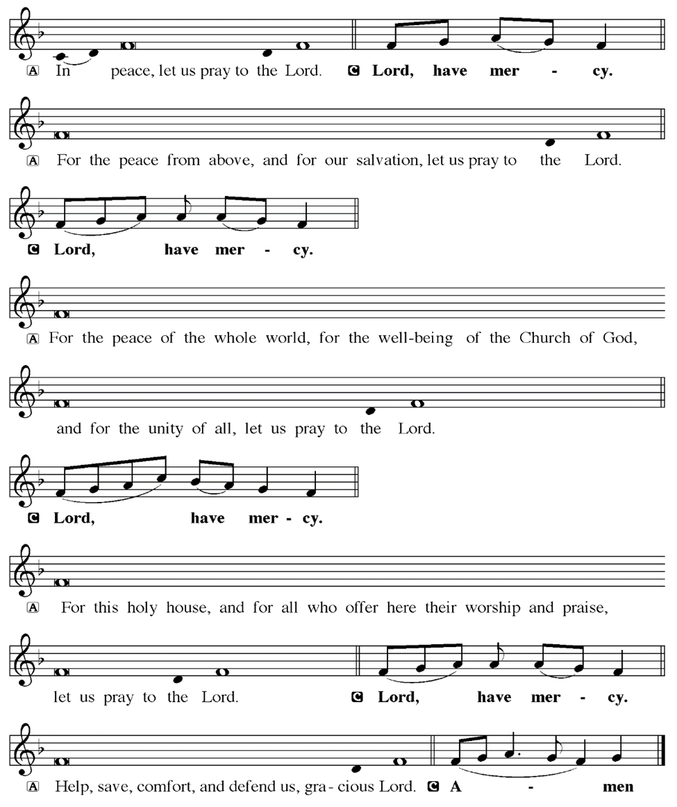
KYRIE

Slide 18
KYRIE

Slide 19
KYRIE

Slide 20
HYMN OF PRAISE
Glory be to God in heaven;
peace, goodwill to all the earth.
Mighty God of all creation,
Father of surpassing worth:
we exalt you, we adore you,
we lift high our thanks and praise.
Saints and angels bow before you; here on earth our songs we raise.

Slide 21
HYMN OF PRAISE
Glory be to Christ forever,
Lamb of God and Lord of love.
Son of God and gracious Savior, you have come from heav’n above;
on the cross you died to save us; now you reign at God’s right hand.
Hear our prayer; restore, forgive us; in your promise firm we stand.

Slide 22
HYMN OF PRAISE
Holy One we now acclaim you;
Lord alone, to you we call;
Holy One in faith we name you,
God most high, yet near to all:
Jesus Christ, with God the Spirit,
in the Father’s splendor bright.
For the peace that we inherit,
glory be to God on high!

Slide 23
PRAYER OF THE DAY
P: Let us pray… Liberating God, you have sent us forth into a world that often seems bent on the destruction of all that is good in your creation. Free us from our fears so that we might proclaim with boldness the truth of your desire for love, justice, and peace. Open a way for us through the voices of anger and hatred that threaten to drown us, that we might pass safely to a better world. In Jesus’ name we pray.
C: Amen

Slide 24


Slide 25
Scripture Reading
R: Our scripture reading is from Exodus, Chapter 14.
C: Glory to you O’ Lord!

Slide 26
Exodus 14:5-7, 10-14, 21-29
5When the king of Egypt was told that the people had fled, the minds of Pharaoh and his officials were changed toward the people, and they said, “What have we done, letting Israel leave our service?” 6So he had his chariot made ready, and took his army with him; 7he took six hundred picked chariots and all the other chariots of Egypt with officers

Slide 27
Exodus 14:5-7, 10-14, 21-29
all of them.
10As Pharaoh drew near, the Israelites looked back, and there were the Egyptians advancing on them. In great fear the Israelites cried out to the Lord. 11They said to Moses, “Was it because there were no graves in Egypt that you have taken us away to die in the wilderness? What have you done to

Slide 28
Exodus 14:5-7, 10-14, 21-29
us, bringing us out of Egypt? 12Is this not the very thing we told you in Egypt, ‘Let us alone and let us serve the Egyptians’? For it would have been better for us to serve the Egyptians than to die in the wilderness.” 13But Moses said to the people, “Do not be afraid, stand firm, and see the deliverance that the Lord will accomplish for you today; for the

Slide 29
Exodus 14:5-7, 10-14, 21-29
Egyptians whom you see today you shall never see again. 14The Lord will fight for you, and you have only to keep still.”
21Then Moses stretched out his hand over the sea. The Lord drove the sea back by a strong east wind all night, and turned the sea into dry land; and the waters were divided. 22The Israelites went into the sea on dry

Slide 30
Exodus 14:5-7, 10-14, 21-29
ground, the waters forming a wall for them on their right and on their left. 23The Egyptians pursued, and went into the sea after them, all of Pharaoh’s horses, chariots, and chariot drivers. 24At the morning watch the Lord in the pillar of fire and cloud looked down upon the Egyptian army, and threw the Egyptian army into panic. 25He clogged their chariot

Slide 31
Exodus 14:5-7, 10-14, 21-29
wheels so that they turned with difficulty. The Egyptians said, “Let us flee from the Israelites, for the Lord is fighting for them against Egypt.” 26Then the Lord said to Moses, “Stretch out your hand over the sea, so that the water may come back upon the Egyptians, upon their chariots and chariot drivers.” 27So Moses stretched out his hand over

Slide 32
Exodus 14:5-7, 10-14, 21-29
the sea, and at dawn the sea returned to its normal depth. As the Egyptians fled before it, the Lord tossed the Egyptians into the sea. 28The waters returned and covered the chariots and the chariot drivers, the entire army of Pharaoh that had followed them into the sea; not one of them remained.

Slide 33
Exodus 14:5-7, 10-14, 21-29
29But the Israelites walked on dry ground through the sea, the waters forming a wall for them on their right and on their left.

Slide 34
Exodus 14:5-7, 10-14, 21-29
R: This is the Word of the Lord.
C: Praise to You, O Christ

Slide 35
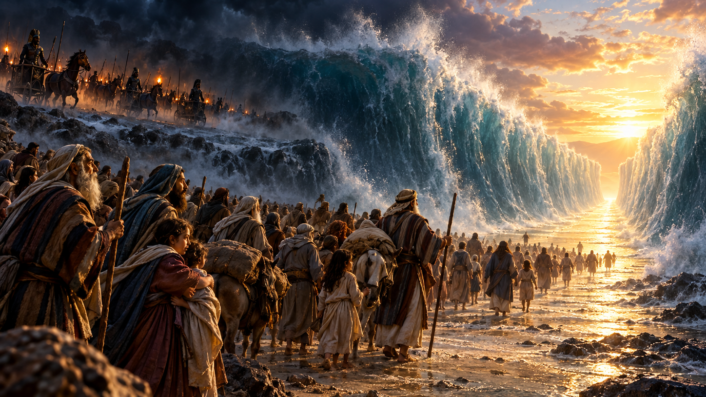
Sermon
RESCUE AT THE SEA
EXODUS 14 • FROM FEAR TO FREEDOM
Notes:
SLIDE 1 — RESCUE AT THE SEA. Opening overview; may also be reused to introduce prayers, hymns, or the sermon theme.

Slide 36
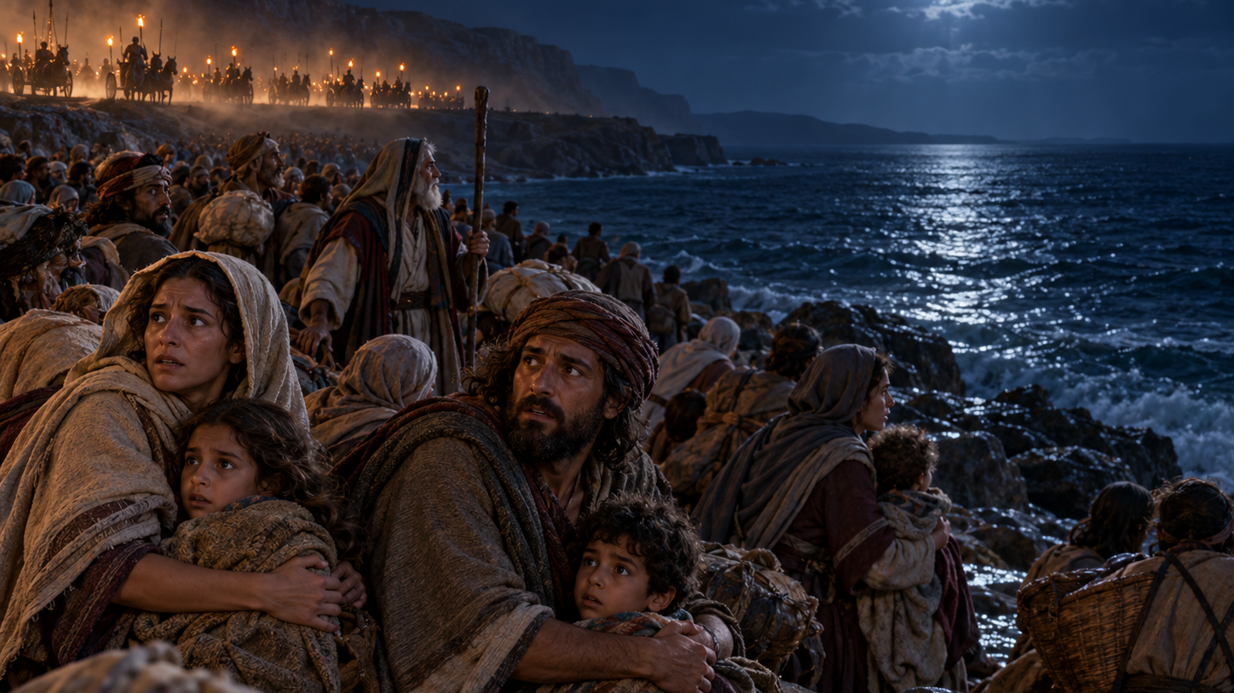
Sermon
FEAR REWRITES THE PAST
Notes:
SLIDE 2 — FEAR REWRITES THE PAST. Advance after the greeting at: ‘The people of Israel have made it out of Egypt, but they’re not yet free.’

Slide 37
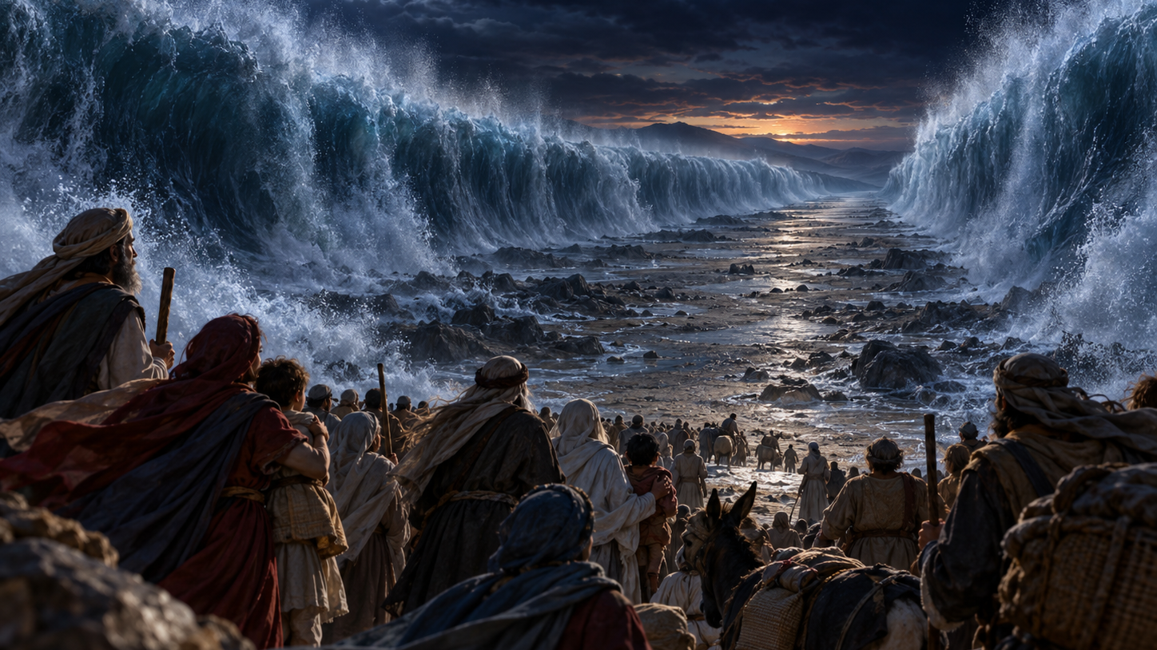
Sermon
A WAY THROUGH THE NIGHT
Notes:
SLIDE 3 — A WAY THROUGH THE NIGHT. Advance at: ‘Moses does not shame the people for being afraid.’

Slide 38
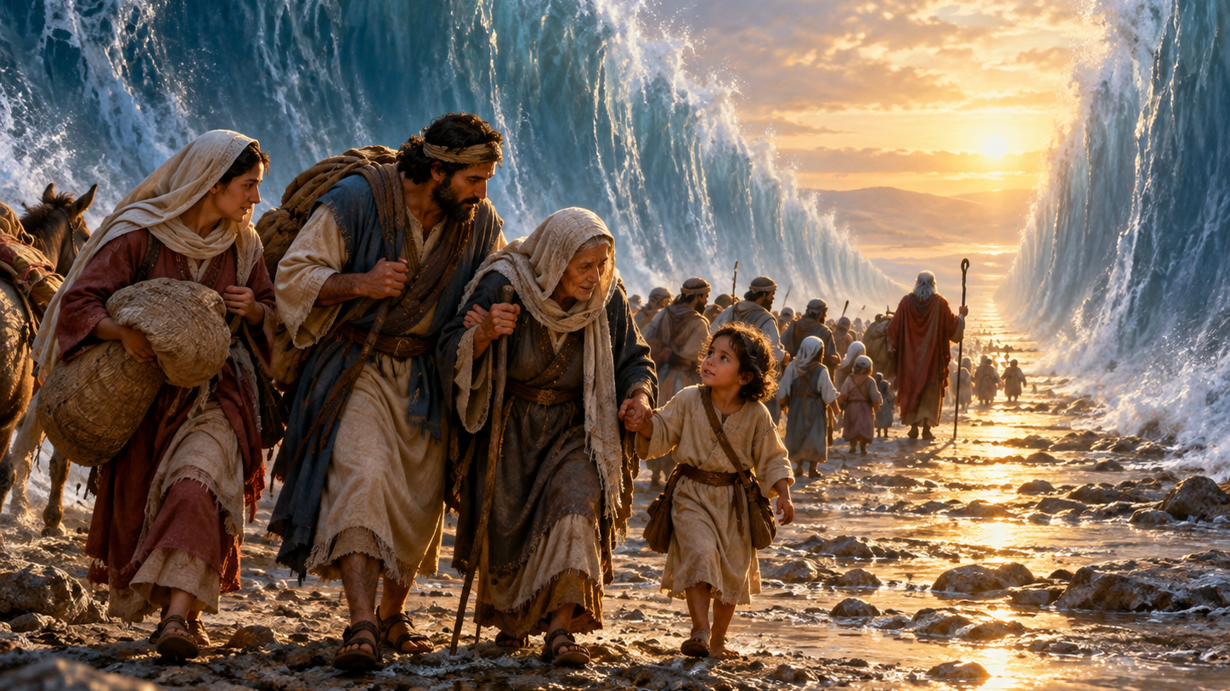
Sermon
STILL, THEN FORWARD
Notes:
SLIDE 4 — STILL, THEN FORWARD. Advance at: ‘Faith holds stillness and movement together.’

Slide 39
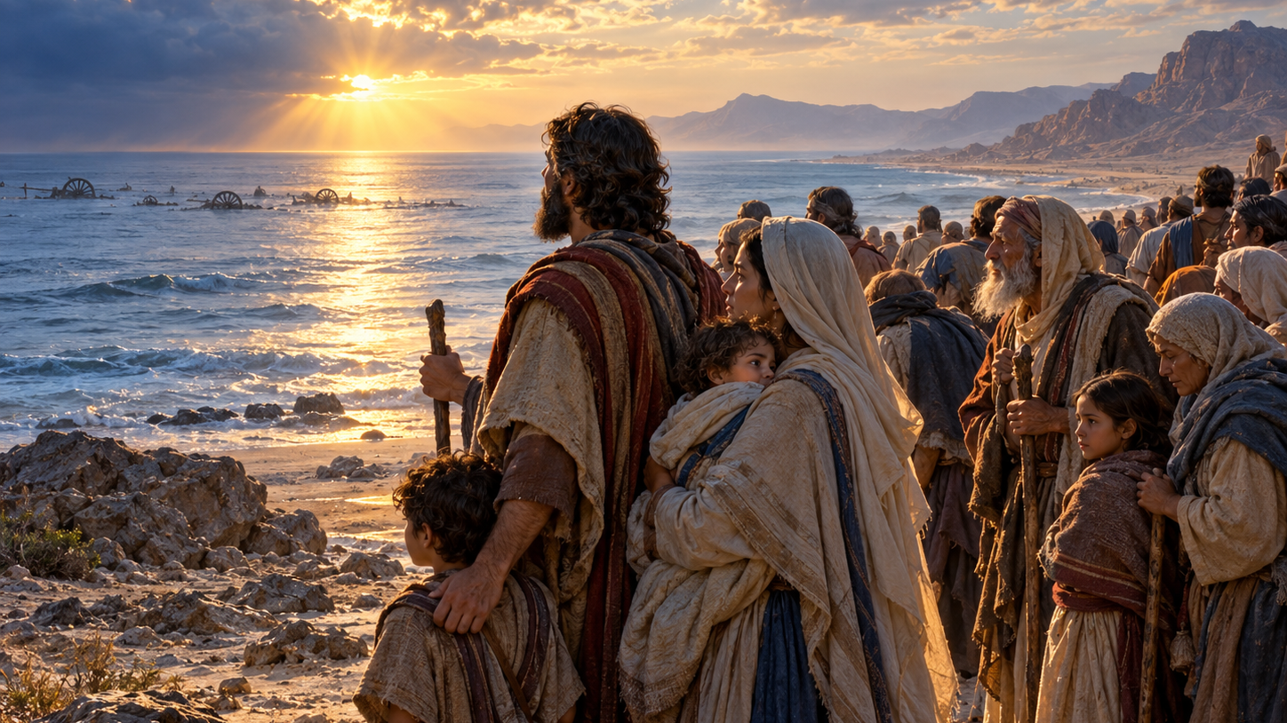
Sermon
LIBERATION WITHOUT DELIGHT IN DEATH
Notes:
SLIDE 5 — LIBERATION WITHOUT DELIGHT IN DEATH. Advance at: ‘This is a story of rescue, but it is not an easy story.’

Slide 40
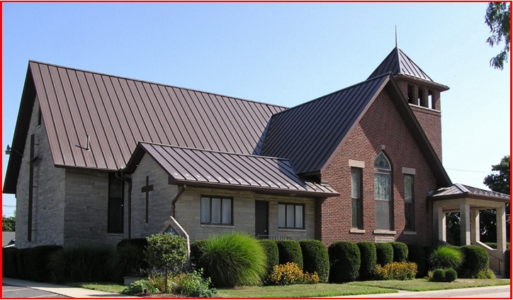
Sermon
RESCUE BECOMES A CALLING
Notes:
SLIDE 6 — RESCUE BECOMES A CALLING. Advance at: ‘The church carries that calling into the world.’

Slide 41
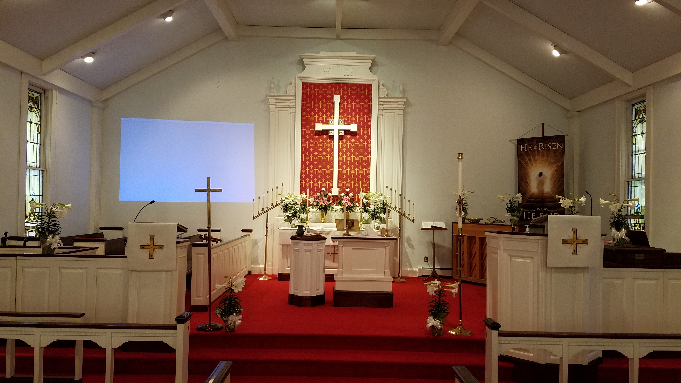
Sermon
THROUGH WATER, FED FOR THE JOURNEY
Notes:
SLIDE 7 — THROUGH WATER, FED FOR THE JOURNEY. Advance at: ‘For Christians, the passage through the sea also echoes at the baptismal font.’

Slide 42
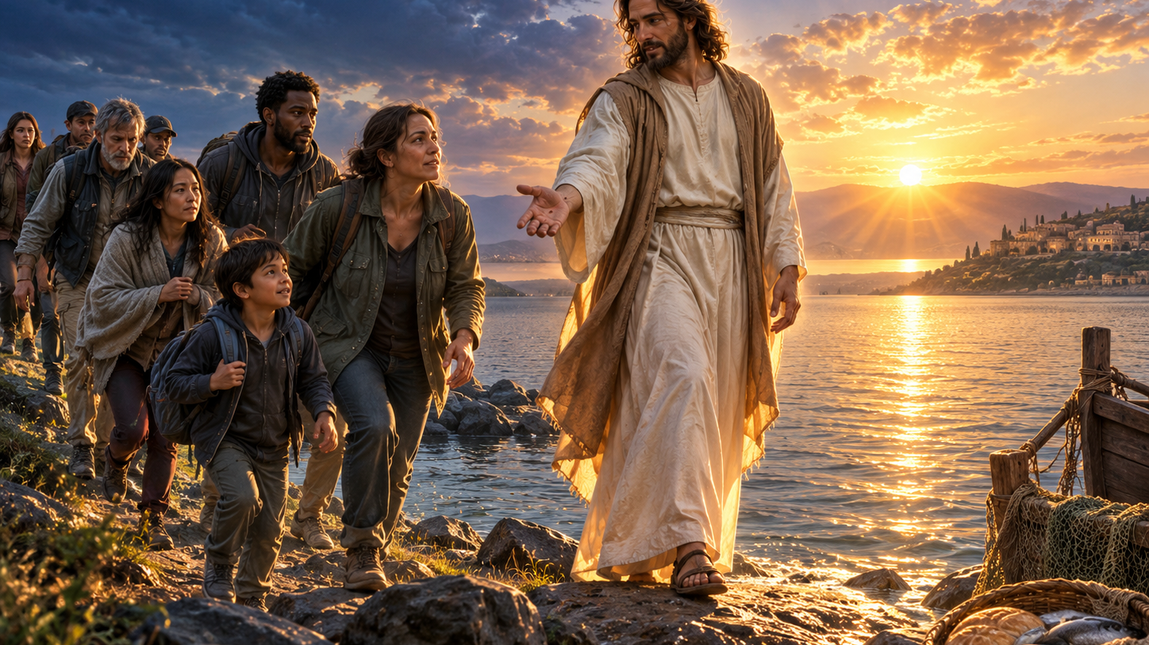
Sermon
CHRIST LEADS US FORWARD
Notes:
SLIDE 8 — CHRIST LEADS US FORWARD. Advance at: ‘Some of us arrive today with an army at our backs.’ Hold through the blessing and Amen.

Slide 43
APOSTLE’S CREED
C: I believe in God, the Father almighty, creator of heaven and earth.

Slide 44
APOSTLE’S CREED
C: I believe in Jesus Christ, his only Son, our Lord. He was conceived by the power of the Holy Spirit and born of the virgin Mary. He suffered under Pontius Pilate, was crucified, died, and was buried.

Slide 45
APOSTLE’S CREED
C: He descended into hell. On the third day he rose again. He ascended into heaven, and is seated at the right hand of the Father. He will come again to judge the living and the dead.

Slide 46
APOSTLE’S CREED
C: I believe in the Holy Spirit, the holy catholic Church, the communion of saints, the forgiveness of sins, the resurrection of the body, and the life everlasting. Amen.

Slide 47
NICENE CREED
C: We believe in one God, the Father, the Almighty, maker of heaven and earth, of all that is, seen and unseen.

Slide 48
NICENE CREED
C: We believe in one Lord, Jesus Christ, the only Son of God, eternally begotten of the Father, God from God, Light from Light, true God from true God, begotten, not made, of one Being with the Father.

Slide 49
NICENE CREED
C: Through him all things were made. For us and for our salvation he came down from heaven; by the power of the Holy Spirit he became incarnate from the virgin Mary, and was made man. For our sake he was crucified under Pontius Pilate;

Slide 50
NICENE CREED
C: he suffered death and was buried. On the third day he rose again in accordance with the Scriptures; he ascended into heaven and is seated at the right hand of the Father. He will come again in glory to judge the living and the dead, and his kingdom will have no end.

Slide 51
NICENE CREED
C: We believe in the Holy Spirit, the Lord, the giver of life, who proceeds from the Father and the Son. With the Father and the Son he is worshiped and glorified. He has spoken through the prophets. We believe in one holy catholic and apostolic Church.

Slide 52
NICENE CREED
C: We acknowledge one Baptism for the forgiveness of sins. We look for the resurrection of the dead, and the life of the world to come. Amen.

Slide 53
PRAYERS OF INTERCESSION
L: Confident that our Creator God listens and answers prayer, we pray for the church, the world, and all who are in need.
A brief silence.

Slide 54
PRAYERS
Each petition will end with the words,
A: God of mercy and grace,
C: We lift our prayers to you.

Slide 55
PRAYERS OF INTERCESSION
The prayer concludes…
P: God who created all that is, we place all for whom we pray, both aloud and in the silence of our hearts, into your loving arms.
C: Amen.

Slide 56
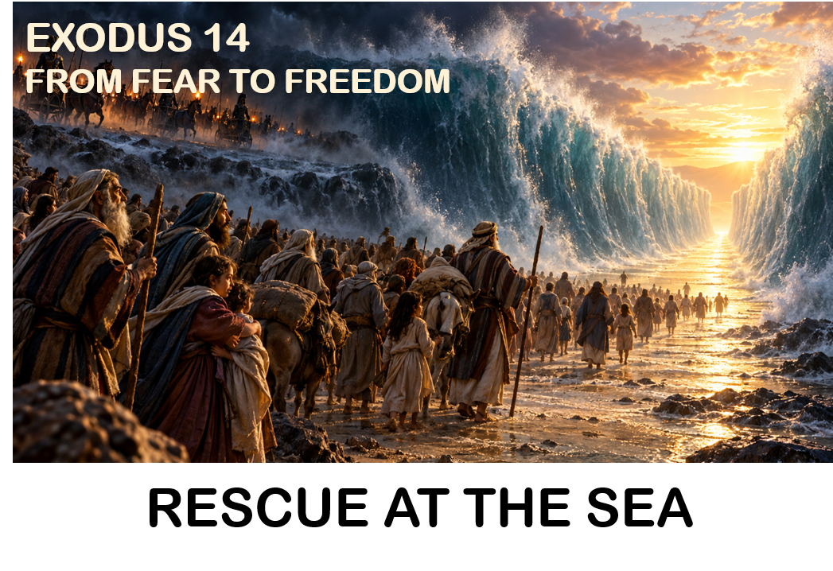
OFFERING/OFFERING PRAYER

Slide 57
THE GREAT THANKSGIVING
Communion is “At The Railing”.
All the Baptized are welcome to celebrate this Holy Meal.

Slide 58
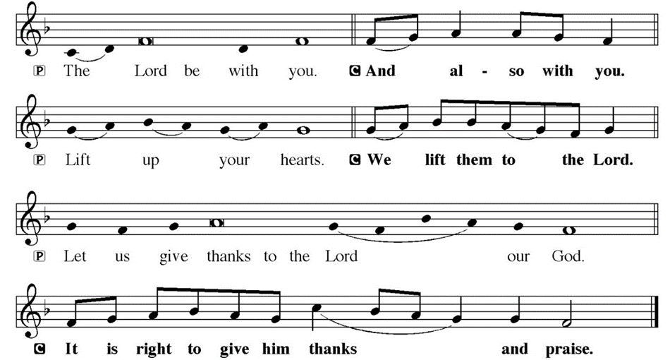
DIALOGUE

Slide 59
THE PREFACE
P: It is indeed right and salutary…
… we praise your name and join their unending hymn.

Slide 60
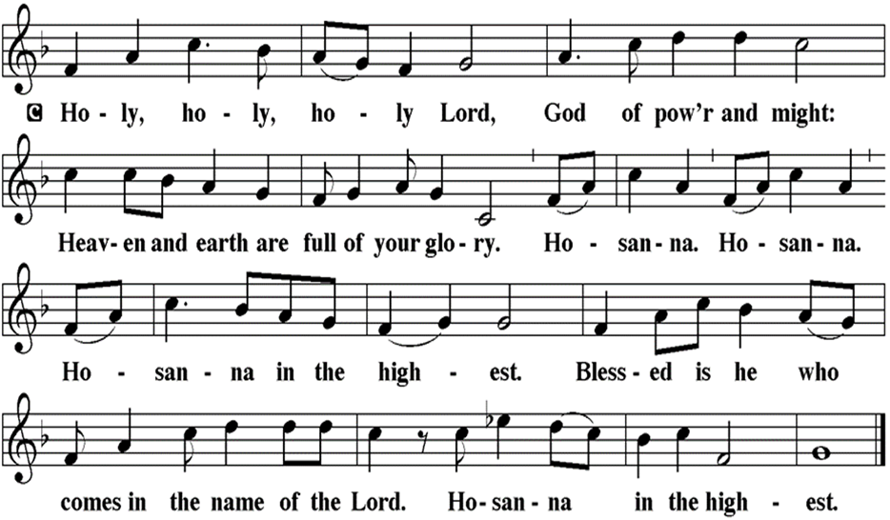
THE SANCTUS

Slide 61
EUCHARISTIC PRAYER
P: Holy God, our Maker, Redeemer…
…Both now and forever.
C: Amen.

Slide 62
THE LORD’S PRAYER
C: Our Father, who art in heaven, hallowed be thy name, thy kingdom come, thy will be done, on earth as it is in heaven. Give us this day our daily bread; and forgive us our trespasses, as we forgive those who trespass against us; and lead us not into temptation, but deliver us from evil.

Slide 63
THE LORD’S PRAYER
C: For thine is the kingdom, and the power, and the glory, forever and ever. Amen.

Slide 64
INVITATION TO COMMUNION
P: God who transforms sadness into joy now invites you to this feast of God’s beloved son, Jesus Christ. Come to the table, where Jesus meets us in this holy meal, forgives us all our sins, and raises us to a joyful new life in his name. All is prepared.

Slide 65
COMMUNION DISTRIBUTION
All may commune “At the Railing”.
The bread may be broken for distribution. As the ministers give the bread and wine, they say these words :
The body of Christ, given for you.
The blood of Christ, shed for you.
The communicant may say: Amen.

Slide 66
POST COMMUNION BLESSING
P: May this Body and Blood of our Lord and Savior, Jesus Christ, strengthen, keep, and unite us, ☩ now and forever.
C: Amen.

Slide 67
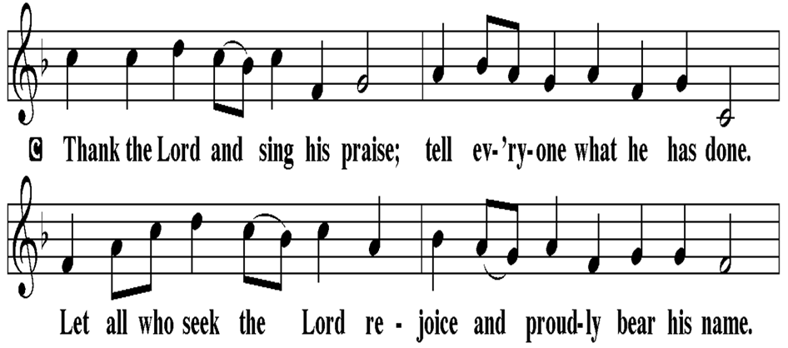
POST COMMUNION CANTACLE

Slide 68
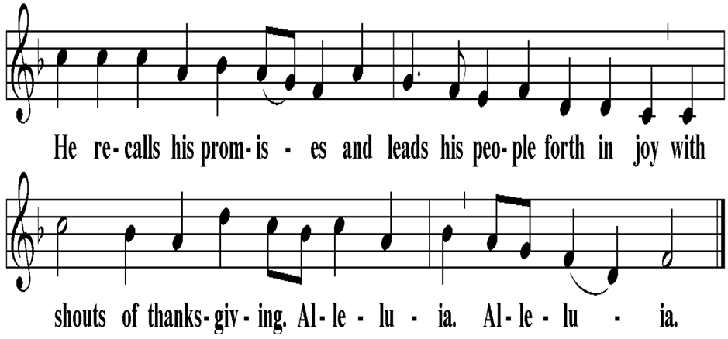
POST COMMUNION CANTACLE

Slide 69
POST COMMUNION PRAYER
P: Let us pray… Sustaining God, with this bread and cup, you nourish us with mercy and abundant life. By your Spirit, send us from this table to serve a needy world. Make us living signs of your liberation, healing, and love, following the way of Jesus, in whose name we pray.
C: Amen

Slide 70
SENDING OF HOMEBOUND COMMUNION
P: Gracious God, whose mercy endures from generation to generation: bless those who go forth to share your word and sacrament with our sisters and brothers who are sick or homebound.

Slide 71
SENDING OF HOMEBOUND COMMUNION
P: In your love and care, nourish and strengthen those to whom we bring this communion, that through the body and blood of your Son we may all know the hope of your promised coming in Jesus Christ our Lord.
C: Amen.

Slide 72
ANNOUNCEMENTS

Slide 73
SENDING BLESSING

Slide 74
SENDING SONG
“Guide Me Ever, Great Redeemer”
LBW 343
EXODUS 14
FROM FEAR TO FREEDOM
RESCUE AT THE SEA

Slide 75
“Guide Me Ever, Great Redeemer” LBW 343
1 Guide me ever, great Redeemer,
pilgrim through this barren land.
I am weak, but you are mighty;
hold me with your pow’rful hand.
Bread of heaven, bread of heaven,
feed me now and evermore,
feed me now and evermore.

Slide 76
“Guide Me Ever, Great Redeemer” LBW 343
2 Open now the crystal fountain
where the healing waters flow;
let the fire and cloudy pillar
lead me all my journey through.
Strong deliv’rer, strong deliv’rer,
shield me with your mighty arm,
shield me with your mighty arm.

Slide 77
“Guide Me Ever, Great Redeemer” LBW 343
3 When I tread the verge of Jordan,
bid my anxious fears subside;
death of death and hell’s destruction,
land me safe on Canaan’s side.
Songs and praises, songs and praises,
I will raise forevermore,
I will raise forevermore.

Slide 78
DISMISSAL
P: Depart in Christ’s Love.
C: Seeking, welcoming, and serving all. Amen!
POSTLUDE
By Pam Sherman
From sundaysandseasons.com. Copyright © 2026 Augsburg Fortress. All rights reserved. Reprinted by permission under Augsburg Fortress Liturgies Annual License #SAS023830. New Revised Standard Version Bible, Copyright © 1989, Division of Christian Education of the National Council of the Churches of Christ in the United States of America. Used by permission. All rights reserved. Revised Common Lectionary, Copyright © 1992 Consultation on Common Texts, admin Augsburg Fortress. Used by permission. Some images generated with ChatGPT (“Theo”) using OpenAI.

