Slide 1


Announcements
Trinity Evangelical Lutheran Church
August 18, 2024
Scan Me!

Slide 2


Slide 3

Body, Mind, Spirit
BODY: Start a regular exercise program.
MIND: Accept others' perspectives.
SPIRIT: Let insults pass through you, cherish the compliments.

Slide 4


Our Office Secretary Is Sharon Fourman
Church Office Schedule
Mon, Tues, & Saturday (This week only)
  8:00 am – 12:00 noon
Church Office: 937 692-5670
Email: secretary@pitsburgtlc.org

Slide 5


The Trinity Trumpet
A Monthly Newsletter
Published by Trinity Lutheran Church,
Pitsburg, OH
We’re looking for stories and pictures of Trinity people in action!
Submit to Secretary, Sharon Fourman at secretary@pitsburgtlc.org
Articles and Info due on or about the 15th of each month

Slide 6

Trinity Trumpet
    Your Trinity Trumpet Newsletter for August is available!
    Please take your copy before you leave today!

Slide 7
Trinity Trumpet
    Newsletter Deadline is Tuesday, August 20, 2024
    Please turn in all your newsworthy items to Sharon Fourman at:
    secretary@pitsburgtlc.org

Slide 8

We’re Online!
www.pitsburgtlc.org
Sermons and announcements are posted weekly
Trinity Trumpet is Posted here too!
The ‘Official’ Trinity Calendar is available for you to see!
Pictures, Videos and more!
Also, like us on FaceBook at
facebook.com/pitsburgtrinitylutheran.church

Slide 9
We’re Online!
www.pitsburgtlc.org
We now have our own QR Code!
Scan this code with your Smartphone and you will connect to all our Online media (Facebook, YouTube, and our own Church Website)

Slide 10
Online Giving
www.pitsburgtlc.org
Click the “Give to Trinity” Button
Stay current in your giving even when you can’t make it to Worship!
Separate Giving Categories for:
    General Treasury
    Benevolence/Mission Support
    Building Fund
    Annual Christmas Auction
    Memorial Funds
    Thrive Capital Campaign

Slide 11


Church
Council
Trinity Church Council
No Council Meeting in August!
Next Regular Meeting
September 18, 2024
@ 7:00 pm

Slide 12


Trinity’s Team Meetings
Next Meeting
TBD
@ 6:00 pm
On the Agenda – Preparing the proposed 2023 budget

Slide 13
Please Pass the Pew Pads
(We now track Communion on the Pads)

Slide 14

Worship Team
Next Meeting:
  TBD

Slide 15

Mutual Ministry Team
  Julie Kossler
  VACANT
  Peggy Didier
  Please see one of them with your comments and suggestions
  Next Meeting - TBD

Slide 16


Choice FISH Pantry
Please join us every Friday @ 3:30 pm
400 Markwith Dr, Greenville OH
Most Needed Items
Kidney Beans
Canned Peas
Hamburger Helper
Pork & Beans
Canned Mixed Veggies
Large Cans of Soups
Applesauce
Boxed Meals
(i.e. Rice a Roni)

Slide 17
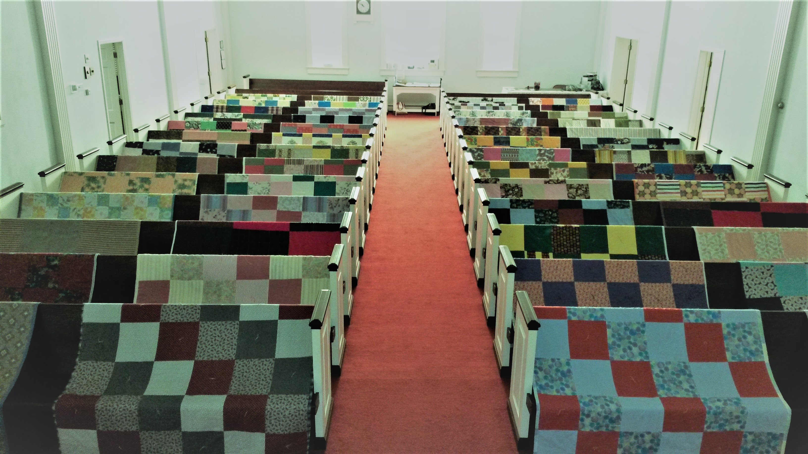
Prayers and Squares
Quilting Ministry
Tuesday, August 27 @ 10:00 am
Thursday, September 12 @ 10:00 am

Slide 18

Next Meeting:
September 11, 2024
@ 11:30 am

Slide 19


ULTIMATE CLEANING CLOTH SALE
1 for $7.00
2 for $10.00
5 for $20.00
See
  Portia Boord or Diane Warner

Slide 20


Ladies and Gents Luncheon
Date: September 19th @ 11:30 am
Where: Mel-O-Dee Restaurant
2350 S Dayton-Lakeview Rd, New Carlisle, OH 45344
For Reservations/Questions:
        See Linda Baker or call her @ 937 545-8410

Slide 21

Confirmation Program
    Weekly Worship attendance is required (In person or via FaceBook)
    Worship Notes may be emailed to pastor@pitsburgtlc.org or placed in Pr Mel’s mailbox outside the Church Office
    Confirmands are HIGHLY encouraged to take turns as Acolyte

Slide 22

    Who can be an Acolyte? YOU CAN!!!
    Ask Pr Mel about training opportunities
    Please sign up for Acolyte Duty on the chart by the Church Office!
    Confirmation Students are Highly Encouraged to perform Acolyte duty…
    Please sign up today!

Slide 23
New Member Class
We are forming a “New Member” Class for anyone who wants to learn more about Being Lutheran and what Being a member of Trinity entails
    Classes will begin January 8th
    Classes start at 12:00 Noon or as soon after Worship as possible
    Please see Pastor Mel if Interested in attending

Slide 24

    If you would like to sponsor the Altar Flowers, see PJ to Sign Up!

Slide 25

Next Meeting
August 2, 2024 @ 10:00 am
Purpose – Review VBS and plan for Rally Day/Sundaes on Sunday
Please come if you can!

Slide 26

Blood Pressure Screening
BP Screening
By Appointment
In The Nursery
Notes:
Cover: Sermon on the Mount by Laura James. Copyright © Laura James. All rights reserved. Used by permission of the artist.

Slide 27


Holy Communion – Today!
Communion Today
Safe for all humans (Especially sinners)
Holy Communion Schedule
    First and Third Sundays each month
    All White and Red Sundays of the Church Year

Slide 28

Calling all Adults!
Join Us For “Christian Conversations”
Not Your Ordinary Adult Sunday School
Sharing – Discussion - Prayer
Free Donuts, Juice, and Coffee
Every Sunday @
9:30 am
Notes:
Cover: Sermon on the Mount by Laura James. Copyright © Laura James. All rights reserved. Used by permission of the artist.

Slide 29

Save The Date!!!
Rally Sunday – August 25!!!
  Blessing of School Bags and Backpacks!
  Sundaes on Sunday
  Church provides Hot Dogs/fixin’s
  Sign-Up Sheets for other foods
Notes:
Cover: Sermon on the Mount by Laura James. Copyright © Laura James. All rights reserved. Used by permission of the artist.

Slide 30

The Chosen
Join Us to watch The Chosen TV Series
Second and Fourth Sundays @ 6:00 – 7:30 pm
Starting September 8th
Notes:
Cover: Sermon on the Mount by Laura James. Copyright © Laura James. All rights reserved. Used by permission of the artist.

Slide 31

Trinity Troops
Date: TODAY!!! -- After Worship
Where: Trinity Fellowship Hall
Who: Youth 5th – 6th Grades
What: Fun and Food! (Ham & Scalloped Potatoes – Yummy!!!)
Trinity Troops!

Slide 32

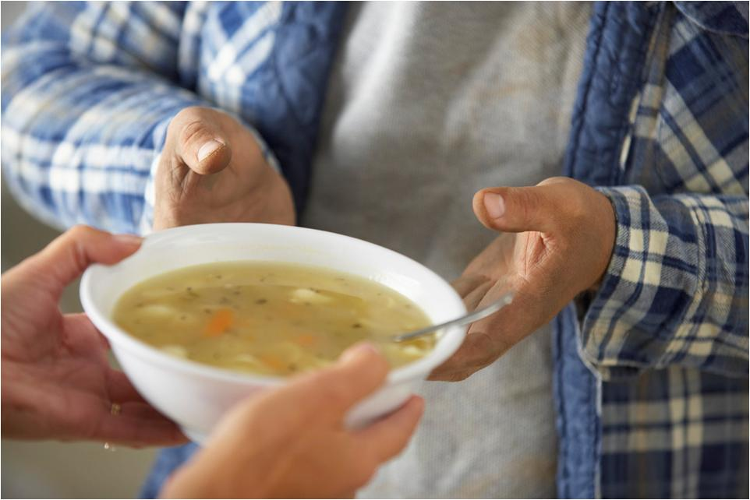
Grace Resurrection Community Center
Soup Kitchen Meal
When: Wednesday, September 18th
10:00 am to 1:00 pm.
Where: 433 Water Street in Greenville

Slide 33
Save The Date!
August 22 – Lutheran Day @ the Great Darke County Fair 12 Noon – 2 pm
August 25 – Rally Day @ Trinity (Sundaes on Sunday!)
September 8 – Screening of The Chosen @ 6:00 pm (Second and fourth Sundays)
October 6 – Pizza Luncheon - Church Funerals Direct Seminar (After Worship)
Notes:
Cover: Sermon on the Mount by Laura James. Copyright © Laura James. All rights reserved. Used by permission of the artist.

Slide 34

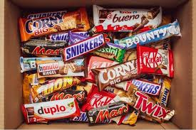
Trinity Youth
Fun (d) Raiser!
Candy Bar Sales!
Large Selection
$2 Each
Supports our youth
Notes:
Cover: Sermon on the Mount by Laura James. Copyright © Laura James. All rights reserved. Used by permission of the artist.

