Slide 1
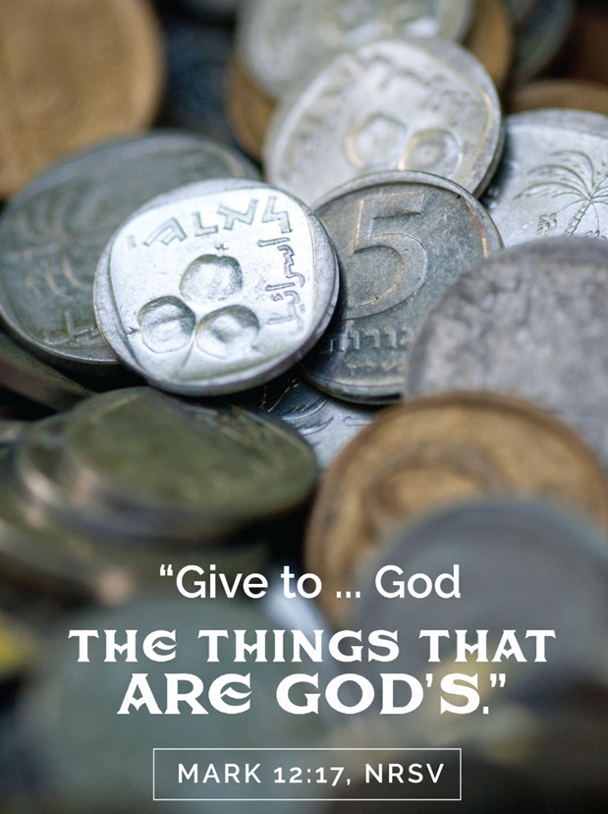
March 3, 2024
WELCOME!
Trinity Lutheran Church
Notes:
Image: Five Loaves by Caroline Coolidge Brown. Copyright © Caroline Coolidge Brown. All rights reserved. Used by permission of the artist.

Slide 2
= Please stand if able
= Please be seated
Prelude - By Pan Sherman
Office of the Acolyte
Ringing of the Bell
Welcome

Slide 3
Baptismal Hymn
“Borning Cry” - ELW 732
(Verses 1 & 2)
Baptismal party gathers at the font.
This Photo by Unknown Author is licensed under CC BY-SA
Notes:
Image: Five Loaves by Caroline Coolidge Brown. Copyright © Caroline Coolidge Brown. All rights reserved. Used by permission of the artist.

Slide 4
Borning Cry
1 "I was there to hear your borning cry,
I'll be there when you are old.
I rejoiced the day you were baptized
to see your life unfold.
I was there when
you were but a child,
with a faith to suit you well;
in a blaze of light you wandered off
to find where demons dwell."
Notes:
Image: Five Loaves by Caroline Coolidge Brown. Copyright © Caroline Coolidge Brown. All rights reserved. Used by permission of the artist.

Slide 5
Borning Cry
"When you heard
the wonder of the Word
I was there to cheer you on;
you were raised to praise
the living Lord,
to whom you now belong.
If you find someone to share your time
and you join your hearts as one,
I'll be there to make your verses rhyme
from dusk till rising sun."
Notes:
Image: Five Loaves by Caroline Coolidge Brown. Copyright © Caroline Coolidge Brown. All rights reserved. Used by permission of the artist.

Slide 6
HOLY BAPTISM - PRESENTATION
P: In Holy Baptism our gracious heavenly Father liberates us from sin and death by joining us to the death and resurrection of our Lord Jesus Christ. We are born children of a fallen humanity; in the waters of Baptism we are reborn children of God and inheritors of eternal life. By water and the Holy Spirit, we are made members of the Church which is the body of Christ.

Slide 7
HOLY BAPTISM
P: As we live with him and with his people, we grow in faith, love, and obedience to the will of God.
Sponsors and Parents present Candidates for Baptism
Sponsors and Parents:
We present Lylah Rae Carnes and Reece Avery Carnes to receive the Sacrament of Holy Baptism.

Slide 8
HOLY BAPTISM
The minister addresses the sponsors and guardians.
P: Reece, called by the Holy Spirit, trusting in the grace and love of God, do you desire to be baptized into Christ? If so, say I Do.
Reece: I do.

Slide 9
HOLY BAPTISM
The minister addresses the sponsors and guardians.
P: Reece and Bryanna, do you desire to have your daughter, Lylah baptized into Christ Jesus? If so, say we do.
Reece and Bryanna: We do.

Slide 10
HOLY BAPTISM
P: As you come to receive the gift of baptism, you are entrusted with responsibilities: to live with your child among God's faithful people, bring her to the word of God and the holy supper, teach her the Lord's Prayer, the Creed, and the Ten Commandments, place in her hands the holy scriptures, and nurture her in faith and prayer, so that both Lylah and Reece may learn to trust God,

Slide 11
HOLY BAPTISM
P: proclaim Christ through word and deed, care for others and the world God made, and work for justice and peace in all the world.
P: Do you promise to live according to these promises and help each other grow in the Christian faith and life?
Sponsors and Parents: We do.

Slide 12
HOLY BAPTISM
PE: As she grows in years, you should place in her hands the Holy Scriptures and provide for her instruction in the Christian faith, that, living in the covenant of her Baptism and in communion with the Church, she may lead a godly life until the day of Jesus Christ.

Slide 13
HOLY BAPTISM
P: Congregation of Trinity Lutheran Church, do you promise to assist these sponsors and parents to fulfill these obligations?
C: We do and we ask God to help and guide us.

Slide 14
HOLY BAPTISM - THANKSGIVING
P: The Lord be with you.
C: And also with you.
P: Let us give thanks to the Lord our God.
C: It is right to give him thanks and praise.
Water is poured into the Baptismal Font as the prayer is said.
P: Holy God, mighty Lord, gracious Father: We give you thanks, for in the beginning your Spirit moved over the waters and you created heaven and earth.

Slide 15
HOLY BAPTISM
P: By the gift of water, you nourish and sustain us and all living things.
By the waters of the flood you condemned the wicked and saved those whom you had chosen, Noah and his family. You led Israel by the pillar of cloud and fire through the sea, out of slavery into the freedom of the promised land.

Slide 16
HOLY BAPTISM
P: In the waters of the Jordan your Son was baptized by John and anointed with the Spirit. By the baptism of his own death and resurrection your beloved Son has set us free from the bondage to sin and death, and has opened the way to the joy and freedom of everlasting life. He made water a sign of the kingdom and of cleansing and rebirth.

Slide 17
HOLY BAPTISM
P: In obedience to his command, we make disciples of all nations, baptizing them in the name of the Father, and of the Son, and of the Holy Spirit.
Pour out your Holy Spirit, so that Reece and Lylah who are about to be here baptized may be given new life.

Slide 18
HOLY BAPTISM
P: Wash away their sins, cleans them by this water, and bring them forth as a heirs of your glorious kingdom. To you be given praise and honor and worship through your Son, Jesus Christ our Lord, in the unity of the Holy Spirit, now and forever.
C: Amen

Slide 19
Profession of Faith
The minister addresses the baptismal group and the congregation.
PM: I ask you to profess your faith in Christ Jesus, reject sin, and confess the faith of the church, the faith in which we baptize. Do you renounce all the forces of evil, the devil, and all his empty promises?
C: I do.

Slide 20
Profession of Faith
PM: Do you believe in God the Father?
C: I believe in God, the Father almighty, creator of heaven and earth.

Slide 21
Profession of Faith
PM: Do you believe in Jesus Christ, the Son of God?
C: I believe in Jesus Christ, his only Son, our Lord. He was conceived by the power of the Holy Spirit and born of the virgin Mary. He suffered under Pontius Pilate, was crucified, died, and was buried. He descended into hell.*
*Or, He descended to the dead.

Slide 22
Profession of Faith
C: On the third day he rose again. He ascended into heaven, and is seated at the right hand of the Father. He will come again to judge the living and the dead.

Slide 23
Profession of Faith
P: Do you believe in God the Holy Spirit?
C: I believe in the Holy Spirit, the holy catholic church, the communion of saints, the forgiveness of sins, the resurrection of the body, and the life everlasting. Amen

Slide 24
BAPTISM
The minister baptizes each child.
P: Reece Avery Carnes, I baptize you in the name of the Father, and of the Son, and of the Holy Spirit. Amen.

Slide 25
BAPTISM
The minister baptizes each child.
P: Lylah Rae Carnes, I baptize you in the name of the Father, and of the Son, and of the Holy Spirit. Amen.

Slide 26
BAPTISM
P: The Lord be with you.
C: And also with you.
The minister lays both hands on the head of each of the baptized and prays for the Holy Spirit:

Slide 27
BAPTISM
P: God, the Father of our Lord Jesus Christ, we give you thanks for freeing your sons and daughters from the power of sin and for raising them up to a new life through this holy sacrament. Pour your Holy Spirit upon Reece Avery Carnes: the spirit of wisdom and understanding, the spirit of counsel and might, the spirit of knowledge and the fear of the Lord, the spirit of joy in your presence.
C: Amen

Slide 28
BAPTISM
P: God, the Father of our Lord Jesus Christ, we give you thanks for freeing your sons and daughters from the power of sin and for raising them up to a new life through this holy sacrament. Pour your Holy Spirit upon Lylah Rae Carnes: the spirit of wisdom and understanding, the spirit of counsel and might, the spirit of knowledge and the fear of the Lord, the spirit of joy in your presence.
C: Amen

Slide 29
BAPTISM
P: Reece Avery Carnes, child of God, you have been sealed by the Holy Spirit and marked with the cross of Christ forever.
C: Amen

Slide 30
BAPTISM
P: Lylah Rae Carnes, child of God, you have been sealed by the Holy Spirit and marked with the cross of Christ forever.
C: Amen

Slide 31
BAPTISM
A lighted candle is given to the baptized (to the sponsor of a young child) by a representative of the congregation who says:
R: Let your light so shine before others that they may see your good works and glorify your Father in heaven.

Slide 32
BAPTISM
P: Let us pray… O God, the giver of all life, look with kindness upon Reece and Bryanna. Let them ever rejoice in the gift you have given them. Make them teachers and examples of righteousness for Lylah. Strengthen them in their own Baptism so they may share eternally with her, the salvation you have given them, through Jesus Christ our Lord.
C: Amen.

Slide 33
Welcome
The ministers and the baptismal group turn toward the congregation:
P: Through Baptism God has made Reece and Lylah our new brother and sister in Christ and fellow members of the priesthood we all share in Christ Jesus, that together we may proclaim the praise of God and bear his creative and redeeming Word to all the world.

Slide 34
Welcome
C: We welcome you into the Lord’s family. We receive you as fellow members of the body of Christ, children of the same heavenly Father, and workers with us in the kingdom of God.
Applause is appropriate as the pastor presents the newly Baptized to the congregation. All return to their places.

Slide 35
Borning Cry
3 "In the middle ages of your life,
not too old, no longer young,
I'll be there to guide you
through the night,
complete what I've begun.
When the evening gently closes in
and you shut your weary eyes,
I'll be there as I have always been,
with just one more surprise."
Notes:
Image: Five Loaves by Caroline Coolidge Brown. Copyright © Caroline Coolidge Brown. All rights reserved. Used by permission of the artist.

Slide 36
Borning Cry
"I was there to hear
your borning cry,
I'll be there when you are old.
I rejoiced the day
you were baptized
to see your life unfold."
Notes:
Image: Five Loaves by Caroline Coolidge Brown. Copyright © Caroline Coolidge Brown. All rights reserved. Used by permission of the artist.

Slide 37
APOSTOLIC GREETING
P: The grace of our Lord Jesus Christ, the love of God, and the communion of the Holy Spirit be with you all.
C: And also with you.
Notes:
Image: Five Loaves by Caroline Coolidge Brown. Copyright © Caroline Coolidge Brown. All rights reserved. Used by permission of the artist.

Slide 38
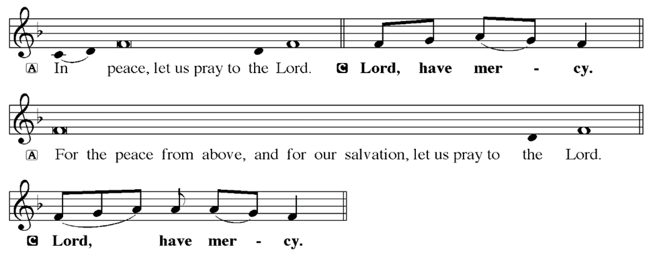
KYRIE
Notes:
Image: Five Loaves by Caroline Coolidge Brown. Copyright © Caroline Coolidge Brown. All rights reserved. Used by permission of the artist.

Slide 39
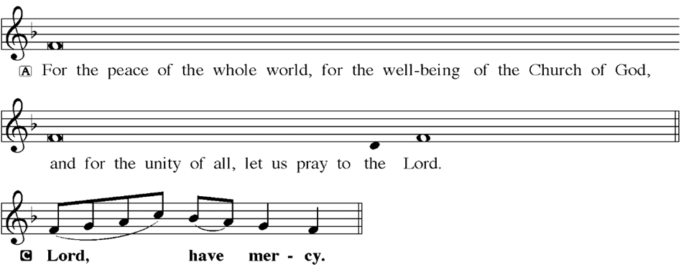
KYRIE
Notes:
Image: Five Loaves by Caroline Coolidge Brown. Copyright © Caroline Coolidge Brown. All rights reserved. Used by permission of the artist.

Slide 40
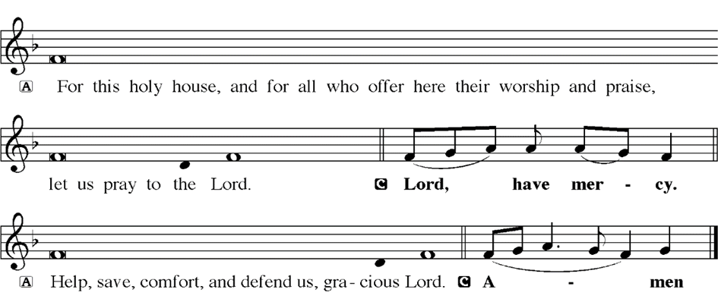
KYRIE
Notes:
Image: Five Loaves by Caroline Coolidge Brown. Copyright © Caroline Coolidge Brown. All rights reserved. Used by permission of the artist.

Slide 41
HYMN OF PRAISE
Glory be to God in heaven;
peace, goodwill to all the earth.
Mighty God of all creation,
Father of surpassing worth:
we exalt you, we adore you,
we lift high our thanks and praise.
Saints and angels bow before you; here on earth our songs we raise.
Notes:
Image: Five Loaves by Caroline Coolidge Brown. Copyright © Caroline Coolidge Brown. All rights reserved. Used by permission of the artist.

Slide 42
HYMN OF PRAISE
Glory be to Christ forever,
Lamb of God and Lord of love.
Son of God and gracious Savior, you have come from heav’n above;
on the cross you died to save us; now you reign at God’s right hand.
Hear our prayer; restore, forgive us; in your promise firm we stand.
Notes:
Image: Five Loaves by Caroline Coolidge Brown. Copyright © Caroline Coolidge Brown. All rights reserved. Used by permission of the artist.

Slide 43
HYMN OF PRAISE
Holy One we now acclaim you;
Lord alone, to you we call;
Holy One in faith we name you,
God most high, yet near to all:
Jesus Christ, with God the Spirit,
in the Father’s splendor bright.
For the peace that we inherit,
glory be to God on high!
Notes:
Image: Five Loaves by Caroline Coolidge Brown. Copyright © Caroline Coolidge Brown. All rights reserved. Used by permission of the artist.

Slide 44
PRAYER OF THE DAY
P: Let us pray… Gracious God, you created all that is, and everything is indelibly stamped with your holy signature. Make us to be careful stewards of all you entrust to us, that we might return it to you joyfully, knowing we have done our best to care for and keep it out of love for you. In Jesus’ name we pray.
C: Amen
Notes:
Image: Five Loaves by Caroline Coolidge Brown. Copyright © Caroline Coolidge Brown. All rights reserved. Used by permission of the artist.

Slide 45
Notes:
Image: Five Loaves by Caroline Coolidge Brown. Copyright © Caroline Coolidge Brown. All rights reserved. Used by permission of the artist.

Slide 46
Scripture Reading
L: Our scripture reading for this day is from the Gospel of Mark, the 12th Chapter.
C: Glory to you O’ Lord!
Notes:
Image: Five Loaves by Caroline Coolidge Brown. Copyright © Caroline Coolidge Brown. All rights reserved. Used by permission of the artist.

Slide 47
Mark 12:1-17
Then he began to speak to them in parables. “A man planted a vineyard, put a fence around it, dug a pit for the wine press, and built a watchtower; then he leased it to tenants and went to another country. ² When the season came, he sent a slave to the tenants to collect from them his share of the produce of the vineyard. ³ But they seized him, and beat him, and sent him
Notes:
Image: Five Loaves by Caroline Coolidge Brown. Copyright © Caroline Coolidge Brown. All rights reserved. Used by permission of the artist.

Slide 48
Mark 12:1-17
away empty-handed. ⁴And again he sent another slave to them; this one they beat over the head and insulted. ⁵ Then he sent another, and that one they killed. And so it was with many others; some they beat, and others they killed. ⁶ He had still one other, a beloved son. Finally he sent him to them, saying, ‘They will respect my son.’ ⁷ But those tenants said to one
Notes:
Image: Five Loaves by Caroline Coolidge Brown. Copyright © Caroline Coolidge Brown. All rights reserved. Used by permission of the artist.

Slide 49
Mark 12:1-17
another, ‘This is the heir; come, let us kill him, and the inheritance will be ours.’ ⁸ So they seized him, killed him, and threw him out of the vineyard. ⁹ What then will the owner of the vineyard do? He will come and destroy the tenants and give the vineyard to others. ¹⁰ Have you not read this scripture:
Notes:
Image: Five Loaves by Caroline Coolidge Brown. Copyright © Caroline Coolidge Brown. All rights reserved. Used by permission of the artist.

Slide 50
Mark 12:1-17
‘The stone that the builders rejected has become the cornerstone; ¹¹ this was the Lord’s doing, and it is amazing in our eyes’?”
¹² When they realized that he had told this parable against them, they wanted to arrest him, but they feared the crowd. So they left him and went away.
¹³ Then they sent to him some Pharisees and some Herodians to trap
Notes:
Image: Five Loaves by Caroline Coolidge Brown. Copyright © Caroline Coolidge Brown. All rights reserved. Used by permission of the artist.

Slide 51
Mark 12:1-17
him in what he said. ¹⁴ And they came and said to him, “Teacher, we know that you are sincere, and show deference to no one; for you do not regard people with partiality, but teach the way of God in accordance with truth. Is it lawful to pay taxes to the emperor, or not? ¹⁵ Should we pay them, or should we not?” But knowing their hypocrisy, he said to them, “Why
Notes:
Image: Five Loaves by Caroline Coolidge Brown. Copyright © Caroline Coolidge Brown. All rights reserved. Used by permission of the artist.

Slide 52
Mark 12:1-17
are you putting me to the test? Bring me a denarius and let me see it.” ¹⁶ And they brought one. Then he said to them, “Whose head is this, and whose title?” They answered, “The emperor’s.” ¹⁷Jesus said to them, “Give to the emperor the things that are the emperor’s, and to God the things that are God’s.” And they were utterly amazed at him.
Notes:
Image: Five Loaves by Caroline Coolidge Brown. Copyright © Caroline Coolidge Brown. All rights reserved. Used by permission of the artist.

Slide 53
Mark 12:1-17
R: This is the Word of the Lord.
C: Praise to You, O Christ
Notes:
Image: Five Loaves by Caroline Coolidge Brown. Copyright © Caroline Coolidge Brown. All rights reserved. Used by permission of the artist.

Slide 54
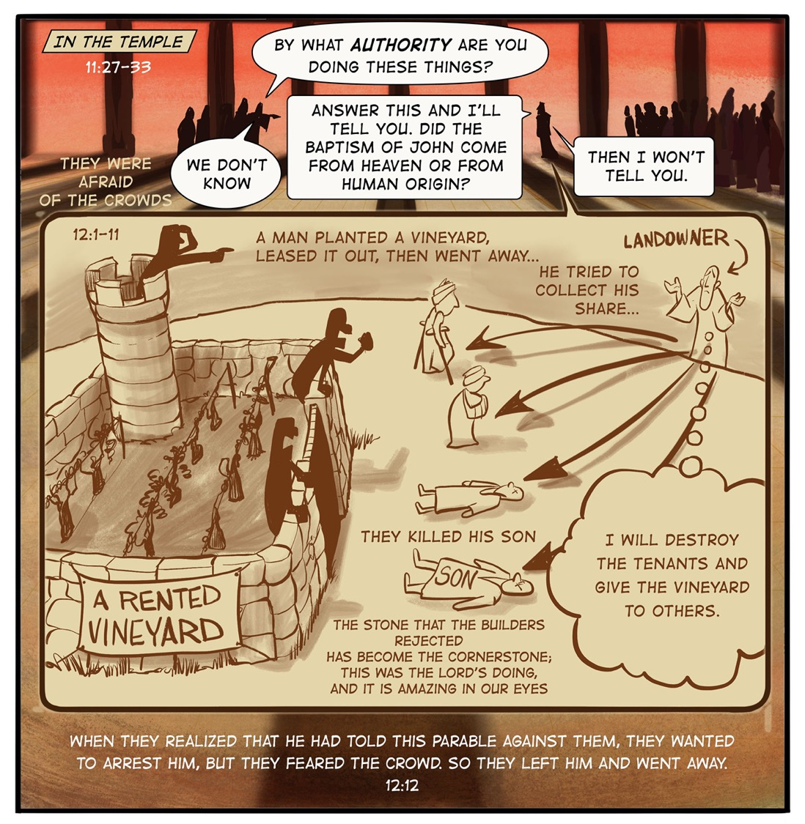
Sermon

Slide 55
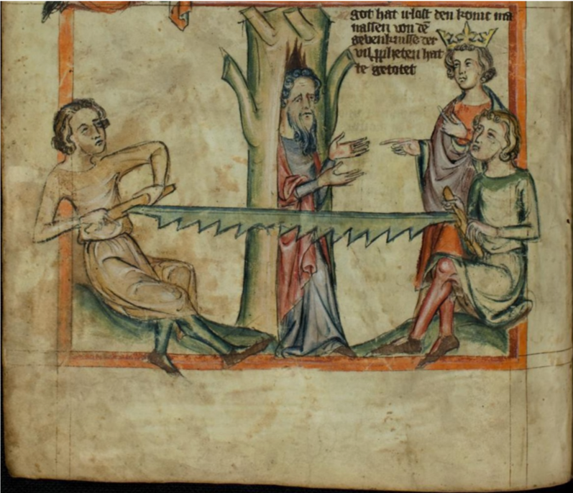
SERMON
Notes:
Image: Five Loaves by Caroline Coolidge Brown. Copyright © Caroline Coolidge Brown. All rights reserved. Used by permission of the artist.

Slide 56
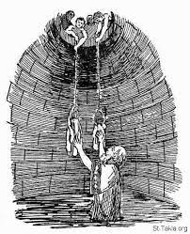
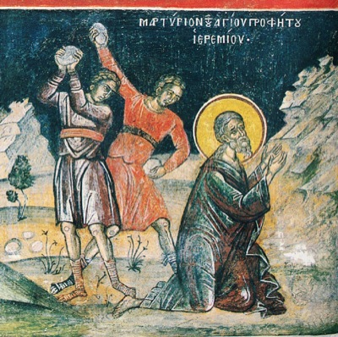
SERMON
Notes:
Image: Five Loaves by Caroline Coolidge Brown. Copyright © Caroline Coolidge Brown. All rights reserved. Used by permission of the artist.

Slide 57
SERMON
Notes:
Image: Five Loaves by Caroline Coolidge Brown. Copyright © Caroline Coolidge Brown. All rights reserved. Used by permission of the artist.

Slide 58
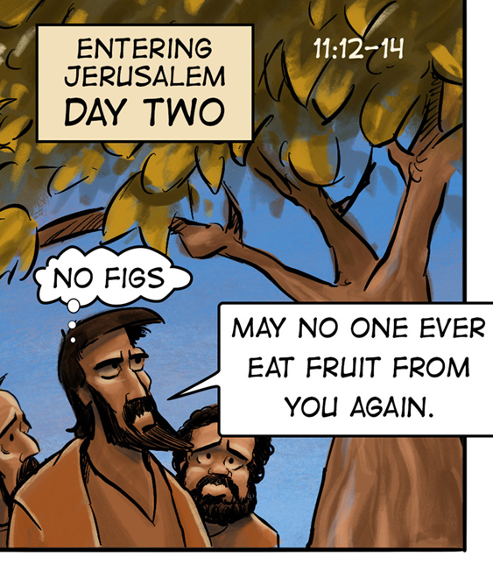
SERMON
Notes:
Image: Five Loaves by Caroline Coolidge Brown. Copyright © Caroline Coolidge Brown. All rights reserved. Used by permission of the artist.

Slide 59
SERMON
Notes:
Image: Five Loaves by Caroline Coolidge Brown. Copyright © Caroline Coolidge Brown. All rights reserved. Used by permission of the artist.

Slide 60
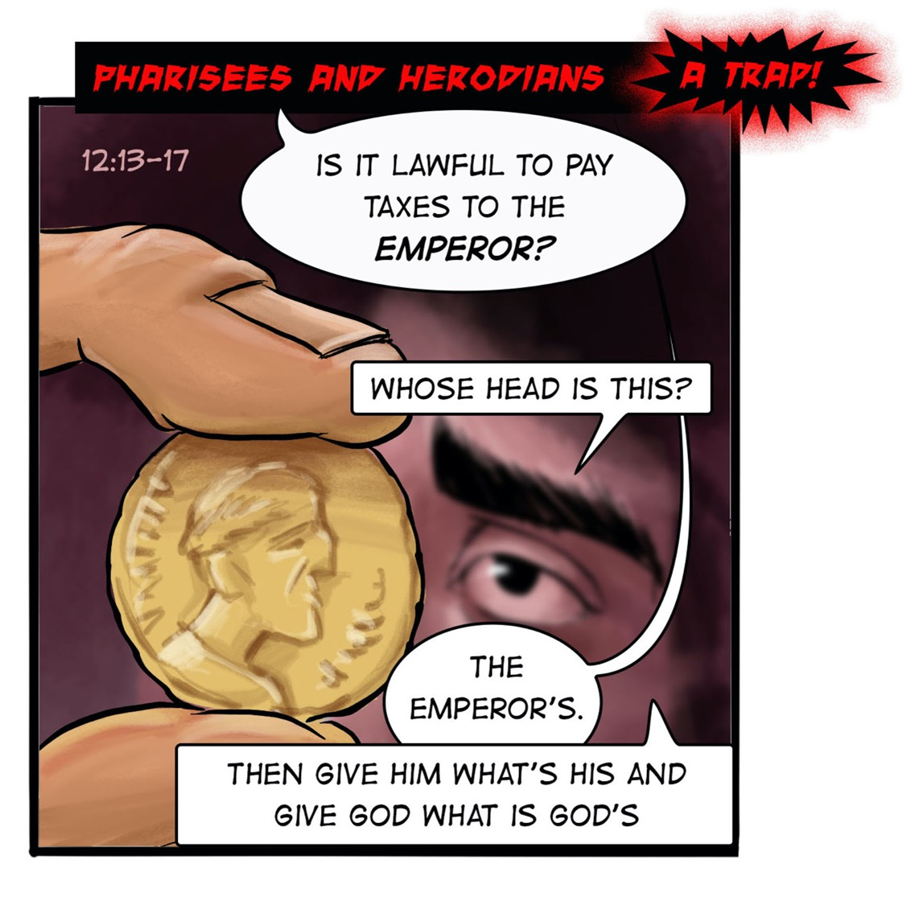
SERMON
Notes:
Image: Five Loaves by Caroline Coolidge Brown. Copyright © Caroline Coolidge Brown. All rights reserved. Used by permission of the artist.

Slide 61
SERMON
Notes:
Image: Five Loaves by Caroline Coolidge Brown. Copyright © Caroline Coolidge Brown. All rights reserved. Used by permission of the artist.

Slide 62
PRAYERS OF INTERCESSION
Each petition will end with the words,
A: God of the journey,
The congregation will respond with:
C: In mercy, hear our prayer.

Slide 63
PRAYERS OF INTERCESSION
The prayer concludes…
P: Confident that you walk alongside us in our need, we lift to you all our prayers, spoken and unspoken, through Jesus Christ our savior.
C: Amen.

Slide 64
OFFERING
Notes:
Image: Five Loaves by Caroline Coolidge Brown. Copyright © Caroline Coolidge Brown. All rights reserved. Used by permission of the artist.

Slide 65
OFFERING PRAYER
Notes:
Image: Five Loaves by Caroline Coolidge Brown. Copyright © Caroline Coolidge Brown. All rights reserved. Used by permission of the artist.

Slide 66
THE GREAT THANKSGIVING
All the Baptized are welcome to celebrate this Holy Meal.

Slide 67
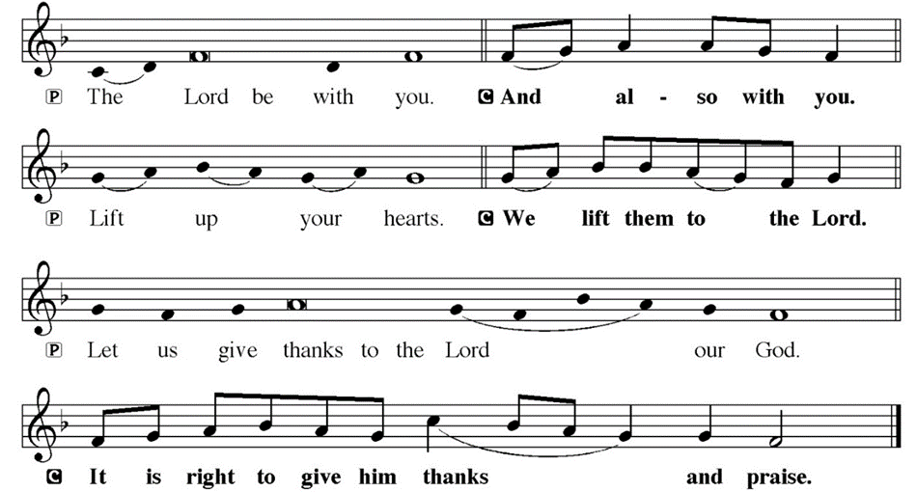
DIALOGUE

Slide 68
THE PREFACE
P: It is indeed right and salutary…
… we praise your name and join their unending hymn.

Slide 69
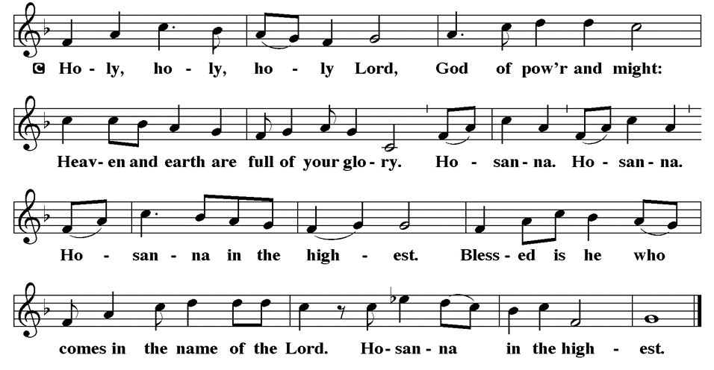
THE SANCTUS

Slide 70
EUCHARISTIC PRAYER
P: Holy God, our living Water…
…both now and forever.
C: Amen.

Slide 71
THE LORD’S PRAYER
C: Our Father, who art in heaven, hallowed be thy name, thy kingdom come, thy will be done, on earth as it is in heaven. Give us this day our daily bread; and forgive us our trespasses, as we forgive those who trespass against us; and lead us not into temptation, but deliver us from evil.

Slide 72
THE LORD’S PRAYER
C: For thine is the kingdom, and the power, and the glory, forever and ever. Amen.

Slide 73
INVITATION TO COMMUNION
P: The vineyard owner’s son, our savior Jesus Christ, invites you now to this feast of bread and wine in remembrance of his sacrifice for the sake of the world. Come and meet him at this table and be strengthened by his presence with you.

Slide 74
COMMUNION DISTRIBUTION
All will commune “at the Rail”.
The bread may be broken for distribution. As the ministers give the bread and wine, they say these words :
The body of Christ, given for you.
The blood of Christ, shed for you.
The communicant may say: Amen.

Slide 75
POST COMMUNION CANTACLE

Slide 76
POST COMMUNION CANTACLE

Slide 77
POST COMMUNION PRAYER
P: Let us pray… Generous God, at this table we have tasted your immeasurable grace. As grains of wheat are gathered into one bread, now make us one loaf to feed the world; in the name of Jesus, the Bread of life.
C: Amen

Slide 78
ANNOUNCEMENTS
Notes:
Image: Five Loaves by Caroline Coolidge Brown. Copyright © Caroline Coolidge Brown. All rights reserved. Used by permission of the artist.

Slide 79
SENDING BLESSING
P: Beloved, we are God’s own people, holy, washed, renewed. God bless you and keep you, shower you with mercy, fill you with courage, and ☩ give you peace.
C: Amen.

Slide 80
Sending Song
“The Church’s One Foundation”
LBW 369
Notes:
Image: Five Loaves by Caroline Coolidge Brown. Copyright © Caroline Coolidge Brown. All rights reserved. Used by permission of the artist.

Slide 81
“The Church’s One Foundation” LBW 369
1 The church's one foundation
is Jesus Christ, her Lord;
she is his new creation
by water and the word.
From heav'n he came and sought her
to be his holy bride;
with his own blood he bought her,
and for her life he died.
Notes:
Image: Preparing yeast dough. Copyright © tomasworks/iStock/Thinkstock. Used by permission.

Slide 82
“The Church’s One Foundation” LBW 369
2 Elect from ev'ry nation,
yet one o'er all the earth,
her charter of salvation
one Lord, one faith, one birth:
one holy name she blesses,
partakes one holy food,
and to one hope she presses,
with ev'ry grace endued.
Notes:
Image: Preparing yeast dough. Copyright © tomasworks/iStock/Thinkstock. Used by permission.

Slide 83
“The Church’s One Foundation” LBW 369
3 Though with a scornful wonder
this world sees her oppressed,
by schisms rent asunder,
by heresies distressed,
yet saints their watch are keeping;
their cry goes up: "How long?"
And soon the night of weeping
shall be the morn of song.
Notes:
Image: Preparing yeast dough. Copyright © tomasworks/iStock/Thinkstock. Used by permission.

Slide 84
“The Church’s One Foundation” LBW 369
4 Through toil and tribulation
and tumult of her war,
she waits the consummation
of peace forevermore;
till with the vision glorious
her longing eyes are blest,
and the great church victorious
shall be the church at rest.
Notes:
Image: Preparing yeast dough. Copyright © tomasworks/iStock/Thinkstock. Used by permission.

Slide 85
“The Church’s One Foundation” LBW 369
5 Yet she on earth has union
with God, the Three in One,
and mystic sweet communion
with those whose rest is won.
Oh, blessed heav'nly chorus!
Lord, save us by your grace,
that we, like saints before us,
may see you face to face.
Notes:
Image: Preparing yeast dough. Copyright © tomasworks/iStock/Thinkstock. Used by permission.

Slide 86
DISMISSAL
P: … Depart in Christ’s Love.
C: Seeking, welcoming, and serving all. Amen!
POSTLUDE
By
Pam Sherman
From sundaysandseasons.com. Copyright © 2024 Augsburg Fortress. All rights reserved. Reprinted by permission under Augsburg Fortress Liturgies Annual License #SAS023830. New Revised Standard Version Bible, Copyright © 1989, Division of Christian Education of the National Council of the Churches of Christ in the United States of America. Used by permission. All rights reserved. Revised Common Lectionary, Copyright © 1992 Consultation on Common Texts, admin Augsburg Fortress. Used by permission.

