Slide 1

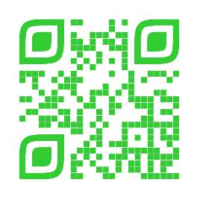
Announcements
Trinity Lutheran Church
May 18, 2025
Scan Me!

Slide 2


Slide 3

Body, Mind, Spirit
MIND: Try painting a picture.
BODY: Try eating a vegetable you have not eaten before.
SPIRIT: Watch the replay of Trinity’s church service. Comment and share.

Slide 4


Our Office Secretary Is Sharon Fourman
Church Office Schedule
Tues, Wed, Thurs – 8-11:30 am
Office Phone: (937) 692-5670
Pastor’s Phone: (937) 626-7100
Email: secretary@pitsburgtlc.org

Slide 5

The Trinity Trumpet
A Monthly Newsletter
Published by Trinity Lutheran Church,
Pitsburg, OH
We’re looking for stories and pictures of Trinity people in action!
Submit to Secretary, Sharon Fourman at secretary@pitsburgtlc.org
Articles and Info due on or about the 15th of each month

Slide 6

Trinity Trumpet
    Your Trinity Trumpet Newsletter for May is available!
    Please take your copy before you leave today!

Slide 7
Trinity Trumpet
    Newsletter Deadline is Tuesday, May 20, 2025
    Please turn in all your newsworthy items to Sharon Fourman at:
    secretary@pitsburgtlc.org

Slide 8

We’re Online!
www.pitsburgtlc.org
Sermons and announcements are posted weekly
Trinity Trumpet is Posted here too!
The ‘Official’ Trinity Calendar is available for you to see!
Pictures, Videos and more!
Also, like us on FaceBook at
facebook.com/pitsburgtrinitylutheran.church

Slide 9
We’re Online!
www.pitsburgtlc.org
We have our own QR Code!
Scan this code with your Smartphone and you will connect to all our Online media (Facebook, YouTube, and our own Church Website)

Slide 10

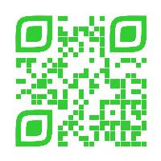
Online Giving
www.pitsburgtlc.org
Click the “Give to Trinity” Button
Stay current in your giving even when you can’t make it to Worship!
Separate Giving Categories for:
    General Treasury
    Benevolence/Mission Support
    Building Fund
    Annual Christmas Auction
    Memorial Funds
    Thrive Capital Campaign

Slide 11


Church
Council
Trinity Church Council
Next Regular Meeting
May 21, 2025
@ 7:00 pm

Slide 12


Trinity’s Team Meetings
Next Meeting
TBD
@ 6:00 pm
On the Agenda – Preparing the proposed 2023 budget

Slide 13
Please Pass the Pew Pads
(We now track Communion on the Pads)

Slide 14

Worship Team
Next Meeting:
  TBD

Slide 15

Mutual Ministry Team
  Julie Kossler
  VACANT
  Peggy Didier
  Please see one of them with your comments and suggestions
  Next Meeting - TBD

Slide 16


Choice FISH Pantry
Please join us every Friday @ 3:30 pm
400 Markwith Dr, Greenville OH
Most Needed Items
Kidney Beans
Canned Peas
Hamburger Helper
Pork & Beans
Canned Mixed Veggies
Large Cans of Soups
Applesauce
Boxed Meals
(i.e. Rice a Roni)

Slide 17
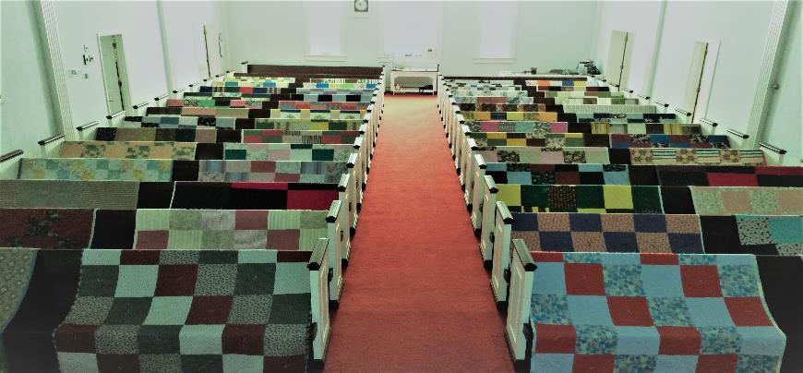
Prayers and Squares
Quilting Ministry
May 27 @ 10:00 am
June 12 @ 10:00 am

Slide 18

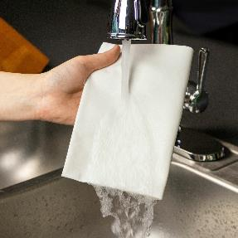
ULTIMATE CLEANING CLOTH SALE
1 for $7.00
2 for $10.00
5 for $20.00
See
  Portia Boord or Diane Warner

Slide 19


Ladies and Gents Luncheon
Date: June 18, 2025 @ 11:30 am
Where: Do Good Restaurant 25 West Main Street, Osgood, OH 45351
For Reservations/Questions:
        See Linda Baker or call her @ 937 545-8410

Slide 20

Confirmation Program
    Sunday Class @ 9:00 am each week
    Weekly Worship attendance is required (In person or via FaceBook)
    Worship Notes may be emailed to pastor@pitsburgtlc.org or placed in Pr Mel’s mailbox outside the Church Office
    Confirmands are HIGHLY encouraged to take turns as Acolyte

Slide 21

    Who can be an Acolyte? YOU CAN!!!
    Ask Pr Mel about training opportunities
    Please sign up for Acolyte Duty on the chart by the Church Office!
    Confirmation Students are Highly Encouraged to perform Acolyte duty…
    Please sign up today!

Slide 22
New Member Class
We are forming a “New Member” Class for anyone who wants to learn more about Being Lutheran and what Being a member of Trinity entails
    Classes will begin January 8th
    Classes start at 12:00 Noon or as soon after Worship as possible
    Please see Pastor Mel if Interested in attending

Slide 23

    If you would like to sponsor the Altar Flowers, see PJ to Sign Up!

Slide 24

Fall Festival Meeting
@ Pitsburg Church of the Brethren
June 5, 2025 @ 9:00 am
Purpose - Plan Fall Festival!
Please come if you can!

Slide 25
Next Regular Meeting
June 5, 2025 @ 10:30 am (Immediately after the Fall Festival Meeting)
Purpose - Plan Summer Events, including VBS!
Please come if you can!

Slide 26

Blood Pressure Screening
BP Screening
By Appointment (See PJ Musser)
In The Nursery
Notes:
Cover: Sermon on the Mount by Laura James. Copyright © Laura James. All rights reserved. Used by permission of the artist.

Slide 27

Calling all Adults!
Join Us For “Christian Conversations”
Not Your Ordinary Adult Sunday School
Sharing – Discussion - Prayer
Every Sunday @
9:30 am
Notes:
Cover: Sermon on the Mount by Laura James. Copyright © Laura James. All rights reserved. Used by permission of the artist.

Slide 28

The Chosen
Video Discussion Group
On Hiatus again in May…
Will return Sunday, June 8th @ 6 pm
Notes:
Cover: Sermon on the Mount by Laura James. Copyright © Laura James. All rights reserved. Used by permission of the artist.

Slide 29

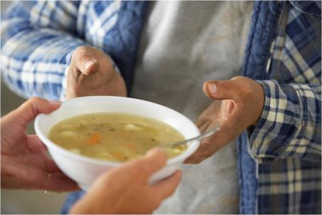
Grace Resurrection Community Center
Soup Kitchen Meal
When: Wednesday, June 18, 2025
10:00 am to 1:00 pm.
Where: 433 Water Street in Greenville

Slide 30

Save the Date
June 22 @ 9:00 am
Learn how to manage your $$ and become debt free
Notes:
Cover: Sermon on the Mount by Laura James. Copyright © Laura James. All rights reserved. Used by permission of the artist.

Slide 31

Trinity Troops
Date: June 29th
Where: Pastor Mel and PJ’s Home @ 7750 S Mote Rd, West Milton OH
Who: Youth 4th – 6th Grades and families
What: Fun and Snacks—POOL PARTY!
Trinity Troops!

Slide 32
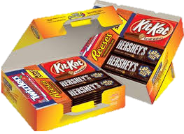
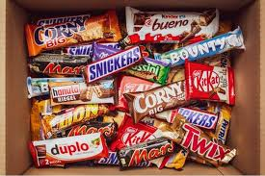
Trinity Youth
Fun (d) Raiser!
Candy Bar Sales!
Large Selection
$2 Each
Supports Our Youth
Notes:
Cover: Sermon on the Mount by Laura James. Copyright © Laura James. All rights reserved. Used by permission of the artist.

