Slide 1
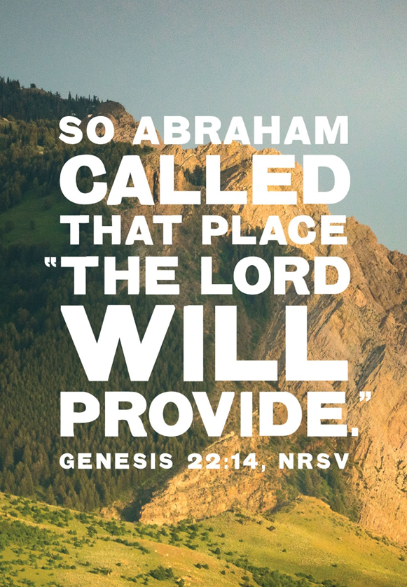
September 14, 2025
WELCOME!
Trinity Lutheran Church
Notes:
Image: Five Loaves by Caroline Coolidge Brown. Copyright © Caroline Coolidge Brown. All rights reserved. Used by permission of the artist.

Slide 2
= Please stand if able
= Please be seated
Prelude - By Roxanne Groff
Office of the Acolyte
Ringing of the Bell
Welcome
Notes:
Image: Five Loaves by Caroline Coolidge Brown. Copyright © Caroline Coolidge Brown. All rights reserved. Used by permission of the artist.

Slide 3
THANKSGIVING FOR BAPTISM
All may make the sign of the cross, the sign marked at baptism, as the presiding minister begins.
P: Blessed be the holy Trinity, ☩ one God, the fountain of living water, the rock who gave us birth, our light and our salvation.
C: Amen.
Notes:
Image: Preparing yeast dough. Copyright © tomasworks/iStock/Thinkstock. Used by permission.

Slide 4
P: Joined to Christ in the waters of baptism, we are clothed with God's mercy and forgiveness. Let us give thanks for the gift of baptism.
Water may be poured into the font as the presiding minister gives thanks.
THANKSGIVING FOR BAPTISM
Notes:
Image: Preparing yeast dough. Copyright © tomasworks/iStock/Thinkstock. Used by permission.

Slide 5
P: We give you thanks, O God, for in the beginning your Spirit moved over the waters and by your Word you created the world, calling forth life in which you took delight. Through the waters of the flood you delivered Noah and his family. Through the sea you led your people Israel from slavery into freedom.
THANKSGIVING FOR BAPTISM
Notes:
Image: Preparing yeast dough. Copyright © tomasworks/iStock/Thinkstock. Used by permission.

Slide 6
P: At the river your Son was baptized by John and anointed with the Holy Spirit. By water and your Word you claim us as daughters and sons, making us heirs of your promise and servants of all. We praise you for the gift of water that sustains life, and above all we praise you for the gift of new life in Jesus Christ.
THANKSGIVING FOR BAPTISM
Notes:
Image: Preparing yeast dough. Copyright © tomasworks/iStock/Thinkstock. Used by permission.

Slide 7
P: Shower us with your Spirit, and renew our lives with your forgiveness, grace, and love. To you be given honor and praise through Jesus Christ our Lord in the unity of the Holy Spirit, now and forever.
THANKSGIVING FOR BAPTISM
C: Amen.
Notes:
Image: Preparing yeast dough. Copyright © tomasworks/iStock/Thinkstock. Used by permission.

Slide 8
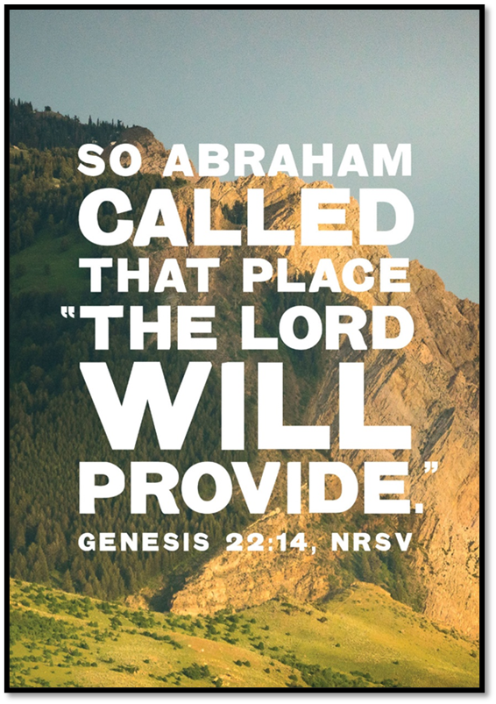
Gathering Song
“Come, Thou Fount of Every Blessing”
LBW 499

Slide 9
“Come, Thou Fount of Every Blessing”
LBW 499
1 Come, thou Fount of ev'ry blessing,
tune my heart to sing thy grace;
streams of mercy, never ceasing,
call for songs of loudest praise.
While the hope of endless glory
fills my heart with joy and love,
teach me ever to adore thee;
may I still thy goodness prove.
Notes:
Image: Five Loaves by Caroline Coolidge Brown. Copyright © Caroline Coolidge Brown. All rights reserved. Used by permission of the artist.

Slide 10
“Come, Thou Fount of Every Blessing”
LBW 499
2 Here I raise my Ebenezer:
"Hither by thy help I've come";
and I hope, by thy good pleasure,
safely to arrive at home.
Jesus sought me when a stranger,
wand'ring from the fold of God;
he, to rescue me from danger,
interposed his precious blood.
Notes:
Image: Five Loaves by Caroline Coolidge Brown. Copyright © Caroline Coolidge Brown. All rights reserved. Used by permission of the artist.

Slide 11
“Come, Thou Fount of Every Blessing”
LBW 499
3 Oh, to grace how great a debtor
daily I'm constrained to be;
let that grace now like a fetter
bind my wand'ring heart to thee.
Prone to wander, Lord, I feel it;
prone to leave the God I love.
Here's my heart, oh, take and seal it;
seal it for thy courts above.
Notes:
Image: Five Loaves by Caroline Coolidge Brown. Copyright © Caroline Coolidge Brown. All rights reserved. Used by permission of the artist.

Slide 12
APOSTOLIC GREETING
P: The grace of our Lord Jesus Christ, the love of God, and the communion of the Holy Spirit be with you all.
C: And also with you.
Notes:
Image: Five Loaves by Caroline Coolidge Brown. Copyright © Caroline Coolidge Brown. All rights reserved. Used by permission of the artist.

Slide 13
PRAYER OF THE DAY
P: Holy God, you did not withhold even your own Son, who willingly gave his life for the redemption of the world. Loosen our grasp on worldly things, that we might be freed from our fears of loss and inspire us to work for justice for all that you have made. In Jesus’ name we pray.
C: Amen.
Notes:
Image: Five Loaves by Caroline Coolidge Brown. Copyright © Caroline Coolidge Brown. All rights reserved. Used by permission of the artist.

Slide 14

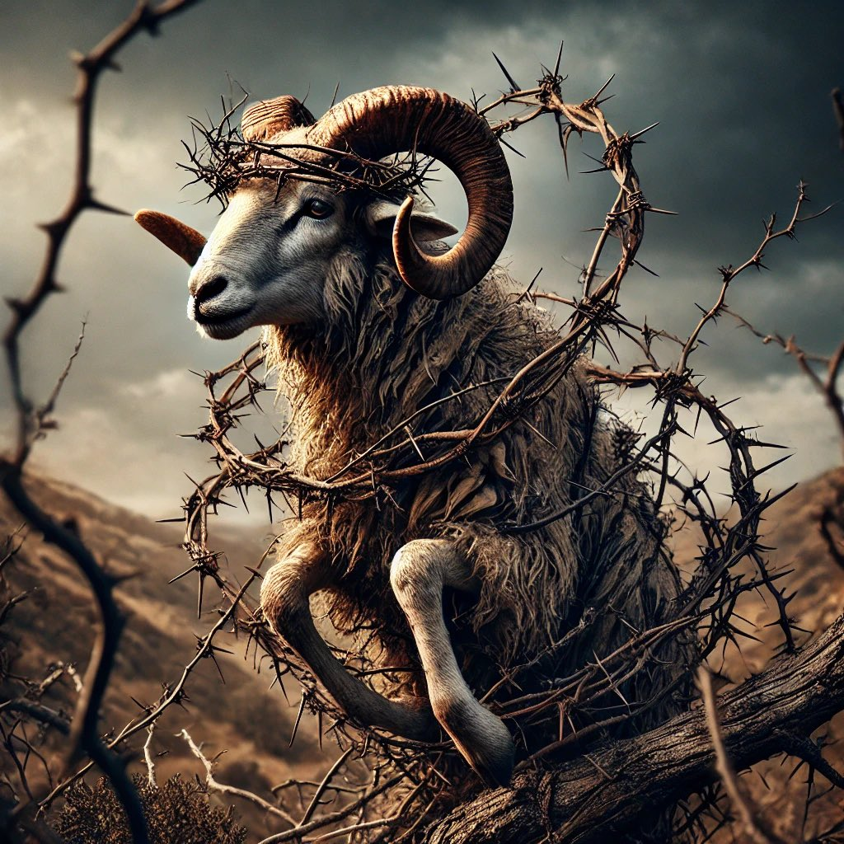
Notes:
Image: Five Loaves by Caroline Coolidge Brown. Copyright © Caroline Coolidge Brown. All rights reserved. Used by permission of the artist.

Slide 15
Scripture Reading
L: Our scripture reading is from Genesis, chapters 21 and 22.
C: Glory to you O’ Lord!
Notes:
Image: Five Loaves by Caroline Coolidge Brown. Copyright © Caroline Coolidge Brown. All rights reserved. Used by permission of the artist.

Slide 16
Genesis 21:1-3; 22:1-14
Chapter 21
The Lord dealt with Sarah as he had said, and the Lord did for Sarah as he had promised. ²Sarah conceived and bore Abraham a son in his old age, at the time of which God had spoken to him. ³Abraham gave the name Isaac to his son whom Sarah bore him.
Notes:
Image: Five Loaves by Caroline Coolidge Brown. Copyright © Caroline Coolidge Brown. All rights reserved. Used by permission of the artist.

Slide 17
Genesis 21:1-3; 22:1-14
Chapter 22
After these things God tested Abraham. He said to him, Abraham!” And he said, “Here I am.” ²He said, “Take your son, your only son Isaac, whom you love, and go to the land of Moriah, and offer him there as a burnt offering on one of the mountains that I shall show you.”
Notes:
Image: Five Loaves by Caroline Coolidge Brown. Copyright © Caroline Coolidge Brown. All rights reserved. Used by permission of the artist.

Slide 18
Genesis 21:1-3; 22:1-14
Chapter 22
³So Abraham rose early in the morning, saddled his donkey, and took two of his young men with him, and his son Isaac; he cut the wood for the burnt offering, and set out and went to the place in the distance that God had shown him. ⁴On the third day Abraham looked up and saw the place far away. ⁵Then
Notes:
Image: Five Loaves by Caroline Coolidge Brown. Copyright © Caroline Coolidge Brown. All rights reserved. Used by permission of the artist.

Slide 19
Genesis 21:1-3; 22:1-14
Chapter 22
Abraham said to his young men, “Stay here with the donkey; the boy and I will go over there; we will worship, and then we will come back to you.” ⁶Abraham took the wood of the burnt offering and laid it on his son Isaac, and he himself carried the fire and the knife. So the two of them walked on together. ⁷Isaac said
Notes:
Image: Five Loaves by Caroline Coolidge Brown. Copyright © Caroline Coolidge Brown. All rights reserved. Used by permission of the artist.

Slide 20
Genesis 21:1-3; 22:1-14
Chapter 22
to his father Abraham, “Father!” And he said, “Here I am, my son.” He said, “The fire and the wood are here, but where is the lamb for a burnt offering?” ⁸Abraham said, “God himself will provide the lamb for a burnt offering, my son.” So the two of them walked on together. ⁹When they came to the place that
Notes:
Image: Five Loaves by Caroline Coolidge Brown. Copyright © Caroline Coolidge Brown. All rights reserved. Used by permission of the artist.

Slide 21
Genesis 21:1-3; 22:1-14
Chapter 22
God had shown him, Abraham built an altar there and laid the wood in order. He bound his son Isaac, and laid him on the altar, on top of the wood. ¹⁰Then Abraham reached out his hand and took the knife to kill his son. ¹¹But the angel of the Lord called to him from heaven, and said, “Abraham, Abraham!” And he said,
Notes:
Image: Five Loaves by Caroline Coolidge Brown. Copyright © Caroline Coolidge Brown. All rights reserved. Used by permission of the artist.

Slide 22
Genesis 21:1-3; 22:1-14
Chapter 22
“Here I am.” ¹²He said, “Do not lay your hand on the boy or do anything to him; for now I know that you fear God, since you have not withheld your son, your only son, from me.” ¹³And Abraham looked up and saw a ram, caught in a thicket by its horns.
Notes:
Image: Five Loaves by Caroline Coolidge Brown. Copyright © Caroline Coolidge Brown. All rights reserved. Used by permission of the artist.

Slide 23
Genesis 21:1-3; 22:1-14
Chapter 22
Abraham went and took the ram and offered it up as a burnt offering instead of his son. ¹⁴So Abraham called that place “The Lord will provide”; as it is said to this day, “On the mount of the Lord it shall be provided.”
Notes:
Image: Five Loaves by Caroline Coolidge Brown. Copyright © Caroline Coolidge Brown. All rights reserved. Used by permission of the artist.

Slide 24
Genesis 21:1-3; 22:1-14
R: This is the Word of the Lord!
C: Praise to You, O Christ
Notes:
Image: Five Loaves by Caroline Coolidge Brown. Copyright © Caroline Coolidge Brown. All rights reserved. Used by permission of the artist.

Slide 25

Sermon

Slide 26
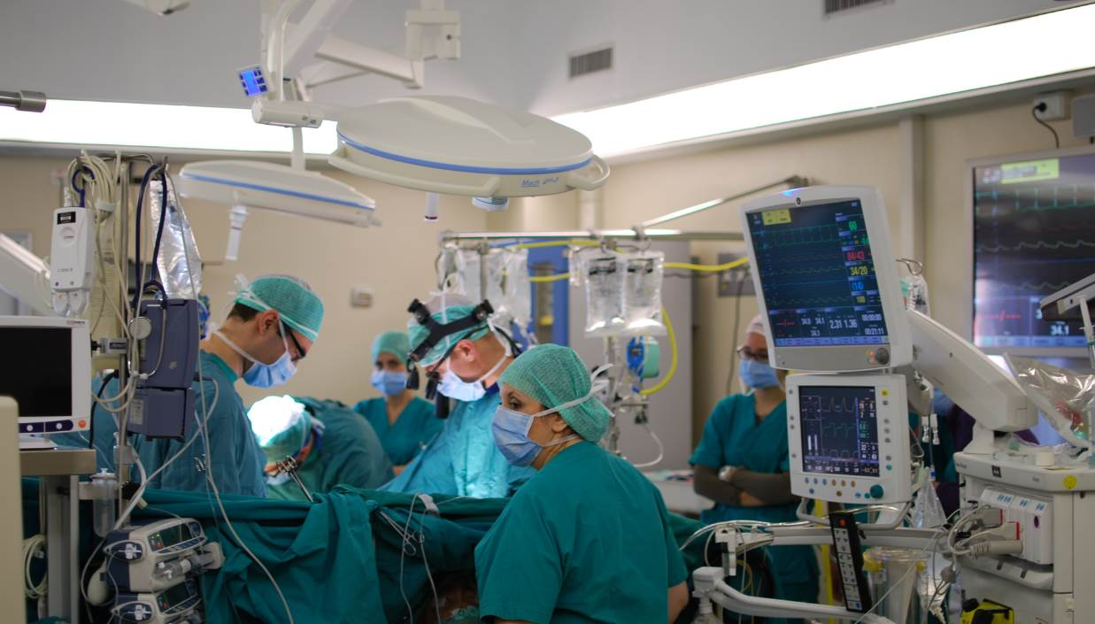
Sermon

Slide 27
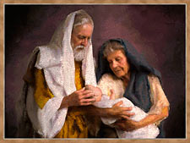
Sermon

Slide 28
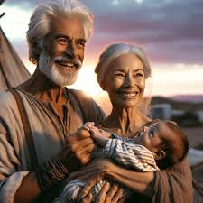
Sermon

Slide 29
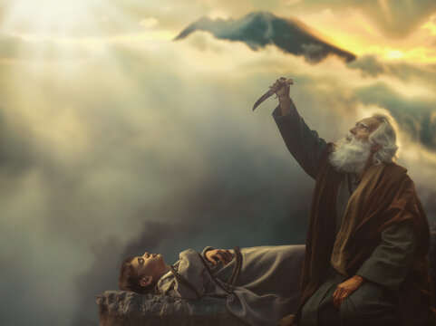
Sermon

Slide 30
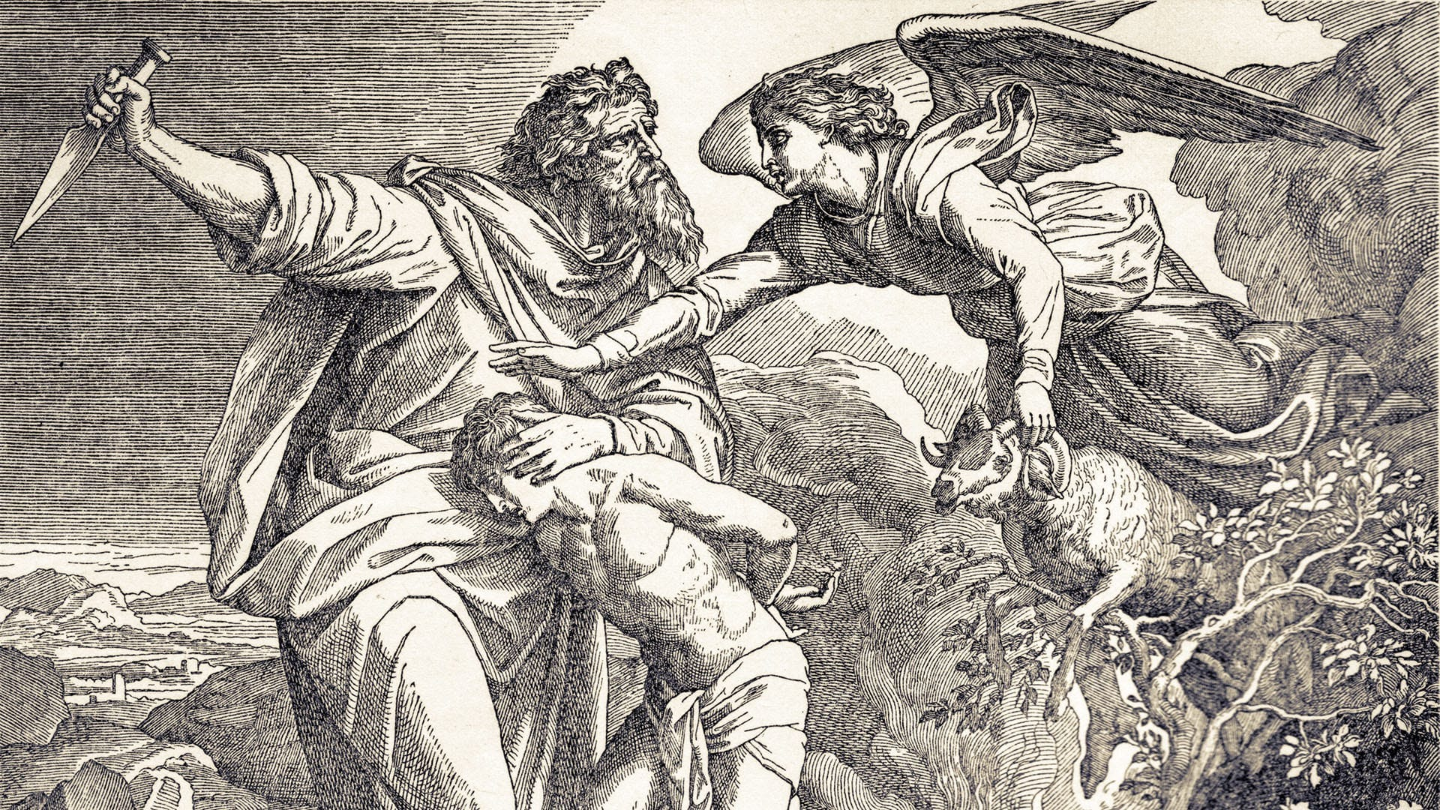
Sermon

Slide 31

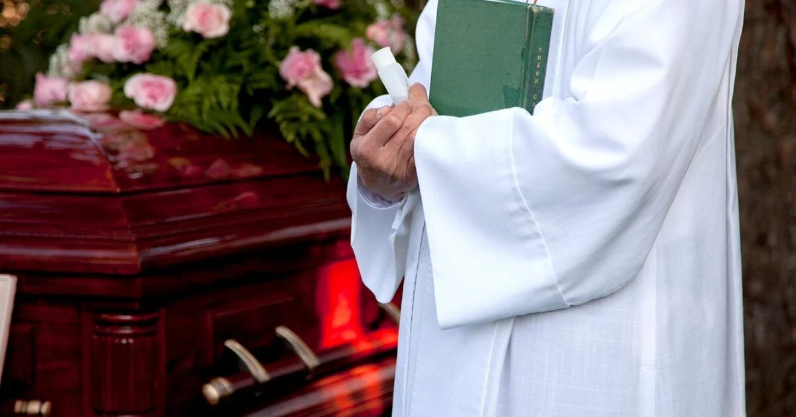
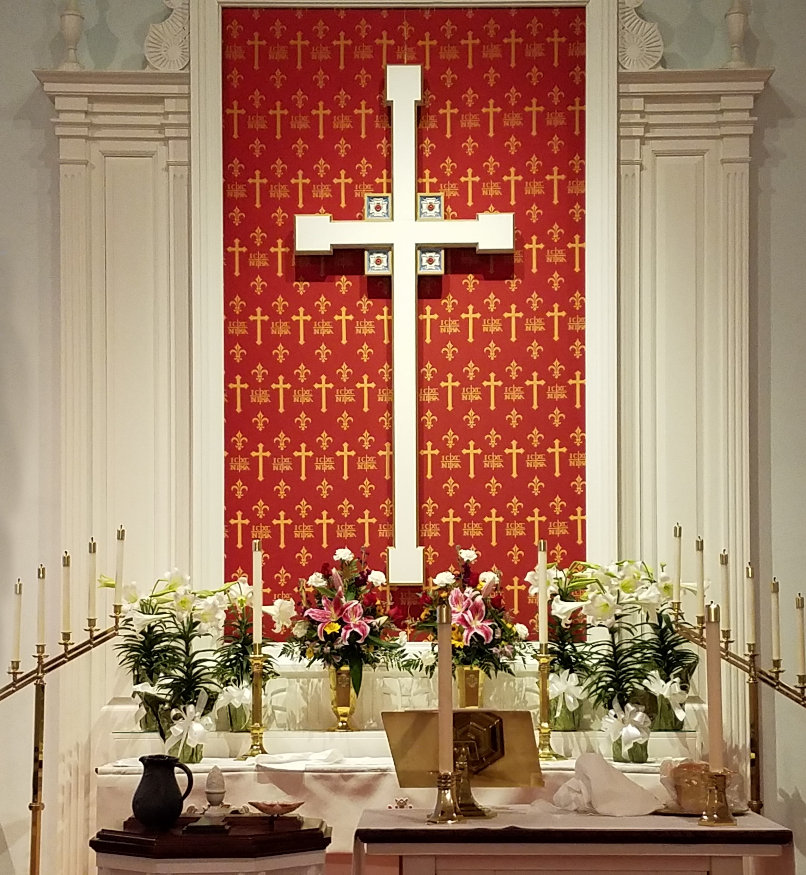
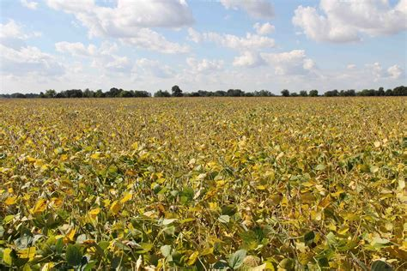
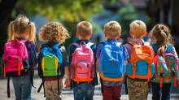
Sermon

Slide 32
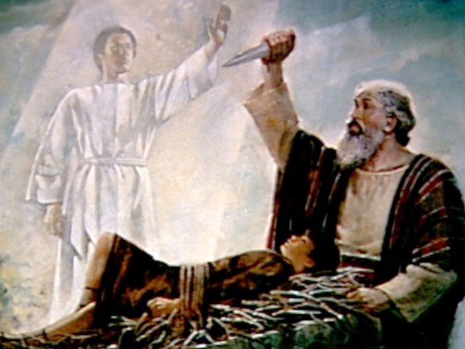
Sermon

Slide 33
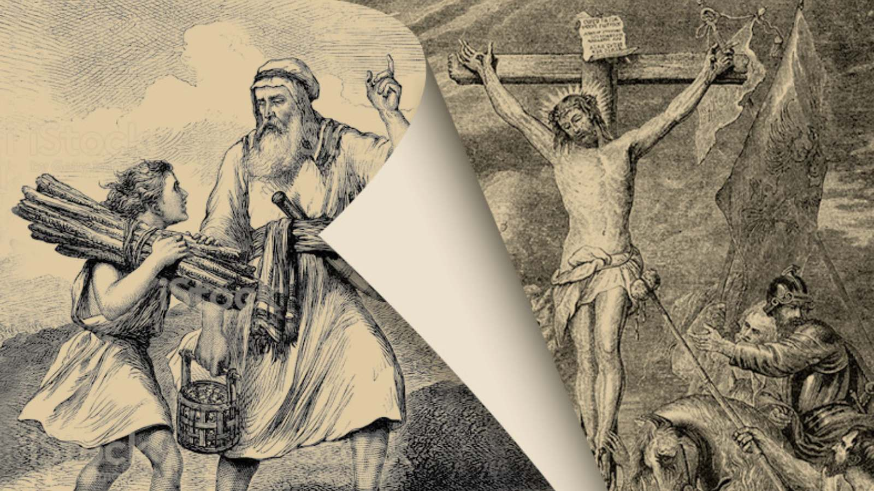
Sermon

Slide 34

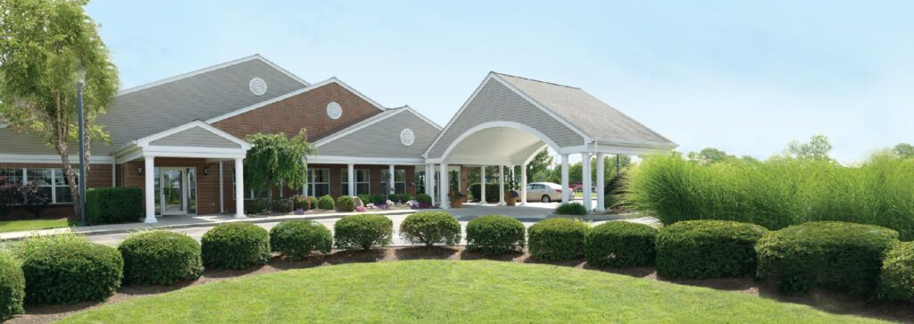
Sermon

Slide 35
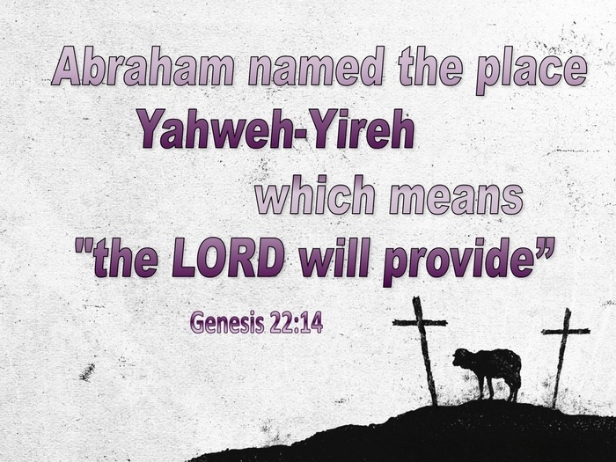

Slide 36
Hymn of the Day
“Faith of Our Fathers”
LBW 500

Slide 37
“Faith of Our Fathers” LBW 500
1 Faith of our fathers, living still
in spite of dungeon, fire, and sword.
Oh, how our hearts beat high with joy
whene'er we hear that glorious word.

Slide 38
“Faith of Our Fathers” LBW 500
Refrain
Faith of our fathers, holy faith,
we will be true to thee till death.

Slide 39
“Faith of Our Fathers” LBW 500
2 The martyrs, chained in prisons dark,
were still in heart and conscience free;
and blest would be their children's fate
if they, like them, should die for thee.

Slide 40
“Faith of Our Fathers” LBW 500
Refrain
Faith of our fathers, holy faith,
we will be true to thee till death.

Slide 41
“Faith of Our Fathers” LBW 500
3 Faith of our fathers! We will love
both friend and foe in all our strife;
proclaim thee too, as love knows how,
by saving word and faithful life.

Slide 42
“Faith of Our Fathers” LBW 500
Refrain
Faith of our fathers, holy faith,
we will be true to thee till death.

Slide 43
APOSTLE’S CREED
C: I believe in God, the Father almighty, creator of heaven and earth.

Slide 44
APOSTLE’S CREED
C: I believe in Jesus Christ, his only Son, our Lord. He was conceived by the power of the Holy Spirit and born of the virgin Mary. He suffered under Pontius Pilate, was crucified, died, and was buried.

Slide 45
APOSTLE’S CREED
C: He descended into hell. On the third day he rose again. He ascended into heaven, and is seated at the right hand of the Father. He will come again to judge the living and the dead.

Slide 46
APOSTLE’S CREED
C: I believe in the Holy Spirit, the holy catholic Church, the communion of saints, the forgiveness of sins, the resurrection of the body, and the life everlasting. Amen.

Slide 47
PRAYERS OF INTERCESSION
Each petition will end with the words,
A: God of promise,
The congregation will respond with:
C: Hear our prayer.

Slide 48
PRAYERS OF INTERCESSION
The prayer concludes…
P: We lift all these prayers, and those of our hearts, to your loving care, O God. Receive them and restore our hope in your promises. In Jesus’ name.
C: Amen.

Slide 49
OFFERING/OFFERING PRAYER
Notes:
Image: Five Loaves by Caroline Coolidge Brown. Copyright © Caroline Coolidge Brown. All rights reserved. Used by permission of the artist.

Slide 50
THE LORD’S PRAYER
C: Our Father, who art in heaven, hallowed be thy name, thy kingdom come, thy will be done, on earth as it is in heaven. Give us this day our daily bread; and forgive us our trespasses, as we forgive those who trespass against us; and lead us not into temptation, but deliver us from evil.

Slide 51
THE LORD’S PRAYER
C: For thine is the kingdom, and the power, and the glory, forever and ever. Amen.

Slide 52

ANNOUNCEMENTS
Notes:
Image: Five Loaves by Caroline Coolidge Brown. Copyright © Caroline Coolidge Brown. All rights reserved. Used by permission of the artist.

Slide 53
SENDING BLESSING
P: The love of God abound in you; the grace of our Savior Jesus Christ fill your hearts; and the life of the Spirit ☩ bless you and give you peace.
C: Amen.

Slide 54
SENDING HYMN
“Great Is Thy Faithfulness”
ELW 733

Slide 55
“Great Is Thy Faithfulness” ELW 733
1 Great is thy faithfulness, O God my Father;
there is no shadow of turning with thee;
thou changest not, thy compassions they fail not;
as thou hast been, thou forever wilt be.

Slide 56
“Great Is Thy Faithfulness” ELW 733
Refrain
Great is thy faithfulness! Great is thy faithfulness!
Morning by morning new mercies I see;
all I have needed thy hand hath provided;
great is thy faithfulness, Lord, unto me!

Slide 57
“Great Is Thy Faithfulness” ELW 733
2 Summer and winter and springtime and harvest,
sun, moon, and stars in their courses above
join with all nature in manifold witness
to thy great faithfulness, mercy, and love.

Slide 58
“Great Is Thy Faithfulness” ELW 733
Refrain
Great is thy faithfulness! Great is thy faithfulness!
Morning by morning new mercies I see;
all I have needed thy hand hath provided;
great is thy faithfulness, Lord, unto me!

Slide 59
“Great Is Thy Faithfulness” ELW 733
3 Pardon for sin and a peace that endureth,
thine own dear presence to cheer and to guide;
strength for today and bright hope for tomorrow,
blessings all mine, with ten thousand beside!

Slide 60
“Great Is Thy Faithfulness” ELW 733
Refrain
Great is thy faithfulness! Great is thy faithfulness!
Morning by morning new mercies I see;
all I have needed thy hand hath provided;
great is thy faithfulness, Lord, unto me!

Slide 61
DISMISSAL
P: … Depart in Christ’s Love.
C: Seeking, welcoming, and serving all. Amen!
POSTLUDE
By
Roxanne Groff
From sundaysandseasons.com. Copyright © 2025 Augsburg Fortress. All rights reserved. Reprinted by permission under Augsburg Fortress Liturgies Annual License #SAS023830. New Revised Standard Version Bible, Copyright © 1989, Division of Christian Education of the National Council of the Churches of Christ in the United States of America. Used by permission. All rights reserved. Revised Common Lectionary, Copyright © 1992 Consultation on Common Texts, admin Augsburg Fortress. Used by permission.

