Slide 1
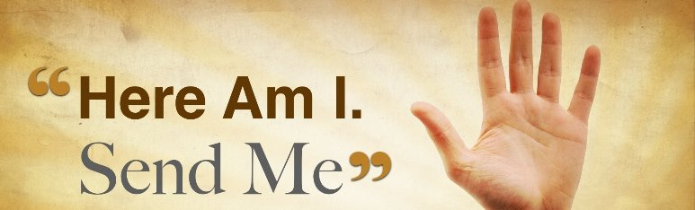
Isaiah 6:1-8
Welcome!
Trinity Evangelical Lutheran Church
November 17, 2024
Notes:
Image: Five Loaves by Caroline Coolidge Brown. Copyright © Caroline Coolidge Brown. All rights reserved. Used by permission of the artist.

Slide 2
Prelude By Roxanne Groff
= Please stand if able
= Please be seated
Office of the Acolyte and Ringing of the Bell
Welcome
Notes:
Image: Five Loaves by Caroline Coolidge Brown. Copyright © Caroline Coolidge Brown. All rights reserved. Used by permission of the artist.

Slide 3
CONFESSION AND FORGIVENESS
All may make the sign of the cross, the sign marked at baptism…
L: We confess our sins before God and one another.
Pause for silence and reflection.
L: Merciful God,
Notes:
Image: Five Loaves by Caroline Coolidge Brown. Copyright © Caroline Coolidge Brown. All rights reserved. Used by permission of the artist.

Slide 4
CONFESSION AND FORGIVENESS
C: We confess that from the beginning of time we have failed to understand your call to us. We have acted as though we are gods in our own lives. We have acted or failed to act in ways that have led to injustice and oppression. We have turned away from you and sought after other gods—possessions, people, media, and other distractions.
Notes:
Image: Five Loaves by Caroline Coolidge Brown. Copyright © Caroline Coolidge Brown. All rights reserved. Used by permission of the artist.

Slide 5
CONFESSION AND FORGIVENESS
C: Forgive us for all the ways in which we have failed you and our neighbors. Call us back into the abundant life of loving service that you offer us in your holy name.
Notes:
Image: Five Loaves by Caroline Coolidge Brown. Copyright © Caroline Coolidge Brown. All rights reserved. Used by permission of the artist.

Slide 6
CONFESSION AND FORGIVENESS
L: Beloved of God, hear these words of hope. God who created you in God’s image has redeemed you in Christ Jesus, and for his sake forgives you for all the ways you have sinned and fallen short. ☩ Receive this forgiveness with joy, in Jesus’ name.
C: Amen.
Notes:
Image: Five Loaves by Caroline Coolidge Brown. Copyright © Caroline Coolidge Brown. All rights reserved. Used by permission of the artist.

Slide 7
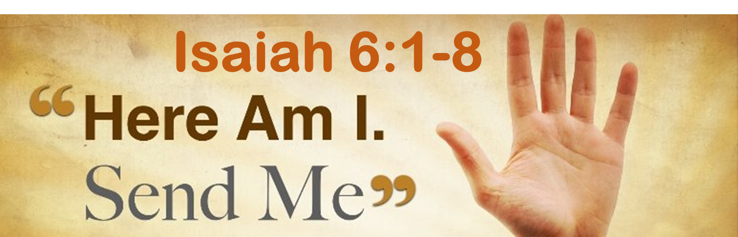
Gathering Song
“Holy, Holy, Holy”
LBW 165
Notes:
Image: Five Loaves by Caroline Coolidge Brown. Copyright © Caroline Coolidge Brown. All rights reserved. Used by permission of the artist.

Slide 8
“Holy, Holy, Holy” LBW 165
1 Holy, holy, holy, Lord God Almighty!
Early in the morning our song shall rise to thee.
Holy, holy, holy, merciful and mighty!
God in three Persons, blessed Trinity!
Notes:
Image: Five Loaves by Caroline Coolidge Brown. Copyright © Caroline Coolidge Brown. All rights reserved. Used by permission of the artist.

Slide 9
“Holy, Holy, Holy” LBW 165
2 Holy, holy, holy! All the saints adore thee,
casting down their golden crowns around the glassy sea;
cherubim and seraphim falling down before thee,
which wert and art and evermore shalt be.
Notes:
Image: Five Loaves by Caroline Coolidge Brown. Copyright © Caroline Coolidge Brown. All rights reserved. Used by permission of the artist.

Slide 10
“Holy, Holy, Holy” LBW 165
3 Holy, holy, holy! Though the darkness hide thee,
though the eye made blind by sin thy glory may not see,
only thou art holy; there is none beside thee,
perfect in pow’r, in love and purity.
Notes:
Image: Five Loaves by Caroline Coolidge Brown. Copyright © Caroline Coolidge Brown. All rights reserved. Used by permission of the artist.

Slide 11
“Holy, Holy, Holy” LBW 165
4 Holy, holy, holy! Lord God Almighty!
All thy works shall praise thy name in earth and sky and sea.
Holy, holy, holy, merciful and mighty!
God in three Persons, blessed Trinity!
Notes:
Image: Five Loaves by Caroline Coolidge Brown. Copyright © Caroline Coolidge Brown. All rights reserved. Used by permission of the artist.

Slide 12
APOSTOLIC GREETING
P: The grace of our Lord Jesus Christ, the love of God, and the communion of the Holy Spirit be with you all.
C: And also with you.
Notes:
Image: Five Loaves by Caroline Coolidge Brown. Copyright © Caroline Coolidge Brown. All rights reserved. Used by permission of the artist.

Slide 13
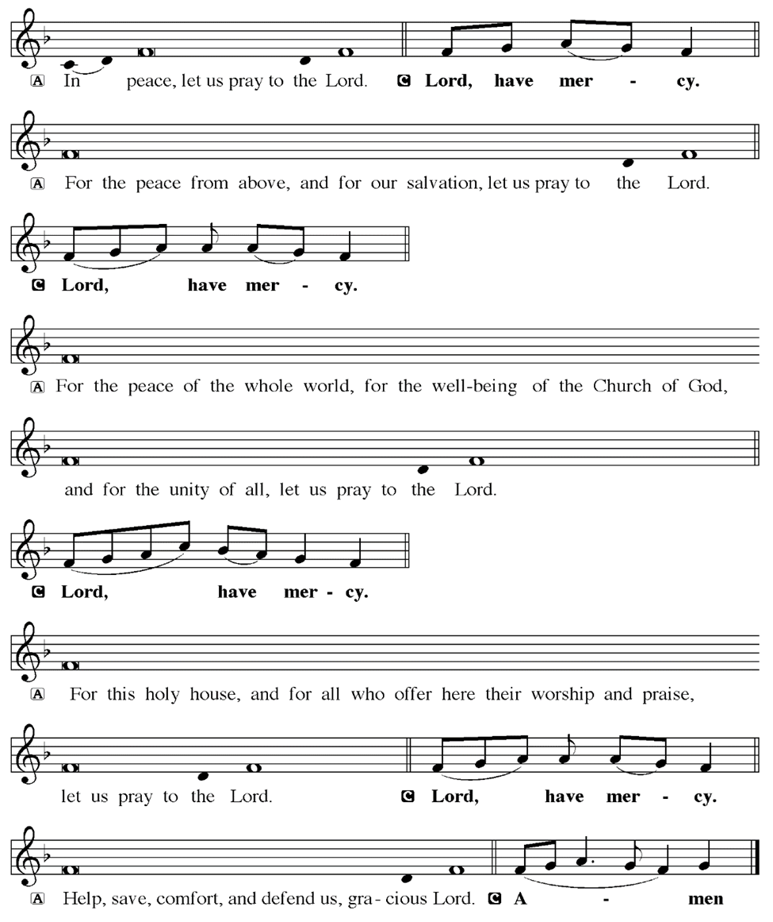
KYRIE
Notes:
Image: Five Loaves by Caroline Coolidge Brown. Copyright © Caroline Coolidge Brown. All rights reserved. Used by permission of the artist.

Slide 14
KYRIE
Notes:
Image: Five Loaves by Caroline Coolidge Brown. Copyright © Caroline Coolidge Brown. All rights reserved. Used by permission of the artist.

Slide 15
KYRIE
Notes:
Image: Five Loaves by Caroline Coolidge Brown. Copyright © Caroline Coolidge Brown. All rights reserved. Used by permission of the artist.

Slide 16
HYMN OF PRAISE
Glory be to God in heaven;
peace, goodwill to all the earth.
Mighty God of all creation,
Father of surpassing worth:
we exalt you, we adore you,
we lift high our thanks and praise.
Saints and angels bow before you; here on earth our songs we raise.
Notes:
Image: Five Loaves by Caroline Coolidge Brown. Copyright © Caroline Coolidge Brown. All rights reserved. Used by permission of the artist.

Slide 17
HYMN OF PRAISE
Glory be to Christ forever,
Lamb of God and Lord of love.
Son of God and gracious Savior, you have come from heav’n above;
on the cross you died to save us; now you reign at God’s right hand.
Hear our prayer; restore, forgive us; in your promise firm we stand.
Notes:
Image: Five Loaves by Caroline Coolidge Brown. Copyright © Caroline Coolidge Brown. All rights reserved. Used by permission of the artist.

Slide 18
HYMN OF PRAISE
Holy One we now acclaim you;
Lord alone, to you we call;
Holy One in faith we name you,
God most high, yet near to all:
Jesus Christ, with God the Spirit,
in the Father’s splendor bright.
For the peace that we inherit,
glory be to God on high!
Notes:
Image: Five Loaves by Caroline Coolidge Brown. Copyright © Caroline Coolidge Brown. All rights reserved. Used by permission of the artist.

Slide 19
PRAYER OF THE DAY
P: God of steadfast love, we stand before you today, humbled by your majesty and glory. Just as Isaiah was filled with awe, so too are we. Help us to be your servants, called to love and serve our neighbors. May we be instruments of your peace in the world.
C: Amen
Notes:
Image: Five Loaves by Caroline Coolidge Brown. Copyright © Caroline Coolidge Brown. All rights reserved. Used by permission of the artist.

Slide 20

Notes:
Image: Preparing yeast dough. Copyright © tomasworks/iStock/Thinkstock. Used by permission.

Slide 21
Scripture Reading
R: Our scripture reading for today is from Isaiah, Chapter 6.
C: Glory to you O’ Lord! (Spoken)
Notes:
Image: Five Loaves by Caroline Coolidge Brown. Copyright © Caroline Coolidge Brown. All rights reserved. Used by permission of the artist.

Slide 22
Isaiah 6:1-8
In the year that King Uzziah died, I saw the Lord sitting on a throne, high and lofty; and the hem of his robe filled the temple. ²Seraphs were in attendance above him; each had six wings: with two they covered their faces, and with two they covered their feet, and with two they flew. ³And one called to another and said: “Holy, holy, holy is the Lord of hosts; the whole earth is
Notes:
Image: Five Loaves by Caroline Coolidge Brown. Copyright © Caroline Coolidge Brown. All rights reserved. Used by permission of the artist.

Slide 23
Isaiah 6:1-8
full of his glory.” ⁴The pivots on the thresholds shook at the voices of those who called, and the house filled with smoke.
⁵And I said: “Woe is me! I am lost, for I am a man of unclean lips, and I live among a people of unclean lips; yet my eyes have seen the King, the Lord of hosts!” ⁶Then one of the seraphs flew to me, holding a live coal that had been
Notes:
Image: Five Loaves by Caroline Coolidge Brown. Copyright © Caroline Coolidge Brown. All rights reserved. Used by permission of the artist.

Slide 24
Isaiah 6:1-8
taken from the altar with a pair of tongs. ⁷The seraph touched my mouth with it and said: “Now that this has touched your lips, your guilt has departed and your sin is blotted out.” ⁸Then I heard the voice of the Lord saying, “Whom shall I send, and who will go for us?” And I said, “Here am I; send me!”
Notes:
Image: Five Loaves by Caroline Coolidge Brown. Copyright © Caroline Coolidge Brown. All rights reserved. Used by permission of the artist.

Slide 25
Isaiah 6:1-8
R: This is the Word of the Lord.
C: Praise to You, O Christ (Spoken)
Notes:
Image: Five Loaves by Caroline Coolidge Brown. Copyright © Caroline Coolidge Brown. All rights reserved. Used by permission of the artist.

Slide 26
Isaiah 6:1-8
SERMON
Notes:
Image: Five Loaves by Caroline Coolidge Brown. Copyright © Caroline Coolidge Brown. All rights reserved. Used by permission of the artist.

Slide 27
APOSTLE’S CREED
C: I believe in God, the Father almighty, creator of heaven and earth.

Slide 28
APOSTLE’S CREED
C: I believe in Jesus Christ, his only Son, our Lord. He was conceived by the power of the Holy Spirit and born of the virgin Mary. He suffered under Pontius Pilate, was crucified, died, and was buried.

Slide 29
APOSTLE’S CREED
C: He descended into hell. On the third day he rose again. He ascended into heaven, and is seated at the right hand of the Father. He will come again to judge the living and the dead.

Slide 30
APOSTLE’S CREED
C: I believe in the Holy Spirit, the holy catholic Church, the communion of saints, the forgiveness of sins, the resurrection of the body, and the life everlasting. Amen.

Slide 31
NICENE CREED
C: We believe in one God, the Father, the Almighty, maker of heaven and earth, of all that is, seen and unseen.

Slide 32
NICENE CREED
C: We believe in one Lord, Jesus Christ, the only Son of God, eternally begotten of the Father, God from God, Light from Light, true God from true God, begotten, not made, of one Being with the Father.

Slide 33
NICENE CREED
C: Through him all things were made. For us and for our salvation he came down from heaven; by the power of the Holy Spirit he became incarnate from the virgin Mary, and was made man. For our sake he was crucified under Pontius Pilate;

Slide 34
NICENE CREED
C: he suffered death and was buried. On the third day he rose again in accordance with the Scriptures; he ascended into heaven and is seated at the right hand of the Father. He will come again in glory to judge the living and the dead, and his kingdom will have no end.

Slide 35
NICENE CREED
C: We believe in the Holy Spirit, the Lord, the giver of life, who proceeds from the Father and the Son. With the Father and the Son he is worshiped and glorified. He has spoken through the prophets. We believe in one holy catholic and apostolic Church.

Slide 36
NICENE CREED
C: We acknowledge one Baptism for the forgiveness of sins. We look for the resurrection of the dead, and the life of the world to come. Amen.

Slide 37
PRAYERS OF INTERCESSION
Each petition will end with the words,
A: Merciful God,
The congregation will respond with:
C: Hear our prayer.

Slide 38
PRAYERS OF INTERCESSION
The prayer concludes…
P: We entrust all our prayers, spoken and unspoken, to you. In Jesus’ name we pray.
C: Amen.

Slide 39
OFFERING

Slide 40
OFFERING PRAYER

Slide 41
THE GREAT THANKSGIVING
All the Baptized are welcome to celebrate this Holy Meal.

Slide 42
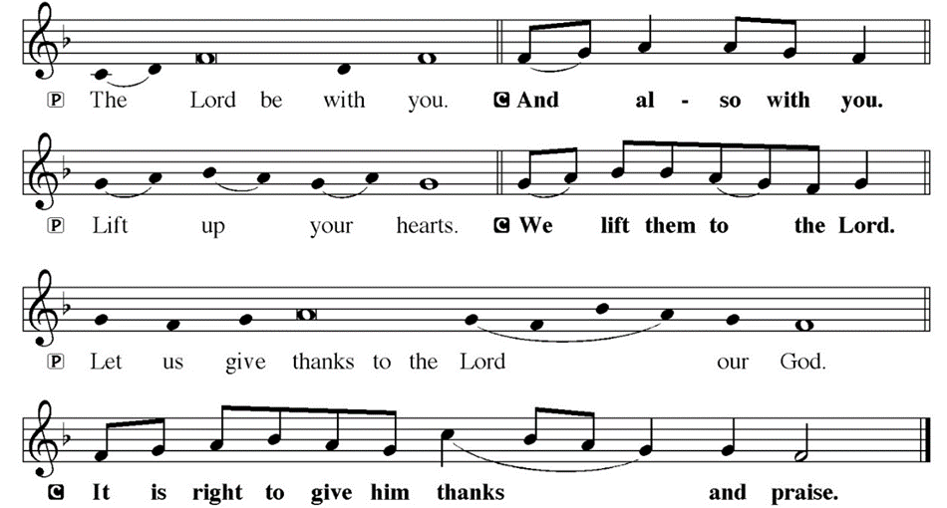
DIALOGUE

Slide 43
THE PREFACE
P: It is indeed right and salutary…
… we praise your name and join their unending hymn.

Slide 44
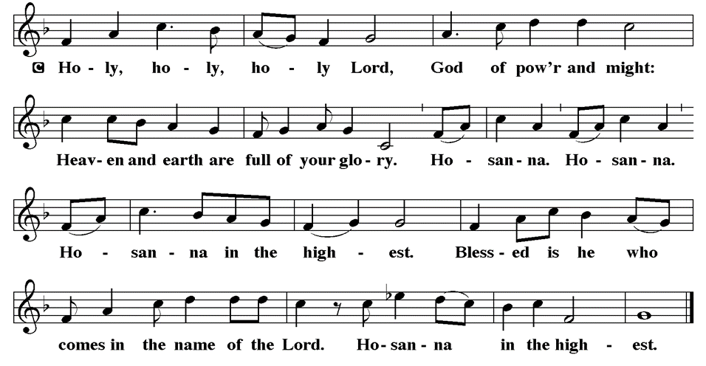
THE SANCTUS

Slide 45
EUCHARISTIC PRAYER
P: Holy God, our maker and redeemer…
…both now and forever.
C: Amen.

Slide 46
THE LORD’S PRAYER
C: Our Father, who art in heaven, hallowed be thy name, thy kingdom come, thy will be done, on earth as it is in heaven. Give us this day our daily bread; and forgive us our trespasses, as we forgive those who trespass against us; and lead us not into temptation, but deliver us from evil.

Slide 47
THE LORD’S PRAYER
C: For thine is the kingdom, and the power, and the glory, forever and ever. Amen.

Slide 48
INVITATION TO COMMUNION
P: We are called not only into the service of witnessing to God’s presence in the world, but also to this table of mercy and forgiveness, where Jesus meets us in bread and wine and equips us to answer God’s call. Come and be fed.

Slide 49
COMMUNION DISTRIBUTION
All will commune “by Station”.
The bread may be broken for distribution. As the ministers give the bread and wine, they say these words :
The body of Christ, given for you.
The blood of Christ, shed for you.
The communicant may say: Amen.

Slide 50
POST COMMUNION BLESSING
P: May this body and blood of our Lord and Savior, Jesus Christ, strengthen, keep and unite us, ☩ now and forever, amen.
C: Amen.

Slide 51
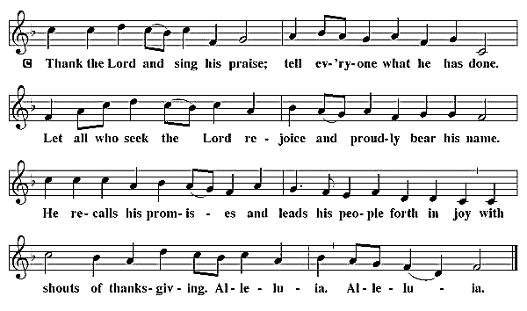
POST COMMUNION CANTACLE

Slide 52
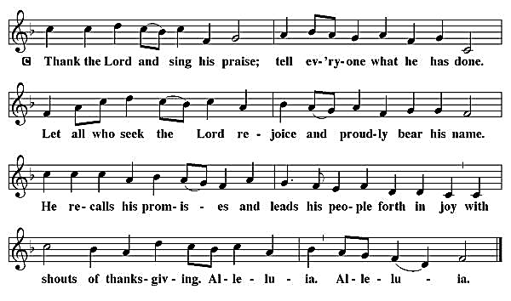
POST COMMUNION CANTACLE

Slide 53
POST COMMUNION PRAYER
P: Let us pray… Faithful God, you have spread before us a feast of rich food and drink in the body and blood of your Son. Now send us out to labor with you, in service to the world you have made, and among the people you have made your home, in Jesus Christ, our Savior and Lord.
C: Amen

Slide 54

ANNOUNCEMENTS
Notes:
Image: Five Loaves by Caroline Coolidge Brown. Copyright © Caroline Coolidge Brown. All rights reserved. Used by permission of the artist.

Slide 55
SENDING BLESSING
P: The Ancient One, enthroned, the Crucified One, now risen, the Indwelling One, poured out, ☩ bless you now and forever..
C: Amen.

Slide 56
Sending Song
“Here I Am, Lord”
ELW 574
Notes:
Image: Five Loaves by Caroline Coolidge Brown. Copyright © Caroline Coolidge Brown. All rights reserved. Used by permission of the artist.

Slide 57
“Here I Am, Lord” ELW 574
1 "I, the Lord of sea and sky,
I have heard my people cry.
All who dwell in dark and sin
my hand will save.
I, who made the stars of night,
I will make their darkness bright.
Who will bear my light to them?
Whom shall I send?"
Notes:
Image: Preparing yeast dough. Copyright © tomasworks/iStock/Thinkstock. Used by permission.

Slide 58
“Here I Am, Lord” ELW 574
Refrain
Here I am, Lord. Is it I, Lord?
I have heard you calling in the night.
I will go, Lord, if you lead me.
I will hold your people in my heart.
Notes:
Image: Preparing yeast dough. Copyright © tomasworks/iStock/Thinkstock. Used by permission.

Slide 59
“Here I Am, Lord” ELW 574
2 "I, the Lord of snow and rain,
I have borne my people's pain.
I have wept for love of them.
They turn away.
I will break their hearts of stone,
give them hearts for love alone.
I will speak my word to them.
Whom shall I send?"
Notes:
Image: Preparing yeast dough. Copyright © tomasworks/iStock/Thinkstock. Used by permission.

Slide 60
“Here I Am, Lord” ELW 574
Refrain
Here I am, Lord. Is it I, Lord?
I have heard you calling in the night.
I will go, Lord, if you lead me.
I will hold your people in my heart.
Notes:
Image: Preparing yeast dough. Copyright © tomasworks/iStock/Thinkstock. Used by permission.

Slide 61
“Here I Am, Lord” ELW 574
3 "I, the Lord of wind and flame,
I will tend the poor and lame.
I will set a feast for them.
My hand will save.
Finest bread I will provide
till their hearts be satisfied.
I will give my life to them.
Whom shall I send?"
Notes:
Image: Preparing yeast dough. Copyright © tomasworks/iStock/Thinkstock. Used by permission.

Slide 62
“Here I Am, Lord” ELW 574
Refrain
Here I am, Lord. Is it I, Lord?
I have heard you calling in the night.
I will go, Lord, if you lead me.
I will hold your people in my heart.
Notes:
Image: Preparing yeast dough. Copyright © tomasworks/iStock/Thinkstock. Used by permission.

Slide 63
DISMISSAL
P: … Depart in Christ’s Love.
C: Seeking, welcoming, and serving all. Amen!
POSTLUDE
By Roxanne Groff
From sundaysandseasons.com. Copyright © 2024 Augsburg Fortress. All rights reserved. Reprinted by permission under Augsburg Fortress Liturgies Annual License #SAS023830. New Revised Standard Version Bible, Copyright © 1989, Division of Christian Education of the National Council of the Churches of Christ in the United States of America. Used by permission. All rights reserved. Revised Common Lectionary, Copyright © 1992 Consultation on Common Texts, admin Augsburg Fortress. Used by permission.

