Slide 1
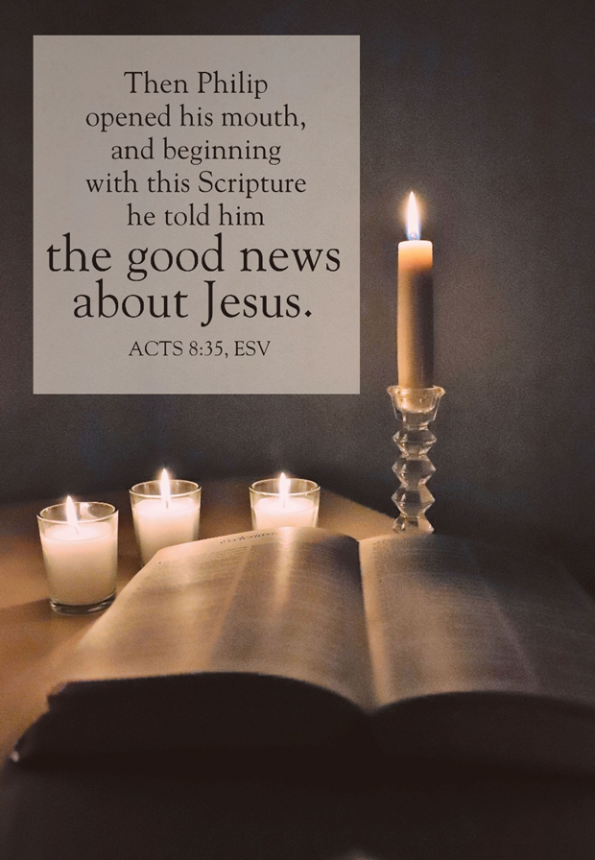
Happy Mother’s Day
May 11, 2025
WELCOME!
Trinity Lutheran Church
Notes:
Image: Five Loaves by Caroline Coolidge Brown. Copyright © Caroline Coolidge Brown. All rights reserved. Used by permission of the artist.

Slide 2
= Please stand if able
= Please be seated
Prelude - By Roxanne Groff
Office of the Acolyte
Ringing of the Bell
Welcome

Slide 3
CONFESSION AND FORGIVENESS
All may make the sign of the cross, the sign marked at baptism…
L: We confess our sins before God and one another.
Pause for silence and reflection.
L: God of new life,
Notes:
Image: Five Loaves by Caroline Coolidge Brown. Copyright © Caroline Coolidge Brown. All rights reserved. Used by permission of the artist.

Slide 4
CONFESSION AND FORGIVENESS
C: We live as though you are still in the grave. We do not rejoice in the good news of liberation for all people without exception. We continue to sin against you and our neighbors by our actions and our failure to act.
Notes:
Image: Five Loaves by Caroline Coolidge Brown. Copyright © Caroline Coolidge Brown. All rights reserved. Used by permission of the artist.

Slide 5
CONFESSION AND FORGIVENESS
C: Shake us out of our complacency, cleanse our hearts of selfishness, and make us joyful participants in the work of bringing about your reign in the world today.
Notes:
Image: Five Loaves by Caroline Coolidge Brown. Copyright © Caroline Coolidge Brown. All rights reserved. Used by permission of the artist.

Slide 6
CONFESSION AND FORGIVENESS
P: We are an Easter people! Through the death and resurrection of Jesus Christ, God has redeemed all of creation. Know that you are made whole, forgiven of all your sins, and empowered to live out the gospel in joy.
C: Amen.
Notes:
Image: Five Loaves by Caroline Coolidge Brown. Copyright © Caroline Coolidge Brown. All rights reserved. Used by permission of the artist.

Slide 7
Gathering Song/Hymn of Praise
“Baptized in Water”
ELW 456

Slide 8
“Baptized in Water” ELW 456
1 Baptized in water, sealed by the Spirit,
cleansed by the blood of Christ our king:
heirs of salvation, trusting his promise,
faithfully now God’s praise we sing.
Notes:
Image: Five Loaves by Caroline Coolidge Brown. Copyright © Caroline Coolidge Brown. All rights reserved. Used by permission of the artist.

Slide 9
“Baptized in Water” ELW 456
2 Baptized in water, sealed by the Spirit,
dead in the tomb with Christ our king:
one with his rising, freed and forgiven,
thankfully now God’s praise we sing.
Notes:
Image: Five Loaves by Caroline Coolidge Brown. Copyright © Caroline Coolidge Brown. All rights reserved. Used by permission of the artist.

Slide 10
“Baptized in Water” ELW 456
3 Baptized in water, sealed by the Spirit,
marked with the sign of Christ our king:
born of the Spirit, we are God's children;
joyfully now God’s praise we sing.
Notes:
Image: Five Loaves by Caroline Coolidge Brown. Copyright © Caroline Coolidge Brown. All rights reserved. Used by permission of the artist.

Slide 11
APOSTOLIC GREETING
P: The grace of our Lord Jesus Christ, the love of God, and the communion of the Holy Spirit be with you all.
C: And also with you.
Notes:
Image: Five Loaves by Caroline Coolidge Brown. Copyright © Caroline Coolidge Brown. All rights reserved. Used by permission of the artist.

Slide 12
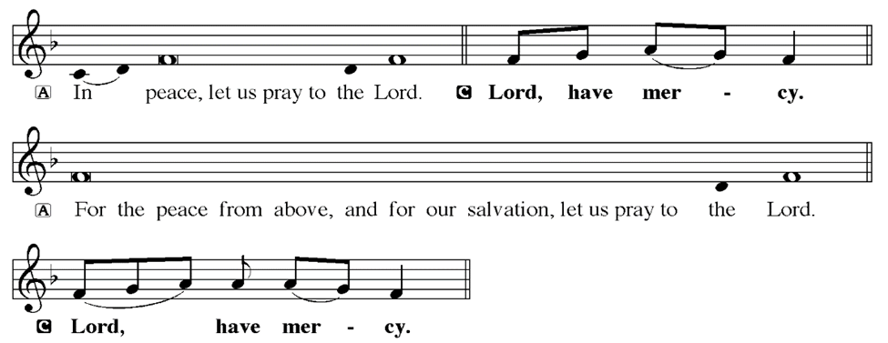
KYRIE
Notes:
Image: Five Loaves by Caroline Coolidge Brown. Copyright © Caroline Coolidge Brown. All rights reserved. Used by permission of the artist.

Slide 13
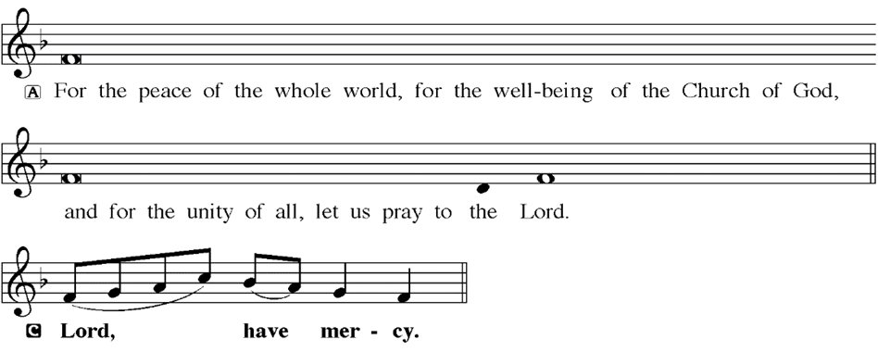
KYRIE
Notes:
Image: Five Loaves by Caroline Coolidge Brown. Copyright © Caroline Coolidge Brown. All rights reserved. Used by permission of the artist.

Slide 14
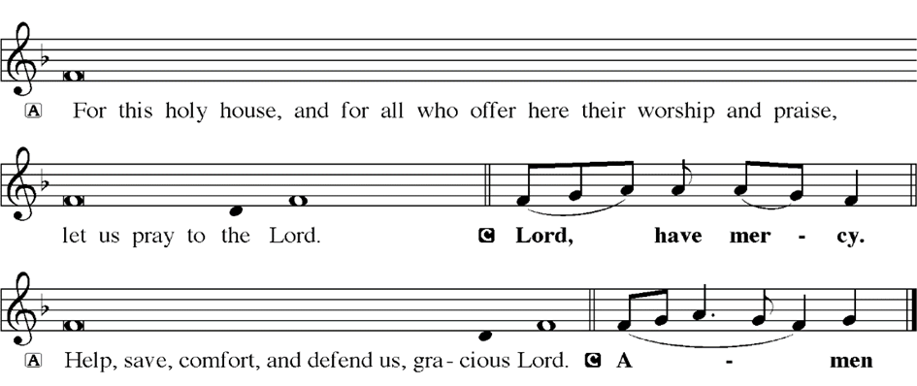
KYRIE
Notes:
Image: Five Loaves by Caroline Coolidge Brown. Copyright © Caroline Coolidge Brown. All rights reserved. Used by permission of the artist.

Slide 15
HYMN OF PRAISE
Glory be to God in heaven;
peace, goodwill to all the earth.
Mighty God of all creation,
Father of surpassing worth:
we exalt you, we adore you,
we lift high our thanks and praise.
Saints and angels bow before you; here on earth our songs we raise.
Notes:
Image: Five Loaves by Caroline Coolidge Brown. Copyright © Caroline Coolidge Brown. All rights reserved. Used by permission of the artist.

Slide 16
HYMN OF PRAISE
Glory be to Christ forever,
Lamb of God and Lord of love.
Son of God and gracious Savior, you have come from heav’n above;
on the cross you died to save us; now you reign at God’s right hand.
Hear our prayer; restore, forgive us; in your promise firm we stand.
Notes:
Image: Five Loaves by Caroline Coolidge Brown. Copyright © Caroline Coolidge Brown. All rights reserved. Used by permission of the artist.

Slide 17
HYMN OF PRAISE
Holy One we now acclaim you;
Lord alone, to you we call;
Holy One in faith we name you,
God most high, yet near to all:
Jesus Christ, with God the Spirit,
in the Father’s splendor bright.
For the peace that we inherit,
glory be to God on high!
Notes:
Image: Five Loaves by Caroline Coolidge Brown. Copyright © Caroline Coolidge Brown. All rights reserved. Used by permission of the artist.

Slide 18
PRAYER OF THE DAY
P: Let us pray… Gracious God, we read your holy word and often find ourselves confused. Send your Holy Spirit into our community that we might discern together what it is you are calling us to do. Give us hearts of welcome to all our neighbors, and make us examples of your love in action. In Jesus’ name we pray.
C: Amen
Notes:
Image: Five Loaves by Caroline Coolidge Brown. Copyright © Caroline Coolidge Brown. All rights reserved. Used by permission of the artist.

Slide 19

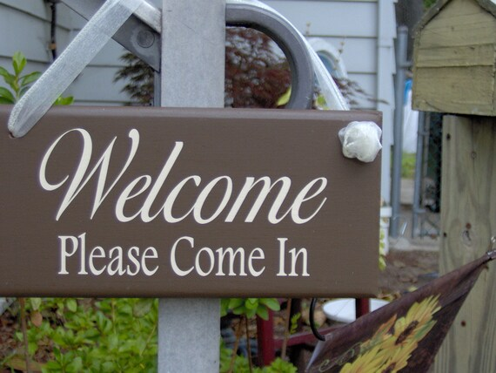
Notes:
Image: Five Loaves by Caroline Coolidge Brown. Copyright © Caroline Coolidge Brown. All rights reserved. Used by permission of the artist.

Slide 20
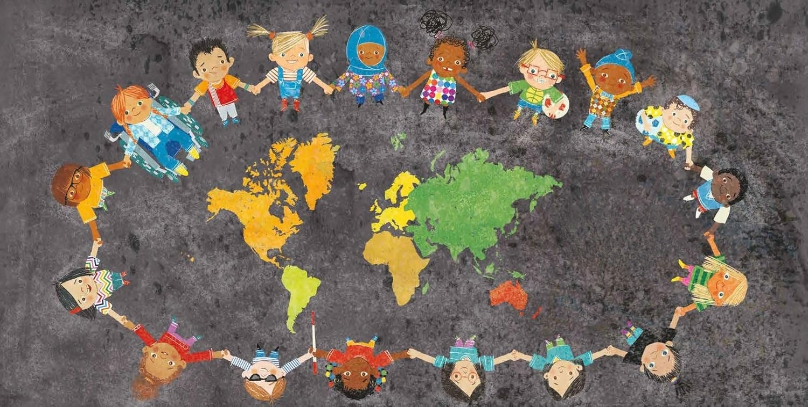
All Are Welcome
In God’s Family!
Notes:
Image: Five Loaves by Caroline Coolidge Brown. Copyright © Caroline Coolidge Brown. All rights reserved. Used by permission of the artist.

Slide 21

Notes:
Image: Five Loaves by Caroline Coolidge Brown. Copyright © Caroline Coolidge Brown. All rights reserved. Used by permission of the artist.

Slide 22
Scripture Reading
L: Our scripture reading is from the Gospel of Acts, chapter 8.
C: Glory to you O’ Lord!
Notes:
Image: Five Loaves by Caroline Coolidge Brown. Copyright © Caroline Coolidge Brown. All rights reserved. Used by permission of the artist.

Slide 23
Acts 8:26-39
²⁶Then an angel of the Lord said to Philip, “Get up and go toward the south to the road that goes down from Jerusalem to Gaza.” (This is a wilderness road.) ²⁷So he got up and went. Now there was an Ethiopian eunuch, a court official of the Candace, queen of the Ethiopians, in charge of her entire treasury. He had come to Jerusalem to worship ²⁸and
Notes:
Image: Five Loaves by Caroline Coolidge Brown. Copyright © Caroline Coolidge Brown. All rights reserved. Used by permission of the artist.

Slide 24
Acts 8:26-39
was returning home; seated in his chariot, he was reading the prophet Isaiah. ²⁹Then the Spirit said to Philip, “Go over to this chariot and join it.” ³⁰So Philip ran up to it and heard him reading the prophet Isaiah. He asked, “Do you understand what you are reading?” ³¹He replied, “How can I, unless someone guides me?” And he invited Philip to get in and sit beside
Notes:
Image: Five Loaves by Caroline Coolidge Brown. Copyright © Caroline Coolidge Brown. All rights reserved. Used by permission of the artist.

Slide 25
Acts 8:26-39
him. ³²Now the passage of the scripture that he was reading was this: “Like a sheep he was led to the slaughter, and like a lamb silent before its shearer, so he does not open his mouth. ³³In his humiliation justice was denied him. Who can describe his generation? For his life is taken away from the earth.” ³⁴The eunuch asked Philip, “About whom,
Notes:
Image: Five Loaves by Caroline Coolidge Brown. Copyright © Caroline Coolidge Brown. All rights reserved. Used by permission of the artist.

Slide 26
Acts 8:26-39
may I ask you, does the prophet say this, about himself or about someone else?” ³⁵Then Philip began to speak, and starting with this scripture, he proclaimed to him the good news about Jesus. ³⁶As they were going along the road, they came to some water; and the eunuch said, “Look, here is water! What is to prevent me from being baptized?”
Notes:
Image: Five Loaves by Caroline Coolidge Brown. Copyright © Caroline Coolidge Brown. All rights reserved. Used by permission of the artist.

Slide 27
Acts 8:26-39
³⁸He commanded the chariot to stop, and both of them, Philip and the eunuch, went down into the water, and Philip baptized him. ³⁹When they came up out of the water, the Spirit of the Lord snatched Philip away; the eunuch saw him no more, and went on his way rejoicing.
Notes:
Image: Five Loaves by Caroline Coolidge Brown. Copyright © Caroline Coolidge Brown. All rights reserved. Used by permission of the artist.

Slide 28
Acts 8:26-39
R: This is the Word of the Lord.
C: Praise to You, O Christ
Notes:
Image: Five Loaves by Caroline Coolidge Brown. Copyright © Caroline Coolidge Brown. All rights reserved. Used by permission of the artist.

Slide 29
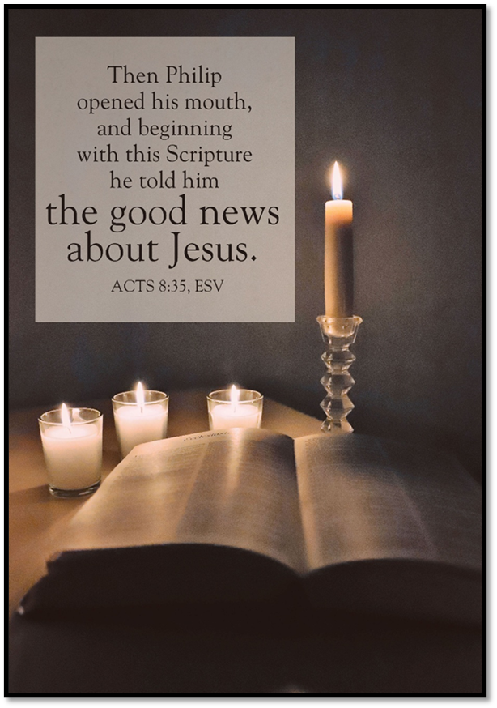
Sermon

Slide 30

Sermon

Slide 31

Sermon

Slide 32
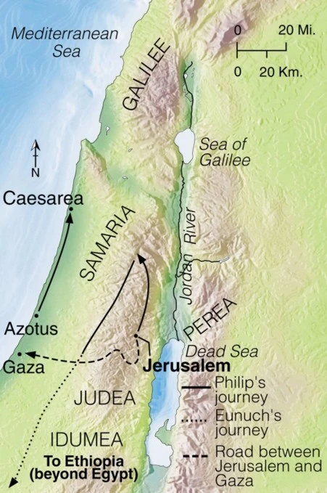
Sermon

Slide 33
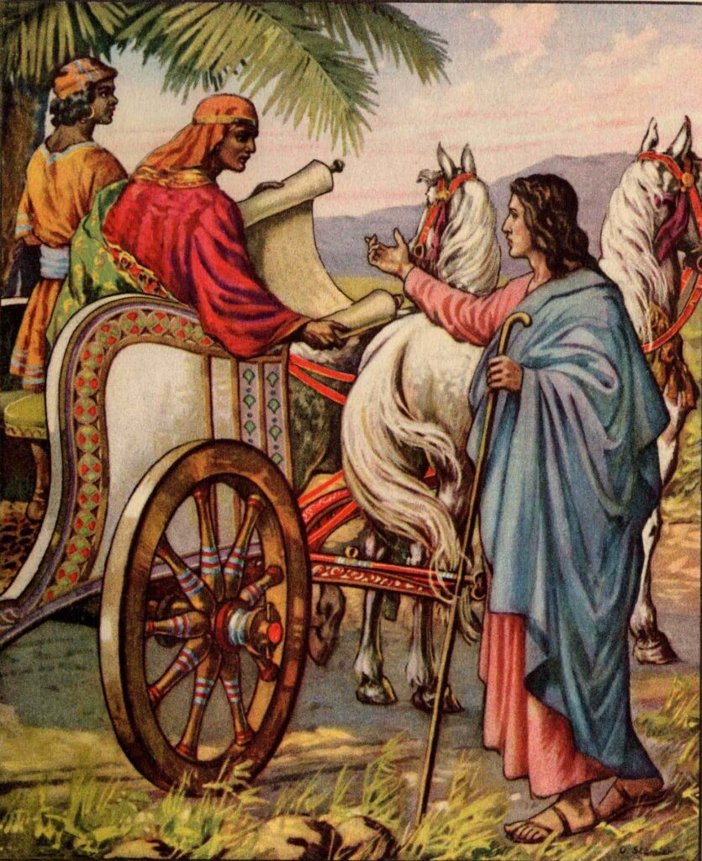
Sermon

Slide 34
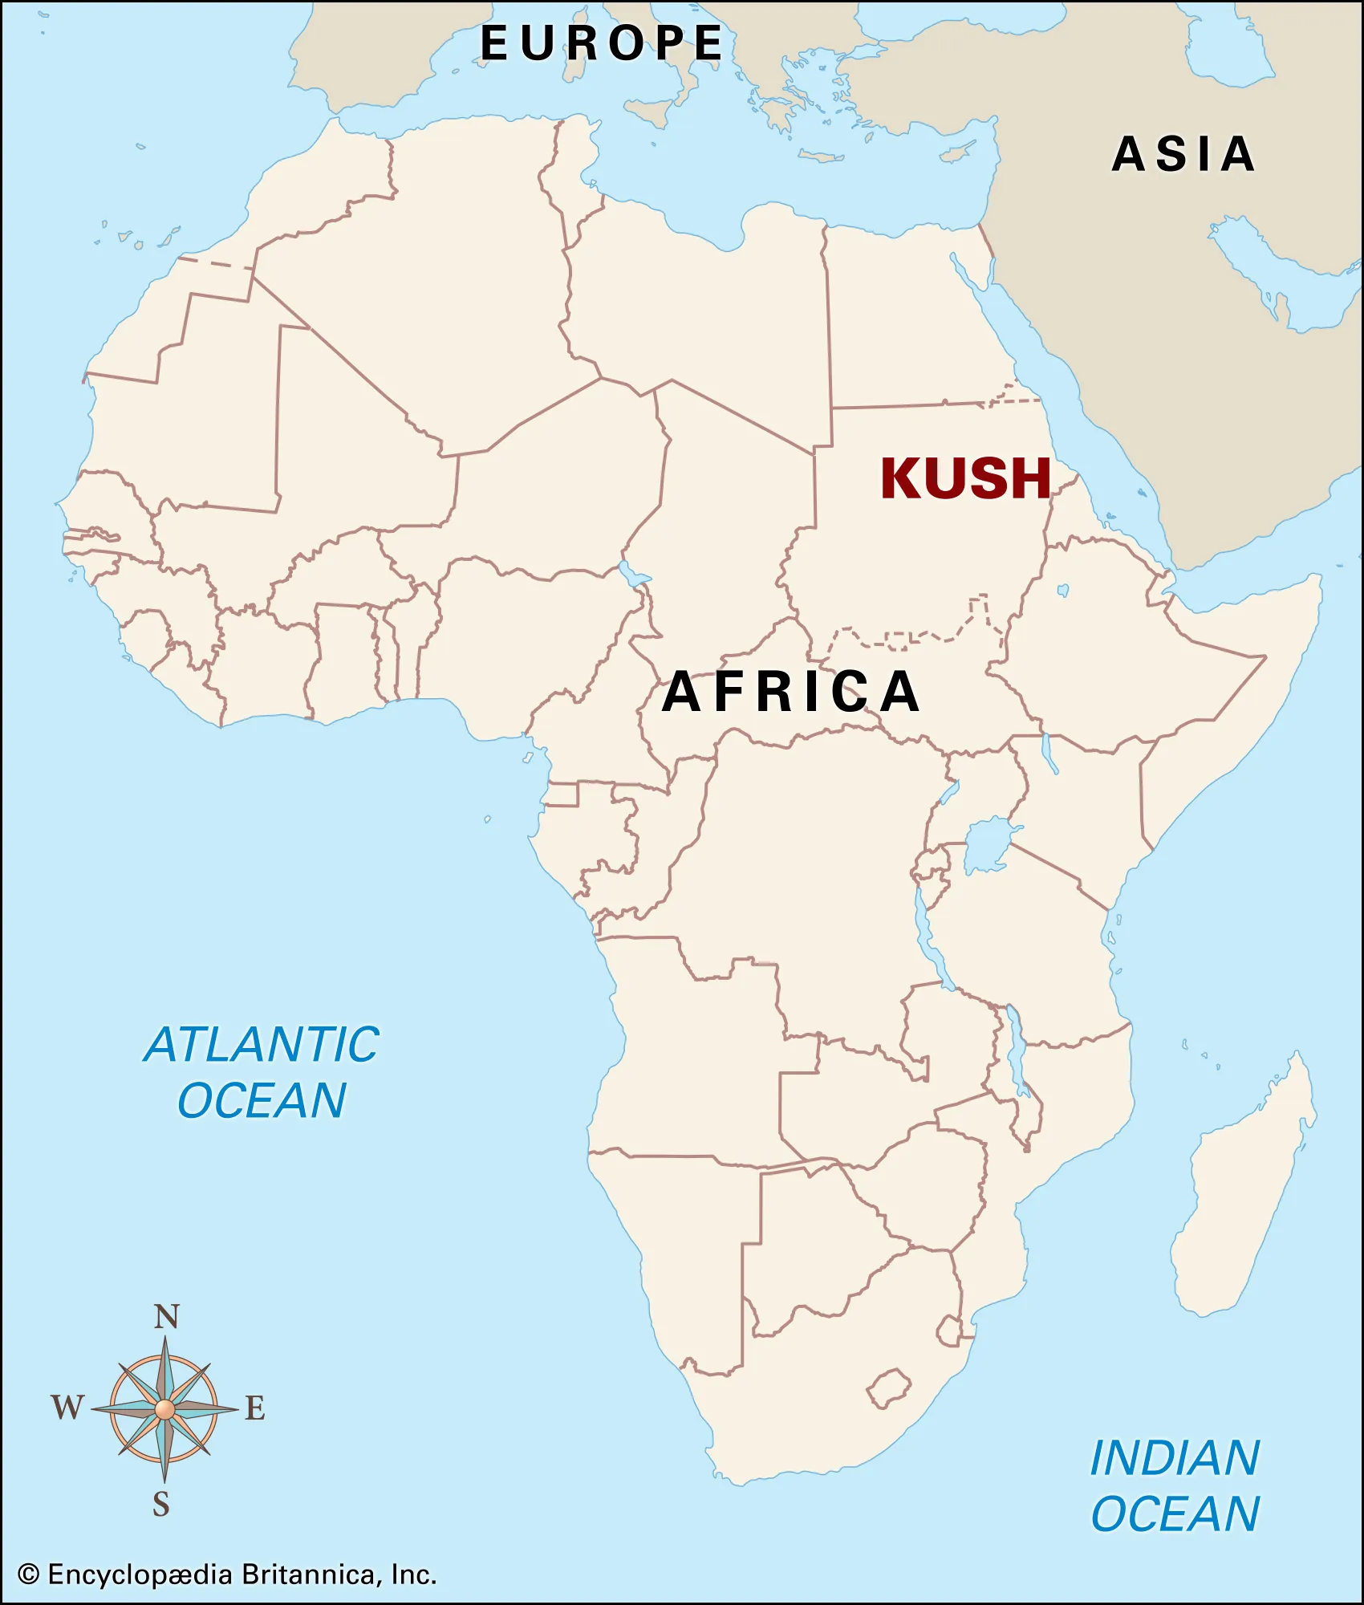
Sermon

Slide 35
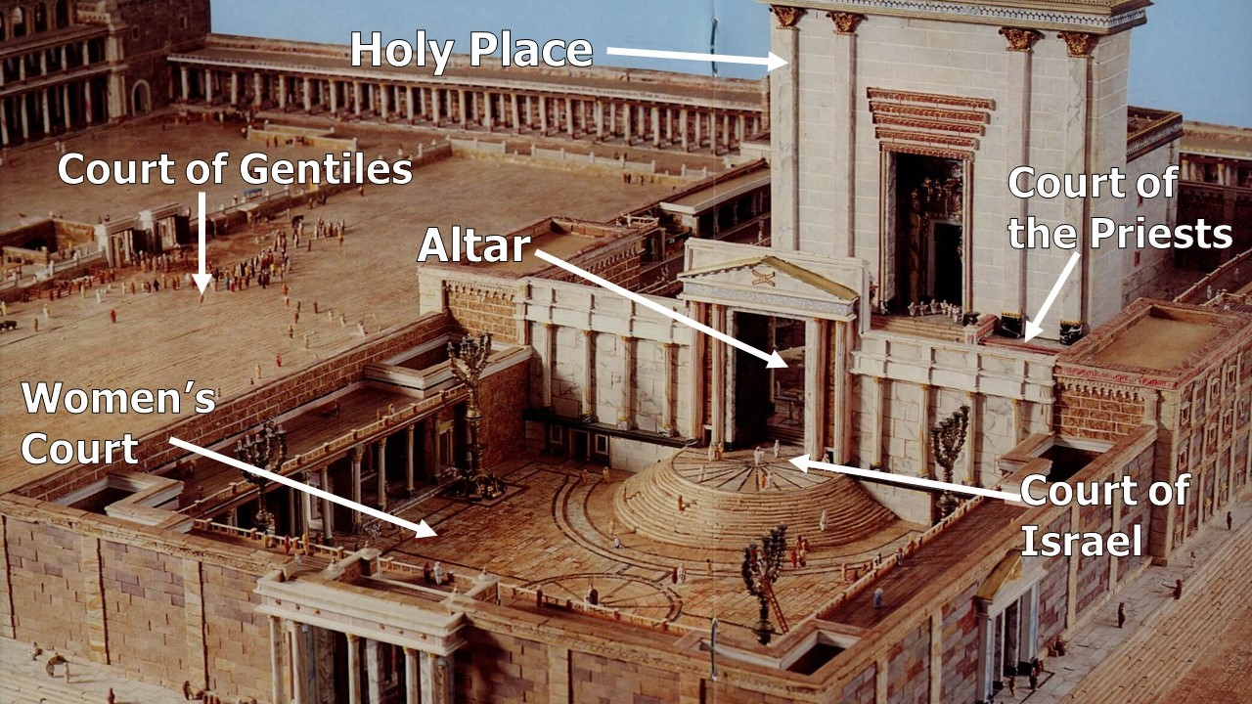
Sermon

Slide 36
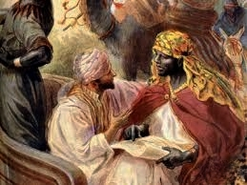
Sermon

Slide 37
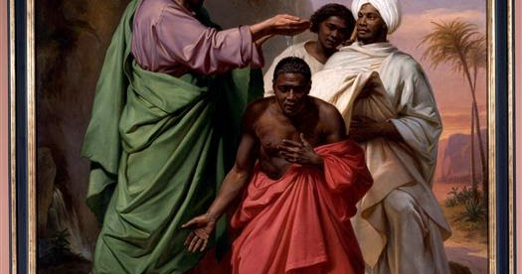
Sermon

Slide 38
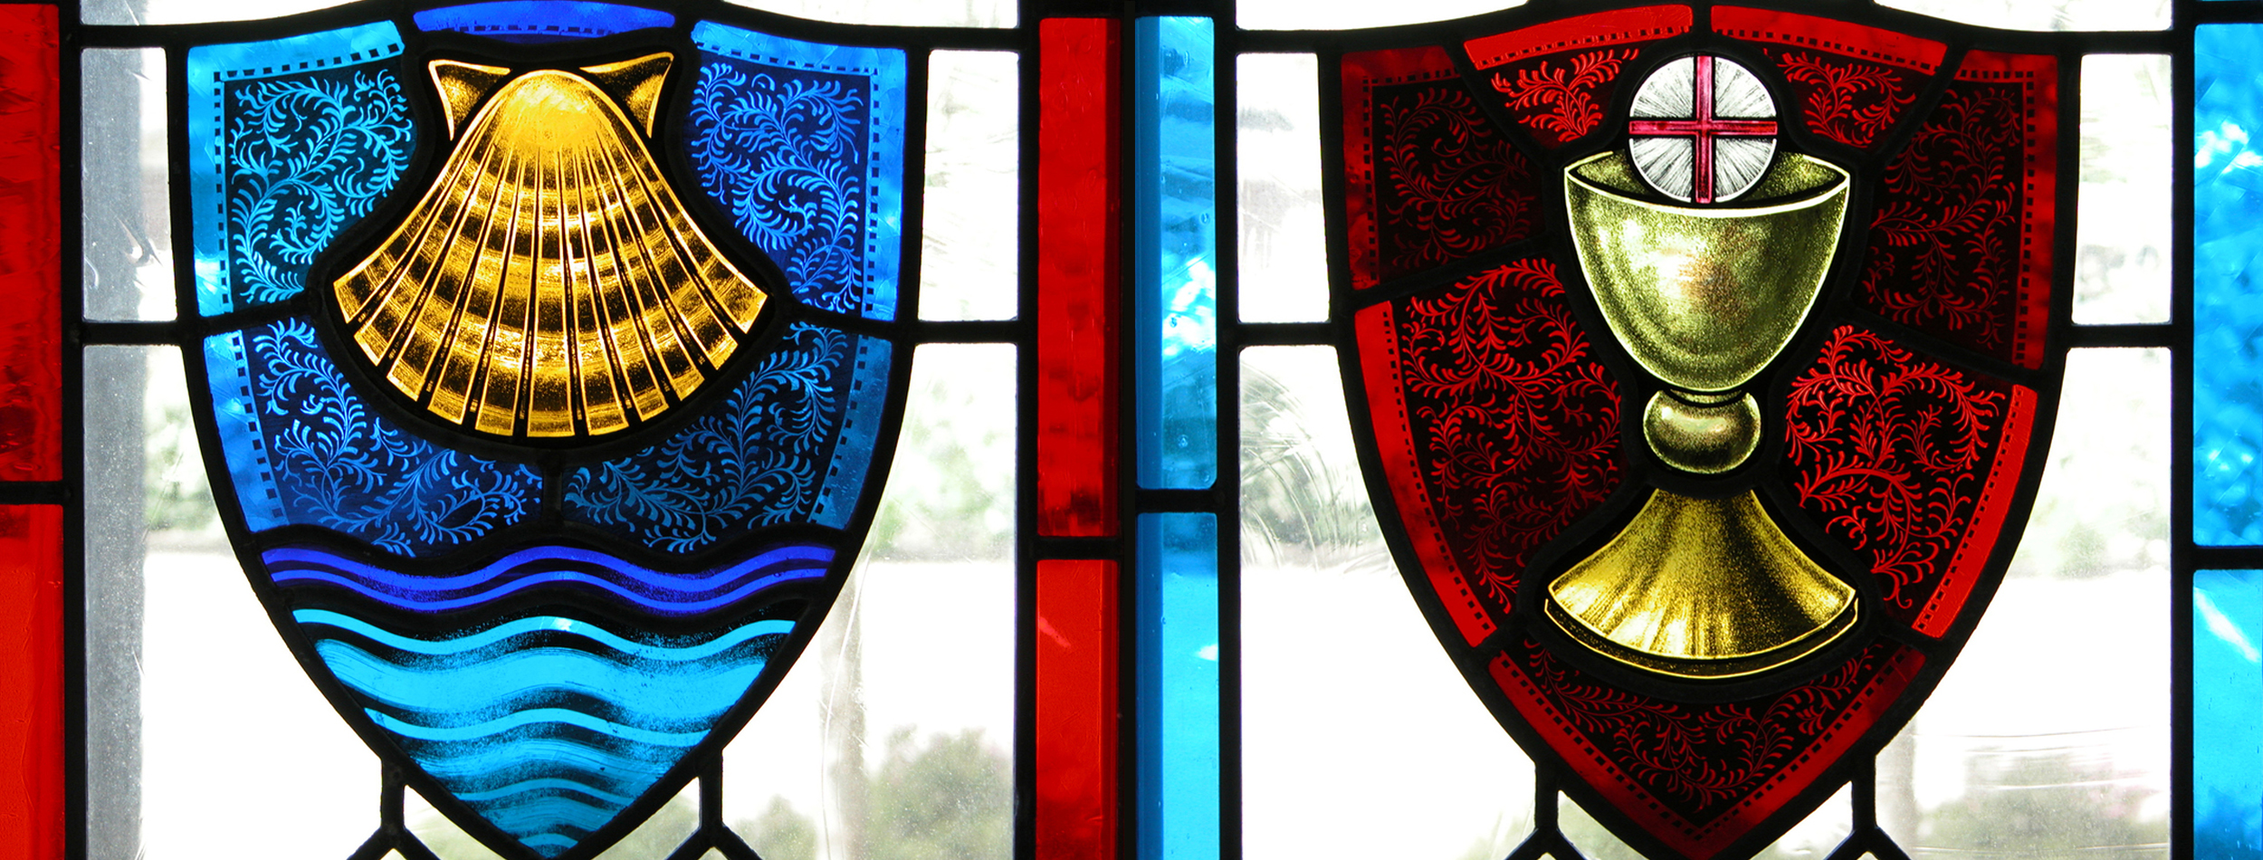
Sermon
God’s Plan
Baptism and Communion
For All People!

Slide 39
APOSTLE’S CREED
C: I believe in God, the Father almighty, creator of heaven and earth.

Slide 40
APOSTLE’S CREED
C: I believe in Jesus Christ, his only Son, our Lord. He was conceived by the power of the Holy Spirit and born of the virgin Mary. He suffered under Pontius Pilate, was crucified, died, and was buried.

Slide 41
APOSTLE’S CREED
C: He descended into hell. On the third day he rose again. He ascended into heaven, and is seated at the right hand of the Father. He will come again to judge the living and the dead.

Slide 42
APOSTLE’S CREED
C: I believe in the Holy Spirit, the holy catholic Church, the communion of saints, the forgiveness of sins, the resurrection of the body, and the life everlasting. Amen.

Slide 43
NICENE CREED
C: We believe in one God, the Father, the Almighty, maker of heaven and earth, of all that is, seen and unseen.

Slide 44
NICENE CREED
C: We believe in one Lord, Jesus Christ, the only Son of God, eternally begotten of the Father, God from God, Light from Light, true God from true God, begotten, not made, of one Being with the Father.

Slide 45
NICENE CREED
C: Through him all things were made. For us and for our salvation he came down from heaven; by the power of the Holy Spirit he became incarnate from the virgin Mary, and was made man. For our sake he was crucified under Pontius Pilate;

Slide 46
NICENE CREED
C: he suffered death and was buried. On the third day he rose again in accordance with the Scriptures; he ascended into heaven and is seated at the right hand of the Father. He will come again in glory to judge the living and the dead, and his kingdom will have no end.

Slide 47
NICENE CREED
C: We believe in the Holy Spirit, the Lord, the giver of life, who proceeds from the Father and the Son. With the Father and the Son he is worshiped and glorified. He has spoken through the prophets. We believe in one holy catholic and apostolic Church.

Slide 48
NICENE CREED
C: We acknowledge one Baptism for the forgiveness of sins. We look for the resurrection of the dead, and the life of the world to come. Amen.

Slide 49
PRAYERS OF INTERCESSION
Each petition will end with the words,
A: Holy and Wonderful God,
C: Hear our prayer.

Slide 50
PRAYERS OF INTERCESSION
The prayer concludes…
P: These and the prayers of all creation we lift to you in Jesus’ name.
C: Amen.

Slide 51
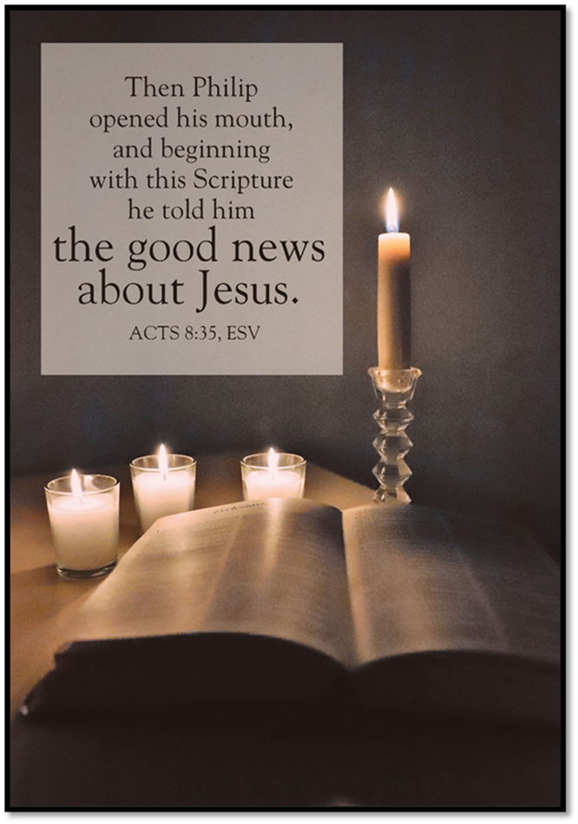
OFFERING/PRAYER
Notes:
Image: Five Loaves by Caroline Coolidge Brown. Copyright © Caroline Coolidge Brown. All rights reserved. Used by permission of the artist.

Slide 52
THE GREAT THANKSGIVING
All the Baptized are welcome to celebrate this Holy Meal.

Slide 53
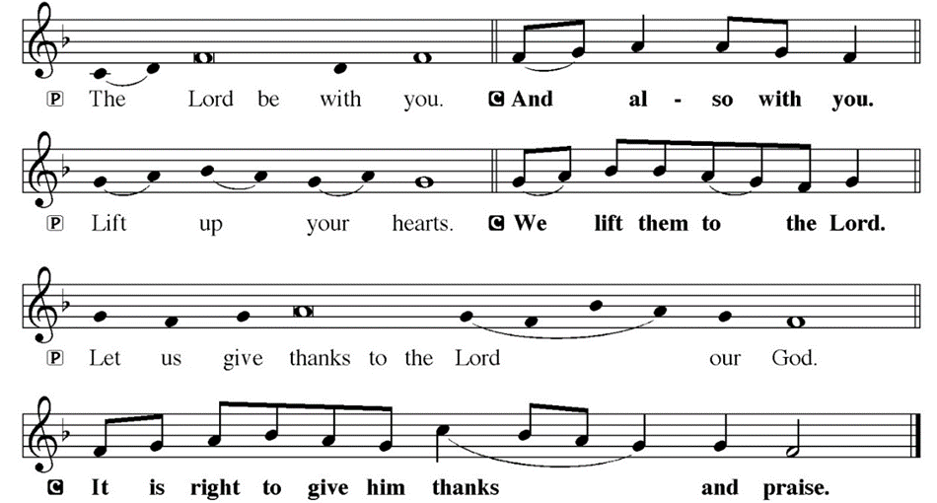
DIALOGUE

Slide 54
THE PREFACE
P: It is indeed right and salutary…
… we praise your name and join their unending hymn.

Slide 55
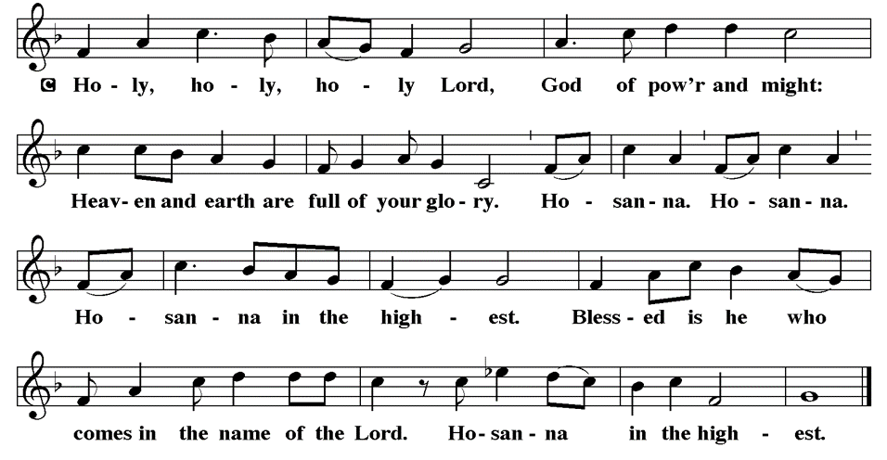
THE SANCTUS

Slide 56
EUCHARISTIC PRAYER
P: Holy, living, and loving God…
…both now and forever.
C: Amen.

Slide 57
THE LORD’S PRAYER
C: Our Father, who art in heaven, hallowed be thy name, thy kingdom come, thy will be done, on earth as it is in heaven. Give us this day our daily bread; and forgive us our trespasses, as we forgive those who trespass against us; and lead us not into temptation, but deliver us from evil.

Slide 58
THE LORD’S PRAYER
C: For thine is the kingdom, and the power, and the glory, forever and ever. Amen.

Slide 59
INVITATION TO COMMUNION
P: Jesus, who reveals himself in the breaking of the bread, invites you now to this meal in which he is fully present. Come and dine with him and your siblings in his holy name, and be fed and nourished for life’s journey.

Slide 60
COMMUNION DISTRIBUTION
All will commune “By Station”.
The bread may be broken for distribution. As the ministers give the bread and wine, they say these words :
The body of Christ, given for you.
The blood of Christ, shed for you.
The communicant may say: Amen.

Slide 61
POST COMMUNION BLESSING
The blessing is said to all after the distribution by station. It is said after each table is fed at the railing.
P: May this body and blood of our Lord and Savior, Jesus Christ, ☩ strengthen, keep and unite us, now and forever, amen.

Slide 62
POST COMMUNION CANTACLE

Slide 63
POST COMMUNION CANTACLE

Slide 64
POST COMMUNION PRAYER
P: Let us pray… Living One, in this feast you have made yourself known to us. Send us now to tell of your wonders, sing of your glory, and proclaim your risen life to a wounded and weary world.
C: Amen.

Slide 65
SENDING OF HOMEBOUND COMMUNION
P: Gracious God, whose mercy endures from generation to generation: bless those who go forth to share your word and sacrament with our sisters and brothers who are sick or homebound.

Slide 66
SENDING OF HOMEBOUND COMMUNION
P: In your love and care, nourish and strengthen those to whom we bring this communion, that through the body and blood of your Son we may all know the hope of your promised coming in Jesus Christ our Lord.
C: Amen.

Slide 67

ANNOUNCEMENTS
Notes:
Image: Five Loaves by Caroline Coolidge Brown. Copyright © Caroline Coolidge Brown. All rights reserved. Used by permission of the artist.

Slide 68
SENDING BLESSING
P: The triune God, who was, who is, and who is to come, Sovereign, Savior, and Spirit, light your way with resurrection dawn, ☩ now and always.
C: Amen.

Slide 69
Sending Song
“Come, Thou Fount of Every Blessing”
LBW 499
Notes:
Image: Five Loaves by Caroline Coolidge Brown. Copyright © Caroline Coolidge Brown. All rights reserved. Used by permission of the artist.

Slide 70
“Come, Thou Fount of Every Blessing” LBW 499
1 Come, thou Fount of ev'ry blessing,
tune my heart to sing thy grace;
streams of mercy, never ceasing,
call for songs of loudest praise.
While the hope of endless glory
fills my heart with joy and love,
teach me ever to adore thee;
may I still thy goodness prove.
Notes:
Image: Preparing yeast dough. Copyright © tomasworks/iStock/Thinkstock. Used by permission.

Slide 71
“Come, Thou Fount of Every Blessing” LBW 499
2 Here I raise my Ebenezer:
"Hither by thy help I've come";
and I hope, by thy good pleasure,
safely to arrive at home.
Jesus sought me when a stranger,
wand'ring from the fold of God;
he, to rescue me from danger,
interposed his precious blood.
Notes:
Image: Preparing yeast dough. Copyright © tomasworks/iStock/Thinkstock. Used by permission.

Slide 72
“Come, Thou Fount of Every Blessing” LBW 499
3 Oh, to grace how great a debtor
daily I'm constrained to be;
let that grace now like a fetter
bind my wand'ring heart to thee.
Prone to wander, Lord, I feel it;
prone to leave the God I love.
Here's my heart, oh, take and seal it;
seal it for thy courts above.
Notes:
Image: Preparing yeast dough. Copyright © tomasworks/iStock/Thinkstock. Used by permission.

Slide 73
DISMISSAL
P: … Depart in Christ’s Love.
C: Seeking, welcoming, and serving all. Amen!
POSTLUDE
By
Roxanne Groff
From sundaysandseasons.com. Copyright © 2025 Augsburg Fortress. All rights reserved. Reprinted by permission under Augsburg Fortress Liturgies Annual License #SAS023830. New Revised Standard Version Bible, Copyright © 1989, Division of Christian Education of the National Council of the Churches of Christ in the United States of America. Used by permission. All rights reserved. Revised Common Lectionary, Copyright © 1992 Consultation on Common Texts, admin Augsburg Fortress. Used by permission.

