Slide 1
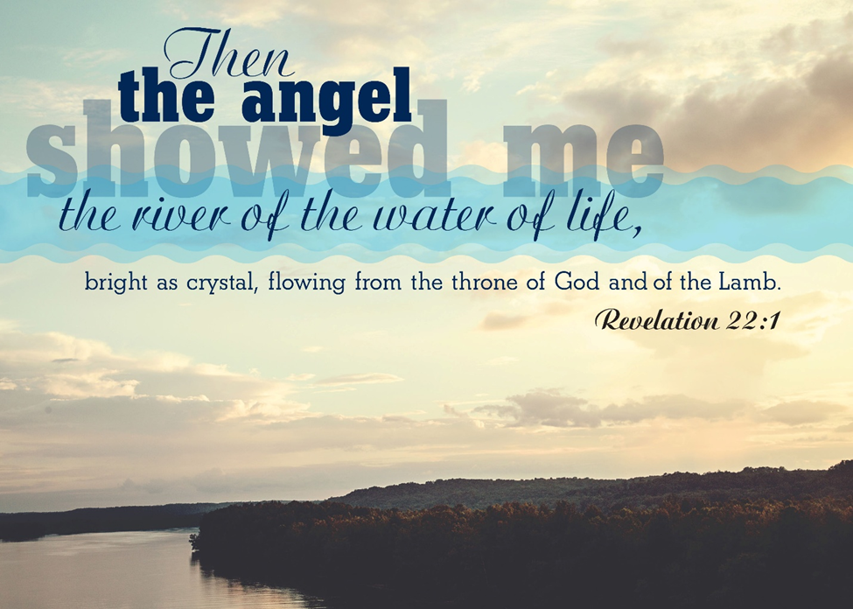
August 31, 2025
WELCOME!
Trinity Lutheran Church
Notes:
Image: Five Loaves by Caroline Coolidge Brown. Copyright © Caroline Coolidge Brown. All rights reserved. Used by permission of the artist.

Slide 2
= Please stand if able
= Please be seated
Prelude - By Pam Sherman
Office of the Acolyte
Ringing of the Bell
Welcome
Notes:
Image: Five Loaves by Caroline Coolidge Brown. Copyright © Caroline Coolidge Brown. All rights reserved. Used by permission of the artist.

Slide 3
THANKSGIVING FOR BAPTISM
All may make the sign of the cross, the sign marked at baptism, as the presiding minister begins.
P: Blessed be the holy Trinity, ☩ one God, the fountain of living water, the rock who gave us birth, our light and our salvation.
C: Amen.
Notes:
Image: Preparing yeast dough. Copyright © tomasworks/iStock/Thinkstock. Used by permission.

Slide 4
P: Joined to Christ in the waters of baptism, we are clothed with God's mercy and forgiveness. Let us give thanks for the gift of baptism.
Water may be poured into the font as the presiding minister gives thanks.
THANKSGIVING FOR BAPTISM
Notes:
Image: Preparing yeast dough. Copyright © tomasworks/iStock/Thinkstock. Used by permission.

Slide 5
P: We give you thanks, O God, for in the beginning your Spirit moved over the waters and by your Word you created the world, calling forth life in which you took delight. Through the waters of the flood you delivered Noah and his family. Through the sea you led your people Israel from slavery into freedom.
THANKSGIVING FOR BAPTISM
Notes:
Image: Preparing yeast dough. Copyright © tomasworks/iStock/Thinkstock. Used by permission.

Slide 6
P: At the river your Son was baptized by John and anointed with the Holy Spirit. By water and your Word you claim us as daughters and sons, making us heirs of your promise and servants of all. We praise you for the gift of water that sustains life, and above all we praise you for the gift of new life in Jesus Christ.
THANKSGIVING FOR BAPTISM
Notes:
Image: Preparing yeast dough. Copyright © tomasworks/iStock/Thinkstock. Used by permission.

Slide 7
P: Shower us with your Spirit, and renew our lives with your forgiveness, grace, and love. To you be given honor and praise through Jesus Christ our Lord in the unity of the Holy Spirit, now and forever.
THANKSGIVING FOR BAPTISM
C: Amen.
Notes:
Image: Preparing yeast dough. Copyright © tomasworks/iStock/Thinkstock. Used by permission.

Slide 8
Gathering Song
“Shall We Gather at the River”
ELW 423

Slide 9
“Shall We Gather at the River” ELW 423
1 Shall we gather at the river,
where bright angel feet have trod,
with its crystal tide forever
flowing by the throne of God?
Refrain
Yes, we'll gather at the river,
the beautiful, the beautiful river;
gather with the saints at the river
that flows by the throne of God.
Notes:
Image: Five Loaves by Caroline Coolidge Brown. Copyright © Caroline Coolidge Brown. All rights reserved. Used by permission of the artist.

Slide 10
“Shall We Gather at the River” ELW 423
2 On the margin of the river,
washing up its silver spray,
we will walk and worship ever,
all the happy golden day.
Refrain
Yes, we'll gather at the river,
the beautiful, the beautiful river;
gather with the saints at the river
that flows by the throne of God.
Notes:
Image: Five Loaves by Caroline Coolidge Brown. Copyright © Caroline Coolidge Brown. All rights reserved. Used by permission of the artist.

Slide 11
“Shall We Gather at the River” ELW 423
3 Ere we reach the shining river,
lay we ev'ry burden down;
grace our spirits will deliver,
and provide a robe and crown.
Refrain
Yes, we'll gather at the river,
the beautiful, the beautiful river;
gather with the saints at the river
that flows by the throne of God.
Notes:
Image: Five Loaves by Caroline Coolidge Brown. Copyright © Caroline Coolidge Brown. All rights reserved. Used by permission of the artist.

Slide 12
“Shall We Gather at the River” ELW 423
4 Soon we'll reach the shining river,
soon our pilgrimage will cease;
soon our happy hearts will quiver
with the melody of peace.
Refrain
Yes, we'll gather at the river,
the beautiful, the beautiful river;
gather with the saints at the river
that flows by the throne of God.
Notes:
Image: Five Loaves by Caroline Coolidge Brown. Copyright © Caroline Coolidge Brown. All rights reserved. Used by permission of the artist.

Slide 13
APOSTOLIC GREETING
P: The grace of our Lord Jesus Christ, the love of God, and the communion of the Holy Spirit be with you all.
C: And also with you.
Notes:
Image: Five Loaves by Caroline Coolidge Brown. Copyright © Caroline Coolidge Brown. All rights reserved. Used by permission of the artist.

Slide 14
PRAYER OF THE DAY
P: Let us pray… God of renewal, …
… In Jesus’ name we pray.
C: Amen.
Notes:
Image: Five Loaves by Caroline Coolidge Brown. Copyright © Caroline Coolidge Brown. All rights reserved. Used by permission of the artist.

Slide 15

Notes:
Image: Five Loaves by Caroline Coolidge Brown. Copyright © Caroline Coolidge Brown. All rights reserved. Used by permission of the artist.

Slide 16
Scripture Reading
L: Our scripture reading is from Revelation, chapters 21 and 22.
C: Glory to you O’ Lord!
Notes:
Image: Five Loaves by Caroline Coolidge Brown. Copyright © Caroline Coolidge Brown. All rights reserved. Used by permission of the artist.

Slide 17
Revelation 21:1-6; 22:1-5
Chapter 21
1 Then I saw a new heaven and a new earth, for the first heaven and the first earth had passed away, and the sea was no more. 2 And I saw the holy city, the new Jerusalem, coming down out of heaven from God, prepared as a bride adorned for her husband. 3 And I heard a loud voice from the throne saying,
Notes:
Image: Five Loaves by Caroline Coolidge Brown. Copyright © Caroline Coolidge Brown. All rights reserved. Used by permission of the artist.

Slide 18
Revelation 21:1-6; 22:1-5
Chapter 21
“See, the home of God is among mortals. He will dwell with them; they will be his peoples, and God himself will be with them and be their God; ⁴ he will wipe every tear from their eyes. Death will be no more; mourning and crying and pain will be no more, for the first things have passed away.”
Notes:
Image: Five Loaves by Caroline Coolidge Brown. Copyright © Caroline Coolidge Brown. All rights reserved. Used by permission of the artist.

Slide 19
Revelation 21:1-6; 22:1-5
Chapter 21
5 And the one who was seated on the throne said, “See, I am making all things new.” Also he said, “Write this, for these words are trustworthy and true.” 6 Then he said to me, “It is done! I am the Alpha and the Omega, the Beginning and the End. To the thirsty I will give water as a gift from the spring of the water of life.
Notes:
Image: Five Loaves by Caroline Coolidge Brown. Copyright © Caroline Coolidge Brown. All rights reserved. Used by permission of the artist.

Slide 20
Revelation 21:1-6; 22:1-5
Chapter 22
1 Then the angel showed me the river of the water of life, bright as crystal, flowing from the throne of God and of the Lamb 2 through the middle of the street of the city. On either side of the river is the tree of life with its twelve kinds of fruit, producing its fruit each month, and the leaves of the tree are for the
Notes:
Image: Five Loaves by Caroline Coolidge Brown. Copyright © Caroline Coolidge Brown. All rights reserved. Used by permission of the artist.

Slide 21
Revelation 21:1-6; 22:1-5
Chapter 22
healing of the nations. 3 Nothing accursed will be found there any more. But the throne of God and of the Lamb will be in it, and his servants will worship him; 4 they will see his face, and his name will be on their foreheads.
Notes:
Image: Five Loaves by Caroline Coolidge Brown. Copyright © Caroline Coolidge Brown. All rights reserved. Used by permission of the artist.

Slide 22
Revelation 21:1-6; 22:1-5
Chapter 22
5 And there will be no more night; they need no light of lamp or sun, for the Lord God will be their light, and they will reign forever and ever.
Notes:
Image: Five Loaves by Caroline Coolidge Brown. Copyright © Caroline Coolidge Brown. All rights reserved. Used by permission of the artist.

Slide 23
Revelation 21:1-6; 22:1-5
R: This is the Word of the Lord!
C: Praise to You, O Christ
Notes:
Image: Five Loaves by Caroline Coolidge Brown. Copyright © Caroline Coolidge Brown. All rights reserved. Used by permission of the artist.

Slide 24
Sermon
Dean Thompson

Slide 25
Hymn of the Day
“I Heard the Voice of Jesus Say”
ELW 611

Slide 26
“I Heard The Voice Of Jesus Say”
ELW 611
1 I heard the voice of Jesus say,
"Come unto me and rest;
lay down, O weary one, lay down
your head upon my breast."
I came to Jesus as I was,
so weary, worn, and sad;
I found in him a resting-place,
and he has made me glad.

Slide 27
“I Heard The Voice Of Jesus Say”
ELW 611
2 I heard the voice of Jesus say,
"Behold, I freely give
the living water, thirsty one;
stoop down and drink and live."
I came to Jesus, and I drank
of that life-giving stream;
my thirst was quenched, my soul revived,
and now I live in him.

Slide 28
“I Heard The Voice Of Jesus Say”
ELW 611
3 I heard the voice of Jesus say,
"I am this dark world's light;
look unto me, your morn shall rise,
and all your day be bright."
I looked to Jesus, and I found
in him my star, my sun;
and in that light of life I'll walk
till trav'ling days are done.

Slide 29
APOSTLE’S CREED
C: I believe in God, the Father almighty, creator of heaven and earth.

Slide 30
APOSTLE’S CREED
C: I believe in Jesus Christ, his only Son, our Lord. He was conceived by the power of the Holy Spirit and born of the virgin Mary. He suffered under Pontius Pilate, was crucified, died, and was buried.

Slide 31
APOSTLE’S CREED
C: He descended into hell. On the third day he rose again. He ascended into heaven, and is seated at the right hand of the Father. He will come again to judge the living and the dead.

Slide 32
APOSTLE’S CREED
C: I believe in the Holy Spirit, the holy catholic Church, the communion of saints, the forgiveness of sins, the resurrection of the body, and the life everlasting. Amen.

Slide 33
PRAYERS OF INTERCESSION
Each petition will end with the words,
A: Alpha and Omega,
The congregation will respond with:
C: Hear our prayer.

Slide 34
PRAYERS OF INTERCESSION
The prayer concludes…
P: All things exist in and through you, loving God. Therefore, we entrust our prayers, our faith, and our lives to you, in the name of Jesus.
C: Amen.

Slide 35
OFFERING/OFFERING PRAYER
Notes:
Image: Five Loaves by Caroline Coolidge Brown. Copyright © Caroline Coolidge Brown. All rights reserved. Used by permission of the artist.

Slide 36
THE LORD’S PRAYER
C: Our Father, who art in heaven, hallowed be thy name, thy kingdom come, thy will be done, on earth as it is in heaven. Give us this day our daily bread; and forgive us our trespasses, as we forgive those who trespass against us; and lead us not into temptation, but deliver us from evil.

Slide 37
THE LORD’S PRAYER
C: For thine is the kingdom, and the power, and the glory, forever and ever. Amen.

Slide 38

ANNOUNCEMENTS
Notes:
Image: Five Loaves by Caroline Coolidge Brown. Copyright © Caroline Coolidge Brown. All rights reserved. Used by permission of the artist.

Slide 39
SENDING BLESSING
P: The love of God abound in you; the grace of our Savior Jesus Christ fill your hearts; and the life of the Spirit ☩ bless you and give you peace.
C: Amen.

Slide 40
SENDING HYMN
“Battle Hymn of the Republic”
LBW 332

Slide 41
“Battle Hymn of the Republic” LBW 332
1 Mine eyes have seen the glory of the coming of the Lord;
he is trampling out the vintage where the grapes of wrath are stored; he has loosed the fateful lightning of his terrible swift sword:
his truth is marching on.

Slide 42
“Battle Hymn of the Republic” LBW 332
Refrain
Glory, glory! Hallelujah!
Glory, glory! Hallelujah!
Glory, glory! Hallelujah!
His truth is marching on.

Slide 43
“Battle Hymn of the Republic” LBW 332
2 He has sounded forth the trumpet that shall never call retreat;
he is sifting out the hearts of men before his judgment seat.
Oh, be swift, my soul, to answer him; be jubilant, my feet!
Our God is marching on.

Slide 44
“Battle Hymn of the Republic” LBW 332
Refrain
Glory, glory! Hallelujah!
Glory, glory! Hallelujah!
Glory, glory! Hallelujah!
His truth is marching on.

Slide 45
“Battle Hymn of the Republic” LBW 332
3 In the beauty of the lilies Christ was born across the sea,
with a glory in his bosom that transfigures you and me.
As he died to make men holy, let us live to make men free,
while God is marching on.

Slide 46
“Battle Hymn of the Republic” LBW 332
Refrain
Glory, glory! Hallelujah!
Glory, glory! Hallelujah!
Glory, glory! Hallelujah!
His truth is marching on.

Slide 47
DISMISSAL
P: … Depart in Christ’s Love.
C: Seeking, welcoming, and serving all. Amen!
POSTLUDE
By
Pam Sherman
From sundaysandseasons.com. Copyright © 2025 Augsburg Fortress. All rights reserved. Reprinted by permission under Augsburg Fortress Liturgies Annual License #SAS023830. New Revised Standard Version Bible, Copyright © 1989, Division of Christian Education of the National Council of the Churches of Christ in the United States of America. Used by permission. All rights reserved. Revised Common Lectionary, Copyright © 1992 Consultation on Common Texts, admin Augsburg Fortress. Used by permission.

