Slide 1

Trinity Evangelical Lutheran Church
Announcements
January 28, 2024

Slide 2

Body, Mind, Spirit
MIND: Read a nonfiction book.
BODY: Don’t forget to floss your teeth.
SPIRIT: Ask others “How may I pray for you?”

Slide 3


Our Office Secretary Is Sharon Fourman
Church Office Schedule
Tues, Wed, & Thurs
  8:00 am – 12:00 noon
Church Office: 937 692-5670
Email: secretary@pitsburgtlc.org

Slide 4


The Trinity Trumpet
A Monthly Newsletter
Published by Trinity Lutheran Church,
Pitsburg, OH
We’re looking for stories and pictures of Trinity people in action!
Submit to Secretary, Sharon Fourman at secretary@pitsburgtlc.org
Articles and Info due on or about the 15th of each month

Slide 5

Trinity Trumpet
    Your Trinity Trumpet Newsletter for January is available!
    Please take your copy before you leave today!

Slide 6
Trinity Trumpet
    Newsletter Deadline is Tuesday, January 23, 2024
    Please turn in all your newsworthy items to Sharon Fourman at:
    secretary@pitsburgtlc.org

Slide 7

We’re Online!
www.pitsburgtlc.org
Sermons and announcements are posted weekly
Trinity Trumpet is Posted here too!
The ‘Official’ Trinity Calendar is available for you to see!
Pictures, Videos and more!
Also, like us on FaceBook at
facebook.com/pitsburgtrinitylutheran.church

Slide 8
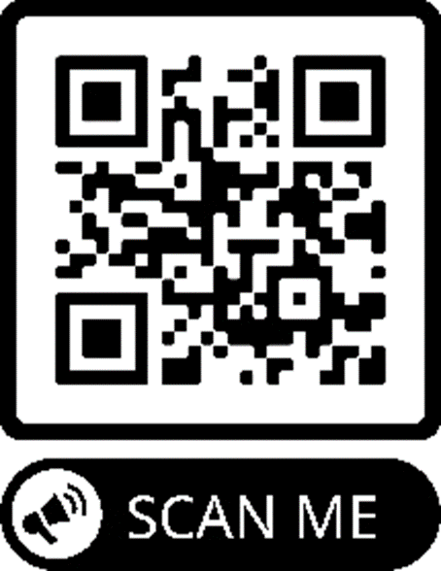
We’re Online!
www.pitsburgtlc.org
We now have our own QR Code!
Scan this code with your Smartphone and you will connect to all our Online media (Facebook, YouTube, and our own Church Website)

Slide 9
Online Giving
www.pitsburgtlc.org
Click the “Give to Trinity” Button
Stay current in your giving even when you can’t make it to Worship!
Separate Giving Categories for:
    General Treasury
    Benevolence/Mission Support
    Building Fund
    Annual Christmas Auction
    Memorial Funds
    Thrive Capital Campaign
    Tyler Norris Fund

Slide 10


Church
Council
Trinity Church Council
Next Regular Meeting
February 21st
@ 7:00 pm

Slide 11


Trinity’s Team Meetings
Next Meeting
TBD
@ 6:00 pm
On the Agenda – Preparing the proposed 2023 budget

Slide 12
Please Pass the Pew Pads
(We now track Communion on the Pads)

Slide 13

Worship Team
Next Meeting:
  TBD

Slide 14

Mutual Ministry Team
  Julie Kossler
  VACANT
  Peggy Didier
  Please see one of them with your comments and suggestions
  Next Meeting - TBD

Slide 15


Choice FISH Pantry
Please join us every Friday @ 3:30 pm
400 Markwith Dr, Greenville OH
Most Needed Items
Kidney Beans
Canned Peas
Hamburger Helper
Pork & Beans
Canned Mixed Veggies
Large Cans of Soups
Applesauce
Boxed Meals
(i.e. Rice a Roni)

Slide 16
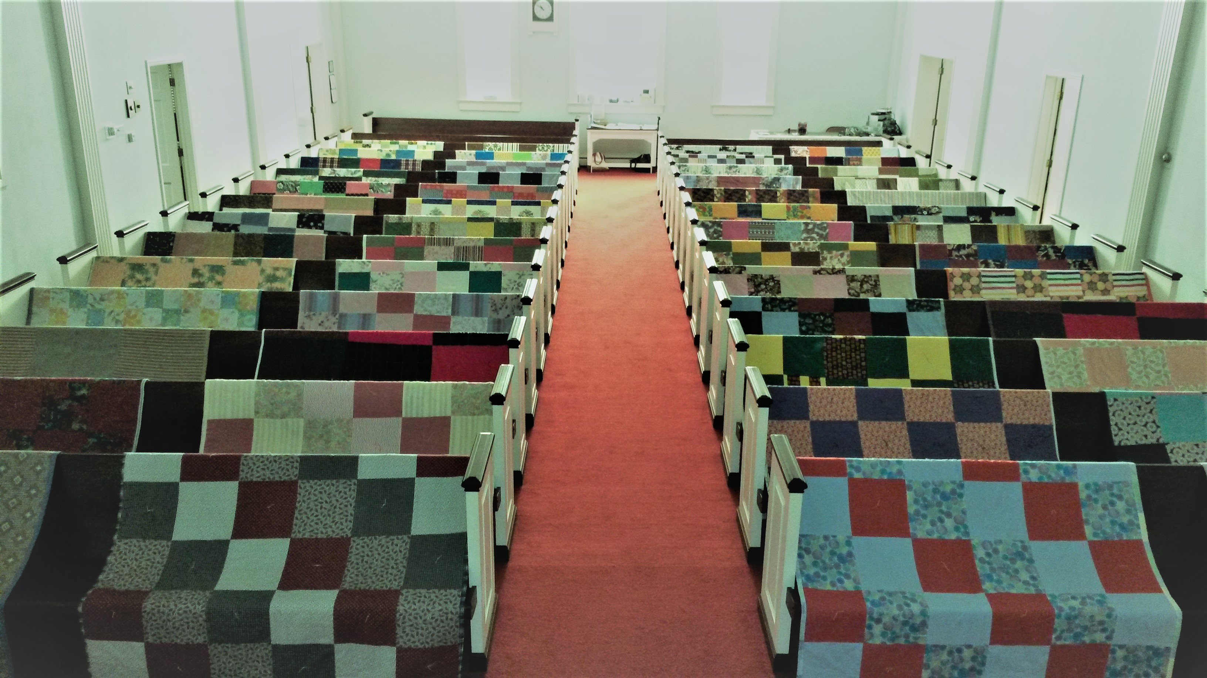
Prayers and Squares
Quilting Ministry
Tuesday, January 30th @ 10:00 am
Thursday, Feb 8 @10:00 am

Slide 17


Ladies and Gents Luncheon
Date: February 15 @ 11:30 am
Where: Tolly’s Gastropub, 644 Wagner Ave, Greenville, OH 45331
For Reservations/Questions:
        See Linda Baker or call her @ 937 545-0975

Slide 18

Confirmation Program
    Next Class – Attend Advent Soup Suppers and Devotions
    Weekly Worship attendance is required (In person or via FaceBook)
    Worship Notes may be emailed to pastor@pitsburgtlc.org or placed in Pr Mel’s mailbox outside the Church Office
    Confirmands are HIGHLY encouraged to take turns as Acolyte

Slide 19

    Who can be an Acolyte? YOU CAN!!!
    Training will be rescheduled for January
    Please sign up for Acolyte Duty on the chart by the Church Office!
    Confirmation Students are Highly Encouraged to perform Acolyte duty…
    Please sign up today!

Slide 20
New Member Class
We are forming a “New Member” Class for anyone who wants to learn more about Being Lutheran and what Being a member of Trinity entails
    Classes will begin January 8th
    Classes start at 12:00 Noon or as soon after Worship as possible
    Please see Pastor Mel if Interested in attending

Slide 21

    Commemorate special days like Anniversaries, Birthdays, Baptisms and more…
    See PJ to Sign Up!

Slide 22

Next Meeting
February 2, 2024 @ 10:00 am
Purpose -- plan for Spring Events
Please come if you can!

Slide 23

Blood Pressure Screening
BP Screening
By Appointment
In The Nursery
Notes:
Cover: Sermon on the Mount by Laura James. Copyright © Laura James. All rights reserved. Used by permission of the artist.

Slide 24


Holy Communion – Today!
Communion Today is “By Station”
Safe for all humans (Especially sinners)
Holy Communion Schedule
    First and Third Sundays each month
    All White and Red Sundays of the Church Year

Slide 25

Calling all Adults!
Join Us For “Christian Conversations”
Not Your Ordinary Adult Sunday School
Sharing – Discussion - Prayer
Free Donuts, Juice, and Coffee
Every Sunday @
9:30 am
Notes:
Cover: Sermon on the Mount by Laura James. Copyright © Laura James. All rights reserved. Used by permission of the artist.

Slide 26
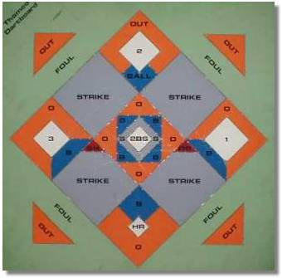


DARTBALL
Tournament Time!!!

Slide 27

Trinity Troops
Date: February 18th -- After Worship
Where: Trinity Fellowship Hall
Who: Youth 5th – 6th Grades
What: Fun and Food! (Ham & Scalloped Potatoes – Yummy!!!)
Trinity Troops!

Slide 28

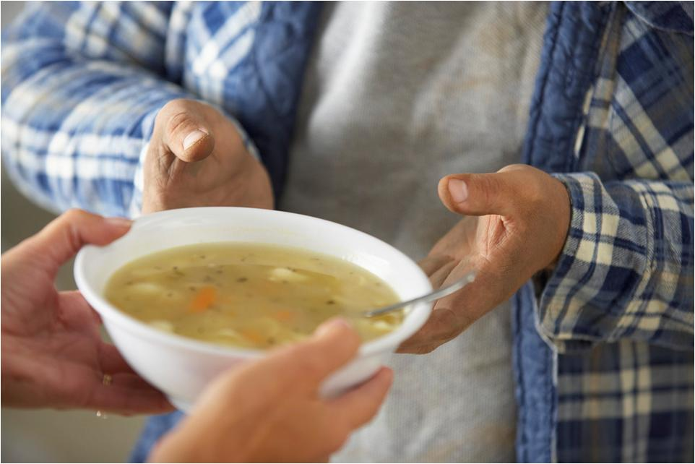
Grace Resurrection Community Center
Soup Kitchen Meal
When: Wednesday, December 20 @ 10:00 am to 1:00 pm.
Where: 433 Water Street in Greenville
If you can help in any way, please contact Katherine Jump at 937-423-2333.

Slide 29

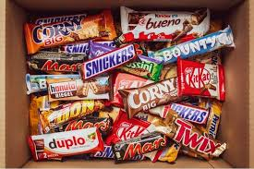
Trinity Youth
Fun (d) Raiser!
Candy Bar Sales!
Large Selection
$2 Each
Supports our youth
Attending our first regional Youth Gathering
January 5-7, 2024
Notes:
Cover: Sermon on the Mount by Laura James. Copyright © Laura James. All rights reserved. Used by permission of the artist.

Slide 30


SUPER BOWL SUNDAY!!!
February 11, 2024
Special Offering for Local Food Pantries
Wear your favorite sports team jersey/tee-shirt, or other merch (as long as it’s orange and brown)

Slide 31

February 11, 2024
Wear your favorite sports team jersey/tee-shirt, or other merch (as long as it’s orange and brown)

Slide 32


Shrove
Tuesday
Pancakes and Sausage Dinner
February 13, 2024 @ 6:30 pm
Mardi Gras Mask Making Crafts
Fun and Fellowship – Before Lenten Fasting Begins!
Please See Pr Mel or PJ if you have a griddle we can use

Slide 33
Lenten Season Begins With Ash Wednesday
February 14, 2024
At 7:00 pm

Slide 34

Lenten Soup Supper
Devotion
Wednesdays @ 6:30 pm
  February 21, 28
  March 6, 13, & 20
Sign-Up for Soup, Bread, Salad, and desert on communications table
Video
and
Discussion

Slide 35

Maundy Thursday – March 28th
  Seder Meal @ 6 pm includes Holy Communion and stripping of the Altar
Good Friday – March 29th
  Worship Service @ 7 pm “A Service of Tenebrae” (Shadows)
Easter Morning – March 31st
  8:00 am – Early Service
  9:15 am Easter Breakfast
  10:00 am Easter Prize Hunt
  10:30 am Late Service

Slide 36

Seder Meal
Maundy Thursday – March 28 @ 6:30
  Symbolic Meal representing a Jewish Passover Meal
  An Actual Meal
  Holy Communion
Everyone Is Invited (Limited Seating)
  Current confirmation Students and their Families
  Others PLEASE RSVP (So we know how much food to prepare)

