Slide 1

Trinity Evangelical Lutheran Church
Announcements
November 5, 2023

Slide 2

Body, Mind, Spirit
MIND: Make a family tree.
BODY: Know your stroke risks.
SPIRIT: Pray for your church family.

Slide 3


Our Office Secretary Is Sharon Fourman
Church Office Schedule
Tues, Wed, & Thurs
  8:00 am – 12:00 noon
Church Office: 937 692-5670
Email: secretary@pitsburgtlc.org

Slide 4


The Trinity Trumpet
A Monthly Newsletter
Published by Trinity Lutheran Church,
Pitsburg, OH
We’re looking for stories and pictures of Trinity people in action!
Submit to Secretary, Sharon Fourman at secretary@pitsburgtlc.org
Articles and Info due on or about the 15th of each month

Slide 5

Trinity Trumpet
    Your Trinity Trumpet Newsletter for November is available!
    Please take your copy before you leave today!

Slide 6
Trinity Trumpet
    Newsletter Deadline is Tuesday, November 21st
    Please turn in all your newsworthy items to Sharon Fourman at:
    secretary@pitsburgtlc.org

Slide 7

We’re Online!
www.pitsburgtlc.org
Sermons and announcements are posted weekly
Trinity Trumpet is Posted here too!
The ‘Official’ Trinity Calendar is available for you to see!
Pictures, Videos and more!
Also, like us on FaceBook at
facebook.com/pitsburgtrinitylutheran.church

Slide 8

We’re Online!
www.pitsburgtlc.org
We now have our own QR Code!
Scan this code with your Smartphone and you will connect to all our Online media (Facebook, YouTube, and our own Church Website)

Slide 9
Online Giving
www.pitsburgtlc.org
Click the “Give to Trinity” Button
Stay current in your giving even when you can’t make it to Worship!
Separate Giving Categories for:
    General Treasury
    Benevolence/Mission Support
    Building Fund
    Annual Christmas Auction
    Donald K. Lucas Memorial Fund
    Thrive Capital Campaign

Slide 10


Church
Council
Trinity Church Council
Next Meeting:
November 15th
@ 7:00 pm

Slide 11


Trinity’s Team Meetings
Next Meeting
TBD
@ 6:00 pm
On the Agenda – Preparing the proposed 2023 budget

Slide 12
Please Pass the Pew Pads
(We now track Communion on the Pads)

Slide 13

Worship Team
Next Meeting:
  TBD

Slide 14

Mutual Ministry Team
  Julie Kossler
  VACANT
  Peggy Didier
  Please see one of them with your comments and suggestions
  Next Meeting - TBD

Slide 15


Choice FISH Pantry
Please join us every Friday @ 3:30 pm
400 Markwith Dr, Greenville OH
Most Needed Items
Kidney Beans
Canned Peas
Hamburger Helper
Pork & Beans
Canned Mixed Veggies
Large Cans of Soups
Applesauce
Boxed Meals
(i.e. Rice a Roni)

Slide 16

Next Meeting:
Wednesday, December 6, 2023
@ 11:30 am
Please note the Date & Time!!!

Slide 17
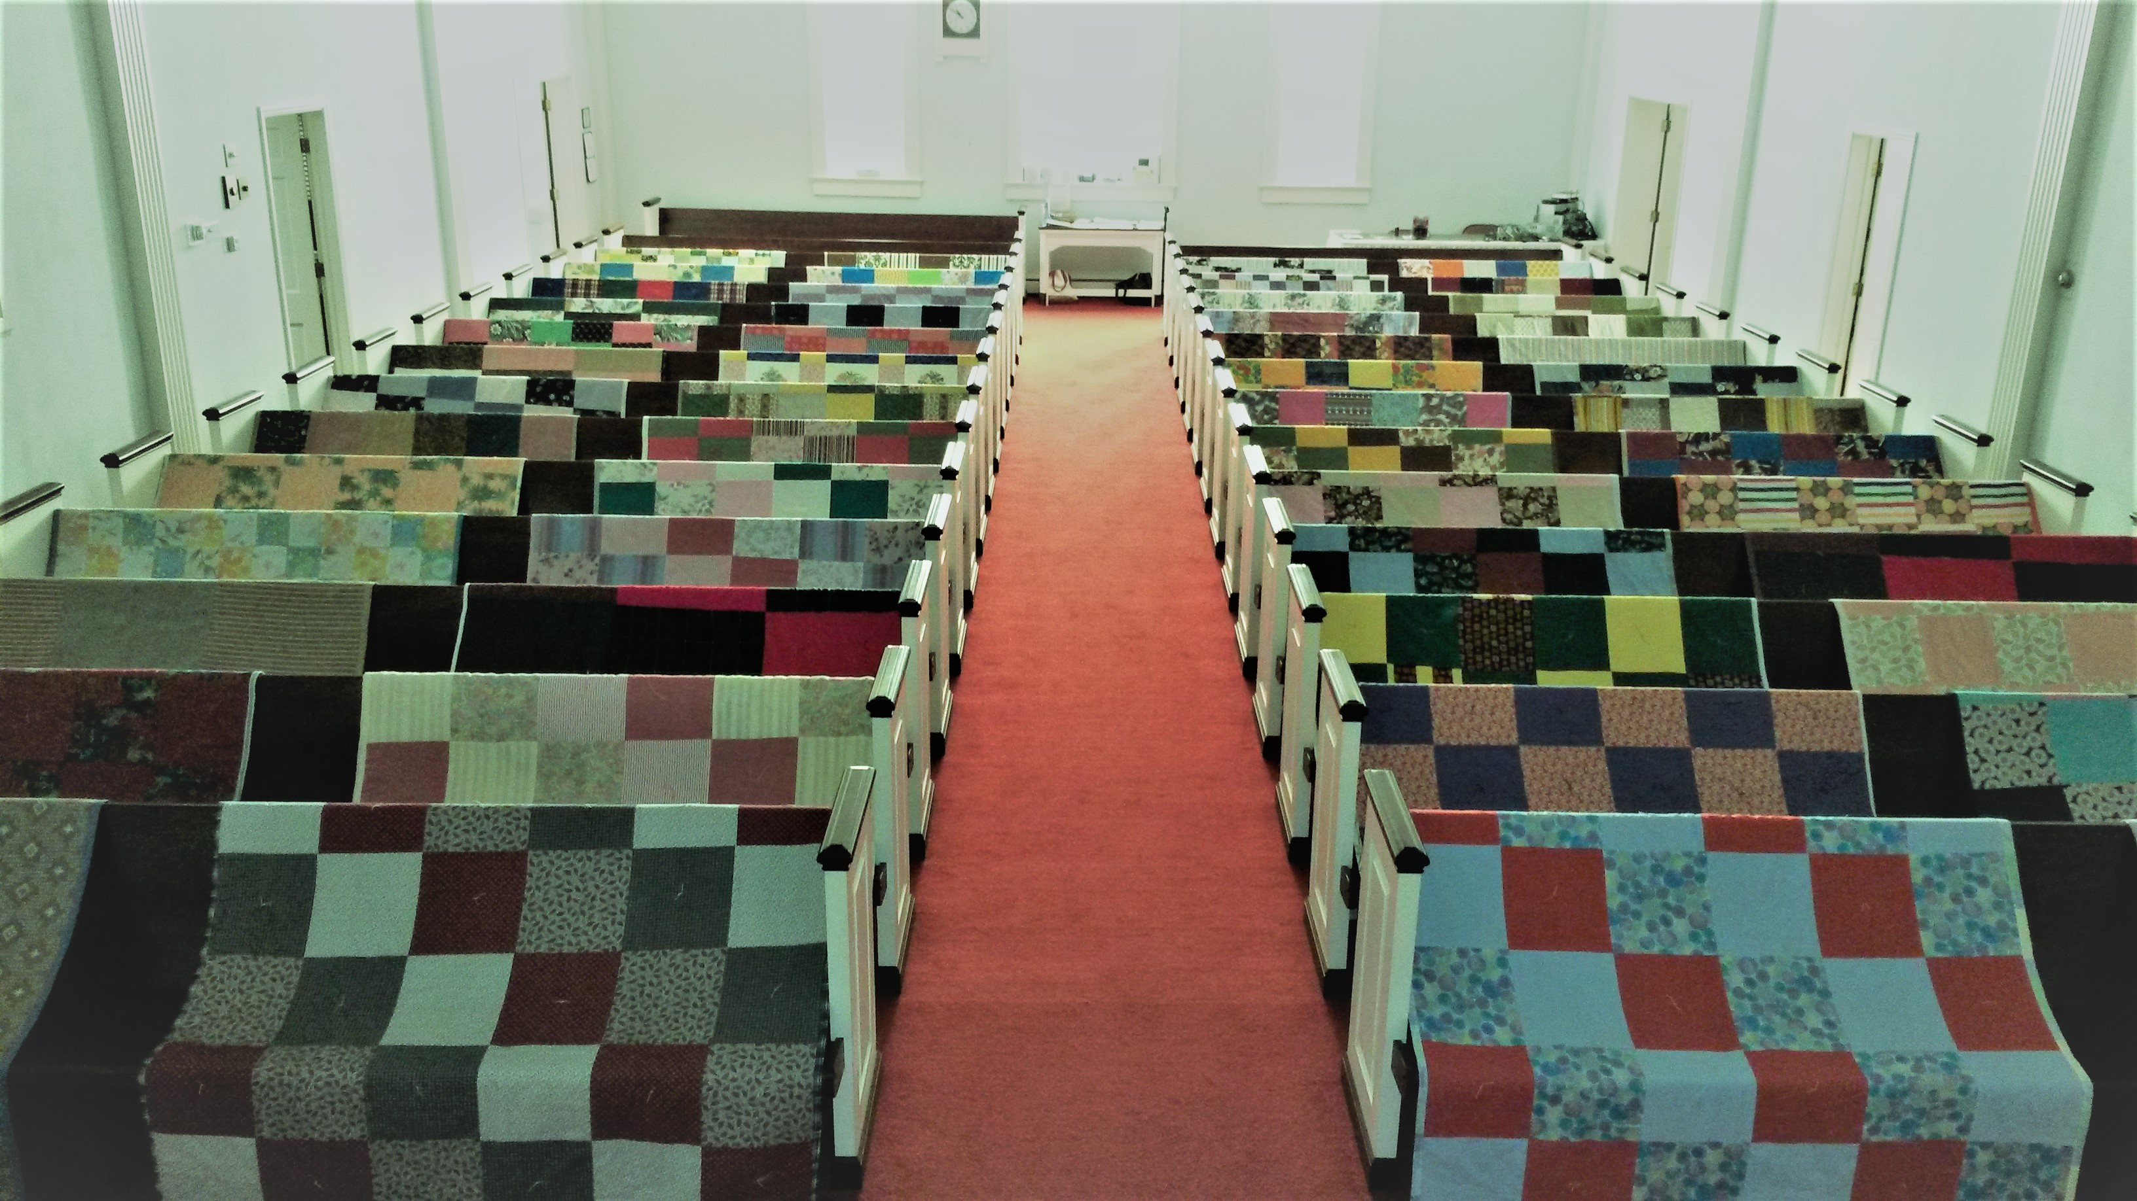
Prayers and Squares
Quilting Ministry
November 9 @ 10:00 am
November 28 @ 10:00 am

Slide 18


Ladies and Gents Luncheon
Date: November 16th @ 11:30 am
Where: Huey Magoo’s Chicken Tenders
9196 N Main St, Englewood, OH
For Reservations:
        See Linda Baker or call her @ 937 545-0975

Slide 19

Confirmation Program
    Next Class – October 25th @ 6:30 pm
    Weekly Worship attendance is required (In person or via FaceBook)
    Worship Notes may be emailed to pastor@pitsburgtlc.org or placed in Pr Mel’s mailbox outside the Church Office
    Confirmands are encouraged to take turns as Acolyte

Slide 20

    Who can be an Acolyte? YOU CAN!!!
    Please sign up for Acolyte Duty on the chart by the Church Office!
    Confirmation Students are Highly Encouraged to perform Acolyte duty…
    Please sign up today!

Slide 21
    Who can be an Acolyte? YOU CAN!!!
    Acolyte Training Classes being offered
    November 12th and 26th (Only one class is required – take one or the other)
    After Worship
    Class should only take 20 – 30 minutes

Slide 22
New Member Class
We are forming a “New Member” Class for anyone who wants to learn more about Being Lutheran and what Being a member of Trinity entails
    Classes will begin January 8th
    Classes start at 12:00 Noon or as soon after Worship as possible
    Please see Pastor Mel if Interested in attending

Slide 23

    Commemorate special days like Anniversaries, Birthdays, Baptisms and more…
    See PJ to Sign Up!

Slide 24
Trinity’s Team Meetings
Youth and Family Ministry Team
Next Meeting
December 7th @ 10:00 am
Purpose -- plan for Christmas Events
Please come if you can!

Slide 25

Blood Pressure Screening
BP Screening
2nd Sundays - After Worship
In The Nursery
Notes:
Cover: Sermon on the Mount by Laura James. Copyright © Laura James. All rights reserved. Used by permission of the artist.

Slide 26


Holy Communion – Today!
Communion Today is “By Station”
Safe for all humans (Especially sinners)
Holy Communion Schedule
    First and Third Sundays each month
    All White and Red Sundays of the Church Year

Slide 27

Calling all Adults!
Join Us For “Christian Conversations”
Not Your Ordinary Adult Sunday School
Sharing – Discussion - Prayer
Free Donuts, Juice, and Coffee
Every Sunday @
9:30 am
Notes:
Cover: Sermon on the Mount by Laura James. Copyright © Laura James. All rights reserved. Used by permission of the artist.

Slide 28
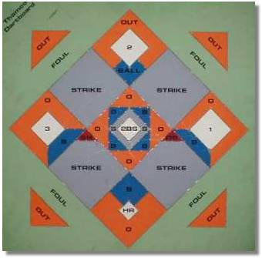


DARTBALL
Monday November 6th @ 7:30 pm
Home Game
Come early to help set up!

Slide 29
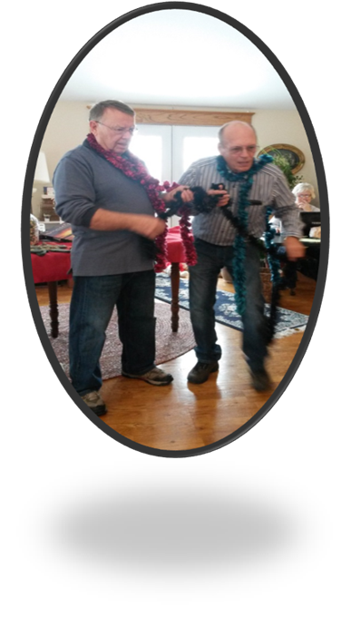
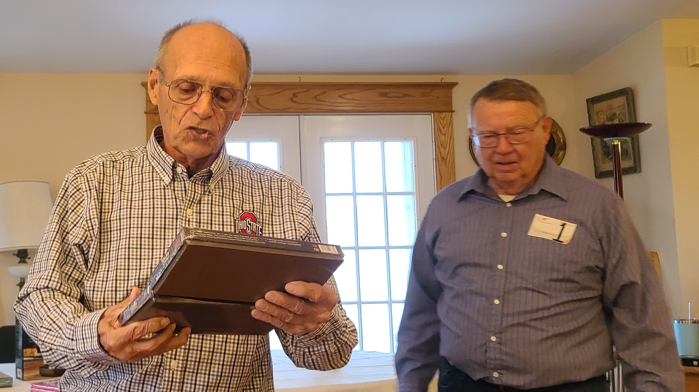
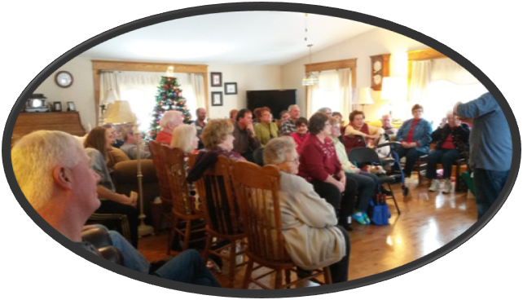
Annual Christmas Auction
  Nov 5th @ 3:00 pm
  Nov 12th @ 3:00 pm
  At Bev & Eldon’s Home
  1385 Littles Rd., Arcanum
  Bring an appetizer and an item or two to auction off

Slide 30

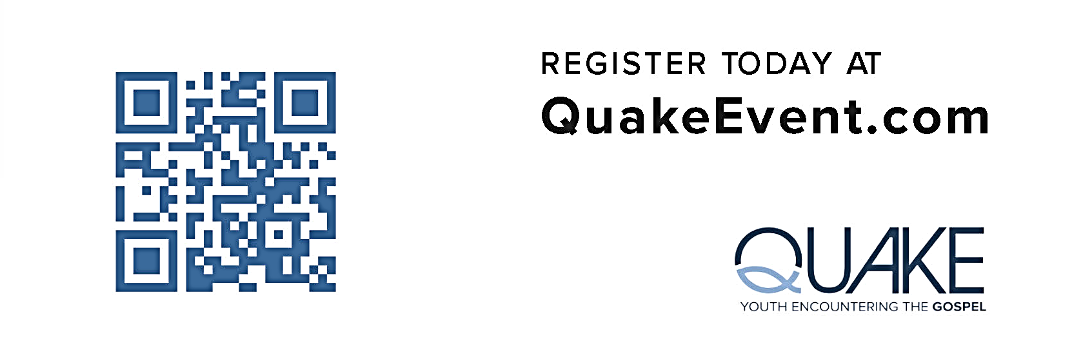
Trinity Youth (7th – 12th Grades)
  Cost: $225 + Food
  Info: Pr Mel or PJ
  Deadline: December 14th
  Ages: 7th – 12th Grades

Slide 31

Trinity Troops
Date: November 19th -- After Worship
Where: Trinity Fellowship Hall
Who: Youth 4th – 6th Grades
What: Food – Games – Service Projects
RSVP to PJ or Pastor Mel (for food planning)
Trinity Troops!

Slide 32

Christmas Decorating Party
Date: Friday, December 1st @ 6:00 pm
Where: Trinity Lutheran Church
Who: Everyone!!!
Pizza will be served!

Slide 33

ADVENT SOUP SUPPERS DEVOTIONS
Dates: All Wednesdays @ 6:30 pm
        Dec 6, 13, & 20
Where: Trinity Lutheran Church
Who: Everyone!!!

Slide 34
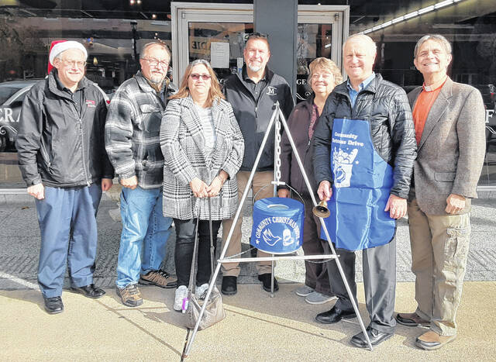

Darke County Christmas Fund Drive
(Christmas Bell Ringers)
Dates: December 15, 16, 21, & 22
Times: From 10:00 am – 8:00 pm
Where: Walmart (South Entrance)
Who: Everyone!!!

