Slide 1
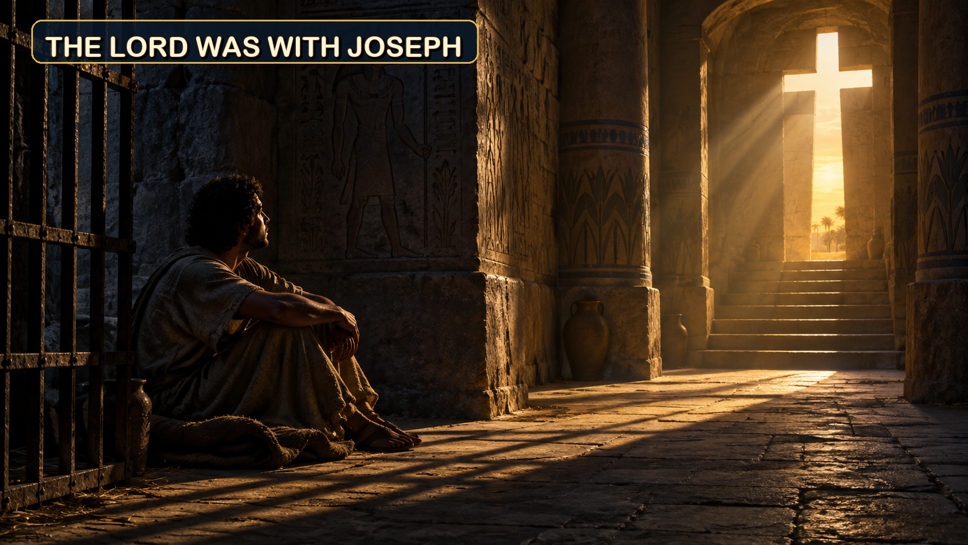
September 27, 2026
WELCOME!
Trinity Lutheran Church
Notes:
Image: Five Loaves by Caroline Coolidge Brown. Copyright © Caroline Coolidge Brown. All rights reserved. Used by permission of the artist.

Slide 2
= Please stand if able
= Please be seated
Prelude - By Pam Sherman
Office of the Acolyte
Ringing of the Bell
Welcome

Slide 3
THANKSGIVING FOR BAPTISM
All may make the sign of the cross, the sign marked at baptism, as the presiding minister begins.
P: Blessed be the holy Trinity, ☩ one God, the fountain of living water, the rock who gave us birth, our light and our salvation.
C: Amen.
Notes:
Image: Preparing yeast dough. Copyright © tomasworks/iStock/Thinkstock. Used by permission.

Slide 4
P: Joined to Christ in the waters of baptism, we are clothed with God's mercy and forgiveness. Let us give thanks for the gift of baptism.
Water may be poured into the font as the presiding minister gives thanks.
THANKSGIVING FOR BAPTISM
Notes:
Image: Preparing yeast dough. Copyright © tomasworks/iStock/Thinkstock. Used by permission.

Slide 5
P: We give you thanks, O God, for in the beginning your Spirit moved over the waters and by your Word you created the world, calling forth life in which you took delight. Through the waters of the flood you delivered Noah and his family. Through the sea you led your people Israel from slavery into freedom.
THANKSGIVING FOR BAPTISM
Notes:
Image: Preparing yeast dough. Copyright © tomasworks/iStock/Thinkstock. Used by permission.

Slide 6
P: At the river your Son was baptized by John and anointed with the Holy Spirit. By water and your Word you claim us as daughters and sons, making us heirs of your promise and servants of all. We praise you for the gift of water that sustains life, and above all we praise you for the gift of new life in Jesus Christ.
THANKSGIVING FOR BAPTISM
Notes:
Image: Preparing yeast dough. Copyright © tomasworks/iStock/Thinkstock. Used by permission.

Slide 7
P: Shower us with your Spirit, and renew our lives with your forgiveness, grace, and love. To you be given honor and praise through Jesus Christ our Lord in the unity of the Holy Spirit, now and forever.
THANKSGIVING FOR BAPTISM
C: Amen.
Notes:
Image: Preparing yeast dough. Copyright © tomasworks/iStock/Thinkstock. Used by permission.

Slide 8
Gathering Song/Hymn of Praise
“My Faith Looks Up to Thee”
LBW 479

Slide 9
“My Faith Looks Up to Thee” LBW 479
1 My faith looks up to thee,
thou Lamb of Calvary,
Savior divine!
Now hear me while I pray,
take all my guilt away,
oh, let me from this day
be wholly thine!
Notes:
Image: Five Loaves by Caroline Coolidge Brown. Copyright © Caroline Coolidge Brown. All rights reserved. Used by permission of the artist.

Slide 10
“My Faith Looks Up to Thee” LBW 479
2 May thy rich grace impart
strength to my fainting heart,
my zeal inspire;
as thou hast died for me,
oh, may my love to thee
pure, warm, and changeless be,
a living fire!
Notes:
Image: Five Loaves by Caroline Coolidge Brown. Copyright © Caroline Coolidge Brown. All rights reserved. Used by permission of the artist.

Slide 11
“My Faith Looks Up to Thee” LBW 479
3 While life's dark maze I tread
and griefs around me spread,
be thou my guide;
bid darkness turn to day,
wipe sorrow's tears away,
nor let me ever stray
from thee aside.
Notes:
Image: Five Loaves by Caroline Coolidge Brown. Copyright © Caroline Coolidge Brown. All rights reserved. Used by permission of the artist.

Slide 12
“My Faith Looks Up to Thee” LBW 479
4 When ends life's transient dream,
when death's cold, sullen stream
shall o'er me roll;
blest Savior, then, in love
fear and distrust remove;
oh, bear me safe above,
a ransomed soul!
Notes:
Image: Five Loaves by Caroline Coolidge Brown. Copyright © Caroline Coolidge Brown. All rights reserved. Used by permission of the artist.

Slide 13
APOSTOLIC GREETING
P: The grace of our Lord Jesus Christ, the love of God, and the communion of the Holy Spirit be with you all.
C: And also with you.
Notes:
Image: Five Loaves by Caroline Coolidge Brown. Copyright © Caroline Coolidge Brown. All rights reserved. Used by permission of the artist.

Slide 14
PRAYER OF THE DAY
P: Let us pray… God with us, your presence never fails, even in the midst of challenges or crises. Stir up in us your fire for truth and make us willing to risk for the sake of the flourishing of others, trusting that you are with us in all things. In Jesus’ name we pray.
C: Amen
Notes:
Image: Five Loaves by Caroline Coolidge Brown. Copyright © Caroline Coolidge Brown. All rights reserved. Used by permission of the artist.

Slide 15

Notes:
Image: Five Loaves by Caroline Coolidge Brown. Copyright © Caroline Coolidge Brown. All rights reserved. Used by permission of the artist.

Slide 16

Notes:
Image: Five Loaves by Caroline Coolidge Brown. Copyright © Caroline Coolidge Brown. All rights reserved. Used by permission of the artist.

Slide 17

This Photo by Unknown Author is licensed under CC BY-NC
Notes:
Image: Five Loaves by Caroline Coolidge Brown. Copyright © Caroline Coolidge Brown. All rights reserved. Used by permission of the artist.

Slide 18

Notes:
Image: Five Loaves by Caroline Coolidge Brown. Copyright © Caroline Coolidge Brown. All rights reserved. Used by permission of the artist.

Slide 19
This Photo by Unknown Author is licensed under CC BY-NC
Notes:
Image: Five Loaves by Caroline Coolidge Brown. Copyright © Caroline Coolidge Brown. All rights reserved. Used by permission of the artist.

Slide 20

Notes:
Image: Five Loaves by Caroline Coolidge Brown. Copyright © Caroline Coolidge Brown. All rights reserved. Used by permission of the artist.

Slide 21
This Photo by Unknown Author is licensed under CC BY-NC
Notes:
Image: Five Loaves by Caroline Coolidge Brown. Copyright © Caroline Coolidge Brown. All rights reserved. Used by permission of the artist.

Slide 22
Scripture Reading
R: Our scripture reading is from Genesis, Chapter 39.
C: Glory to you O’ Lord!
Notes:
Image: Five Loaves by Caroline Coolidge Brown. Copyright © Caroline Coolidge Brown. All rights reserved. Used by permission of the artist.

Slide 23
Genesis 39:1-23
Now Joseph was taken down to Egypt, and Potiphar, an officer of Pharaoh, the captain of the guard, an Egyptian, bought him from the Ishmaelites who had brought him down there. ²The Lord was with Joseph, and he became a successful man; he was in the house of his Egyptian master. ³His master saw that the Lord was with
Notes:
Image: Five Loaves by Caroline Coolidge Brown. Copyright © Caroline Coolidge Brown. All rights reserved. Used by permission of the artist.

Slide 24
Genesis 39:1-23
him, and that the Lord caused all that he did to prosper in his hands. ⁴So Joseph found favor in his sight and attended him; he made him overseer of his house and put him in charge of all that he had. ⁵From the time that he made him overseer in his house and over all that he had, the Lord blessed the Egyptian’s house for Joseph’s sake; the
Notes:
Image: Five Loaves by Caroline Coolidge Brown. Copyright © Caroline Coolidge Brown. All rights reserved. Used by permission of the artist.

Slide 25
Genesis 39:1-23
blessing of the Lord was on all that he had, in house and field. ⁶So he left all that he had in Joseph’s charge; and, with him there, he had no concern for anything but the food that he ate. Now Joseph was handsome and good-looking.
⁷And after a time his master’s wife cast her eyes on Joseph and said, “Lie with me.” ⁸But he refused and
Notes:
Image: Five Loaves by Caroline Coolidge Brown. Copyright © Caroline Coolidge Brown. All rights reserved. Used by permission of the artist.

Slide 26
Genesis 39:1-23
said to his master’s wife, “Look, with me here, my master has no concern about anything in the house, and he has put everything that he has in my hand. ⁹He is not greater in this house than I am, nor has he kept back anything from me except yourself, because you are his wife. How then could I do this great wickedness, and sin against God?”
Notes:
Image: Five Loaves by Caroline Coolidge Brown. Copyright © Caroline Coolidge Brown. All rights reserved. Used by permission of the artist.

Slide 27
Genesis 39:1-23
¹⁰And although she spoke to Joseph day after day, he would not consent to lie beside her or to be with her. ¹¹One day, however, when he went into the house to do his work, and while no one else was in the house, ¹²she caught hold of his garment, saying, “Lie with me!” But he left his garment in her hand, and fled and ran outside.
Notes:
Image: Five Loaves by Caroline Coolidge Brown. Copyright © Caroline Coolidge Brown. All rights reserved. Used by permission of the artist.

Slide 28
Genesis 39:1-23
¹³When she saw that he had left his garment in her hand and had fled outside, ¹⁴she called out to the members of her household and said to them, “See, my husband has brought among us a Hebrew to insult us! He came in to me to lie with me, and I cried out with a loud voice; ¹⁵and when he heard me raise my voice and cry out, he left
Notes:
Image: Five Loaves by Caroline Coolidge Brown. Copyright © Caroline Coolidge Brown. All rights reserved. Used by permission of the artist.

Slide 29
Genesis 39:1-23
his garment beside me, and fled outside.” ¹⁶Then she kept his garment by her until his master came home, ¹⁷and she told him the same story, saying, “The Hebrew servant, whom you have brought among us, came in to me to insult me; ¹⁸but as soon as I raised my voice and cried out, he left his garment beside me, and fled outside.”
Notes:
Image: Five Loaves by Caroline Coolidge Brown. Copyright © Caroline Coolidge Brown. All rights reserved. Used by permission of the artist.

Slide 30
Genesis 39:1-23
¹⁹When his master heard the words that his wife spoke to him, saying, “This is the way your servant treated me,” he became enraged. ²⁰And Joseph’s master took him and put him into the prison, the place where the king’s prisoners were confined; he remained there in prison. ²¹But the Lord was with Joseph and showed him steadfast
Notes:
Image: Five Loaves by Caroline Coolidge Brown. Copyright © Caroline Coolidge Brown. All rights reserved. Used by permission of the artist.

Slide 31
Genesis 39:1-23
love; he gave him favor in the sight of the chief jailer. ²²The chief jailer committed to Joseph’s care all the prisoners who were in the prison, and whatever was done there, he was the one who did it. ²³The chief jailer paid no heed to anything that was in Joseph’s care, because the Lord was with him; and whatever he did, the Lord made it prosper.
Notes:
Image: Five Loaves by Caroline Coolidge Brown. Copyright © Caroline Coolidge Brown. All rights reserved. Used by permission of the artist.

Slide 32
Genesis 39:1-23
R: This is the Word of the Lord.
C: Praise to You, O Christ
Notes:
Image: Five Loaves by Caroline Coolidge Brown. Copyright © Caroline Coolidge Brown. All rights reserved. Used by permission of the artist.

Slide 33
Sermon

Slide 34
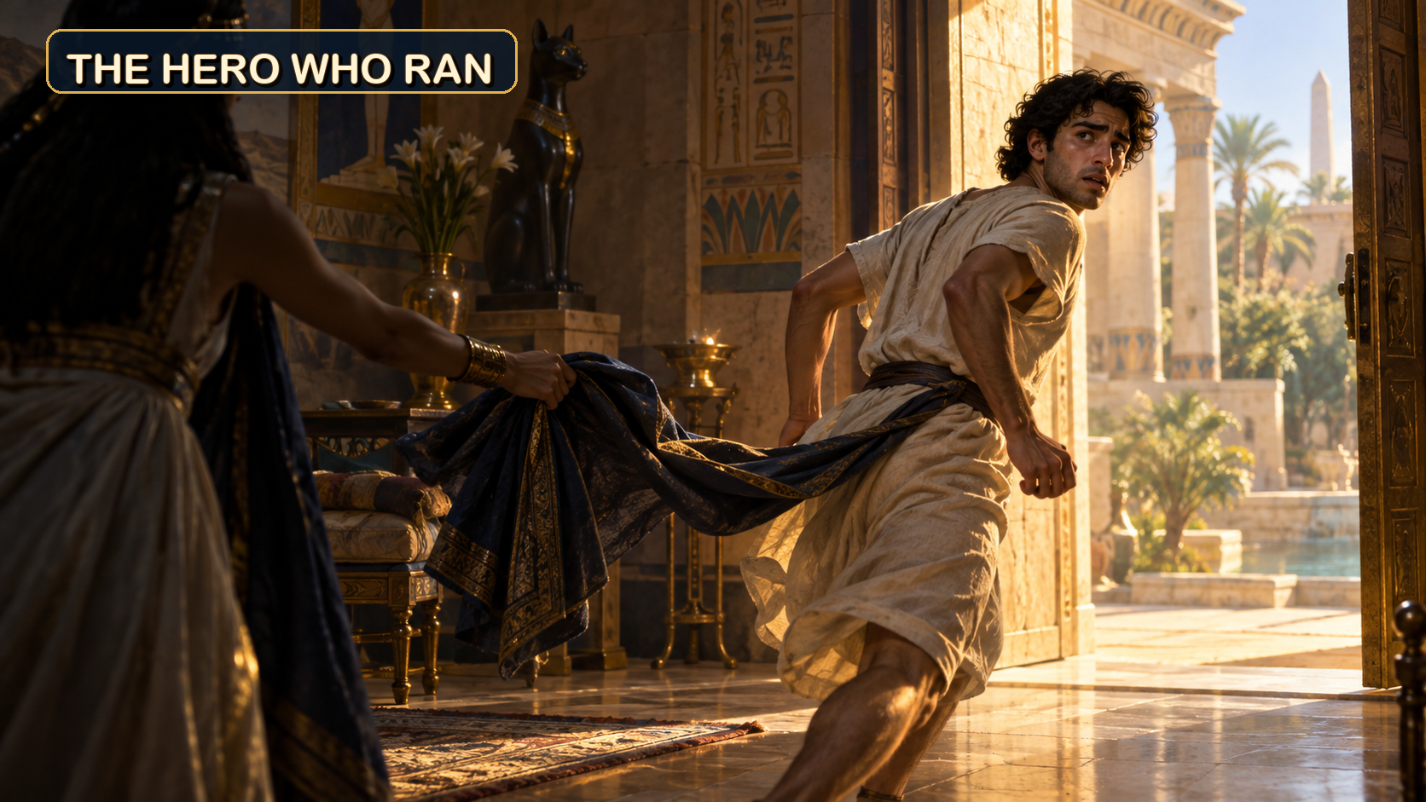
Sermon

Slide 35
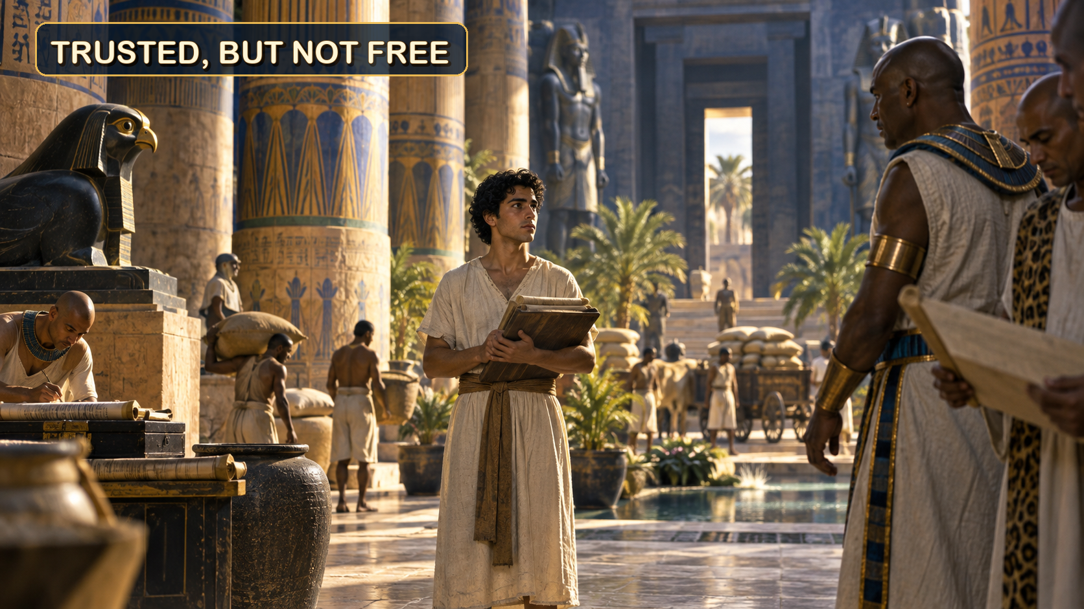
Sermon

Slide 36
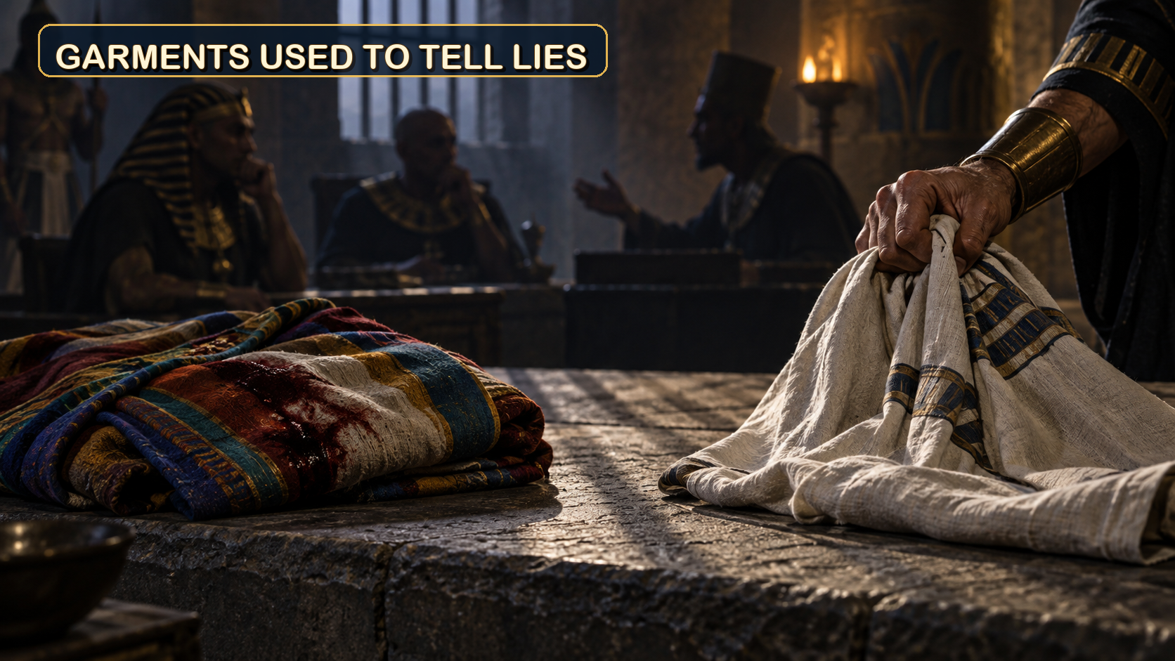
Sermon

Slide 37
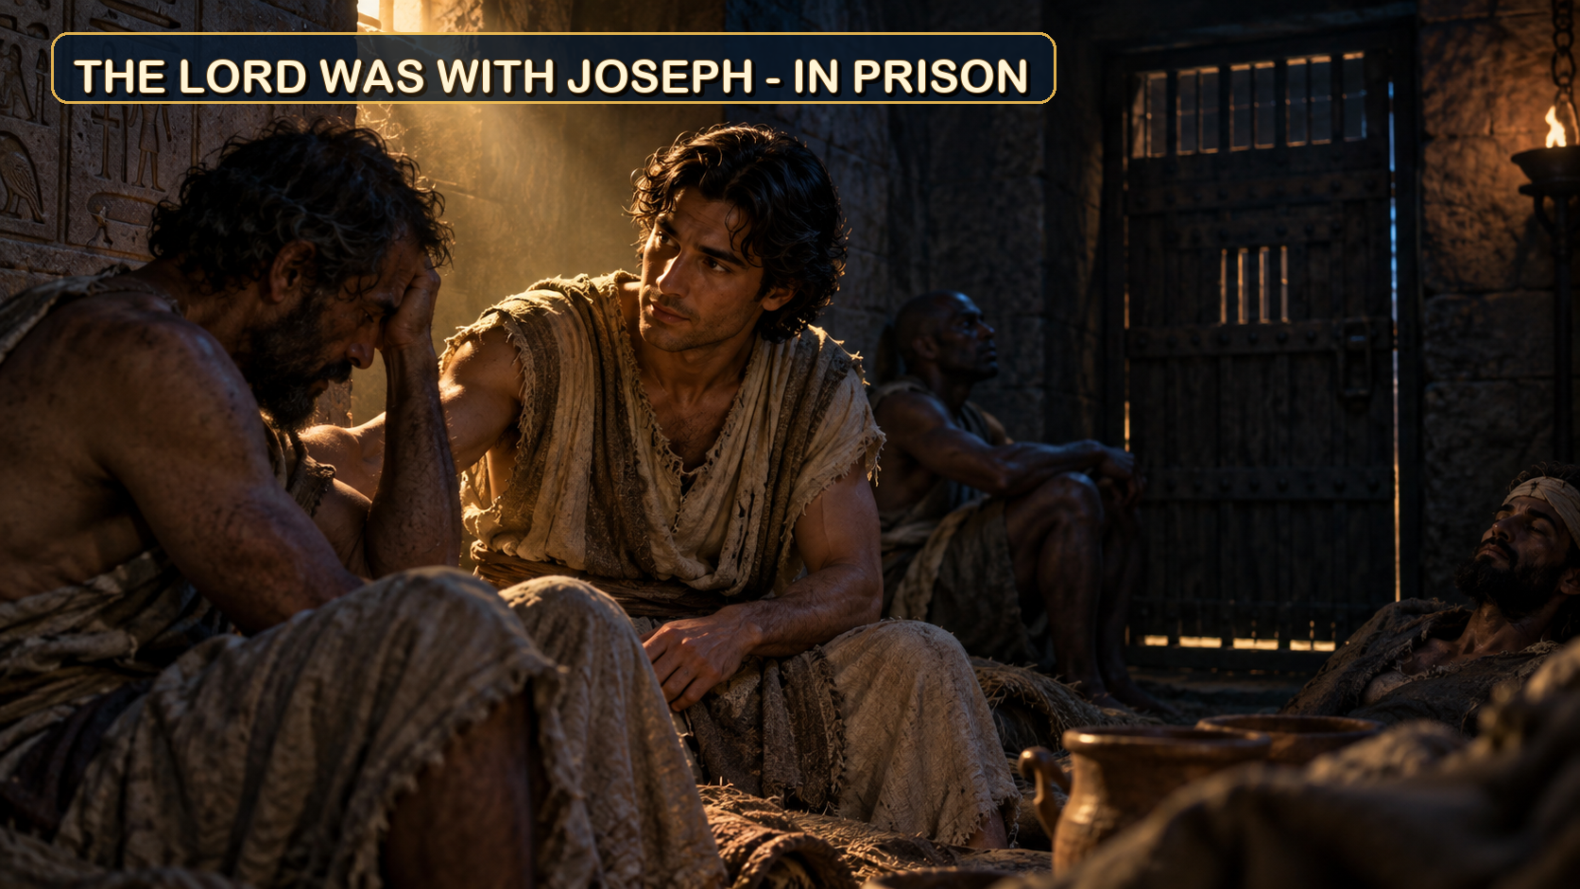
Sermon

Slide 38
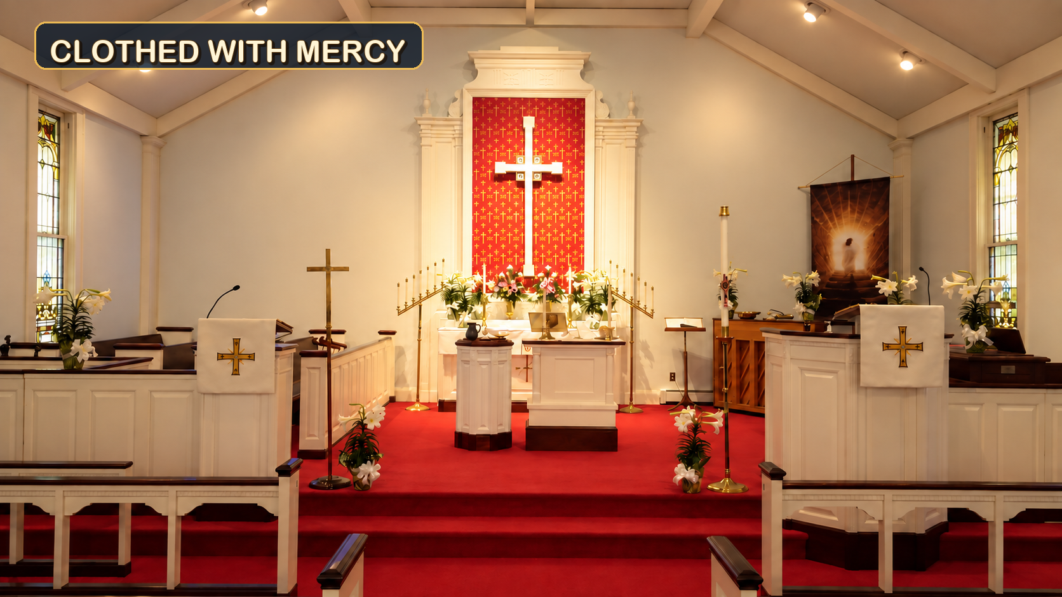
Sermon

Slide 39
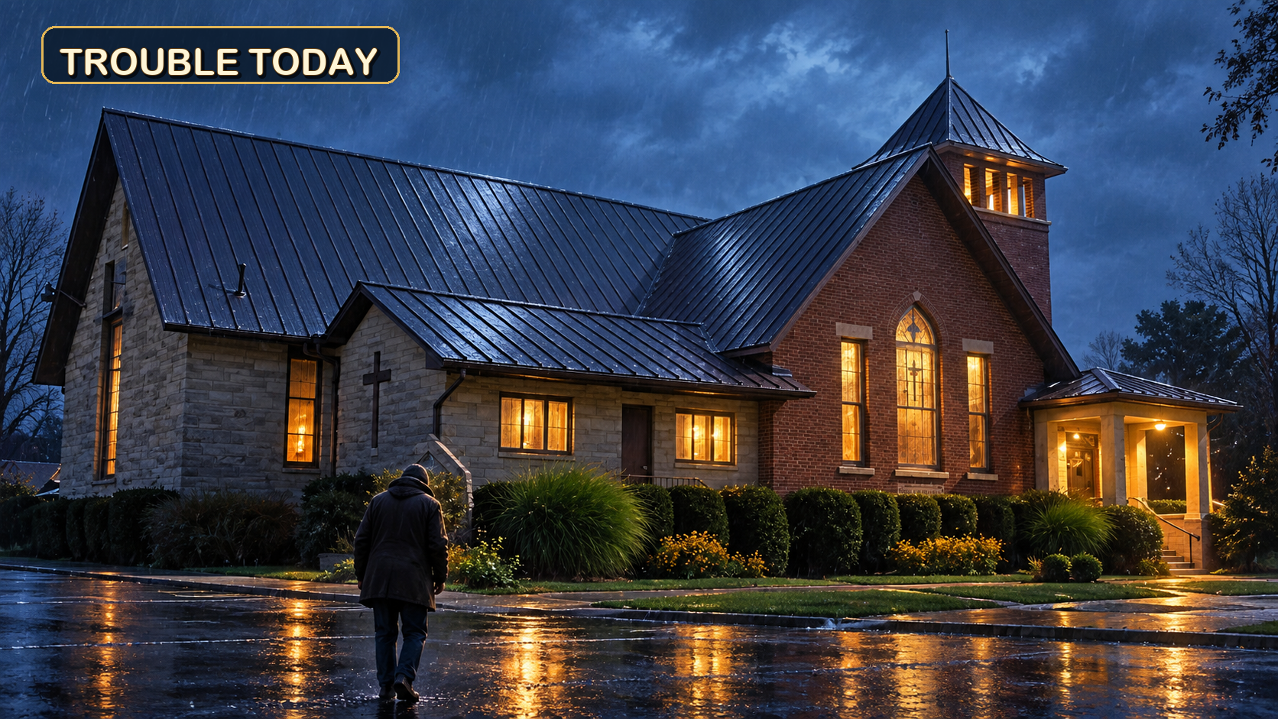
Sermon

Slide 40
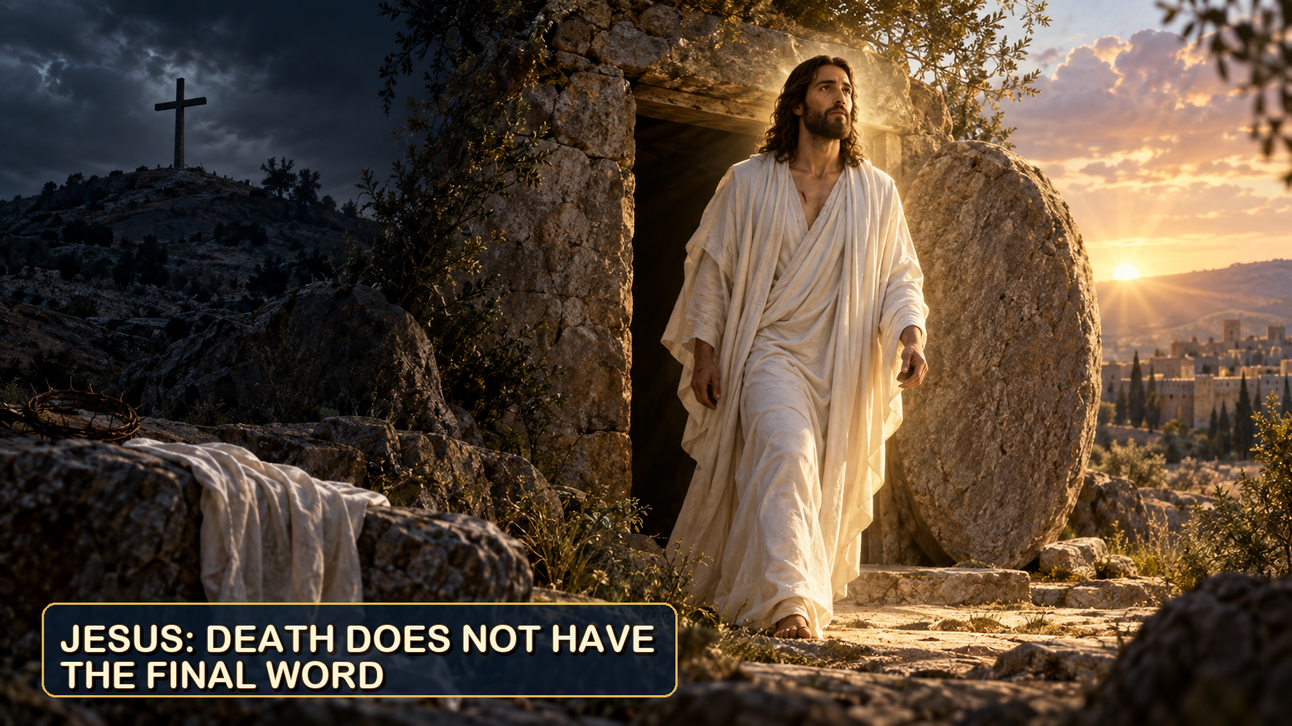
Sermon

Slide 41
Hymn of the Day
“Amazing Grace, How Sweet the Sound”
LBW 448

Slide 42
“Amazing Grace” LBW 448
1 Amazing grace, how sweet the sound,
that saved a wretch like me!
I once was lost, but now am found;
was blind, but now I see.
Notes:
Image: Five Loaves by Caroline Coolidge Brown. Copyright © Caroline Coolidge Brown. All rights reserved. Used by permission of the artist.

Slide 43
“Amazing Grace” LBW 448
2 ’Twas grace that taught my heart to fear,
and grace my fears relieved;
how precious did that grace appear
the hour I first believed!
Notes:
Image: Five Loaves by Caroline Coolidge Brown. Copyright © Caroline Coolidge Brown. All rights reserved. Used by permission of the artist.

Slide 44
“Amazing Grace” LBW 448
3 Through many dangers, toils, and snares
I have already come;
’tis grace has brought me safe thus far,
and grace will lead me home.
Notes:
Image: Five Loaves by Caroline Coolidge Brown. Copyright © Caroline Coolidge Brown. All rights reserved. Used by permission of the artist.

Slide 45
“Amazing Grace” LBW 448
4 The Lord has promised good to me;
his word my hope secures;
he will my shield and portion be
as long as life endures.
Notes:
Image: Five Loaves by Caroline Coolidge Brown. Copyright © Caroline Coolidge Brown. All rights reserved. Used by permission of the artist.

Slide 46
APOSTLE’S CREED
C: I believe in God, the Father almighty, creator of heaven and earth.

Slide 47
APOSTLE’S CREED
C: I believe in Jesus Christ, his only Son, our Lord. He was conceived by the power of the Holy Spirit and born of the virgin Mary. He suffered under Pontius Pilate, was crucified, died, and was buried.

Slide 48
APOSTLE’S CREED
C: He descended into hell. On the third day he rose again. He ascended into heaven, and is seated at the right hand of the Father. He will come again to judge the living and the dead.

Slide 49
APOSTLE’S CREED
C: I believe in the Holy Spirit, the holy catholic Church, the communion of saints, the forgiveness of sins, the resurrection of the body, and the life everlasting. Amen.

Slide 50
PRAYERS
Each petition will end with the words,
A: God of mercy and grace,
C: We lift our prayers to you.

Slide 51
PRAYERS OF INTERCESSION
The prayer concludes…
P: God who created all that is, we place all for whom we pray, both aloud and in the silence of our hearts, into your loving arms.
C: Amen.

Slide 52
OFFERING - * OFFERING PRAYER
Notes:
Image: Five Loaves by Caroline Coolidge Brown. Copyright © Caroline Coolidge Brown. All rights reserved. Used by permission of the artist.

Slide 53
THE LORD’S PRAYER
C: Our Father, who art in heaven, hallowed be thy name, thy kingdom come, thy will be done, on earth as it is in heaven. Give us this day our daily bread; and forgive us our trespasses, as we forgive those who trespass against us; and lead us not into temptation, but deliver us from evil.

Slide 54
THE LORD’S PRAYER
C: For thine is the kingdom, and the power, and the glory, forever and ever. Amen.

Slide 55
ANNOUNCEMENTS
Notes:
Image: Five Loaves by Caroline Coolidge Brown. Copyright © Caroline Coolidge Brown. All rights reserved. Used by permission of the artist.

Slide 56
SENDING BLESSING
P: Creator, Redeemer, Sustainer, one God, bless, heal, and hold you ☩ today and always.
C: Amen.

Slide 57
Sending Song
“Great Is Thy Faithfulness”
ELW 733
Notes:
Image: Five Loaves by Caroline Coolidge Brown. Copyright © Caroline Coolidge Brown. All rights reserved. Used by permission of the artist.

Slide 58
“Great Is Thy Faithfulness” ELW 733
1 Great is thy faithfulness, O God my Father;
there is no shadow of turning with thee;
thou changest not, thy compassions they fail not;
as thou hast been, thou forever wilt be.
Notes:
Image: Preparing yeast dough. Copyright © tomasworks/iStock/Thinkstock. Used by permission.

Slide 59
“Great Is Thy Faithfulness” ELW 733
Refrain
Great is thy faithfulness! Great is thy faithfulness!
Morning by morning new mercies I see;
all I have needed thy hand hath provided;
great is thy faithfulness, Lord, unto me!
Notes:
Image: Preparing yeast dough. Copyright © tomasworks/iStock/Thinkstock. Used by permission.

Slide 60
“Great Is Thy Faithfulness” ELW 733
2 Summer and winter and springtime and harvest,
sun, moon, and stars in their courses above
join with all nature in manifold witness
to thy great faithfulness, mercy, and love.
Notes:
Image: Preparing yeast dough. Copyright © tomasworks/iStock/Thinkstock. Used by permission.

Slide 61
“Great Is Thy Faithfulness” ELW 733
Refrain
Great is thy faithfulness! Great is thy faithfulness!
Morning by morning new mercies I see;
all I have needed thy hand hath provided;
great is thy faithfulness, Lord, unto me!
Notes:
Image: Preparing yeast dough. Copyright © tomasworks/iStock/Thinkstock. Used by permission.

Slide 62
“Great Is Thy Faithfulness” ELW 733
3 Pardon for sin and a peace that endureth,
thine own dear presence to cheer and to guide;
strength for today and bright hope for tomorrow,
blessings all mine, with ten thousand beside!
Notes:
Image: Preparing yeast dough. Copyright © tomasworks/iStock/Thinkstock. Used by permission.

Slide 63
“Great Is Thy Faithfulness” ELW 733
Refrain
Great is thy faithfulness! Great is thy faithfulness!
Morning by morning new mercies I see;
all I have needed thy hand hath provided;
great is thy faithfulness, Lord, unto me!
Notes:
Image: Preparing yeast dough. Copyright © tomasworks/iStock/Thinkstock. Used by permission.

Slide 64
DISMISSAL
P: … Depart in Christ’s Love.
C: Seeking, welcoming, and serving all. Amen!
POSTLUDE
By
Roxanne Groff
From sundaysandseasons.com. Copyright © 2025 Augsburg Fortress. All rights reserved. Reprinted by permission under Augsburg Fortress Liturgies Annual License #SAS023830. New Revised Standard Version Bible, Copyright © 1989, Division of Christian Education of the National Council of the Churches of Christ in the United States of America. Used by permission. All rights reserved. Revised Common Lectionary, Copyright © 1992 Consultation on Common Texts, admin Augsburg Fortress. Used by permission. Some images were generated by Open AI ChatGPT (Theo).

