Slide 1
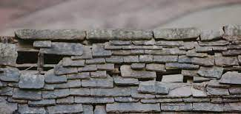
January 7, 2024
WELCOME!
Trinity Lutheran Church
Notes:
Image: Five Loaves by Caroline Coolidge Brown. Copyright © Caroline Coolidge Brown. All rights reserved. Used by permission of the artist.

Slide 2
= Please stand if able
= Please be seated
Prelude - By Roxanne Groff
Office of the Acolyte
Ringing of the Bell
Welcome

Slide 3
THANKSGIVING FOR BAPTISM
All may make the sign of the cross, the sign marked at baptism, as the presiding minister begins.
P: Blessed be the holy Trinity, ☩ one God, the fountain of living water, the rock who gave us birth, our light and our salvation.
C: Amen.
Notes:
Image: Preparing yeast dough. Copyright © tomasworks/iStock/Thinkstock. Used by permission.

Slide 4
P: Joined to Christ in the waters of baptism, we are clothed with God's mercy and forgiveness. Let us give thanks for the gift of baptism.
Water may be poured into the font as the presiding minister gives thanks.
THANKSGIVING FOR BAPTISM
Notes:
Image: Preparing yeast dough. Copyright © tomasworks/iStock/Thinkstock. Used by permission.

Slide 5
P: We give you thanks, O God, for in the beginning your Spirit moved over the waters and by your Word you created the world, calling forth life in which you took delight. Through the waters of the flood you delivered Noah and his family. Through the sea you led your people Israel from slavery into freedom.
THANKSGIVING FOR BAPTISM
Notes:
Image: Preparing yeast dough. Copyright © tomasworks/iStock/Thinkstock. Used by permission.

Slide 6
P: At the river your Son was baptized by John and anointed with the Holy Spirit. By water and your Word you claim us as daughters and sons, making us heirs of your promise and servants of all. We praise you for the gift of water that sustains life, and above all we praise you for the gift of new life in Jesus Christ.
THANKSGIVING FOR BAPTISM
Notes:
Image: Preparing yeast dough. Copyright © tomasworks/iStock/Thinkstock. Used by permission.

Slide 7
P: Shower us with your Spirit, and renew our lives with your forgiveness, grace, and love. To you be given honor and praise through Jesus Christ our Lord in the unity of the Holy Spirit, now and forever.
THANKSGIVING FOR BAPTISM
C: Amen.
Notes:
Image: Preparing yeast dough. Copyright © tomasworks/iStock/Thinkstock. Used by permission.

Slide 8
CONFESSION AND FORGIVENESS
All may make the sign of the cross, the sign marked at baptism…
L: We confess our sins before God and one another.
Pause for silence and reflection.
L: God of all that is,
Notes:
Image: Five Loaves by Caroline Coolidge Brown. Copyright © Caroline Coolidge Brown. All rights reserved. Used by permission of the artist.

Slide 9
CONFESSION AND FORGIVENESS
C: We have failed to trust you to care for us. We have tried to be our own god in our lives and the lives of others. We have not listened to your call, nor lived in faithfulness to you. We have caused harm directly and indirectly to ourselves, our neighbors, and your creation.
Notes:
Image: Five Loaves by Caroline Coolidge Brown. Copyright © Caroline Coolidge Brown. All rights reserved. Used by permission of the artist.

Slide 10
CONFESSION AND FORGIVENESS
C: In your infinite grace and mercy, forgive and restore us, so that with your help, we might become the people you created us to be.
Notes:
Image: Five Loaves by Caroline Coolidge Brown. Copyright © Caroline Coolidge Brown. All rights reserved. Used by permission of the artist.

Slide 11
CONFESSION AND FORGIVENESS
L: Hear the good news: By the power of the Holy Spirit we are made new creations in Christ Jesus, and through his selfless sacrifice, God forgives us all our sin. ☩ Walk with God in this newness of life.
C: Amen.
Notes:
Image: Five Loaves by Caroline Coolidge Brown. Copyright © Caroline Coolidge Brown. All rights reserved. Used by permission of the artist.

Slide 12

Gathering Song/Hymn of Praise
“Brightest and Best”
LBW 84
(Verses 1-4 Only)

Slide 13
“Brightest and Best” LBW 84
1 Brightest and best of the stars of the morning,
dawn on our darkness and lend us your aid.
Star of the East, the horizon adorning,
guide where our infant redeemer is laid.
Notes:
Image: Five Loaves by Caroline Coolidge Brown. Copyright © Caroline Coolidge Brown. All rights reserved. Used by permission of the artist.

Slide 14
“Brightest and Best” LBW 84
2 Cold on his cradle the dewdrops are shining;
low lies his head with the beasts of the stall;
angels adore him in slumber reclining,
maker and monarch and savior of all.
Notes:
Image: Five Loaves by Caroline Coolidge Brown. Copyright © Caroline Coolidge Brown. All rights reserved. Used by permission of the artist.

Slide 15
“Brightest and Best” LBW 84
3 Shall we not yield him, in costly devotion,
fragrance of Edom and off’rings divine,
gems of the mountain and pearls of the ocean,
myrrh from the forest or gold from the mine?
Notes:
Image: Five Loaves by Caroline Coolidge Brown. Copyright © Caroline Coolidge Brown. All rights reserved. Used by permission of the artist.

Slide 16
“Brightest and Best” LBW 84
4 Vainly we offer each ample oblation,
vainly with gifts would his favor secure;
richer by far is the heart’s adoration,
dearer to God are the prayers of the poor.
Notes:
Image: Five Loaves by Caroline Coolidge Brown. Copyright © Caroline Coolidge Brown. All rights reserved. Used by permission of the artist.

Slide 17
APOSTOLIC GREETING
P: The grace of our Lord Jesus Christ, the love of God, and the communion of the Holy Spirit be with you all.
C: And also with you.
Notes:
Image: Five Loaves by Caroline Coolidge Brown. Copyright © Caroline Coolidge Brown. All rights reserved. Used by permission of the artist.

Slide 18
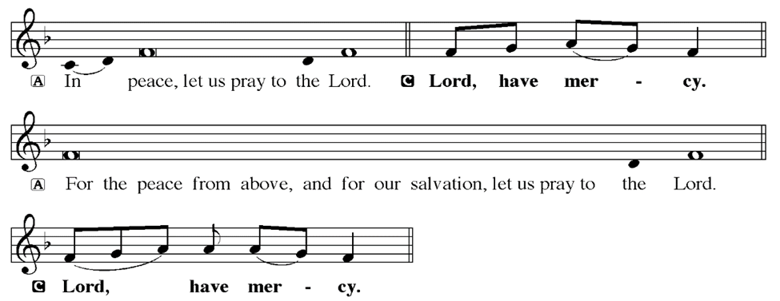
KYRIE
Notes:
Image: Five Loaves by Caroline Coolidge Brown. Copyright © Caroline Coolidge Brown. All rights reserved. Used by permission of the artist.

Slide 19
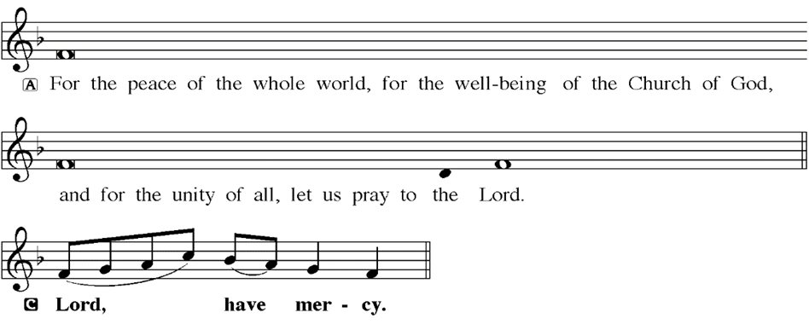
KYRIE
Notes:
Image: Five Loaves by Caroline Coolidge Brown. Copyright © Caroline Coolidge Brown. All rights reserved. Used by permission of the artist.

Slide 20
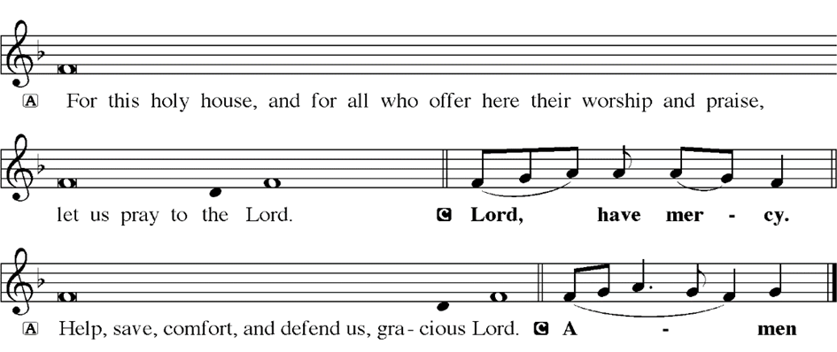
KYRIE
Notes:
Image: Five Loaves by Caroline Coolidge Brown. Copyright © Caroline Coolidge Brown. All rights reserved. Used by permission of the artist.

Slide 21
HYMN OF PRAISE
Glory be to God in heaven;
peace, goodwill to all the earth.
Mighty God of all creation,
Father of surpassing worth:
we exalt you, we adore you,
we lift high our thanks and praise.
Saints and angels bow before you; here on earth our songs we raise.
Notes:
Image: Five Loaves by Caroline Coolidge Brown. Copyright © Caroline Coolidge Brown. All rights reserved. Used by permission of the artist.

Slide 22
HYMN OF PRAISE
Glory be to Christ forever,
Lamb of God and Lord of love.
Son of God and gracious Savior, you have come from heav’n above;
on the cross you died to save us; now you reign at God’s right hand.
Hear our prayer; restore, forgive us; in your promise firm we stand.
Notes:
Image: Five Loaves by Caroline Coolidge Brown. Copyright © Caroline Coolidge Brown. All rights reserved. Used by permission of the artist.

Slide 23
HYMN OF PRAISE
Holy One we now acclaim you;
Lord alone, to you we call;
Holy One in faith we name you,
God most high, yet near to all:
Jesus Christ, with God the Spirit,
in the Father’s splendor bright.
For the peace that we inherit,
glory be to God on high!
Notes:
Image: Five Loaves by Caroline Coolidge Brown. Copyright © Caroline Coolidge Brown. All rights reserved. Used by permission of the artist.

Slide 24
PRAYER OF THE DAY
P: Let us pray… Transforming God, in Christ Jesus you make all things new, turning the status quo on its head and calling us to push out of our comfort zones for the sake of others. Strengthen our faith through your holy word and meal that we might carry Jesus’ message with us to the world. In his name we pray.
C: Amen
Notes:
Image: Five Loaves by Caroline Coolidge Brown. Copyright © Caroline Coolidge Brown. All rights reserved. Used by permission of the artist.

Slide 25

Notes:
Image: Five Loaves by Caroline Coolidge Brown. Copyright © Caroline Coolidge Brown. All rights reserved. Used by permission of the artist.

Slide 26
Scripture Reading
L: Our scripture reading for this day is from the Gospel of Mark, the 2nd Chapter.
C: Glory to you O’ Lord!
Notes:
Image: Five Loaves by Caroline Coolidge Brown. Copyright © Caroline Coolidge Brown. All rights reserved. Used by permission of the artist.

Slide 27
Mark 2:1-22
¹When he returned to Capernaum after some days, it was reported that he was at home. ²So many gathered around that there was no longer room for them, not even in front of the door; and he was speaking the word to them. ³Then some people came, bringing to him a paralyzed man, carried by four of them. ⁴And when they could not bring him to Jesus
Notes:
Image: Five Loaves by Caroline Coolidge Brown. Copyright © Caroline Coolidge Brown. All rights reserved. Used by permission of the artist.

Slide 28
Mark 2:1-22
because of the crowd, they removed the roof above him; and after having dug through it, they let down the mat on which the paralytic lay. ⁵When Jesus saw their faith, he said to the paralytic, "Son, your sins are forgiven." ⁶Now some of the scribes were sitting there, questioning in their hearts, ⁷Why does this fellow speak in this way? It is blasphemy! Who can forgive sins but
Notes:
Image: Five Loaves by Caroline Coolidge Brown. Copyright © Caroline Coolidge Brown. All rights reserved. Used by permission of the artist.

Slide 29
Mark 2:1-22
God alone? ⁸At once Jesus perceived in his spirit that they were discussing these questions among themselves; and he said to them, "Why do you raise such questions in your hearts? ⁹Which is easier, to say to the paralytic, 'Your sins are forgiven,' or to say, 'Stand up and take your mat and walk'? ¹⁰But so that you may know that the Son of Man has authority on earth to forgive sins"
Notes:
Image: Five Loaves by Caroline Coolidge Brown. Copyright © Caroline Coolidge Brown. All rights reserved. Used by permission of the artist.

Slide 30
Mark 2:1-22
— he said to the paralytic — ¹¹I say to you, stand up, take your mat and go to your home. ¹²And he stood up, and immediately took the mat and went out before all of them; so that they were all amazed and glorified God, saying, "We have never seen anything like this!"
¹³Jesus went out again beside the sea; the whole crowd gathered around him, and he taught them. ¹⁴As he was
Notes:
Image: Five Loaves by Caroline Coolidge Brown. Copyright © Caroline Coolidge Brown. All rights reserved. Used by permission of the artist.

Slide 31
Mark 2:1-22
walking along, he saw Levi son of Alphaeus sitting at the tax booth, and he said to him, "Follow me." And he got up and followed him.
¹⁵And as he sat at dinner in Levi's house, many tax collectors and sinners were also sitting with Jesus and his disciples — for there were many who followed him. ¹⁶When the scribes of the Pharisees saw that he was eating with
Notes:
Image: Five Loaves by Caroline Coolidge Brown. Copyright © Caroline Coolidge Brown. All rights reserved. Used by permission of the artist.

Slide 32
Mark 2:1-22
sinners and tax collectors, they said to his disciples, "Why does he eat with tax collectors and sinners?" ¹⁷When Jesus heard this, he said to them, "Those who are well have no need of a physician, but those who are sick; I have come to call not the righteous but sinners."
¹⁸Now John's disciples and the Pharisees were fasting; and people came and said to him, "Why do John's
Notes:
Image: Five Loaves by Caroline Coolidge Brown. Copyright © Caroline Coolidge Brown. All rights reserved. Used by permission of the artist.

Slide 33
Mark 2:1-22
disciples and the disciples of the Pharisees fast, but your disciples do not fast?" ¹⁹Jesus said to them, "The wedding guests cannot fast while the bridegroom is with them, can they? As long as they have the bridegroom with them, they cannot fast. ²⁰The days will come when the bridegroom is taken away from them, and then they will fast on that day.
Notes:
Image: Five Loaves by Caroline Coolidge Brown. Copyright © Caroline Coolidge Brown. All rights reserved. Used by permission of the artist.

Slide 34
Mark 2:1-22
²¹No one sews a piece of unshrunk cloth on an old cloak; otherwise, the patch pulls away from it, the new from the old, and a worse tear is made. ²²And no one puts new wine into old wineskins; otherwise, the wine will burst the skins, and the wine is lost, and so are the skins; but one puts new wine into fresh wineskins."
Notes:
Image: Five Loaves by Caroline Coolidge Brown. Copyright © Caroline Coolidge Brown. All rights reserved. Used by permission of the artist.

Slide 35
Mark 2:1-22
R: This is the Word of the Lord.
C: Praise to You, O Christ
Notes:
Image: Five Loaves by Caroline Coolidge Brown. Copyright © Caroline Coolidge Brown. All rights reserved. Used by permission of the artist.

Slide 36
Sermon

Slide 37
APOSTLE’S CREED
C: I believe in God, the Father almighty, creator of heaven and earth.

Slide 38
APOSTLE’S CREED
C: I believe in Jesus Christ, his only Son, our Lord. He was conceived by the power of the Holy Spirit and born of the virgin Mary. He suffered under Pontius Pilate, was crucified, died, and was buried.

Slide 39
APOSTLE’S CREED
C: He descended into hell. On the third day he rose again. He ascended into heaven, and is seated at the right hand of the Father. He will come again to judge the living and the dead.

Slide 40
APOSTLE’S CREED
C: I believe in the Holy Spirit, the holy catholic Church, the communion of saints, the forgiveness of sins, the resurrection of the body, and the life everlasting. Amen.

Slide 41
NICENE CREED
C: We believe in one God, the Father, the Almighty, maker of heaven and earth, of all that is, seen and unseen.

Slide 42
NICENE CREED
C: We believe in one Lord, Jesus Christ, the only Son of God, eternally begotten of the Father, God from God, Light from Light, true God from true God, begotten, not made, of one Being with the Father.

Slide 43
NICENE CREED
C: Through him all things were made. For us and for our salvation he came down from heaven; by the power of the Holy Spirit he became incarnate from the virgin Mary, and was made man. For our sake he was crucified under Pontius Pilate;

Slide 44
NICENE CREED
C: he suffered death and was buried. On the third day he rose again in accordance with the Scriptures; he ascended into heaven and is seated at the right hand of the Father. He will come again in glory to judge the living and the dead, and his kingdom will have no end.

Slide 45
NICENE CREED
C: We believe in the Holy Spirit, the Lord, the giver of life, who proceeds from the Father and the Son. With the Father and the Son he is worshiped and glorified. He has spoken through the prophets. We believe in one holy catholic and apostolic Church.

Slide 46
NICENE CREED
C: We acknowledge one Baptism for the forgiveness of sins. We look for the resurrection of the dead, and the life of the world to come. Amen.

Slide 47
QUILT TYING AND PRESENTATION
This Quilt was lovingly crafted for recovery and healing especially for XXX.
Let us pray…

Slide 48
PRAYERS OF INTERCESSION
Each petition will end with the words,
A: God our teacher and healer,
The congregation will respond with:
C: In mercy, hear our prayer.

Slide 49
PRAYERS OF INTERCESSION
The prayer concludes…
P: Confident that in Christ Jesus you answer prayer, we lift to you all for whom pray, aloud and in our hearts, through Jesus Christ, our savior.
C: Amen.

Slide 50
OFFERING
Notes:
Image: Five Loaves by Caroline Coolidge Brown. Copyright © Caroline Coolidge Brown. All rights reserved. Used by permission of the artist.

Slide 51
OFFERING PRAYER
Notes:
Image: Five Loaves by Caroline Coolidge Brown. Copyright © Caroline Coolidge Brown. All rights reserved. Used by permission of the artist.

Slide 52
THE GREAT THANKSGIVING
All the Baptized are welcome to celebrate this Holy Meal.

Slide 53
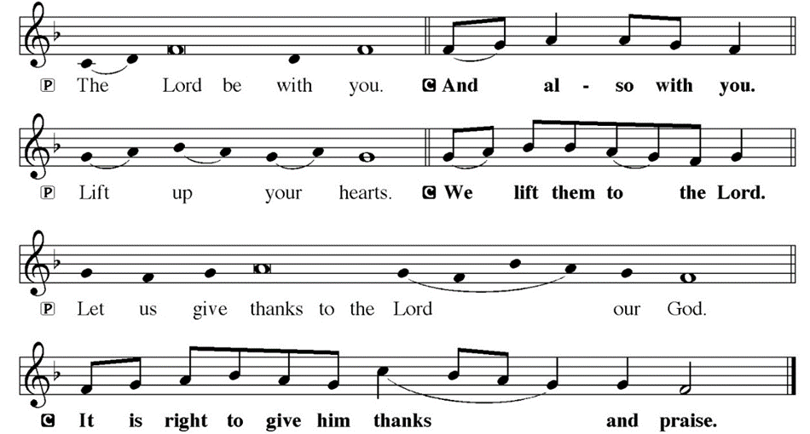
DIALOGUE

Slide 54
THE PREFACE
P: It is indeed right and salutary…
… we praise your name and join their unending hymn.

Slide 55
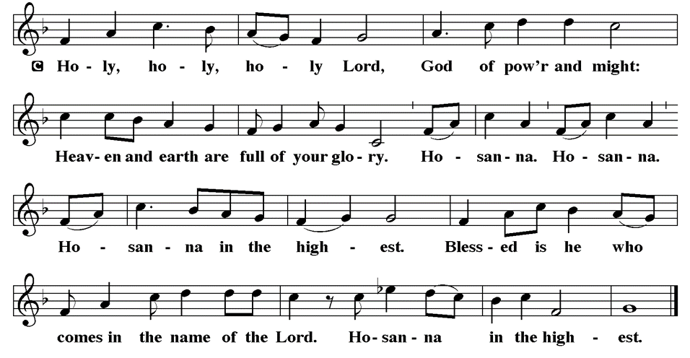
THE SANCTUS

Slide 56
EUCHARISTIC PRAYER
P: Holy God…
…both now and forever.
C: Amen.

Slide 57
THE LORD’S PRAYER
C: Our Father, who art in heaven, hallowed be thy name, thy kingdom come, thy will be done, on earth as it is in heaven. Give us this day our daily bread; and forgive us our trespasses, as we forgive those who trespass against us; and lead us not into temptation, but deliver us from evil.

Slide 58
THE LORD’S PRAYER
C: For thine is the kingdom, and the power, and the glory, forever and ever. Amen.

Slide 59
INVITATION TO COMMUNION
P: Jesus who will never leave us now invites us to the table to share in the feast of life. Come and dine, for all is prepared for you.

Slide 60
COMMUNION DISTRIBUTION
All will commune “By Station”.
The bread may be broken for distribution. As the ministers give the bread and wine, they say these words :
The body of Christ, given for you.
The blood of Christ, shed for you.
The communicant may say: Amen.

Slide 61
POST COMMUNION BLESSING
P: May this body and blood of our Lord and Savior, Jesus Christ, strengthen, keep, and unity us, ☩ now and forever,
C: Amen.

Slide 62
POST COMMUNION CANTACLE

Slide 63
POST COMMUNION CANTACLE

Slide 64
POST COMMUNION PRAYER
P: Let us pray… Blessed be your name, O God, for we have feasted on your Word, Christ Jesus, the joy and delight of our hearts. Strengthened by this food, send us to gather the world to your banquet, where none are left out and all are satisfied. In Jesus’ name we pray.
C: Amen

Slide 65
ANNOUNCEMENTS
Notes:
Image: Five Loaves by Caroline Coolidge Brown. Copyright © Caroline Coolidge Brown. All rights reserved. Used by permission of the artist.

Slide 66
SENDING BLESSING
P: God who names you, Christ who claims you, and the Holy Spirit who dwells in you, bless you and remain with you always.
C: Amen.

Slide 67
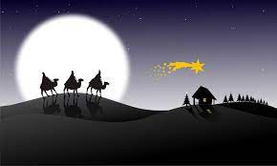
Sending Song
“As With Gladness Men of Old”
LBW 82
(Verses 1-4 Only)
Notes:
Image: Five Loaves by Caroline Coolidge Brown. Copyright © Caroline Coolidge Brown. All rights reserved. Used by permission of the artist.

Slide 68
As With Gladness Men of Old LBW 82
1 As with gladness men of old
did the guiding star behold;
as with joy they hailed its light,
leading onward, beaming bright;
so, most gracious Lord, may we
evermore be led by thee.
Notes:
Image: Preparing yeast dough. Copyright © tomasworks/iStock/Thinkstock. Used by permission.

Slide 69
As With Gladness Men of Old LBW 82
2 As with joyful steps they sped,
Savior, to thy lowly bed,
there to bend the knee before
thee, whom heav'n and earth adore;
so may we with willing feet
ever seek thy mercy seat.
Notes:
Image: Preparing yeast dough. Copyright © tomasworks/iStock/Thinkstock. Used by permission.

Slide 70
As With Gladness Men of Old LBW 82
3 As they offered gifts most rare
at thy cradle, rude and bare,
so may we with holy joy,
pure and free from sin's alloy,
all our costliest treasures bring,
Christ, to thee, our heav'nly king.
Notes:
Image: Preparing yeast dough. Copyright © tomasworks/iStock/Thinkstock. Used by permission.

Slide 71
As With Gladness Men of Old LBW 82
4 Holy Jesus, ev'ry day
keep us in the narrow way;
and when earthly things are past,
bring our ransomed souls at last
where they need no star to guide,
where no clouds thy glory hide.
Notes:
Image: Preparing yeast dough. Copyright © tomasworks/iStock/Thinkstock. Used by permission.

Slide 72
DISMISSAL
P: … Depart in Christ’s Love.
C: Seeking, welcoming, and serving all. Amen!
POSTLUDE
By
Roxanne Groff
From sundaysandseasons.com. Copyright © 2024 Augsburg Fortress. All rights reserved. Reprinted by permission under Augsburg Fortress Liturgies Annual License #SAS023830. New Revised Standard Version Bible, Copyright © 1989, Division of Christian Education of the National Council of the Churches of Christ in the United States of America. Used by permission. All rights reserved. Revised Common Lectionary, Copyright © 1992 Consultation on Common Texts, admin Augsburg Fortress. Used by permission.

