Slide 1
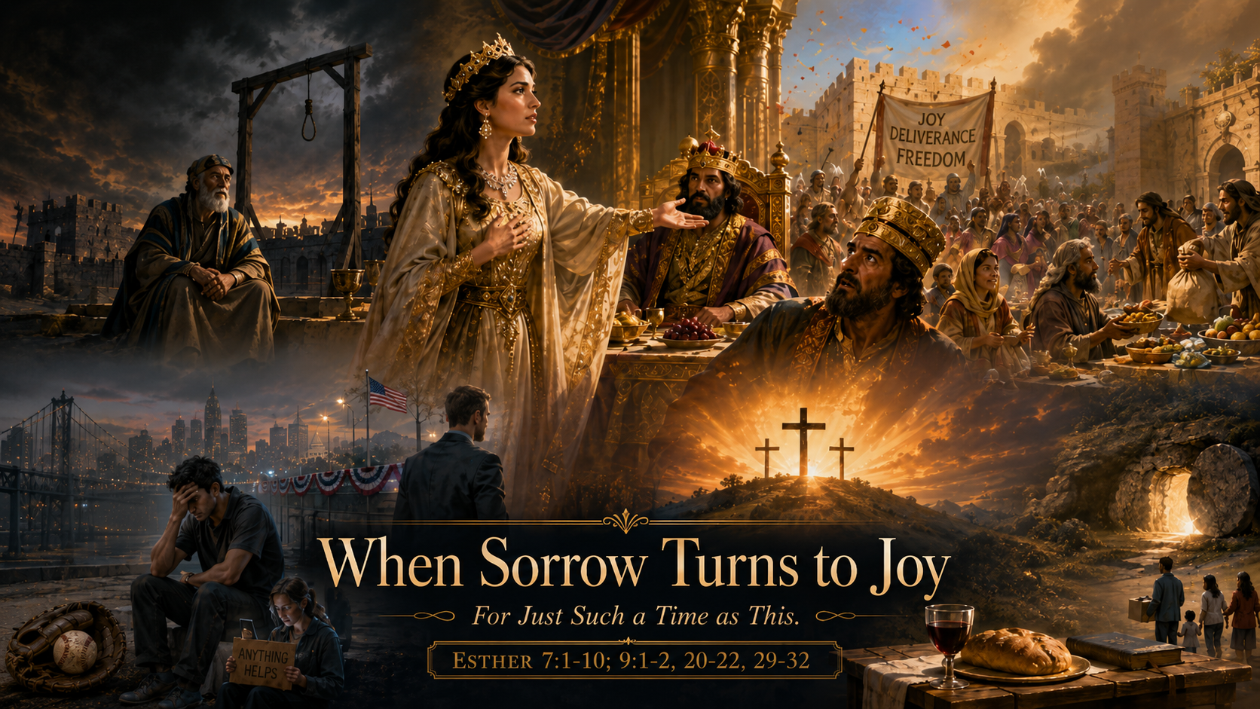
Trinity Evangelical Lutheran Church
July 5, 2026
The Story of Esther
WELCOME!

Slide 2
= Please stand if able
= Please be seated
  Prelude by Roxanne Groff
  Office of the Acolyte
  Ringing of the Bell
  Welcome

Slide 3
CONFESSION AND FORGIVENESS
All may make the sign of the cross, the sign marked at baptism…
L: We confess our sins before God and one another.
Pause for silence and reflection.
L: Merciful God,

Slide 4
CONFESSION AND FORGIVENESS
C: We confess to you and to one another that we have fallen short in our commitment to you and our neighbors. We have neglected the immigrant, the outcast, and those suffering poverty or oppression in our communities and around the world. We have failed to see you in the faces of our neighbors.

Slide 5
CONFESSION AND FORGIVENESS
C: Open our eyes, our minds, and our hearts to receive all who seek only to live peacefully with us. Make us to have the willingness of Ruth, the compassion of Boaz, and the courage of Esther, for the sake of Jesus Christ whose ministry and death fully embodied these principles.

Slide 6
CONFESSION AND FORGIVENESS
L: Our God, whose hand created all that is, and whose heart is for all that God created, reaches out to you with mercy and grace and calls you beloved. Know that your sins are forgiven, and that God empowers each of you to grow closer to God’s will for you each day. In Jesus’ holy name we pray.
C: Amen.

Slide 7
Gathering Song
“Praise to the Lord, the Almighty”
LBW 543

Slide 8
“Praise to the Lord, the Almighty”
LBW 543
1 Praise to the Lord, the Almighty, the King of creation!
O my soul, praise him, for he is your health and salvation!
Let all who hear now to his temple draw near,
joining in glad adoration!

Slide 9
“Praise to the Lord, the Almighty”
LBW 543
2 Praise to the Lord, who o'er all things is wondrously reigning
and, as on wings of an eagle, uplifting, sustaining.
Have you not seen all that is needful has been
sent by his gracious ordaining?

Slide 10
“Praise to the Lord, the Almighty”
LBW 543
3 Praise to the Lord, who will prosper your work and defend you;
surely his goodness and mercy shall daily attend you.
Ponder anew what the Almighty can do
if with his love he befriend you.

Slide 11
“Praise to the Lord, the Almighty”
LBW 543
4 Praise to the Lord! Oh, let all that is in me adore him!
All that has life and breath, come now with praises before him!
Let the amen sound from his people again.
Gladly forever adore him!

Slide 12
APOSTOLIC GREETING
P: The grace of our Lord Jesus Christ, the love of God, and the communion of the Holy Spirit be with you all.
C: And also with you.

Slide 13
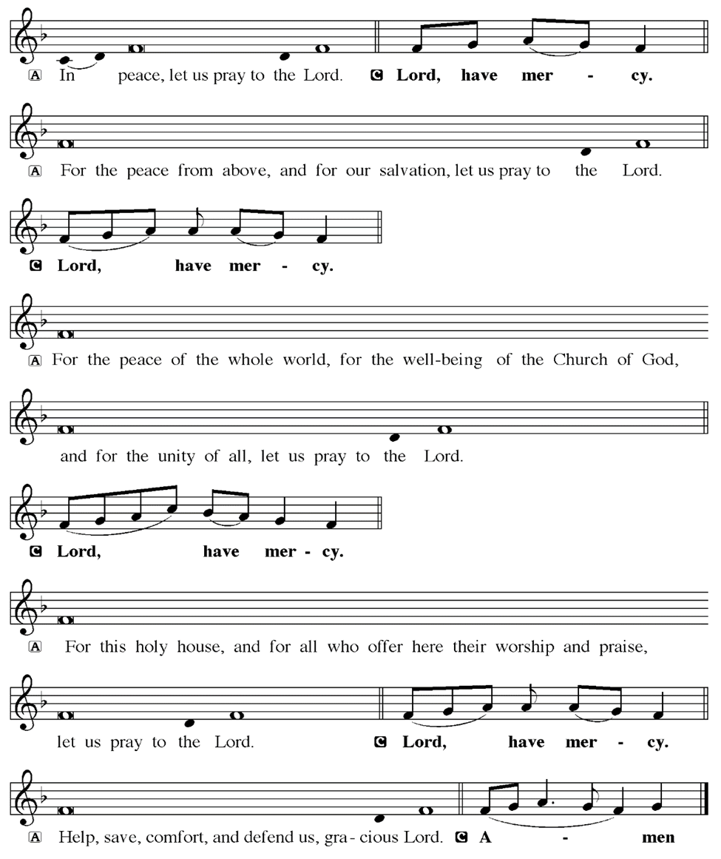
KYRIE

Slide 14
KYRIE

Slide 15
KYRIE

Slide 16
HYMN OF PRAISE
Glory be to God in heaven;
peace, goodwill to all the earth.
Mighty God of all creation,
Father of surpassing worth:
we exalt you, we adore you,
we lift high our thanks and praise.
Saints and angels bow before you; here on earth our songs we raise.

Slide 17
HYMN OF PRAISE
Glory be to Christ forever,
Lamb of God and Lord of love.
Son of God and gracious Savior, you have come from heav’n above;
on the cross you died to save us; now you reign at God’s right hand.
Hear our prayer; restore, forgive us; in your promise firm we stand.

Slide 18
HYMN OF PRAISE
Holy One we now acclaim you;
Lord alone, to you we call;
Holy One in faith we name you,
God most high, yet near to all:
Jesus Christ, with God the Spirit,
in the Father’s splendor bright.
For the peace that we inherit,
glory be to God on high!

Slide 19
PRAYER OF THE DAY
P: Let us pray… God of deliverance… … In Jesus’ name we pray.
C: Amen

Slide 20

The Story of Esther

Slide 21
Scripture Reading
R: Our scripture reading is from the Book of Esther, Chapters 7 and 9.
C: Glory to you O’ Lord!

Slide 22
Esther 7:1-10, 9:1-2, 20-22, 29-32
Chapter 7
So the king and Haman went in to feast with Queen Esther. ²On the second day, as they were drinking wine, the king again said to Esther, “What is your petition, Queen Esther? It shall be granted you. And what is your request? Even to the half of my kingdom, it shall be fulfilled.” ³Then Queen Esther

Slide 23
Esther 7:1-10, 9:1-2, 20-22, 29-32
Chapter 7
answered, “If I have won your favor, O king, and if it pleases the king, let my life be given me—that is my petition—and the lives of my people—that is my request. ⁴For we have been sold, I and my people, to be destroyed, to be killed, and to be annihilated. If we had been sold merely as slaves,

Slide 24
Esther 7:1-10, 9:1-2, 20-22, 29-32
Chapter 7
men and women, I would have held my peace; but no enemy can compensate for this damage to the king.” ⁵Then King Ahasuerus said to Queen Esther, “Who is he, and where is he, who has presumed to do this?” ⁶Esther said, “A foe and enemy, this wicked Haman!” Then Haman was terrified before the

Slide 25
Esther 7:1-10, 9:1-2, 20-22, 29-32
Chapter 7
king and the queen.
⁷The king rose from the feast in wrath and went into the palace garden, but Haman stayed to beg his life from Queen Esther, for he saw that the king had determined to destroy him. ⁸When the king returned from the palace garden to the banquet hall, Haman had

Slide 26
Esther 7:1-10, 9:1-2, 20-22, 29-32
Chapter 7
thrown himself on the couch where Esther was reclining; and the king said, “Will he even assault the queen in my presence, in my own house?” As the words left the mouth of the king, they covered Haman’s face. ⁹Then Harbona, one of the eunuchs in attendance on the king, said, “Look, the very

Slide 27
Esther 7:1-10, 9:1-2, 20-22, 29-32
Chapter 7
gallows that Haman has prepared for Mordecai, whose word saved the king, stands at Haman’s house, fifty cubits high.” And the king said, “Hang him on that.” ¹⁰So they hanged Haman on the gallows that he had prepared for Mordecai. Then the anger of the king abated.

Slide 28
Esther 7:1-10, 9:1-2, 20-22, 29-32
Chapter 9
Now in the twelfth month, which is the month of Adar, on the thirteenth day, when the king’s command and edict were about to be executed, on the very day when the enemies of the Jews hoped to gain power over them, but which had been changed to a day when the Jews would gain power over

Slide 29
Esther 7:1-10, 9:1-2, 20-22, 29-32
Chapter 9
their foes, ²the Jews gathered in their cities throughout all the provinces of King Ahasuerus to lay hands on those who had sought their ruin; and no one could withstand them, because the fear of them had fallen upon all peoples.

Slide 30
Esther 7:1-10, 9:1-2, 20-22, 29-32
Chapter 9
²⁰Mordecai recorded these things, and sent letters to all the Jews who were in all the provinces of King Ahasuerus, both near and far, ²¹enjoining them that they should keep the fourteenth day of the month Adar and also the fifteenth day of the same month, year by year, ²²as the days on which the

Slide 31
Esther 7:1-10, 9:1-2, 20-22, 29-32
Chapter 9
Jews gained relief from their enemies, and as the month that had been turned for them from sorrow into gladness and from mourning into a holiday; that they should make them days of feasting and gladness, days for sending gifts of food to one another and presents to the poor.

Slide 32
Esther 7:1-10, 9:1-2, 20-22, 29-32
Chapter 9
²⁹Queen Esther daughter of Abihail, along with the Jew Mordecai, gave full written authority, confirming this second letter about Purim. ³⁰Letters were sent wishing peace and security to all the Jews, to the one hundred twenty-seven provinces of the kingdom of Ahasuerus, ³¹and

Slide 33
Esther 7:1-10, 9:1-2, 20-22, 29-32
Chapter 9
giving orders that these days of Purim should be observed at their appointed seasons, as the Jew Mordecai and Queen Esther enjoined on the Jews, just as they had laid down for themselves and for their descendants regulations concerning their fasts and their lamentations.

Slide 34
Esther 7:1-10, 9:1-2, 20-22, 29-32
Chapter 9
³²The command of Queen Esther fixed these practices of Purim, and it was recorded in writing.

Slide 35
Esther 7:1-10, 9:1-2, 20-22, 29-32
R: This is the Word of the Lord.
C: Praise to You, O Christ

Slide 36

Sermon

Slide 37

Sermon

Slide 38
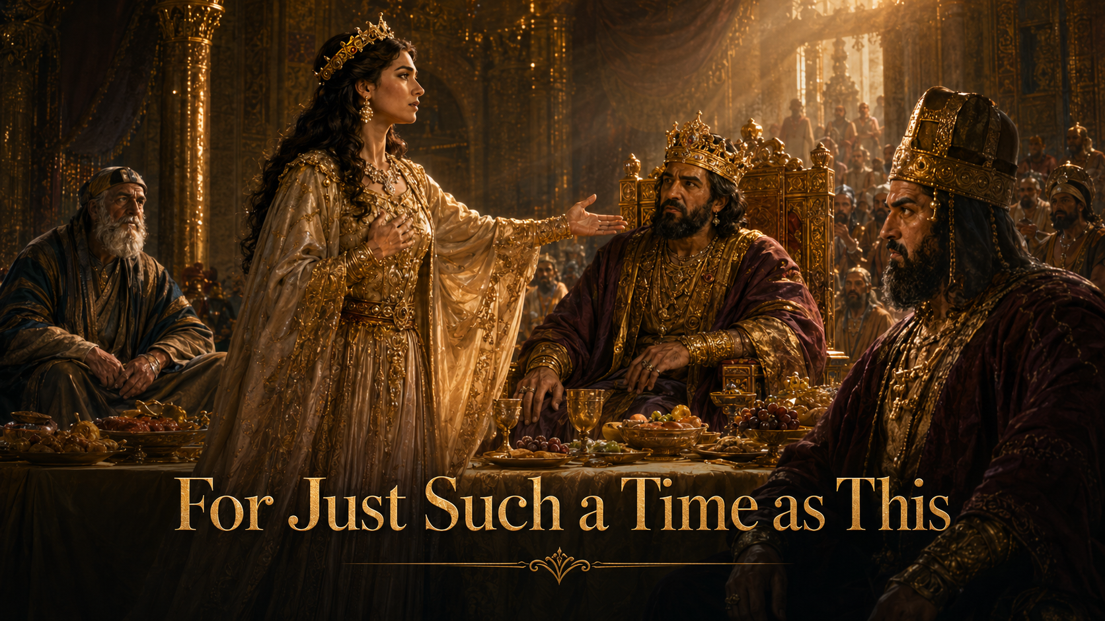
Sermon

Slide 39

Sermon

Slide 40

Sermon

Slide 41
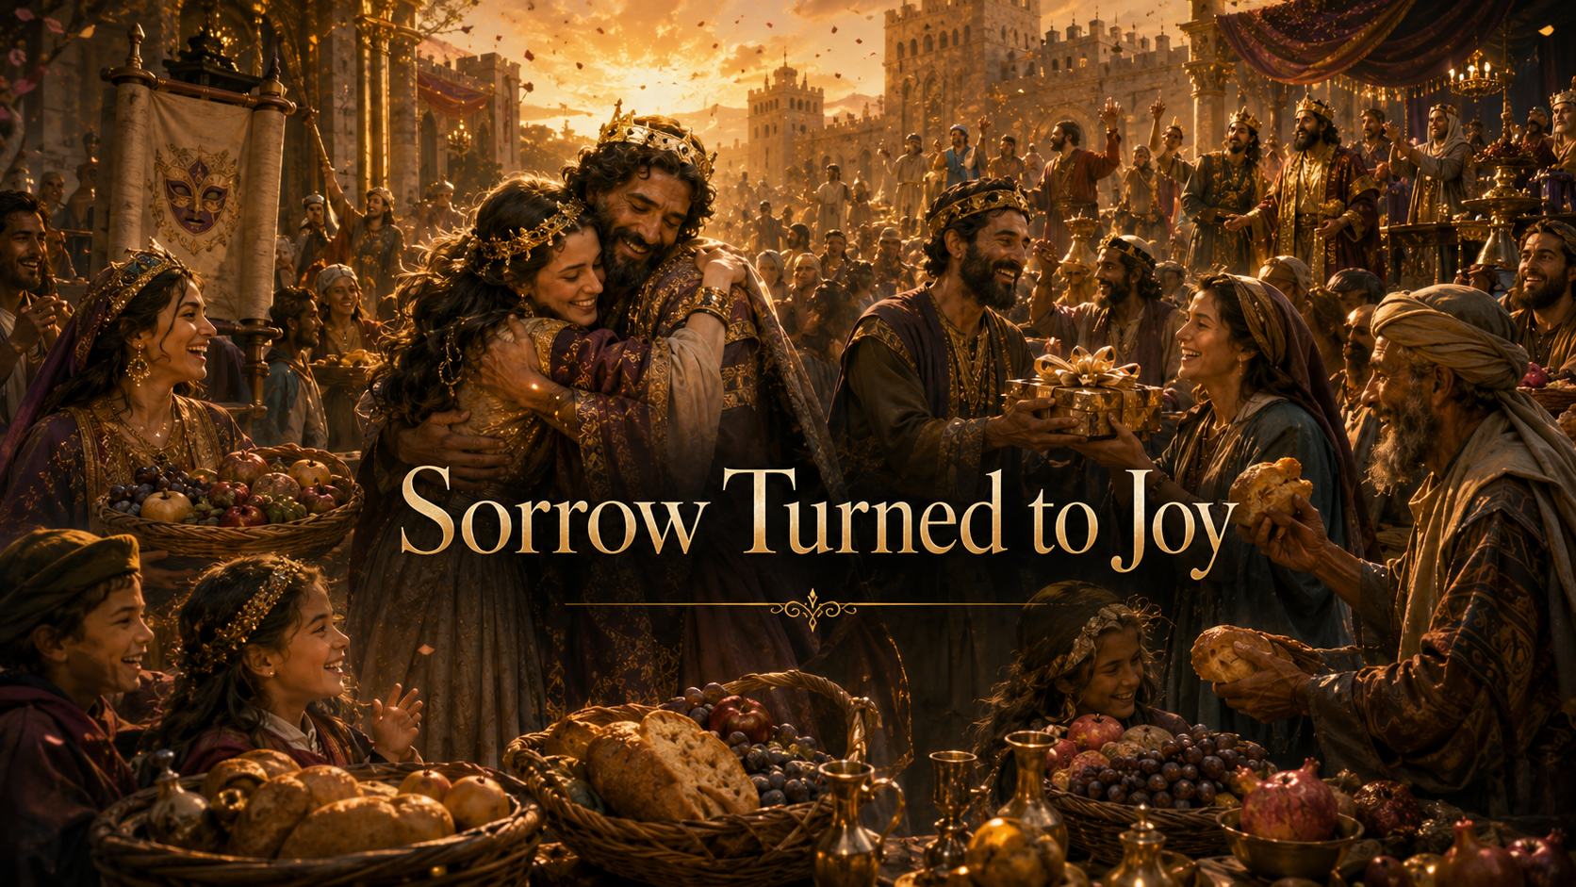
Sermon

Slide 42

Sermon

Slide 43

Sermon

Slide 44
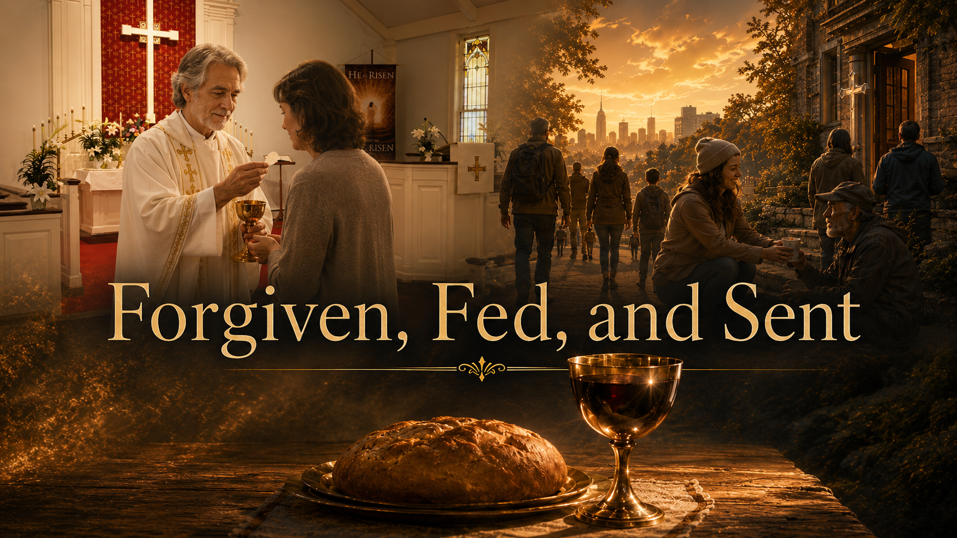
Sermon

Slide 45
APOSTLE’S CREED
C: I believe in God, the Father almighty, creator of heaven and earth.

Slide 46
APOSTLE’S CREED
C: I believe in Jesus Christ, his only Son, our Lord. He was conceived by the power of the Holy Spirit and born of the virgin Mary. He suffered under Pontius Pilate, was crucified, died, and was buried.

Slide 47
APOSTLE’S CREED
C: He descended into hell. On the third day he rose again. He ascended into heaven, and is seated at the right hand of the Father. He will come again to judge the living and the dead.

Slide 48
APOSTLE’S CREED
C: I believe in the Holy Spirit, the holy catholic Church, the communion of saints, the forgiveness of sins, the resurrection of the body, and the life everlasting. Amen.

Slide 49
NICENE CREED
C: We believe in one God, the Father, the Almighty, maker of heaven and earth, of all that is, seen and unseen.

Slide 50
NICENE CREED
C: We believe in one Lord, Jesus Christ, the only Son of God, eternally begotten of the Father, God from God, Light from Light, true God from true God, begotten, not made, of one Being with the Father.

Slide 51
NICENE CREED
C: Through him all things were made. For us and for our salvation he came down from heaven; by the power of the Holy Spirit he became incarnate from the virgin Mary, and was made man. For our sake he was crucified under Pontius Pilate;

Slide 52
NICENE CREED
C: he suffered death and was buried. On the third day he rose again in accordance with the Scriptures; he ascended into heaven and is seated at the right hand of the Father. He will come again in glory to judge the living and the dead, and his kingdom will have no end.

Slide 53
NICENE CREED
C: We believe in the Holy Spirit, the Lord, the giver of life, who proceeds from the Father and the Son. With the Father and the Son he is worshiped and glorified. He has spoken through the prophets. We believe in one holy catholic and apostolic Church.

Slide 54
NICENE CREED
C: We acknowledge one Baptism for the forgiveness of sins. We look for the resurrection of the dead, and the life of the world to come. Amen.

Slide 55
PRAYERS OF INTERCESSION
L: Confident that God acts on our behalf, we pray for the church, the world, and all those in need.
A brief silence.

Slide 56
PRAYERS
Each petition will end with the words,
A: God in your mercy,
C: You hear our prayer.

Slide 57
PRAYERS OF INTERCESSION
The prayer concludes…
P: With gratitude for your faithfulness, we pray these things in the name of Jesus Christ, our savior.
C: Amen.

Slide 58

OFFERING/OFFERING PRAYER

Slide 59
THE GREAT THANKSGIVING
Communion is “At The Railing”.
All the Baptized are welcome to celebrate this Holy Meal.

Slide 60
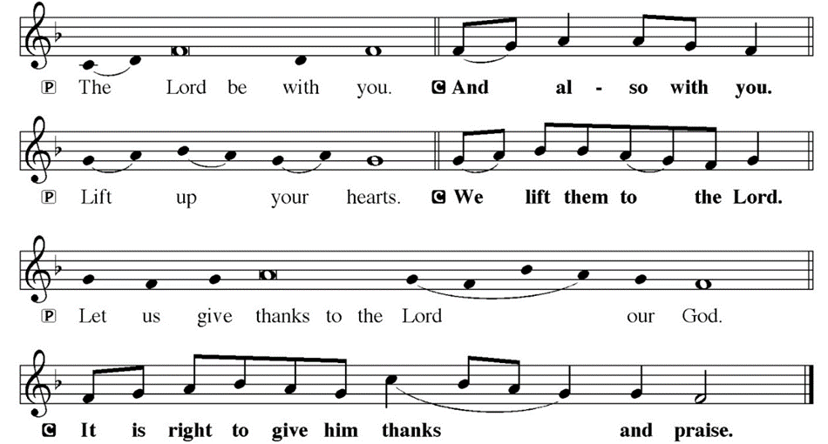
DIALOGUE

Slide 61
THE PREFACE
P: It is indeed right and salutary…
… we praise your name and join their unending hymn.

Slide 62
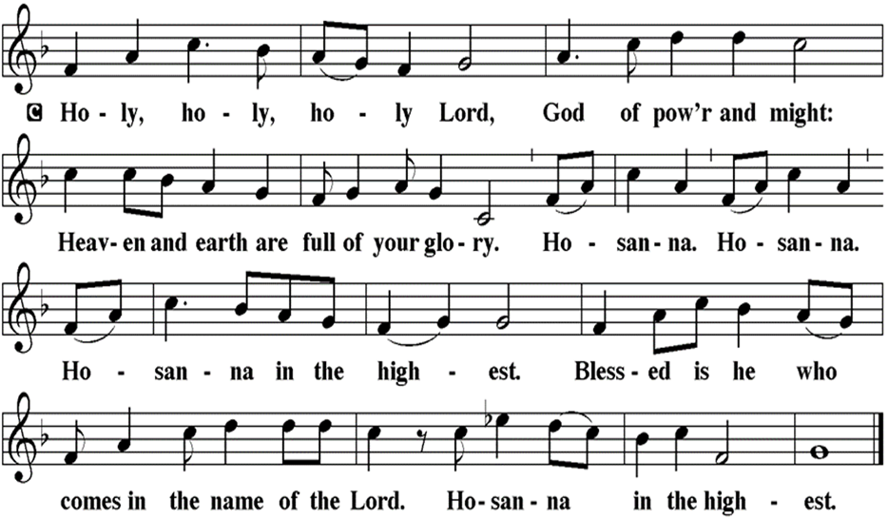
THE SANCTUS

Slide 63
EUCHARISTIC PRAYER
P: Holy God, our Maker, Redeemer…
…Both now and forever.
C: Amen.

Slide 64
THE LORD’S PRAYER
C: Our Father, who art in heaven, hallowed be thy name, thy kingdom come, thy will be done, on earth as it is in heaven. Give us this day our daily bread; and forgive us our trespasses, as we forgive those who trespass against us; and lead us not into temptation, but deliver us from evil.

Slide 65
THE LORD’S PRAYER
C: For thine is the kingdom, and the power, and the glory, forever and ever. Amen.

Slide 66
INVITATION TO COMMUNION
P: God who transforms sadness into joy now invites you to this feast of God’s beloved son, Jesus Christ. Come to the table, where Jesus meets us in this holy meal, forgives us all our sins, and raises us to a joyful new life in his name. All is prepared.

Slide 67
COMMUNION DISTRIBUTION
All may commune “At the Railing”.
The bread may be broken for distribution. As the ministers give the bread and wine, they say these words :
The body of Christ, given for you.
The blood of Christ, shed for you.
The communicant may say: Amen.

Slide 68
POST COMMUNION BLESSING
P: May this Body and Blood of our Lord and Savior, Jesus Christ, strengthen, keep, and unite us, ☩ now and forever.
C: Amen.

Slide 69
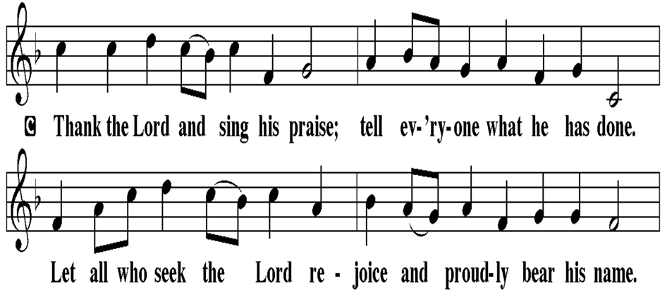
POST COMMUNION CANTACLE

Slide 70
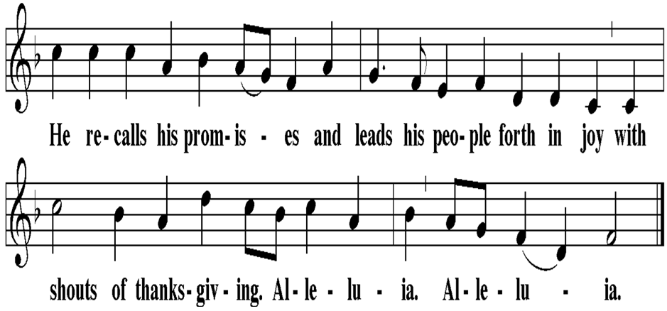
POST COMMUNION CANTACLE

Slide 71
POST COMMUNION PRAYER
P: Let us pray… Compassionate God, through the gifts of bread and wine our hearts are filled with the abundance of your love. Strengthen us that we, through this holy meal, may share your love freely, as you have shared with us. We ask this in the name of Jesus, through the Spirit nourishing us now and forever.
C: Amen

Slide 72
SENDING OF HOMEBOUND COMMUNION
P: Gracious God, whose mercy endures from generation to generation: bless those who go forth to share your word and sacrament with our sisters and brothers who are sick or homebound.

Slide 73
SENDING OF HOMEBOUND COMMUNION
P: In your love and care, nourish and strengthen those to whom we bring this communion, that through the body and blood of your Son we may all know the hope of your promised coming in Jesus Christ our Lord.
C: Amen.

Slide 74

ANNOUNCEMENTS

Slide 75
SENDING BLESSING

Slide 76
SENDING SONG
“Blessed Assurance”
ELW 638

Slide 77
“Blessed Assurance” ELW 638
1 Blessed assurance, Jesus is mine!
Oh, what a foretaste of glory divine!
Heir of salvation, purchase of God,
born of his Spirit, washed in his blood.

Slide 78
“Blessed Assurance” ELW 638
Refrain
This is my story, this is my song,
praising my Savior, all the day long:
this is my story, this is my song,
praising my Savior all the day long.

Slide 79
“Blessed Assurance” ELW 638
2 Perfect submission, perfect delight,
visions of rapture now burst on my sight;
angels descending bring from above
echoes of mercy, whispers of love.

Slide 80
“Blessed Assurance” ELW 638
Refrain
This is my story, this is my song,
praising my Savior, all the day long:
this is my story, this is my song,
praising my Savior all the day long.

Slide 81
“Blessed Assurance” ELW 638
3 Perfect submission, all is at rest;
I in my Savior am happy and blest,
watching and waiting, looking above,
filled with his goodness, lost in his love.

Slide 82
“Blessed Assurance” ELW 638
Refrain
This is my story, this is my song,
praising my Savior, all the day long:
this is my story, this is my song,
praising my Savior all the day long.

Slide 83
DISMISSAL
P: Depart in Christ’s Love.
C: Seeking, welcoming, and serving all. Amen!
POSTLUDE
By Roxanne Groff
From sundaysandseasons.com. Copyright © 2026 Augsburg Fortress. All rights reserved. Reprinted by permission under Augsburg Fortress Liturgies Annual License #SAS023830. New Revised Standard Version Bible, Copyright © 1989, Division of Christian Education of the National Council of the Churches of Christ in the United States of America. Used by permission. All rights reserved. Revised Common Lectionary, Copyright © 1992 Consultation on Common Texts, admin Augsburg Fortress. Used by permission. Some images generated with ChatGPT (“Theo”) using OpenAI.

