Slide 1
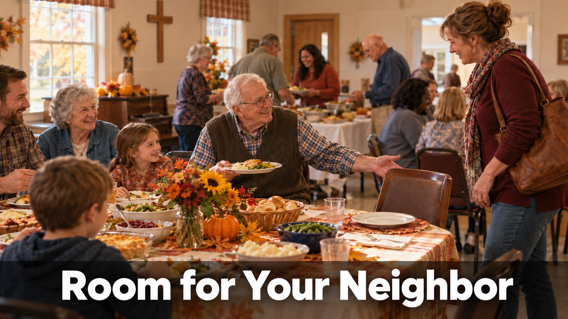
October 11, 2026
WELCOME!
Trinity Lutheran Church
Notes:
Image: Five Loaves by Caroline Coolidge Brown. Copyright © Caroline Coolidge Brown. All rights reserved. Used by permission of the artist.

Slide 2
= Please stand if able
= Please be seated
Prelude - By Roxanne Groff
Office of the Acolyte
Ringing of the Bell
Welcome

Slide 3
THANKSGIVING FOR BAPTISM
All may make the sign of the cross, the sign marked at baptism, as the presiding minister begins.
P: Blessed be the holy Trinity, ☩ one God, the fountain of living water, the rock who gave us birth, our light and our salvation.
C: Amen.
Notes:
Image: Preparing yeast dough. Copyright © tomasworks/iStock/Thinkstock. Used by permission.

Slide 4
P: Joined to Christ in the waters of baptism, we are clothed with God's mercy and forgiveness. Let us give thanks for the gift of baptism.
Water may be poured into the font as the presiding minister gives thanks.
THANKSGIVING FOR BAPTISM
Notes:
Image: Preparing yeast dough. Copyright © tomasworks/iStock/Thinkstock. Used by permission.

Slide 5
P: We give you thanks, O God, for in the beginning your Spirit moved over the waters and by your Word you created the world, calling forth life in which you took delight. Through the waters of the flood you delivered Noah and his family. Through the sea you led your people Israel from slavery into freedom.
THANKSGIVING FOR BAPTISM
Notes:
Image: Preparing yeast dough. Copyright © tomasworks/iStock/Thinkstock. Used by permission.

Slide 6
P: At the river your Son was baptized by John and anointed with the Holy Spirit. By water and your Word you claim us as daughters and sons, making us heirs of your promise and servants of all. We praise you for the gift of water that sustains life, and above all we praise you for the gift of new life in Jesus Christ.
THANKSGIVING FOR BAPTISM
Notes:
Image: Preparing yeast dough. Copyright © tomasworks/iStock/Thinkstock. Used by permission.

Slide 7
THANKSGIVING FOR BAPTISM
P: Shower us with your Spirit, and renew our lives with your forgiveness, grace, and love. To you be given honor and praise through Jesus Christ our Lord in the unity of the Holy Spirit, now and forever.
C: Amen.
Notes:
Image: Preparing yeast dough. Copyright © tomasworks/iStock/Thinkstock. Used by permission.

Slide 8
Gathering Song/Hymn of Praise
“Lord, Speak to Us, That We May Speak”
LBW 403

Slide 9
“Lord, Speak to Us, That We May Speak” LBW 403
1 Lord, speak to us, that we may speak
in living echoes of your tone;
as you have sought, so let us seek
your straying children, lost and lone.
Notes:
Image: Five Loaves by Caroline Coolidge Brown. Copyright © Caroline Coolidge Brown. All rights reserved. Used by permission of the artist.

Slide 10
“Lord, Speak to Us, That We May Speak” LBW 403
2 Oh, lead us, Lord, that we may lead
the wand’ring and the wav’ring feet;
oh, feed us, Lord, that we may feed
your hung’ring ones with manna sweet.
Notes:
Image: Five Loaves by Caroline Coolidge Brown. Copyright © Caroline Coolidge Brown. All rights reserved. Used by permission of the artist.

Slide 11
“Lord, Speak to Us, That We May Speak” LBW 403
3 Oh, teach us, Lord, that we may teach
the precious truths which you impart;
and wing our words, that they may reach
the hidden depths of many a heart.
Notes:
Image: Five Loaves by Caroline Coolidge Brown. Copyright © Caroline Coolidge Brown. All rights reserved. Used by permission of the artist.

Slide 12
“Lord, Speak to Us, That We May Speak” LBW 403
4 Oh, fill us with your fullness, Lord,
until our very hearts o’erflow
in kindling thought and glowing word,
your love to tell, your praise to show.
Notes:
Image: Five Loaves by Caroline Coolidge Brown. Copyright © Caroline Coolidge Brown. All rights reserved. Used by permission of the artist.

Slide 13
APOSTOLIC GREETING
P: The grace of our Lord Jesus Christ, the love of God, and the communion of the Holy Spirit be with you all.
C: And also with you.
Notes:
Image: Five Loaves by Caroline Coolidge Brown. Copyright © Caroline Coolidge Brown. All rights reserved. Used by permission of the artist.

Slide 14
Scripture Reading
R: Our scripture reading is from Exodus, Chapters 19 and 20.
C: Glory to you O’ Lord!
Notes:
Image: Five Loaves by Caroline Coolidge Brown. Copyright © Caroline Coolidge Brown. All rights reserved. Used by permission of the artist.

Slide 15
Exodus 19:3-7; 20:1-17
Chapter 19
³Then Moses went up to God; the Lord called to him from the mountain, saying, “Thus you shall say to the house of Jacob, and tell the Israelites: ⁴You have seen what I did to the Egyptians, and how I bore you on eagles’ wings and brought you to myself. ⁵Now therefore, if you obey my voice and keep my
Notes:
Image: Five Loaves by Caroline Coolidge Brown. Copyright © Caroline Coolidge Brown. All rights reserved. Used by permission of the artist.

Slide 16
Exodus 19:3-7; 20:1-17
Chapter 19
covenant, you shall be my treasured possession out of all the peoples. Indeed, the whole earth is mine, ⁶but you shall be for me a priestly kingdom and a holy nation. These are the words that you shall speak to the Israelites.” ⁷So Moses came, summoned the elders of the people,
Notes:
Image: Five Loaves by Caroline Coolidge Brown. Copyright © Caroline Coolidge Brown. All rights reserved. Used by permission of the artist.

Slide 17
Exodus 19:3-7; 20:1-17
Chapter 19
and set before them all these words that the Lord had commanded him.
Chapter 20
Then God spoke all these words: ²I am the Lord your God, who brought you out of the land of Egypt, out of the house of slavery; ³you shall have no other gods before me. ⁴You shall
Notes:
Image: Five Loaves by Caroline Coolidge Brown. Copyright © Caroline Coolidge Brown. All rights reserved. Used by permission of the artist.

Slide 18
Exodus 19:3-7; 20:1-17
Chapter 20
not make for yourself an idol, whether in the form of anything that is in heaven above, or that is on the earth beneath, or that is in the water under the earth. ⁵You shall not bow down to them or worship them; for I the Lord your God am a jealous God, punishing children for the iniquity of parents, to the third and the fourth
Notes:
Image: Five Loaves by Caroline Coolidge Brown. Copyright © Caroline Coolidge Brown. All rights reserved. Used by permission of the artist.

Slide 19
Exodus 19:3-7; 20:1-17
Chapter 20
generation of those who reject me, ⁶but showing steadfast love to the thousandth generation of those who love me and keep my commandments. ⁷You shall not make wrongful use of the name of the Lord your God, for the Lord will not acquit anyone who misuses his name. ⁸Remember the sabbath day, and
Notes:
Image: Five Loaves by Caroline Coolidge Brown. Copyright © Caroline Coolidge Brown. All rights reserved. Used by permission of the artist.

Slide 20
Exodus 19:3-7; 20:1-17
Chapter 20
keep it holy. ⁹Six days you shall labor and do all your work. ¹⁰But the seventh day is a sabbath to the Lord your God; you shall not do any work—you, your son or your daughter, your male or female slave, your livestock, or the alien resident in your towns. ¹¹For in six days the Lord made heaven and earth, the
Notes:
Image: Five Loaves by Caroline Coolidge Brown. Copyright © Caroline Coolidge Brown. All rights reserved. Used by permission of the artist.

Slide 21
Exodus 19:3-7; 20:1-17
Chapter 20
sea, and all that is in them, but rested the seventh day; therefore the Lord blessed the sabbath day and consecrated it.
¹²Honor your father and your mother, so that your days may be long in the land that the Lord your God is giving you. ¹³You shall not murder. ¹⁴You shall not commit adultery. ¹⁵You shall
Notes:
Image: Five Loaves by Caroline Coolidge Brown. Copyright © Caroline Coolidge Brown. All rights reserved. Used by permission of the artist.

Slide 22
Exodus 19:3-7; 20:1-17
Chapter 20
not steal. ¹⁶You shall not bear false witness against your neighbor. ¹⁷You shall not covet your neighbor’s house; you shall not covet your neighbor’s wife, or male or female slave, or ox, or donkey, or anything that belongs to your neighbor.
Notes:
Image: Five Loaves by Caroline Coolidge Brown. Copyright © Caroline Coolidge Brown. All rights reserved. Used by permission of the artist.

Slide 23
Exodus 19:3-7; 20:1-17
R: This is the Word of the Lord.
C: Praise to You, O Christ
Notes:
Image: Five Loaves by Caroline Coolidge Brown. Copyright © Caroline Coolidge Brown. All rights reserved. Used by permission of the artist.

Slide 24
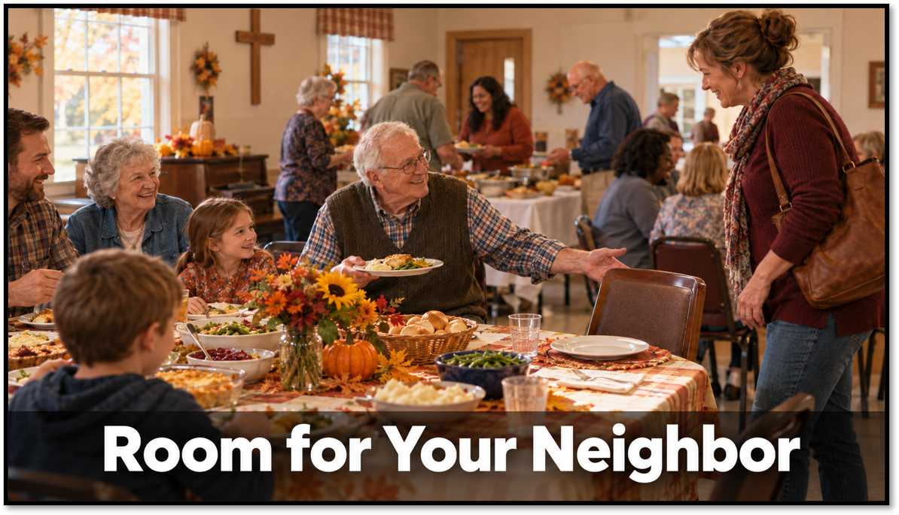
Sermon

Slide 25

Sermon

Slide 26
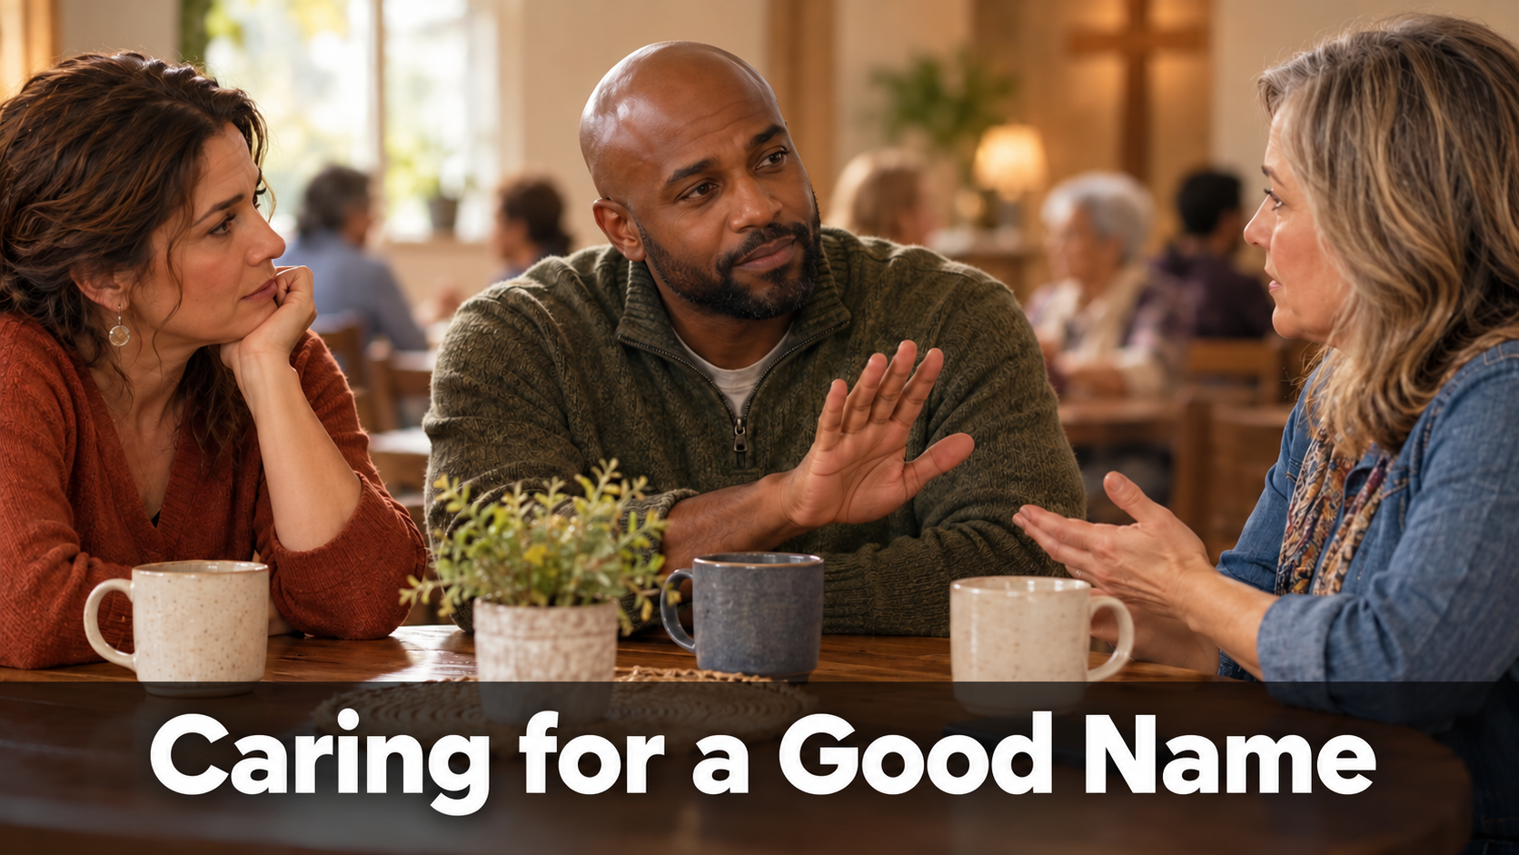
Sermon

Slide 27

Sermon

Slide 28

Sermon

Slide 29

Sermon

Slide 30
Hymn of the Day
“Rock of Ages, Cleft for Me”
LBW 327

Slide 31
“Rock of Ages, Cleft for Me” LBW 327
1 Rock of Ages, cleft for me,
let me hide myself in thee;
let the water and the blood,
from thy riven side which flowed,
be of sin the double cure;
cleanse me from its guilt and pow'r.
Notes:
Image: Five Loaves by Caroline Coolidge Brown. Copyright © Caroline Coolidge Brown. All rights reserved. Used by permission of the artist.

Slide 32
“Rock of Ages, Cleft for Me” LBW 327
2 Not the labors of my hands
can fulfill thy law's demands;
could my zeal no respite know,
could my tears forever flow,
all for sin could not atone;
thou must save, and thou alone.
Notes:
Image: Five Loaves by Caroline Coolidge Brown. Copyright © Caroline Coolidge Brown. All rights reserved. Used by permission of the artist.

Slide 33
“Rock of Ages, Cleft for Me” LBW 327
3 Nothing in my hand I bring;
simply to thy cross I cling.
Naked, come to thee for dress;
helpless, look to thee for grace;
foul, I to the fountain fly;
wash me, Savior, or I die.
Notes:
Image: Five Loaves by Caroline Coolidge Brown. Copyright © Caroline Coolidge Brown. All rights reserved. Used by permission of the artist.

Slide 34
“Rock of Ages, Cleft for Me” LBW 327
4 While I draw this fleeting breath,
when mine eyelids close in death,
when I soar to worlds unknown,
see thee on thy judgment throne,
Rock of Ages, cleft for me,
let me hide myself in thee.
Notes:
Image: Five Loaves by Caroline Coolidge Brown. Copyright © Caroline Coolidge Brown. All rights reserved. Used by permission of the artist.

Slide 35
APOSTLE’S CREED
C: I believe in God, the Father almighty, creator of heaven and earth.

Slide 36
APOSTLE’S CREED
C: I believe in Jesus Christ, his only Son, our Lord. He was conceived by the power of the Holy Spirit and born of the virgin Mary. He suffered under Pontius Pilate, was crucified, died, and was buried.

Slide 37
APOSTLE’S CREED
C: He descended into hell. On the third day he rose again. He ascended into heaven, and is seated at the right hand of the Father. He will come again to judge the living and the dead.

Slide 38
APOSTLE’S CREED
C: I believe in the Holy Spirit, the holy catholic Church, the communion of saints, the forgiveness of sins, the resurrection of the body, and the life everlasting. Amen.

Slide 39
PRAYERS
Each petition will end with the words,
A: God of mercy and grace,
C: We lift our prayers to you.

Slide 40
PRAYERS OF INTERCESSION
The prayer concludes…
P: God who created all that is, we place all for whom we pray, both aloud and in the silence of our hearts, into your loving arms.
C: Amen.

Slide 41
OFFERING - * OFFERING PRAYER
Notes:
Image: Five Loaves by Caroline Coolidge Brown. Copyright © Caroline Coolidge Brown. All rights reserved. Used by permission of the artist.

Slide 42
THE LORD’S PRAYER
C: Our Father, who art in heaven, hallowed be thy name, thy kingdom come, thy will be done, on earth as it is in heaven. Give us this day our daily bread; and forgive us our trespasses, as we forgive those who trespass against us; and lead us not into temptation, but deliver us from evil.

Slide 43
THE LORD’S PRAYER
C: For thine is the kingdom, and the power, and the glory, forever and ever. Amen.

Slide 44
ANNOUNCEMENTS
Notes:
Image: Five Loaves by Caroline Coolidge Brown. Copyright © Caroline Coolidge Brown. All rights reserved. Used by permission of the artist.

Slide 45
SENDING BLESSING
P: Creator, Redeemer, Sustainer, one God, bless, heal, and hold you ☩ today and always.
C: Amen.

Slide 46
Sending Song
“My Faith Looks Up to Thee”
LBW 479
Notes:
Image: Five Loaves by Caroline Coolidge Brown. Copyright © Caroline Coolidge Brown. All rights reserved. Used by permission of the artist.

Slide 47
“My Faith Looks Up to Thee” LBW 479
1 My faith looks up to thee,
thou Lamb of Calvary,
Savior divine!
Now hear me while I pray,
take all my guilt away,
oh, let me from this day
be wholly thine!
Notes:
Image: Preparing yeast dough. Copyright © tomasworks/iStock/Thinkstock. Used by permission.

Slide 48
“My Faith Looks Up to Thee” LBW 479
2 May thy rich grace impart
strength to my fainting heart,
my zeal inspire;
as thou hast died for me,
oh, may my love to thee
pure, warm, and changeless be,
a living fire!
Notes:
Image: Preparing yeast dough. Copyright © tomasworks/iStock/Thinkstock. Used by permission.

Slide 49
“My Faith Looks Up to Thee” LBW 479
3 While life's dark maze I tread
and griefs around me spread,
be thou my guide;
bid darkness turn to day,
wipe sorrow's tears away,
nor let me ever stray
from thee aside.
Notes:
Image: Preparing yeast dough. Copyright © tomasworks/iStock/Thinkstock. Used by permission.

Slide 50
“My Faith Looks Up to Thee” LBW 479
4 When ends life's transient dream,
when death's cold, sullen stream
shall o'er me roll;
blest Savior, then, in love
fear and distrust remove;
oh, bear me safe above,
a ransomed soul!
Notes:
Image: Preparing yeast dough. Copyright © tomasworks/iStock/Thinkstock. Used by permission.

Slide 51
DISMISSAL
P: … Depart in Christ’s Love.
C: Seeking, welcoming, and serving all. Amen!
POSTLUDE
By
Roxanne Groff
From sundaysandseasons.com. Copyright © 2025 Augsburg Fortress. All rights reserved. Reprinted by permission under Augsburg Fortress Liturgies Annual License #SAS023830. New Revised Standard Version Bible, Copyright © 1989, Division of Christian Education of the National Council of the Churches of Christ in the United States of America. Used by permission. All rights reserved. Revised Common Lectionary, Copyright © 1992 Consultation on Common Texts, admin Augsburg Fortress. Used by permission. Some images were generated by Open AI ChatGPT (Theo).

