Slide 1
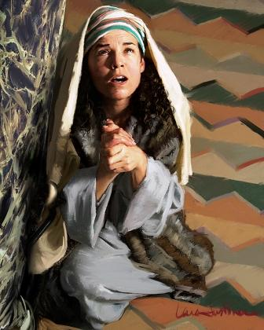
Trinity Evangelical Lutheran Church
October 13, 2024
WELCOME!
Hannah Prays for a Son
Notes:
Image: Five Loaves by Caroline Coolidge Brown. Copyright © Caroline Coolidge Brown. All rights reserved. Used by permission of the artist.

Slide 2
Prelude By Roxanne Groff
= Please stand if able
= Please be seated
Office of the Acolyte and Ringing of the Bell
Welcome
Notes:
Image: Five Loaves by Caroline Coolidge Brown. Copyright © Caroline Coolidge Brown. All rights reserved. Used by permission of the artist.

Slide 3
CONFESSION AND FORGIVENESS
All may make the sign of the cross, the sign marked at baptism…
L: We confess our sins before God and one another.
Pause for silence and reflection.
L: Merciful God,
Notes:
Image: Five Loaves by Caroline Coolidge Brown. Copyright © Caroline Coolidge Brown. All rights reserved. Used by permission of the artist.

Slide 4
CONFESSION AND FORGIVENESS
C: We confess that from the beginning of time we have failed to understand your call to us. We have acted as though we are gods in our own lives. We have acted or failed to act in ways that have led to injustice and oppression. We have turned away from you and sought after other gods—possessions, people, media, and other distractions.
Notes:
Image: Five Loaves by Caroline Coolidge Brown. Copyright © Caroline Coolidge Brown. All rights reserved. Used by permission of the artist.

Slide 5
CONFESSION AND FORGIVENESS
C: Forgive us for all the ways in which we have failed you and our neighbors. Call us back into the abundant life of loving service that you offer us in your holy name.
Notes:
Image: Five Loaves by Caroline Coolidge Brown. Copyright © Caroline Coolidge Brown. All rights reserved. Used by permission of the artist.

Slide 6
CONFESSION AND FORGIVENESS
L: Beloved of God, hear these words of hope. God who created you in God’s image has redeemed you in Christ Jesus, and for his sake forgives you for all the ways you have sinned and fallen short. ☩ Receive this forgiveness with joy, in Jesus’ name.
C: Amen.
Notes:
Image: Five Loaves by Caroline Coolidge Brown. Copyright © Caroline Coolidge Brown. All rights reserved. Used by permission of the artist.

Slide 7
THANKSGIVING FOR BAPTISM
All may make the sign of the cross, the sign marked at baptism, as the presiding minister begins.
P: Blessed be the holy Trinity, ☩ one God, the fountain of living water, the rock who gave us birth, our light and our salvation.
C: Amen.
Notes:
Image: Preparing yeast dough. Copyright © tomasworks/iStock/Thinkstock. Used by permission.

Slide 8
P: Joined to Christ in the waters of baptism, we are clothed with God's mercy and forgiveness. Let us give thanks for the gift of baptism.
Water may be poured into the font as the presiding minister gives thanks.
THANKSGIVING FOR BAPTISM
Notes:
Image: Preparing yeast dough. Copyright © tomasworks/iStock/Thinkstock. Used by permission.

Slide 9
P: We give you thanks, O God, for in the beginning your Spirit moved over the waters and by your Word you created the world, calling forth life in which you took delight. Through the waters of the flood you delivered Noah and his family. Through the sea you led your people Israel from slavery into freedom.
THANKSGIVING FOR BAPTISM
Notes:
Image: Preparing yeast dough. Copyright © tomasworks/iStock/Thinkstock. Used by permission.

Slide 10
P: At the river your Son was baptized by John and anointed with the Holy Spirit. By water and your Word you claim us as daughters and sons, making us heirs of your promise and servants of all. We praise you for the gift of water that sustains life, and above all we praise you for the gift of new life in Jesus Christ.
THANKSGIVING FOR BAPTISM
Notes:
Image: Preparing yeast dough. Copyright © tomasworks/iStock/Thinkstock. Used by permission.

Slide 11
P: Shower us with your Spirit, and renew our lives with your forgiveness, grace, and love. To you be given honor and praise through Jesus Christ our Lord in the unity of the Holy Spirit, now and forever.
THANKSGIVING FOR BAPTISM
C: Amen.
Notes:
Image: Preparing yeast dough. Copyright © tomasworks/iStock/Thinkstock. Used by permission.

Slide 12
Gathering Song
“Abide with Me”
LBW 272
Notes:
Image: Five Loaves by Caroline Coolidge Brown. Copyright © Caroline Coolidge Brown. All rights reserved. Used by permission of the artist.

Slide 13
“Abide with Me” LBW 272
1 Abide with me, fast falls the eventide.
The darkness deepens; Lord, with me abide.
When other helpers fail and comforts flee,
help of the helpless, oh, abide with me.
Notes:
Image: Five Loaves by Caroline Coolidge Brown. Copyright © Caroline Coolidge Brown. All rights reserved. Used by permission of the artist.

Slide 14
“Abide with Me” LBW 272
2 I need thy presence ev’ry passing hour;
what but thy grace can foil the tempter’s pow’r?
Who like thyself my guide and stay can be?
Through cloud and sunshine, oh, abide with me.
Notes:
Image: Five Loaves by Caroline Coolidge Brown. Copyright © Caroline Coolidge Brown. All rights reserved. Used by permission of the artist.

Slide 15
“Abide with Me” LBW 272
3 Swift to its close ebbs out life’s little day;
earth’s joys grow dim, its glories pass away;
change and decay in all around I see;
O thou who changest not, abide with me.
Notes:
Image: Five Loaves by Caroline Coolidge Brown. Copyright © Caroline Coolidge Brown. All rights reserved. Used by permission of the artist.

Slide 16
“Abide with Me” LBW 272
4 I fear no foe, with thee at hand to bless;
ills have no weight, and tears no bitterness.
Where is death’s sting? Where, grave, thy victory?
I triumph still, if thou abide with me!
Notes:
Image: Five Loaves by Caroline Coolidge Brown. Copyright © Caroline Coolidge Brown. All rights reserved. Used by permission of the artist.

Slide 17
“Abide with Me” LBW 272
5 Hold thou thy cross before my closing eyes,
shine through the gloom, and point me to the skies;
heav’n’s morning breaks, and earth’s vain shadows flee;
in life, in death, O Lord, abide with me.
Notes:
Image: Five Loaves by Caroline Coolidge Brown. Copyright © Caroline Coolidge Brown. All rights reserved. Used by permission of the artist.

Slide 18
APOSTOLIC GREETING
P: The grace of our Lord Jesus Christ, the love of God, and the communion of the Holy Spirit be with you all.
C: And also with you.
Notes:
Image: Five Loaves by Caroline Coolidge Brown. Copyright © Caroline Coolidge Brown. All rights reserved. Used by permission of the artist.

Slide 19
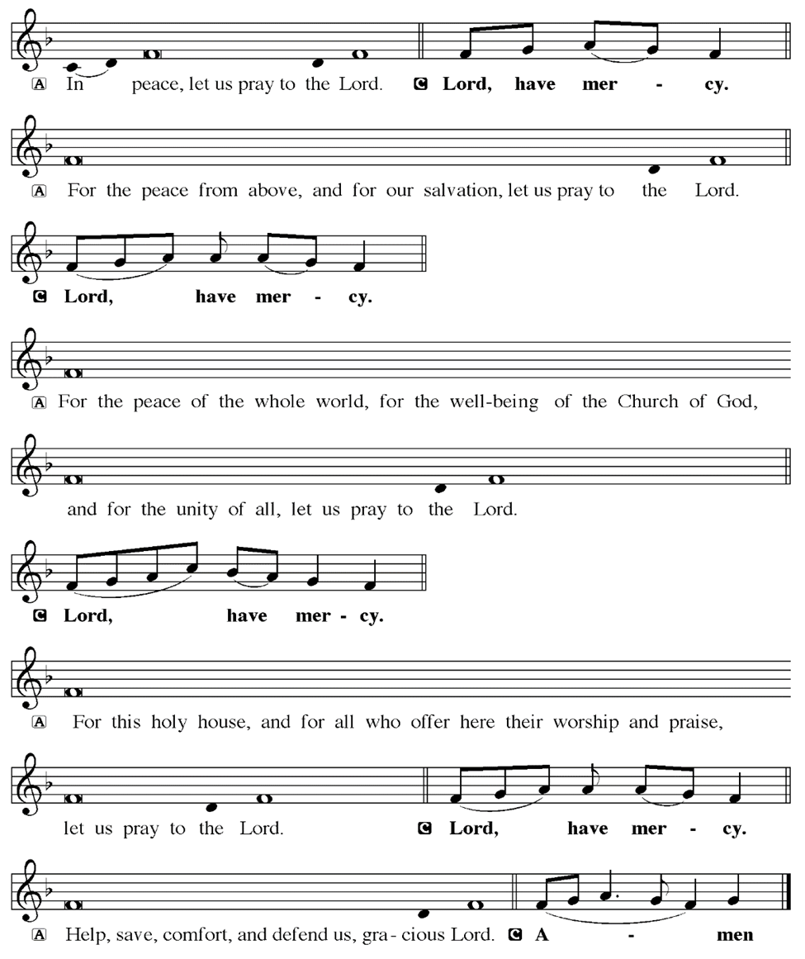
KYRIE
Notes:
Image: Five Loaves by Caroline Coolidge Brown. Copyright © Caroline Coolidge Brown. All rights reserved. Used by permission of the artist.

Slide 20
KYRIE
Notes:
Image: Five Loaves by Caroline Coolidge Brown. Copyright © Caroline Coolidge Brown. All rights reserved. Used by permission of the artist.

Slide 21
KYRIE
Notes:
Image: Five Loaves by Caroline Coolidge Brown. Copyright © Caroline Coolidge Brown. All rights reserved. Used by permission of the artist.

Slide 22
HYMN OF PRAISE
Glory be to God in heaven;
peace, goodwill to all the earth.
Mighty God of all creation,
Father of surpassing worth:
we exalt you, we adore you,
we lift high our thanks and praise.
Saints and angels bow before you; here on earth our songs we raise.
Notes:
Image: Five Loaves by Caroline Coolidge Brown. Copyright © Caroline Coolidge Brown. All rights reserved. Used by permission of the artist.

Slide 23
HYMN OF PRAISE
Glory be to Christ forever,
Lamb of God and Lord of love.
Son of God and gracious Savior, you have come from heav’n above;
on the cross you died to save us; now you reign at God’s right hand.
Hear our prayer; restore, forgive us; in your promise firm we stand.
Notes:
Image: Five Loaves by Caroline Coolidge Brown. Copyright © Caroline Coolidge Brown. All rights reserved. Used by permission of the artist.

Slide 24
HYMN OF PRAISE
Holy One we now acclaim you;
Lord alone, to you we call;
Holy One in faith we name you,
God most high, yet near to all:
Jesus Christ, with God the Spirit,
in the Father’s splendor bright.
For the peace that we inherit,
glory be to God on high!
Notes:
Image: Five Loaves by Caroline Coolidge Brown. Copyright © Caroline Coolidge Brown. All rights reserved. Used by permission of the artist.

Slide 25
PRAYER OF THE DAY
P: Holy God, you are our rock and salvation. We rejoice for all that you have done. Thank you for your faithfulness, and for hearing the cries of your people.
C: Amen
Notes:
Image: Five Loaves by Caroline Coolidge Brown. Copyright © Caroline Coolidge Brown. All rights reserved. Used by permission of the artist.

Slide 26

Notes:
Image: Preparing yeast dough. Copyright © tomasworks/iStock/Thinkstock. Used by permission.

Slide 27
Scripture Reading
R: Our scripture reading for today is from first Samuel, chapters 1 & 2.
C: Glory to you O’ Lord! (Spoken)
Notes:
Image: Five Loaves by Caroline Coolidge Brown. Copyright © Caroline Coolidge Brown. All rights reserved. Used by permission of the artist.

Slide 28
1 Samuel 1:9-11, 19-20; 2:1-10
Chapter 1
⁹After they had eaten and drunk at Shiloh, Hannah rose and presented herself before the Lord. Now Eli the priest was sitting on the seat beside the doorpost of the temple of the Lord. ¹⁰She was deeply distressed and prayed to the Lord, and wept bitterly. ¹¹She made this vow: “O Lord of hosts, if only you will look on the misery of
Notes:
Image: Five Loaves by Caroline Coolidge Brown. Copyright © Caroline Coolidge Brown. All rights reserved. Used by permission of the artist.

Slide 29
1 Samuel 1:9-11, 19-20; 2:1-10
Chapter 1
your servant, and remember me, and not forget your servant, but will give to your servant a male child, then I will set him before you as a nazirite until the day of his death. He shall drink neither wine nor intoxicants, and no razor shall touch his head.”
¹⁹They rose early in the morning and worshiped before the Lord; then they
Notes:
Image: Five Loaves by Caroline Coolidge Brown. Copyright © Caroline Coolidge Brown. All rights reserved. Used by permission of the artist.

Slide 30
1 Samuel 1:9-11, 19-20; 2:1-10
Chapter 1
went back to their house at Ramah. Elkanah knew his wife Hannah, and the Lord remembered her. ²⁰In due time Hannah conceived and bore a son. She named him Samuel, for she said, “I have asked him of the Lord.”
Notes:
Image: Five Loaves by Caroline Coolidge Brown. Copyright © Caroline Coolidge Brown. All rights reserved. Used by permission of the artist.

Slide 31
1 Samuel 1:9-11, 19-20; 2:1-10
Chapter 2
Hannah prayed and said, “My heart exults in the Lord; my strength is exalted in my God. My mouth derides my enemies, because I rejoice in my victory.
²“There is no Holy One like the Lord, no one besides you; there is no Rock like our God. ³Talk no more so very proudly, let not arrogance come from
Notes:
Image: Five Loaves by Caroline Coolidge Brown. Copyright © Caroline Coolidge Brown. All rights reserved. Used by permission of the artist.

Slide 32
1 Samuel 1:9-11, 19-20; 2:1-10
Chapter 2
your mouth; for the Lord is a God of knowledge, and by him actions are weighed. ⁴The bows of the mighty are broken, but the feeble gird on strength. ⁵Those who were full have hired themselves out for bread, but those who were hungry are fat with spoil. The barren has borne seven, but she who has many children is forlorn.
Notes:
Image: Five Loaves by Caroline Coolidge Brown. Copyright © Caroline Coolidge Brown. All rights reserved. Used by permission of the artist.

Slide 33
1 Samuel 1:9-11, 19-20; 2:1-10
⁶The Lord kills and brings to life; he brings down to Sheol and raises up. ⁷The Lord makes poor and makes rich; he brings low, he also exalts. ⁸He raises up the poor from the dust; he lifts the needy from the ash heap, to make them sit with princes and inherit a seat of honor. For the pillars of the earth are the Lord’s, and on them he has set the world.
Notes:
Image: Five Loaves by Caroline Coolidge Brown. Copyright © Caroline Coolidge Brown. All rights reserved. Used by permission of the artist.

Slide 34
1 Samuel 1:9-11, 19-20; 2:1-10
⁹“He will guard the feet of his faithful ones, but the wicked shall be cut off in darkness; for not by might does one prevail. ¹⁰The Lord! His adversaries shall be shattered; the Most High will thunder in heaven. The Lord will judge the ends of the earth; he will give strength to his king, and exalt the power of his anointed.”
Notes:
Image: Five Loaves by Caroline Coolidge Brown. Copyright © Caroline Coolidge Brown. All rights reserved. Used by permission of the artist.

Slide 35
1 Samuel 1:9-11, 19-20; 2:1-10
R: This is the Word of the Lord.
C: Praise to You, O Christ (Spoken)
Notes:
Image: Five Loaves by Caroline Coolidge Brown. Copyright © Caroline Coolidge Brown. All rights reserved. Used by permission of the artist.

Slide 36
SERMON
Notes:
Image: Five Loaves by Caroline Coolidge Brown. Copyright © Caroline Coolidge Brown. All rights reserved. Used by permission of the artist.

Slide 37
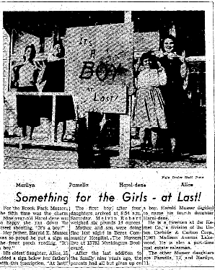
SERMON
Cleveland Plain Dealer
January 6, 1958
(Front page above the fold!)
Notes:
Image: Five Loaves by Caroline Coolidge Brown. Copyright © Caroline Coolidge Brown. All rights reserved. Used by permission of the artist.

Slide 38
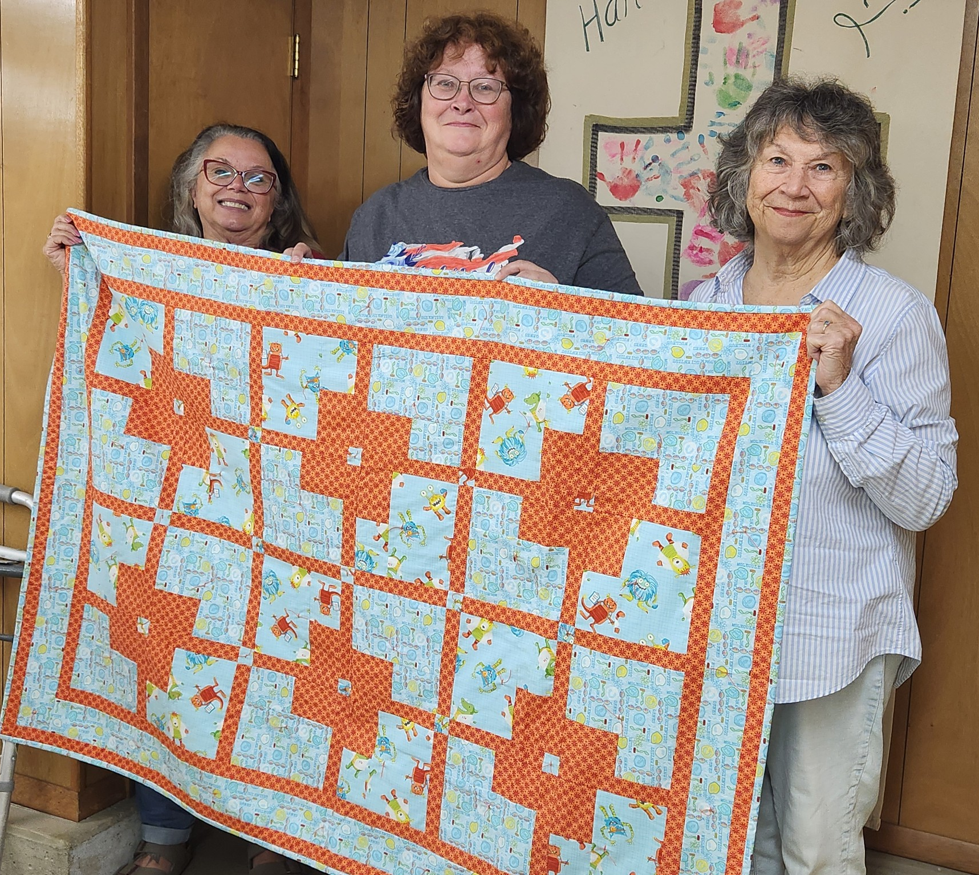
SERMON
Notes:
Image: Five Loaves by Caroline Coolidge Brown. Copyright © Caroline Coolidge Brown. All rights reserved. Used by permission of the artist.

Slide 39
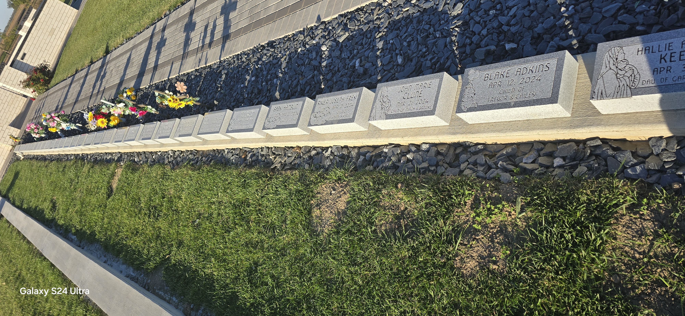
SERMON
Notes:
Image: Five Loaves by Caroline Coolidge Brown. Copyright © Caroline Coolidge Brown. All rights reserved. Used by permission of the artist.

Slide 40
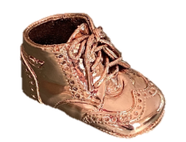
SERMON
Notes:
Image: Five Loaves by Caroline Coolidge Brown. Copyright © Caroline Coolidge Brown. All rights reserved. Used by permission of the artist.

Slide 41
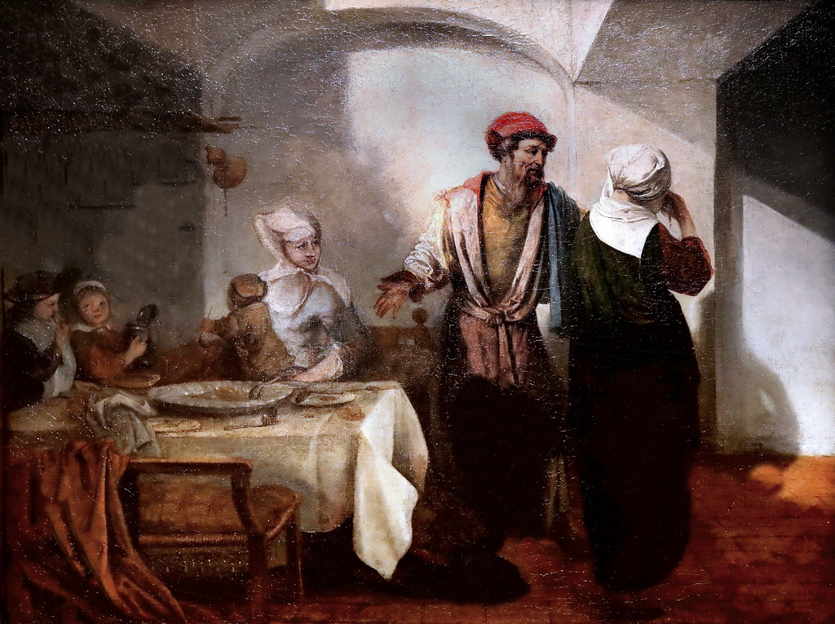
SERMON
Notes:
Image: Five Loaves by Caroline Coolidge Brown. Copyright © Caroline Coolidge Brown. All rights reserved. Used by permission of the artist.

Slide 42
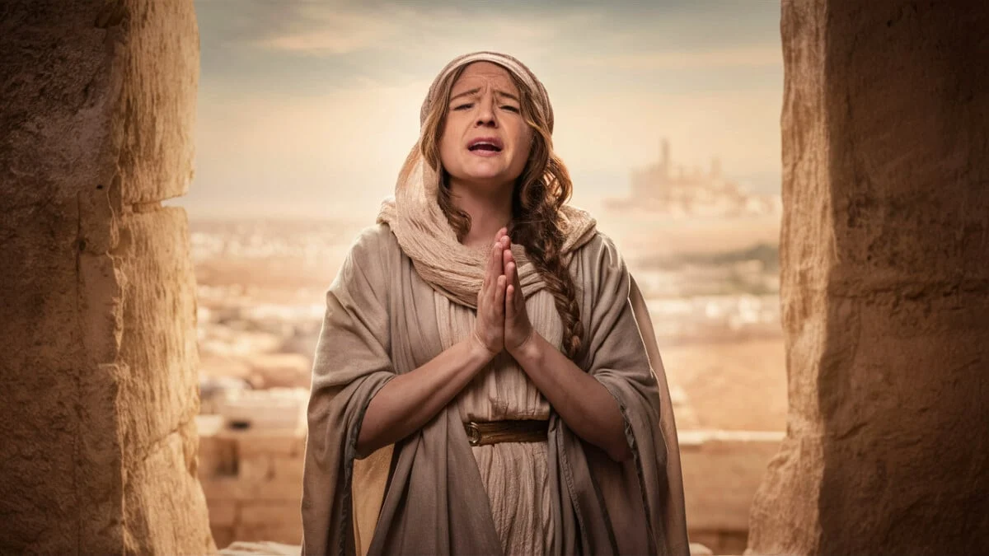
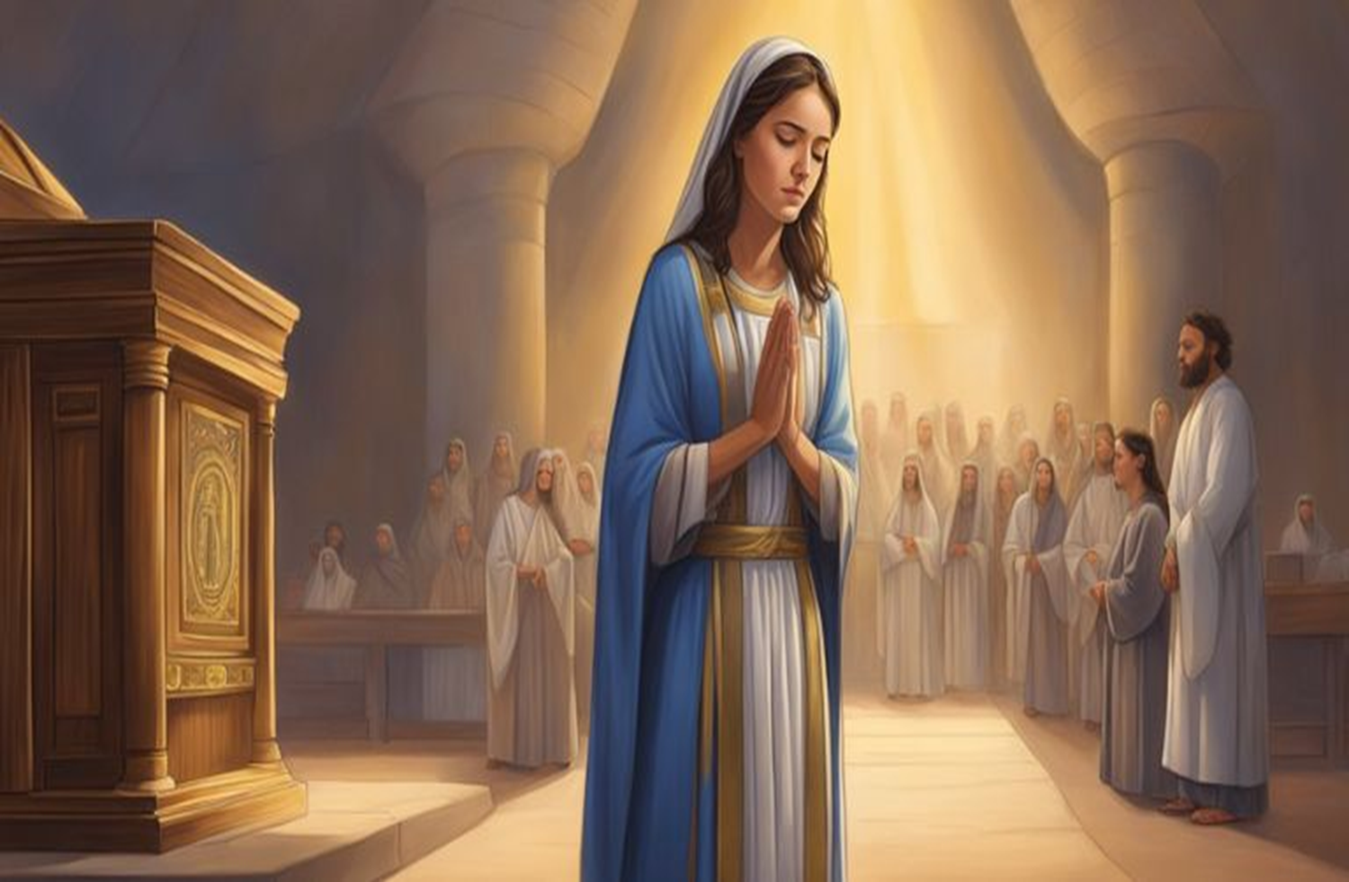
SERMON
Notes:
Image: Five Loaves by Caroline Coolidge Brown. Copyright © Caroline Coolidge Brown. All rights reserved. Used by permission of the artist.

Slide 43

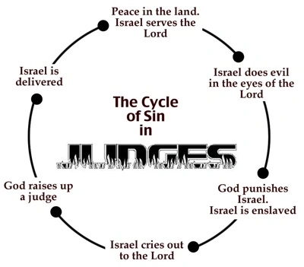
SERMON
Notes:
Image: Five Loaves by Caroline Coolidge Brown. Copyright © Caroline Coolidge Brown. All rights reserved. Used by permission of the artist.

Slide 44

SERMON
Notes:
Image: Five Loaves by Caroline Coolidge Brown. Copyright © Caroline Coolidge Brown. All rights reserved. Used by permission of the artist.

Slide 45
SERMON
Notes:
Image: Five Loaves by Caroline Coolidge Brown. Copyright © Caroline Coolidge Brown. All rights reserved. Used by permission of the artist.

Slide 46
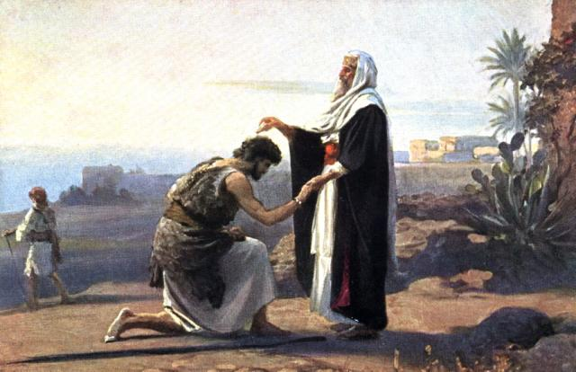
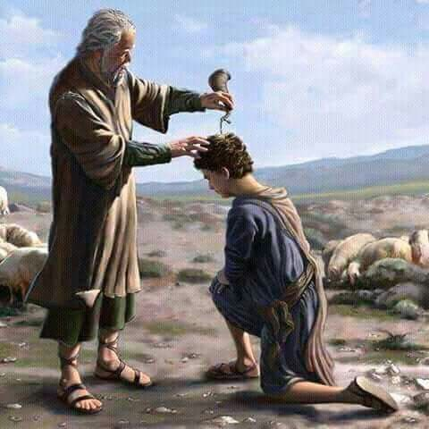
SERMON
Samuel Anoints King Saul
Samuel Anoints King David
Notes:
Image: Five Loaves by Caroline Coolidge Brown. Copyright © Caroline Coolidge Brown. All rights reserved. Used by permission of the artist.

Slide 47
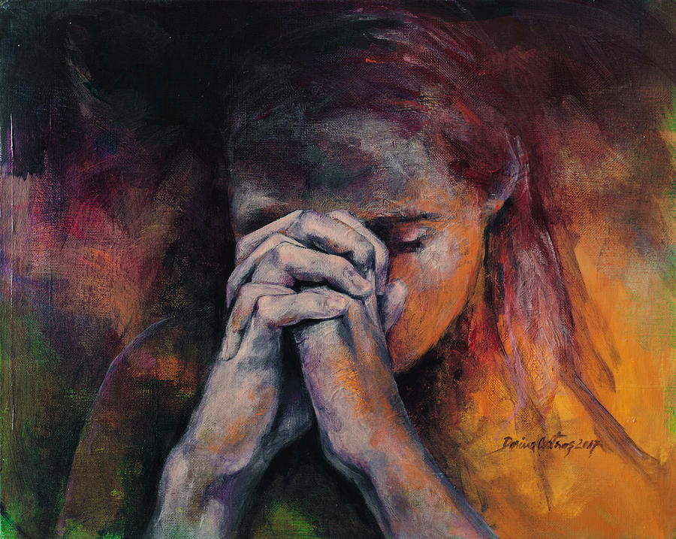
SERMON
Notes:
Image: Five Loaves by Caroline Coolidge Brown. Copyright © Caroline Coolidge Brown. All rights reserved. Used by permission of the artist.

Slide 48
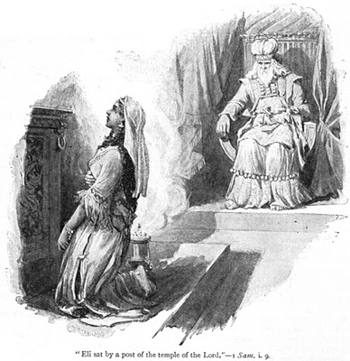
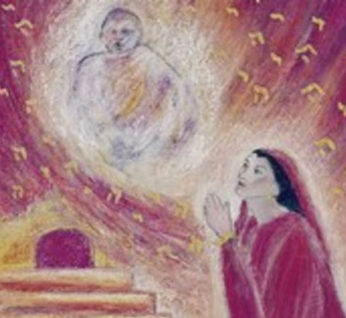
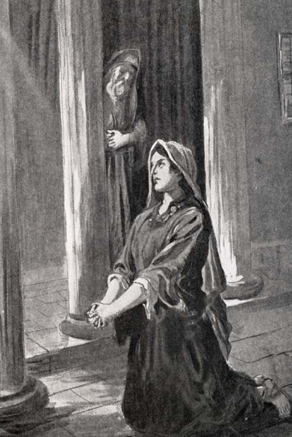
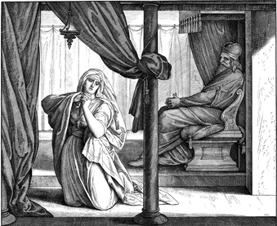
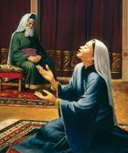
SERMON
Notes:
Image: Five Loaves by Caroline Coolidge Brown. Copyright © Caroline Coolidge Brown. All rights reserved. Used by permission of the artist.

Slide 49
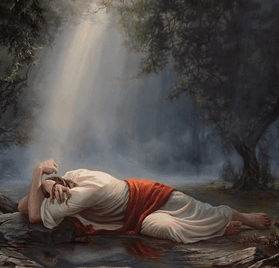
SERMON
Notes:
Image: Five Loaves by Caroline Coolidge Brown. Copyright © Caroline Coolidge Brown. All rights reserved. Used by permission of the artist.

Slide 50
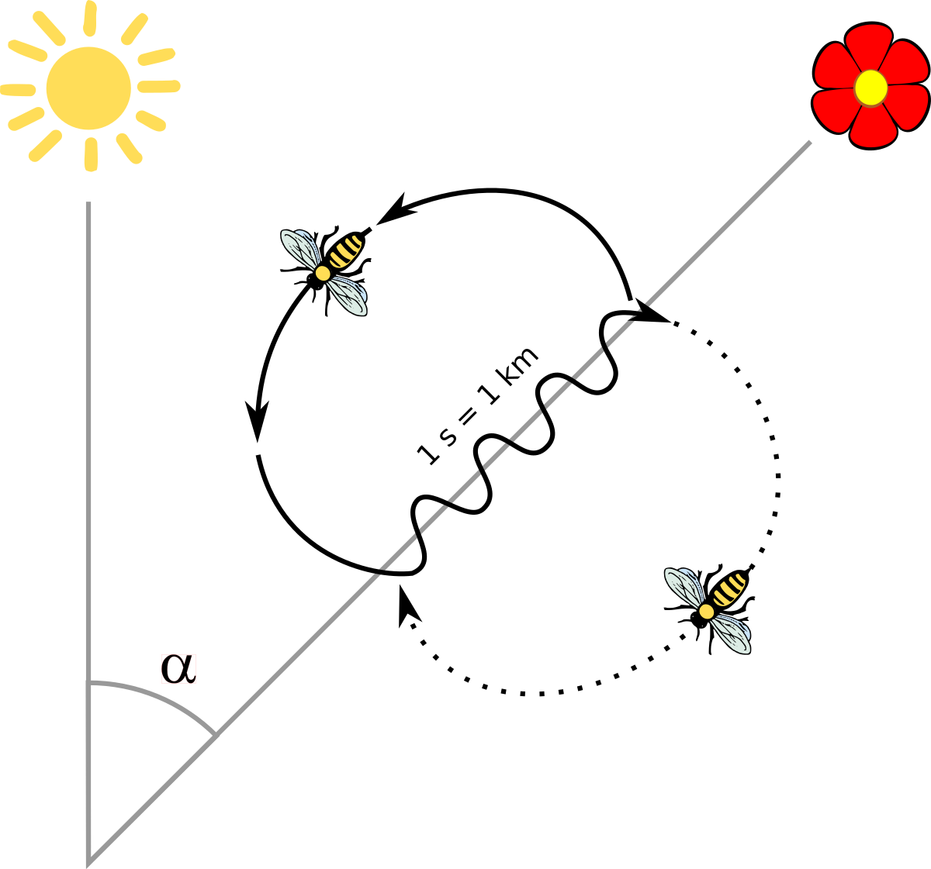
SERMON
Notes:
Image: Five Loaves by Caroline Coolidge Brown. Copyright © Caroline Coolidge Brown. All rights reserved. Used by permission of the artist.

Slide 51
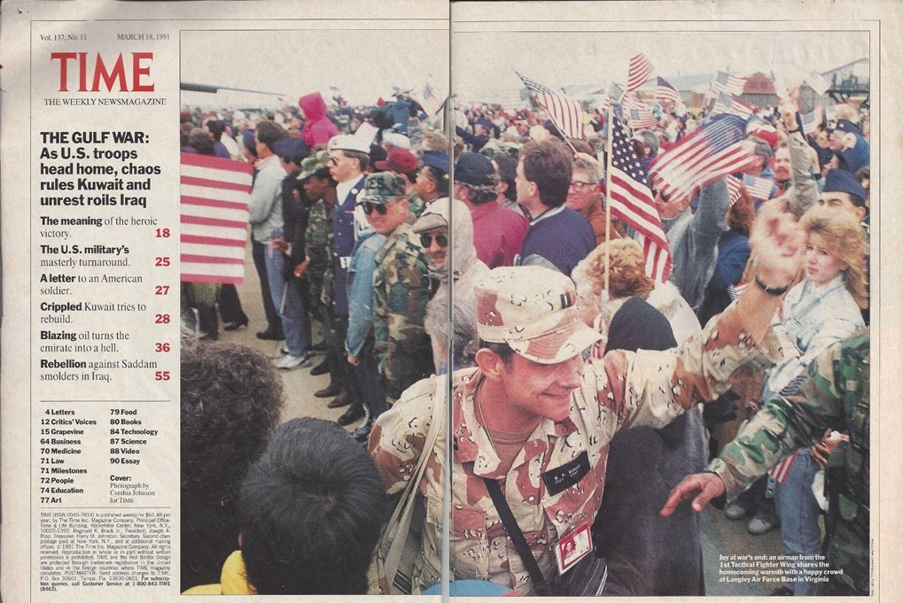
SERMON
Notes:
Image: Five Loaves by Caroline Coolidge Brown. Copyright © Caroline Coolidge Brown. All rights reserved. Used by permission of the artist.

Slide 52
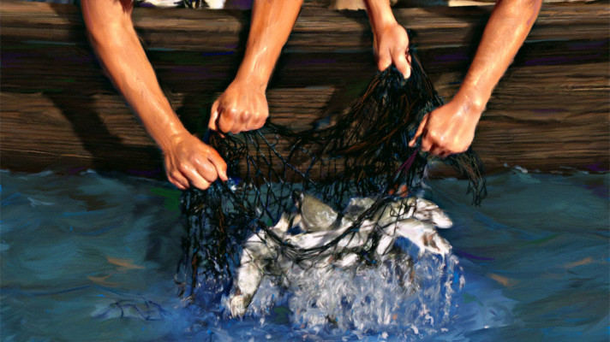
SERMON
Notes:
Image: Five Loaves by Caroline Coolidge Brown. Copyright © Caroline Coolidge Brown. All rights reserved. Used by permission of the artist.

Slide 53
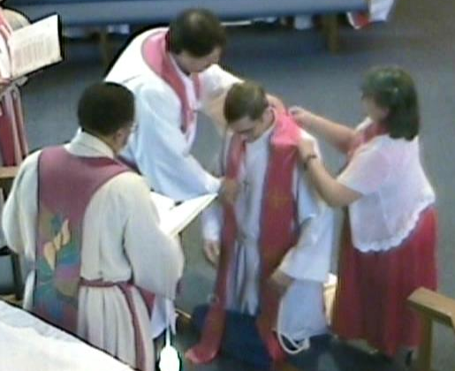
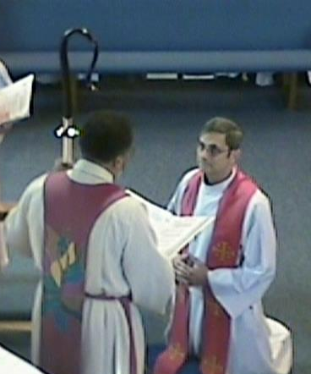
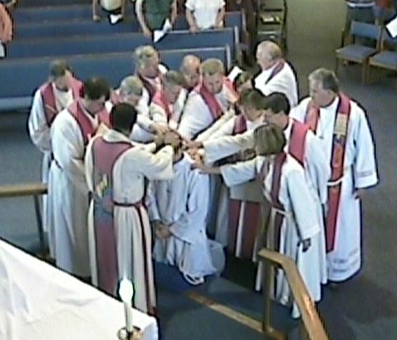
SERMON
Notes:
Image: Five Loaves by Caroline Coolidge Brown. Copyright © Caroline Coolidge Brown. All rights reserved. Used by permission of the artist.

Slide 54
Hymn of the Day
“Take My Life, That I May Be”
LBW 406
Notes:
Image: Five Loaves by Caroline Coolidge Brown. Copyright © Caroline Coolidge Brown. All rights reserved. Used by permission of the artist.

Slide 55
“Take My Life, That I May Be” LBW 406
1 Take my life, that I may be
consecrated, Lord, to thee;
take my moments and my days;
let them flow in ceaseless praise.
2 Take my hands and let them move
at the impulse of thy love;
take my feet and let them be
swift and beautiful for thee.

Slide 56
“Take My Life, That I May Be” LBW 406
3 Take my voice and let me sing
always, only, for my King;
take my lips and let them be
filled with messages from thee.
4 Take my silver and my gold,
not a mite would I withhold;
take my intellect and use
ev'ry pow'r as thou shall choose.

Slide 57
“Take My Life, That I May Be” LBW 406
5 Take my will and make it thine,
it shall be no longer mine.
Take my heart, it is thine own,
it shall be thy royal throne.
6 Take my love; my Lord, I pour
at thy feet its treasure store;
take myself, and I will be
ever, only, all for thee.

Slide 58
APOSTLE’S CREED
C: I believe in God, the Father almighty, creator of heaven and earth.

Slide 59
APOSTLE’S CREED
C: I believe in Jesus Christ, his only Son, our Lord. He was conceived by the power of the Holy Spirit and born of the virgin Mary. He suffered under Pontius Pilate, was crucified, died, and was buried.

Slide 60
APOSTLE’S CREED
C: He descended into hell. On the third day he rose again. He ascended into heaven, and is seated at the right hand of the Father. He will come again to judge the living and the dead.

Slide 61
APOSTLE’S CREED
C: I believe in the Holy Spirit, the holy catholic Church, the communion of saints, the forgiveness of sins, the resurrection of the body, and the life everlasting. Amen.

Slide 62
NICENE CREED
C: We believe in one God, the Father, the Almighty, maker of heaven and earth, of all that is, seen and unseen.

Slide 63
NICENE CREED
C: We believe in one Lord, Jesus Christ, the only Son of God, eternally begotten of the Father, God from God, Light from Light, true God from true God, begotten, not made, of one Being with the Father.

Slide 64
NICENE CREED
C: Through him all things were made. For us and for our salvation he came down from heaven; by the power of the Holy Spirit he became incarnate from the virgin Mary, and was made man. For our sake he was crucified under Pontius Pilate;

Slide 65
NICENE CREED
C: he suffered death and was buried. On the third day he rose again in accordance with the Scriptures; he ascended into heaven and is seated at the right hand of the Father. He will come again in glory to judge the living and the dead, and his kingdom will have no end.

Slide 66
NICENE CREED
C: We believe in the Holy Spirit, the Lord, the giver of life, who proceeds from the Father and the Son. With the Father and the Son he is worshiped and glorified. He has spoken through the prophets. We believe in one holy catholic and apostolic Church.

Slide 67
NICENE CREED
C: We acknowledge one Baptism for the forgiveness of sins. We look for the resurrection of the dead, and the life of the world to come. Amen.

Slide 68
PRAYERS OF INTERCESSION
Each petition will end with the words,
A: God, in your mercy,
The congregation will respond with:
C: Hear our prayer.

Slide 69
PRAYERS OF INTERCESSION
The prayer concludes…
P: These and all our prayers we lift up to you, O God.
C: Amen.

Slide 70
OFFERING
Notes:
Image: Five Loaves by Caroline Coolidge Brown. Copyright © Caroline Coolidge Brown. All rights reserved. Used by permission of the artist.

Slide 71
OFFERING PRAYER
Notes:
Image: Five Loaves by Caroline Coolidge Brown. Copyright © Caroline Coolidge Brown. All rights reserved. Used by permission of the artist.

Slide 72
THE GREAT THANKSGIVING
All the Baptized are welcome to celebrate this Holy Meal.

Slide 73
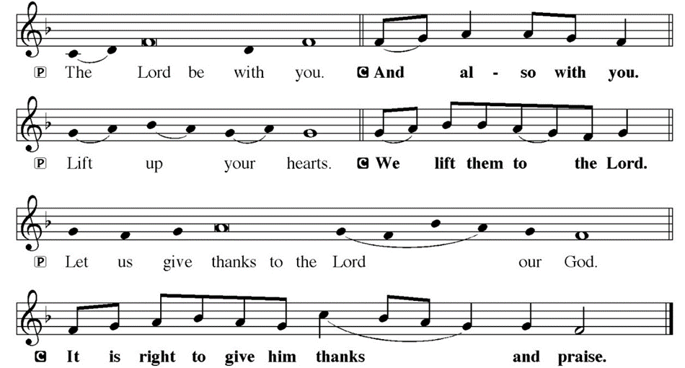
DIALOGUE

Slide 74
THE PREFACE
P: It is indeed right and salutary…
… we praise your name and join their unending hymn.

Slide 75
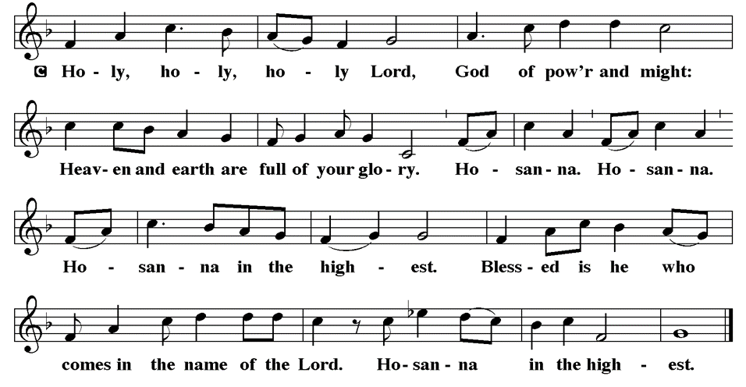
THE SANCTUS

Slide 76
EUCHARISTIC PRAYER
P: Holy God, our maker and redeemer…
…both now and forever.
C: Amen.

Slide 77
THE LORD’S PRAYER
C: Our Father, who art in heaven, hallowed be thy name, thy kingdom come, thy will be done, on earth as it is in heaven. Give us this day our daily bread; and forgive us our trespasses, as we forgive those who trespass against us; and lead us not into temptation, but deliver us from evil.

Slide 78
THE LORD’S PRAYER
C: For thine is the kingdom, and the power, and the glory, forever and ever. Amen.

Slide 79
INVITATION TO COMMUNION
P: With all of God’s children throughout all times and places, who outnumber the stars, Jesus invites us into his presence in this holy meal. Come and receive blessing and forgiveness.

Slide 80
COMMUNION DISTRIBUTION
All will commune “by Station”.
The bread may be broken for distribution. As the ministers give the bread and wine, they say these words :
The body of Christ, given for you.
The blood of Christ, shed for you.
The communicant may say: Amen.

Slide 81
POST COMMUNION BLESSING
P: May this body and blood of our Lord and Savior, Jesus Christ, strengthen, keep and unite us, ☩ now and forever, amen.
C: Amen.

Slide 82
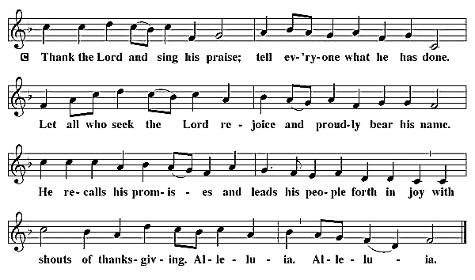
POST COMMUNION CANTACLE

Slide 83
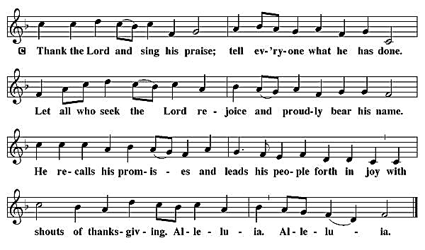
POST COMMUNION CANTACLE

Slide 84
POST COMMUNION PRAYER
P: Let us pray… Holy God, you have welcomed us to this meal and fed us with dignity at your table. Send us now to welcome others and to be at peace with one another, through Jesus Christ our Lord.
C: Amen

Slide 85

ANNOUNCEMENTS
Notes:
Image: Five Loaves by Caroline Coolidge Brown. Copyright © Caroline Coolidge Brown. All rights reserved. Used by permission of the artist.

Slide 86
SENDING BLESSING
P: God all mighty, God most merciful bless you, keep you, and give you peace. ☩
C: Amen.

Slide 87
Sending Song
“We Give Thee but Thine Own”
LBW 410
Notes:
Image: Five Loaves by Caroline Coolidge Brown. Copyright © Caroline Coolidge Brown. All rights reserved. Used by permission of the artist.

Slide 88
“We Give Thee but Thine Own” LBW 410
1 We give thee but thine own,
whate’er the gift may be;
all that we have is thine alone,
a trust, O Lord, from thee.
2 May we thy bounties thus
as stewards true receive,
and gladly, as thou blessest us,
to thee our firstfruits give.
Notes:
Image: Preparing yeast dough. Copyright © tomasworks/iStock/Thinkstock. Used by permission.

Slide 89
“We Give Thee but Thine Own” LBW 410
3 Hearts still are bruised and dead,
and homes are bare and cold,
and lambs for whom the Shepherd bled
are straying from the fold.
4 To comfort and to bless,
to find a balm for woe,
to tend those lost in loneliness,
is angels’ work below.
5 The captive to release,
the lost to God to bring,
to teach the way of life and peace--
it is a Christlike thing.
6 And we believe thy word,
though dim our faith may be:
whate’er we do for thine, O Lord,
we do it unto thee.
Notes:
Image: Preparing yeast dough. Copyright © tomasworks/iStock/Thinkstock. Used by permission.

Slide 90
“We Give Thee but Thine Own” LBW 410
5 The captive to release,
the lost to God to bring,
to teach the way of life and peace--
it is a Christlike thing.
6 And we believe thy word,
though dim our faith may be:
whate’er we do for thine, O Lord,
we do it unto thee.
Notes:
Image: Preparing yeast dough. Copyright © tomasworks/iStock/Thinkstock. Used by permission.

Slide 91
DISMISSAL
P: … Depart in Christ’s Love.
C: Seeking, welcoming, and serving all. Amen!
POSTLUDE
By Roxanne Groff
From sundaysandseasons.com. Copyright © 2024 Augsburg Fortress. All rights reserved. Reprinted by permission under Augsburg Fortress Liturgies Annual License #SAS023830. New Revised Standard Version Bible, Copyright © 1989, Division of Christian Education of the National Council of the Churches of Christ in the United States of America. Used by permission. All rights reserved. Revised Common Lectionary, Copyright © 1992 Consultation on Common Texts, admin Augsburg Fortress. Used by permission.

