Slide 1

Trinity Evangelical Lutheran Church
May 19, 2024
WELCOME!
Notes:
Image: Five Loaves by Caroline Coolidge Brown. Copyright © Caroline Coolidge Brown. All rights reserved. Used by permission of the artist.

Slide 2
Prelude By Roxanne Groff
= Please stand if able
= Please be seated
Office of the Acolyte and Ringing of the Bell
Welcome
Notes:
Image: Five Loaves by Caroline Coolidge Brown. Copyright © Caroline Coolidge Brown. All rights reserved. Used by permission of the artist.

Slide 3

Gathering Song
“Spirit of Gentleness”
ELW 396
Notes:
Image: Five Loaves by Caroline Coolidge Brown. Copyright © Caroline Coolidge Brown. All rights reserved. Used by permission of the artist.

Slide 4
“Spirit of Gentleness” ELW 396
Refrain
Spirit, Spirit of gentleness,
blow through the wilderness calling and free;
Spirit, Spirit of restlessness,
stir me from placidness, wind, wind on the sea.
Notes:
Image: Five Loaves by Caroline Coolidge Brown. Copyright © Caroline Coolidge Brown. All rights reserved. Used by permission of the artist.

Slide 5
“Spirit of Gentleness” ELW 396
1 You moved on the waters, you called to the deep,
then you coaxed up the mountains from the valleys of sleep;
and over the eons you called to each thing:
"Awake from your slumbers and rise on your wings."
Notes:
Image: Five Loaves by Caroline Coolidge Brown. Copyright © Caroline Coolidge Brown. All rights reserved. Used by permission of the artist.

Slide 6
“Spirit of Gentleness” ELW 396
Refrain
Spirit, Spirit of gentleness,
blow through the wilderness calling and free;
Spirit, Spirit of restlessness,
stir me from placidness, wind, wind on the sea.
Notes:
Image: Five Loaves by Caroline Coolidge Brown. Copyright © Caroline Coolidge Brown. All rights reserved. Used by permission of the artist.

Slide 7
“Spirit of Gentleness” ELW 396
2 You swept through the desert, you stung with the sand,
and you goaded your people with a law and a land;
and when they were blinded with idols and lies,
then you spoke through your prophets to open their eyes.
Notes:
Image: Five Loaves by Caroline Coolidge Brown. Copyright © Caroline Coolidge Brown. All rights reserved. Used by permission of the artist.

Slide 8
“Spirit of Gentleness” ELW 396
Refrain
Spirit, Spirit of gentleness,
blow through the wilderness calling and free;
Spirit, Spirit of restlessness,
stir me from placidness, wind, wind on the sea.
Notes:
Image: Five Loaves by Caroline Coolidge Brown. Copyright © Caroline Coolidge Brown. All rights reserved. Used by permission of the artist.

Slide 9
“Spirit of Gentleness” ELW 396
3 You sang in a stable, you cried from a hill,
then you whispered in silence when the whole world was still;
and down in the city you called once again,
when you blew through your people on the rush of the wind.
Notes:
Image: Five Loaves by Caroline Coolidge Brown. Copyright © Caroline Coolidge Brown. All rights reserved. Used by permission of the artist.

Slide 10
“Spirit of Gentleness” ELW 396
Refrain
Spirit, Spirit of gentleness,
blow through the wilderness calling and free;
Spirit, Spirit of restlessness,
stir me from placidness, wind, wind on the sea.
Notes:
Image: Five Loaves by Caroline Coolidge Brown. Copyright © Caroline Coolidge Brown. All rights reserved. Used by permission of the artist.

Slide 11
“Spirit of Gentleness” ELW 396
4 You call from tomorrow, you break ancient schemes.
From the bondage of sorrow all the captives dream dreams;
our women see visions, our men clear their eyes.
With bold new decisions your people arise.
Notes:
Image: Five Loaves by Caroline Coolidge Brown. Copyright © Caroline Coolidge Brown. All rights reserved. Used by permission of the artist.

Slide 12
“Spirit of Gentleness” ELW 396
Refrain
Spirit, Spirit of gentleness,
blow through the wilderness calling and free;
Spirit, Spirit of restlessness,
stir me from placidness, wind, wind on the sea.
Notes:
Image: Five Loaves by Caroline Coolidge Brown. Copyright © Caroline Coolidge Brown. All rights reserved. Used by permission of the artist.

Slide 13
CONFESSION AND FORGIVENESS
All may make the sign of the cross, the sign marked at baptism…
L: We confess our sins before God and one another.
Pause for silence and reflection.
L: Risen God,
Notes:
Image: Five Loaves by Caroline Coolidge Brown. Copyright © Caroline Coolidge Brown. All rights reserved. Used by permission of the artist.

Slide 14
CONFESSION AND FORGIVENESS
C: We confess to you, to ourselves, and to one another that we have caused harm by the things we have said and done, and by the things we have not said and not done.
Notes:
Image: Five Loaves by Caroline Coolidge Brown. Copyright © Caroline Coolidge Brown. All rights reserved. Used by permission of the artist.

Slide 15
CONFESSION AND FORGIVENESS
C: Take away our sins that we might fully embody your commandment to love you with all our hearts, souls, minds, and strength, and to love our neighbors as ourselves.
Notes:
Image: Five Loaves by Caroline Coolidge Brown. Copyright © Caroline Coolidge Brown. All rights reserved. Used by permission of the artist.

Slide 16
CONFESSION AND FORGIVENESS
L: In grace and mercy, God forgives all our sins, and with joy and expectation calls us into new life for the sake of the world, ☩ through Jesus Christ our savior.
C: Amen.
Notes:
Image: Five Loaves by Caroline Coolidge Brown. Copyright © Caroline Coolidge Brown. All rights reserved. Used by permission of the artist.

Slide 17
APOSTOLIC GREETING
P: The grace of our Lord Jesus Christ, the love of God, and the communion of the Holy Spirit be with you all.
C: And also with you.
Notes:
Image: Five Loaves by Caroline Coolidge Brown. Copyright © Caroline Coolidge Brown. All rights reserved. Used by permission of the artist.

Slide 18
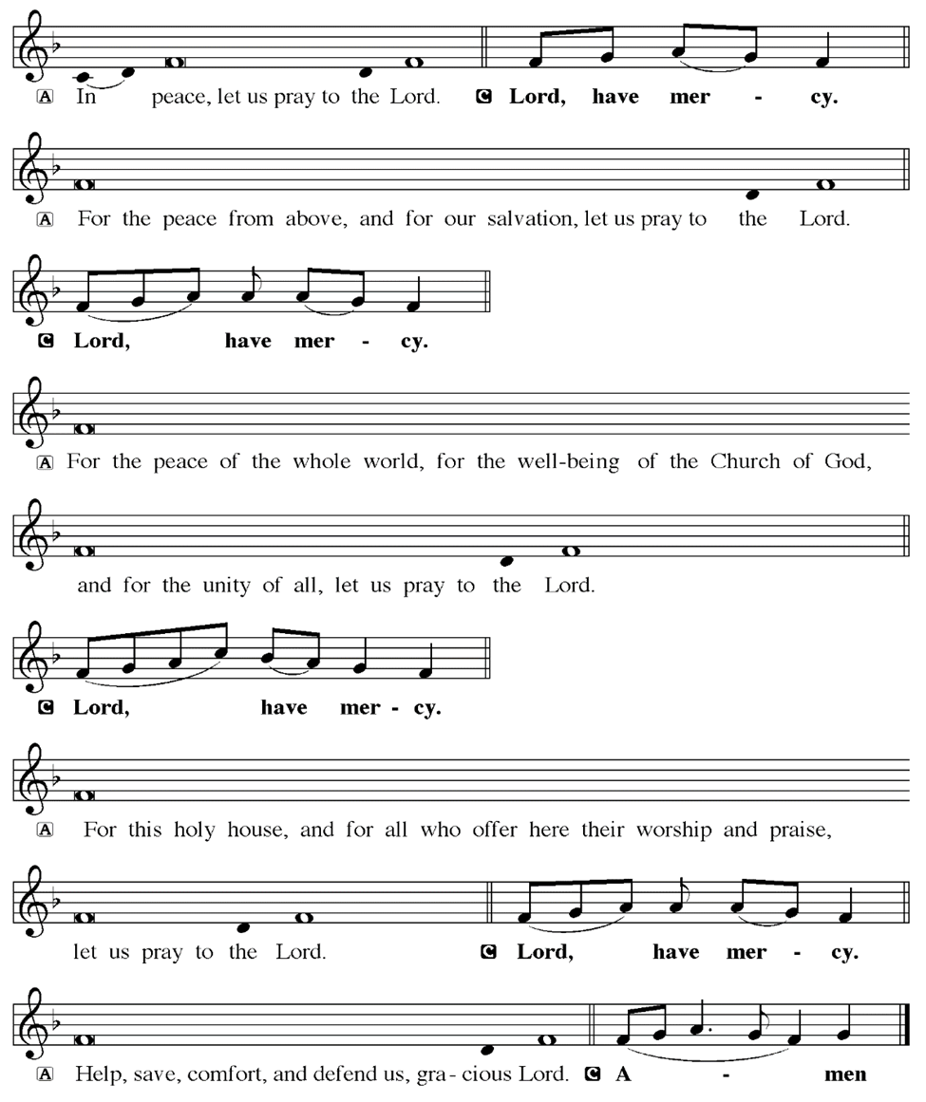
KYRIE
Notes:
Image: Five Loaves by Caroline Coolidge Brown. Copyright © Caroline Coolidge Brown. All rights reserved. Used by permission of the artist.

Slide 19
KYRIE
Notes:
Image: Five Loaves by Caroline Coolidge Brown. Copyright © Caroline Coolidge Brown. All rights reserved. Used by permission of the artist.

Slide 20
KYRIE
Notes:
Image: Five Loaves by Caroline Coolidge Brown. Copyright © Caroline Coolidge Brown. All rights reserved. Used by permission of the artist.

Slide 21
HYMN OF PRAISE
Glory be to God in heaven;
peace, goodwill to all the earth.
Mighty God of all creation,
Father of surpassing worth:
we exalt you, we adore you,
we lift high our thanks and praise.
Saints and angels bow before you; here on earth our songs we raise.
Notes:
Image: Five Loaves by Caroline Coolidge Brown. Copyright © Caroline Coolidge Brown. All rights reserved. Used by permission of the artist.

Slide 22
HYMN OF PRAISE
Glory be to Christ forever,
Lamb of God and Lord of love.
Son of God and gracious Savior, you have come from heav’n above;
on the cross you died to save us; now you reign at God’s right hand.
Hear our prayer; restore, forgive us; in your promise firm we stand.
Notes:
Image: Five Loaves by Caroline Coolidge Brown. Copyright © Caroline Coolidge Brown. All rights reserved. Used by permission of the artist.

Slide 23
HYMN OF PRAISE
Holy One we now acclaim you;
Lord alone, to you we call;
Holy One in faith we name you,
God most high, yet near to all:
Jesus Christ, with God the Spirit,
in the Father’s splendor bright.
For the peace that we inherit,
glory be to God on high!
Notes:
Image: Five Loaves by Caroline Coolidge Brown. Copyright © Caroline Coolidge Brown. All rights reserved. Used by permission of the artist.

Slide 24
PRAYER OF THE DAY
P: Let us pray… Holy Spirit, by your power, the church came to be, and by your power, we continue to carry the good news of Jesus into the world. Inspire us to give the gifts you have given us in service to God, our neighbors, and the whole of creation. In Jesus’ name we pray.
C: Amen
Notes:
Image: Five Loaves by Caroline Coolidge Brown. Copyright © Caroline Coolidge Brown. All rights reserved. Used by permission of the artist.

Slide 25


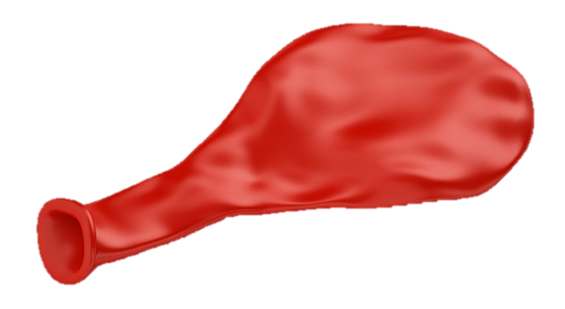
Notes:
Image: Preparing yeast dough. Copyright © tomasworks/iStock/Thinkstock. Used by permission.

Slide 26
Scripture Reading
R: Our scripture readings are from the Book of Acts, Chapter 2 and from First Corinthians, chapter 12.
C: Glory to you O’ Lord! (Spoken)
Notes:
Image: Five Loaves by Caroline Coolidge Brown. Copyright © Caroline Coolidge Brown. All rights reserved. Used by permission of the artist.

Slide 27
Acts 2:1-4; 1 Corinthians 12:1-13
Acts 2:1-4
When the day of Pentecost had come, they were all together in one place. ² And suddenly from heaven there came a sound like the rush of a violent wind, and it filled the entire house where they were sitting. ³ Divided tongues, as of fire, appeared among them, and a tongue rested on each of them.
Notes:
Image: Five Loaves by Caroline Coolidge Brown. Copyright © Caroline Coolidge Brown. All rights reserved. Used by permission of the artist.

Slide 28
Acts 2:1-4; 1 Corinthians 12:1-13
Acts 2:1-4
⁴ All of them were filled with the Holy Spirit and began to speak in other languages, as the Spirit gave them ability.
Notes:
Image: Five Loaves by Caroline Coolidge Brown. Copyright © Caroline Coolidge Brown. All rights reserved. Used by permission of the artist.

Slide 29
Acts 2:1-4; 1 Corinthians 12:1-13
1 Corinthians 12:1-13
Now concerning spiritual gifts, brothers and sisters, I do not want you to be uninformed. ²You know that when you were pagans, you were enticed and led astray to idols that could not speak. ³Therefore I want you to understand that no one speaking by the Spirit of God ever says “Let Jesus be cursed!” and no
Notes:
Image: Five Loaves by Caroline Coolidge Brown. Copyright © Caroline Coolidge Brown. All rights reserved. Used by permission of the artist.

Slide 30
Acts 2:1-4; 1 Corinthians 12:1-13
1 Corinthians 12:1-13
one can say “Jesus is Lord” except by the Holy Spirit.
⁴ Now there are varieties of gifts, but the same Spirit; ⁵and there are varieties of services, but the same Lord; ⁶ and there are varieties of activities, but it is the same God who activates all of them in everyone. ⁷ To each is given the
Notes:
Image: Five Loaves by Caroline Coolidge Brown. Copyright © Caroline Coolidge Brown. All rights reserved. Used by permission of the artist.

Slide 31
Acts 2:1-4; 1 Corinthians 12:1-13
1 Corinthians 12:1-13
manifestation of the Spirit for the common good. ⁸ To one is given through the Spirit the utterance of wisdom, and to another the utterance of knowledge according to the same Spirit, ⁹ to another faith by the same Spirit, to another gifts of healing by the one Spirit, ¹⁰ to another the working of miracles, to
Notes:
Image: Five Loaves by Caroline Coolidge Brown. Copyright © Caroline Coolidge Brown. All rights reserved. Used by permission of the artist.

Slide 32
Acts 2:1-4; 1 Corinthians 12:1-13
1 Corinthians 12:1-13
another prophecy, to another the discernment of spirits, to another various kinds of tongues, to another the interpretation of tongues. ¹¹All these are activated by one and the same Spirit, who allots to each one individually just as the Spirit chooses.
Notes:
Image: Five Loaves by Caroline Coolidge Brown. Copyright © Caroline Coolidge Brown. All rights reserved. Used by permission of the artist.

Slide 33
Acts 2:1-4; 1 Corinthians 12:1-13
1 Corinthians 12:1-13
¹² For just as the body is one and has many members, and all the members of the body, though many, are one body, so it is with Christ. ¹³ For in the one Spirit we were all baptized into one body—Jews or Greeks, slaves or free—and we were all made to drink of one Spirit.
Notes:
Image: Five Loaves by Caroline Coolidge Brown. Copyright © Caroline Coolidge Brown. All rights reserved. Used by permission of the artist.

Slide 34
Acts 2:1-4; 1 Corinthians 12:1-13
R: This is the Word of the Lord.
C: Praise to You, O Christ (Spoken)
Notes:
Image: Five Loaves by Caroline Coolidge Brown. Copyright © Caroline Coolidge Brown. All rights reserved. Used by permission of the artist.

Slide 35
Sermon
Notes:
Image: Five Loaves by Caroline Coolidge Brown. Copyright © Caroline Coolidge Brown. All rights reserved. Used by permission of the artist.

Slide 36

SERMON
Notes:
Image: Five Loaves by Caroline Coolidge Brown. Copyright © Caroline Coolidge Brown. All rights reserved. Used by permission of the artist.

Slide 37

SERMON
Notes:
Image: Five Loaves by Caroline Coolidge Brown. Copyright © Caroline Coolidge Brown. All rights reserved. Used by permission of the artist.

Slide 38

SERMON
Notes:
Image: Five Loaves by Caroline Coolidge Brown. Copyright © Caroline Coolidge Brown. All rights reserved. Used by permission of the artist.

Slide 39
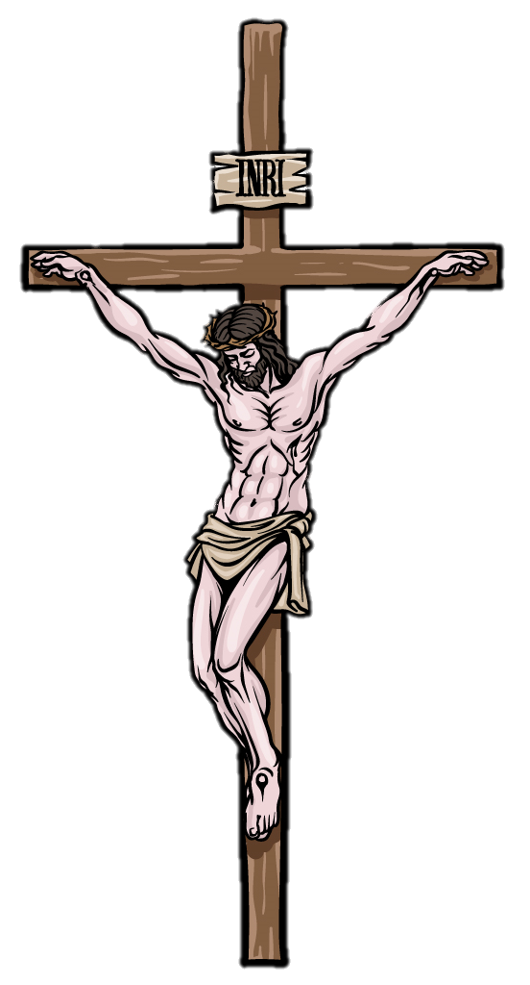
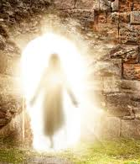
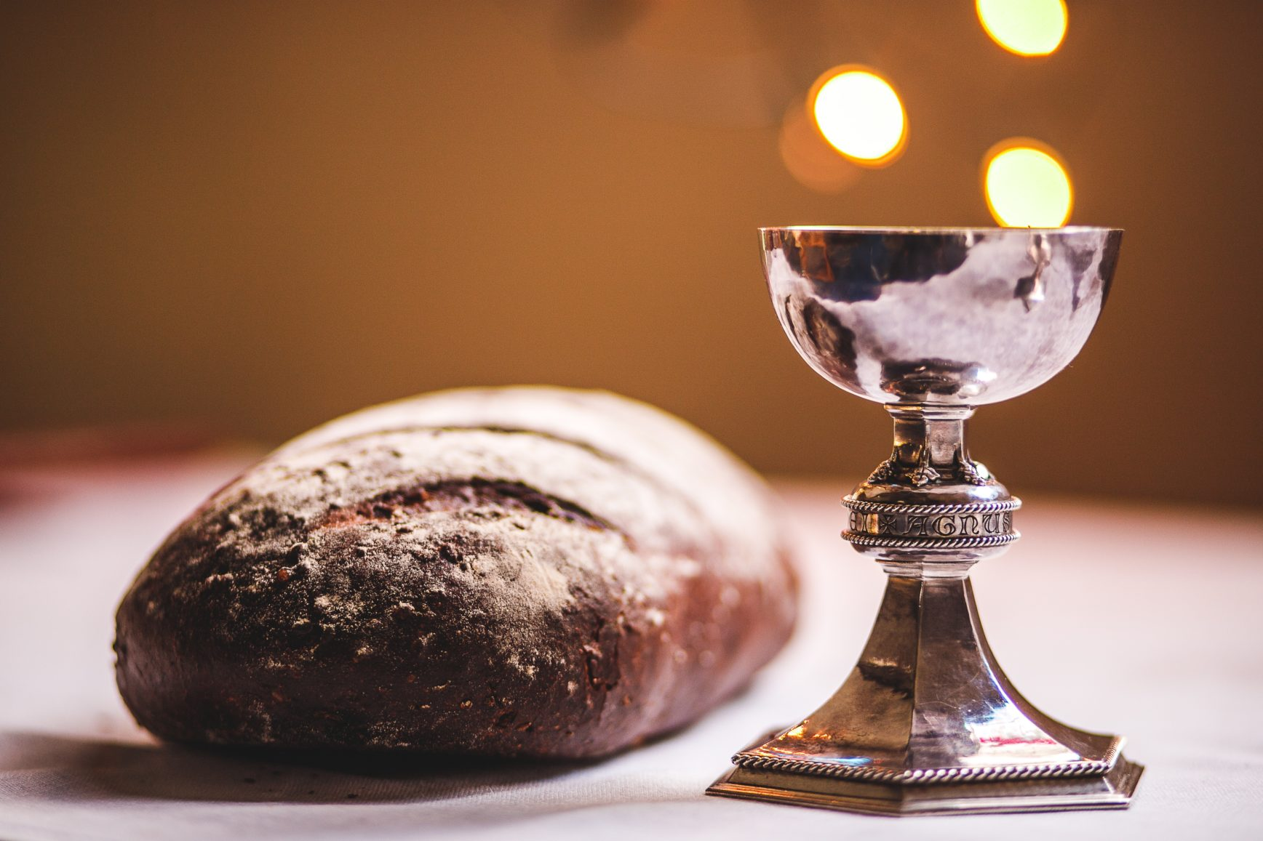
SERMON
Notes:
Image: Five Loaves by Caroline Coolidge Brown. Copyright © Caroline Coolidge Brown. All rights reserved. Used by permission of the artist.

Slide 40
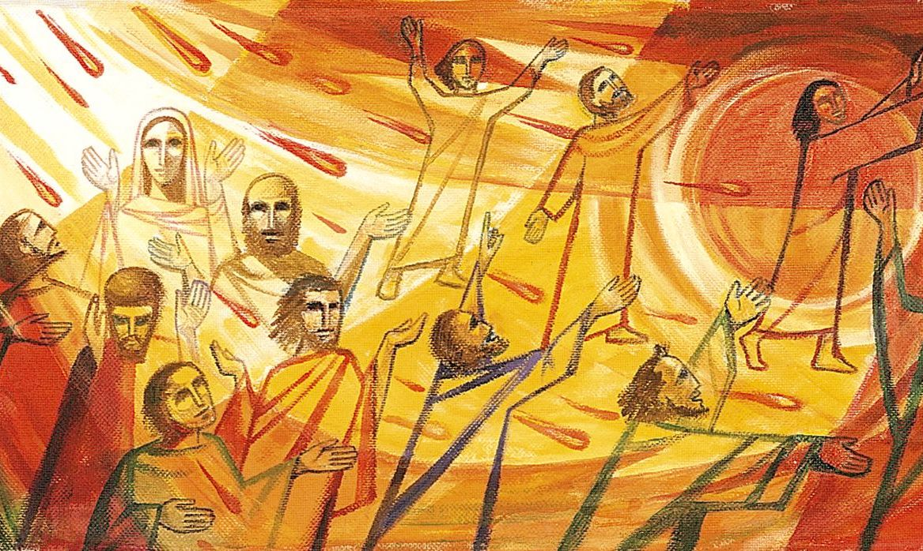
SERMON
Notes:
Image: Five Loaves by Caroline Coolidge Brown. Copyright © Caroline Coolidge Brown. All rights reserved. Used by permission of the artist.

Slide 41
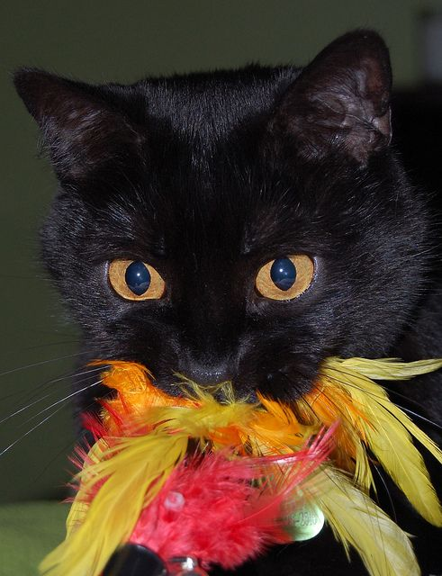
SERMON
Notes:
Image: Five Loaves by Caroline Coolidge Brown. Copyright © Caroline Coolidge Brown. All rights reserved. Used by permission of the artist.

Slide 42

SERMON
Notes:
Image: Five Loaves by Caroline Coolidge Brown. Copyright © Caroline Coolidge Brown. All rights reserved. Used by permission of the artist.

Slide 43
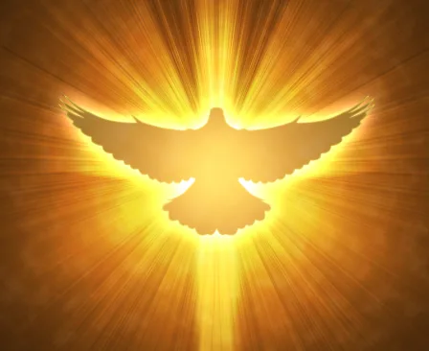
SERMON
Notes:
Image: Five Loaves by Caroline Coolidge Brown. Copyright © Caroline Coolidge Brown. All rights reserved. Used by permission of the artist.

Slide 44
NICENE CREED
C: We believe in one God, the Father, the Almighty, maker of heaven and earth, of all that is, seen and unseen.

Slide 45
NICENE CREED
C: We believe in one Lord, Jesus Christ, the only Son of God, eternally begotten of the Father, God from God, Light from Light, true God from true God, begotten, not made, of one Being with the Father.

Slide 46
NICENE CREED
C: Through him all things were made. For us and for our salvation he came down from heaven; by the power of the Holy Spirit he became incarnate from the virgin Mary, and was made man. For our sake he was crucified under Pontius Pilate;

Slide 47
NICENE CREED
C: he suffered death and was buried. On the third day he rose again in accordance with the Scriptures; he ascended into heaven and is seated at the right hand of the Father. He will come again in glory to judge the living and the dead, and his kingdom will have no end.

Slide 48
NICENE CREED
C: We believe in the Holy Spirit, the Lord, the giver of life, who proceeds from the Father and the Son. With the Father and the Son he is worshiped and glorified. He has spoken through the prophets. We believe in one holy catholic and apostolic Church.

Slide 49
NICENE CREED
C: We acknowledge one Baptism for the forgiveness of sins. We look for the resurrection of the dead, and the life of the world to come. Amen.

Slide 50
PRAYERS OF INTERCESSION
Each petition will end with the words,
A: God of new life,
The congregation will respond with:
C: In mercy, hear our prayer.

Slide 51
PRAYERS OF INTERCESSION
The prayer concludes…
P: We place in your arms all for whom we pray, out loud or in our hearts, confident in your mercy and grace, through Jesus Christ, our savior.
C: Amen.

Slide 52
OFFERING
Notes:
Image: Five Loaves by Caroline Coolidge Brown. Copyright © Caroline Coolidge Brown. All rights reserved. Used by permission of the artist.

Slide 53
OFFERING PRAYER
Notes:
Image: Five Loaves by Caroline Coolidge Brown. Copyright © Caroline Coolidge Brown. All rights reserved. Used by permission of the artist.

Slide 54
THE GREAT THANKSGIVING
All the Baptized are welcome to celebrate this Holy Meal.

Slide 55
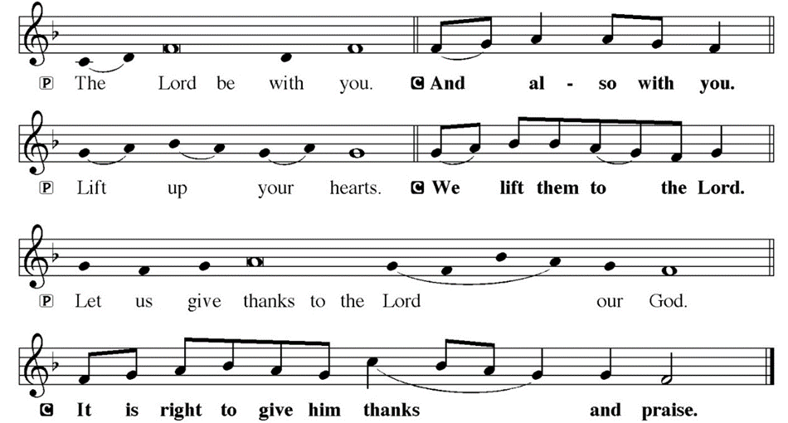
DIALOGUE

Slide 56
THE PREFACE
P: It is indeed right and salutary…
… we praise your name and join their unending hymn.

Slide 57
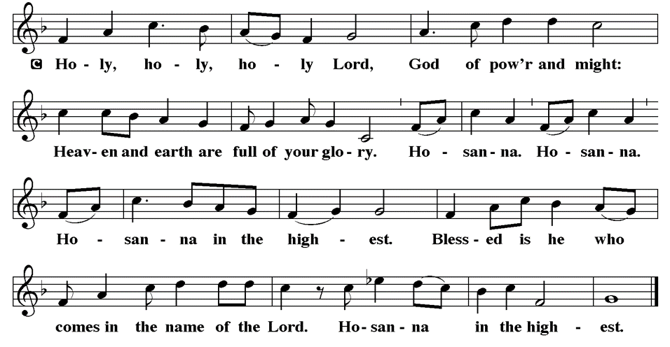
THE SANCTUS

Slide 58
EUCHARISTIC PRAYER
P: Holy, God, breath of life…
…both now and forever.
C: Amen.

Slide 59
THE LORD’S PRAYER
C: Our Father, who art in heaven, hallowed be thy name, thy kingdom come, thy will be done, on earth as it is in heaven. Give us this day our daily bread; and forgive us our trespasses, as we forgive those who trespass against us; and lead us not into temptation, but deliver us from evil.

Slide 60
THE LORD’S PRAYER
C: For thine is the kingdom, and the power, and the glory, forever and ever. Amen.

Slide 61
INVITATION TO COMMUNION
P: Christ whose body is the whole church united invites you now to this table to share with one another the bread and wine that is his presence in our midst. Come and be fed, for all is prepared.

Slide 62
COMMUNION DISTRIBUTION
All will commune “By Station”.
The bread may be broken for distribution. As the ministers give the bread and wine, they say these words :
The body of Christ, given for you.
The blood of Christ, shed for you.
The communicant may say: Amen.

Slide 63
POST COMMUNION BLESSING
P: May this body and blood of our Lord and Savior, Jesus Christ, strengthen, keep and unite us, ☩ now and forever, amen.
C: Amen.

Slide 64
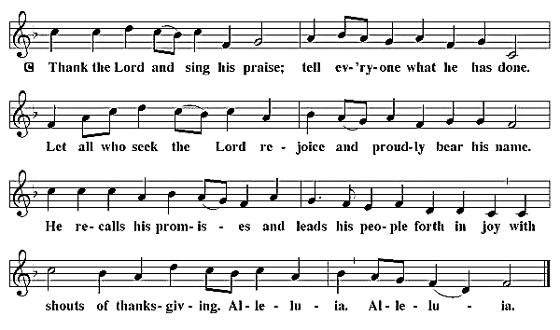
POST COMMUNION CANTACLE

Slide 65
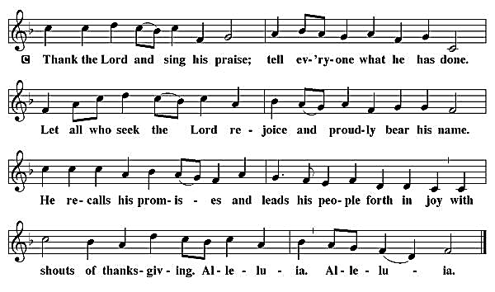
POST COMMUNION CANTACLE

Slide 66
POST COMMUNION PRAYER
P: Let us pray… Shepherding God, you have prepared a table before us and nourished us with your love. Send us forth from this banquet to proclaim your goodness and share the abundant mercy of Jesus, our redeemer and friend.
C: Amen

Slide 67

ANNOUNCEMENTS
Notes:
Image: Five Loaves by Caroline Coolidge Brown. Copyright © Caroline Coolidge Brown. All rights reserved. Used by permission of the artist.

Slide 68
SENDING BLESSING
P: May the Lord Bless you and keep you. May the Lord look upon you with favor, and ☩ give you peace.
C: Amen.

Slide 69
Sending Song
“Holy Spirit, Ever Dwelling”
LBW 523
Notes:
Image: Five Loaves by Caroline Coolidge Brown. Copyright © Caroline Coolidge Brown. All rights reserved. Used by permission of the artist.

Slide 70
“Holy Spirit, Ever Dwelling” LBW 523
1 Holy Spirit, ever dwelling
in the holiest realms of light;
Holy Spirit, ever brooding
o'er a world of gloom and night;
Holy Spirit, ever raising
those of earth to thrones on high;
living, life-imparting Spirit,
you we praise and magnify.
Notes:
Image: Preparing yeast dough. Copyright © tomasworks/iStock/Thinkstock. Used by permission.

Slide 71
“Holy Spirit, Ever Dwelling” LBW 523
2 Holy Spirit, ever living
as the church's very life;
Holy Spirit, ever striving
through us in a ceaseless strife;
Holy Spirit, ever forming
in the church the mind of Christ:
you we praise with endless worship
for your gifts and fruits unpriced.
Notes:
Image: Preparing yeast dough. Copyright © tomasworks/iStock/Thinkstock. Used by permission.

Slide 72
“Holy Spirit, Ever Dwelling” LBW 523
3 Holy Spirit, ever working
through the church's ministry;
quick'ning, strength'ning, and absolving,
setting captive sinners free;
Holy Spirit, ever binding
age to age and soul to soul
in communion never ending,
you we worship and extol.
Notes:
Image: Preparing yeast dough. Copyright © tomasworks/iStock/Thinkstock. Used by permission.

Slide 73
DISMISSAL
P: … Depart in Christ’s Love.
C: Seeking, welcoming, and serving all. Amen!
POSTLUDE
By Roxanne Groff
From sundaysandseasons.com. Copyright © 2024 Augsburg Fortress. All rights reserved. Reprinted by permission under Augsburg Fortress Liturgies Annual License #SAS023830. New Revised Standard Version Bible, Copyright © 1989, Division of Christian Education of the National Council of the Churches of Christ in the United States of America. Used by permission. All rights reserved. Revised Common Lectionary, Copyright © 1992 Consultation on Common Texts, admin Augsburg Fortress. Used by permission.

